Slide 1
DSN2097 MERN Internship Hospital Management
Final
Submitted By : Kumkum Verma 20BCG10078

Slide 2
Contents
Introduction
Problem Definition
Challenges
Knowledge Gain
Conclusion
Bibliography

Slide 3
Introduction
MERN Stack:
The MERN stack comprises four key technologies:
MongoDB: A NoSQL database that stores data in a flexible, JSON-like format.
Express.js: A web application framework for Node.js that simplifies building APIs and handling HTTP requests.
React.js: A JavaScript library for building user interfaces. It allows developers to create dynamic, interactive components.
Node.js: A runtime environment that enables server-side JavaScript execution.
MERN Internship:
During a MERN internship, I gain hands-on experience by working on real-world projects using the MERN stack.
learned how to:
Design and develop back-end services and APIs using Express.js and MongoDB.
Create responsive front-end components using React.js.
Build full-stack web applications from scratch

Slide 4
Project
Hospital Management
Hospital Management System (HMS) with MERN Stack:
A Hospital Management System is a comprehensive software solution designed to streamline various administrative, clinical, and operational tasks within a hospital or healthcare facility.
Here are some key features typically found in a MERN-based Hospital Management System:
User Authentication
Hospital Status
Updates
Staff Management
Patient Interactio
Rating Hospitals: Allowing users to rate hospitals based on their experiences.
Medicine Prescription

Slide 5
Engaging the audience
Make eye contact with your audience to create a sense of intimacy and involvement
Weave relatable stories into your presentation using narratives that make your message memorable and impactful
Encourage questions and provide thoughtful responses to enhance audience participation
Use live polls or surveys to gather audience opinions, promoting engagement and making sure the audience feel involved

Slide 6
Project Visuals

Slide 7
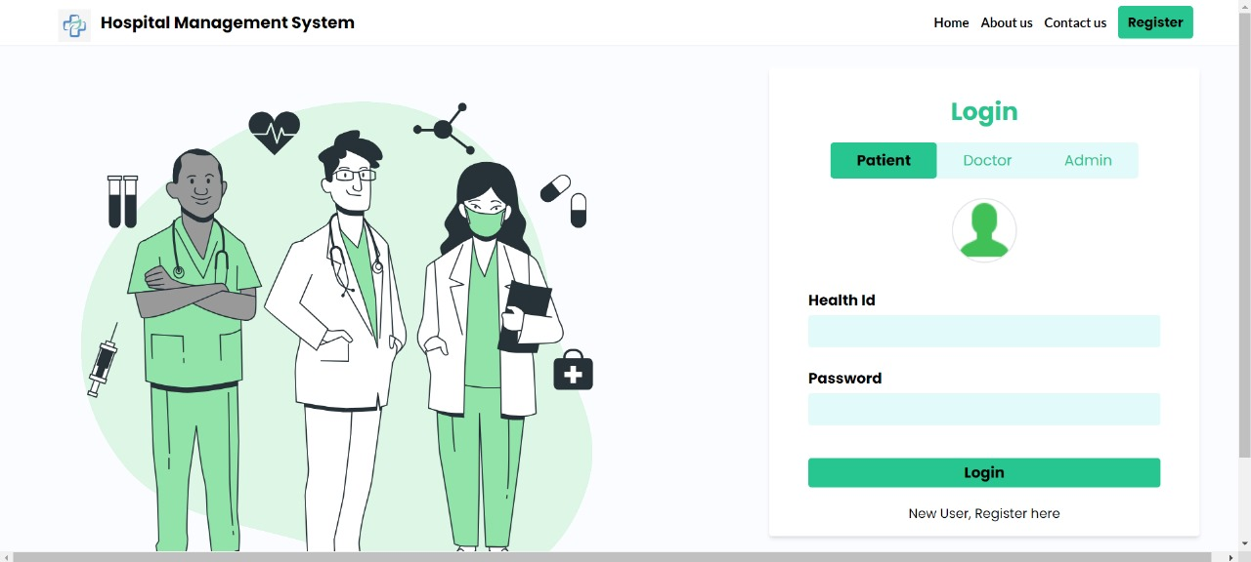

Slide 8
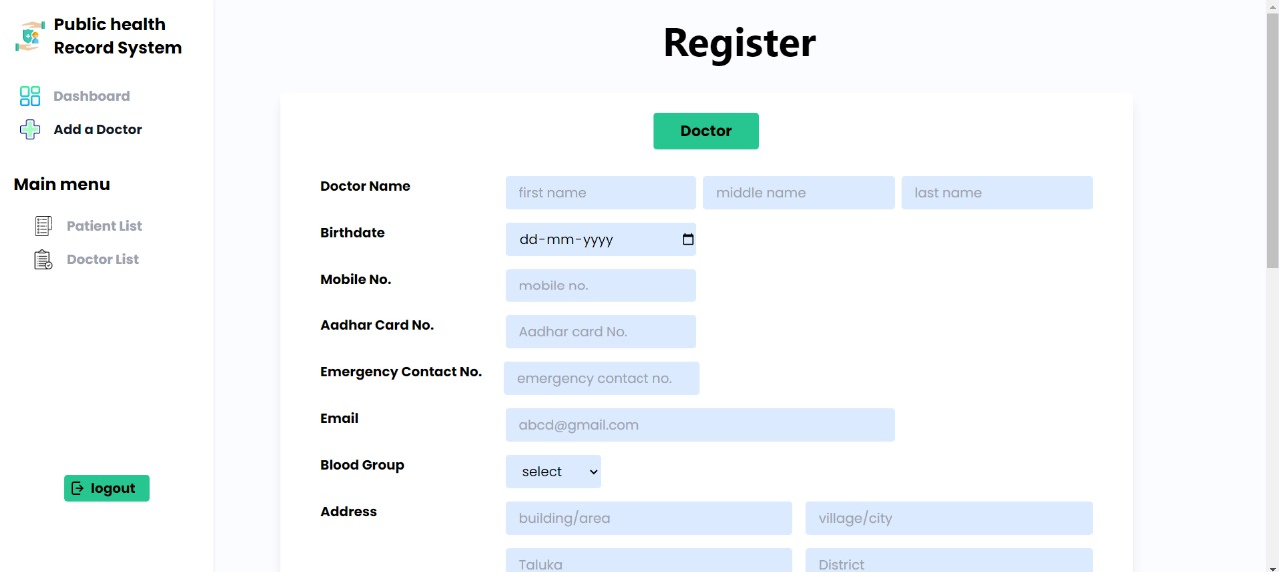

Slide 9
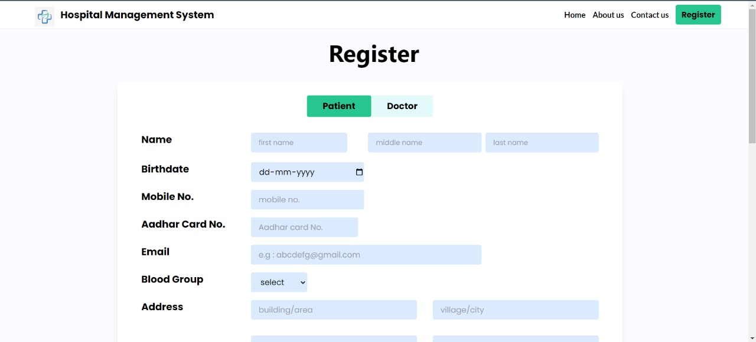

Slide 10
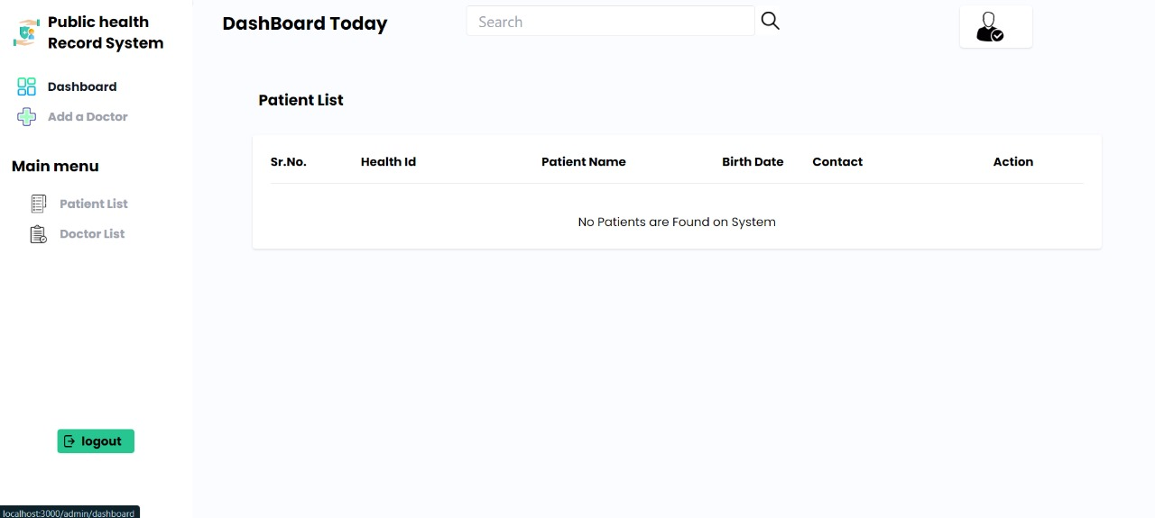

Slide 11
Challenges Faced
User Experience Design
Integration with External System
Deployment and Maintenance

Slide 12
Learnings
MERN Technical Skills
Domain Specific Knowledge
Guidance from Ethnus
Project Management
Time management

Slide 13

Conclusion
MERN Internship with Ethnus overall helped me engage with a new Technology and taught me how to apply it which can be showcased in the project Hospital Management.

Slide 14
Thank you
Kumkum Verma
DSN2097

