Slide 1
Introducing .NET Core WinForms/WPF
Tomoya Yamanaka
Notes:
Can you hear me well? Sorry my voice with Japanese accent is not good to hear(><;

Slide 2
Self-Introduction
Name: Tomoya Yamanaka
Home: Ortigas, Metro Manila, Philippines
Hobby: Attending/Organizing IT Events
Certifications: MCT (Microsoft Certified Trainer), and so on…
Role: Wankuma Alliance Manila Director
www.facebook.com/groups/WankumaAlliancePh/

Slide 3

Hobby: Attending/Organizing IT Events
Wankuma Alliance IT seminar group
https://www.facebook.com/groups/WankumaAlliancePh/

Slide 4
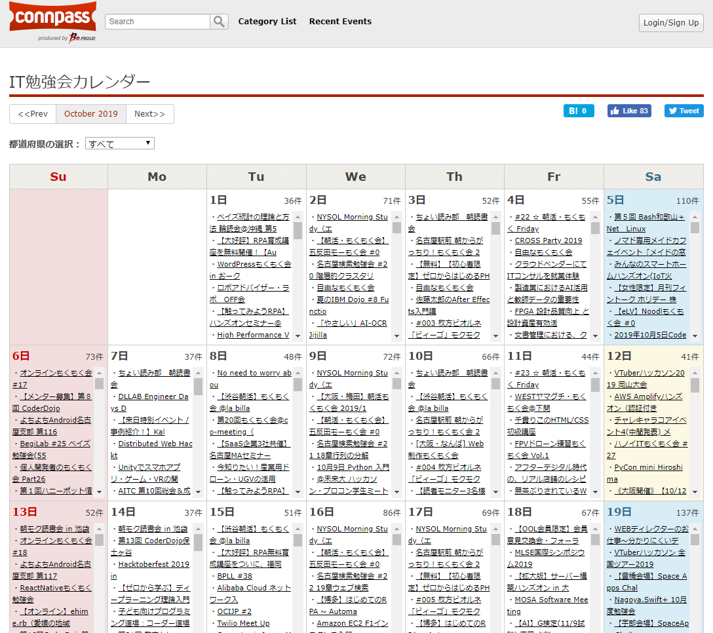
IT Event Calendar in Japan https://connpass.com/calendar/
Notes:
In Japan, there are super many events all time!!

Slide 5
Too Few IT Events in Manila Still!
Let’s have more events!!

Slide 6
The Topic for Today .NET Core Ver. WinForms/WPF

Slide 7
But first, Let’s review WinForms & WPF

Slide 8
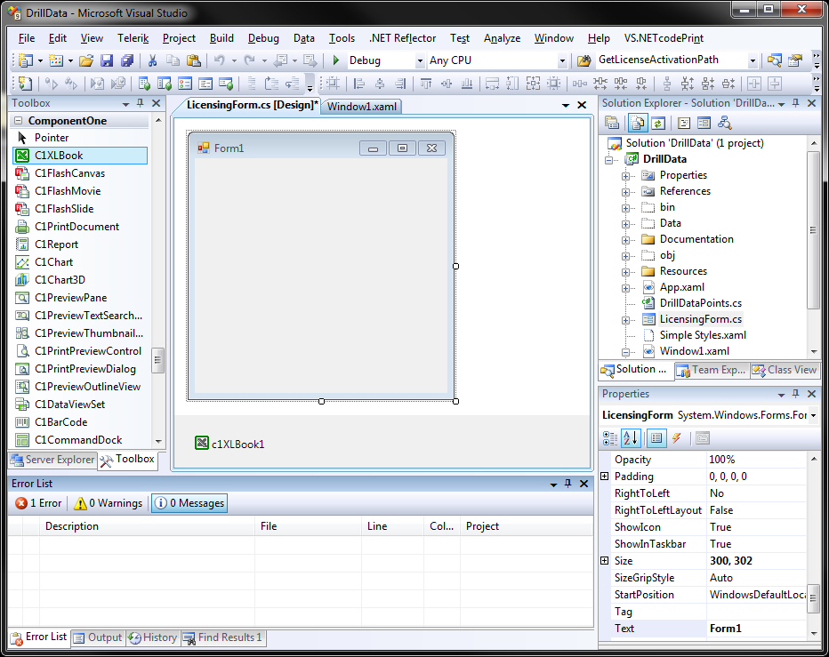
Review: WinForms
Windows Forms (WinForms) is a graphical (GUI) class library included as a part of Microsoft .NET Framework… by Wikipedia
https://en.wikipedia.org/wiki/Windows_Forms

Slide 9
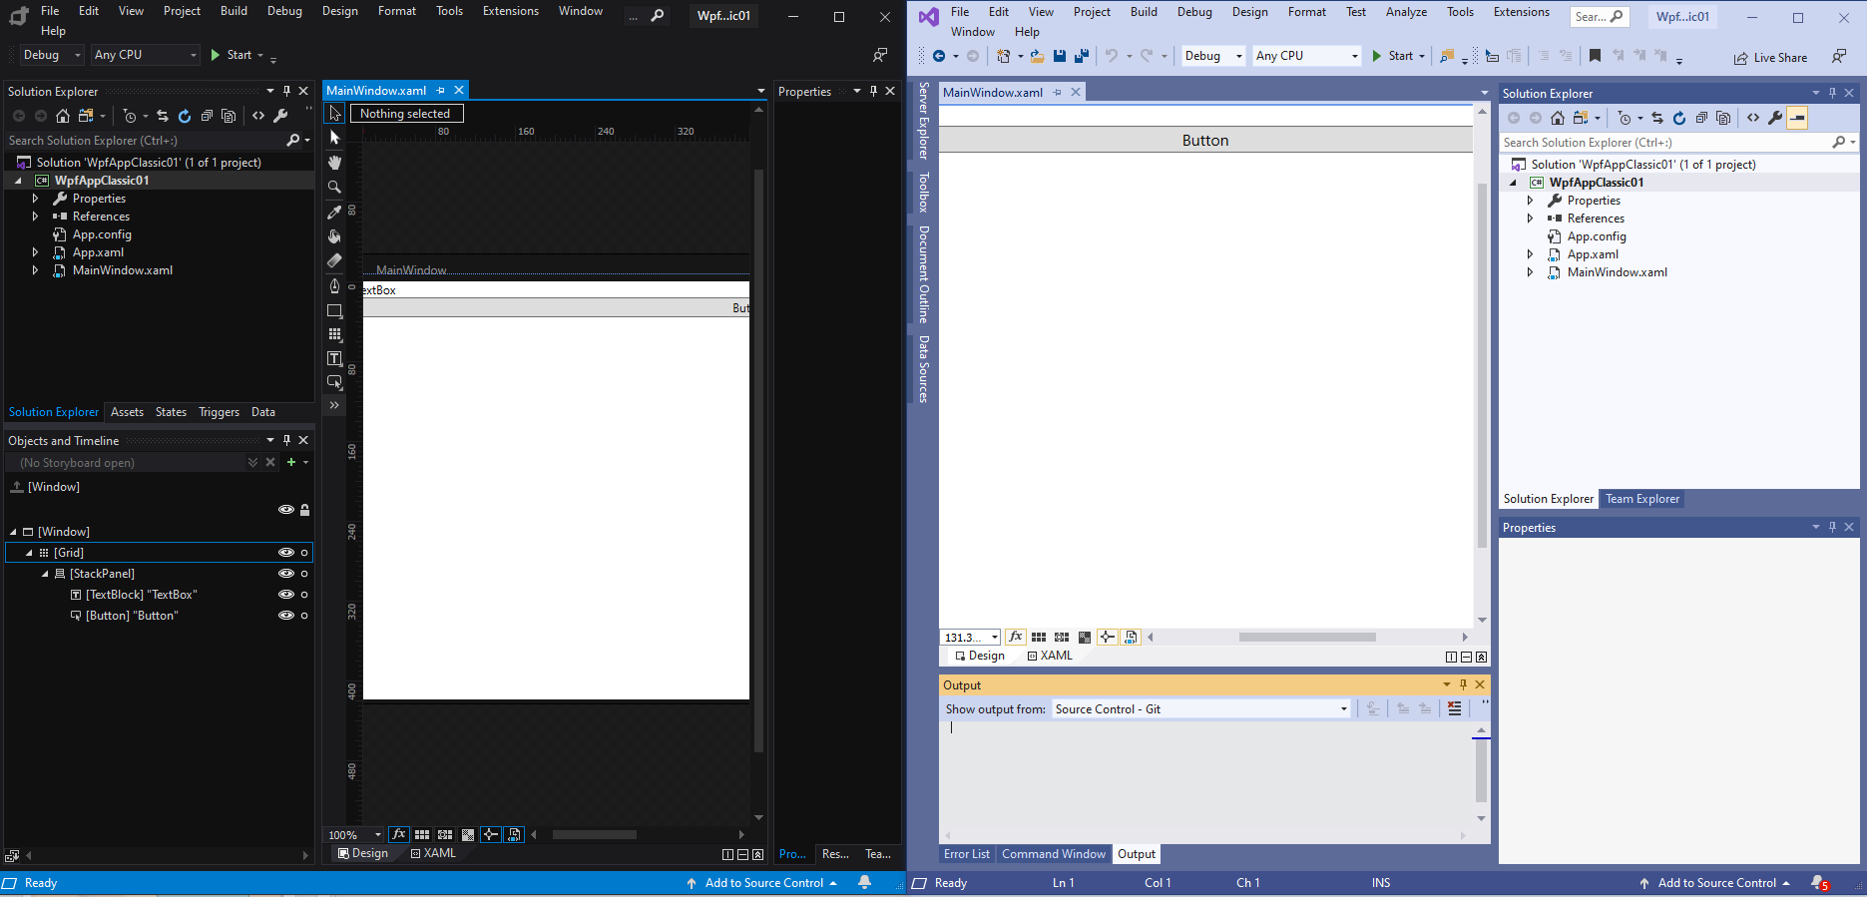
Review: WPF
Windows Presentation Foundation (WPF) is a graphical subsystem (similar to WinForms) originally developed by Microsoft for rendering user interfaces in Windows-based applications. by Wikipedia
https://en.wikipedia.org/wiki/Windows_Presentation_Foundation
Notes:
The left screen is Blend and the right one is Visual Studio

Slide 10
WinForms/WPF Comparison
 | WinForms | WPF
Coding | C#/VB (Easier to Learn) | XAML+C#/VB (Harder to Learn)
Designer Tool | -(None) | Microsoft Blend
Appearance | .NET Framework 1.0 (Year 2002) | .NET Framework 3.0 (Year 2006)
Graphic Support | Basic Only | Advanced (Such as Animation)
Platform | Windows Only | Windows Only
Problem: .NET Framework is fading out.

Slide 11
.NET Past and Future
.NET Core is taking over the part where .NET Framework was used even in old code part like WinForms.
Windows Only
Multi Platform
Windows Only
(WinForms, WPF, and so on)
.NET Framework
.NET 5
(.NET Core Base)
Stop
.NET Core
Continue

Slide 12
Then now, NET Core ver. WinForms & WPF are released, … as early version. Not for business use for now, I think. I’ll tell you why later…

Slide 13
.NET Core WinForms/WPF Comparison
 | .NET Core WinForms | .NET Core WPF
Coding | C#/VB (Easier to Learn) | XAML+C#/VB (Harder to Learn)
Designer Tool | -(None) | Microsoft Blend
Appearance | .NET Core 3.0 (Year 2019) | .NET Core 3.0 (Year 2019)
Graphic Support | Basic Only | Advanced (Such as Animation)
Platform | Windows Only | Windows Only
Still Windows only!
Notes:
If you want multi-platform, go to Xamarin or others. Our business project used WebAPI local server(Restful API local server) + React.

Slide 14
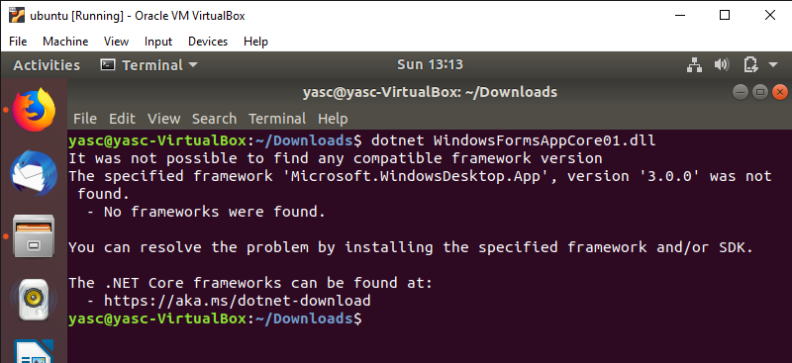
Windows Only
Even though .NET Core is multi-platform framework, WinForms and WPF are still only on Windows.
Windows dependent library is needed…

Slide 15
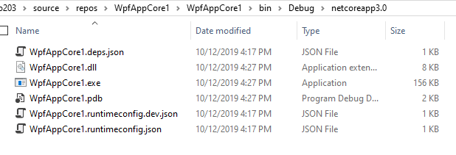
By the way, about .NET Core output
In .NET Core Ver. *.dll is the real program.
*.exe is just a launcher.

Slide 16
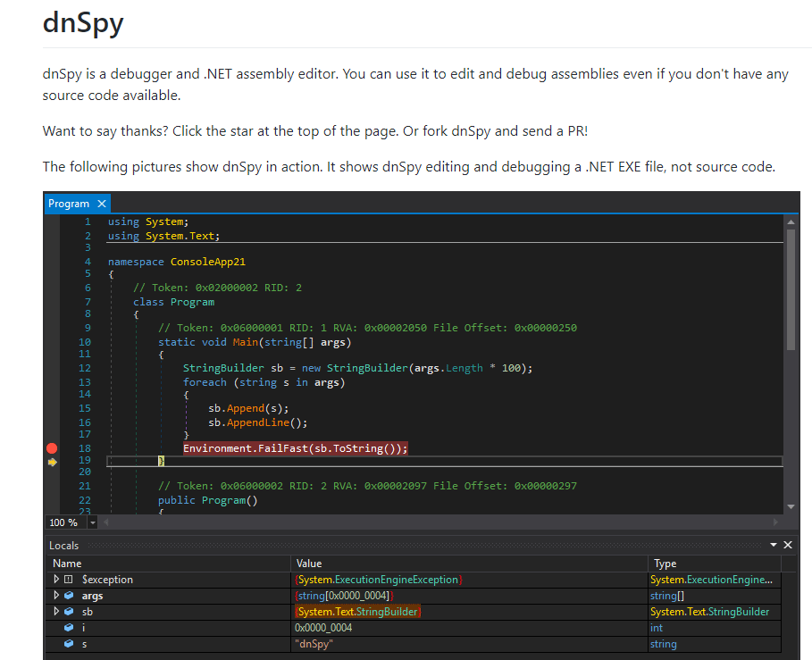
Tool : dnSpy
https://github.com/0xd4d/dnSpy
Good Open Source Tool !!
Notes:
Getting source code from *.exe or *.dll. It can be used to VB.NET code to C# (making VB.NET’s *.exe program and generage C# code from the *.exe)

Slide 17
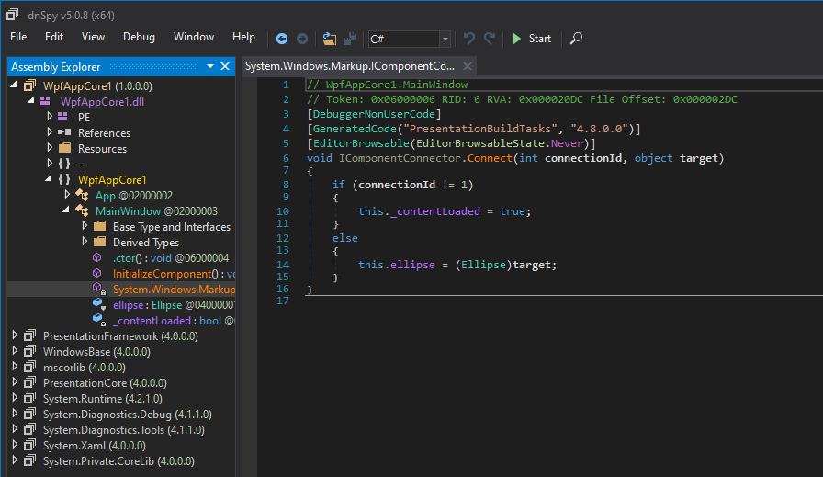
In DLL, Your Code Will Be In.

Slide 18
.NET Core is open source. Thus, .NET Core Ver. WinForms & WPF are open source also!

Slide 19
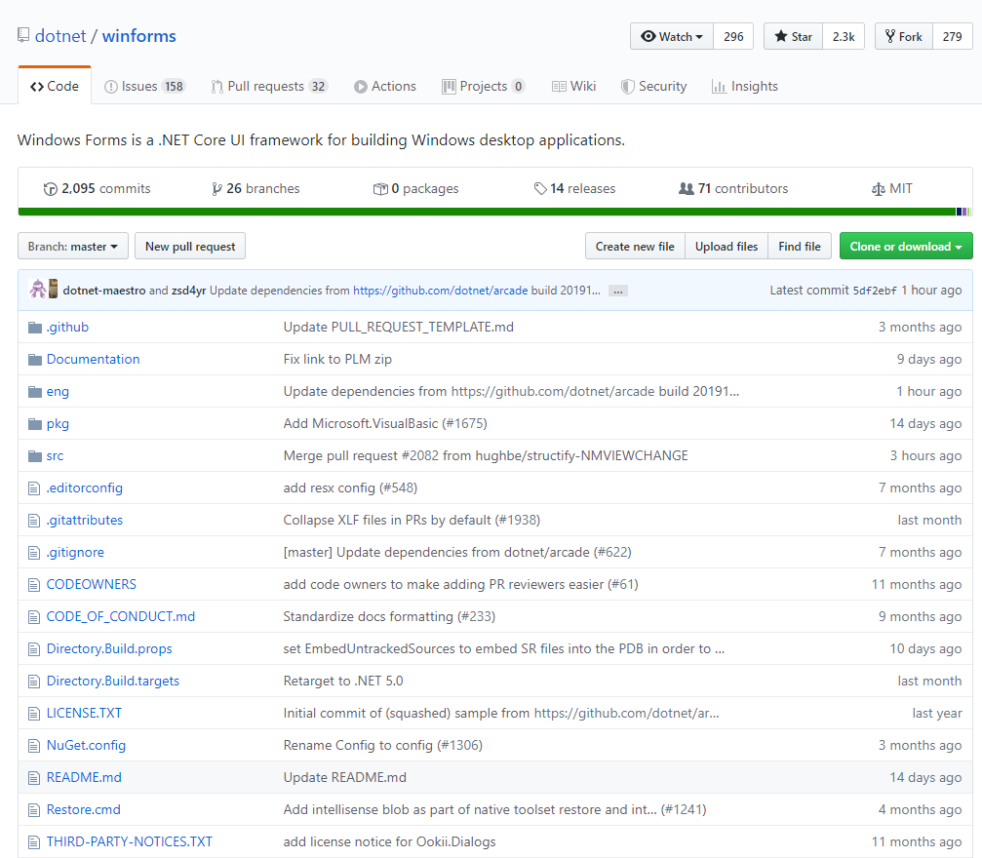
Source Code for .NET Core WinForms
https://github.com/dotnet/winforms

Slide 20
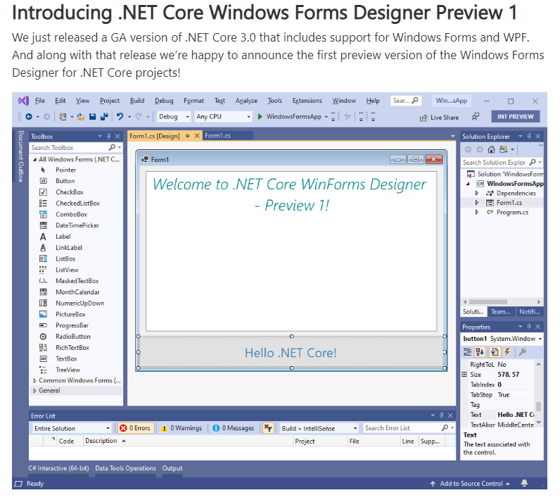
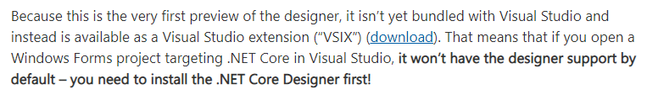
(Caution!)About WinForms Designer
https://devblogs.microsoft.com/dotnet/introducing-net-core-windows-forms-designer-preview-1/
Need to be installed as VS extension!
Notes:
This is one reason that I say not for business now

Slide 21

Source Code for .NET Core WPF
https://github.com/dotnet/wpf

Slide 22
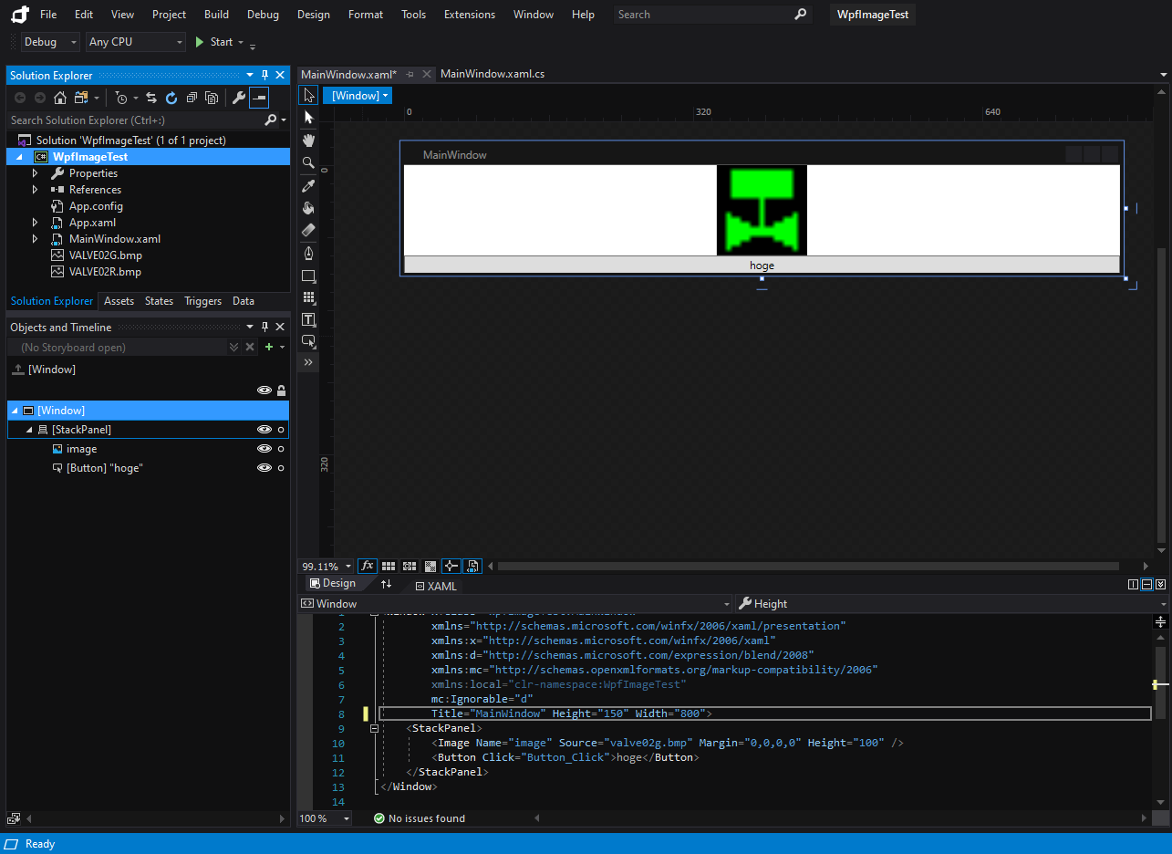
About Blend Support for WPF
This is .NET Framework project

Slide 23
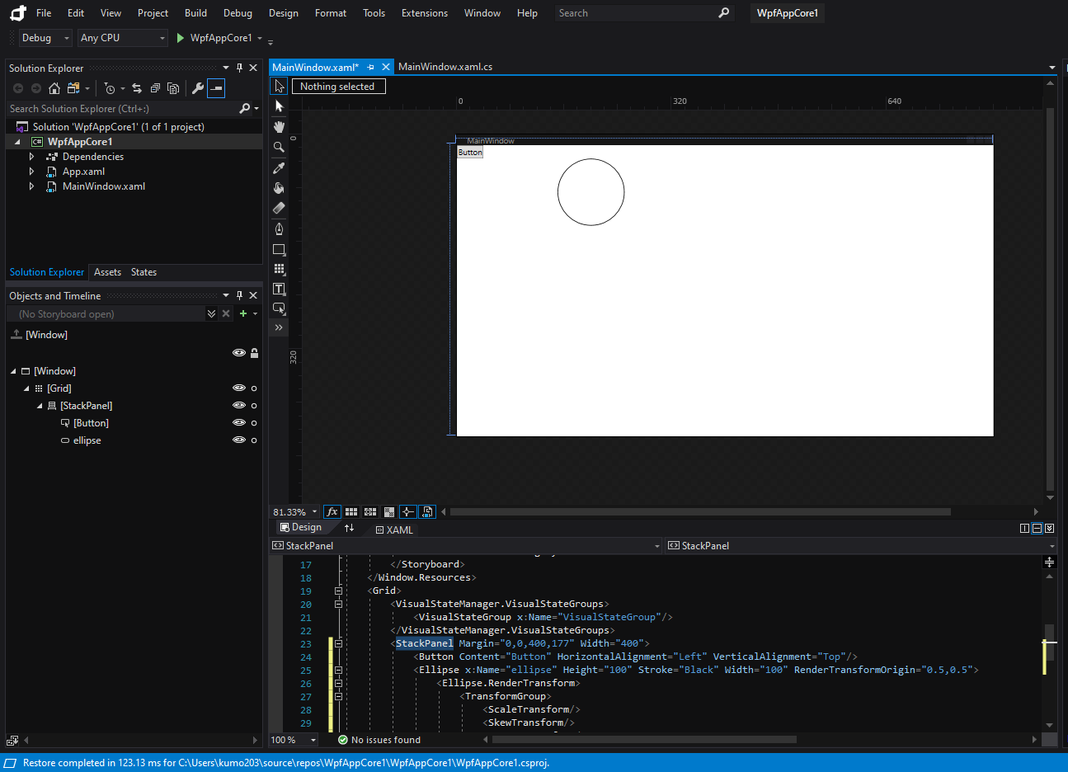
About Blend Support Support for WPF
This is .NET Core project. Some windows are missing…
Notes:
This is another reason why I say not for business now…

Slide 24

About VB support
VB road map will come soon, maybe(><;
Notes:
I feel VB support is becoming weaker these days. It seems MS is busy for supporting other tech such as TypeScript and so on.

Slide 25
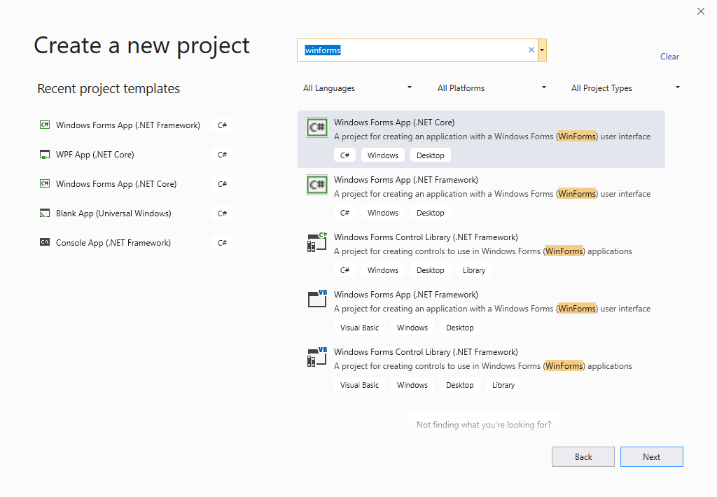
About VB support in WinForms
No .NET Core WinForms VB project

Slide 26
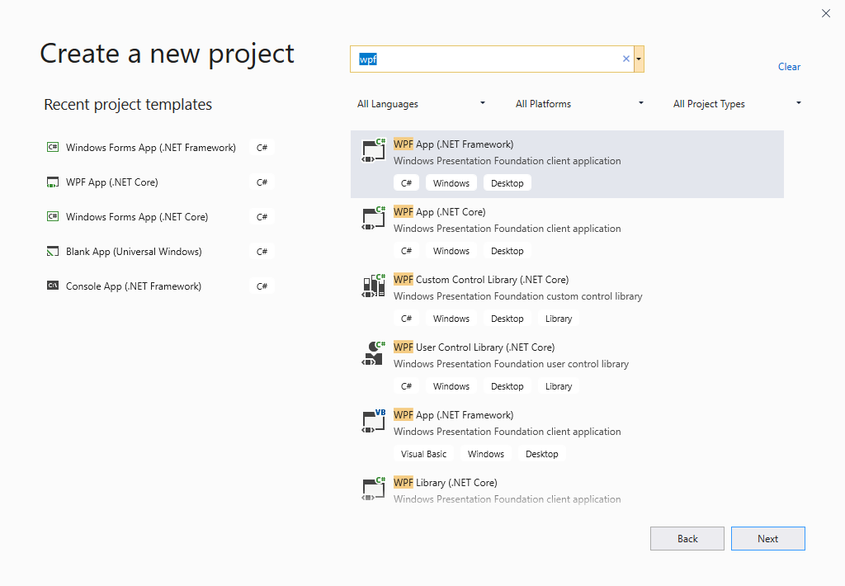
About VB support in WPF
No .NET Core WPF VB project

Slide 27
When to Choose .NET Core Ver. WinForms/WPF?

Slide 28
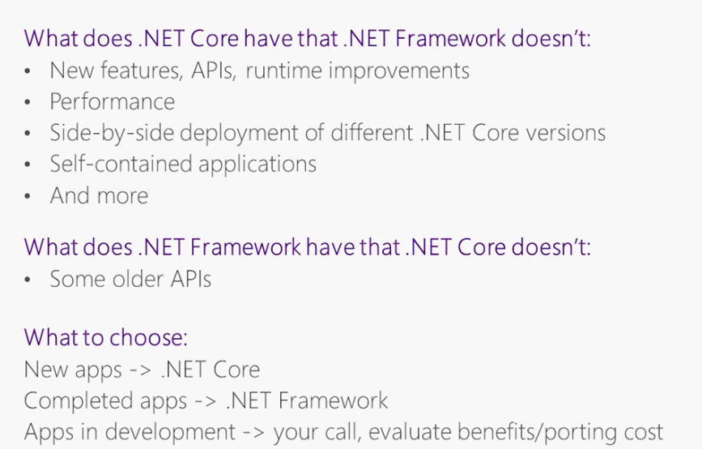
When to Choose .NET Core Ver.
https://channel9.msdn.com/Series/Desktop-and-NET-Core-101/NET-Core-and-NET-Framework-what-to-choose
Notes:
Thus, when we make a new program, .NET Core ver. but due to the limited support on the editors, I think .NET Ver. WinForms/WPF making is too early for now…

Slide 29
Conclusion
.NET Core is evolving to cover all range of .NET ecosystem, and the Windows desktop app developments are shifting into it.
With its open source nature, we can study .NET Core Ver. WinForms/WPF already. (…but not for business use yet, in my opinion)
Let’s keep to see/use them to share the benefit in future together!

Slide 30
END
(Q&A Time)

