Slide 1
Azure DevOps Usage in Wankuma Alliance
Tomoya Yamanaka

Slide 2
Self-Introduction
Name: Tomoya Yamanaka
Home: Ortigas, Metro Manila, Philippines
Hobby: Attending/Organizing IT Events
Certifications: MCT (Microsoft Certified Trainer),
and so on…
Role: Wankuma Alliance Manila Director
www.facebook.com/groups/WankumaAlliancePh/

Slide 3
Hobby: Attending/Organizing IT Events
More IT events are needed!!

Slide 4
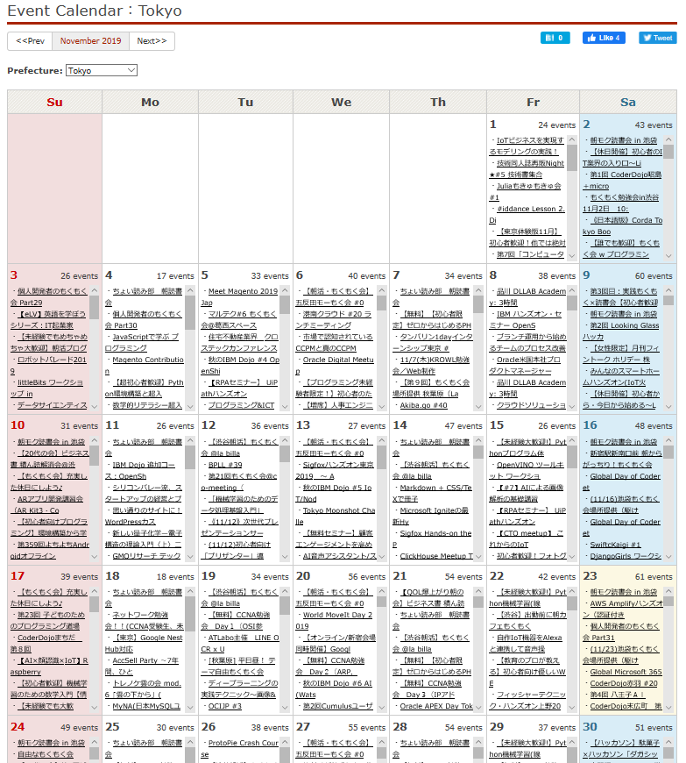
For Example: IT Events in Tokyo
https://connpass.com/calendar/tokyo/
Notes:
Same gigantic city but much more events!

Slide 5
Topic for Today How Wankuma Alliance use Azure DevOps

Slide 6
!!Caution!! The talk is fully my opinion. Choose whether you believe or not with your decision, please! To make it simple and funny, I summarized things, but it can perhaps conflict your opinion.

Slide 7
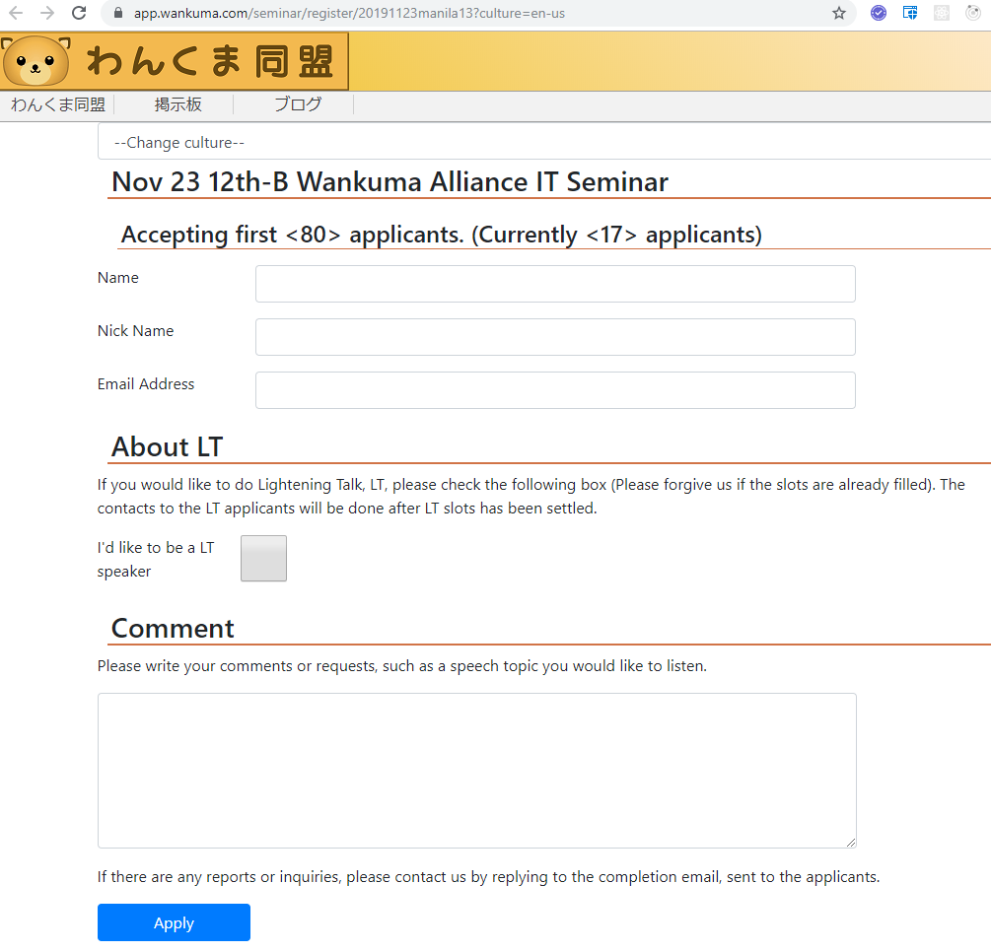
Wankuma Alliance Event Registration System
Wankuma Alliance has its own event registration system. (Thus, sometimes it gets down, gee…)
It’s not to share attendees info to other services to protect.

Slide 8
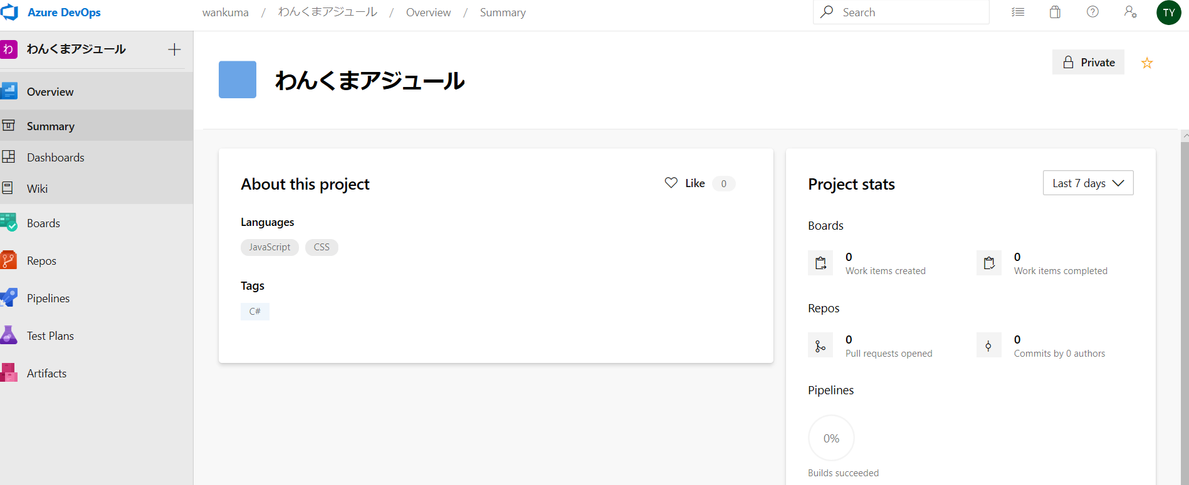
Wankuma Alliance Event Registration System
To manage its development, Azure DevOps is used. Thus, I’ll explain about it today … to recruit new developer volunteer, fuhahaha!

Slide 9
By the way, what is Azure DevOps?

Slide 10
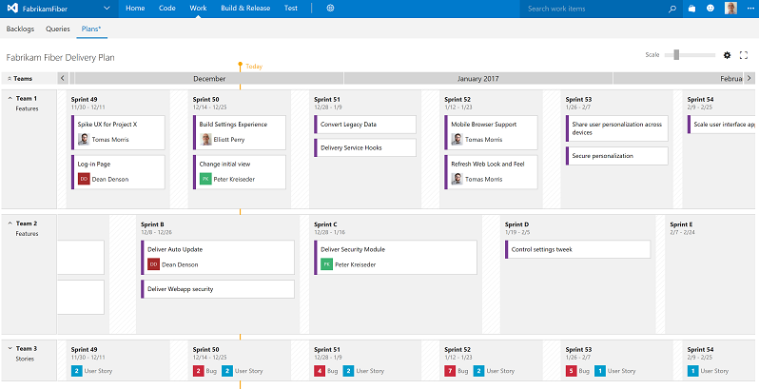
What is Azure DevOps?
Azure DevOps is formerly called Visual Studio Team Services. It’s just a re-branding the name with new buzz word.
https://azure.microsoft.com/en-gb/blog/visual-studio-team-services-march-2017-digest/
Notes:
When you open Visual Studio Team Services related link, it goes to Azure DevOps now.

Slide 11
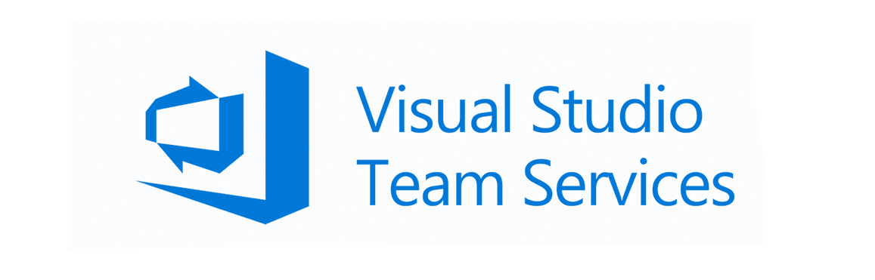

What is Azure DevOps?
Notes:
When you open Visual Studio Team Services related link, it goes to Azure DevOps now.

Slide 12
What is DevOps?
DevOps is the combined word of Development and Operations. With the word, managers are justifying to let developers and operators to work double. Thus, they need to call DOLE… joking!
Often time, DevOps means automating the software deployment & test process. And the meaning was called in different term Agile, before.
Again re-branding. Gee, confusing but it’s the business world we chose…
Confusing as if it’s totally new but it’s not so.

Slide 13
What is Agile?
Agile is one software making style. It iterates smaller term development cycle, such as 1 week cycle. With doing so, software development plan can be adjusted more often.
…But often time Agile was used to hide that managers failed to make a long term, Waterfall style, project plan, gee.
Develop
Test
Design
Operate
Agile

Slide 14
Before Agile(DevOps)
Before Agile(DevOps) becomes common, most software development projects were Waterfall. But it was not allowing to go back the process and change the plan. Thus, short term and less critical software development, such as web page making needed the new style.
Waterfall
Agile
Develop
Test
Design
Operate
Requirement Define
Design
Develop
Test
Operate

Slide 15
Before Agile(DevOps)
Requirement Define
Design
Develop
Test
Operate
Waterfall
Agile
Develop
Test
Design
Operate
Notes:
Waterfall is still common in critical project, such as embedded system(IoT) development because changing such kind of system software after deployment is not easy.

Slide 16
Now, we are ready to learn about Azure DevOps. Let’s review it!

Slide 17
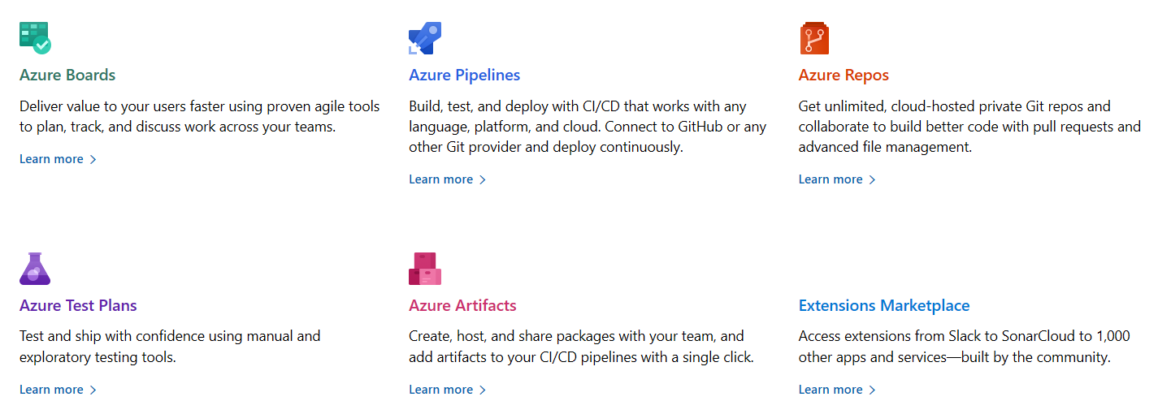
Functions in Azure DevOps
There are 5 function groups and extensions in the marketplace.
https://docs.microsoft.com/en-us/azure/devops

Slide 18
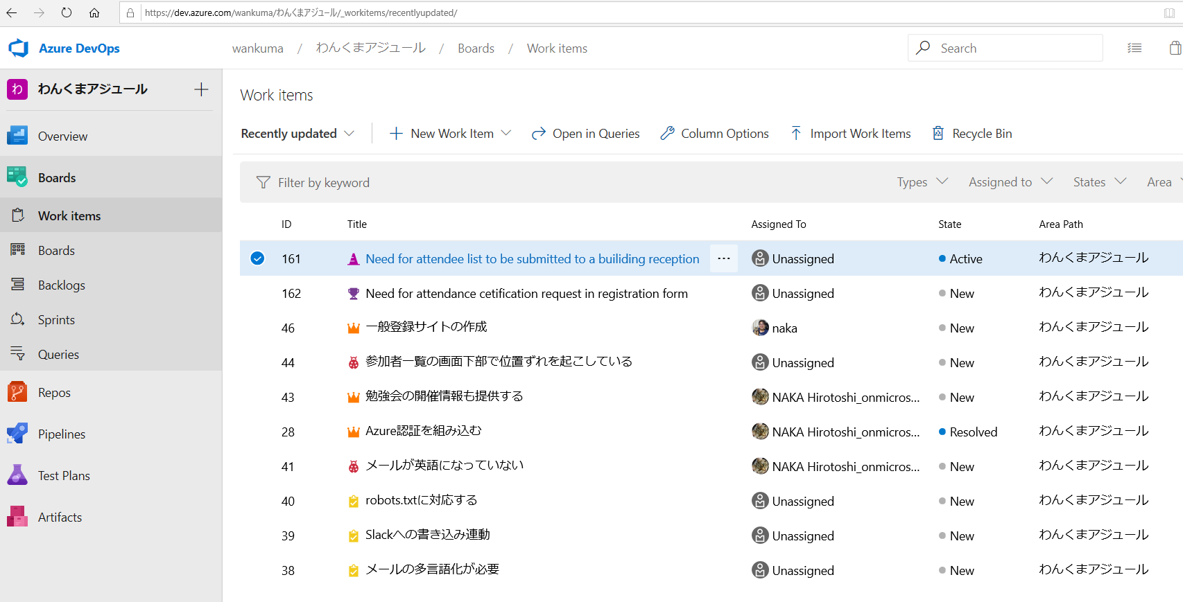
Azure Boards
Azure Boards are task ticket or Kanban management system. We can list up the tasks.

Slide 19
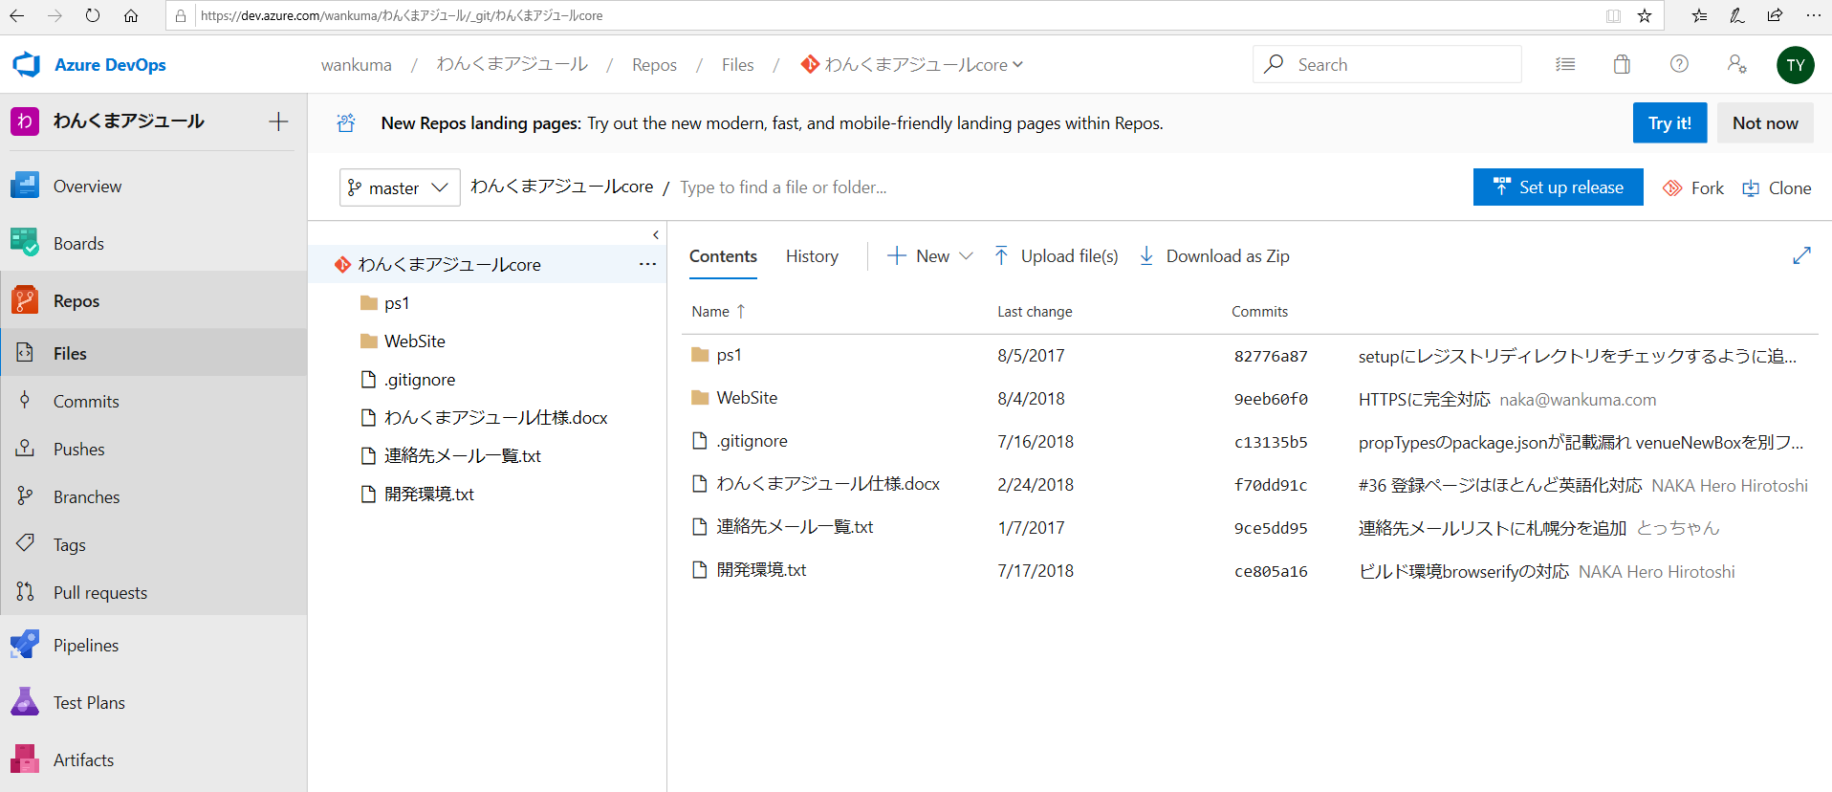
Azure Repos
Azure Repos are file repository management system. We can manage the files with Git.

Slide 20
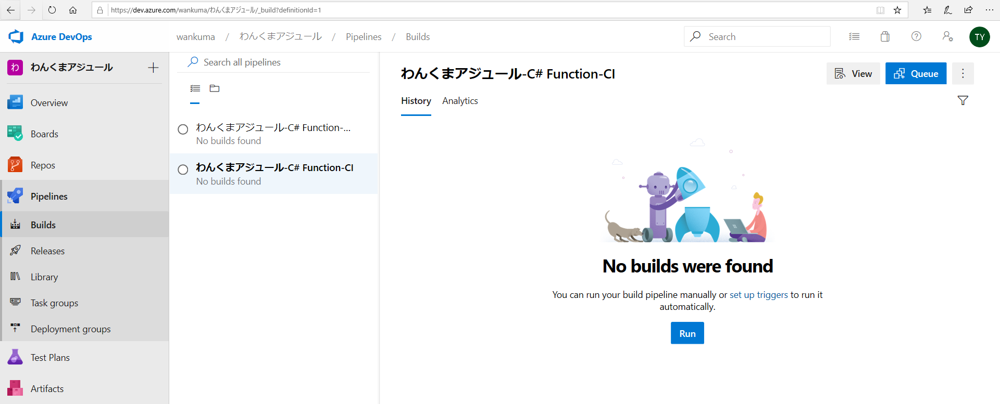
Azure Pipelines
Azure Pipelines are automated deploy and test management system. It’s for Continues Integration, or CI, such as Jenkins provides.

Slide 21
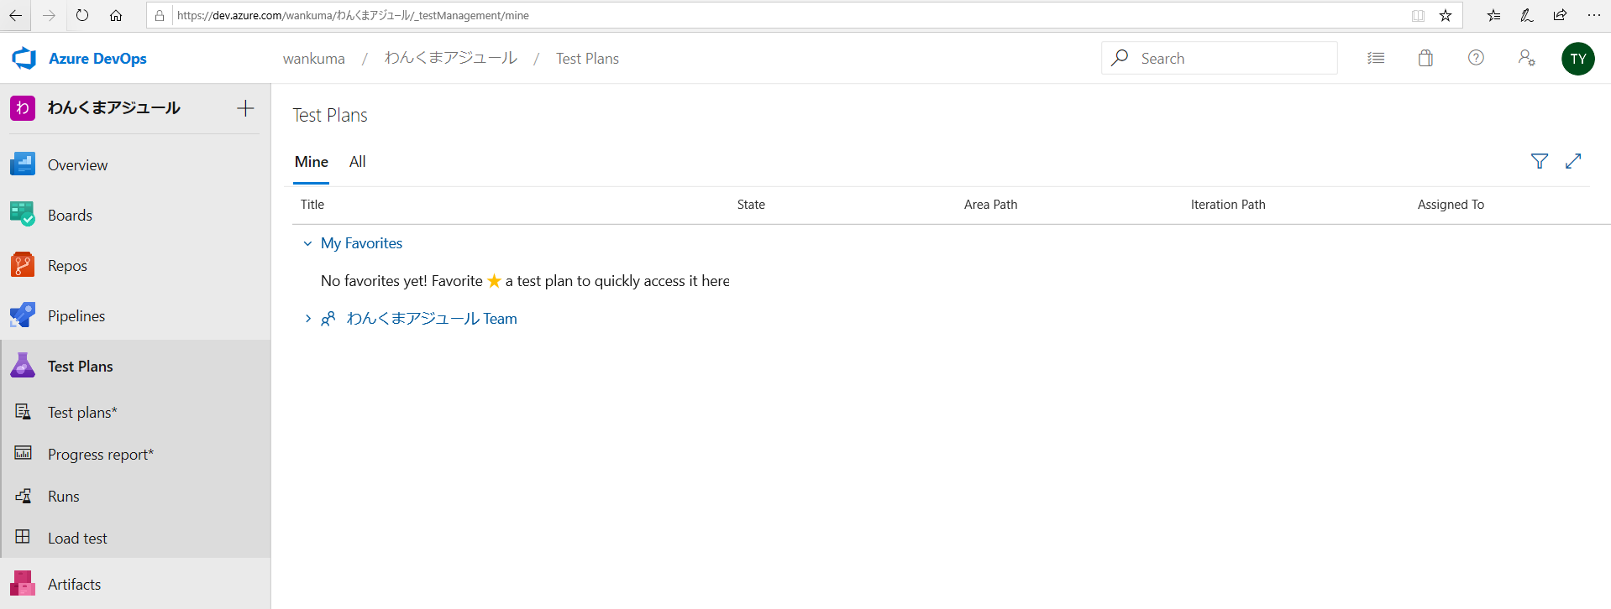
Azure Test Plans
Azure Test Plans are test plan management system. You can plan load/stress tests with it, such as using Apache JMeter.

Slide 22
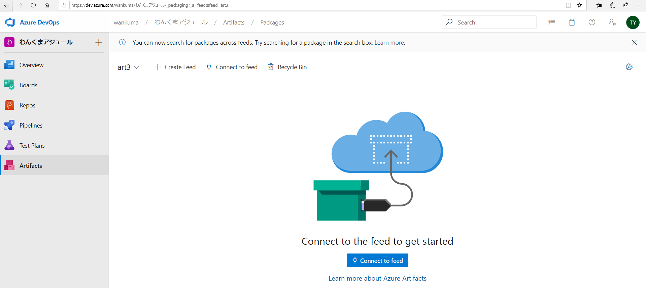
Azure Artifacts
Azure Artifacts are software package management system. Software packages, such as NuGet packages, used in can be controlled with this.

Slide 23
…Well, Wankuma Alliance Event Registration System is made by using only Azure Boards and Repos. But so many software projects are like so. It is good enough to start to use it now with needed minimal functions!

Slide 24
About Azure Boards Usage Experience
To make a good task order, the team needs to assign one of its top engineers as the maintainer. But engineers don’t like management task so that they show negative reactions. Thus, the entire team needs to understand the maintainer task’s importance in the team and appreciate the maintainer.

Slide 25
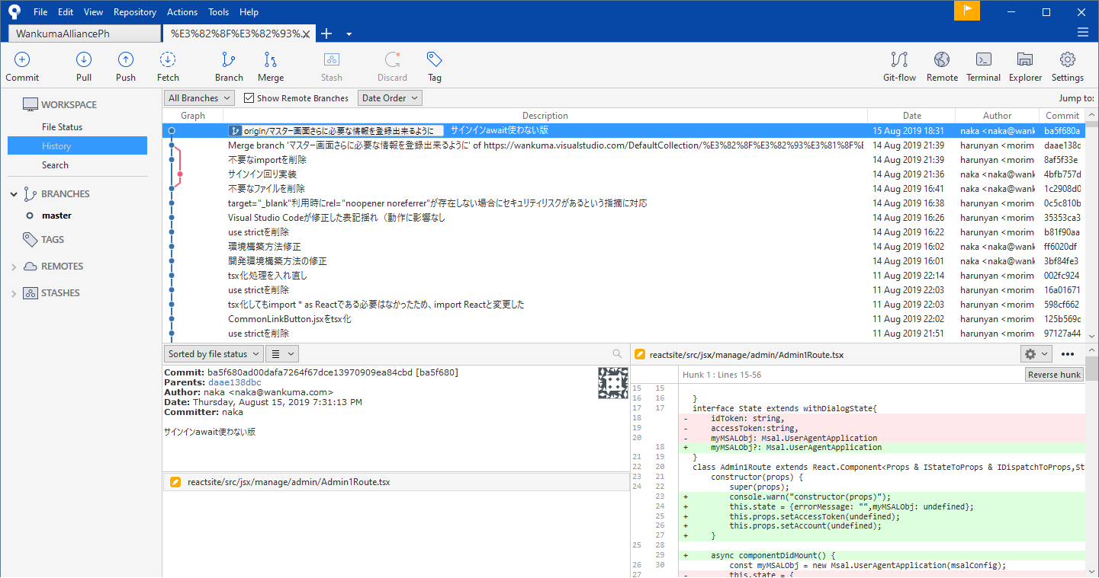
About Azure Repos Experience
We use SourceTree to access our Git repository in our Azure Repos. It was easiest to use for us.
https://www.sourcetreeapp.com/

Slide 26
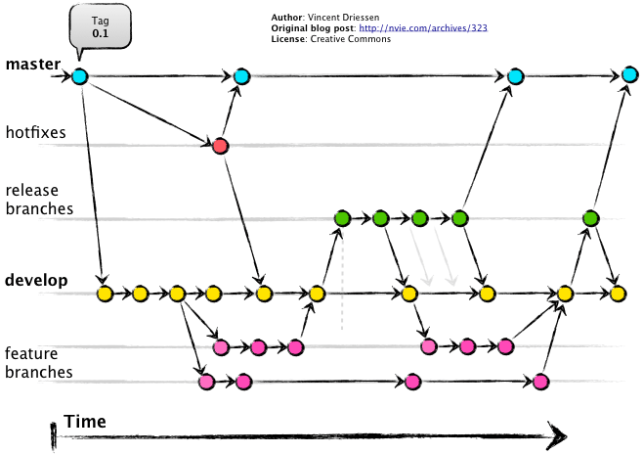
About Azure Repos Experience
About Git branch control, currently, we are simply merging into Master branch because few volunteer developer. But we maybe need to think about the rule in future such as using Git-Flow rule.
https://lucamezzalira.com/2014/03/10/git-flow-vs-github-flow/

Slide 27
Conclusion
Azure DevOps is a new service set provided by Microsoft, but most of its component is re-branded ones so that we don’t need to afraid too much.
DevOps itself is a kind of blur buzz word but it will allow us to make things more productive with automating tools.
Let’s take advantage of it!!

Slide 28
END
(Q&A Time)

Slide 29
About Git
Git is a free and open source distributed version control system designed to handle everything from small to very large projects with speed and efficiency.
https://git-scm.com/
Now, majority of software projects are maintained by Git. Thus, understanding Git usage is common required knowledge for IT people.

