Slide 1
About Gijutsusho-Ten
Tomoya Yamanaka

Slide 2
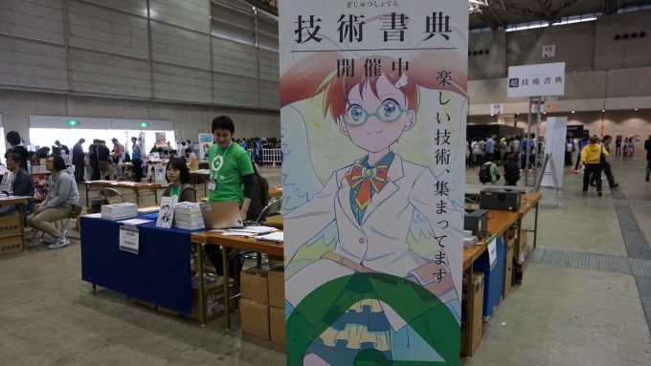
What is Gijutusho-ten?
Gijutusho-ten, 技術書典- https://techbookfest.org/ -, is like this.

Slide 3
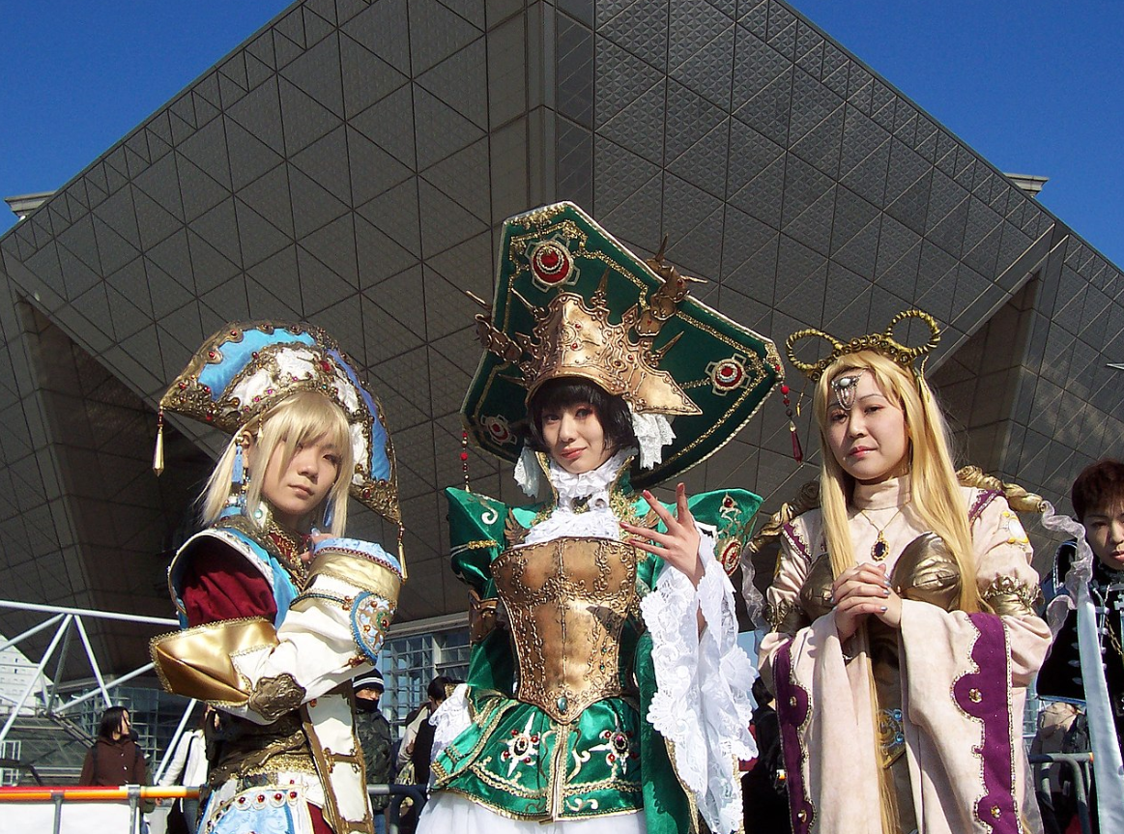
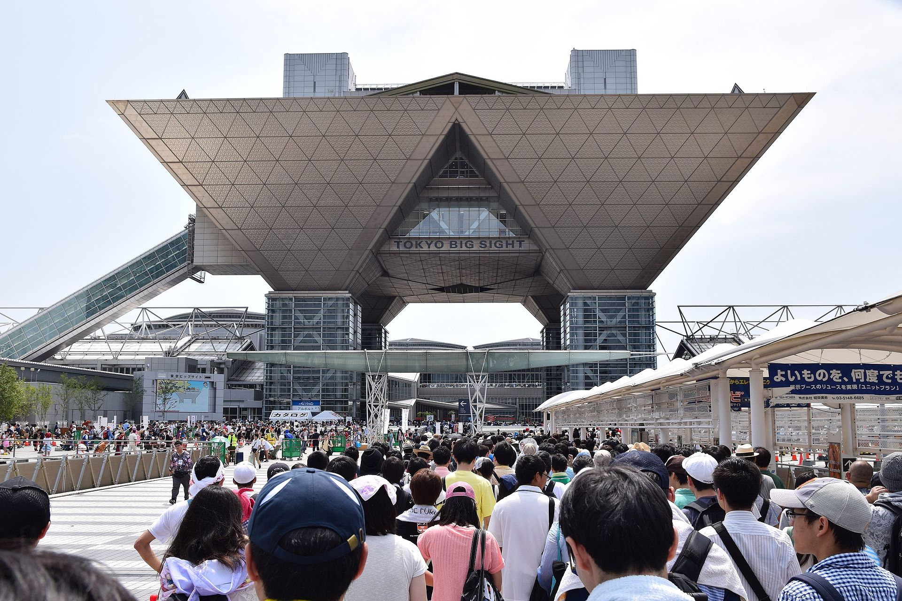
Making and selling a book
Making and selling a technical book in the event, like what done in Comiket-https://en.wikipedia.org/wiki/Comiket-

Slide 4

Example
I saw the beginning of this book writing.

Slide 5
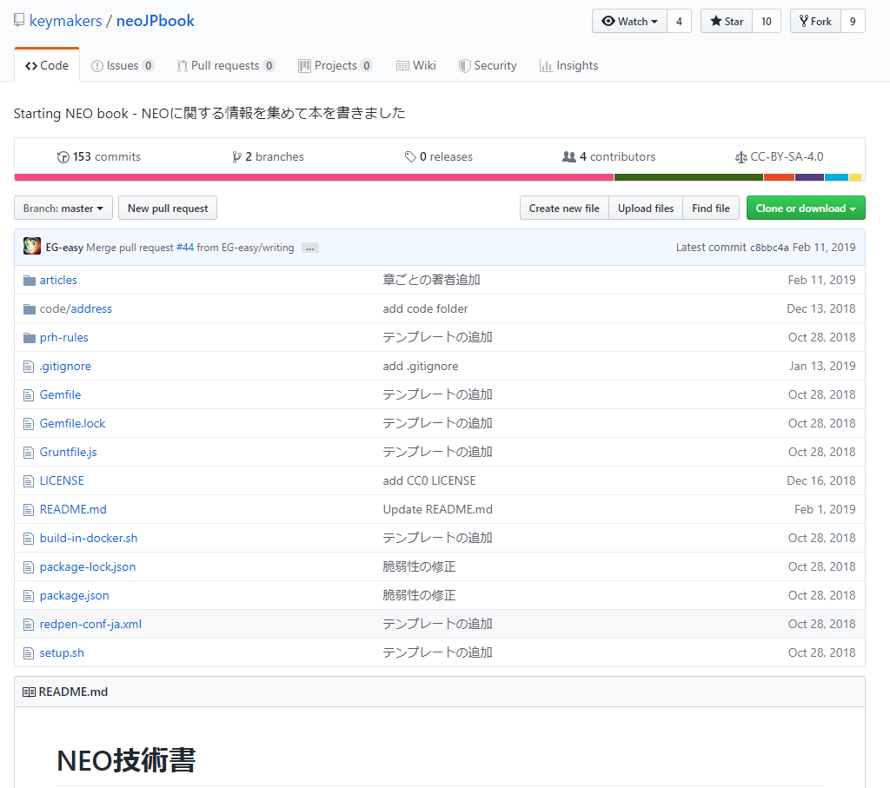
What is Gijutusho-ten?
https://github.com/keymakers/neoJPbook
The writers used GitHub.

Slide 6
How about doing it in us?

Slide 7
END

