Slide 1
Introducing .NET Core WinForms/WPF + α
Tomoya Yamanaka

Slide 2
Self-Introduction
Name: Tomoya Yamanaka
Home: Ortigas, Metro Manila, Philippines
Hobby: Attending/Organizing IT Events
Certifications: MCT (Microsoft Certified Trainer), and so on…
Role: Wankuma Alliance Manila Director
www.facebook.com/groups/WankumaAlliancePh/

Slide 3
Hobby: Attending/Organizing IT Events
Let’s do more and more IT events!!

Slide 4
The Topic for Today .NET Core Ver. WinForms/WPF (with Demo)

Slide 5
But first, Let’s review WinForms & WPF

Slide 6
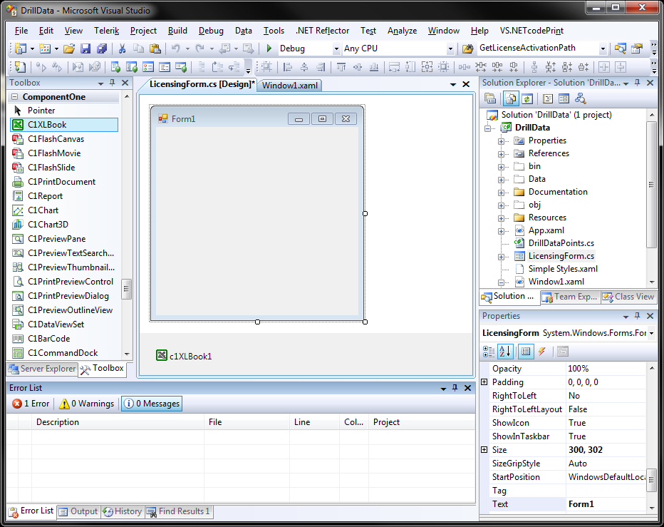
Review: WinForms
Windows Forms (WinForms) is a graphical (GUI) class library included as a part of Microsoft .NET Framework… by Wikipedia
https://en.wikipedia.org/wiki/Windows_Forms

Slide 7
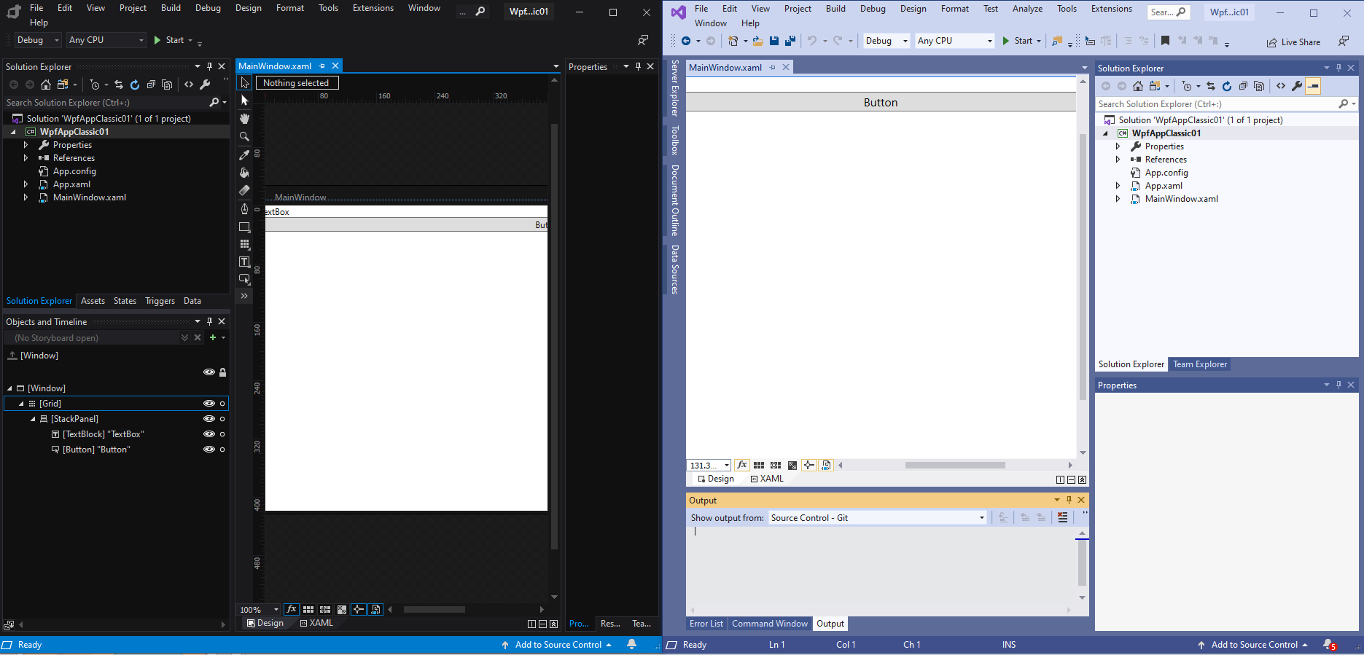
Review: WPF
Windows Presentation Foundation (WPF) is a graphical subsystem (similar to WinForms) originally developed by Microsoft for rendering user interfaces in Windows-based applications. by Wikipedia
https://en.wikipedia.org/wiki/Windows_Presentation_Foundation

Slide 8
WPF has designer tool Microsoft Blend
Microsoft Blend for Visual Studio (formerly Microsoft Expression Blend) is a user interface design tool… by Wikipedia
https://en.wikipedia.org/wiki/Microsoft_Blend
Notes:
Demo of Blend if people don’t know

Slide 9
WinForms/WPF Comparison
 | WinForms | WPF
Coding | C#/VB (Easier to Learn) | XAML+C#/VB (Harder to Learn)
Designer Tool | -(None) | Microsoft Blend
Appearance | .NET Framework 1.0 (Year 2002) | .NET Framework 3.0 (Year 2006)
Graphic Support | Basic Only | Advanced (Such as Animation)
Platform | Windows Only | Windows Only
Problem: .NET Framework is fading out.

Slide 10
.NET’s Past and Future
.NET Core is taking over the part where .NET Framework was used even in old code part like WinForms.
Windows Only
Multi Platform
Windows Only
(WinForms, WPF, and so on)
.NET Framework
.NET 5
(.NET Core Base)
Year 2002
Stop
.NET Core
Continue
Year 2016

Slide 11
Then now, NET Core ver. WinForms & WPF are released, … as early version. Not for business use for now, I think. I’ll tell you why later…

Slide 12
.NET Core WinForms/WPF Comparison
 | .NET Core WinForms | .NET Core WPF
Coding | C#/VB (Easier to Learn) | XAML+C#/VB (Harder to Learn)
Designer Tool | -(None) | Microsoft Blend
Appearance | .NET Core 3.0 (Year 2019) | .NET Core 3.0 (Year 2019)
Graphic Support | Basic Only | Advanced (Such as Animation)
Platform | Windows Only | Windows Only
Still Windows only!

Slide 13
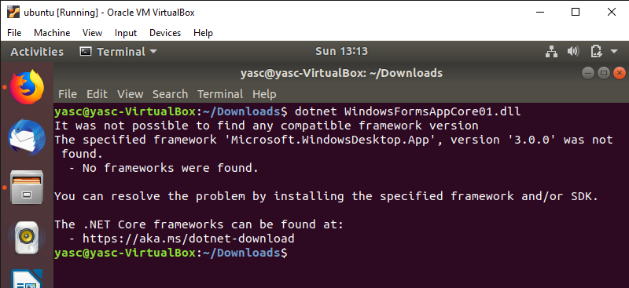
Windows Only
Even though .NET Core is multi-platform framework, WinForms and WPF are still only on Windows.
Windows dependent library is needed…

Slide 14
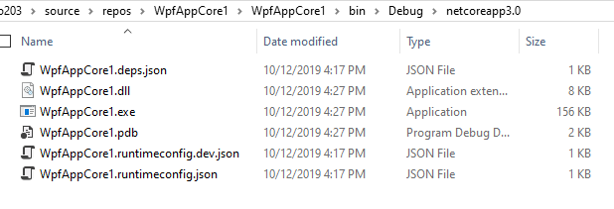
By the way, about .NET Core output
In .NET Core Ver. *.dll is the real program.
*.exe is just a launcher.

Slide 15
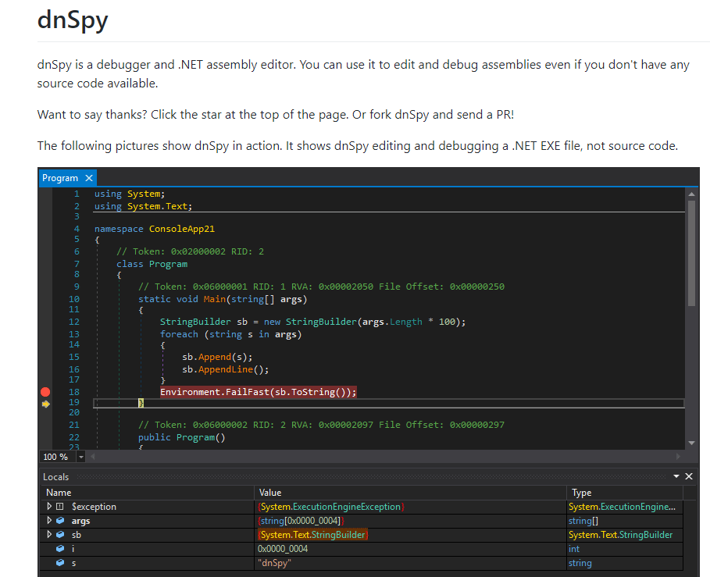
Tool : dnSpy
https://github.com/0xd4d/dnSpy
Good Open Source Tool !!
Notes:
Getting source code from *.exe or *.dll. It can be used to VB.NET code to C# (making VB.NET’s *.exe program and generage C# code from the *.exe)

Slide 16
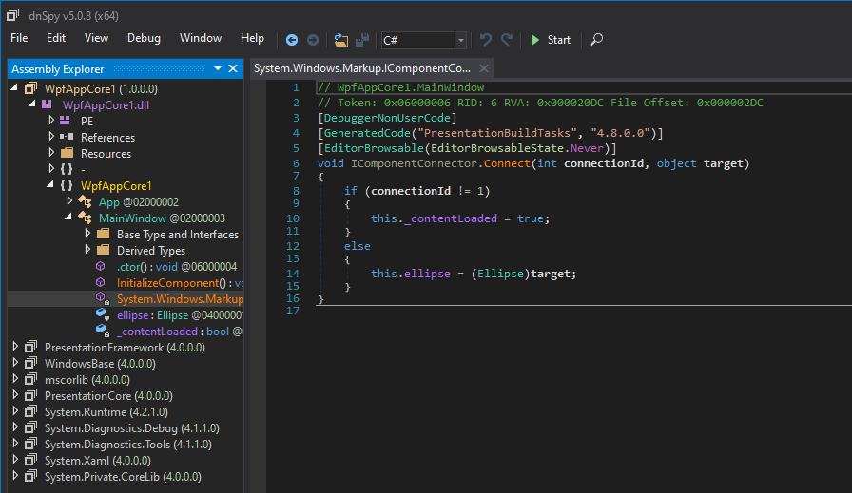
In DLL, Your Code Will Be.
Notes:
Demom dnSpy

Slide 17
.NET Core is open source. Thus, .NET Core Ver. WinForms & WPF are open source also!

Slide 18
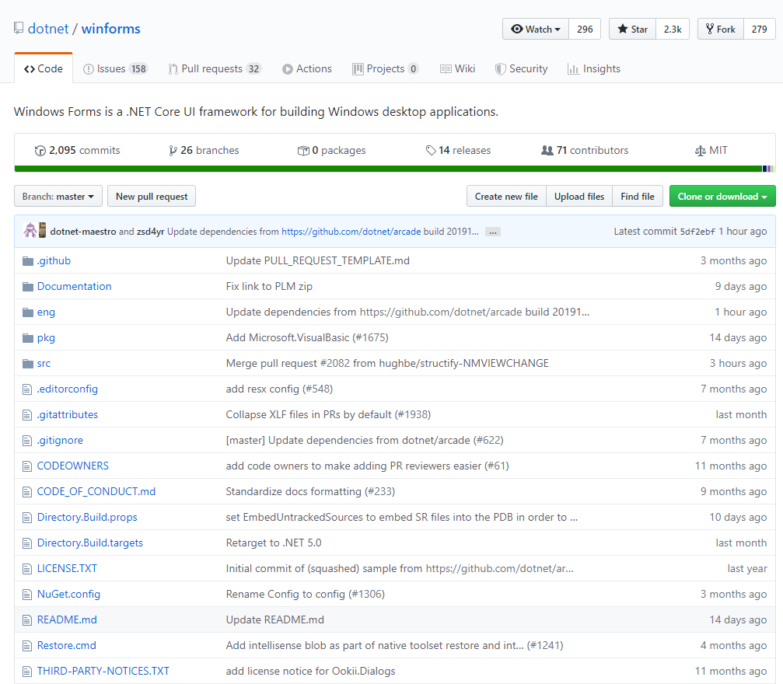
Source Code for .NET Core WinForms
https://github.com/dotnet/winforms

Slide 19
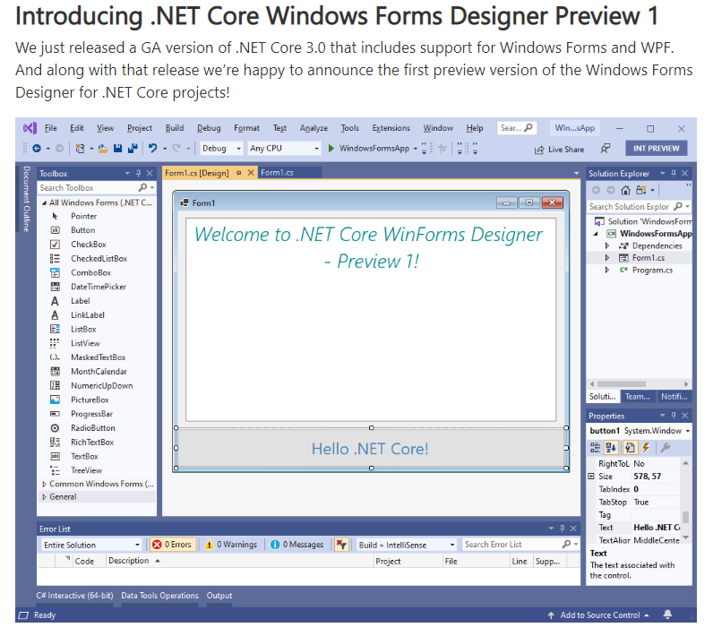
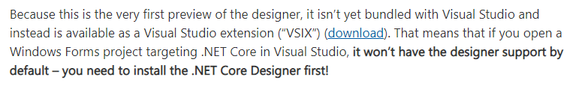
(Caution!)About WinForms Designer
https://devblogs.microsoft.com/dotnet/introducing-net-core-windows-forms-designer-preview-1/
Need to be install as VS extension!
Notes:
This is one reason that I say not for business now

Slide 20

Source Code for .NET Core WPF
https://github.com/dotnet/wpf

Slide 21
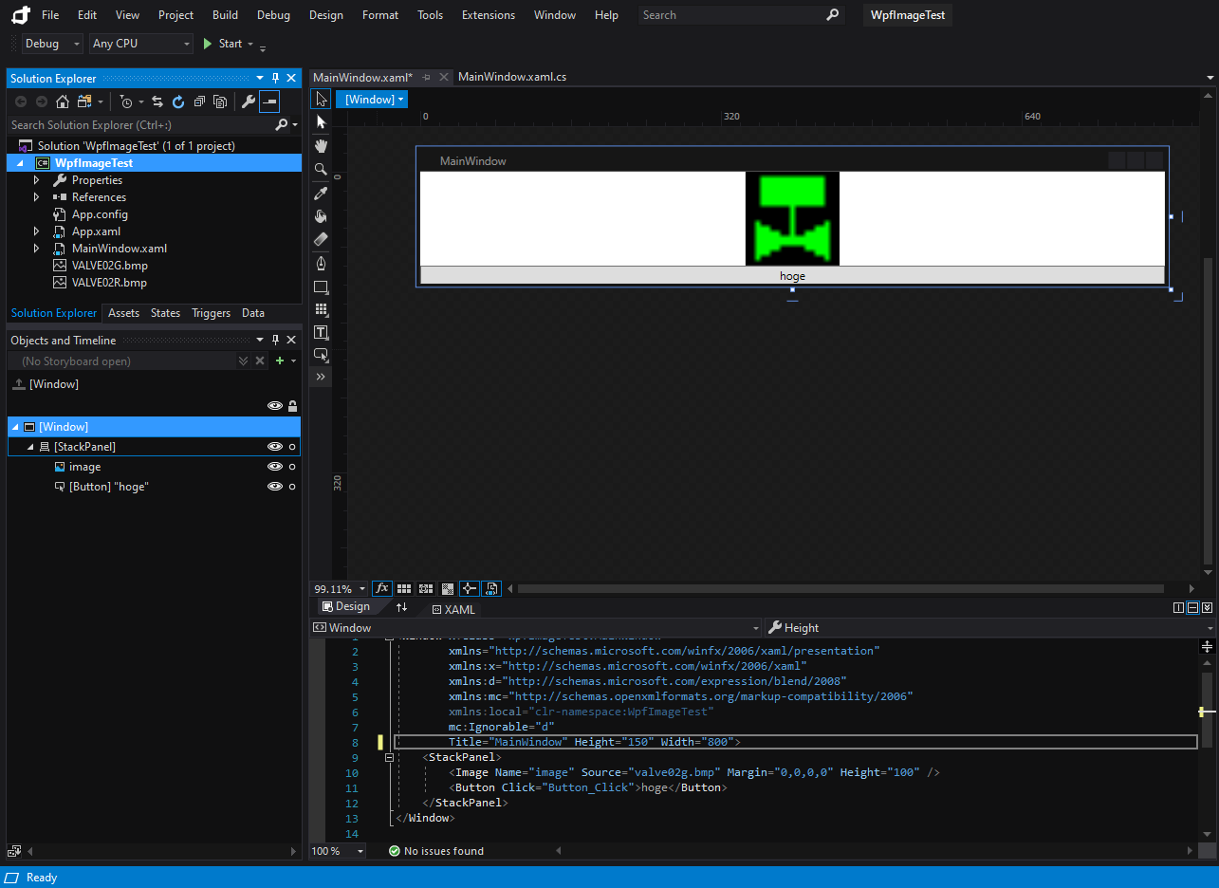
About Blend Support for WPF
This is .NET Framework project

Slide 22
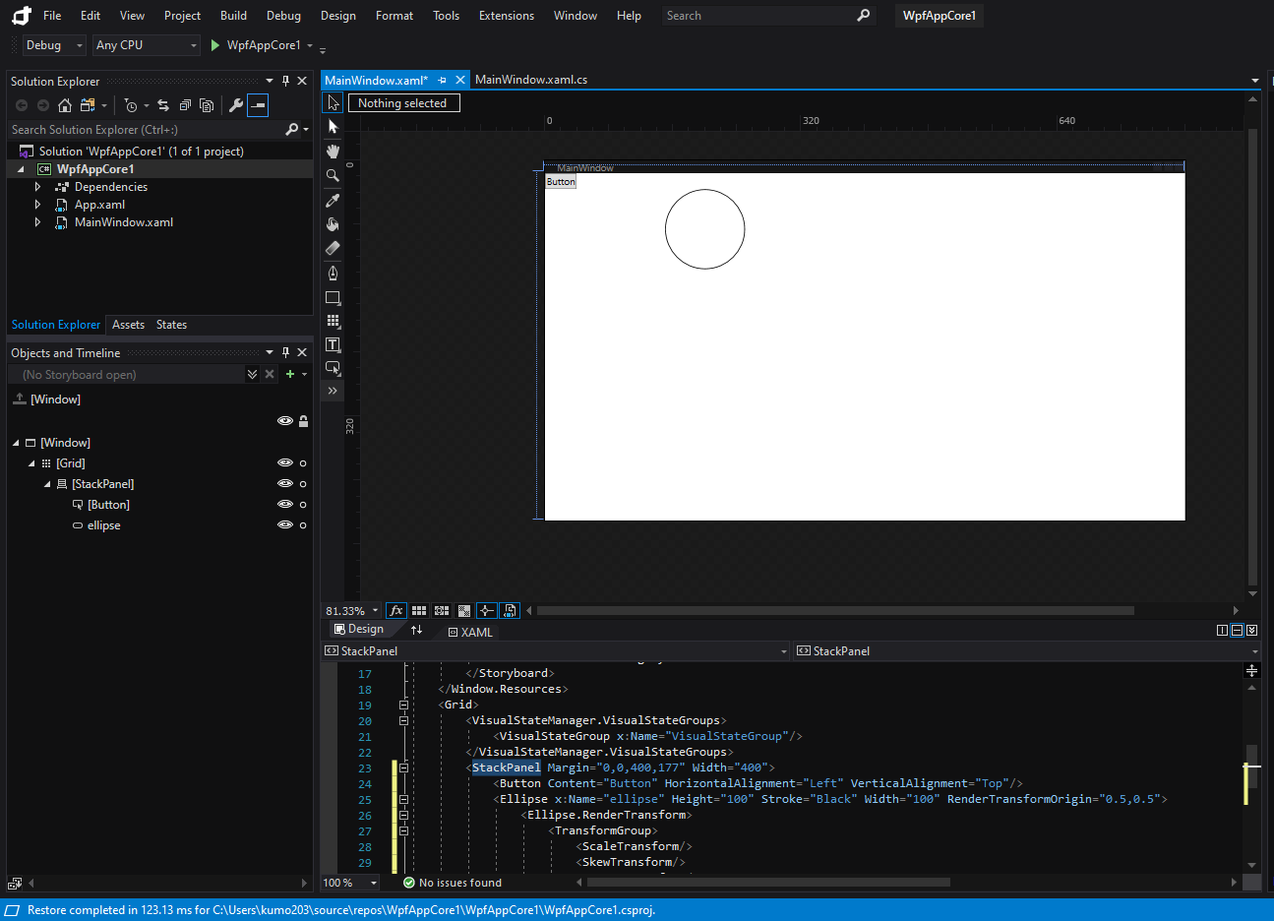
About Blend Support Support for WPF
This is .NET Core project. Some windows are missing…
Notes:
This is another reason why I say not for business now…

Slide 23

About VB support
VB road map will come soon, maybe(><;
Notes:
I feel VB support is becoming weaker these days. It seems MS is busy for supporting other tech such as TypeScript and so on.

Slide 24
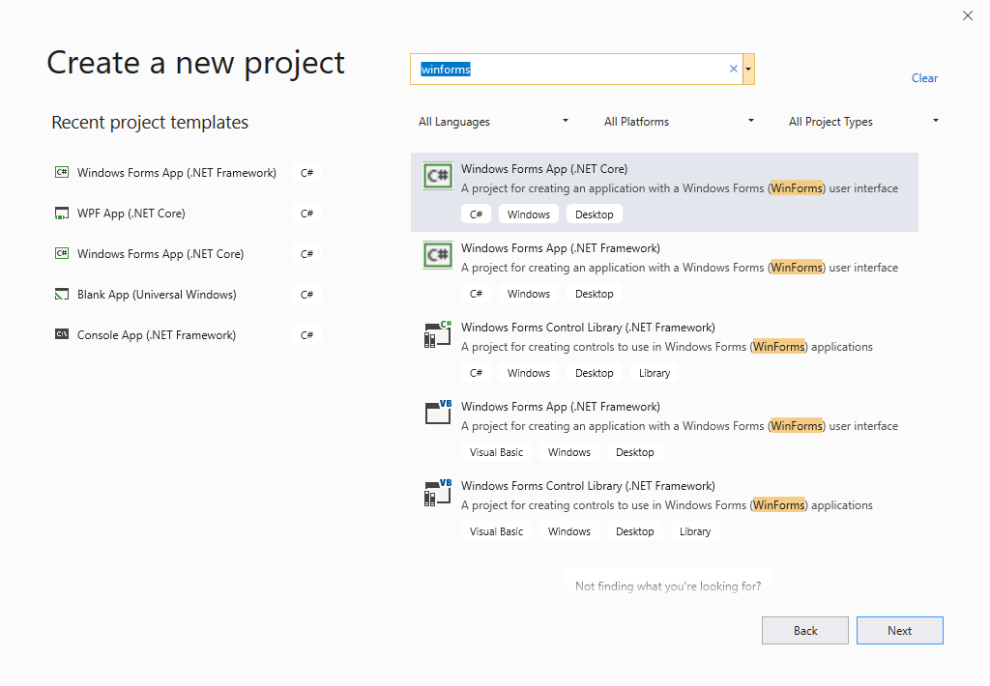
About VB support in WinForms
No .NET Core WinForms VB project

Slide 25
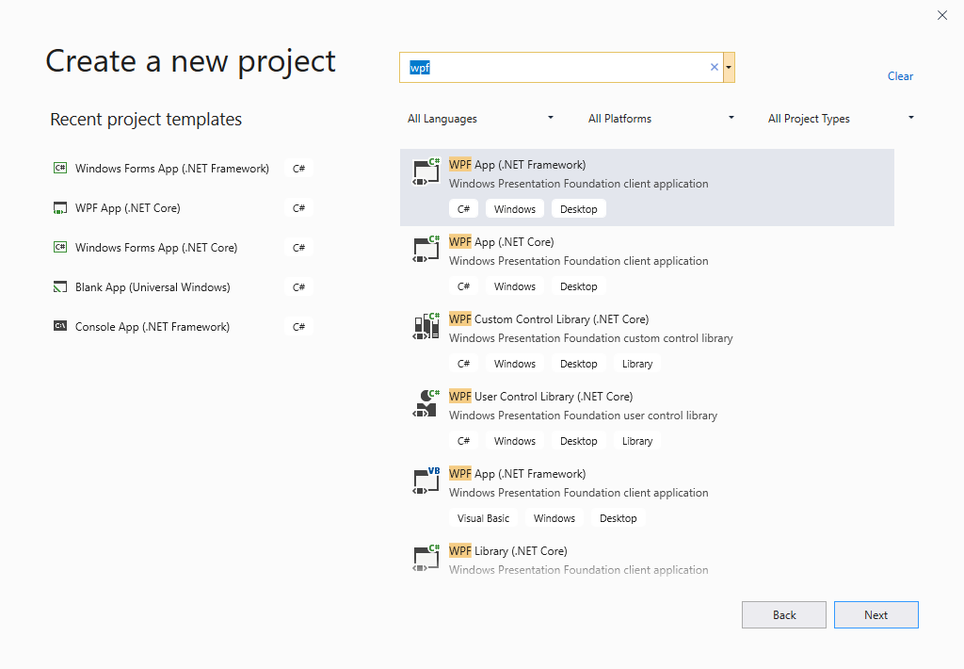
About VB support in WPF
No .NET Core WPF VB project

Slide 26
When to Choose .NET Core Ver. WinForms/WPF?

Slide 27
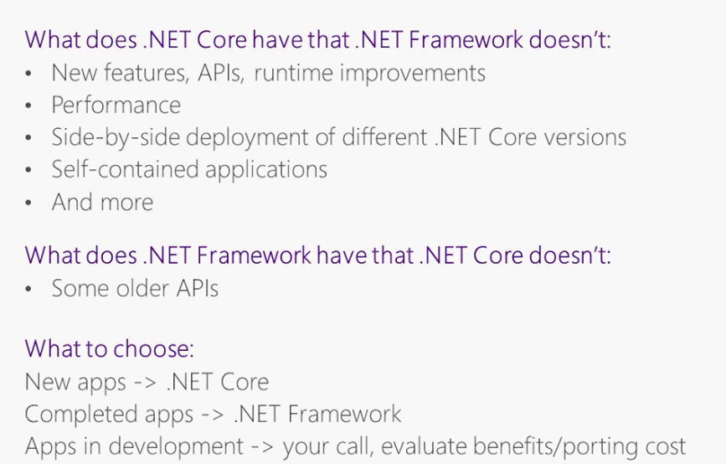
When to Choose .NET Core Ver.
https://channel9.msdn.com/Series/Desktop-and-NET-Core-101/NET-Core-and-NET-Framework-what-to-choose
Notes:
Thus, when we make a new program, .NET Core ver. but due to the limited support on the editors, I think .NET Ver. WinForms/WPF making is too early for now…

Slide 28

When to Choose .NET Core Ver.
https://blogs.windows.com/windowsdeveloper/2019/09/30/windows-10-winrt-api-packs-released/
New library works in .NET Core ver. only
Notes:
Thus, when we make a new program, .NET Core ver. but due to the limited support on the editors, I think .NET Ver. WinForms/WPF making is too early for now…

Slide 29
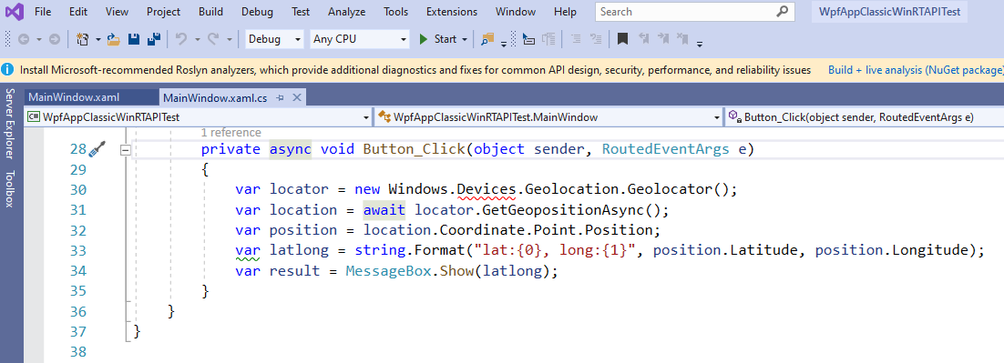
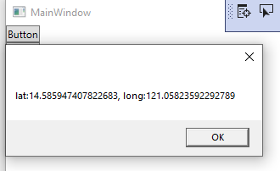
When to Choose .NET Core Ver.
In .NET Framework Ver. WPF, error…
In .NET Core Ver. WPF, working!
Notes:
Thus, when we make a new program, .NET Core ver. but due to the limited support on the editors, I think .NET Ver. WinForms/WPF making is too early for now…

Slide 30
Conclusion
.NET Core is evolving to cover all range of .NET ecosystem, and the Windows desktop app developments are shifting into it.
With its open source nature, we can study .NET Core Ver. WinForms/WPF already. (…but not for business use yet, in my opinion)
Let’s keep to see/use them to share the benefit in future together!

Slide 31
END
(Q&A Time)

Slide 32
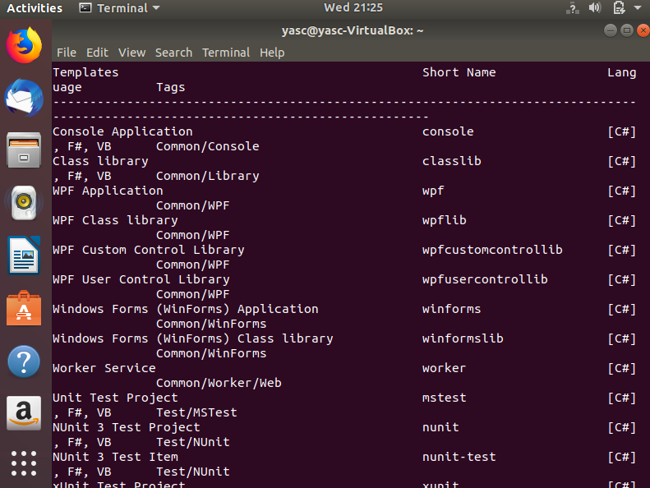
Windows Only
However, WinForms/WPF projects are in new project list even in other OS.
It’s in the list in ‘dotnet new’ command result.
Notes:
Demo if there is time

Slide 33

.NET Conf 2019 video
https://channel9.msdn.com/Events/dotnetConf/NET-Conf-2019
Notes:
Additional reference info

