Slide 1
About Azure API Management
Tomoya Yamanaka

Slide 2
Self-Introduction
Name: Tomoya Yamanaka
Home: Ortigas, Metro Manila, Philippines
Hobby: Attending/Organizing IT Events
Certifications: MCT (Microsoft Certified Trainer), and so on…
Role: Wankuma Alliance Manila Director
www.facebook.com/groups/WankumaAlliancePh/

Slide 3
Hobby: Attending/Organizing IT Events
I want more IT events here in Manila!!

Slide 4
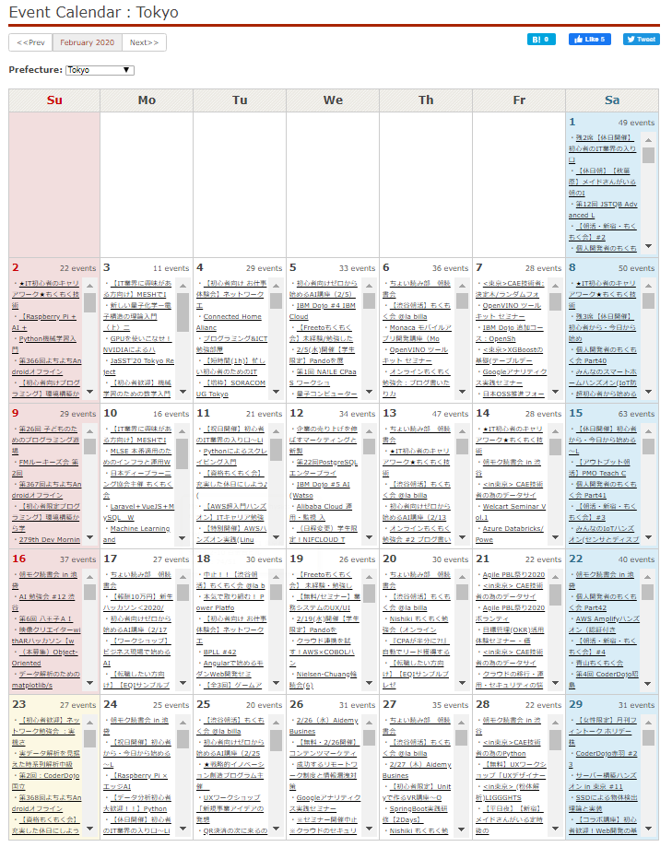
IT Events in Tokyo
https://connpass.com/calendar/tokyo/

Slide 5
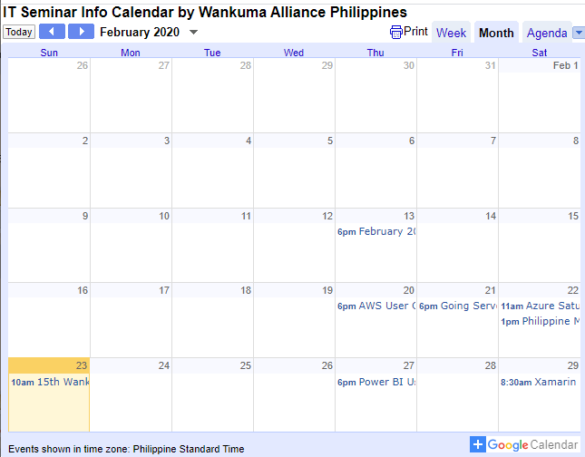
IT Events in Manila
https://calendar.google.com/calendar/embed?src=gbv6fi7etkb23vdpqn4dr4sbd0%40group.calendar.google.com&ctz=Asia%2FManila

Slide 6
Let’s attend or do more events!

Slide 7
Coming events
Power BI Users Meetup Group Session #19
https://www.meetup.com/7008169b-6cb9-4ad3-8211-28cf1ca0fb15/events/268345793
Xamarin Workshop - February
https://www.eventbrite.com/e/xamarin-workshop-february-tickets-95762517267

Slide 8
My Topic for Today ↓ Azure API Management(APIM)

Slide 9
What is it?

Slide 10
Let’s create! (PowerShell Demo)
Notes:
$azemail = "foo@Bar.com"
$azpw = "FooBar"
$azTenant = "333509fc-868d-4474-b079-5b33a7193456"
$target_location = "japaneast"
$target_resource_group = "yama20200223tsbp1rg"
$target_storage_name = "yama20200223tsbp1strg01"
$target_container_name = "publicapilog"
$target_eventhub_ns = "yama20200223tsbp1evthns"
$target_eventhub = "yama20200223tsbp1evth"
$target_apim_name = "yama20200223apim"
$org_name = "YASC"
$admin_email = "tomoya.yamanaka@yasc.info"
$apim_product_id = 100;
$apim_product_title = "Yasc Product";
$apiapim_product_desc = "This is Yasc's product!"
#Azure Signin
$secpasswd = ConvertTo-SecureString $azpw -AsPlainText -Force
$mycreds = New-Object System.Management.Automation.PSCredential ($azemail, $secpasswd)
Login-AzAccount -Tenant $azTenant #-Credential $mycreds
#Resource Group
$temp_rg = $null
$temp_rg = Get-AzResourceGroup -name $target_resource_group -ErrorAction SilentlyContinue
if ( $temp_rg -eq $null )
{
New-AzResourceGroup -Location $target_location -Name $target_resource_group
}
#APIM Management
$temp = Get-AzApiManagement -Name $target_apim_name -ResourceGroupName $target_resource_group -ErrorAction SilentlyContinue
if ( $temp -eq $null )
{
New-AzApiManagement -ResourceGroupName $target_resource_group -Name $target_apim_name -Location $target_location -Organization $org_name -AdminEmail $admin_email
$Api = Get-AzAPIManagement -ResourceGroupName $target_resource_group -Name $target_apim_name
$apiContext = New-AzApiManagementContext -ResourceGroupName $api.resourcegroupname -ServiceName $api.name
$newProduct = New-AzApiManagementProduct -Context $apiContext -ProductId $apim_product_id -Title $apim_product_title -Description $apiapim_product_desc -State Published
}

Slide 11
It takes time…(about 30min)

Slide 12
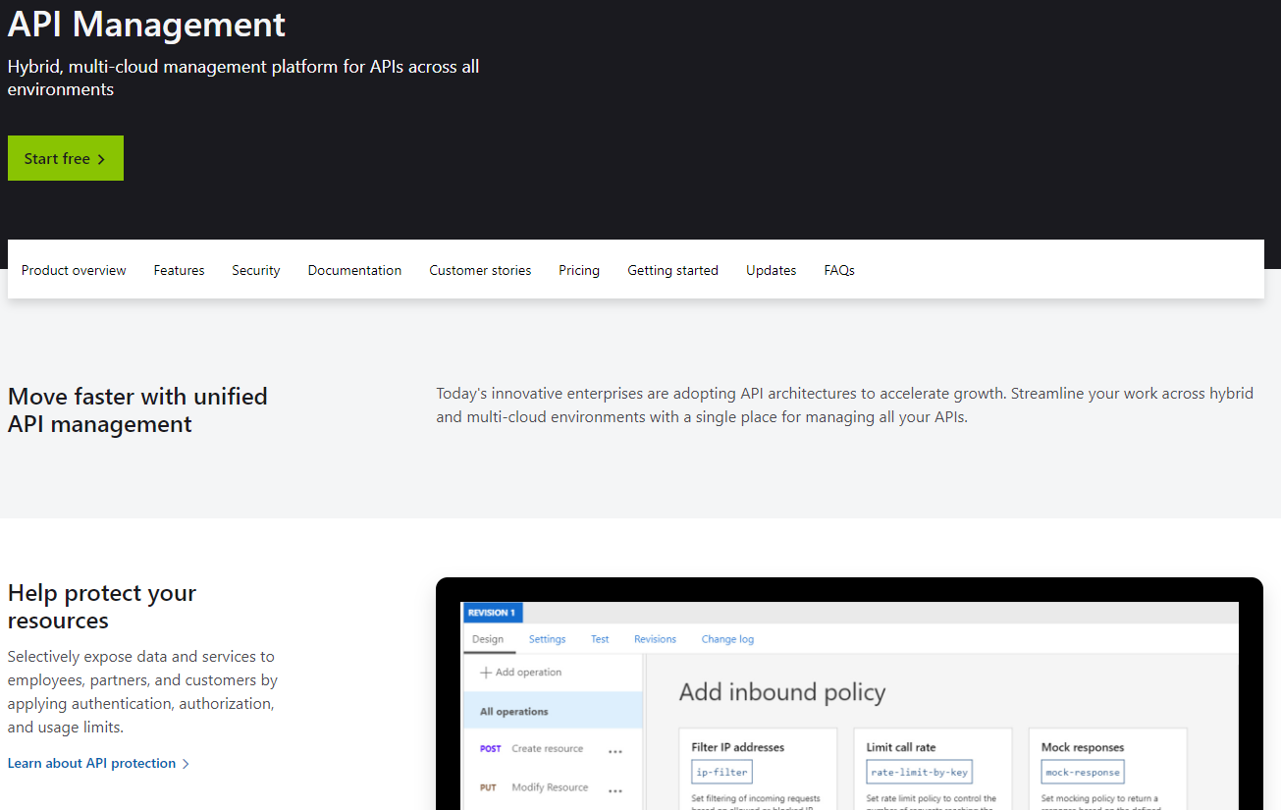
Official Page
https://azure.microsoft.com/en-us/services/api-management/

Slide 13
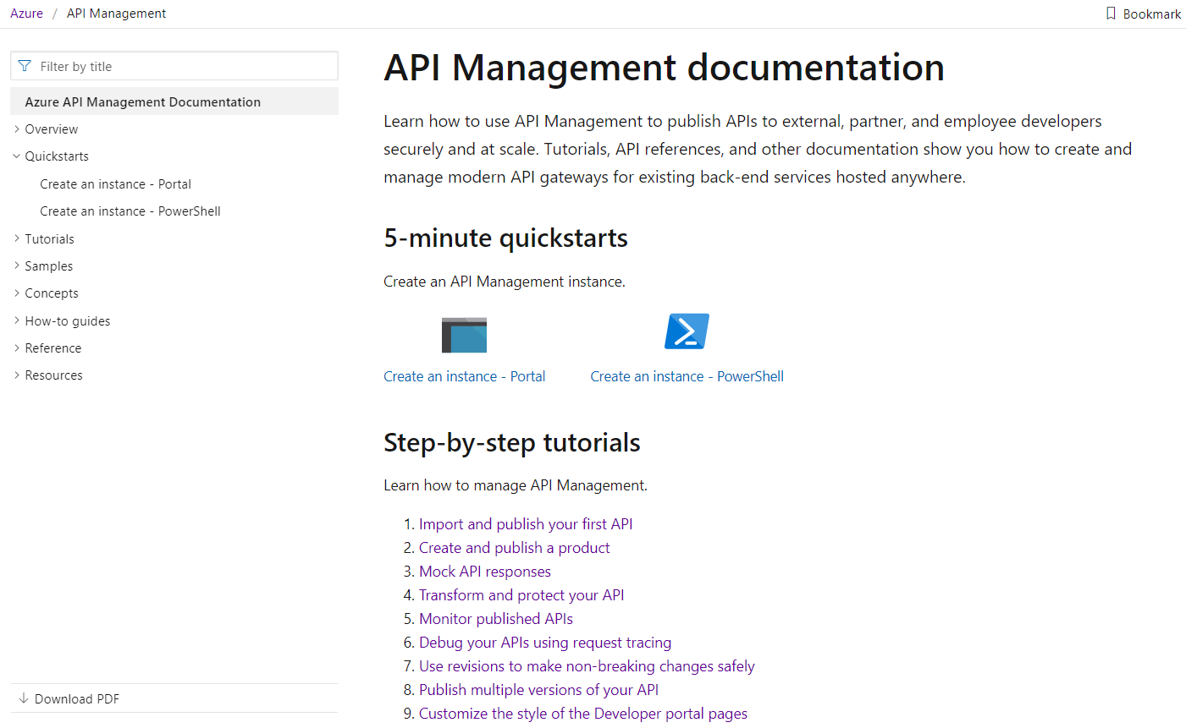
Document Page
https://docs.microsoft.com/en-us/azure/api-management/

Slide 14
Let’s take a look the already created one! (Demo)
Notes:
-Showing Azure Instance
-Showing Azure Functions
-Showing Postman demo (PowerShell code generation also)
-Subscription Demo
-Rate Limit Demo

Slide 15
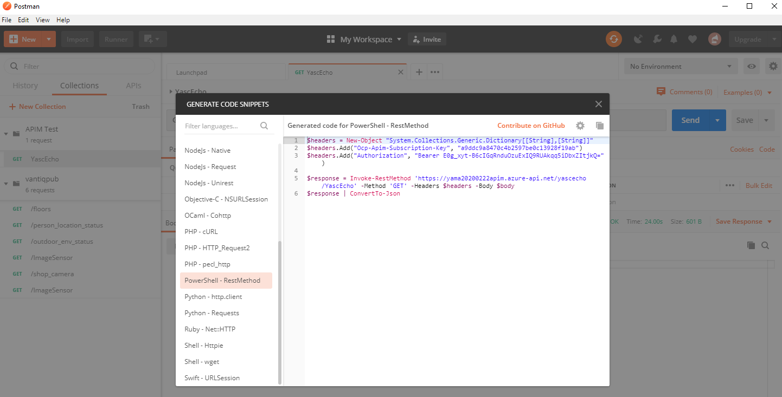
Nice tool for WebAPI test, Postman
https://www.postman.com/

Slide 16
By the way, why this kind of WebAPI related products are needed nowadays?

Slide 17

Because of pirated software issue!

Slide 18
Software service monetizing has shifted to subscription style!

Slide 19
Then, to check the subscription validity, WebAPI is usually used.

Slide 20
But such subscription management system making is tiring and boring…

Slide 21
Thus, APIM exits!!!

Slide 22
It’s nice! So why didn’t people usually use it already?

Slide 23
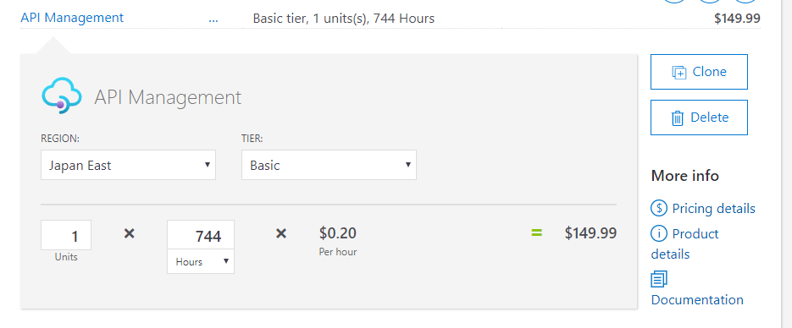
APIM is not cheap!
It costs nice amount for business use…
Microsoft Azure Pricing calculator
https://azure.microsoft.com/en-us/pricing/calculator/
Notes:
I recommend you to check Azure Calc at the beginning of the system designing phase.

Slide 24
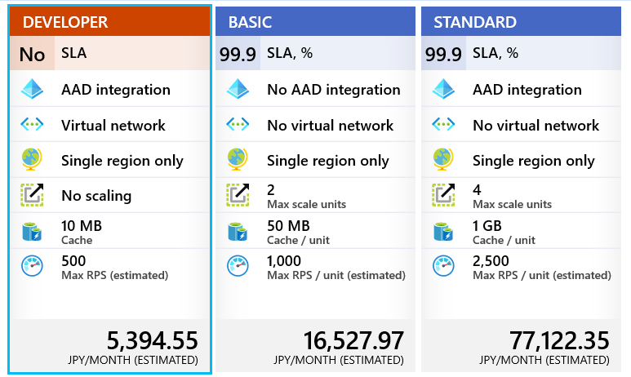
APIM Plans(1/2)

Slide 25
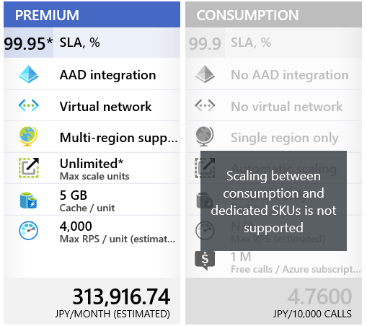
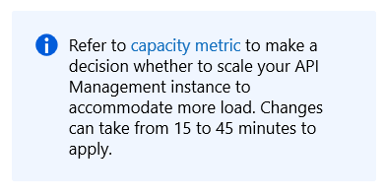
APIM Plans(2/2)
Notes:
Creation or change of APIM instance takes time…

Slide 26

O…OK, but it’s useful. And at least better to hire some people to make the same system. Let companies pay for it!
Notes:
Or u might be able to use a simple token or shared key to manage accessing users if your system

Slide 27
Conclusion
APIM is useful, and not cheap, WebAPI management system.
When we need to manage WebAPI access subscription, centralizing, versioning, and so on, we can think about using it.
Let’s use the nice management system to manage not creative part so that we can focus on making brand new services!

Slide 28
END
(Q&A Time)

