Slide 1
About Cloud Support Plan
Tomoya Yamanaka

Slide 2
Problem of Could Services, Too Many to Study!
Nowadays, using cloud services is so common for software projects.
But but cloud services are too many and all are changing everyday.
Gee, we cannot follow all…

Slide 3
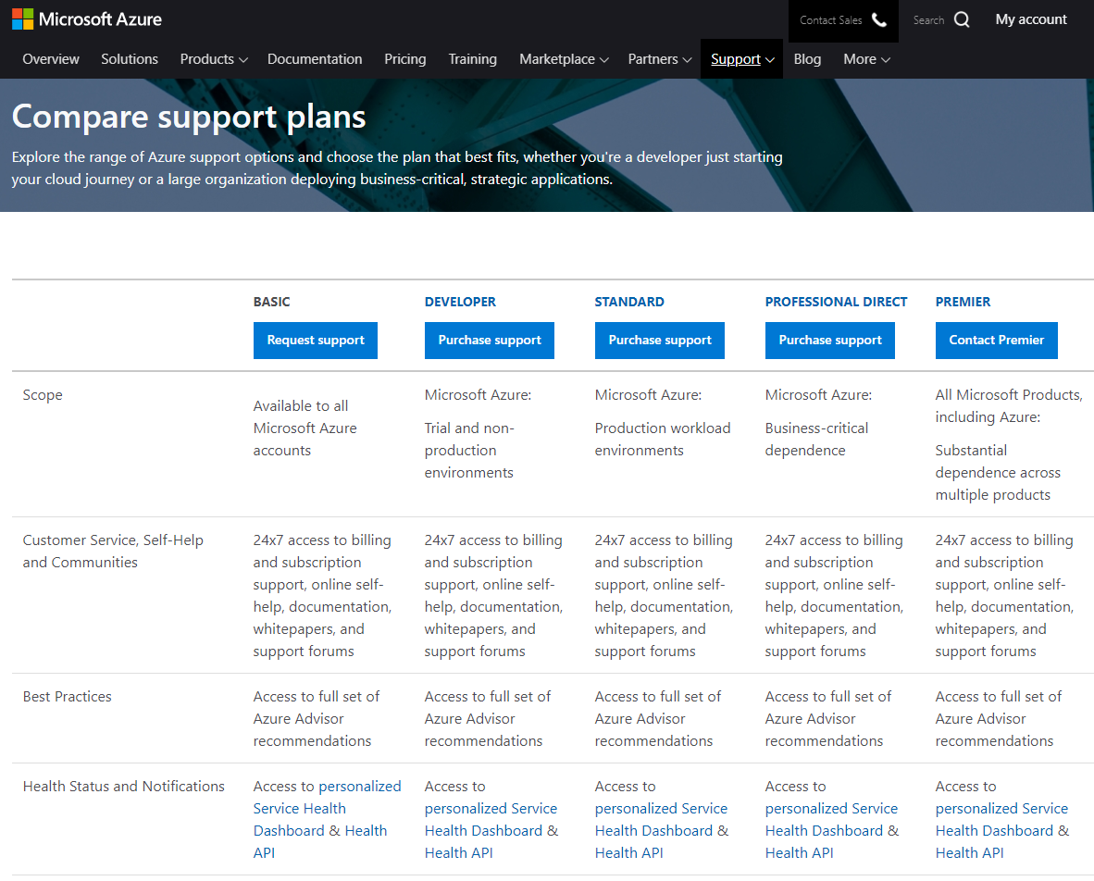
Support Service Plan
https://azure.microsoft.com/en-us/support/plans/

Slide 4
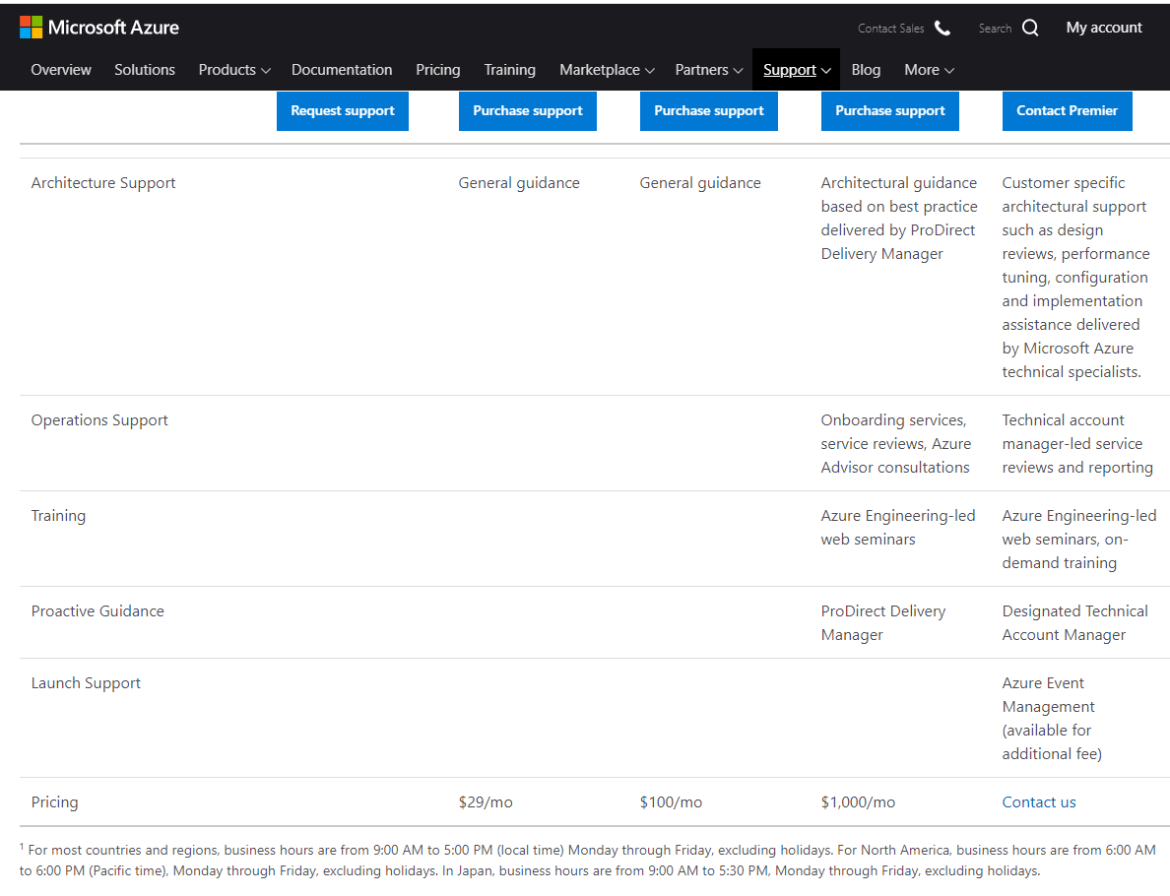
Support Service Plan
https://azure.microsoft.com/en-us/support/plans/
The price starts from okay level

Slide 5
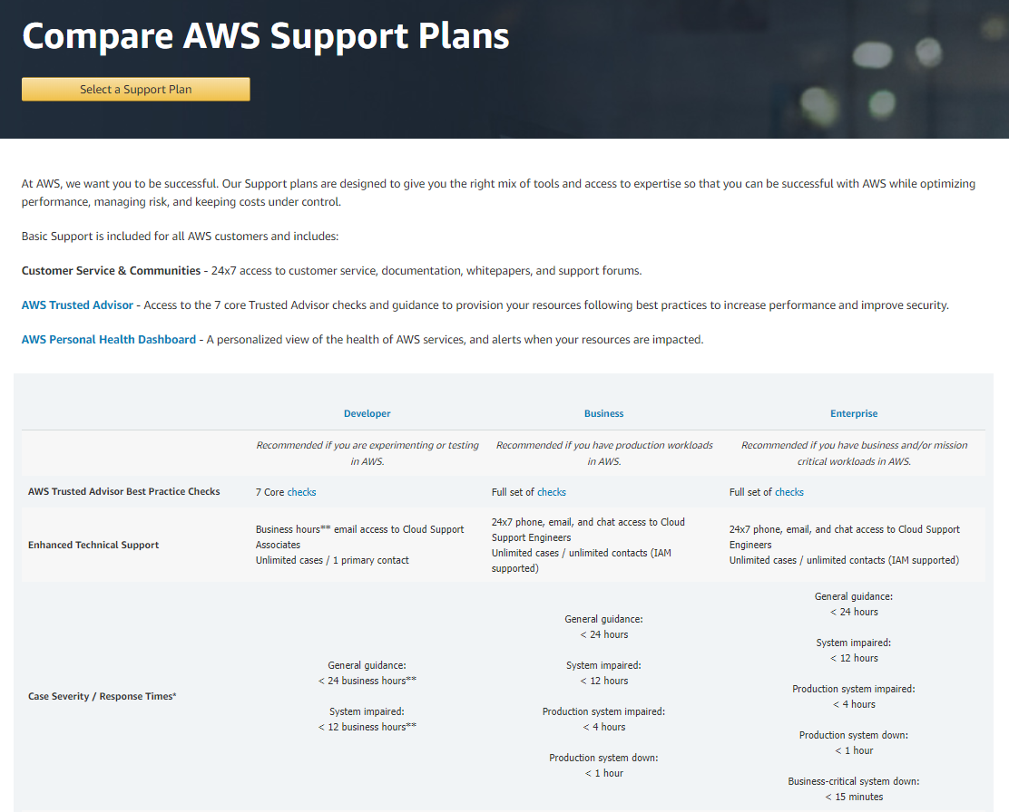
There is similar one in AWS also, or maybe it is the original.
https://aws.amazon.com/premiumsupport/plans/

Slide 6
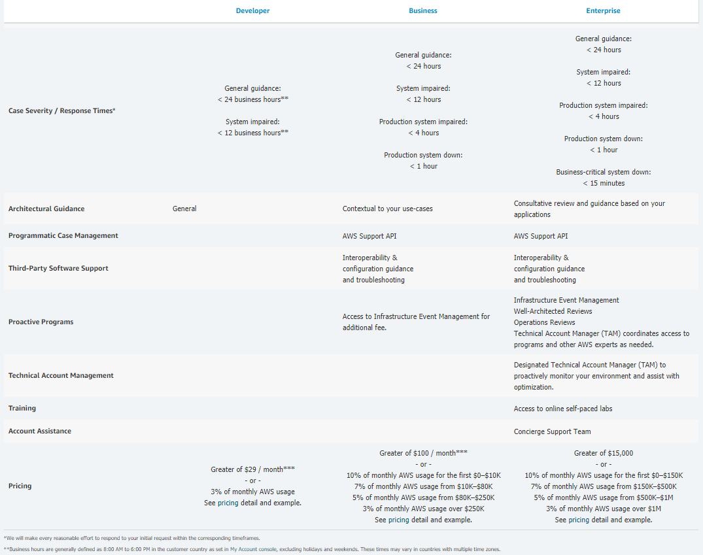
There is similar one in AWS also, or maybe it is the original.
https://aws.amazon.com/premiumsupport/plans/
It might be expensive in AWS. Be careful!

Slide 7
END

