Slide 1
About OPC UA
Tomoya Yamanaka

Slide 2
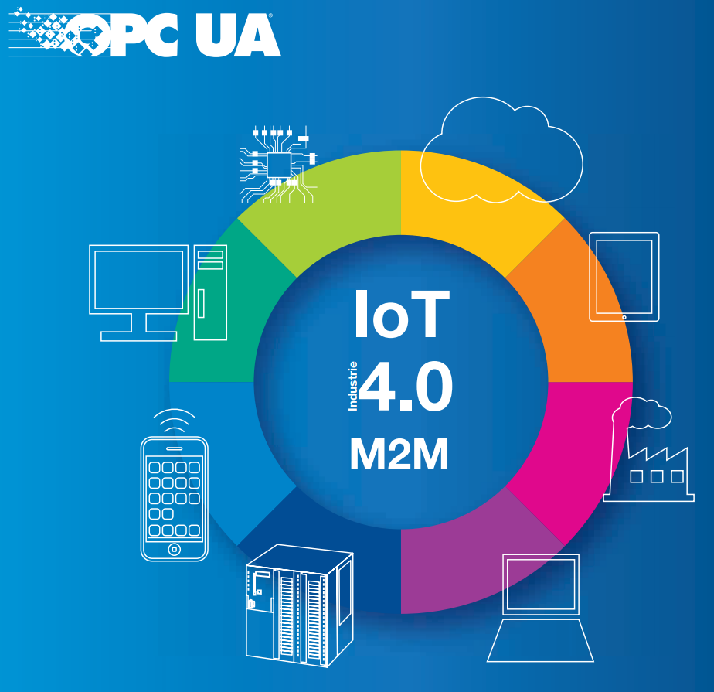
There is an organization for factory equipment communication protocol, OPC Foundation. And OPC UA is a framework made by it.
https://opcfoundation.org/wp-content/uploads/2017/11/OPC-UA-Interoperability-For-Industrie4-and-IoT-EN.pdf

Slide 3
UPC UA is used for what?
OPC UA is used for Industry 4.0, IIoT and so on, according to OPC Foundation.
Thus, using it should be cool!!

Slide 4
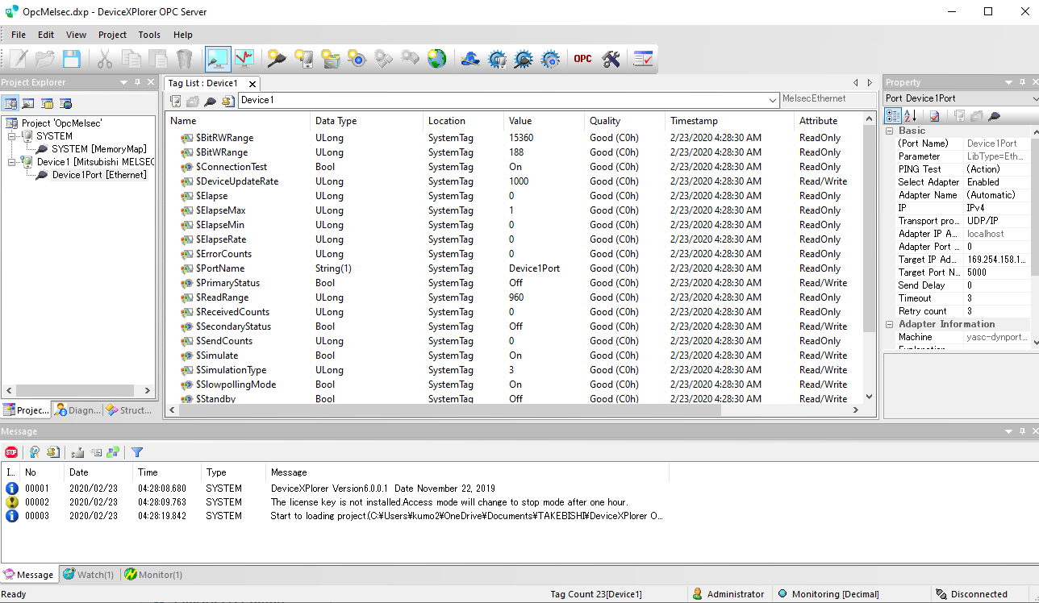
How can we use it?
I’m using TAKEBISHI DeviceXPlorer OPC Server
https://www.faweb.net/en/product/opc/

Slide 5
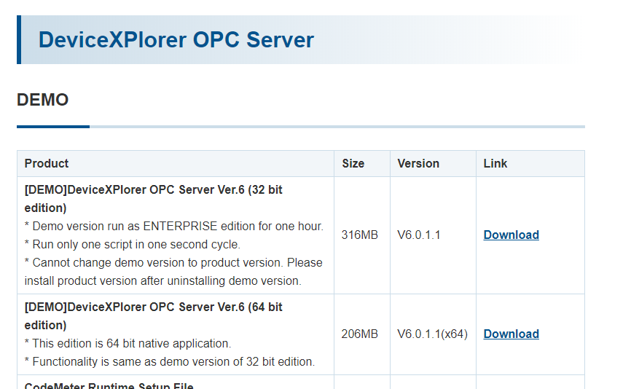
There is demo version
DEMO version is available!
https://www.faweb.net/en/download/download/#opc

Slide 6
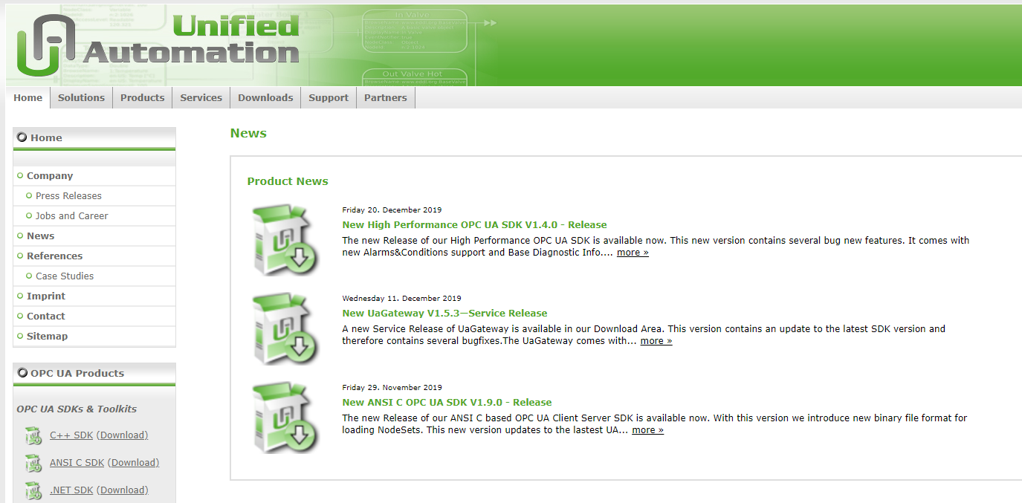
For client, there is SDK
This is a famous OPC UA SDK according to OPC person.
https://www.unified-automation.com/

Slide 7
END

