Slide 1
Why Don’t you be MCT?
Tomoya Yamanaka

Slide 2
What is MCT?
MCT means Microsoft Certified Trainer.
You can become it with passing several MCP,
Microsoft Certified Professional, exams.
For more info.
https://www.microsoft.com/en-us/learning/mct-certification.aspx

Slide 3
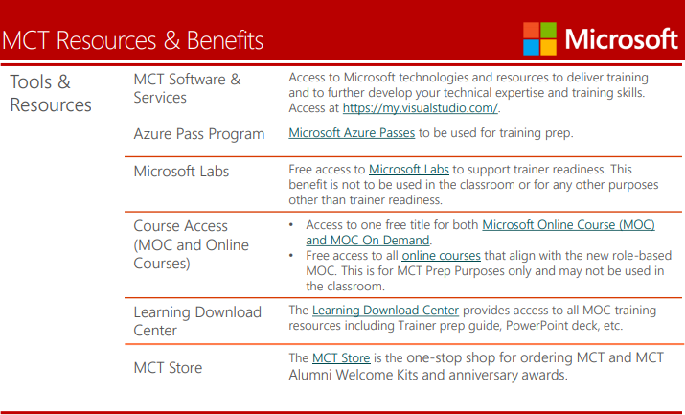
What is MCT benefits?
https://query.prod.cms.rt.microsoft.com/cms/api/am/binary/RE23o0Z

Slide 4
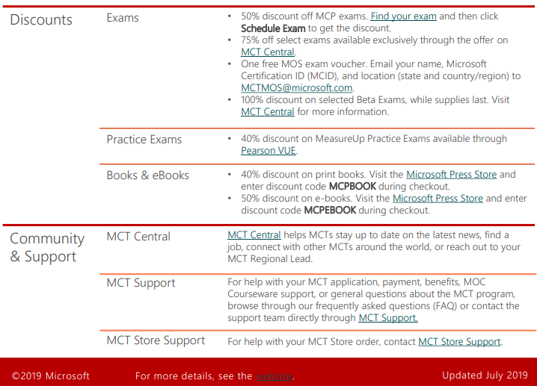
What is MCT benefits?
https://query.prod.cms.rt.microsoft.com/cms/api/am/binary/RE23o0Z

Slide 5
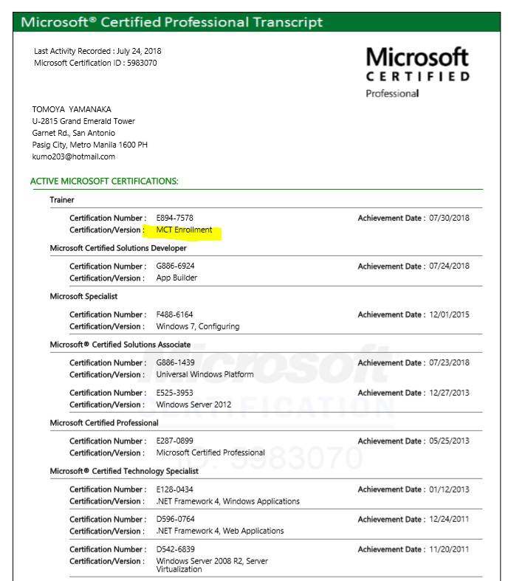
What is MCT benefits?
You can get your transcript issued by Microsoft.

Slide 6
How did I become?
I took and passed following exams. It’s one pass for Windows developers.
It took about 1 month in total for me.
70-357: Developing Mobile Apps
70-411: Developing Microsoft Azure and Web Services
70-483: Programming in C#

Slide 7
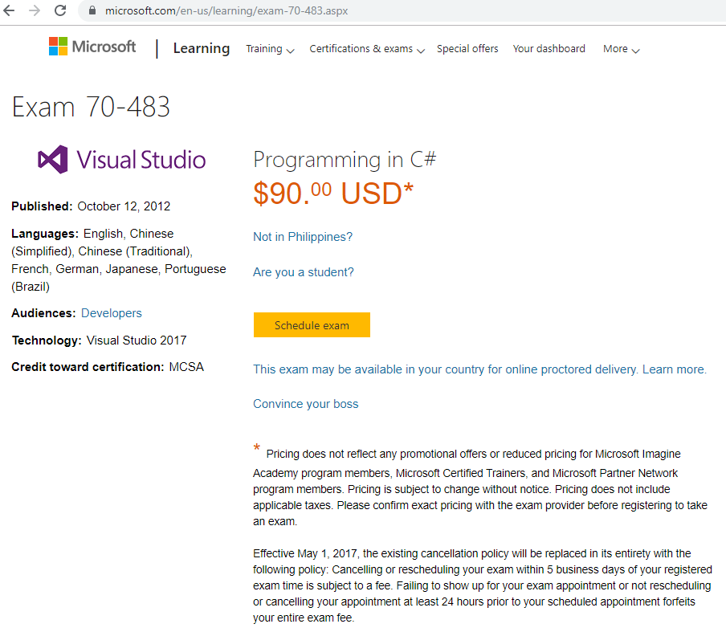
How much to be?
MCP exam fee in Philippines.

Slide 8
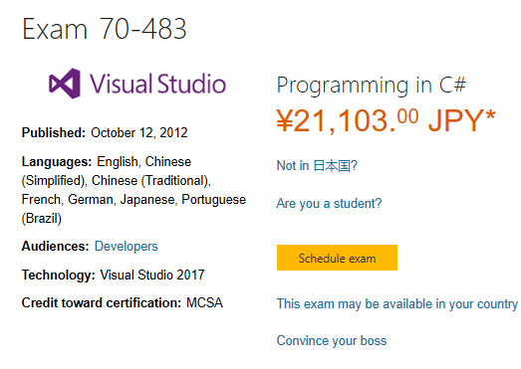
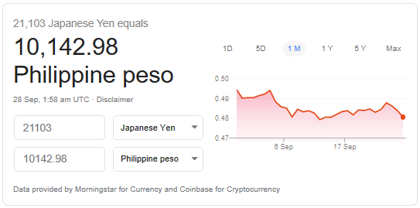
How much to be?
MCP exam fee in Japan.
By Google computation

Slide 9
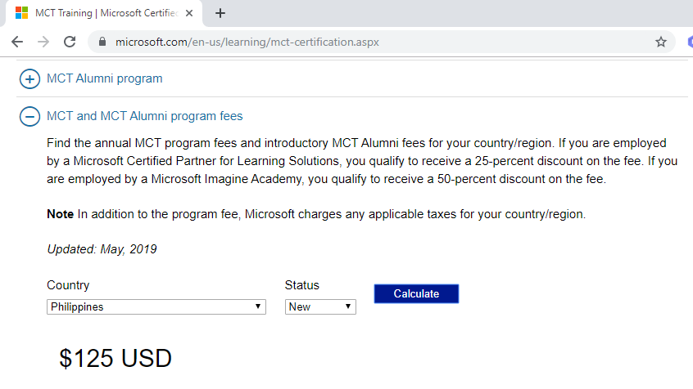
How much to be?
MCP exam fee in Philippines.

Slide 10
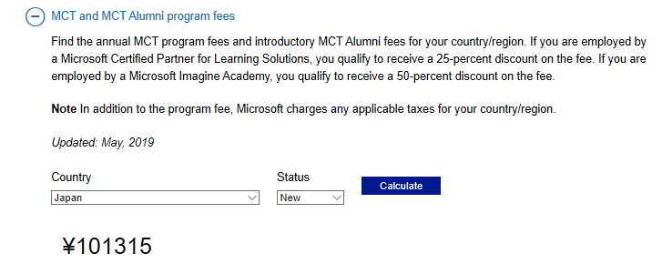
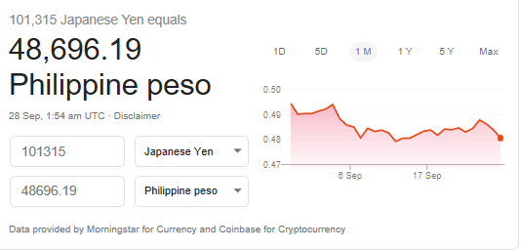
How much to be?
MCP exam fee in Japan.
By Google computation

Slide 11
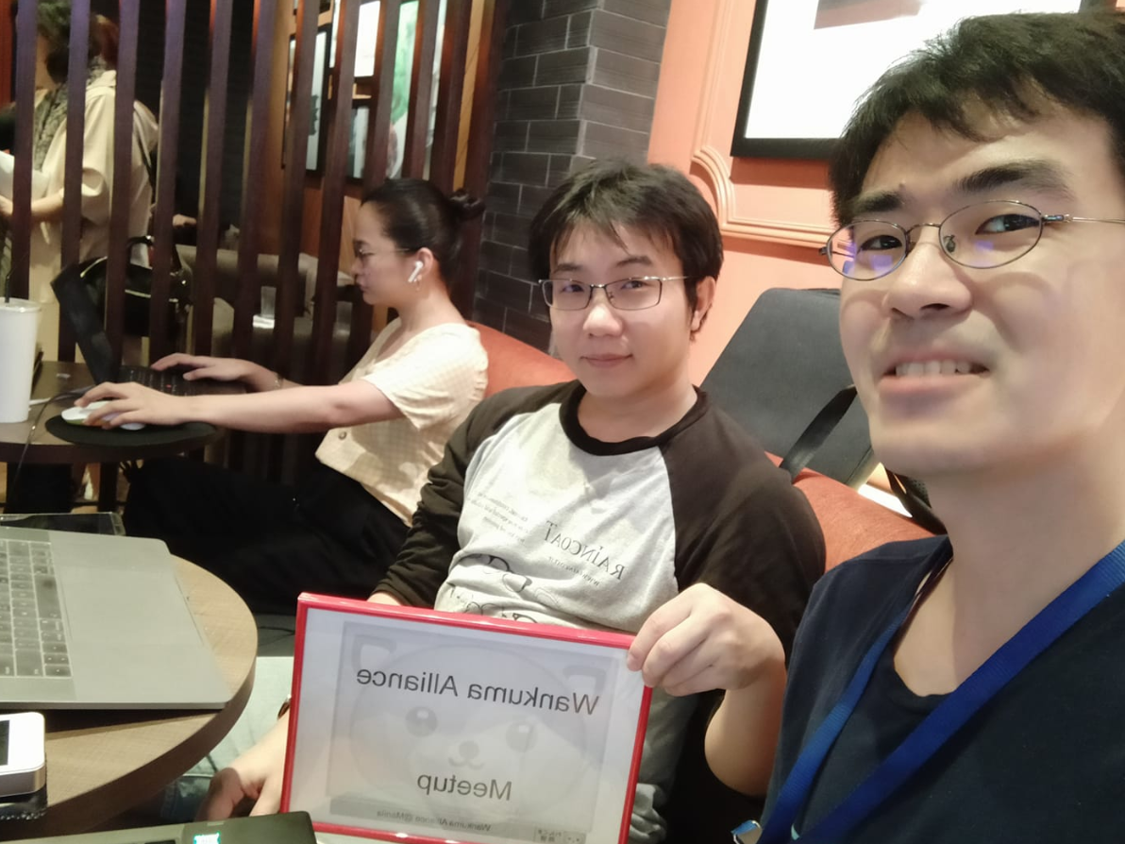
How-To Study
Wankuma Alliance@Manila Saturday Café meetup
www.facebook.com/groups/WankumaAlliancePh/

Slide 12
END

