Slide 1
About Windows Scripting Environments
Tomoya Yamanaka

Slide 2
Agenda
Self-Introduction
Why Scripting in Windows?
And its Scripting Environments
Scripting Usage Demo
Conclusion

Slide 3
Part I: Self-Introduction

Slide 4
Self-Introduction
Name: Tomoya Yamanaka
Home: Ortigas, Metro Manila, Philippines
Work： IT Engineer(Consultant?)
Hobby: Attending/Organizing IT Events
Certifications:Microsoft Certified Trainer(MCT), and so on…
Role: Wankuma Alliance Manila Director
www.facebook.com/groups/WankumaAlliancePh/

Slide 5
Hobby: Attending/Organizing IT Events

Slide 6
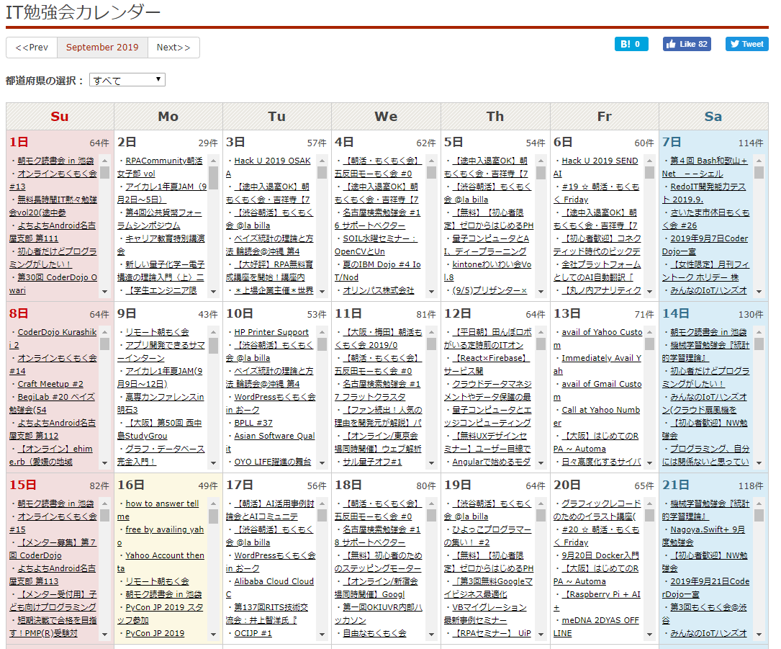
IT Event Calendar in Japan https://connpass.com/calendar/
Notes:
In Japan, there are super many events all time!!

Slide 7
Too Few IT Events in Manila Still!!

Slide 8

Let’s have more events!!
Wankuma Alliance@Manila Saturday Café meetup
www.facebook.com/groups/WankumaAlliancePh/
This Event!!
Wankuma Alliance@Manila
IT Seminar

Slide 9
Part II: Why Scripting in Windows? And its Scripting Environments

Slide 10
Why Scripting in Windows?
In Wankuma Alliance@Manila Saturday
Café meetup, I thought “Gee, I cannot
talk to everybody all time. We need a
useful text material for attendees to
accommodate more!”

Slide 11
Why Scripting in Windows?
OK, then about what?
My answer is Windows Scripting.
It’s available in Windows already.
Anybody can try immediately without setup!!

Slide 12
Answer Ahead!
If you know about PowerShell, it’s the best answer in most case. I tell you the answer ahead!
But there was a history to reach the best answer.
I’d like to talk about it to clarify.

Slide 13
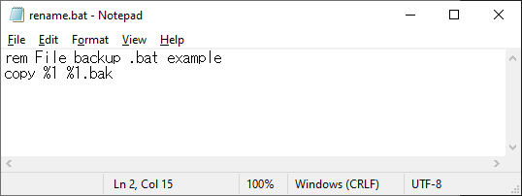
Windows Scripting Examples
Batch File(.bat)
Batch File is just text file with .bat extension and its content is composed of Windows commands.
Because of it, it’s functionality is limited. No Regular Expression support is especially a problem (><;
Notes:
rem File backup .bat example
copy %1 %1.bak

Slide 14
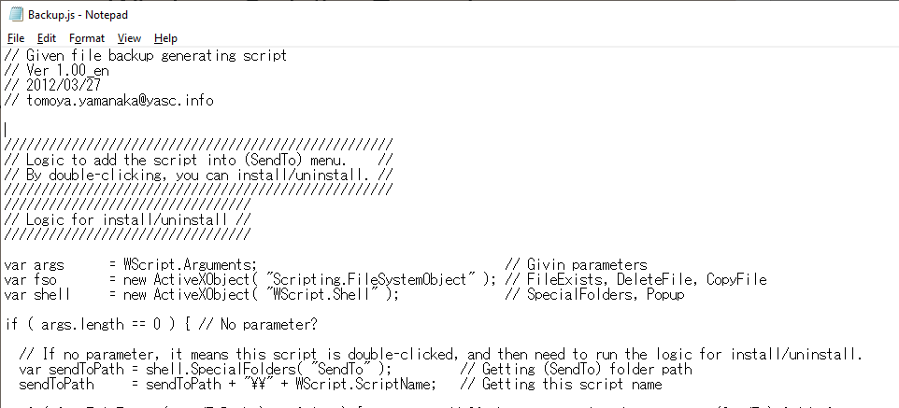
Windows Scripting Examples
Windows Script Host(.wsh, .vbs, .js)
Windows Script Host File is more powerful mechanism for scripting in Windows.
It supports Regular Expression and also ActiveX or COM technology to support powerful functionality, but…
Notes:
// Given file backup generating script
// Ver 1.00_en
// 2012/03/27
// tomoya.yamanaka@yasc.info
////////////////////////////////////////////////////
// Logic to add the script into (SendTo) menu. //
// By double-clicking, you can install/uninstall. //
////////////////////////////////////////////////////
/////////////////////////////////
// Logic for install/uninstall //
/////////////////////////////////
var args = WScript.Arguments; // Givin parameters
var fso = new ActiveXObject( "Scripting.FileSystemObject" ); // FileExists, DeleteFile, CopyFile
var shell = new ActiveXObject( "WScript.Shell" ); // SpecialFolders, Popup
if ( args.length == 0 ) { // No parameter?
// If no parameter, it means this script is double-clicked, and then need to run the logic for install/uninstall.
var sendToPath = shell.SpecialFolders( "SendTo" ); // Getting (SendTo) folder path
sendToPath = sendToPath + "\\" + WScript.ScriptName; // Getting this script name
if ( fso.FileExists( sendToPath ) == false ) { // If this script already exists in (SendTo) folder?
// This script doesn't exist yet, so show a dialog to ask the installation.
var ret = shell.Popup( "Do you want to install " + sendToPath + "?", 0, "Install", 1 + 64 );
if ( ret == 1 ) { // [OK] button is pressed
fso.CopyFile( WScript.ScriptFullName, sendToPath ); // Copy this scprint into (SendTo) folder.[Install]
}
} else {
// This script exists already, so show a dialog to ask the uninstallation.
var ret = shell.Popup( "Do you want to uninstall " + sendToPath + "?", 0, "Uninstall", 1 + 64 );
if ( ret == 1 ) { // [OK] button is pressed
fso.DeleteFile( sendToPath, true ); // Delete this scprint from (SendTo) folder.[Uninstall]
}
}
WScript.Quit(); // Exit from script
}
////////////////////////////////////////
// End of logic for install/uninstall //
////////////////////////////////////////
function getDateStr()
{
var date = new Date();
var year = date.getYear().toString();
var month = date.getMonth() + 1; // getMonth() returns 0~11. Thus, adjusting.
if ( month < 10 ) {
month = "0" + month;
}
var day = date.getDate();
if ( day < 10 ) {
day = "0" + day;
}
return "_" + year + month + day;
}
var args = WScript.Arguments;
var fso = new ActiveXObject( "Scripting.FileSystemObject" );
if ( args.length == 0 ) {
WScript.Echo( "Please D&D your target file to backup" );
WScript.Quit();
}
var i = 0;
for ( i = 0; i < args.length; i++ ) {
var anArg = args.item( i );
if ( fso.FileExists( anArg ) ) {
var ScriptPass= fso.GetParentFolderName( anArg );
var NewName = ScriptPass + "\\" + fso.GetBaseName( anArg ) + getDateStr() + "." + fso.getExtensionName( anArg ) ;
var num = 1;
while ( fso.FileExists( NewName) ) {
NewName = ScriptPass + "\\" + fso.GetBaseName( anArg ) + "_" + num + getDateStr() + "." + fso.getExtensionName( anArg );
num++;
}
fso.CopyFile( anArg, NewName, false );
} else {
var NewName = anArg + getDateStr();
var num = 1;
while ( fso.FolderExists( NewName) ) {
NewName = anArg+ "_" + num + getDateStr();
num++;
}
fso.CopyFolder( anArg, NewName, false );
}
}

Slide 15
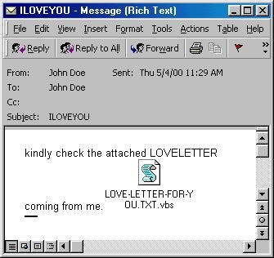
Windows Scripting Examples
Windows Script Host problem
https://en.wikipedia.org/wiki/ILOVEYOU
It was very much used for computer viruses… Thus, it will cause virus check warning often…

Slide 16
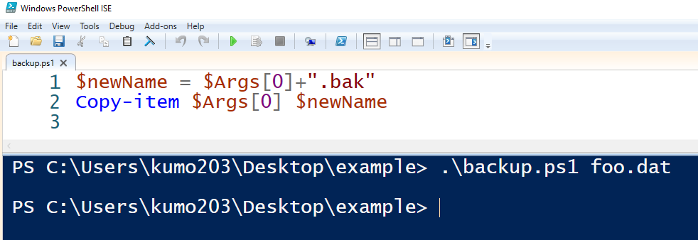
Windows Scripting Examples
PowerShell(.ps1)
PowerShell is the newest integrated scripting environment in Windows.
It supports the latest development platform .NET framework to support its powerful functionality!
Notes:
$newName = $Args[0]+".bak"
Copy-item $Args[0] $newName

Slide 17
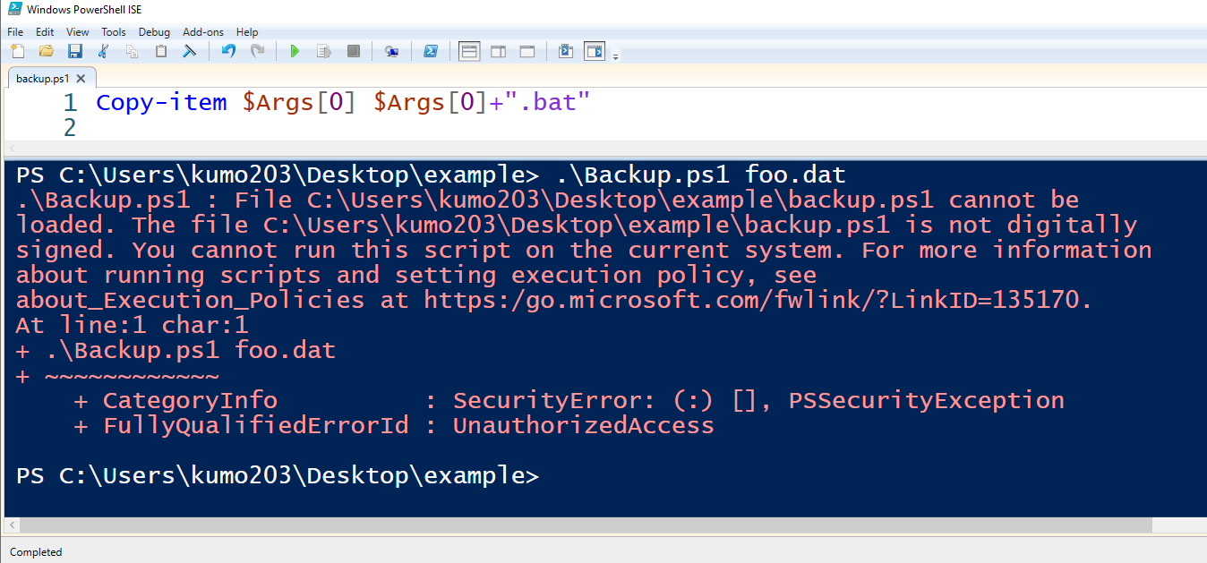
Windows Scripting Examples
PowerShell problem
But because of the fear of computer viruses, PowerShell needs a small setting change to use…

Slide 18
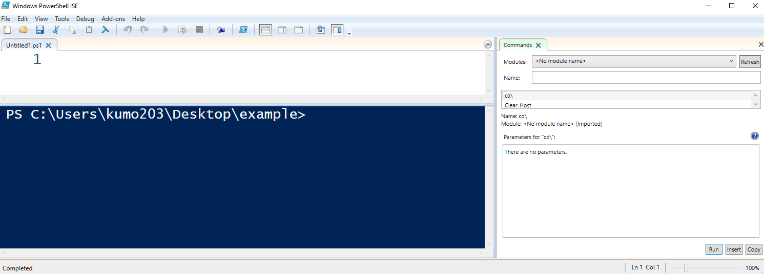
Windows Scripting Examples
PowerShell Editor
There is PowerShell ISE, the build-in editor.

Slide 19
Windows Scripting Examples
 | Batch | Windows Script Host | PowerShell
OS Support | MS-DOS or Later | Win 98 or Later | Win 7 or Later
Background Technology | Command Line | ActiveX (or COM) | .NET Framework
Regular Expression | None | Available | Available
Functionality | Poor | So-So | Rich
Security | Poor | Poor | Rich(or Stubborn)
Requirement | None(or Disable Anti-Virus) | None(or Disable Anti-Virus) | Setting Change (ExecutionPolicy)
Integrated Editor | None | None | PowerShell ISE
Future Potential | None | None | Good(OSS Project)
It seems PowerShell is the one to study most!
Others can be also used in limited cases!

Slide 20
Part III: Scripting Usage Demo

Slide 21
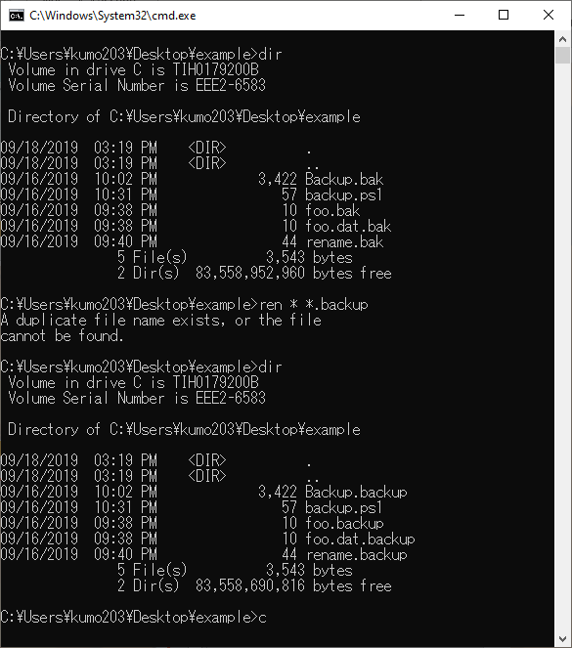
About File Rename(.bat)
Let’s rename all files in a folder to add .backup with .bat
Notes:
ren * *.backup

Slide 22
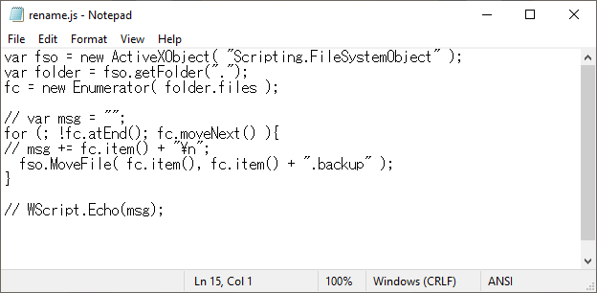
About File Rename(.js)
Let’s rename all files in a folder to add .backup with .js
Notes:
var fso = new ActiveXObject( "Scripting.FileSystemObject" );
var folder = fso.getFolder(".");
fc = new Enumerator( folder.files );
// var msg = "";
for (; !fc.atEnd(); fc.moveNext() ){
// msg += fc.item() + "\n";
fso.MoveFile( fc.item(), fc.item() + ".backup" );
}
// WScript.Echo(msg);

Slide 23
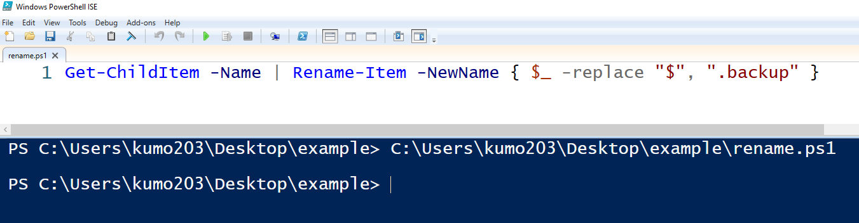
About File Rename(.ps1)
Let’s rename all files in a folder to add .backup with .ps1
Notes:
Get-ChildItem -Name | Rename-Item -NewName { $_ -replace "$", ".backup" }

Slide 24
Gee, PowerShell is the most strong and flexible one.
But the syntax is a bit unique.

Slide 25
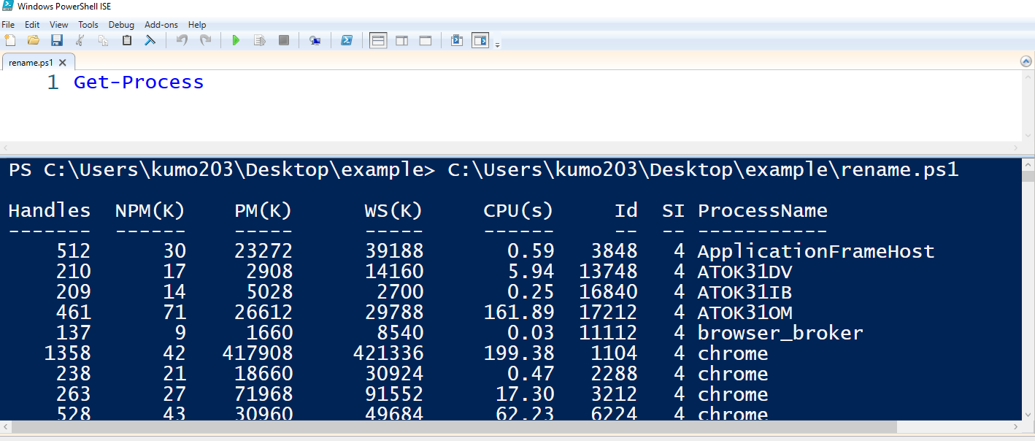
More Practices in .ps1
Let’s get all running processes.

Slide 26
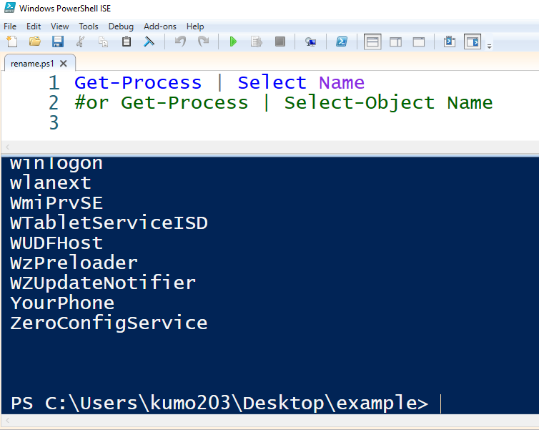
More Practices in .ps1
Let’s show Name of processes only.
Notes:
Get-Process | Select Name
#or Get-Process | Select-Object Name

Slide 27
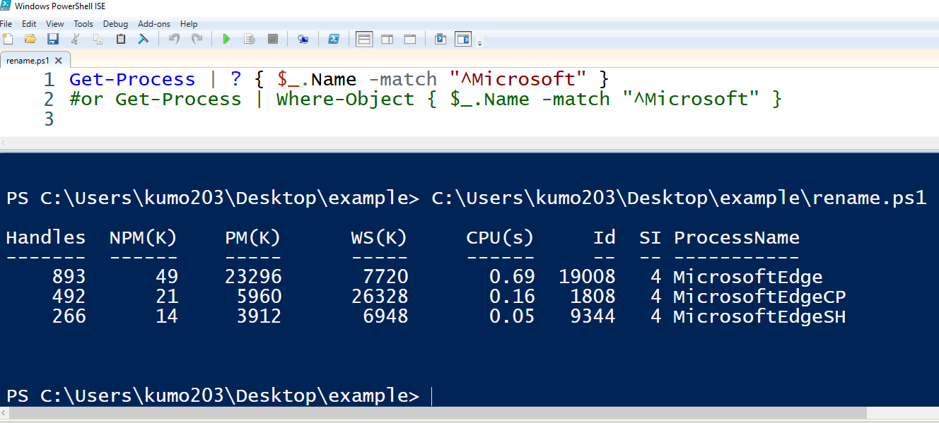
More Practices in .ps1
Let’s show Name of processes which start with “Microsoft” only.
Notes:
Get-Process | ? { $_.Name -match "^Microsoft" }
#or Get-Process | Where-Object { $_.Name -match "^Microsoft" }

Slide 28
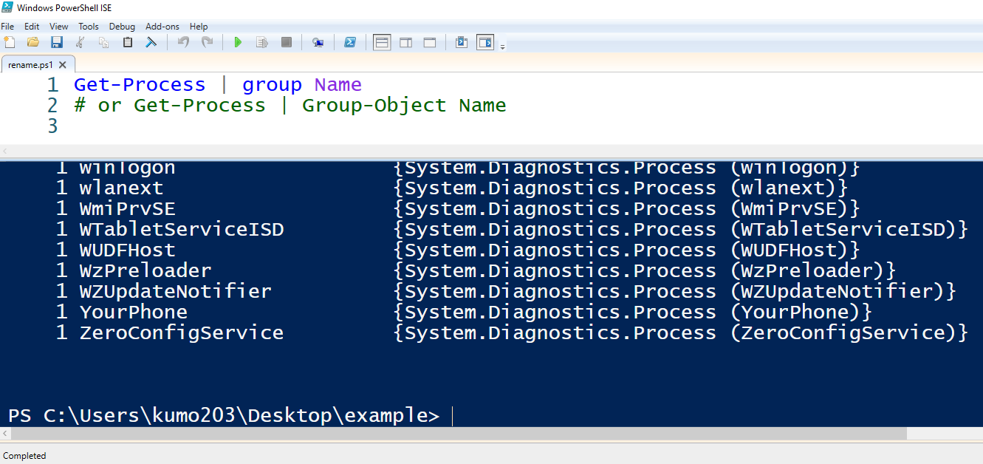
More Practices in .ps1
Let’s group the processes by name.
Notes:
Get-Process | group Name
# or Get-Process | Group-Object Name

Slide 29
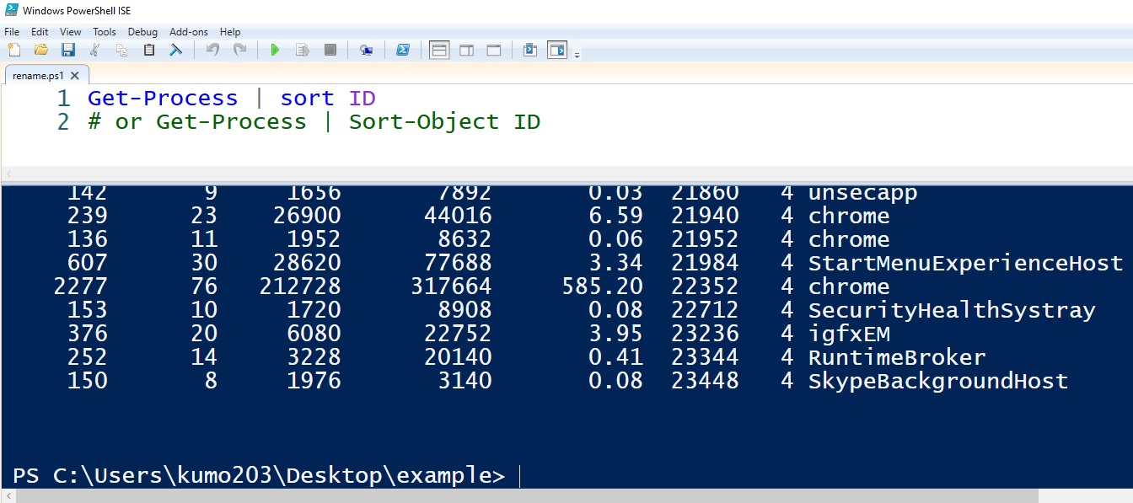
More Practices in .ps1
Let’s sort the processes by ID.
Notes:
Get-Process | sort ID
# or Get-Process | Sort-Object ID

Slide 30
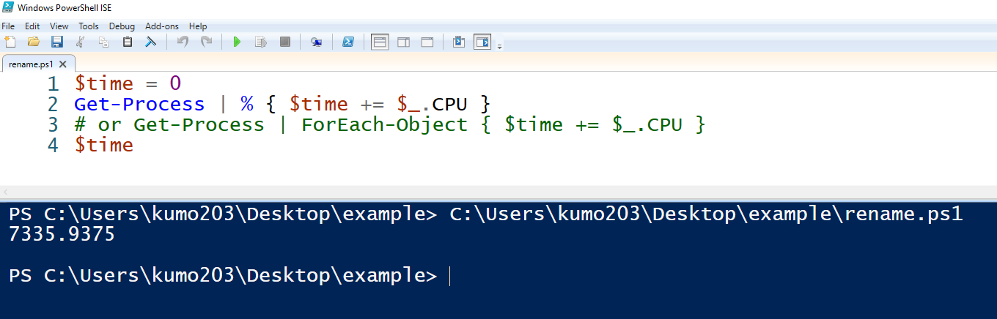
More Practices in .ps1
Let’s calculate the total CPU time.
Notes:
$time = 0
Get-Process | % { $time += $_.CPU }
# or Get-Process | ForEach-Object { $time += $_.CPU }
$time

Slide 31
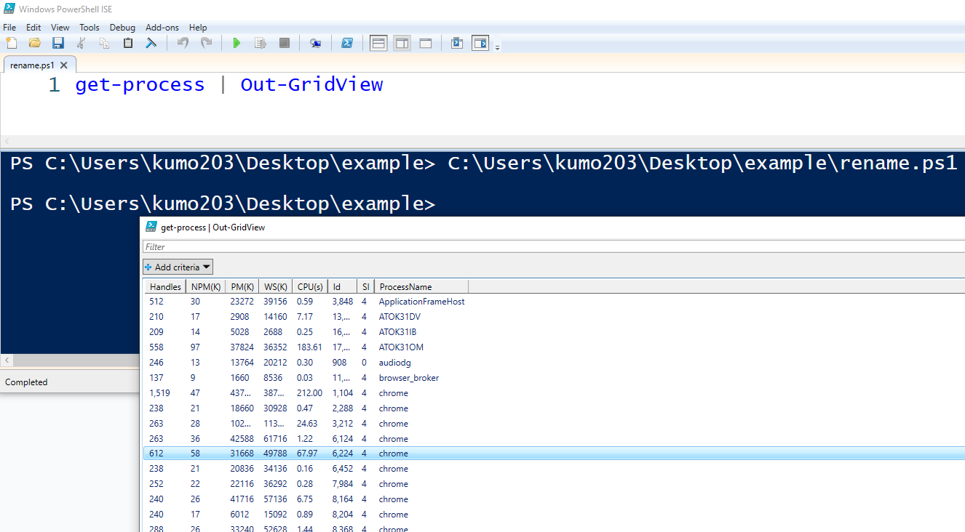
More Practices in .ps1
Let’s show the processes in grid dialog.
Notes:
get-process | Out-GridView

Slide 32
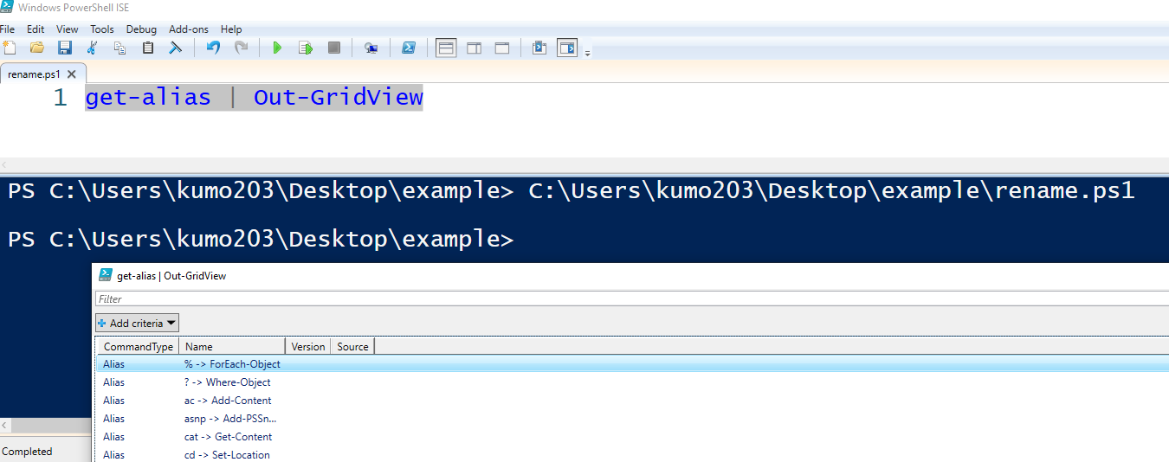
More Practices in .ps1
We saw many alias in PowerShell.
Let’s see them in grid dialog also for further scripting.
Notes:
get-alias | Out-GridView

Slide 33
Part IV: Conclusion

Slide 34
Conclusion
There are several available scripting environments in Windows and each made progresses in its functionality.
Currently, PowerShell is the recommended one to newly study.
I hope you understand why so through this presentation.
For further study, check existing web pages or our Wankuma Alliance Facebook page, please!

Slide 35
Further Information
Batch File(.bat)
???(My favorite pages are already gone…)
Windows Script Host(.wsh, .vbs, .js)
???(Also gone…)
PowerShell(.ps1)
https://docs.microsoft.com/en-us/powershell/

Slide 36
END

