Slide 1
Today’s Topic
How to write a “hello world” program using IDE
How to use SEASnet Linux servers
Introduction to C++
Slides for CS 31 discussion session
TA: Hsiao-Yun (Katie) Tseng tsenghy@g.ucla.edu
Credit to former TA Bo-Jhang Ho (bojhang@cs.ucla.edu), CS31 Discussion 1E, Spring 17’
Credit to former TA Chelsea Ju (chelsea.ju@cs.ucla.edu)

Slide 2
Learning Tips
Keep up with the lecture material
Start early
Problem solving & coding may take longer than you think
Read carefully
Double/Triple check the project requirements
Develop incrementally
Add bits of code at a time, then compile, and run.
It is easier to isolate any bugs, and to understand if the code is doing what you expected
Don’t give up!!

Slide 3
IDE Configuration
IDE = Integrated Development Environment
A programming environment that has been packaged as an application program
A graphical user interface (GUI), and a code editor
A compiler
A debugger
A lot of different tools (energy analysis, CPU utilization, …)
More on Class website
http://cs.ucla.edu/classes/spring17/cs31/
Mac | Linux | Windows
Xcode Command Line | - Terminal - Gnu toolchain | - Visual C++

Slide 4
Demo – Let’s rock!
Demo
Xcode
Old-fashion way to write code
VIM to write code
Use terminal to compile code and execute binary

Slide 5
Example #1 – A simple program
Please just copy and paste this to your code editor
#include <iostream> using namespace std; int main() { cout << "Hey, this really works!" << endl; return 0; }

Slide 6
Example #2 – A simple interactive program
Please just copy and paste this to your code editor
#include <iostream> using namespace std; int main() { int num; cout << "Hey, give me a number: "; cin >> num; int numSquare = num * num; cout << "The square of this number is " << numSquare << endl; return 0; }

Slide 7
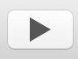
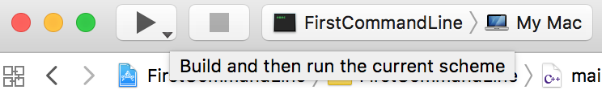
Details of build process
What exactly is going on when I click ?
The hint from Xcode (the IDE)

Slide 8

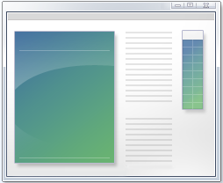
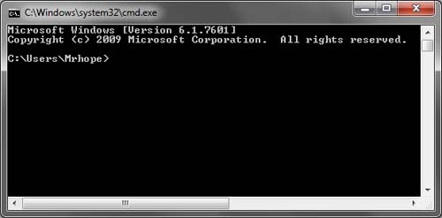
Details of build process
What exactly is going on when I click ?
The hint from Xcode (the IDE)
Source code
Executable or
Binary
Run the program

Slide 9
Details of build process
What exactly is going on when I click ?
The hint from Xcode (the IDE)
Compile (Build)
Execute a program
Source code
Executable or
Binary
Run the program

Slide 10
SEASNet
The reason that we encourage you to put your program on SEASNet server and run it
We grade assignments on SEASNet server
Check everything works fine on the server. Sometimes platform variation can cause compilation failure
It’s your responsibility to make sure your code is compliable on SEASNet server
Procedure
Step 1: Upload your code to SEASNet server
Step 2: Use Putty/ssh to connect to the server and run your code

Slide 11

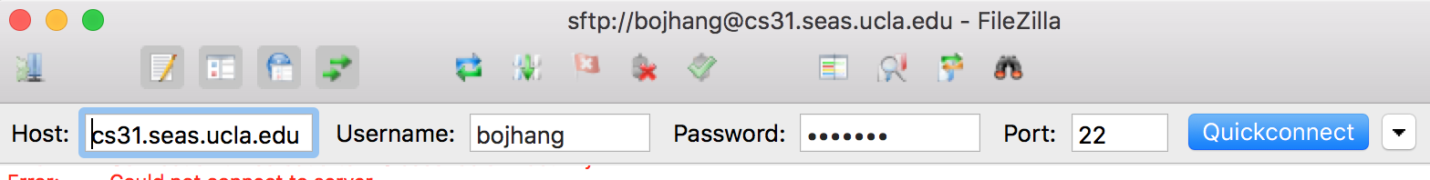
Step 1: Uploading your code
(a) Download “Filezilla Client”
(b) Connect to the server
1.
2.
3.
4.
5.

Slide 12
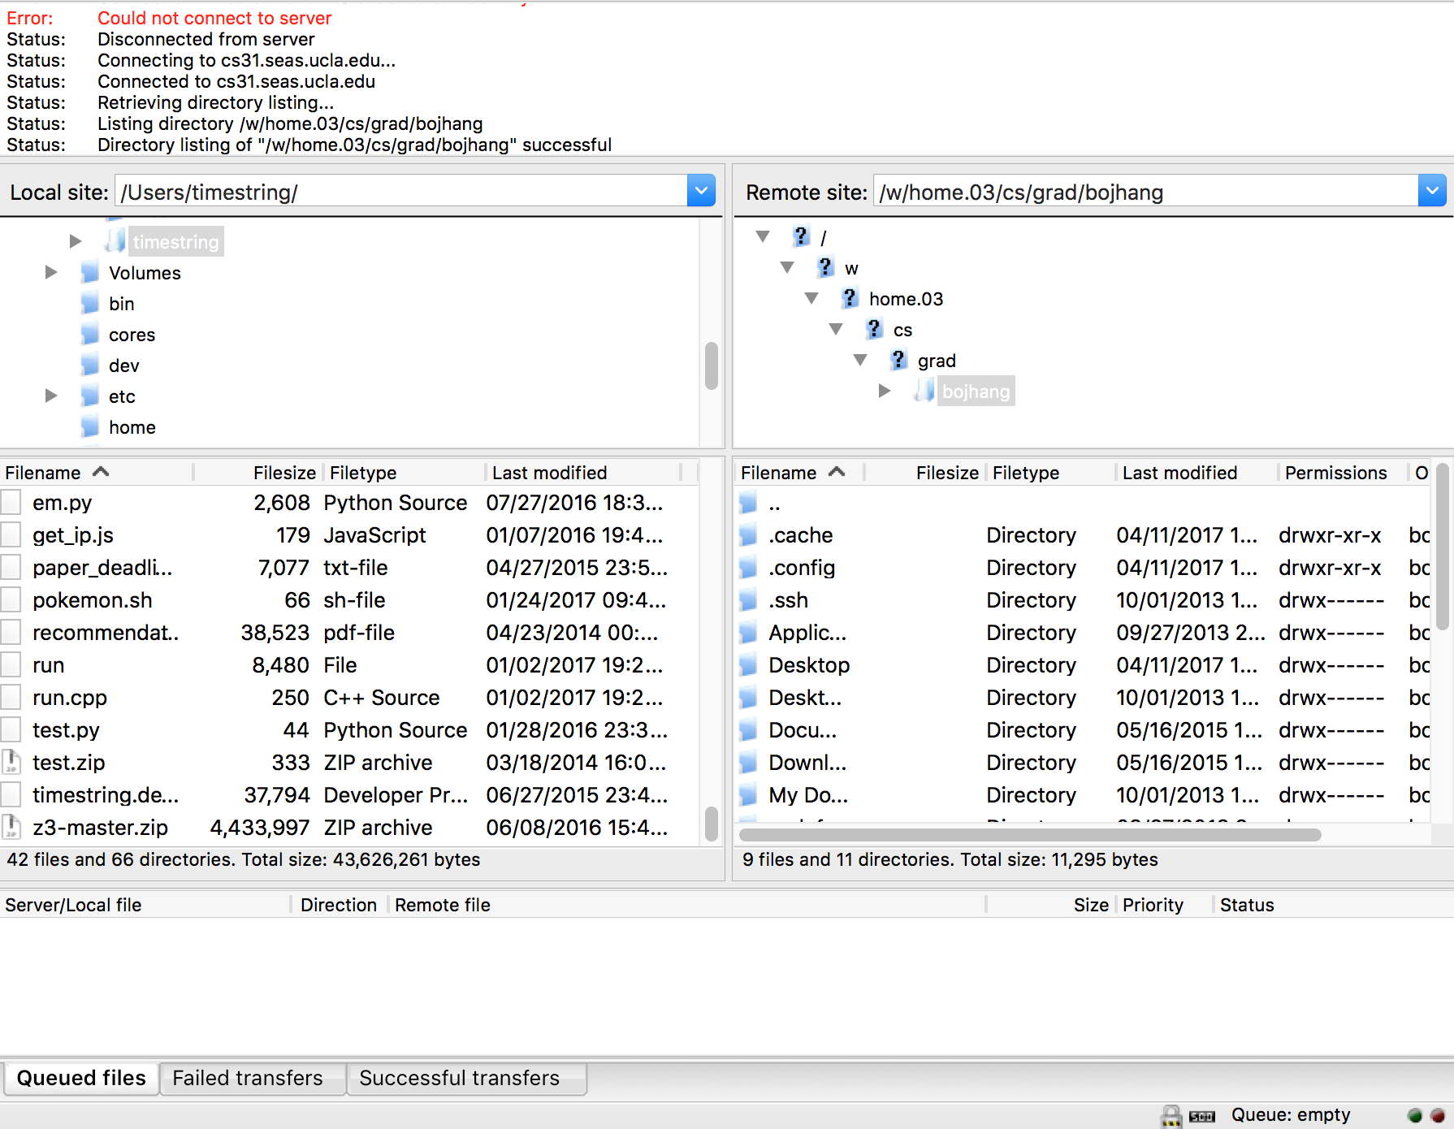
Step 1: Uploading your code
(c) Drag the files from local to remote
Remote (SEASnet)
Local (your computer)

Slide 13
Step 2: Compile and run your program remotely
(a) Login to the server
Windows: put “cs31.seas.ucla.edu” to host field
Mac: Launch terminal app and type “ssh <account>@cs31.seas.ucla.edu”
(b) Some useful commands
pwd – Show your current directory
cd – Change direction.
“cd ..” means go back to parent folder
ls – List all files in current directory
(c) Compile and run
g31 code.cpp -o code.out
./code.out

Slide 14
It works on Mac but doesn’t work on SEASNet
#include <iostream> using namespace std; int main() { int arr[5]; arr[0] = 10; arr[1] = 3; arr[2] = 9; arr[3] = 7; arr[4] = 1; sort(arr, arr + 5); for (int i = 0; i < 5; i++) cout << arr[i] << " "; cout << endl; return 0; }
Demo time!

Slide 15
What is C++?
Is a (programming) language so that you can create a valid computer program
C++
C++
C
Assembly
Machine code (Binary)

Slide 16
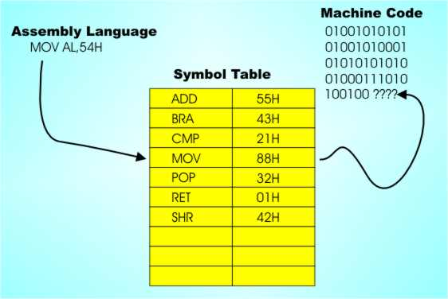
What is C++?
Is a (programming) language so that you can create a valid computer program
C++
C++
C
Assembly
Machine code (Binary)

Slide 17
What is C++?
Is a (programming) language so that you can create a valid computer program
C++
C++
Object-oriented language
Procedural
language
C
Assembly
Machine code (Binary)

Slide 18
The skeleton C++ code
This is the only time in this quarter I ask you to memorize codes!!
#include <iostream> using namespace std; int main() { return 0; }

Slide 19
The skeleton code from week 01
#include <iostream> using namespace std; int main() { return 0; }
Why the first two lines?
#include <iosteam> so that we can use std::cout
Using namespace so that we don’t need to type std:: whenever we have to use cout

Slide 20
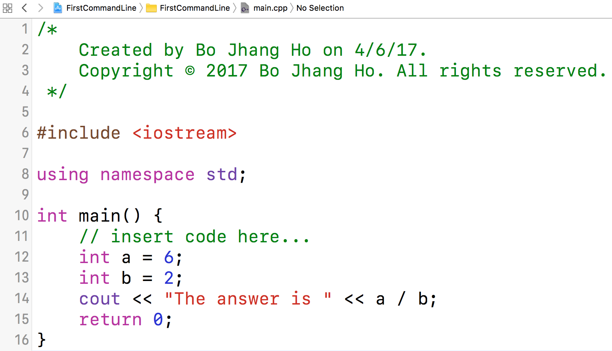
Basic components in C++
Block comment
One-line comment
Include header file
Main function
Variable type
Variable
String
Operator
Return statement

Slide 21
Example #3 – Another interactive program
What is cin and cout?
How do you distinguish >> and <<?
#include <iostream> using namespace std; int main() { int i, j; cout << "Please enter the value for i: " << endl; cin >> i; cout << "Please enter the value for j: " << endl; cin >> j; cout << "i + j = " << i + j << endl; return 0; }

Slide 22
Example #3 – Another interactive program (Cont’d)
#include <iostream> using namespace std; int main() { int i, j; cout << "Please enter the value for i: " << endl; cin >> i; cout << "Please enter the value for j: " << endl; cin >> j; cout << "i + j = " << i + j << endl; return 0; }
There must be a reason that the language is designed like this
Delete one character/word, what error messages can you get?

Slide 23
Example #3 – Another interactive program (Cont’d)
Potential errors you can get:
Unbalanced bracket
Missing semicolon
Undefined variable
Undefined operator
No number after return keyword
Library doesn’t exist
Etc.

Slide 24
Example #4 – Division
#include <iostream> using namespace std; int main() { int i, j; cout << "Please enter the value for i: " << endl; cin >> i; cout << "Please enter the value for j: " << endl; cin >> j; cout << "i / j = " << i / j << endl; return 0; }

Slide 25
Example #4 – Division
#include <iostream> using namespace std; int main() { int i, j; cout << "Please enter the value for i: " << endl; cin >> i; cout << "Please enter the value for j: " << endl; cin >> j; cout << "i / j = " << i / j << endl; return 0; }
Test i=5 and j=2?
Test i=7 and j=0?
Test i=99999999999999999 and j=1?

Slide 26
Example #5 – What’s wrong with this code?
#include <iostream> using namespace std; int main() int a = 10; cout << A << endl; return 0; }
Paste it to your programming editor to find the answers

Slide 27
Example #6 – Access invalid index in an array (advanced)
#include <iostream> using namespace std; int main() { int arr[100]; arr[-99999999] = 3; return 0; }
Since there are only 100 available spots whose index ranged from 0 to 99, write back to any other index beyond this range will screw the memory and may crash the program

