Slide 1
Today’s Topic
Project 1
Slides for CS 31 discussion session
TA: Hsiao-Yun (Katie) Tseng tsenghy@g.ucla.edu
Credit to former TA Bo-Jhang Ho (bojhang@cs.ucla.edu), CS31 Discussion 1E, Spring 17’
Credit to former TA Chelsea Ju (chelsea.ju@cs.ucla.edu)

Slide 2
Project #1
Read the specification carefully, don’t get a 0 in any assignment!
What to submit?
C++ scripts
original.cpp
logic_error.cpp
compile_error.cpp
Report in MS Word format or Plain text
report.doc or report.docx or report.txt
Discuss any error messages the compiler reports, and incorrect/unusual results.
Keep it short!!!!!!
Compress everything into one zip file, and submit online.

Slide 3
3 types of errors
Compilation error
Syntax error
Program crashes (Segmentation fault)
The program runs into an invalid state
Incorrect memory access
Runtime error
Logic error
Wrong answer

Slide 4
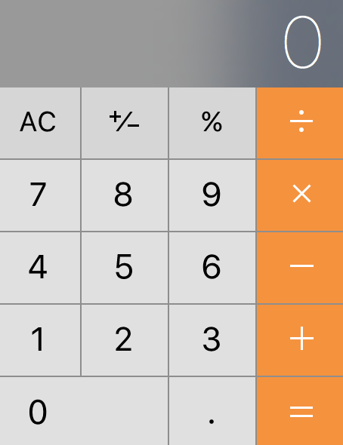
Compilation error
Use the language c++ to communicate with machines
Machines cannot understand even they miss a word!!
23 + 5 = ?

Slide 5
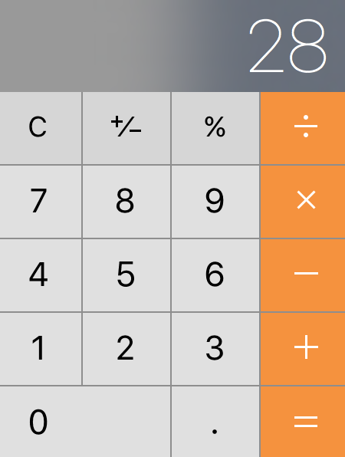





Compilation error
Use the language c++ to communicate with machines
Machines cannot understand even they miss a word!!
23 + 5 = ?

Slide 6

Compilation error
Use the language c++ to communicate with machines
Machines cannot understand even they miss a word!!
23 + 5 = ?

Slide 7


Logic error
Use the language c++ to communicate with machines
Machines cannot understand even they miss a word!!
23 + 5 * 7 = ?

Slide 8
Logic error
Use the language c++ to communicate with machines
Machines cannot understand even they miss a word!!
23 + 5 * 7 = ?
196

Slide 9


Logic error
Use the language c++ to communicate with machines
Machines cannot understand even they miss a word!!
23 + 5 * 7 = ?
58

Slide 10
Project 1 – Generate some bugs
// Code for Project 1 // Report poll results #include <iostream> using namespace std; // pp. 38-39 in Savitch 6/e explains this line int main() { int numSurveyed; int numApprove; int numDisapprove; cout << "How many people were surveyed? "; cin >> numSurveyed; cout << "How many of them approve of the way the president is handling his job? "; cin >> numApprove; cout << "How many of them disapprove of the way the president is handling his job? "; cin >> numDisapprove; double pctApprove = 100.0 * numApprove / numSurveyed; double pctDisapprove = 100.0 * numDisapprove / numSurveyed; cout.setf(ios::fixed); // see pp. 32-33 in Savitch 6/e cout.precision(1); cout << endl; cout << pctApprove << "% say they approve." << endl; cout << pctDisapprove << "% say they disapprove." << endl; if (numApprove > numDisapprove) cout << "More people approve than disapprove." << endl; else cout << "More people disapprove than approve." << endl; }

Slide 11
Precision issue (correct version)
int numApprove = 2; int numSurveyed = 7;
double pctApprove = 100.0 * numApprove / numSurveyed;
cout << pctApprove << endl;
The result shows 28.5714

Slide 12
Precision issue (wrong version 1)
int numApprove = 2; int numSurveyed = 7;
int pctApprove = 100.0 * numApprove / numSurveyed;
cout << pctApprove << endl;
Instead of 28.5714, the result shows 28 now!
It is because we try to score a fraction number into an integer variable

Slide 13
Precision issue (wrong version 2)
int numApprove = 2; int numSurveyed = 7;
double pctApprove = 100 * numApprove / numSurveyed;
cout << pctApprove << endl;
We still get 28!
C++ is a strongly type language. Everything in C++ has a type.
When an integer “interacts” with another integer, it still produces an integer.

