Slide 1
Today’s Topic
The first programming assignment (project 2)
Slides for CS 31 discussion session
TA: Hsiao-Yun (Katie) Tseng tsenghy@g.ucla.edu

Slide 2
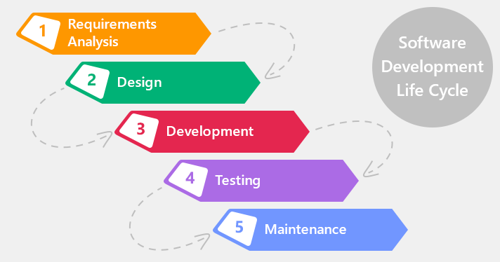
Where to start?
Software development life cycle:
I need a program that prints fare tickets for bus riders

Slide 3
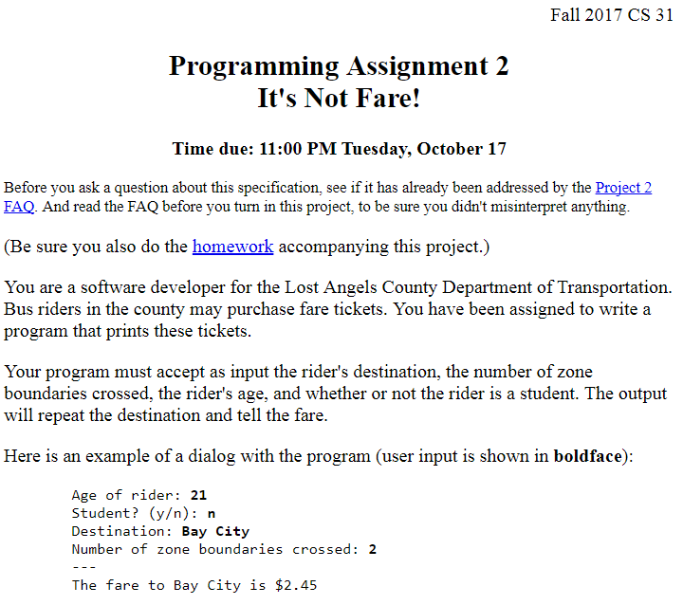
Where to start?
Software development life cycle:
Define the specification

Slide 4
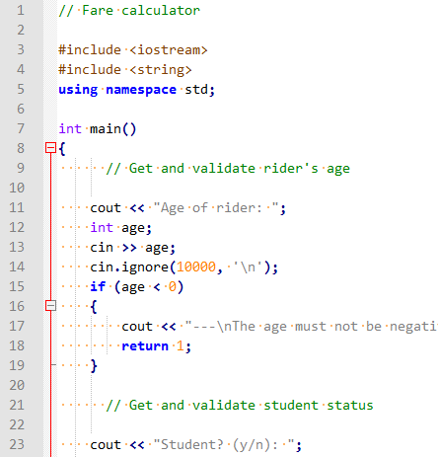
Where to start?
Software development life cycle:
Coding

Slide 5
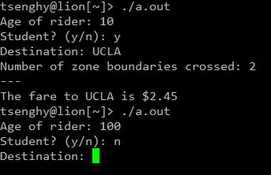
Where to start?
Software development life cycle:
Make sure your program works for all kinds of input data

Slide 6
Your tasks
Software development life cycle:
Read the specification. Ask questions if it is not well-defined.
Coding
Make sure your program works for all kinds of input data

Slide 7
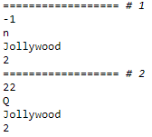
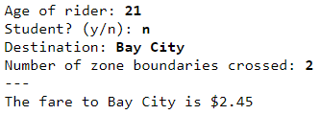
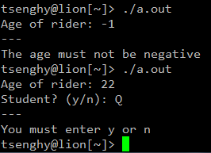
How to test your program
1. Generate a list of input data according to the specification
2. input data from the terminal
The age must not be negative
If the student status is not y or n
You must enter a destination
The number of zone boundaries crossed must not be negative
…

Slide 8
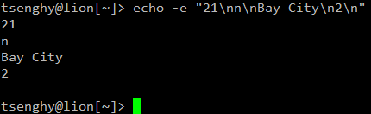

Use a lot of input data to test your program
Optional
Input data from the terminal one at a time is tiring
Can we generate the input data automatically?
In C++ we use cout:
cout << “21\nn\nBay City\n2\n”;
In linux command line, we can use echo
What did we do:
> 21
> n
> Bay City
> 2
Use “program1 | program2” to send the output generate by program1 to program2

Slide 9
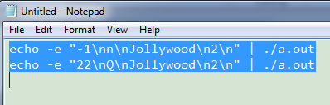
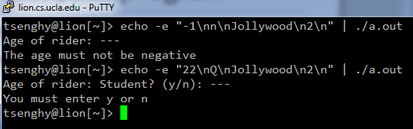
Use a lot of input data to test your program
Optional
Input data from the terminal one at a time is tiring
Can we generate the input data automatically?
copy
echo -e "-1\nn\nJollywood\n2\n" | ./a.out
echo -e "22\nQ\nJollywood\n2\n" | ./a.out
paste

Slide 10
Check the output
Optional
Method 1: check by yourself
Method 2: check by another program
Correct!
Correct!
Find the difference between “the output of your program” and “the output we expect”

Slide 11
Check the output of your program
Optional
What did the program do:
cout << “Age of rider: “;
cout << “Student?: (y/n): ”;
cout << “Destination: “;
cout << “Number of zone boundaries crossed: “;
cout << “---\n“;
cout << “The fare to Bay City is $2.45“;
In C++ we use cout
In linux command line, we can use echo
> echo -e "Age of rider: Student? (y/n): Destination: Number of zone boundaries crossed: ---\nThe fare to Bay City is \$2.45"
Find the difference between “the output of your program” and “the output we expect”
diff <(echo -e "-1\nn\nJollywood\n2\n" | ./a.out) <(echo -e "Age of rider: Student? (y/n): Destination: Number of zone boundaries crossed: ---\nThe fare to Bay City is \$2.45")

Slide 12
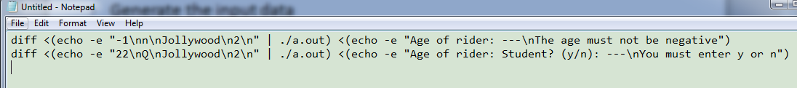
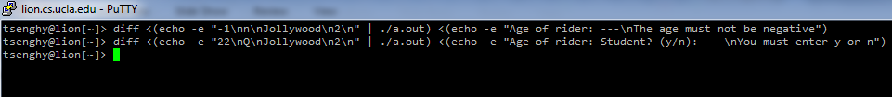
Use a lot of input data to test your program
Optional
Generate the input data
Check the output result
copy
diff <(echo -e "-1\nn\nJollywood\n2\n" | ./a.out) <(echo -e "Age of rider: ---\nThe age must not be negative")
diff <(echo -e "22\nQ\nJollywood\n2\n" | ./a.out) <(echo -e "Age of rider: Student? (y/n): ---\nYou must enter y or n")
paste
No difference ➔ Correct!!

Slide 13
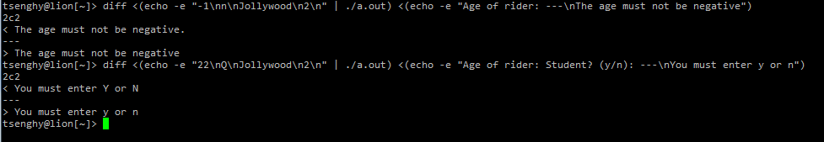
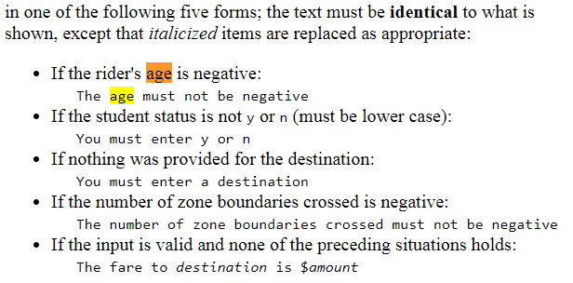
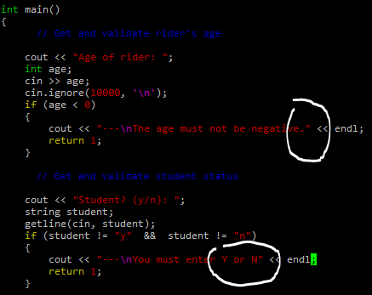
Wrong answer
Optional
diff will print out the lines that are not the same
No period!
Lowercase “y” “n”!

