Slide 1
Introduction to Linux
Week 1 - Monday

Slide 2
A Brief History of Operating Systems
The Dark Ages
  No OS until 1960s
  Manually loaded programs
  Reboot after each program
Batch OS
  Unified application development across systems
  Output via printer, later via monitor
  I/O via magnetic tape or disk
  Written in assembler (e.g., OS/360)
  Multiprocess

Slide 3
A Brief History of Operating Systems
Timesharing OS
  Multiuser
  Multics (1964)
    Segmented memory
    Paged virtual memory
    Applications written in many languages
    Shared multiprocess memory
Personal Computer
  Single machine for single user
  OS must manage screen and input devices
  Window, Icon, Menu, Pointing Device (WIMP, e.g., MacOS, 1984)
Cutting-Edge OS
  High performance computer (HPC) clusters (e.g., BlueGene/L at LLNL rated at 280.6 teraFLOPS)
  Cell phones, video
  Video games
  Browsers

Slide 4
Why Knoppix?
Multics (1964) → Unix (1970) → Minix (1987) → GNU/Linux (1991) → Knoppix (2003)
Free software package via GNU
Linux kernel (Unix-like OS)
LiveCD Linux distribution
Allows us to understand the workings of Unix
Practice software construction via command line interface (CLI)

Slide 5
CLI vs. GUI
CLI
Steep learning curve
Pure control (e.g., scripting)
Cumbersome multitasking
Speed: Hack away at keys
Convenient remote access
GUI
Intuitive
Limited Control
Easy multitasking
Limited by pointing
Bulky remote access

Slide 6
Unix File System Layout
Everything is a file (including devices)
Tree structured hierarchy (with some exceptions)
Lost?
  man: get manual or man pages

Slide 7
The Basics: Moving Around
pwd: print working directory
cd: change working directory
~: home directory
.: current directory
/: root directory, or directory separator
..: parent directory

Slide 8
The Basics: Dealing with Files
The basics continued…
  mv: move a file (no undos!)
  cp: copy a file
  rm: remove a file
  mkdir: make a directory
  rmdir: remove a directory
  ls: list contents of a directory
    -d: list only directories
    -a: list all files including hidden ones
    -l: show long listing including permission info
    -s: show size of each file, in blocks

Slide 9
The Basics: File Name Matching
?: matches any single character in a filename
*: matches one or more characters in a filename
[]: matches any one of the characters between the brackets. Use ‘-’ to separate a range of consecutive characters.

Slide 10
The Basics: History
<up arrow>: previous command
<tab>: auto-complete
!!: replace with previous command
![str]: refer to previous command with str
^[str]: replace with command referred to as str

Slide 11
The Basics: Look These Up
cat
head
tail
du
ps
kill
diff
cmp
wc
sort

Slide 12
The Basics: Redirection
> file: write stdout to a file
>> file: append stdout to a file
< file: use contents of a file as stdin

Slide 13
The Basics: Changing File Attributes
ln: create a link
  Hard links: points to physical data
  Soft links aka symbolic links (-s): points to a file
touch: update access & modification time to current time
chmod
  read (r), write (w), executable (x)
  User, group, others

Slide 14
The Basics: find
-type: type of a file (e.g,, directory, symbolic link)
-perm: permission of a file
-name: name of a file
-prune: don’t descend into a directory
-o: or
-ls: list current file

Slide 15
vi
Modes:
  Normal: Enter commands
  Insert: Insert text
  Visual: Like normal, but you can highlight
  Replace: Like insert, but you replace characters as you type
  Recording: Record a sequence of key sequences

Slide 16
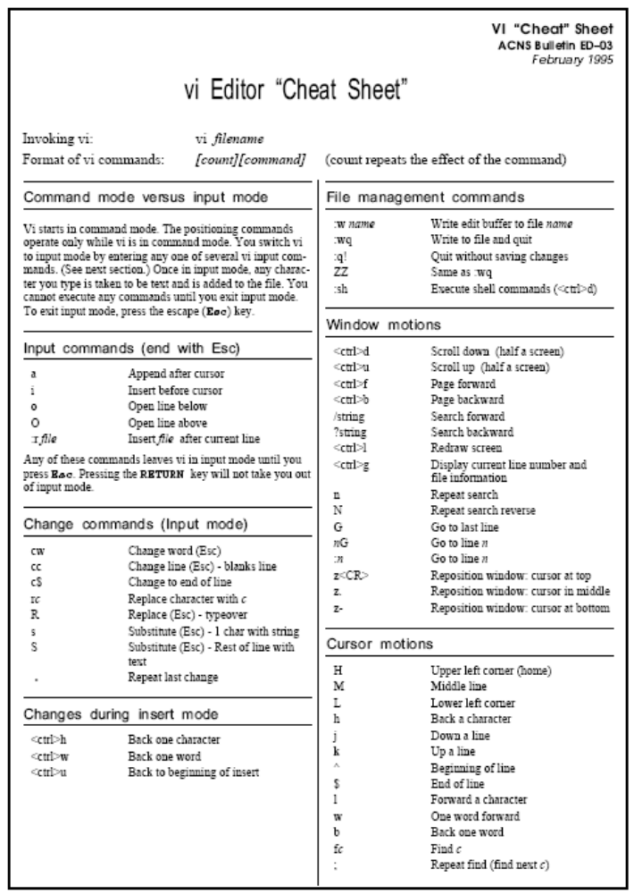
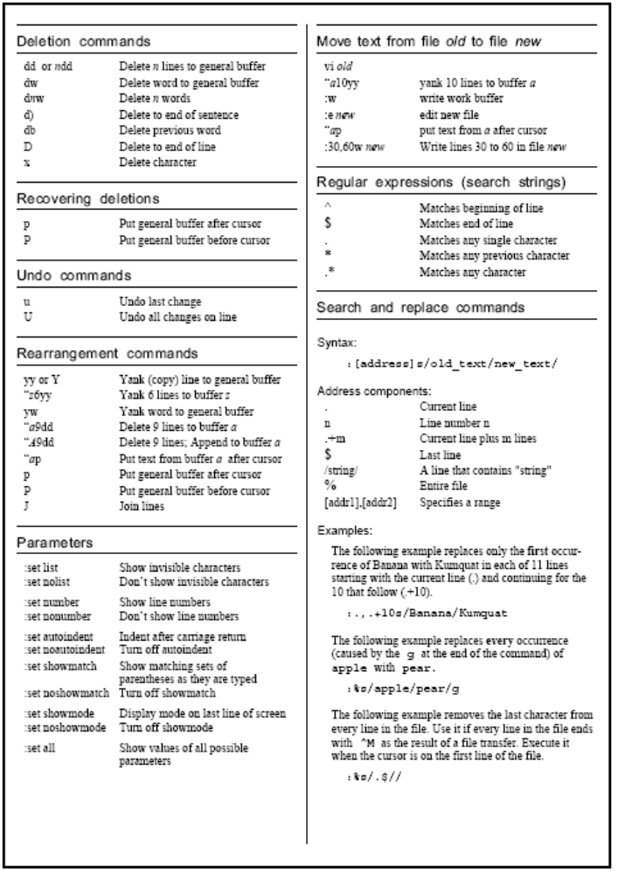

Slide 17
Emacs
Almost like a Windows text editor, but much more powerful
IMHO, easier to use that vi

Slide 18
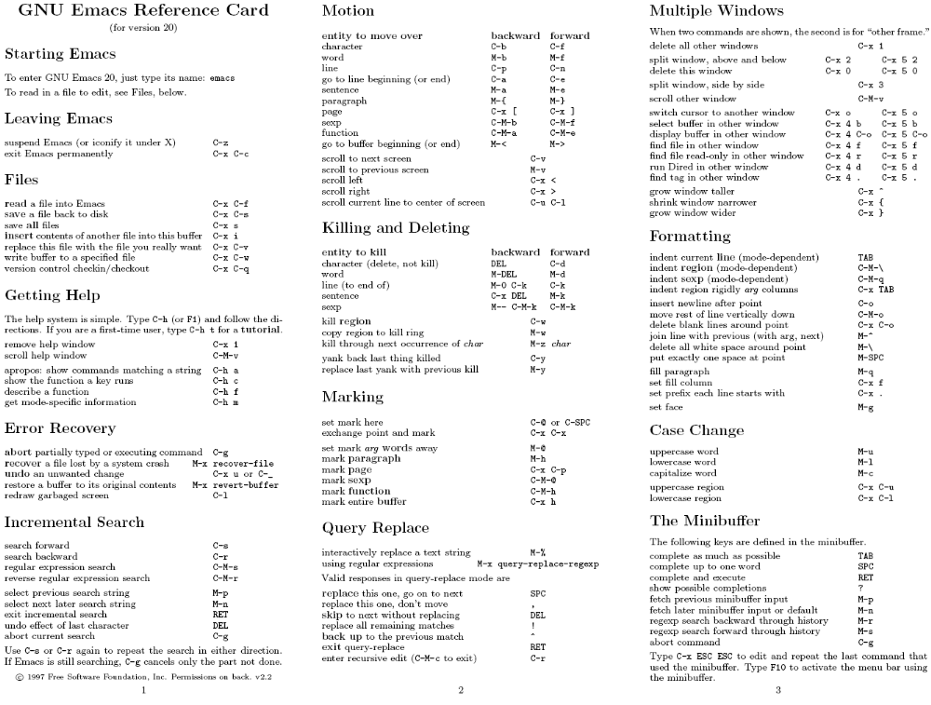

Slide 19
