Slide 1
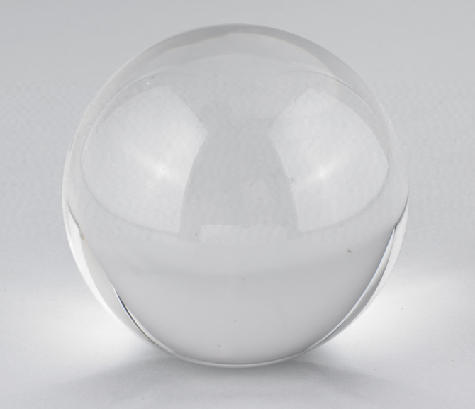
The Crystal Ball

Slide 2
Trends in Computing R&D
Internet Technologies
  Wireless
  Security
Embedded Systems
  Sensor networks
  Ubiquitous Computing
Intelligent Systems and Interfaces
  Data mining
  Data visualization
  The Internet
Software Systems
  Security
  Sensor Networks

Slide 3
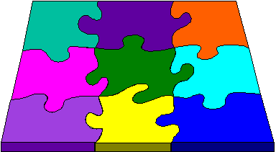
Convergence of Technologies
Networking
Operating
Systems
Visualization
Databases
Biology &
Medicine
Machine
Learning
Internet
Networks
Architecture

Slide 4
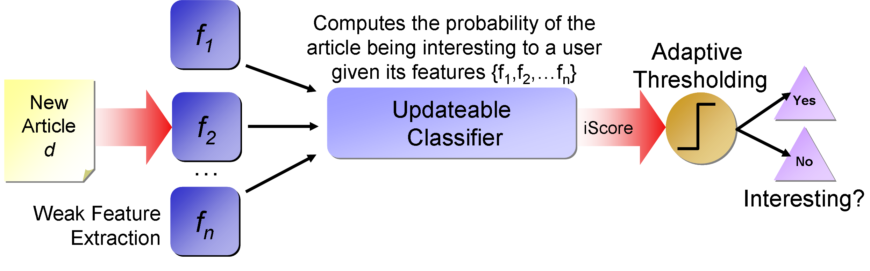
What I do
Data mining
  Build a recommendation system to predict interesting news
  Its like Tivo but for news

Slide 5
How to do well in Upper Divs
Use what you’ve learned in this class
  Debugging
  Scripting
  Tools to make your life easier
Refine your problem solving skills
All your classes converge and aren’t meant to be understood in isolation

Slide 6
Upper Divs
Perseverance
Don’t give up
If something doesn’t work or if you don’t understand, go back to the beginning until you do understand
Don’t skip stuff because everything builds upon everything else

Slide 7

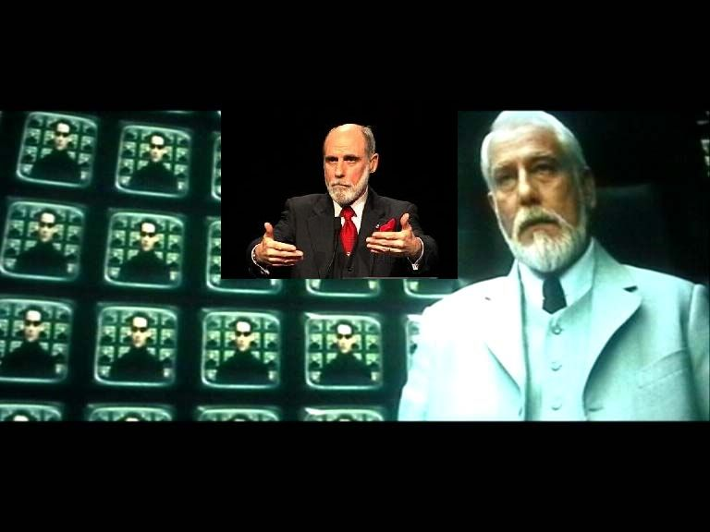
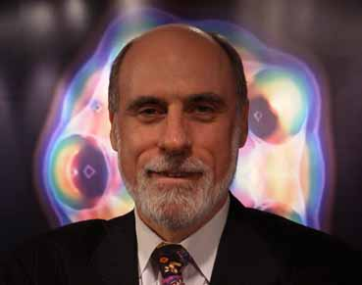
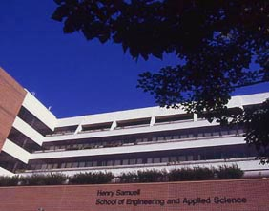
Upper Divs
No whining!
Your predecessors did it and have done well
  Henry Samueli
  Vint Cerf
Suck it up or go to USC

Slide 8
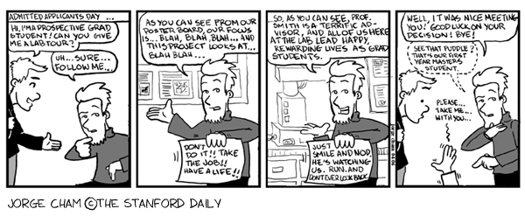
Why Grad School?
Teaches you how to do research and improves your problem solving skills
Its only 2 years (for MS at least, for a PhD… who knows?)

Slide 9
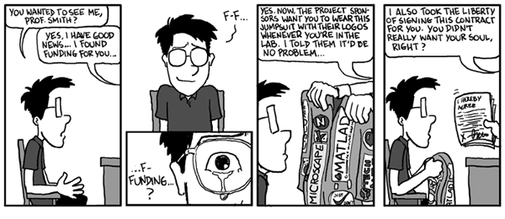
The Money
2 years = $10k/year increase in salary
The economy isn’t so hot right now
If you do a PhD, its FREE
Some companies will pay for a MS (ex: Sandia, Northrop, Raytheon)

Slide 10
Getting into Grad School
See yourself as an engineer instead of a student
  Be curious
  Solve problems
  Social responsibility
Organize yourself
  Carefully choose your activities
  Surround yourself with smart people
Talk to your professors and TAs

Slide 11
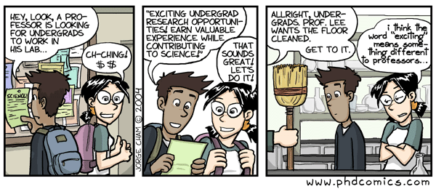
Getting into Grad School
Do CS199 or grunt work for a professor
  Learn how to do research
  Learn what’s important and what to write on your personal statement
  Get that letter of recommendation

Slide 12
Getting into Grad School
Join an engineering student group
  Leadership
  Practical Experience
  Example: IEEE, ACM
Get an internship
  Start looking now
  Companies pay really well
  Helps build your recommendation list

Slide 13
Getting into Grad School
Order of Importance
  Letters of Recommendation
  Personal Statement
  Grades
  GREs
When applying, demonstrate an interest in research area you want to work in
Research a professor

Slide 14
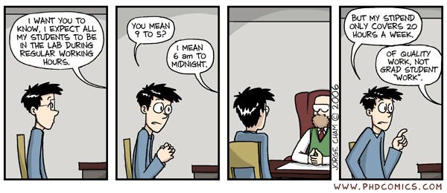
Now You’re in Grad School, now what?
Its not like undergrad
Its like the working world but…
  Less pay
  More work

Slide 15
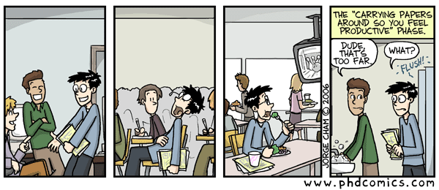
Now What?
Fewer and longer projects
Professors know you
You have to read A LOT
  Learn to read fast
  Learn how to read for importance

Slide 16
Research Resources
Google: www.google.com
IEEExplore: www.ieeexplore.ieee.org
ACM Portal: portal.acm.org
CDL: www.library.ucla.edu
People
  TAs
  Professors
  Peers

Slide 17
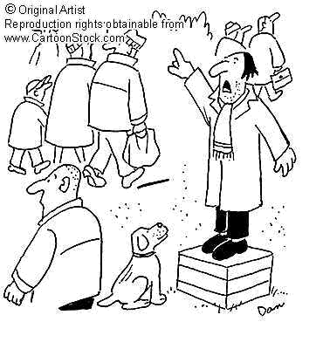
Time for my soap box rant
You have a social responsibility
You build things for other people
Sometimes lives depend on it

Slide 18

Motivation: People
The improvement of the quality of life of others
Not money
Our love of technology should be grounded by our love of people

Slide 19
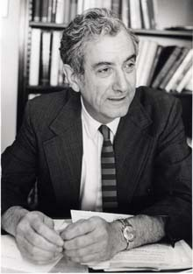
Russell O’Neill
College of Letters and Sciences: produces better people
School of Engineering: produces people who build a better world

