Slide 1
Change Management
Week 4

Slide 2
Backporting a change

Slide 3
What We’ll Be Doing
You maintain a large site that support GNU/Linux users
You get annoyed by people always asking you how to remove files that start with a dash
  E.g., rm -foo results in an error
So you find a patch that was applied to a later version of coreutils but you want to keep running version 5.2.1
Patch coreutils 5.2.1 with the posted patch

Slide 4
Getting Started
Download coreutils 5.2.1
  wget http://ftp.gnu.org/gnu/coreutils/coreutils-5.2.1.tar.gz
  Gunzip and untar it
  You should have a directory called coreutils-5.2.1 somewhere now
Copy and paste the patch from the web and put in a file called backportPatch

Slide 5
Patching
Read man patch
  patch –pNUM –b <patch
  -p strips the smallest prefixing containing NUM leading slashes from each file name found in the patch file. In this case, you can use 3.
  -b tells patch to make a backup of the original file
It will prompt you which files to patch
And it will tell which files failed to patch.
Use your favorite editor to make the fixes

Slide 6
Test the Patch
Configure your makefiles, make, and make install
Test it
  mkdir test
  cd test
  touch ./-ooops a b c
  rm *

Slide 7
Generate a tentative version of your patch
diff –u rm.c rm.c.orig
rm.c.orig is your backup file for rm.c

Slide 8
CVS

Slide 9
What is a Versioning System?
The process of recording and being able to retrieve changes to a project
Benefits
  Any stored revision of a file can be retrieved, viewed, and changed.
  The differences between any two revisions can be displayed.
  Patches can be created automatically.
  Multiple developers can work simultaneously on the same project or file without overwriting one another's changes.
  The project can be branched to allow simultaneous development along varied tracks. These branches can be merged back into the main line of development.
  Distributed development is supported across large or small networks. (CVS offers a variety of authentication mechanisms.)

Slide 10
Terminology
'Module' - a particular set of files kept in CVS. Often referred to as a project.
'Repository' - Location on CVS server where modules are kept.
'Revision' - A certain version of a file.
'Tag' - A certain milestone in a file or module's development.
'Branch' - A 'fork' of the module.

Slide 11
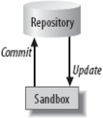
Repository
File-based database called the CVS repository
Contains all historic data about your project
Developers work from a sandbox which contains working copies of the files in your project
Changes from a sandbox are committed to the repository
Changes in the repository but not in your sandbox are updated from the repository
Each file is associated with a revision number

Slide 12
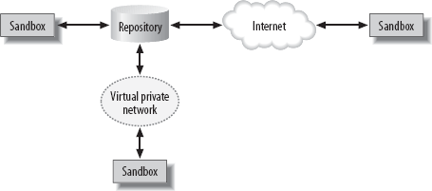
Repository with Multiple Users

Slide 13
Creating Your First Repository
Create a directory (typically named cvsroot) somewhere. This is where your repository will be and referred to as the repository_root_directory
Initialize the repoistory:
  cvs –d repository_root_directory init
  It creates a bunch of subdirectories in your repository

Slide 14
Importing Projects
You have an existing projected called FooBar stored in a directory called FooBar-1.1
From within FooBar-1.1, you import the project with the command:
  cvs –d repository_path name_of_project vendor_tag release_tag
Typically the name of the project, and vendor tag is the same as the name of the project and the release tag is the same as the release tag
It’ll open an editor and you can add notes to the CVS log regarding your changes/imports.
CVS import will complete after you quit and save the log
You can also import/access projects to other machines!

Slide 15
Checking Out Files
CVS stores projects and files in a central repository, but you work from a working copy, the sandbox.
CVS creates the sandbox as a subdirectory of your current working directory:
  cvs -d repository_path checkout project_name

Slide 16
Editing Files
Once you’ve checked out your files into a sandbox, you can edit them with your favorite editors.
Some CVS functions won’t work on binary files like MS Word files.

Slide 17
Committing Changes
Changes to your sandbox are not synchronized with the repository until you run the cvs commit command
Its best run from the root directory of your sandbox and must be run within the sandbox
When you commit, CVS examines each directory and subdirectory under the current working directory. It searches for files that it is tracking that have changes and commits all changes to the repository.

Slide 18
Updating Sandboxes
cvs update command checks your sandbox against the repository and downloads any changed files to the sandbox.
Use the –d option to download new directories.

Slide 19
Adding Files
To add a file to the a project in the repository
  Create the file in your sandbox
  cvs add filename

Slide 20
Removing Files
To remove a file from the repository
  Remove the file from the sandbox
  cvs remove filename

Slide 21
Comparing File Revisions
You can call cvs diff with filenames, directories, or module names.
Usually, you call cvs diff with at least one -r tag or -D date command option. If you invoke it with a single -r or -D parameter, CVS compares the current copy in the working directory with the version in the repository
If you invoke cvs diff with two -r or -D options, CVS compares the two revisions against each other.

Slide 22
Tagging
CVS allows you to retrieve any checked-in revision of a file
Although retrieving revisions of individual files is useful, it's even more useful to be able to retrieve the compatible set of revisions that make up a complete, functional version of a project, such as all the revisions that become release 1.0 of a program,

Slide 23
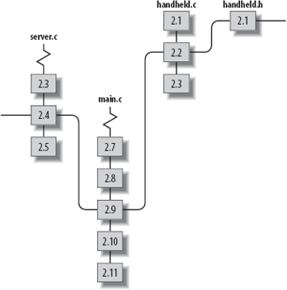
Tagging
Way of marking a group of file revisions as belonging together
You can't use the revision numbers for this purpose, because revision 2.3 of one file might belong with revision 2.17 of another

Slide 24
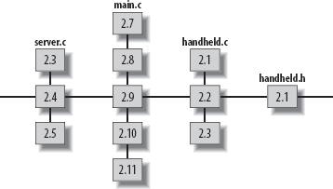
Tagging
Create a single tag that denotes all the file revisions that connect to that virtual string.
CVS can "pull the string" to locate the tagged revisions
A tag can mark a specific revision of a single file or a specific set of revisions of a group of files—in essence, naming the string.
Convenient way to retrieve that revision or matched set of revisions.
Tags are often used to record the version number used by the developers, rather than the CVS revision number.

Slide 25
Tagging
Tag names must start with a letter and can contain alphanumeric characters, hyphens (-), and underscores (_). Each tag must be unique within the tagged file.
Use the cvs tag command to tag the files in the current sandbox directory and all subdirectories.
You can also specify files to tag by providing their filenames as an argument to cvs tag.

Slide 26
Tagging
Tagging by Date or Revision:
cvs rtag
Retrieving Tagged Files:
cvs checkout/update –r tagname
Remove tag:
cvs tag –d tagname [filename]

Slide 27
Stickiness
When a file in a sandbox has a persistent state that is not the default state in the repository, the persistent state is said to be sticky.
A sandbox copy of a file can be set to a specific revision, belong to a branch, or have specific keyword options.
Stickiness is created or changed using the -k, -D, or -r options to cvs checkout or cvs update. It can be removed with cvs update -A

Slide 28

Branching
Branch is a forked line of development in your project, with the line that has been forked off called the branch, and the main line the trunk.
CVS builds the branch and the trunk from the same source data, up until the point at which they diverge, which is called the base of the branch.
From that point, CVS stores the changes made to the branch separately from the changes in the trunk. Revisions on the branch are given their own revision numbers, based on the revision number of the base of the branch.

Slide 29
Use for Branches
Variations on a Theme
Bugfix management
Experimental Work
Major changes like complete code rewrite
Release candidates for testing
Standards compliance

Slide 30
Making a Branch
You can make a branch with the -b option to the cvs tag or cvs rtag commands.
Branch creation occurs in the repository, not the sandbox.
To edit the branch revision of the files, check out a branch sandbox or use update to alter the current sandbox to the branch

Slide 31
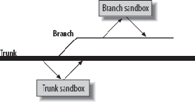
Creating a Branch Sandbox
Create a branch sandbox with the -r branch-tag-name argument to cvs checkout or cvs update.
In a branch sandbox, cvs commit commits the changes to the branch in the repository and cvs update brings down changes from the repository copy of the branch to the sandbox.

Slide 32
Add/Removing Files in a Branch
When cvs add or cvs remove are applied to files in a branch sandbox, the addition or removal applies only to the branch and does not affect the trunk.

Slide 33
Merging Branches
Merging a branch to the trunk applies the differences created during the life of the branch to the most recent revisions of the trunk code.
Merging from branch to trunk:
cvs update -j branchbasetag -j branchname
Merging from trunk to branch:
cvs update -j branchbasetag -j HEAD
Merging from branch to branch
  cvs update -j branchbasetag -j otherbranch

Slide 34
Vendor Branches
A vendor branch is a special type of branch that CVS creates automatically when you import a project.
If your project is based on code external to the project itself, such as in-house patches to a vendor's code base, the vendor branch provides a way to merge updates from the external source with your own code.

Slide 35
Vendor Branches
If you intend to use vendor branches, create your project with cvs import, using the vendor's code as the initial directory for the project.
Make your changes on the main trunk and run the project normally; the vendor branch is used only when the vendor releases a new set of code.
When the vendor provides a new release, use the cvs import command to add the new code to the same CVS project with the same vendor tag and a new release tag. In effect, this is a special cvs commit to the vendor branch.

Slide 36
When CVS Goes Bad
Merge conflicts (e.g., two users editing the same line in the same file)
You can’t really move files in CVS
You can’t really delete directories in CVS

Slide 37
CVS is History
CVS is slowly being replaced by other version control systems like SubVersion and Git

Slide 38
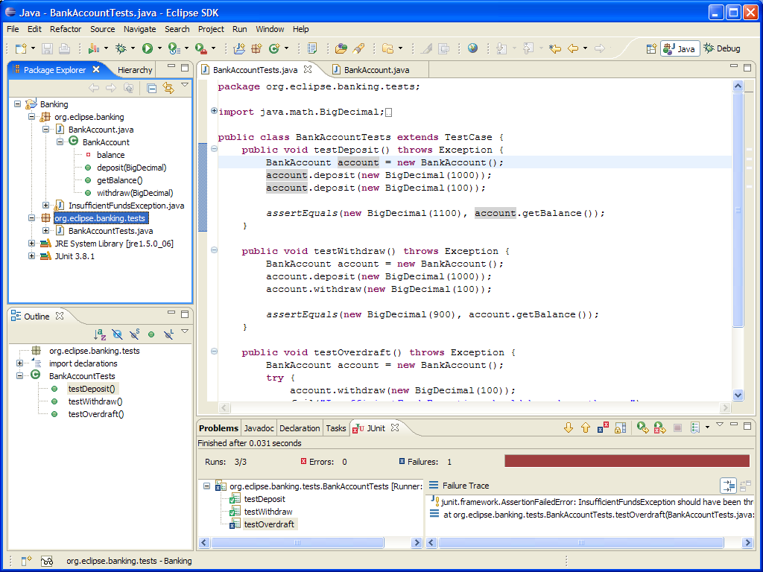
CVS/Subversion with Eclipse

Slide 39
To Get Started
Create a CVS repository in your home directory
  mkdir cvsroot
  cvs –d /home/knoppix/cvsroot init
Let’s say you want to add coreutils to your CVS repository
  Go inside the coreutils-5.2.1 directory
  cvs –d /home/knoppix/cvsroot import coreutils coreutils ver_1

Slide 40
Play with CVS
Create a local sandbox version of coreutils from your repository
  Go to your home directory
  cvs –d /home/knoppix/cvsroot checkout coreutils
  What just happened? What directory was created? What’s in it?
Edit a file
Commit the file to the repository
  cvs commit
Update your sandbox
  cvs update
  Did anything get updated? Why or why not?
Delete a file
  rm filename
  cvs remove filename
  cvs commit

