Slide 1
Buffer Overruns
Week 7

Slide 2
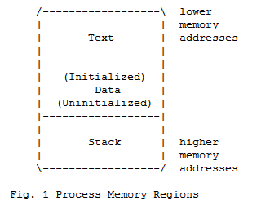
Memory

Slide 3
The Stack
Contiguous block of memory containing data
The stack pointer (SP) points to top of stack
Bottom of stack is at a fixed address

Slide 4
The Frame
Stack consists of logical stack frames that are pushed when calling a function and popped when returning
Stack frame contains parameters to function, local variables, and data necessary to recover previous stack frame including the instruction pointer at the time of the function call
Frame pointer (FP) points to fixed location within a frame and variables are referenced by offsets to the FP

Slide 5
Calling a Procedure
Save previous FP
Copies SP into FP to create the FP
Advances SP to reserve space for the local variables

Slide 6
Buffer overflows
Result of stuffing more data into a buffer than it can handle

Slide 7
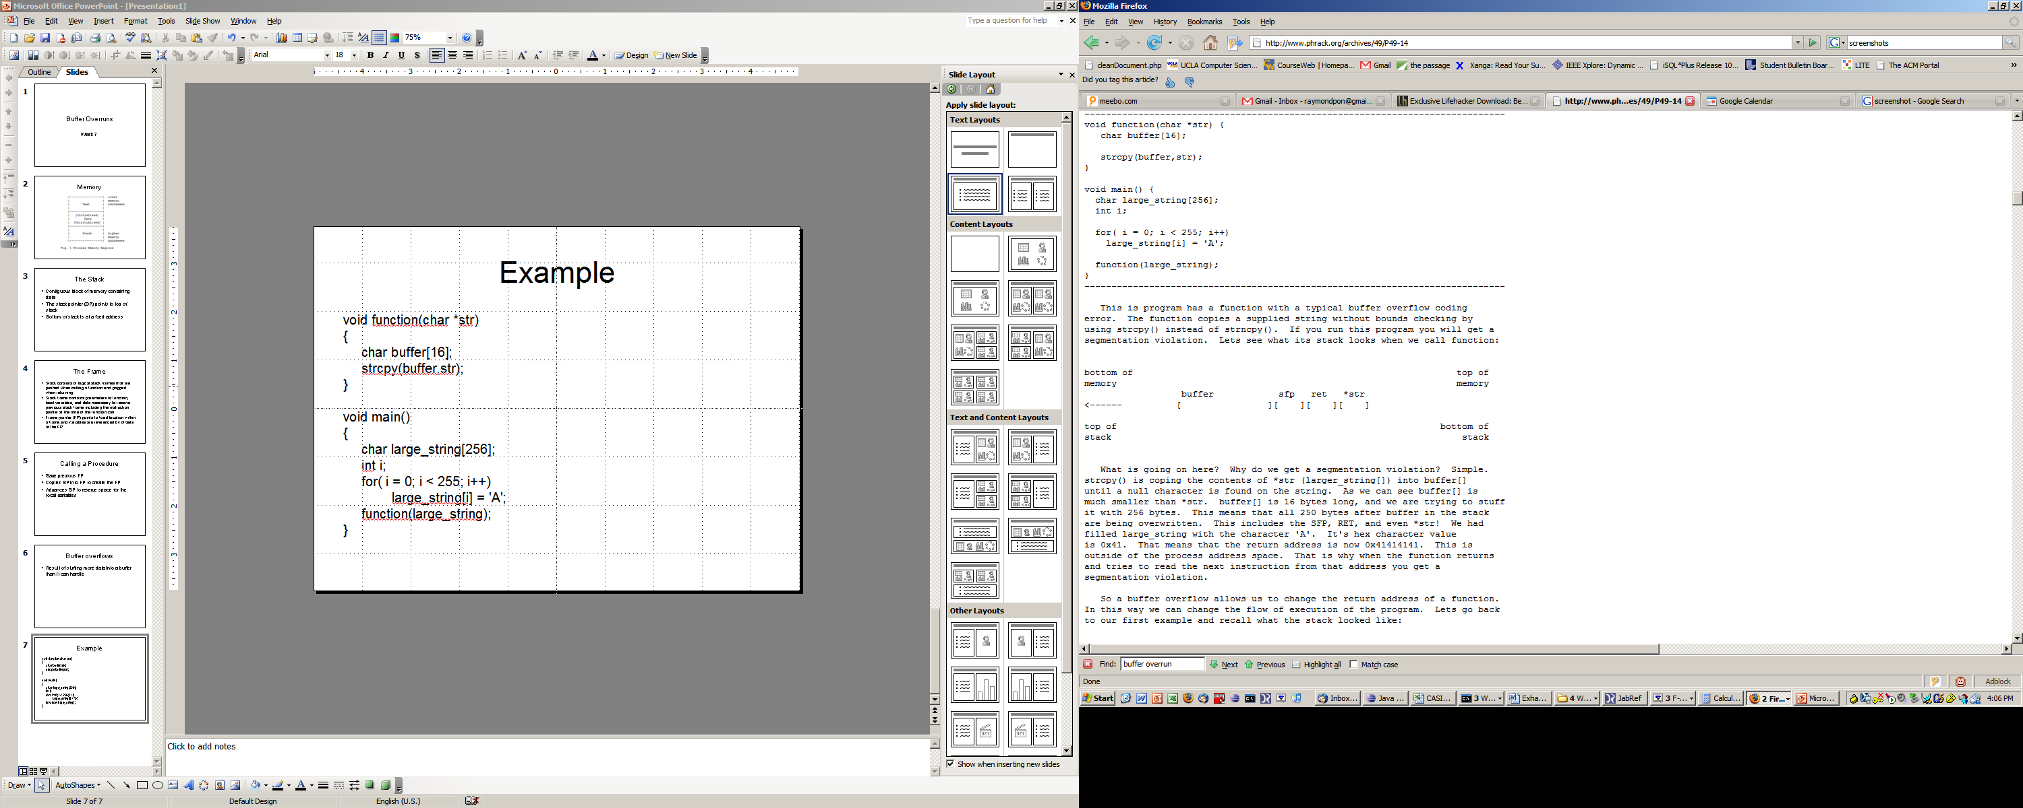
Example
void main()
{
char large_string[256];
int i;
for( i = 0; i < 255; i++)
large_string[i] = 'A';
function(large_string);
}
void function(char *str)
{
char buffer[16];
strcpy(buffer,str);
}

Slide 8
What’s Going to Happen?
What happened to buffer and the other regions in the stack?
If the character ‘A’ hex value is 0x41, what is the return address?
What happens when the function returns?

Slide 9
Shell Code
Now that we can modify the return address and the flow of execution, what program to execute?
We want to spawn a shell so we can execute anything else.
We need to place instructions into the program’s address space

Slide 10
The Answer
Place the code we are trying to execute in the buffer we are overflowing
Overwrite the return address so it points back into the buffer

Slide 11
Prevention?
Hardware?
Software?

Slide 12
Laboratory
Build thttpd 2.25b with the patch
  Gunzip and untar it
  Patch it
  Configure it
  Make it
Run it on port 8080
  ./thttpd –p 8080
Do a simple request like
  wget http://localhost:8080

Slide 13
Laboratory
Crash the web server by sending it a suitably-formatted request
  Wget –post-data “foo=111111111…1” http://localhost:8080
  Where does the buffer overrun occur? Why?

Slide 14
Laboratory
Run the web server under GDB and get traceback (bt) after the crash
  ./thttpd –p 8080
  Find the pid for thttpd: ps –e | grep thttpd
  gdb thttpd pid
  Send your crashing request
  Continue and when it crashes do bt
  Include this in lab7.txt
Describe how you would build a remote exploit in the modified thttpd
  Smashing the stack for Fun and Profit will be helpful

Slide 15
Homework
Things to think about…
  Significance of Damage
  Ease of Exploitation
  Widespread
  Ease of repair/prevention

