Slide 1
Internship Project Presentation
Prepared By : Preeti Kumari

Slide 2
Agenda
Company Overview
Internship Overview
ERP
Organization Structure
SD Process Overview
Master Data in SD
Make to Order Flow
Transfer of Requirements
Sales Document Types
Implementation of Automotive company in SAP ERP
Q&A

Slide 3




SI2 Technologies Pvt. Ltd.
SI2 Technologies is a strategic premier application and infrastructure outsourcing company.
Locations – Vadodara , Noida and Pune
Team of:
SAP Certified Professionals
Salesforce Certified Professionals
O9 Certified Professionals
Microsoft Certified Professionals
Citrix Certified Professional
Cisco Certified Professionals
Palo Alto Certified Professionals
AWS Certified Professionals
VMware Certified Engineers
ISO27001 Certified Lead auditors
ITIL Certified consultants

Slide 4
Overview of Internship till now
Start date of parttime Internship – 14 Oct 2021
Start date of fulltime Internship – 2 Jan 2022
Time – 10am to 6:30pm , five days a week.
Trainer – Gaurav More
Learned about basics of ERP and SAP ERP.
I was appointed as SAP SD Trainee.
Completed the two and half book SAP SD out of four till now and 101 assignments till now.
Start date of Project - 1st February 2022
Title of Project – Implementation of Automotive company in SAP ERP

Slide 5
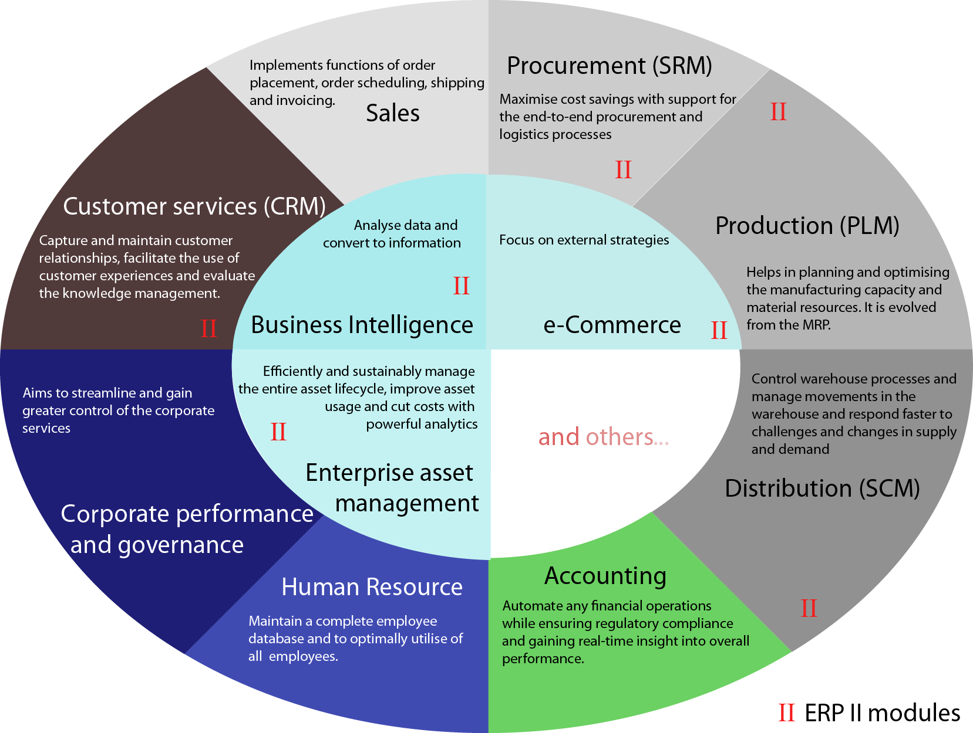
ERP

Slide 6

SAP ERP

Slide 7
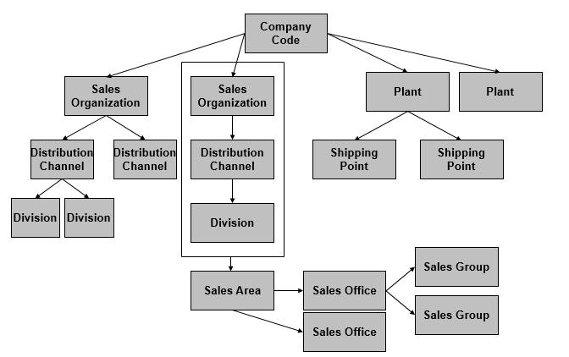
Organization Structure

Slide 8
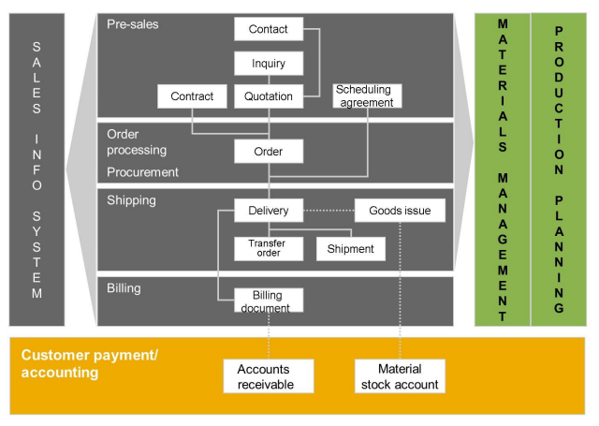
SD Process Overview

Slide 9
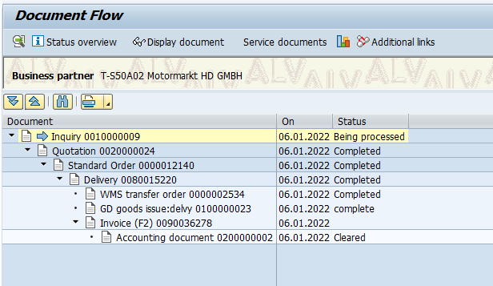
Document flow of OTC

Slide 10
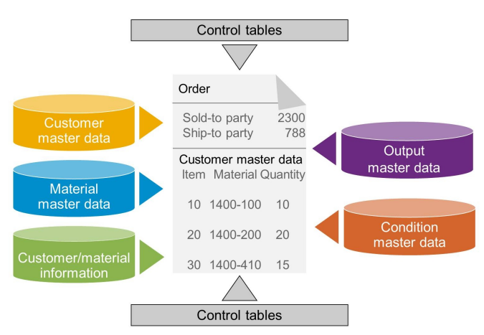
Master Data in SD

Slide 11
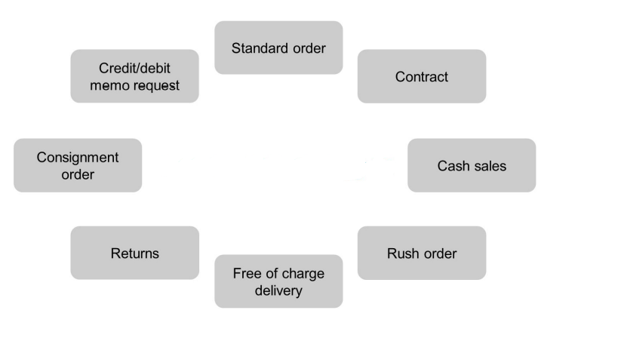
Sales Document Types

Slide 12

Implementation of Automotive company in SAP ERP

Slide 13
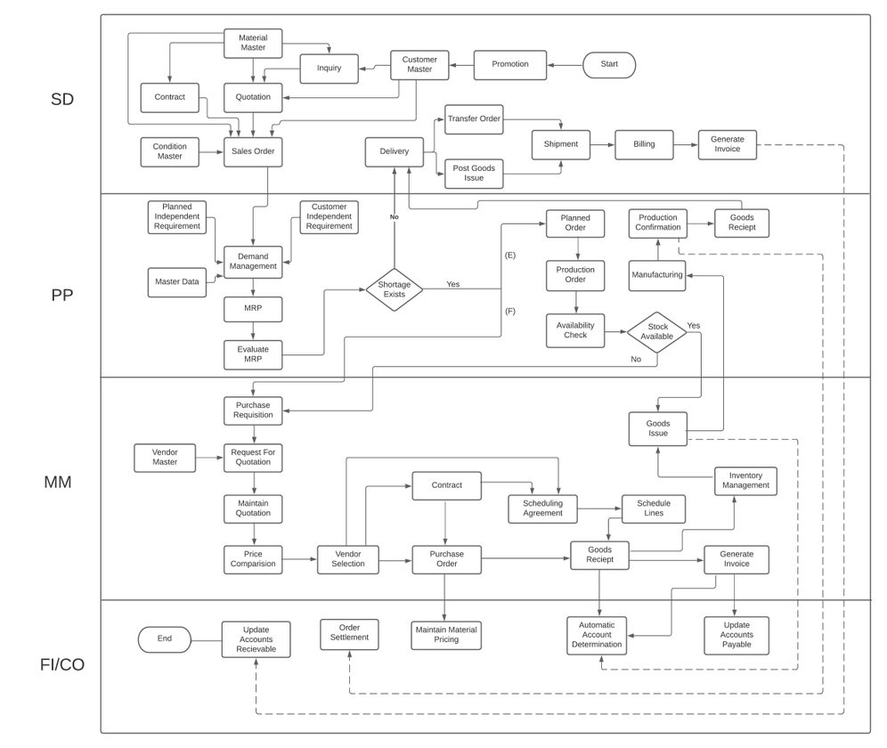
Business Flow Diagram

Slide 14
Sales Area for HY22​ | Sales Area for AD22​
VDSO/CA/H2​ VDSO/AC/H2​ | MHSO/RC/CP​ MHSO/RA/CP​
Plant and Storage Loc for HY22​ | Plant and Storage Loc for AD22​
VDSP - SLOC​ | MHSP - MHSL​
Shipping Point for HY22​ | Shipping Point for AD22​
SPVD​ | SPMH​

Slide 15
Partner Functions for HY22 | Partner Functions for AD22
HDPF SP – Sold-to party SH – Ship-to party BP – Bill-to Party PY- Payer | AD SP – Sold-to party SH – Ship-to party BP – Bill-to Party PY- Payer
Output type for Sales order | Output type for delivery | Output type for billing
ZORD | ZDEL | HYIN

Slide 16
Document types for HY22 and AD22
IN (Inquiry)
QT (Quotation)
OR (Standard Order)
CS (Cash Sales)
CR (Credit Memo)
CP (Consignment Pickup)
CF (Consignment Fill up)
CI (Consignment Issue)
CONR (Consignment Return)
QC (Quantity Contract)
DR (Debit Memo )
DS (Scheduling Agreement)
RE (Returns )
RO (Rush Order)

Slide 17
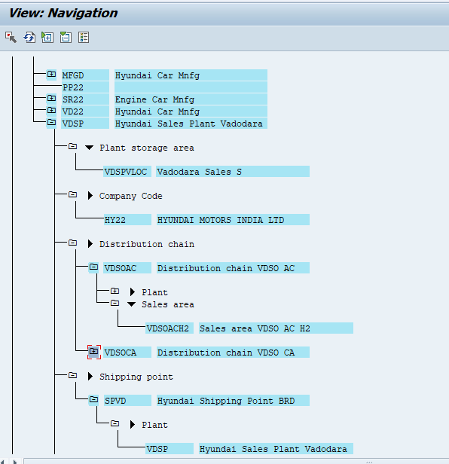
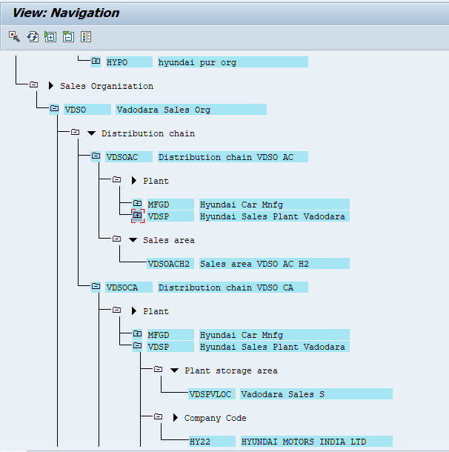
HY22

Slide 18
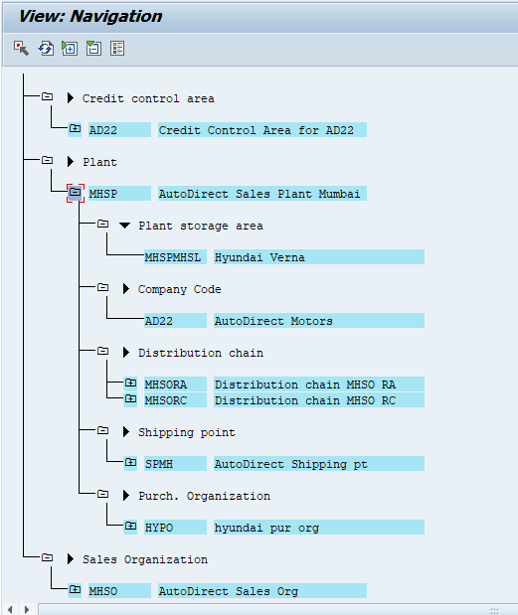
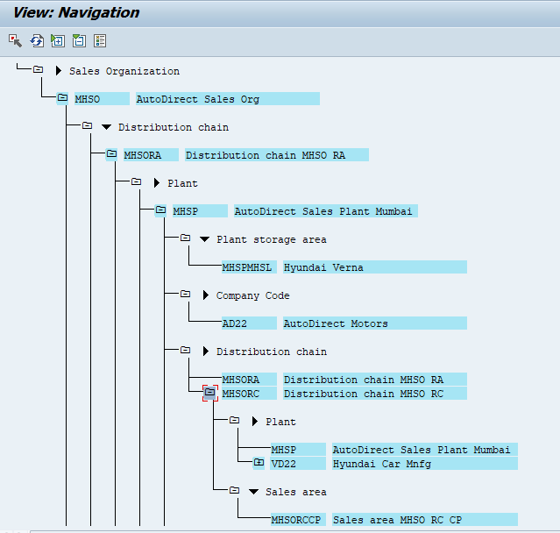
AD22

Slide 19
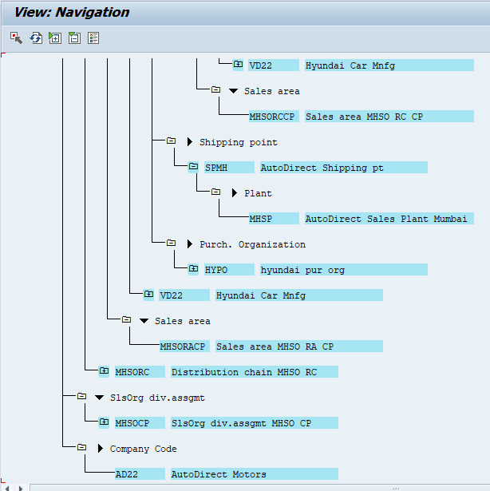

Slide 20
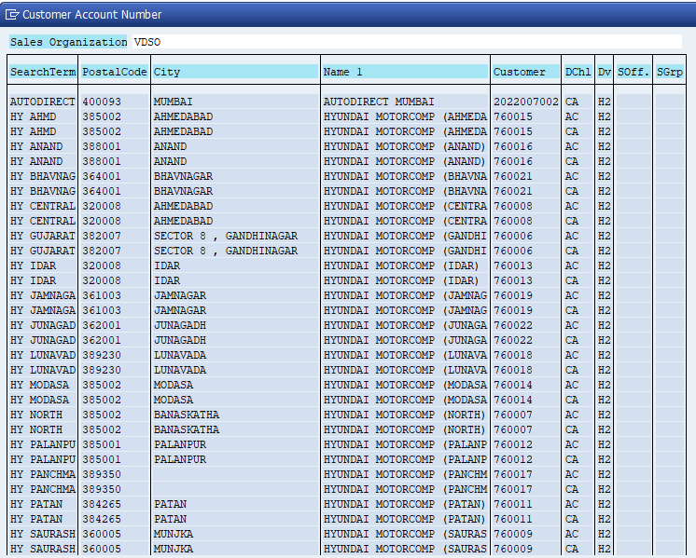
Customer Master data for HY22

Slide 21
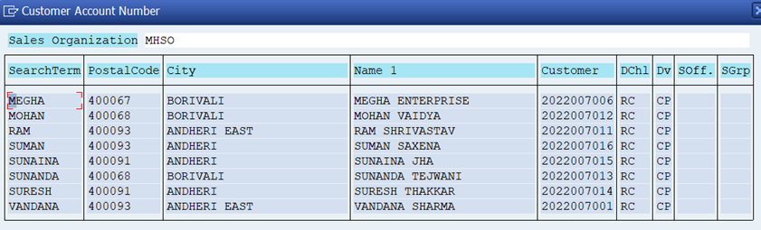
Customer Master data for AD22

Slide 22
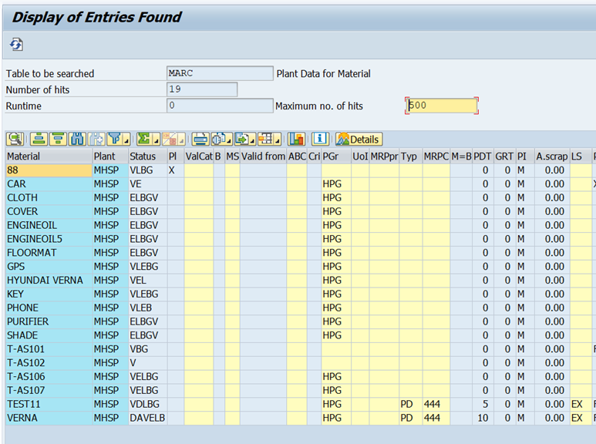
Material Master data for HY22 and AD22

Slide 23
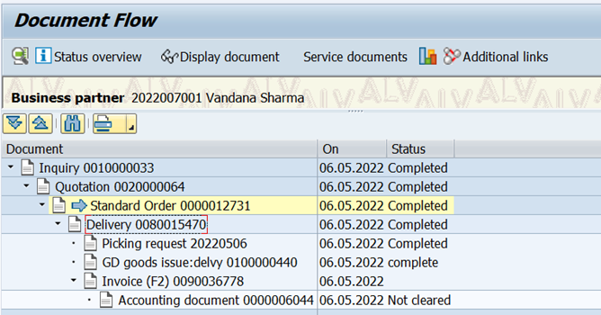
Document Flow for HY22 (Hyundai Motors)

Slide 24
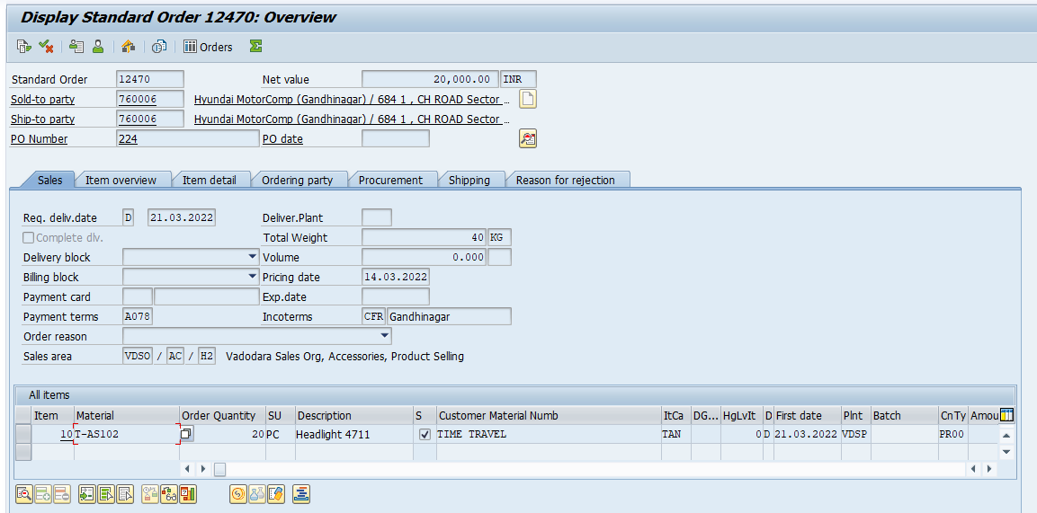
Sales Order

Slide 25
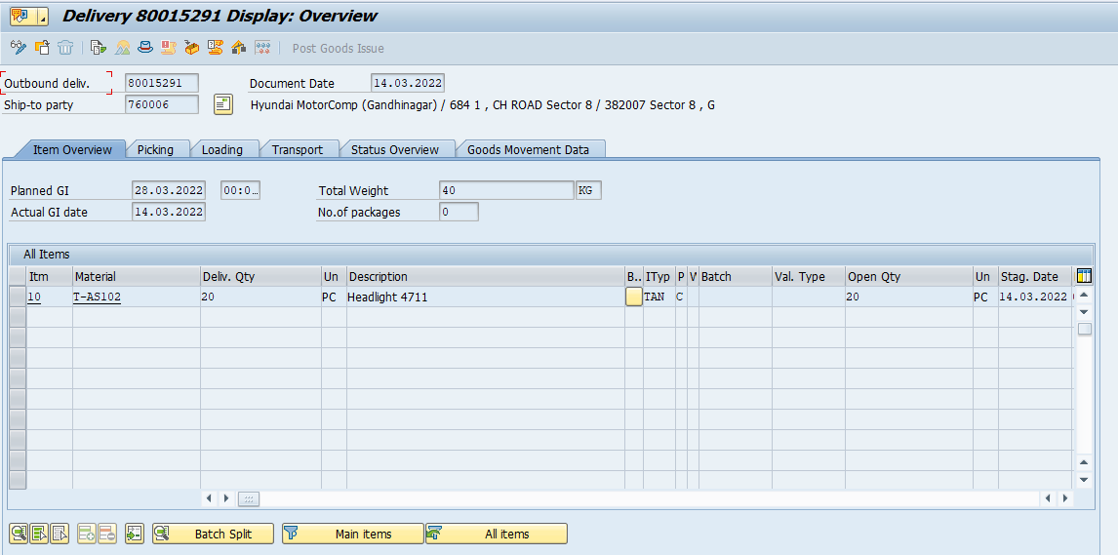
Delivery Document

Slide 26
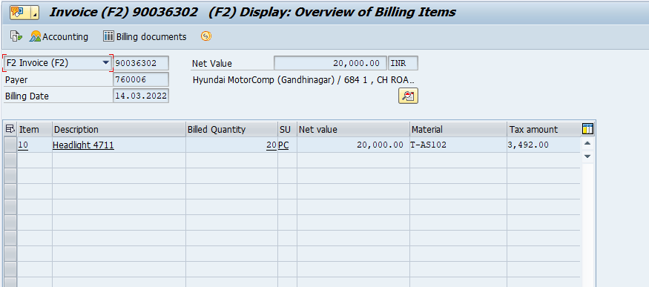
Billing Document

Slide 27
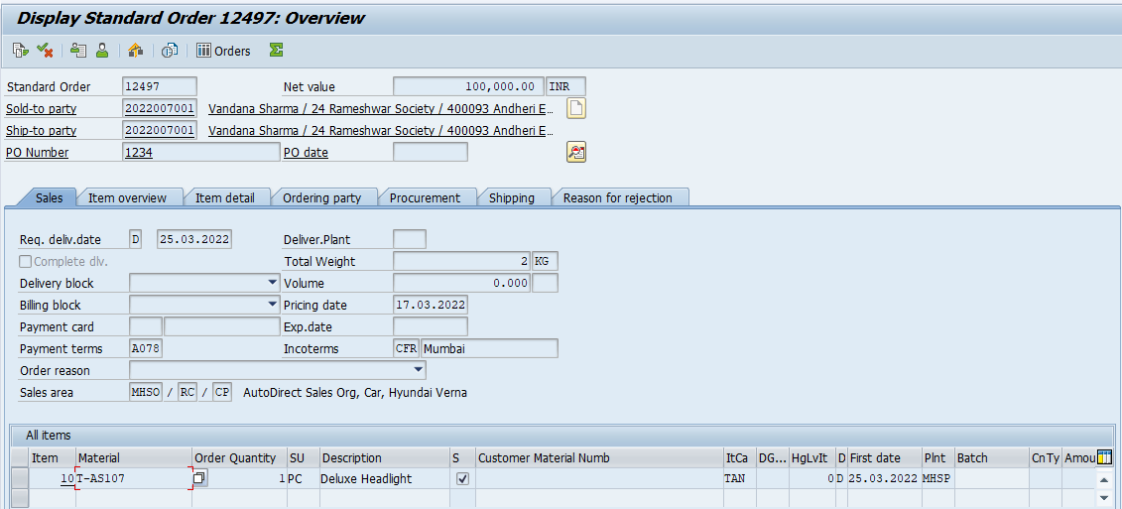
Sales order Document

Slide 28
Functional Specifications for Smart Forms and ALV Report
Sales Order document
Delivery document
Invoice
ALV Report
Custom TCode - ZSDALV

Slide 29
Q & A

