Slide 1
Speed dating : Tinder
What makes people like each other ?
21 waves between 2002 and 2004
552 id
Data Exploration Ideas :*
What are the least desirable attributes in a male partner? Does this differ for female partners?*
How important do people think attractiveness is in potential mate selection vs. its real impact?*
Are shared interests more important than a shared racial background?*
Can people accurately predict their own perceived value in the dating market?*
In terms of getting a second date, is it better to be someone's first speed date of the night or their last?

Slide 2

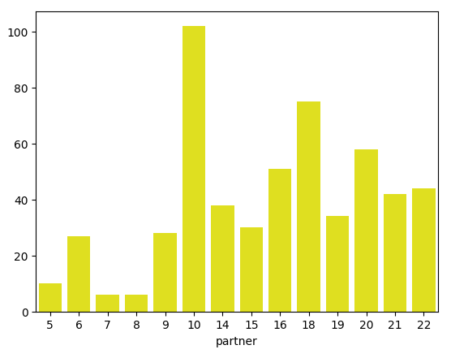
# of wave :
For each wave, up to 22 people of one gender
# of people in total : iid = 551, but goes up to 552. There is no 118.
Each of the 552 people on the study encountered 5 to 22 people
Total # of participants: 551 persons, including 274 females and 277 males.

Slide 3
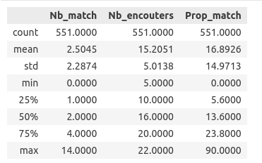
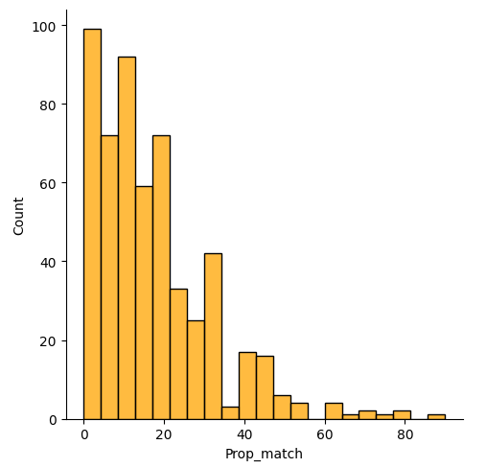
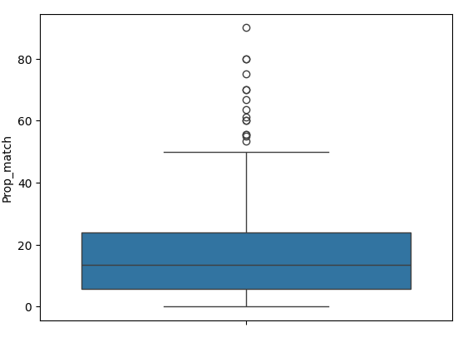
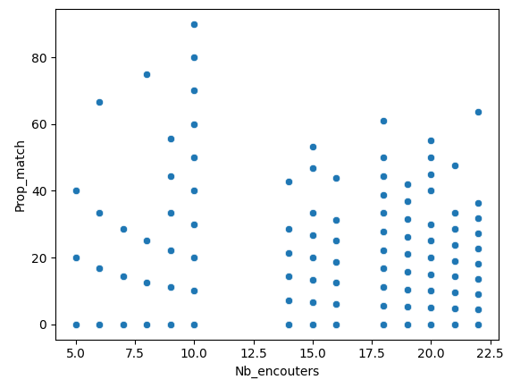
Le pic de match est autour de 0 %
La proportion de match ne dépend pas du nombre de partenaires rencontrés.

Slide 4
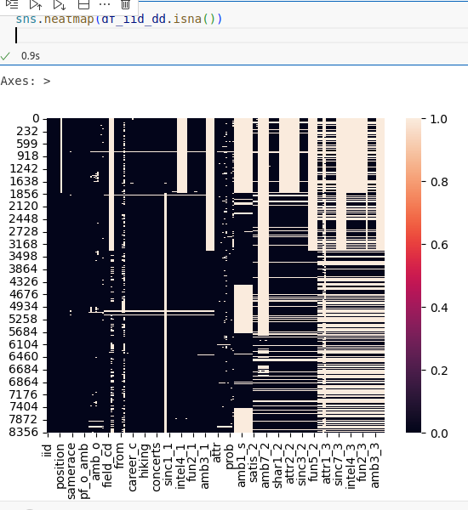
df_dropduplicates.isna()
Certaines colonnes ne valent pas le coup d’être gardées...

