Slide 1
Speed dating : Tinder
What makes people like each other ?
21 waves between 2002 and 2004
552 id
Data Exploration Ideas :*
What are the least desirable attributes in a male partner? Does this differ for female partners?*
How important do people think attractiveness is in potential mate selection vs. its real impact?*
Are shared interests more important than a shared racial background?*
Can people accurately predict their own perceived value in the dating market?*
In terms of getting a second date, is it better to be someone's first speed date of the night or their last?

Slide 2
To do
Done
En cours
To do
1. Check the dataset. Identify architecture, columns and questions
2. Dataset encoding, missing values...
STAT DESCRIPTIVES
Q1 : Nombre rencontres par personne, nombre de paritcipants
2. Faire des sous-sets par participants
2. Faire la conversion dec₀ et match
Q2 : La proportion de match ne dépend pas du nombre de rencontre. Elle est majoriataire à 0 %
2. Faire le tableau dtype and dvalue 10 columns/10 columns

Slide 3
List of object columns: ['field', 'undergra', 'mn_sat', 'tuition', 'from', 'zipcode', 'income', 'career']
Field = ok, encoded with field_cd
undergra': ok. school attended for undergraduate degree. ‘Missing values = no school.’
mn_sat: Median SAT score for the undergraduate institution where attended. Taken from Barron’s 25th Edition college profile book. Proxy for intelligence.
→ it is a score. Should be float or integers, but too much NaN
tuition: Tuition listed for each response to undergrad in Barron’s 25th Edition college profile book.
→ it is a score. Should be float or integers, but too much NaN
'from' = ok, but
df.groupby('from')['from'].nunique().index # mix of countries and departments, 269 locations
'zipcode' = ‘71,003’ means 71003. Should be an integer without ‘,’ , but since it is a category, don’t care.
'income' =’ 69,487.00’ but should be integer. It is in dollar according to postal code...
'career' = ok. Encoded in career_c but some mistakes.
Coming from the same country ???
It depends : Did they encouter people from different countries ?
Where were the wave ?
Check zipcode + country pour comparer
Verifier la distribution… Pour voir si tout est bien en dollar.

Slide 4
WAS OBJECT :
['field', 'undergra', 'mn_sat', 'tuition', 'from', 'zipcode', 'income', 'career']
OK :
'id' subject number in wave, _ last was nan. → same value as the line before since same participant. + Conversion in integer.
pid = pb with 118 which doesn’t exist and has been counted with NaN . I removed the lines, anyway he is not in the iid anyway.
Field, field_cd, career, career_c → codes = ok
'sports', 'tvsports', 'exercise', 'dining', 'museums', 'art', 'hiking', 'gaming', 'clubbing', 'reading', 'tv', 'theater', 'movies', 'concerts', 'music', 'shopping', 'yoga',
'positin1', (tation number where started
'pid',
'int_corr',
'age_o',
'race_o',
'pf_o_att'
, 'pf_o_sin'
, 'pf_o_int'
, 'pf_o_fun',
'pf_o_amb',
'pf_o_sha', 'attr_o', 'sinc_o', 'intel_o', 'fun_o', 'amb_o', 'shar_o', 'like_o', 'prob_o', 'met_o', 'age',
'undergra',
'mn_sat',
'tuition',
'race', 'imprace', 'imprelig', 'from', 'zipcode', 'income', 'goal', 'date', 'go_out', ', 'exphappy', 'expnum',
'attr1_1', 'sinc1_1', 'intel1_1', 'fun1_1', 'amb1_1', 'shar1_1',
'attr4_1', 'sinc4_1', 'intel4_1', 'fun4_1', 'amb4_1', 'shar4_1',
'attr2_1', 'sinc2_1', 'intel2_1', 'fun2_1', 'amb2_1', 'shar2_1',
'attr3_1', 'sinc3_1', 'fun3_1', 'intel3_1', 'amb3_1',
'attr5_1', 'sinc5_1', 'intel5_1', 'fun5_1', 'amb5₁'
, 'attr',
'sinc', 'intel', 'fun', 'amb', 'shar', 'like', 'prob', 'met', 'match_es', 'attr1_s', 'sinc1_s', 'intel1_s', 'fun1_s', 'amb1_s', 'shar1_s', 'attr3_s', 'sinc3_s', 'intel3_s', 'fun3_s', 'amb3_s', 'satis_2', 'length', 'numdat_2', 'attr7_2', 'sinc7_2', 'intel7_2', 'fun7_2', 'amb7_2', 'shar7_2', 'attr1_2', 'sinc1_2', 'intel1_2', 'fun1_2', 'amb1_2', 'shar1_2', 'attr4_2', 'sinc4_2', 'intel4_2', 'fun4_2', 'amb4_2', 'shar4_2', 'attr2_2', 'sinc2_2', 'intel2_2', 'fun2_2', 'amb2_2', 'shar2_2', 'attr3_2', 'sinc3_2', 'intel3_2', 'fun3_2', 'amb3_2', 'attr5_2', 'sinc5_2', 'intel5_2', 'fun5_2', 'amb5_2', 'you_call', 'them_cal', 'date_3', 'numdat_3', 'num_in_3',
'attr1_3', 'sinc1_3', 'intel1_3', 'fun1_3', 'amb1_3', 'shar1_3', 'attr7_3', 'sinc7_3', 'intel7_3', 'fun7_3', 'amb7_3', 'shar7_3', 'attr4_3', 'sinc4_3', 'intel4_3', 'fun4_3', 'amb4_3', 'shar4_3', 'attr2_3', 'sinc2_3', 'intel2_3', 'fun2_3', 'amb2_3', 'shar2_3', 'attr3_3', 'sinc3_3', 'intel3_3', 'fun3_3', 'amb3_3', 'attr5_3', 'sinc5_3', 'intel5_3', 'fun5_3', 'amb5_3']

Slide 5

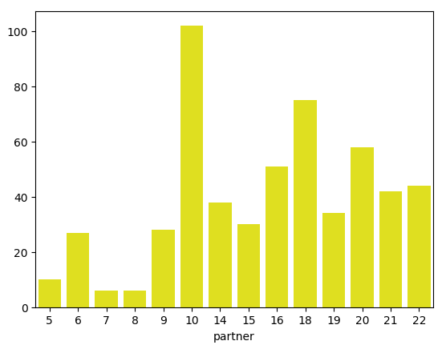
# of wave :
For each wave, up to 22 people of one gender
# of people in total : iid = 551, but goes up to 552. There is no 118.
Each of the 552 people on the study encountered 5 to 22 people
Total # of participants: 551 persons, including 274 females and 277 males.

Slide 6
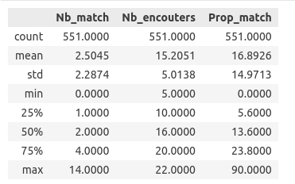
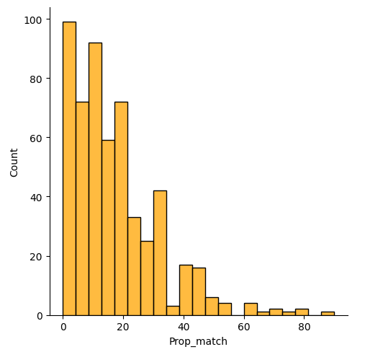
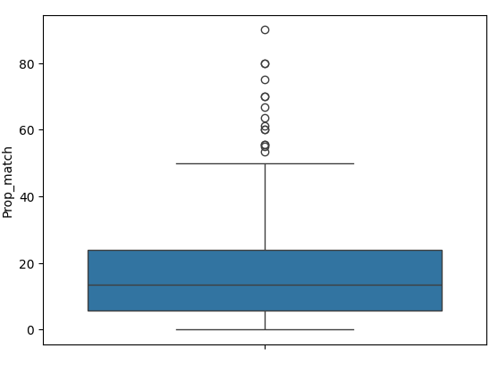
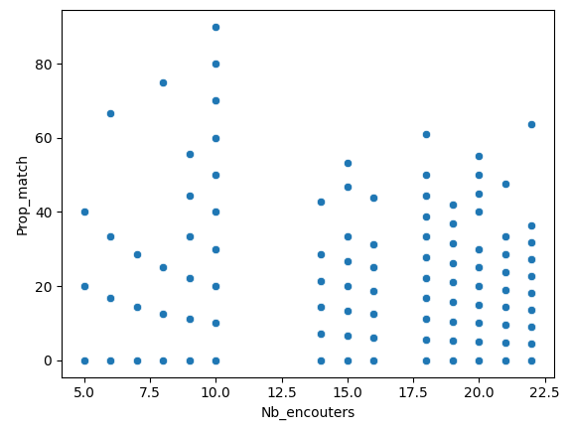
Le pic de match est autour de 0 %
La proportion de match ne dépend pas du nombre de partenaires rencontrés.

