Slide 1


Object Oriented Programming Mini Project
NITTE MEENAKSHI INSTITUTE OF TECHNOLOGY
Under the guidance of : Dr Vijaya Shetty
Done By:Kumuda K
Ritika Subudhi
Sheetal S Harshini
Shreya A Hegde

Slide 2

CONNECT-4

Slide 4
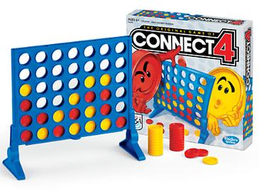
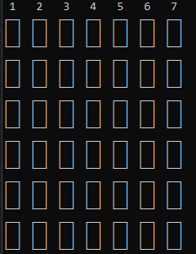
ABOUT THE GAME
Connect Four is a two-player connection game in which the players first choose a color and then take turns dropping one colored disc from the top into a seven-column, six-row vertically suspended grid.

Slide 5
OBJECTIVE
The pieces fall straight down, occupying the lowest available space within the column.
The objective of the game is to be the first to form a horizontal, vertical, or diagonal line of four of one's own discs to win the game.

Slide 6
HOW TO PLAY
Type the column number where you want to drop your disk.
You can connect the 4 tiles of your disk type in a:
1. VERTICAL
2. HORIZONTAL
3. DIAGONAL fashion.
The first player to get four of their disk type either VERTICALLY or HORIZONTALLY or DIAGONALLY wins the game.

Slide 7
Wondering how we created a simulation of this game?
-We are here to break it down for you to understand.

Slide 8
Let’s brush up on what classes are, before we start of.

Slide 9
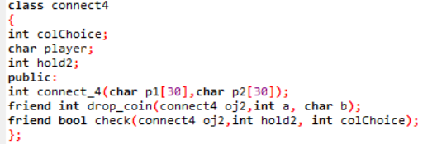
The building block of C++, an Object Oriented programming language, is a Class. It is a user defined data type, which holds its own data members and member functions, which can be accessed and used by creating an instance of that class.
An Object is an instance of a Class. When a class is defined, no memory is allocated but when it is instantiated (i.e. an object is created) memory is allocated.

Slide 10
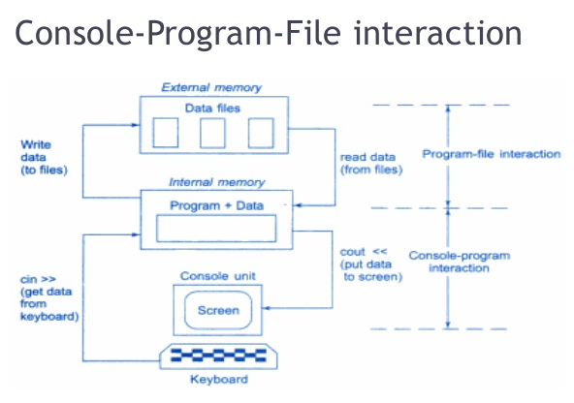
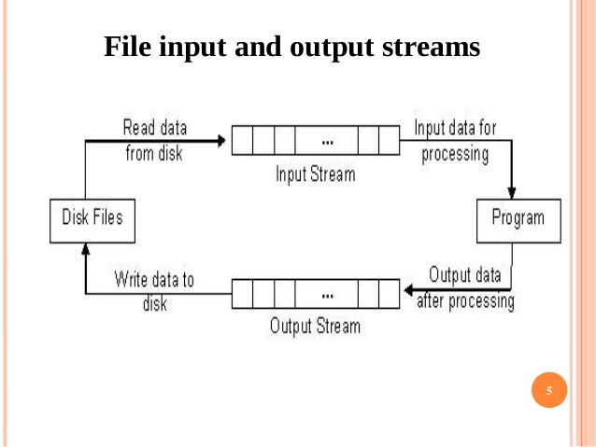

Slide 11
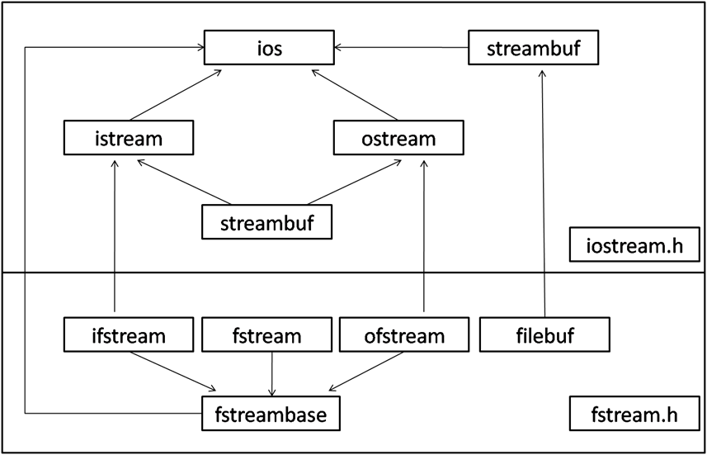

Slide 12
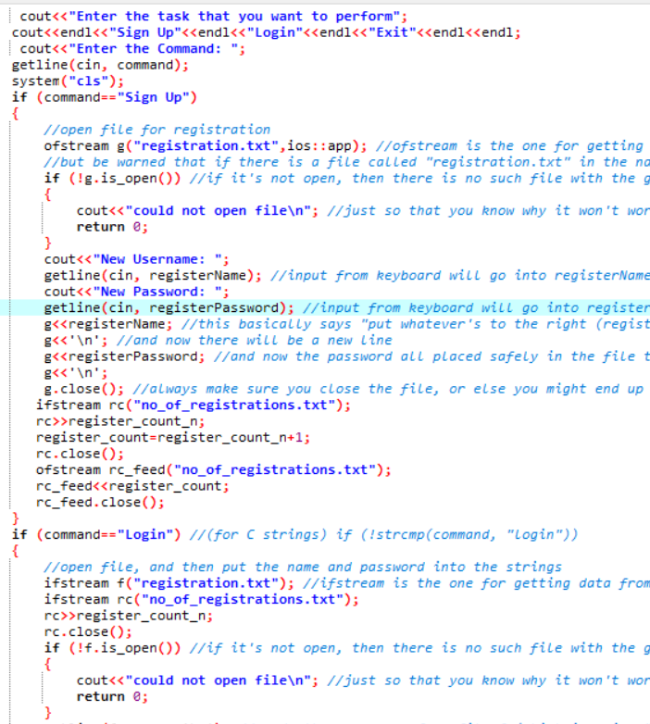
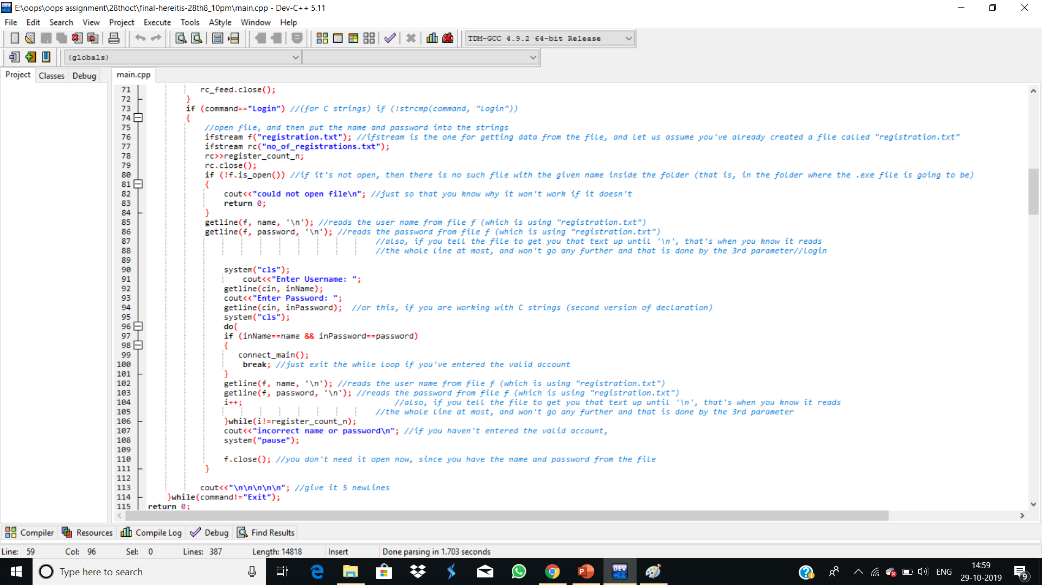

Slide 13
Okay… But how does the game work?

Slide 14
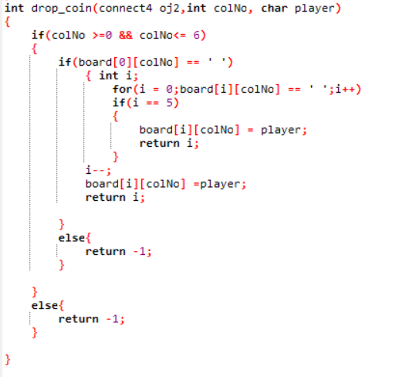

Slide 15
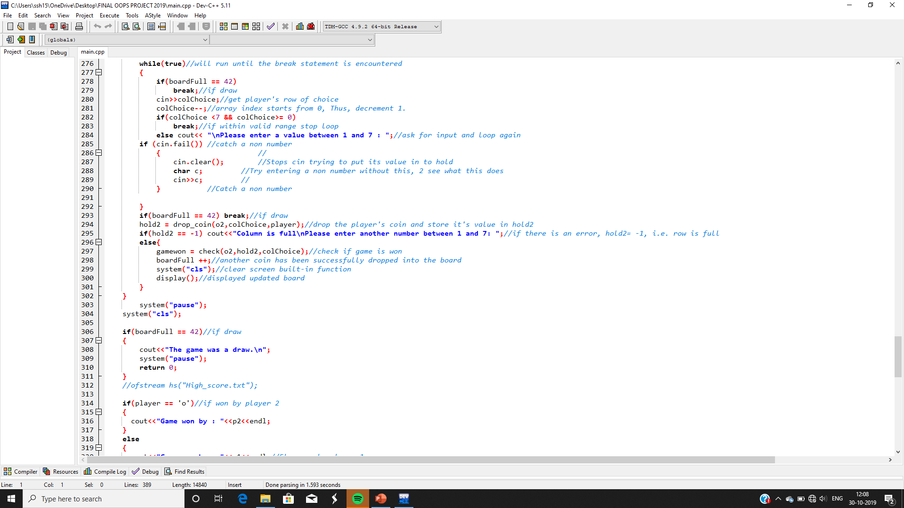

Slide 16
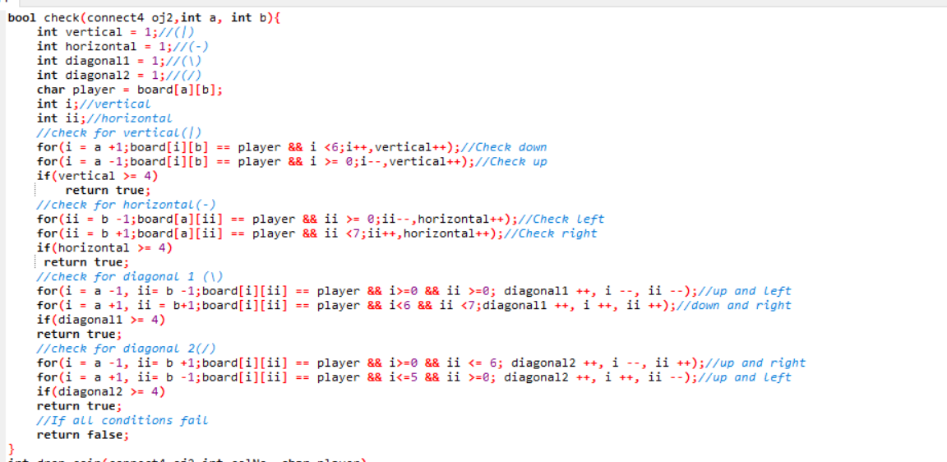

Slide 17
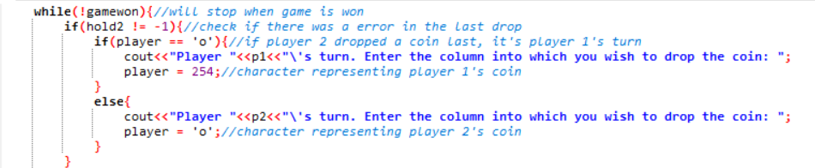
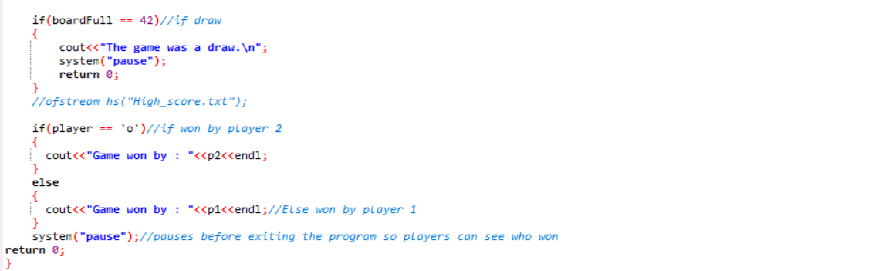
.
.
.
.
.
.
.

Slide 18
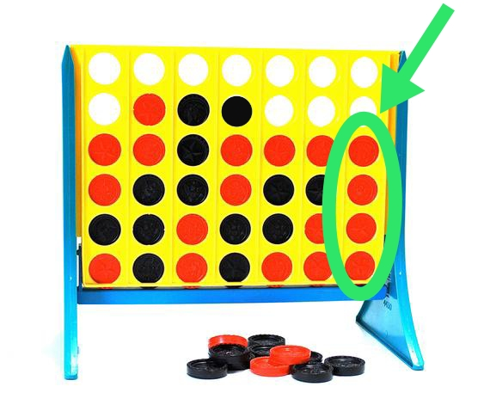
Checking for coins in vertical
To check if there are 4 consecutive coins of the same player in the same column.
Once the above condition is satisfied, the player to whom the coin belongs is declared as the winner.

Slide 19
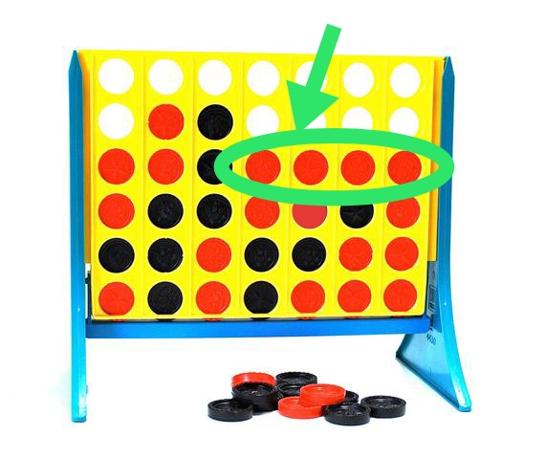
Checking for coins in horizontal
To check if there are 4 consecutive coins of the same player in the same row.
Once the above condition is satisfied, the player to whom the coin belongs is declared as the winner

Slide 20
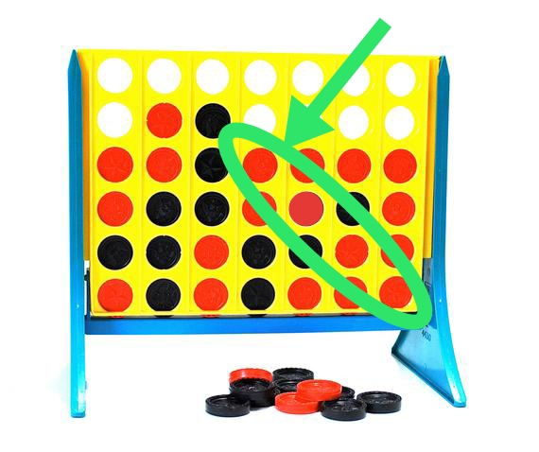
Checking for coins in left diagonal
To check if there are 4 consecutive coins of the same player in the left diagonal.
Once the above condition is satisfied, the player to whom the coin belongs is declared as the winner.

Slide 21
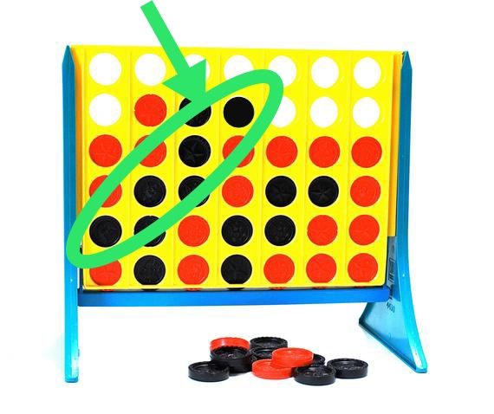
Checking for coins in the right diagonal
To check if there are 4 consecutive coins of the same player in the right diagonal.
Once the above condition is satisfied, the player to whom the coin belongs is declared as the winner.

Slide 22

THANK YOU

