Slide 1

Recursion
Function calls itself until base case

Slide 2
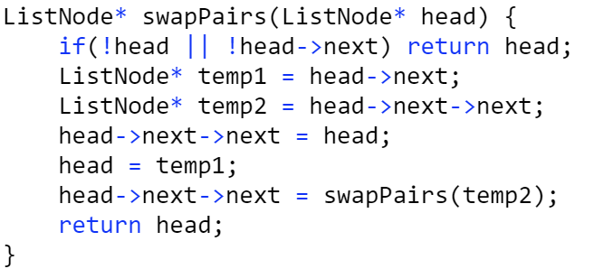
Swap Pairs in Linked List https://leetcode.com/explore/learn/card/recursion-i/250/principle-of-recursion/1681/

Slide 3
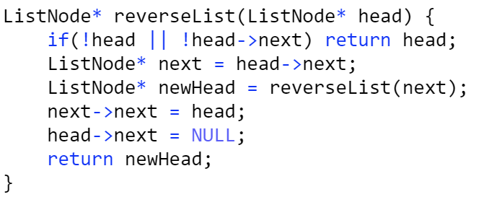
Reverse Linked List https://leetcode.com/explore/learn/card/recursion-i/251/scenario-i-recurrence-relation/2378/

Slide 4
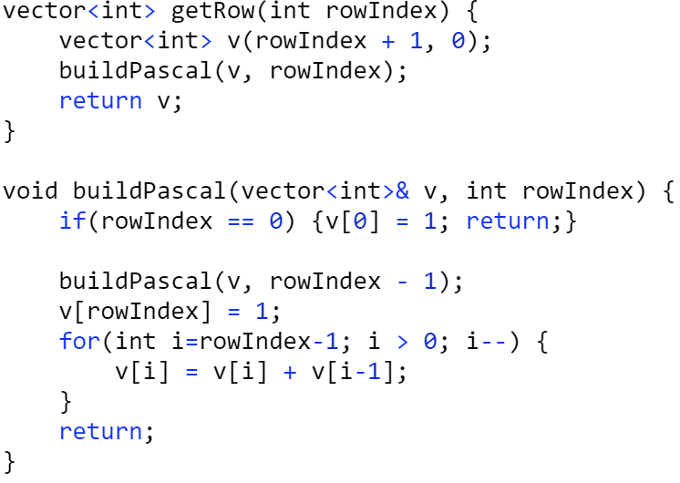
Pascals Triangle II https://leetcode.com/explore/learn/card/recursion-i/251/scenario-i-recurrence-relation/3234/

Slide 5
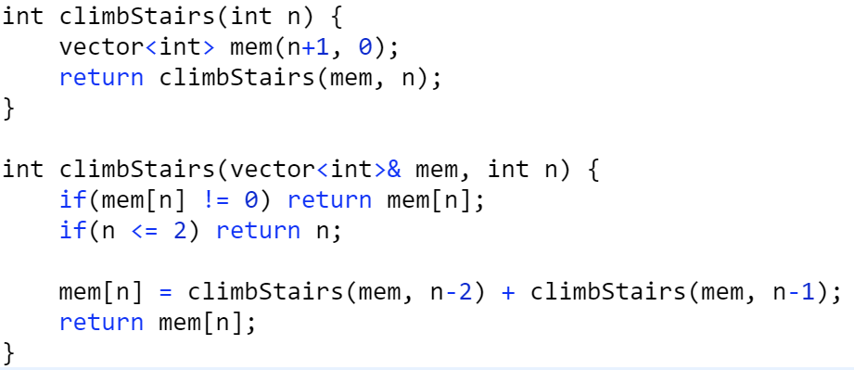
Climb Stairs https://leetcode.com/explore/learn/card/recursion-i/255/recursion-memoization/1662/

Slide 6
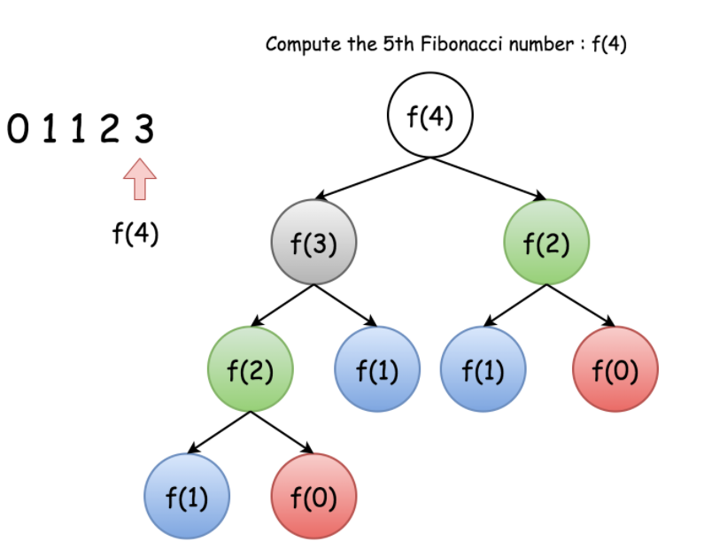
Complexity Analysis of Recusive Function. https://leetcode.com/explore/learn/card/recursion-i/256/complexity-analysis/1669/ Fibannocci function without memorization: T(n) T(n) = T(n-1) + T(n-2) + O(1) T(n) is O(2^n). The height of the tree is n-1. No of nodes is < 2 ^ (n-1) O(2^n) is not a tight bound. Tight bound is O(1.6^n)

Slide 7
Space Analysis of Recusive Function. https://leetcode.com/explore/learn/card/recursion-i/256/complexity-analysis/1671/ Maximum amount of space occupied during the runtime of the program. i.e considering height of the tree One way to reduce the space complexity in case of recusrsion is Tail Recursion https://leetcode.com/explore/learn/card/recursion-i/256/complexity-analysis/2374/

Slide 8
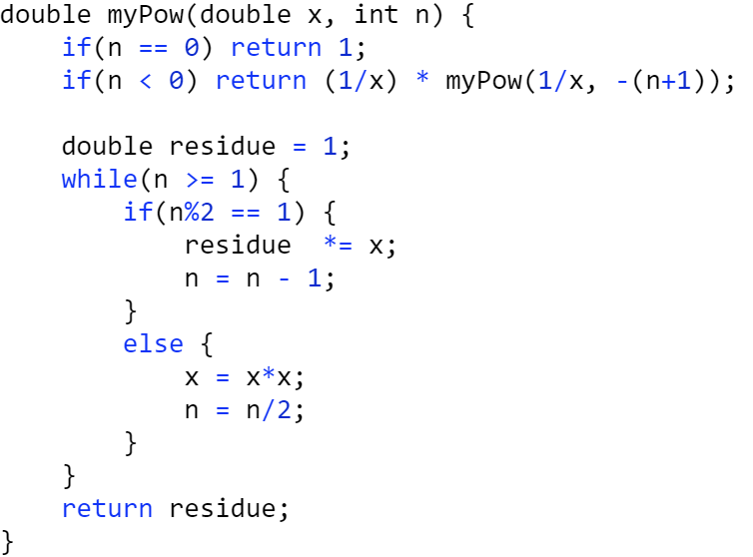
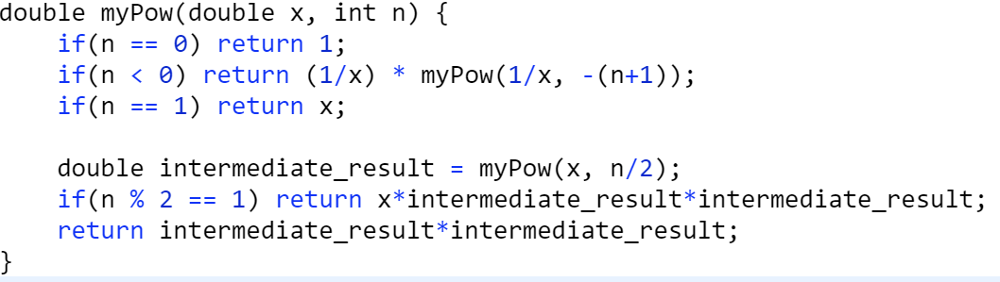
Pow(x,n) https://leetcode.com/explore/learn/card/recursion-i/256/complexity-analysis/2380/

Slide 9
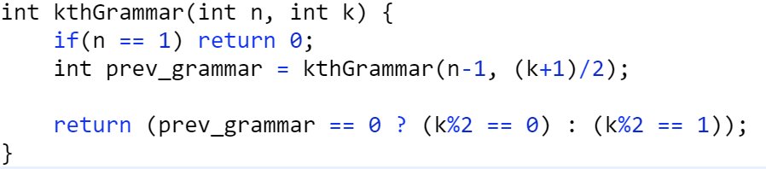
Kth Grammar https://leetcode.com/explore/learn/card/recursion-i/253/conclusion/1675/

Slide 10
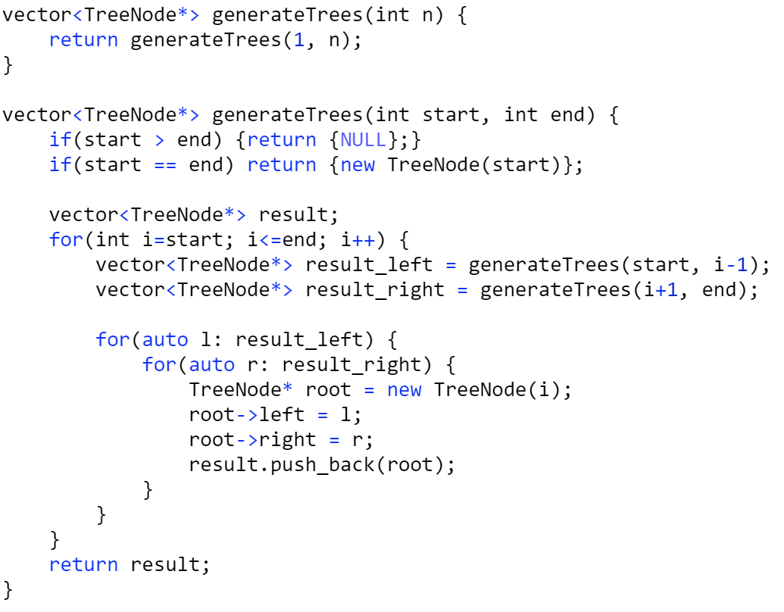
Unique BSTs https://leetcode.com/explore/learn/card/recursion-i/253/conclusion/2384/

Slide 11
Important Techniques in Recursion
Memoization – Store the sub-problem output to avoid duplicate calculations
Divide and Conquer – Divide the problem into two or more subproblems.
However, Recursion in which we reduce the problem into a single subproblem is called Decrease and Conquer
BackTracking

Slide 12
Divide and Conquer
Problem is divided into 2 or more sub-problems.
Final output is the combined result of them.
Example : Merge Sort
If we are reducing the current problem to a single sub-problem. This technique is called decrease and Conquer.
Ex: Binary Search

Slide 13
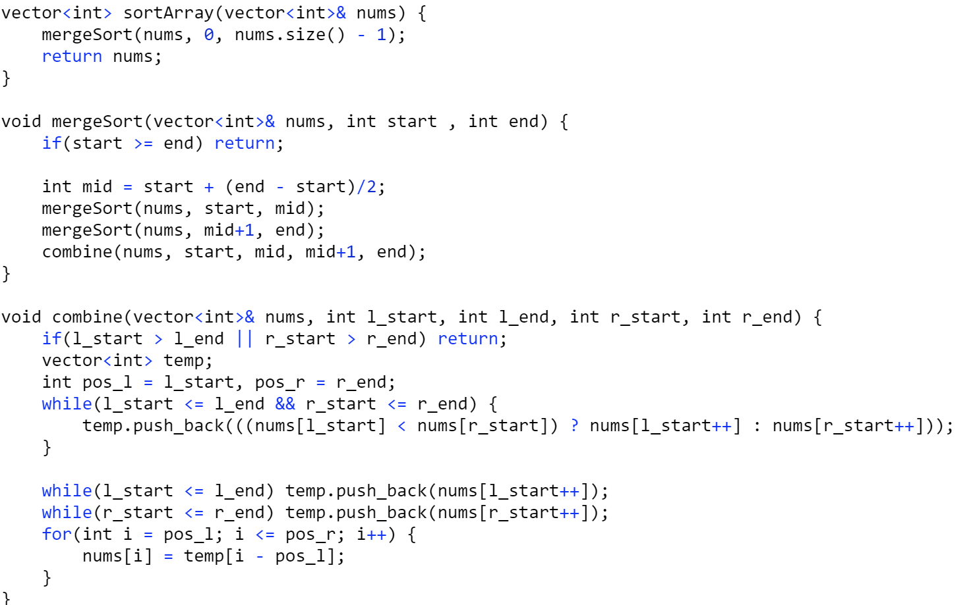
Merge Sort

Slide 14
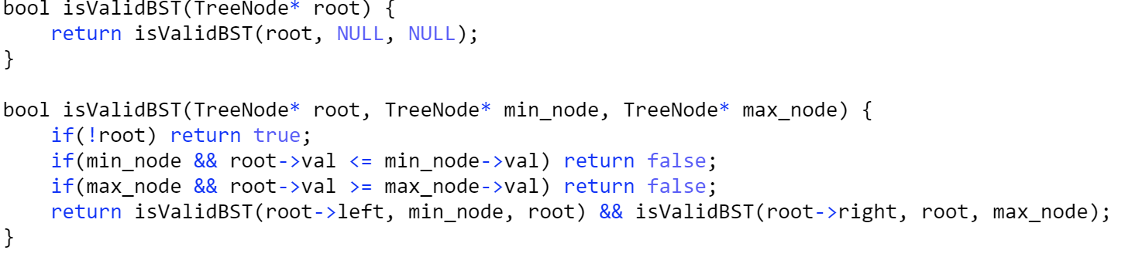
IsValid BST https://leetcode.com/explore/learn/card/recursion-ii/470/divide-and-conquer/2874/

Slide 15
IsValid BST https://leetcode.com/explore/learn/card/recursion-ii/470/divide-and-conquer/2874/

Slide 16
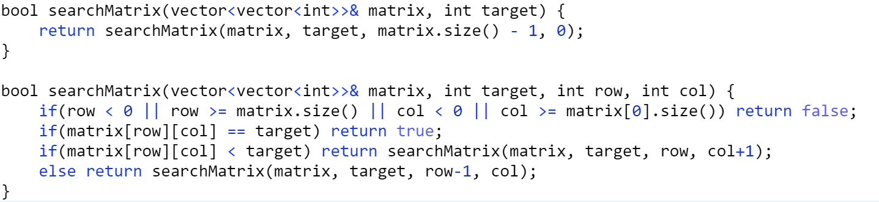
Search Matrix 2D https://leetcode.com/explore/learn/card/recursion-ii/470/divide-and-conquer/2872/

Slide 17
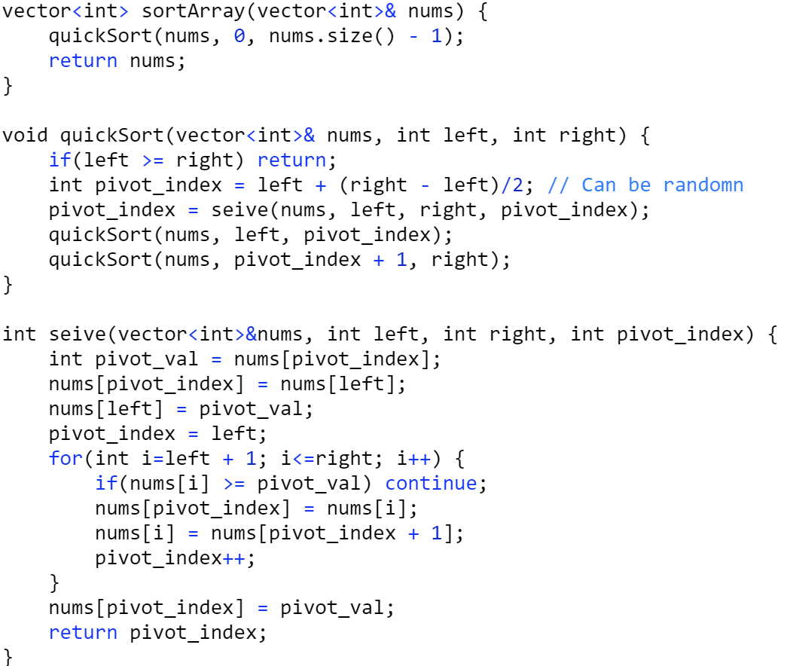
Quick Sort https://leetcode.com/explore/learn/card/recursion-ii/470/divide-and-conquer/2870/

Slide 18
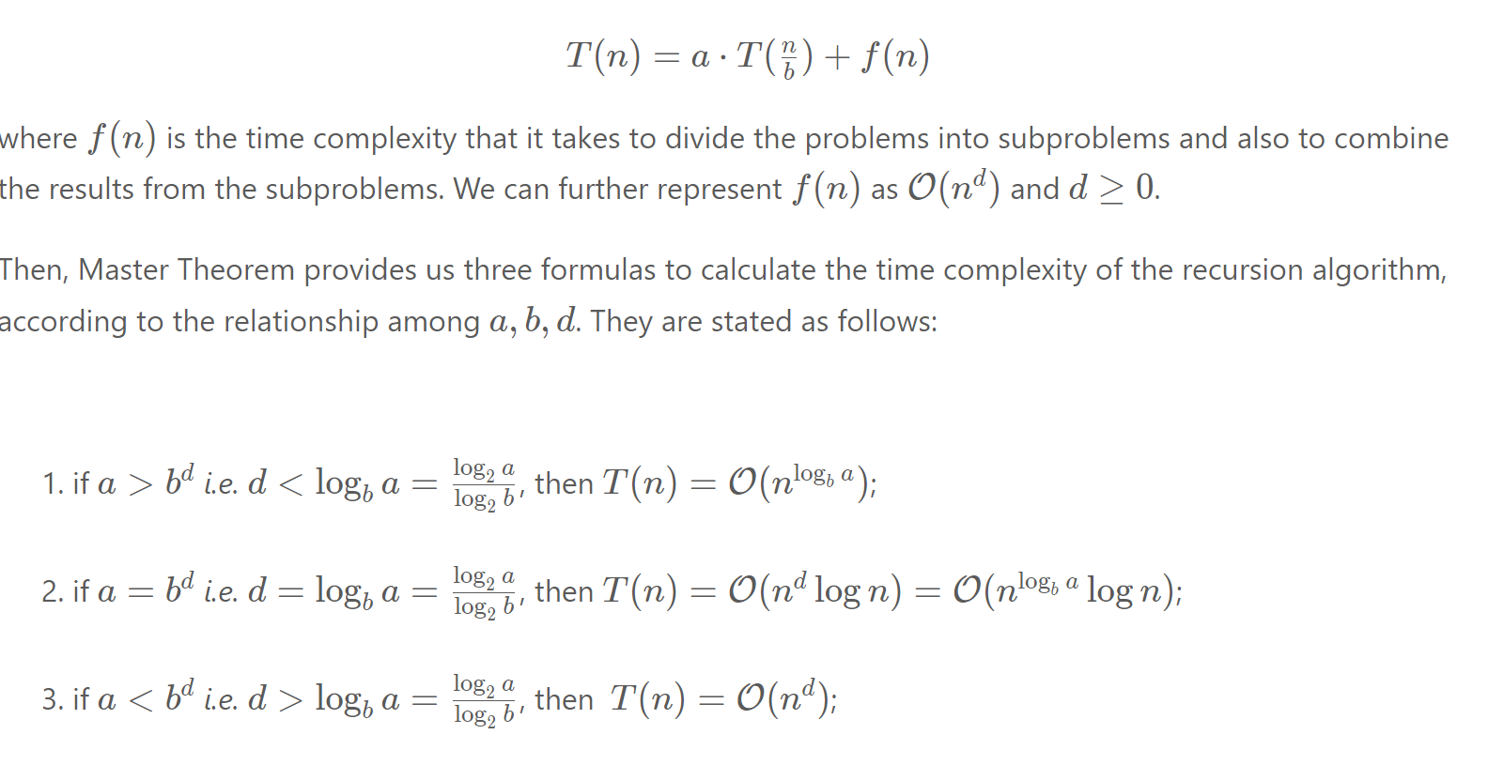
Master Theorem https://leetcode.com/explore/learn/card/recursion-ii/470/divide-and-conquer/2871/

Slide 19
BackTracking
Once a path is not leading to solution, we don’t further explore it and go back and search for other paths.
This is better than Brute-Force Solution, since we are eliminating many paths, without actually traversings
I.E unlike in brute-force solution, we evaluate the partial solutions and check if a candidate is worth exploring further

Slide 20
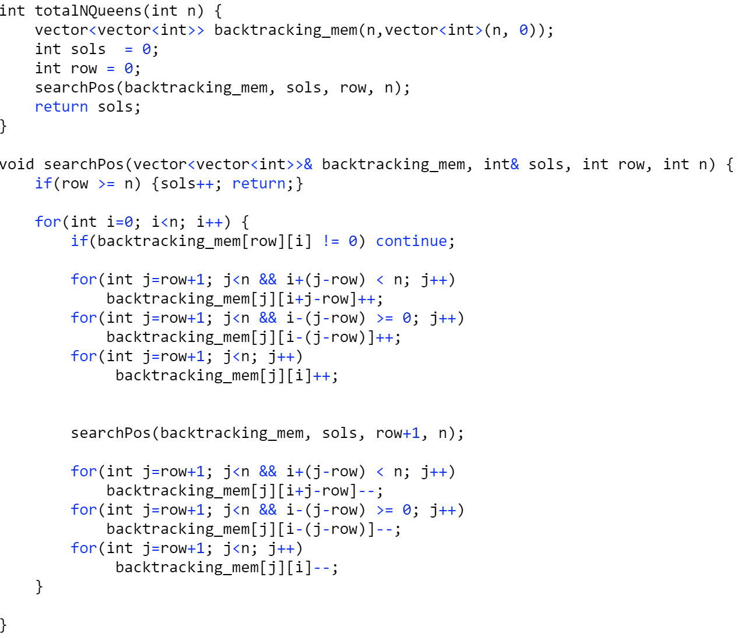
N Queens - II https://leetcode.com/explore/learn/card/recursion-ii/472/backtracking/2804/

Slide 21
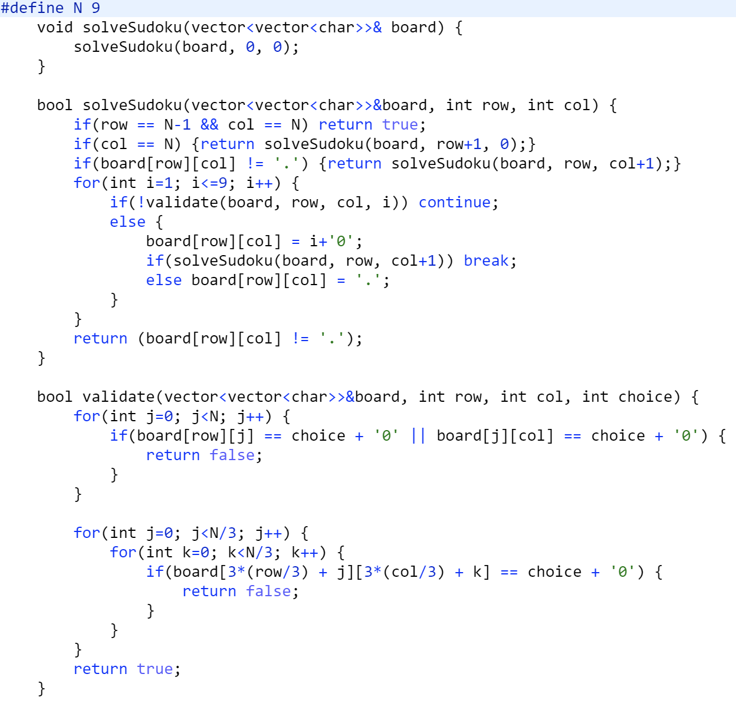
Sudoku Solver https://leetcode.com/explore/learn/card/recursion-ii/472/backtracking/2796/

Slide 22
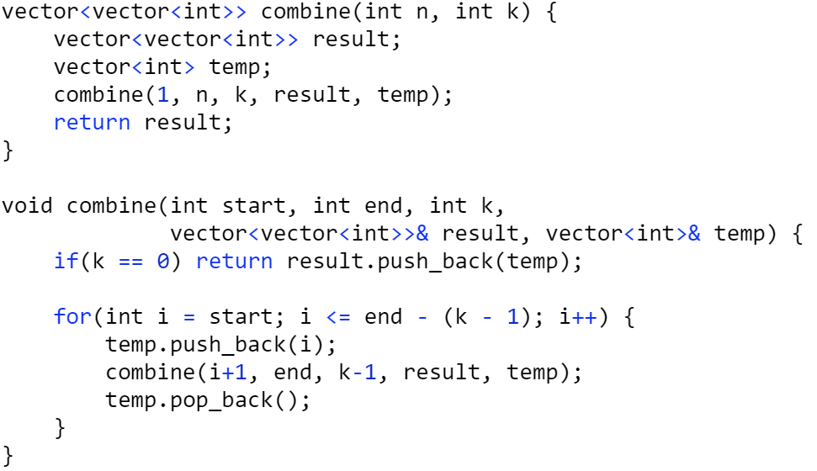
Combinations https://leetcode.com/explore/learn/card/recursion-ii/472/backtracking/2798/

Slide 23
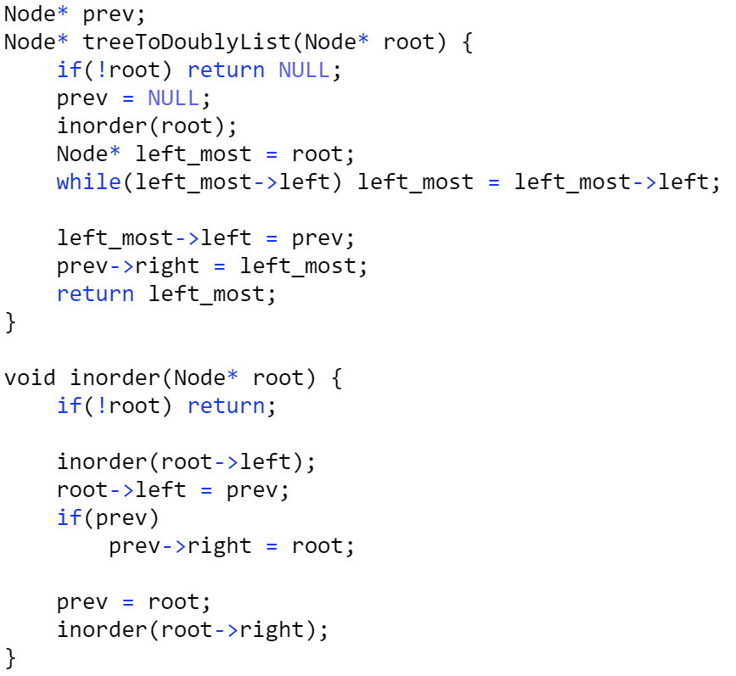
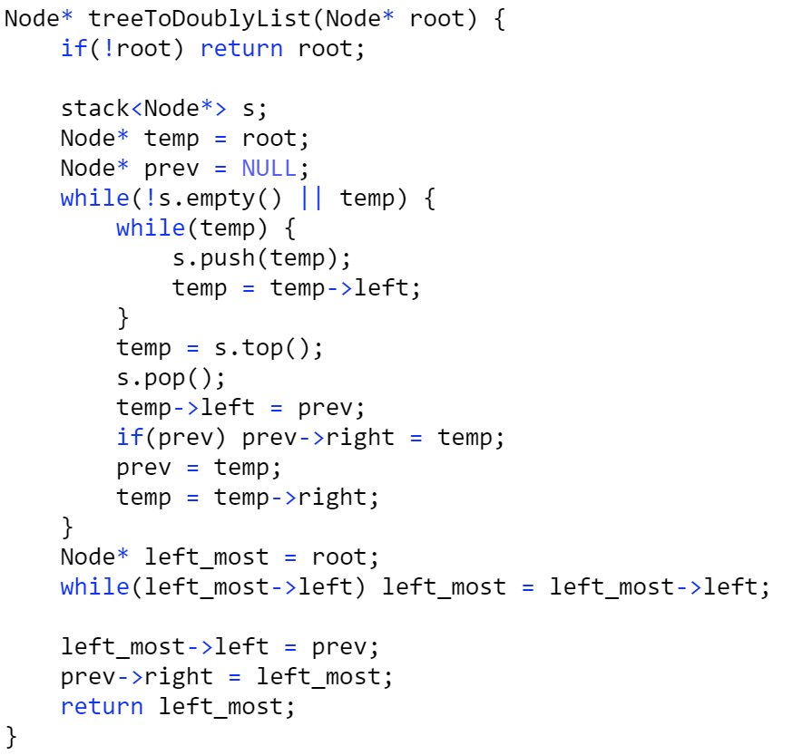
Convert Binary Search Tree to Doubly Linked list https://leetcode.com/explore/learn/card/recursion-ii/507/beyond-recursion/2899/
Iterative Solution

Slide 24
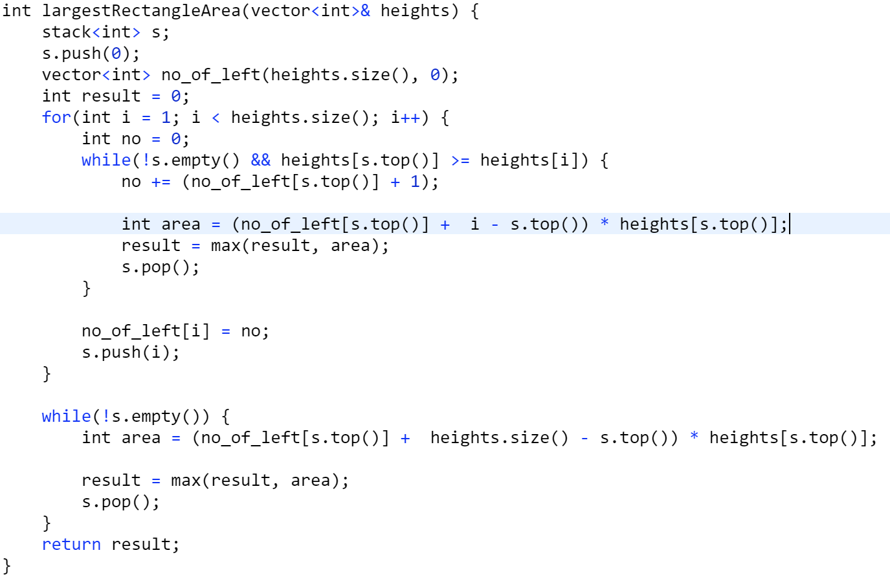
Largest Rectangle in Histogram https://leetcode.com/explore/learn/card/recursion-ii/507/beyond-recursion/2901/

Slide 25
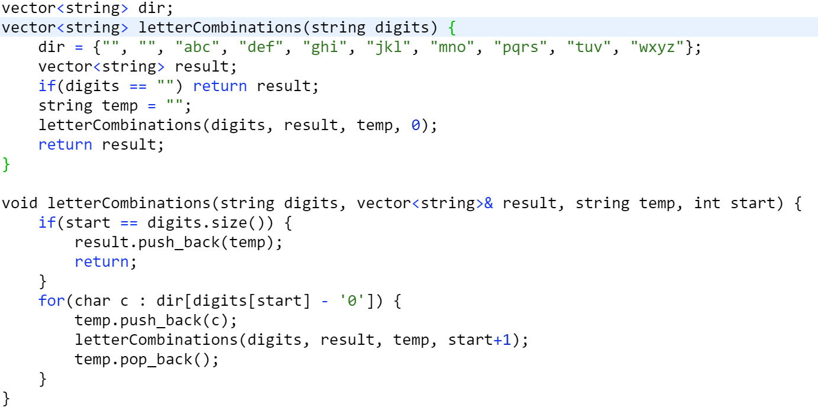
Letter Combinations https://leetcode.com/explore/learn/card/recursion-ii/507/beyond-recursion/2905/

