Slide 1
Binary Tree and Binary Search Tree

Slide 2
Tree : Directed Acyclic Graph with N nodes and N-1 edges

Slide 3
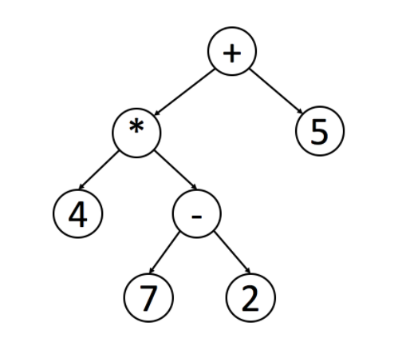
Tree Traversal
PreOrder Traversal -> Root First, Left child, Right child
InOrder Traversal -> Left sub tree, Root, Right subtree.
Incase of Binary Search tree, result would be in ascending order
Post Order Traversal -> Left Subtree, Right Subtree, Root
Useful to delete all the nodes in a tree. Since we want to delete all the children before deleting the parent node
Compute the mathematical expression

Slide 4
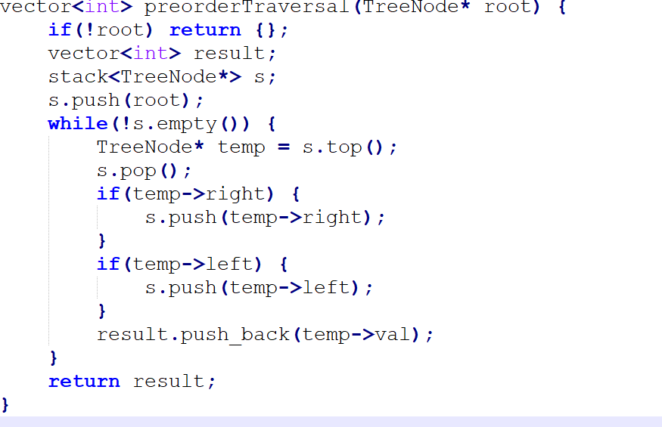
PreOrder Traversal

Slide 5
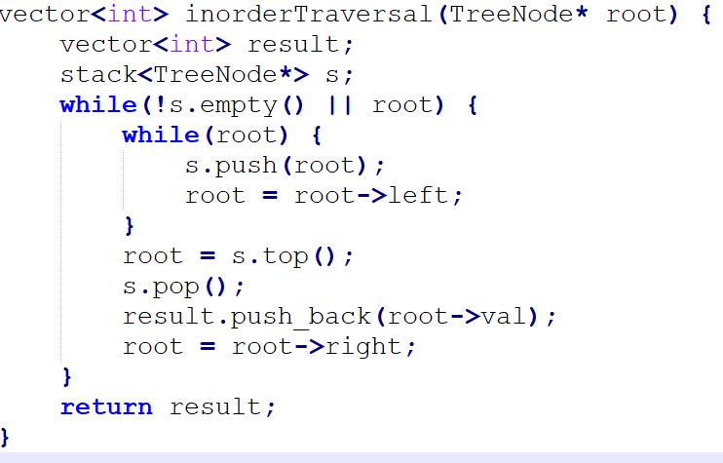
Inorder Traversal https://leetcode.com/explore/learn/card/data-structure-tree/134/traverse-a-tree/929/

Slide 6
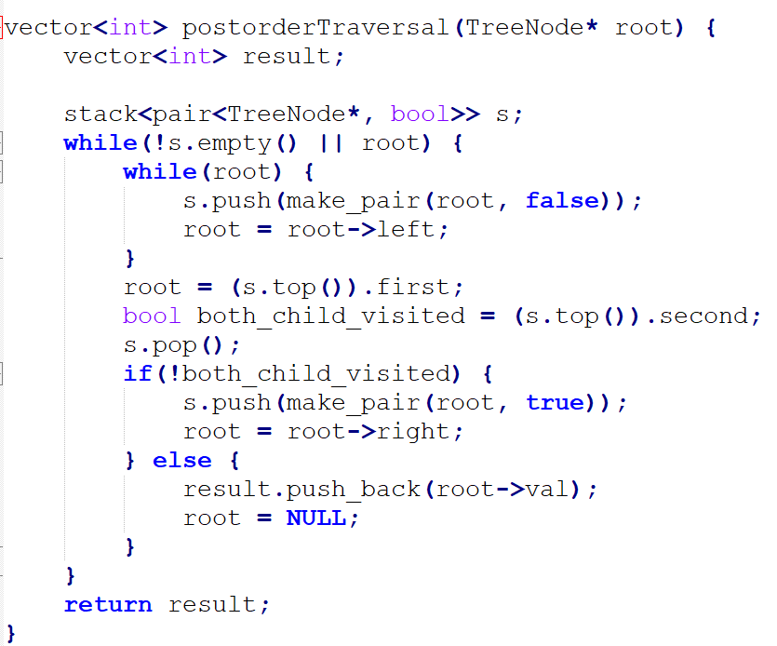
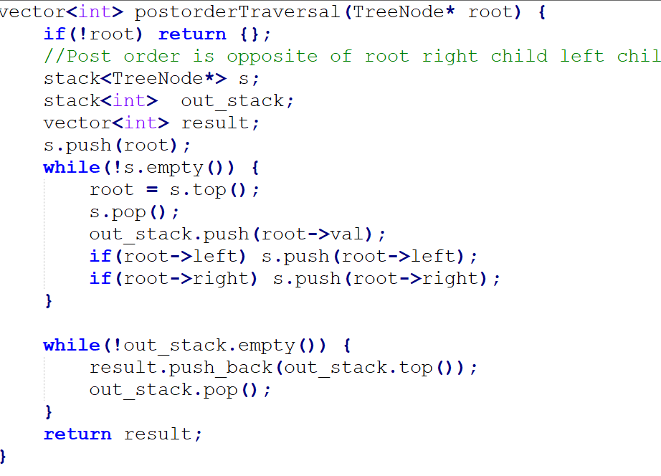
PostOrder Traversal https://leetcode.com/explore/learn/card/data-structure-tree/134/traverse-a-tree/930/
Using 2 stacks

Slide 7
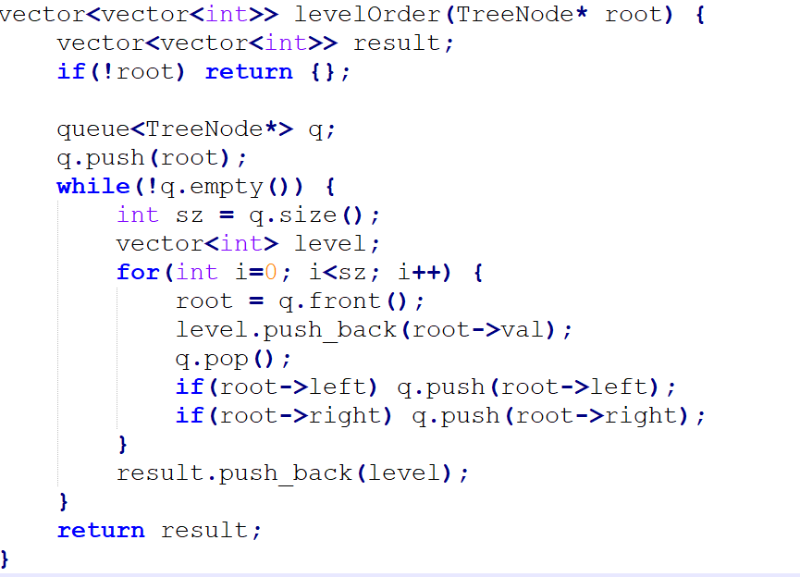
Binary Tree Level Order Traversal https://leetcode.com/explore/learn/card/data-structure-tree/134/traverse-a-tree/931/

Slide 8
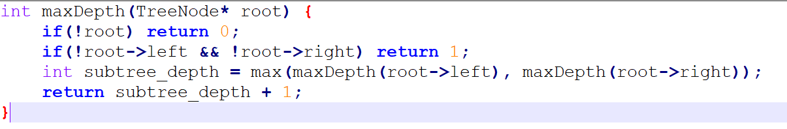
Max Depth of Binary Tree https://leetcode.com/explore/learn/card/data-structure-tree/17/solve-problems-recursively/535/

Slide 9
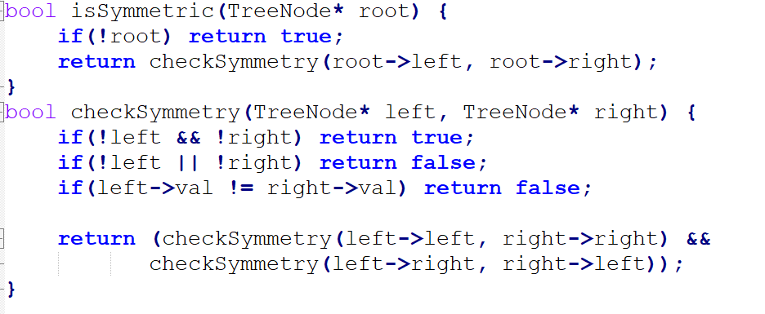
Symmetric Tree https://leetcode.com/explore/learn/card/data-structure-tree/17/solve-problems-recursively/536/

Slide 10
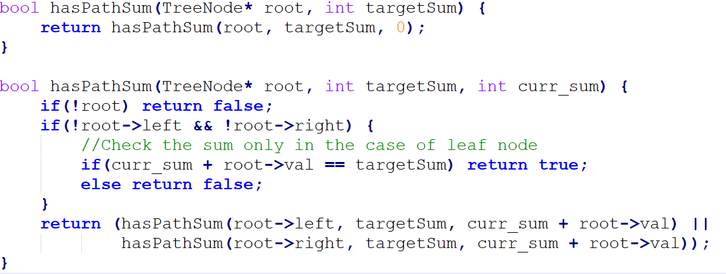
Target Sum https://leetcode.com/explore/learn/card/data-structure-tree/17/solve-problems-recursively/537/

Slide 11
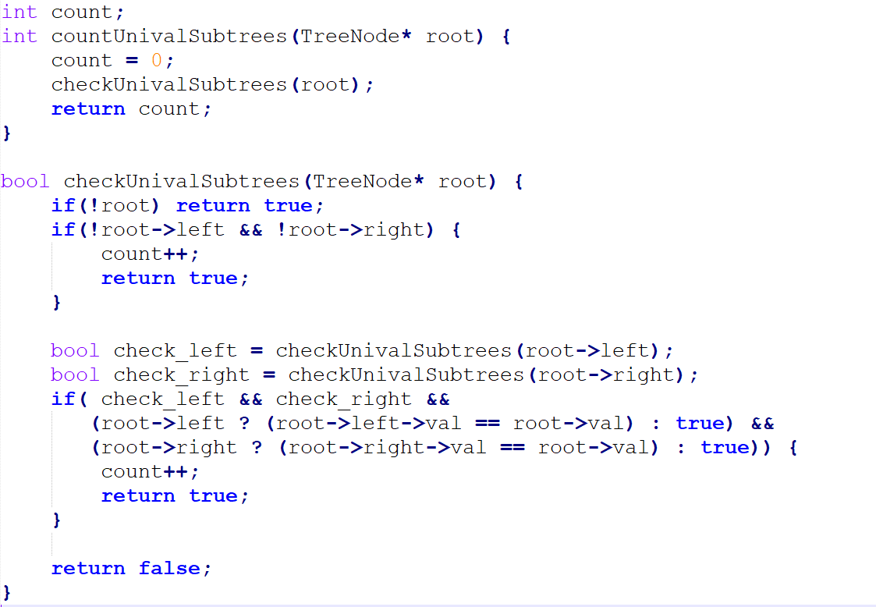
Count UniValue Subtrees https://leetcode.com/explore/learn/card/data-structure-tree/17/solve-problems-recursively/538/

Slide 12
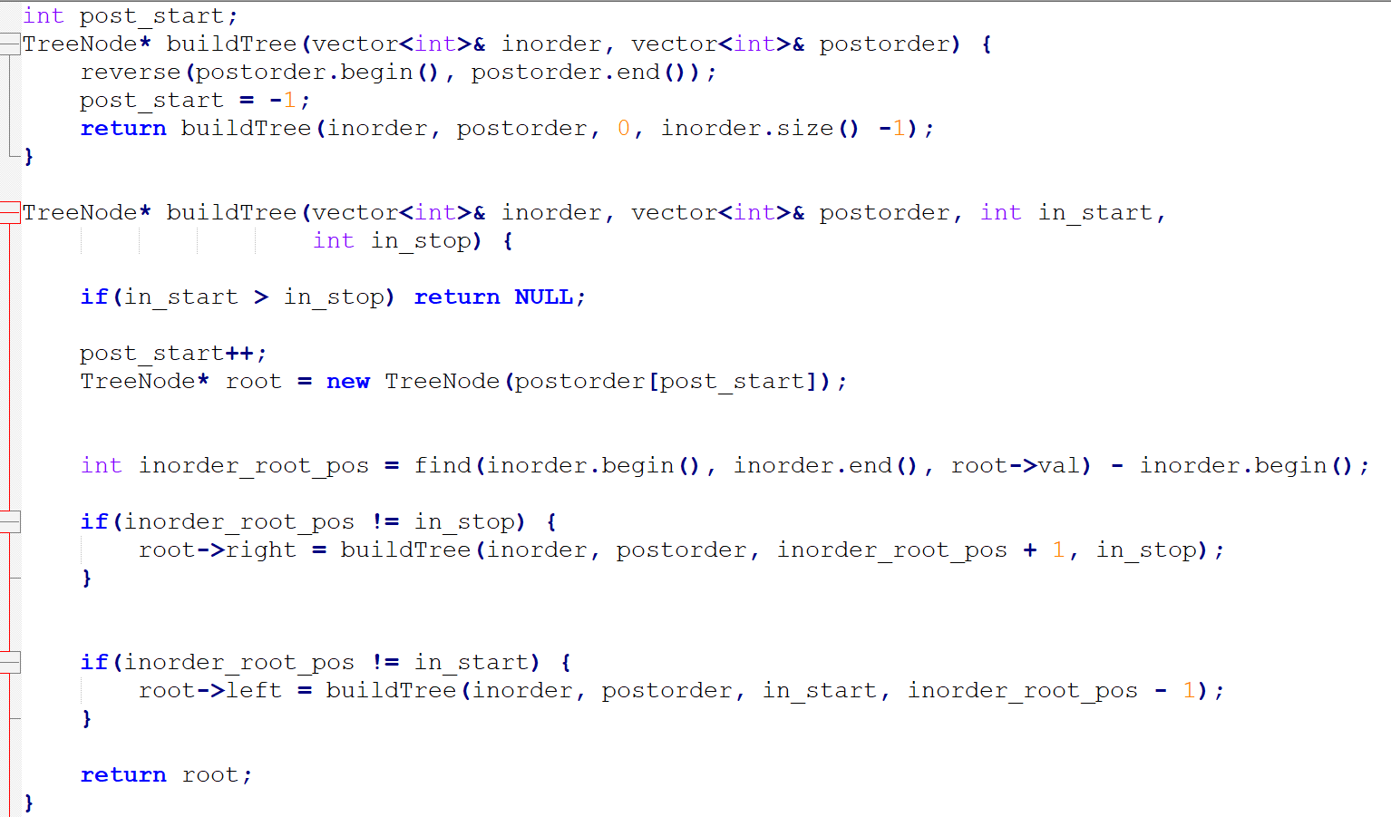
Construct Binary Tree from Inorder and Postorder Traversal https://leetcode.com/explore/learn/card/data-structure-tree/133/conclusion/942/
Since all values in the tree are unique,
Better optimization is to store hashmap of Value, index in Inorder Vector. This will replace find

Slide 13
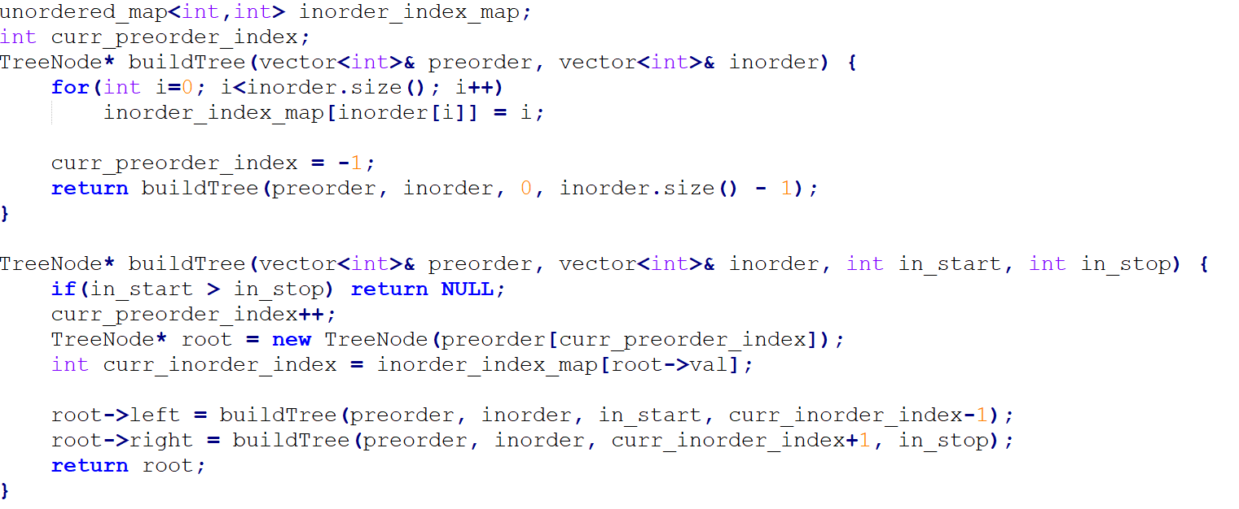
Construct Binary Tree from Preorder and Inorder https://leetcode.com/explore/learn/card/data-structure-tree/133/conclusion/943/

Slide 14
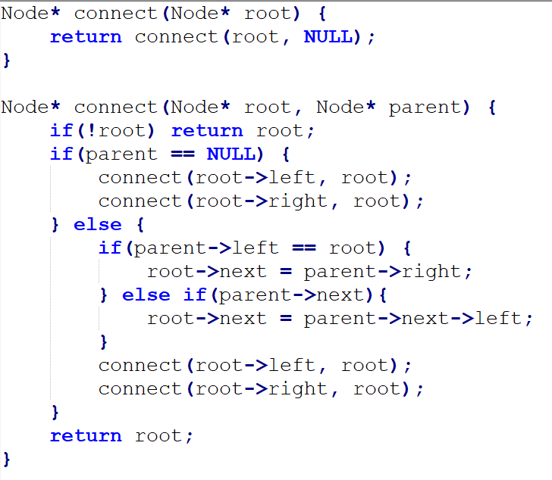
Populating Next Right Pointers in Each Node https://leetcode.com/explore/learn/card/data-structure-tree/133/conclusion/994/

Slide 15
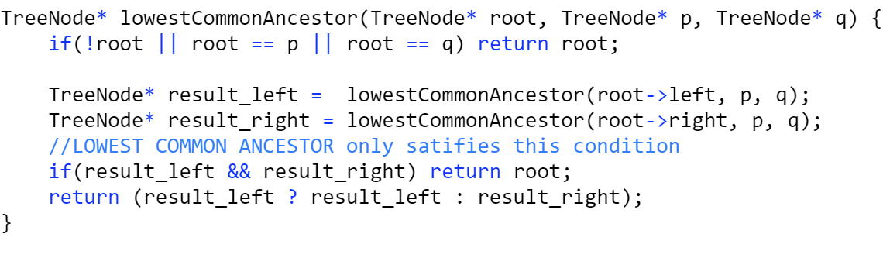
Lowest Common Ancestor of a Binary Tree https://leetcode.com/explore/learn/card/data-structure-tree/133/conclusion/932/

Slide 16
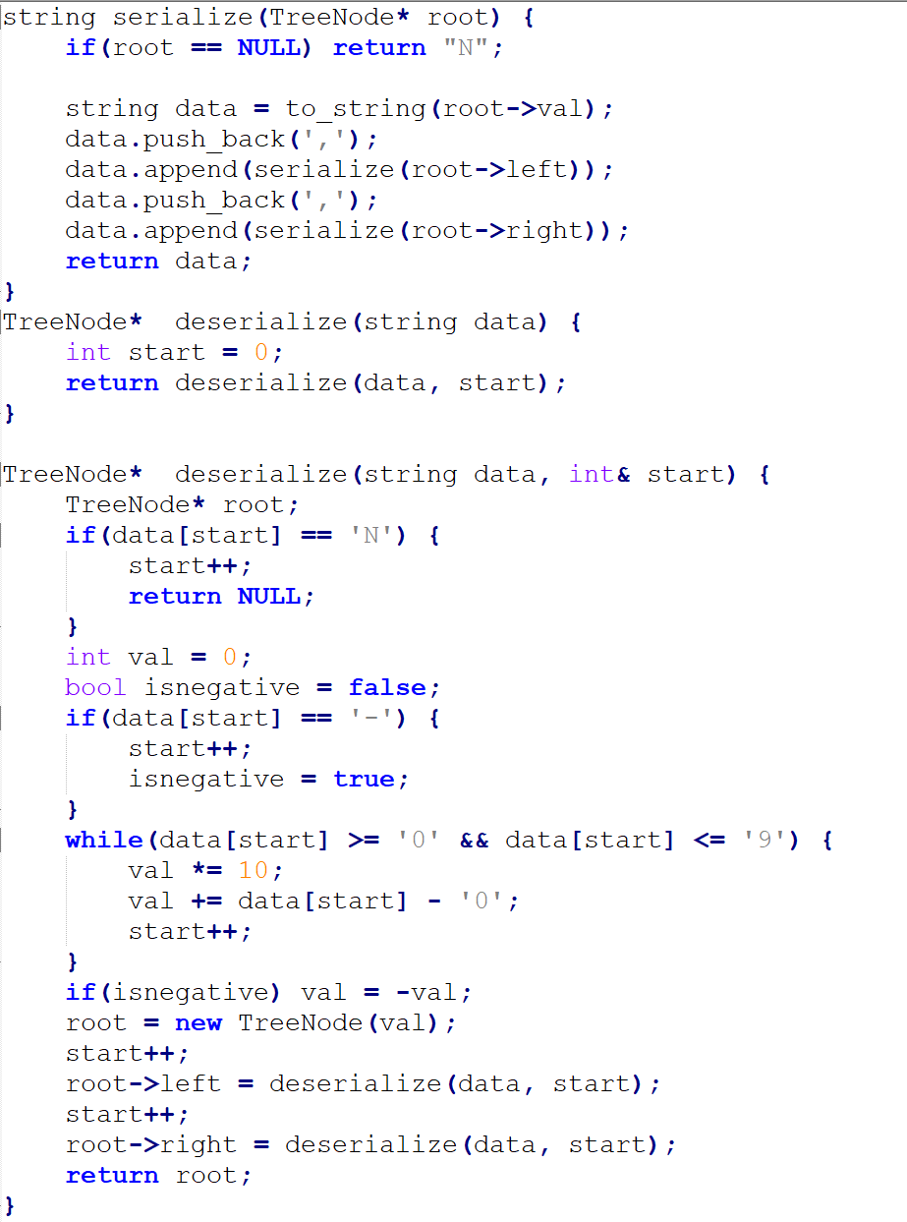
Serialize and DeSerialize Binary Tree https://leetcode.com/explore/learn/card/data-structure-tree/133/conclusion/995/

Slide 17
Binary Search Tree
The value of the node is >= every node value in left subtree
The value of the node is <= every node value in right subtree
For search to be easier:
The value of the node is >= every node value in left subtree
The value of the node is < every node value in right subtree
O(h) for insertion/Deletion/Search a val

Slide 18
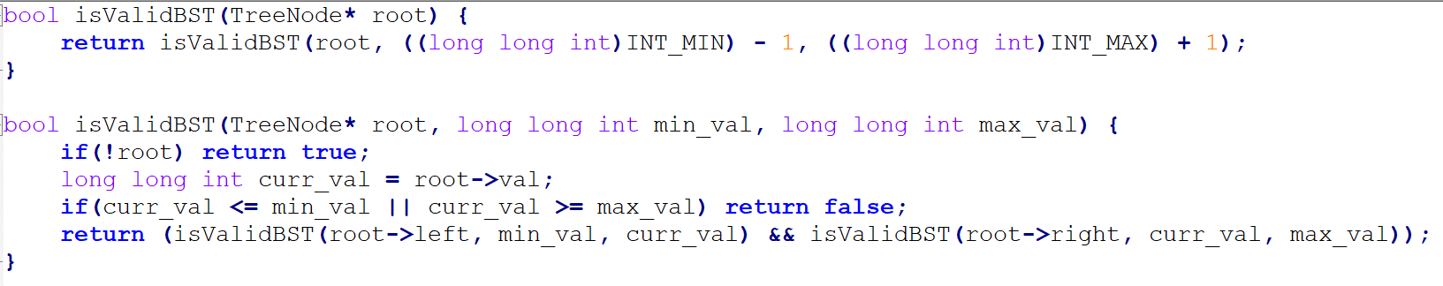
isValidBST https://leetcode.com/explore/learn/card/introduction-to-data-structure-binary-search-tree/140/introduction-to-a-bst/997/

Slide 19
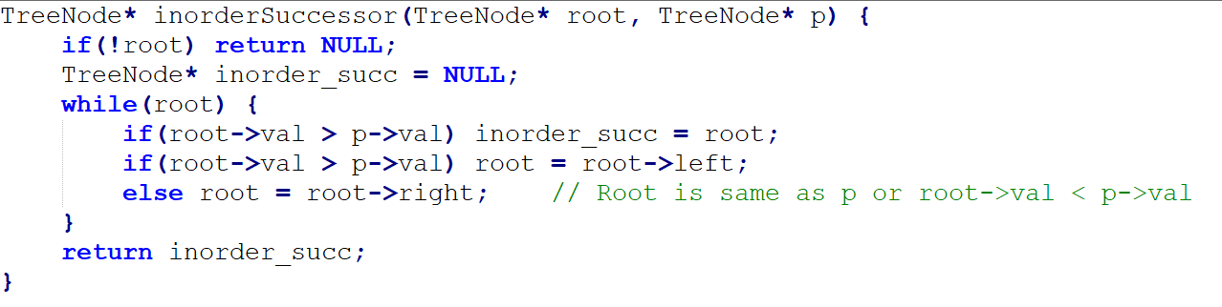
Inorder Successor https://leetcode.com/explore/learn/card/introduction-to-data-structure-binary-search-tree/140/introduction-to-a-bst/998/

Slide 20
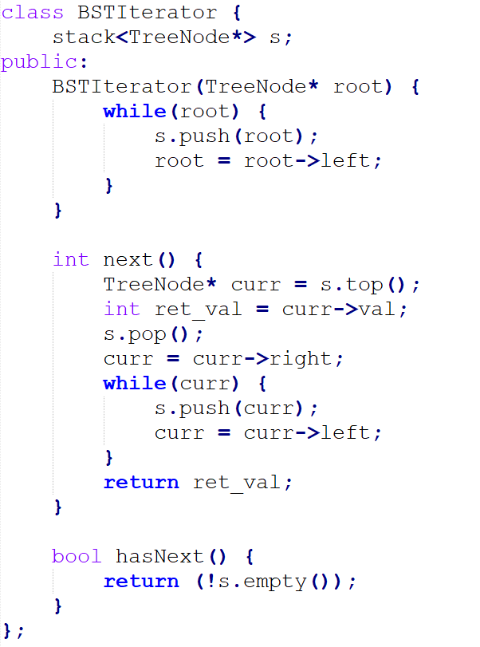
Binary Search Tree Iterator https://leetcode.com/explore/learn/card/introduction-to-data-structure-binary-search-tree/140/introduction-to-a-bst/1008/
Time Complexity
hasNext -> O(1)
next -> O(1) on Average
Memory -> O(h)

Slide 21
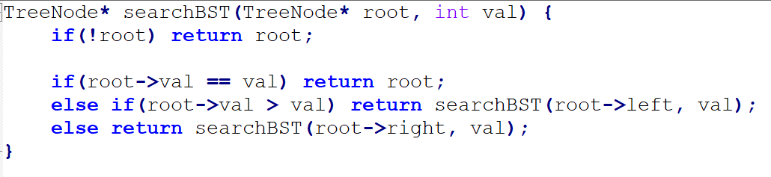
Search in BST https://leetcode.com/explore/learn/card/introduction-to-data-structure-binary-search-tree/141/basic-operations-in-a-bst/1000/

Slide 22
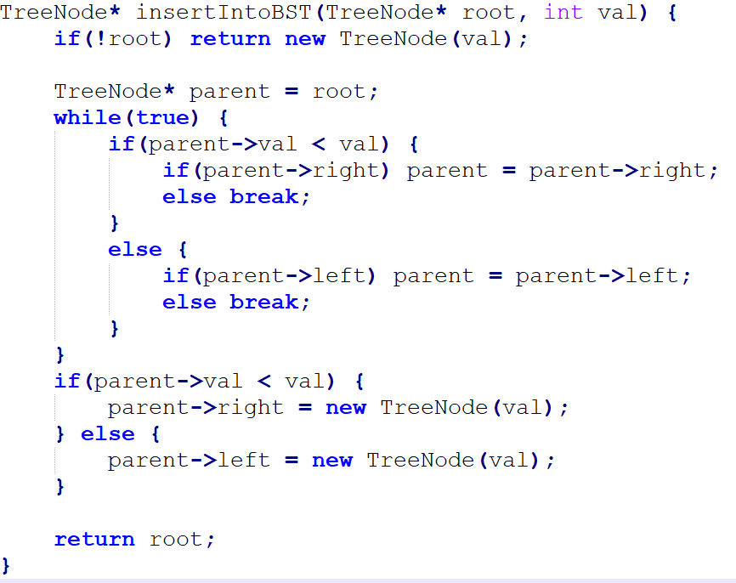
Insertion in BST https://leetcode.com/explore/learn/card/introduction-to-data-structure-binary-search-tree/141/basic-operations-in-a-bst/1003/

Slide 23
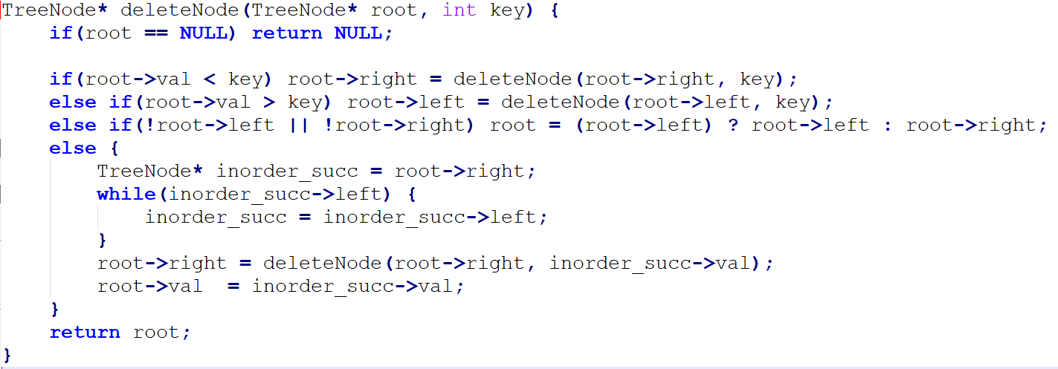
Delete Node in BST https://leetcode.com/explore/learn/card/introduction-to-data-structure-binary-search-tree/141/basic-operations-in-a-bst/1006/

Slide 24
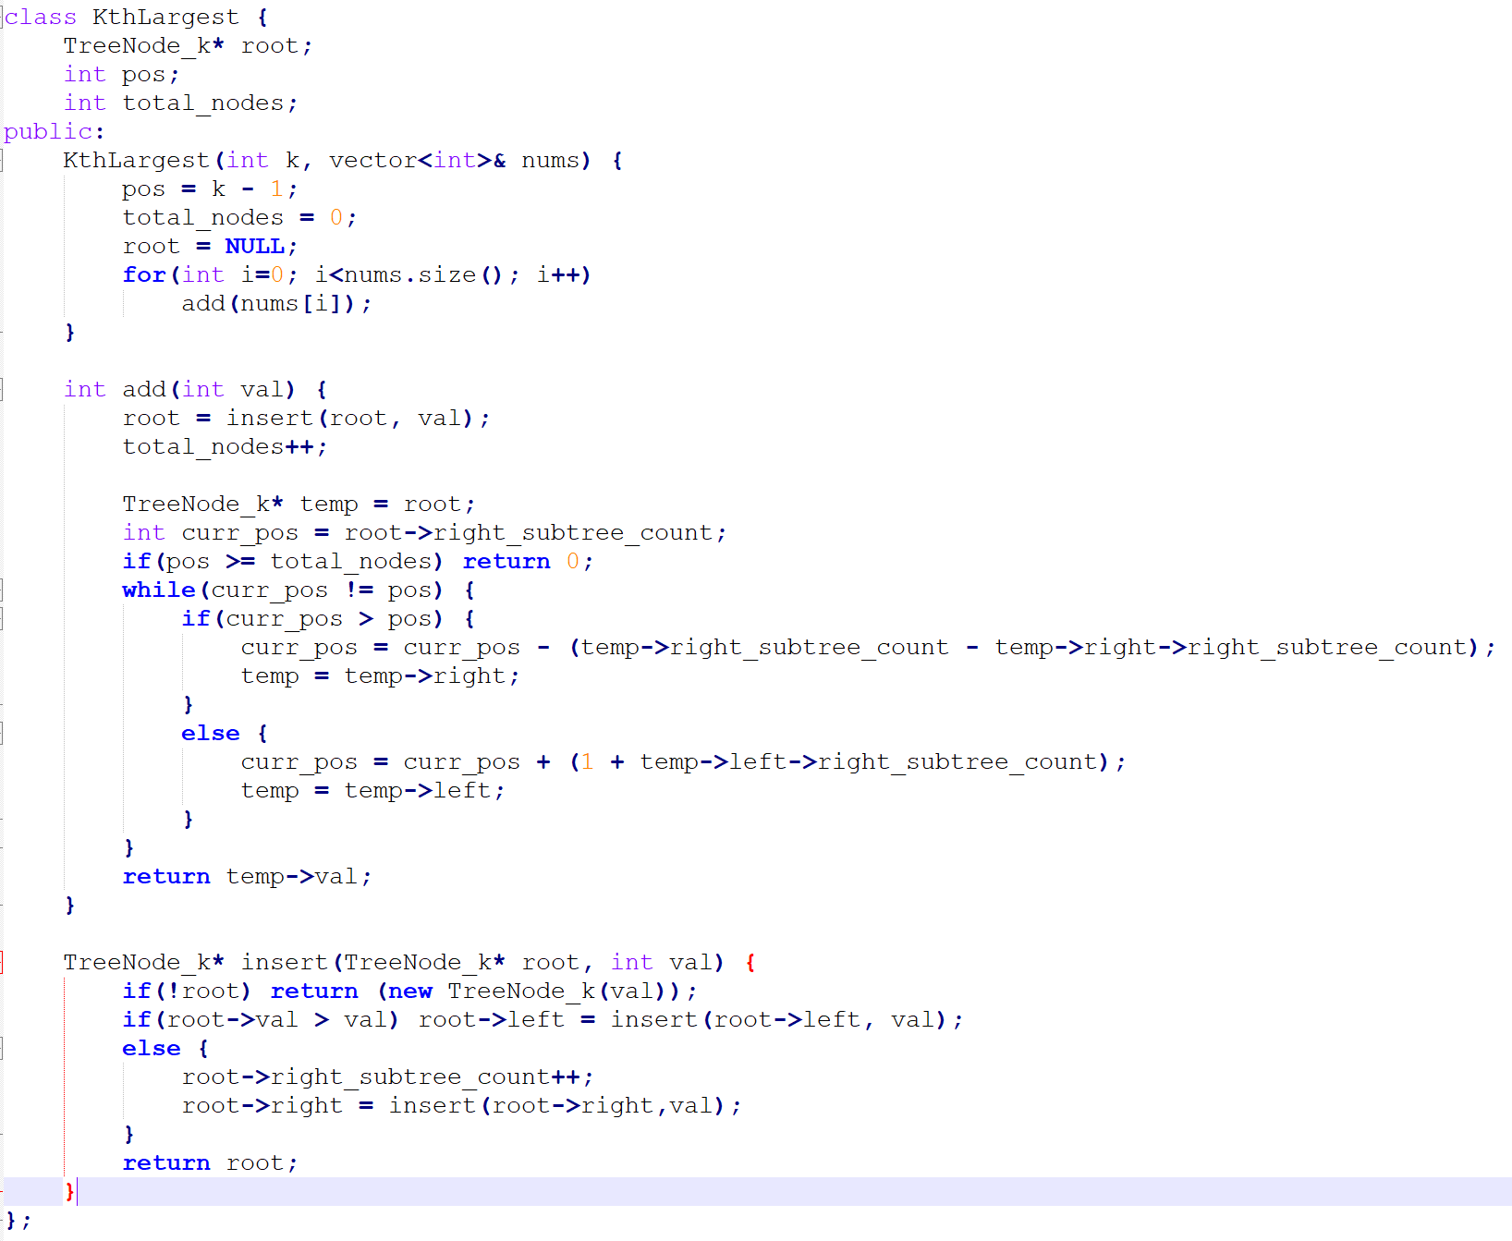
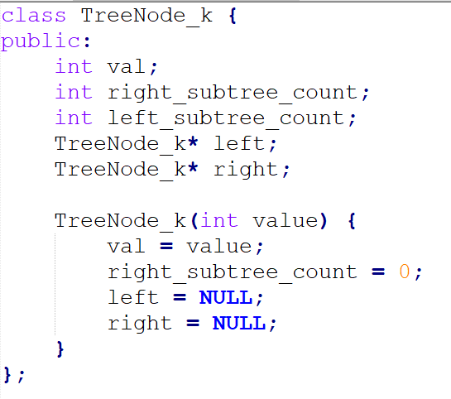
Kth largest elt in stream https://leetcode.com/explore/learn/card/introduction-to-data-structure-binary-search-tree/142/conclusion/1018/

Slide 25
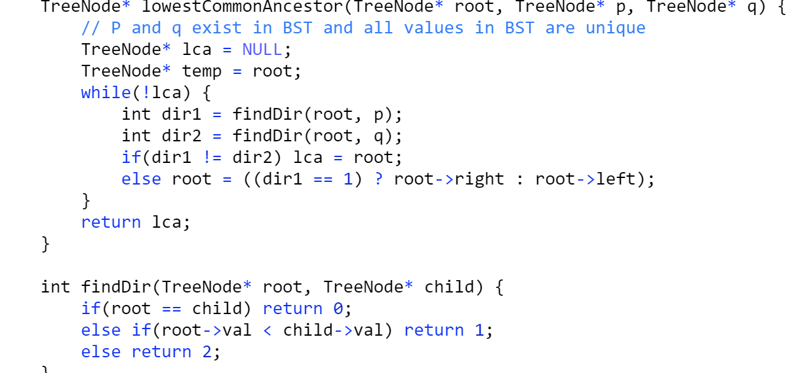
Find LCA in BST https://leetcode.com/explore/learn/card/introduction-to-data-structure-binary-search-tree/142/conclusion/1012/

Slide 26
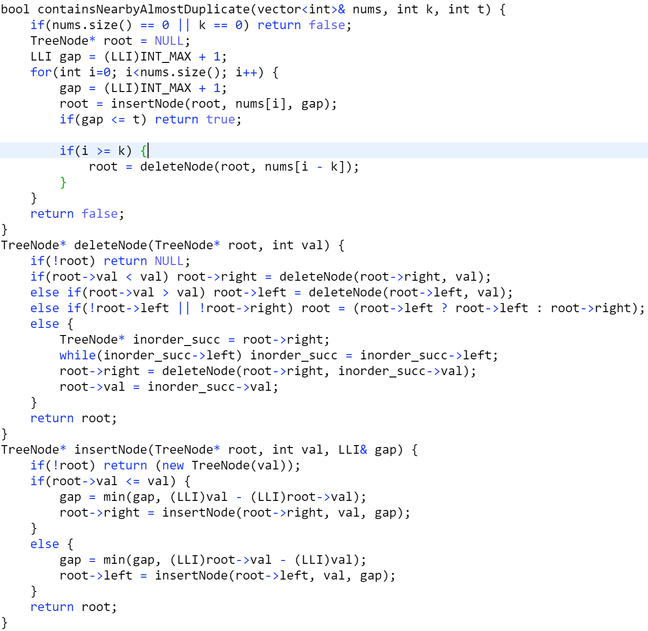
Contains a Duplicate III https://leetcode.com/explore/learn/card/introduction-to-data-structure-binary-search-tree/142/conclusion/1013/

Slide 27
Height Balanced Tree https://leetcode.com/explore/learn/card/introduction-to-data-structure-binary-search-tree/143/appendix-height-balanced-bst/1021/
Height of any node’s two subtree differ <= 1
Height of the tree is logN
ordered_set and ordered_map are implemented in C++ using height balanced tree. So, Worst case insertion/Deletion/Search is O(logN)
Depth of a node: No of edges from root to the node
Height of a node: Max No of edges from node to it’s leaf
Height of Tree: Height of root

Slide 28
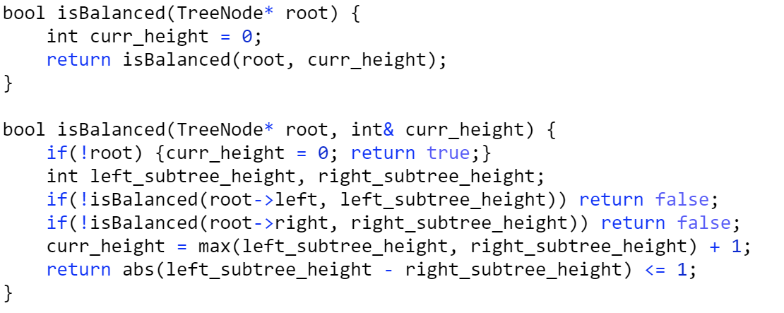
Balanced Binary Tree https://leetcode.com/explore/learn/card/introduction-to-data-structure-binary-search-tree/143/appendix-height-balanced-bst/1027/

Slide 29
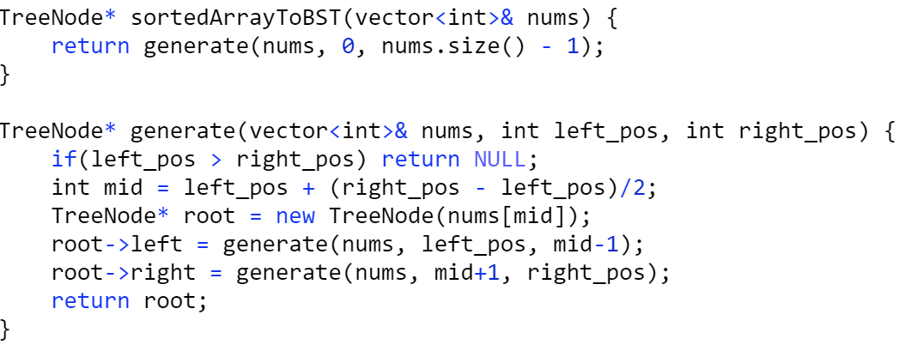
Convert Sorted Array to Height Balanced Tree https://leetcode.com/explore/learn/card/introduction-to-data-structure-binary-search-tree/143/appendix-height-balanced-bst/1015/

