Slide 1
Linked Lists

Slide 2
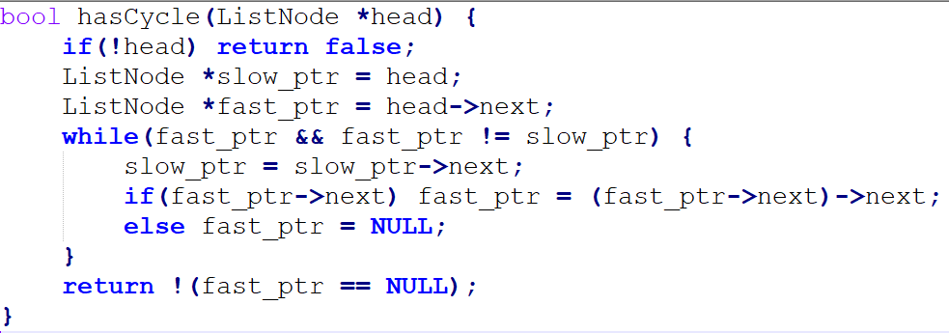
Linked List Cycle https://leetcode.com/explore/learn/card/linked-list/214/two-pointer-technique/1212/

Slide 3
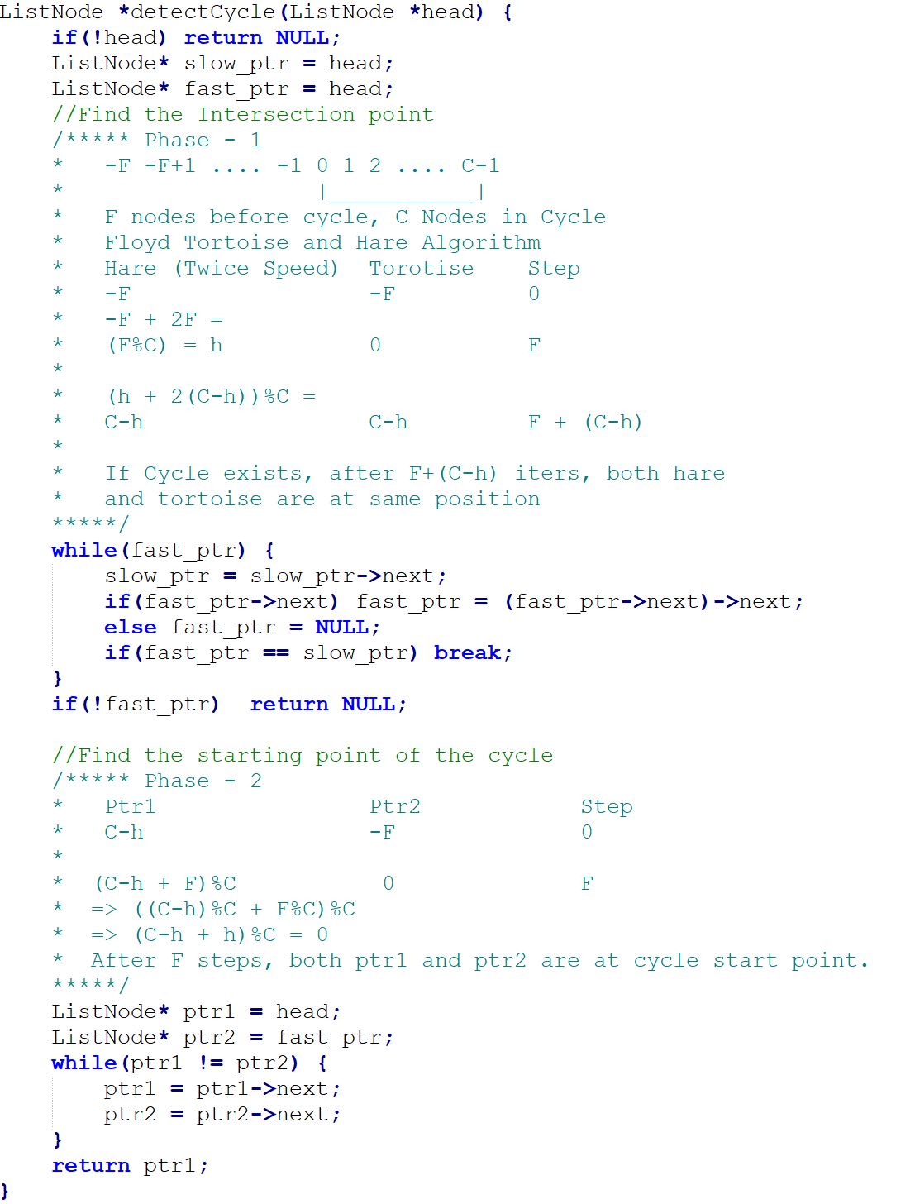
Linked List Cycle – 2 https://leetcode.com/explore/learn/card/linked-list/214/two-pointer-technique/1212/ Floyd’s Hare and Tortoise Algorithm Time Complexity : O(F + C – h + F) = O(F + C) = O(n) n being total no of nodes Space Complexity: O(1)

Slide 4
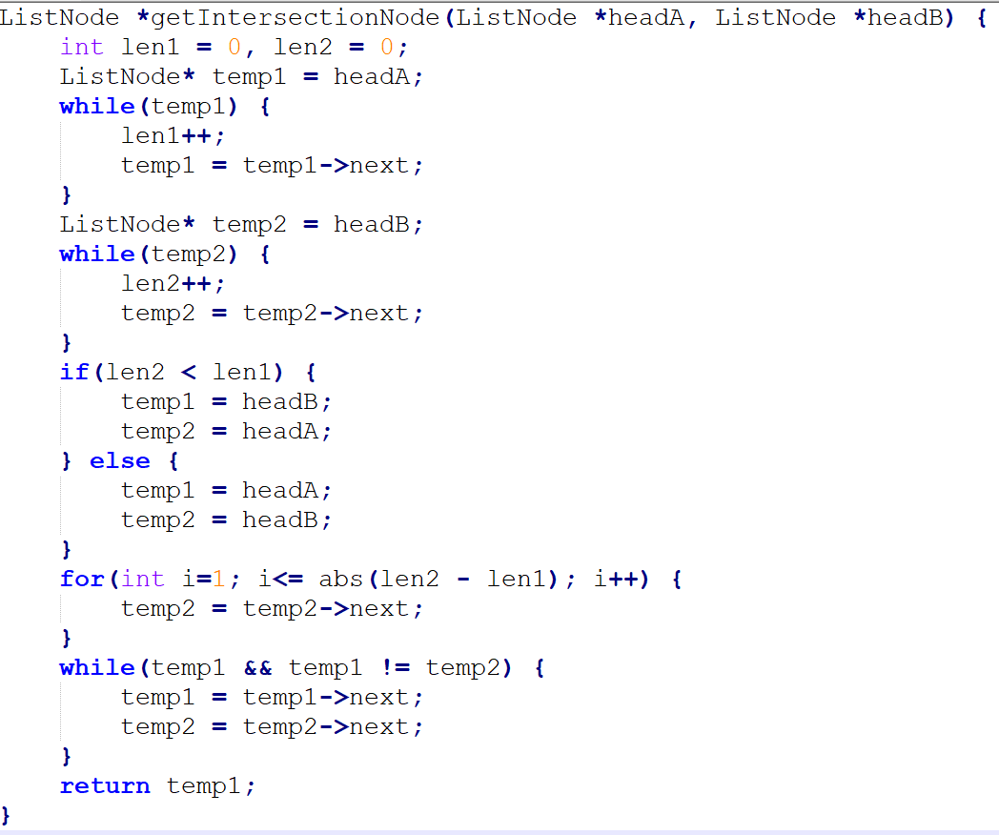
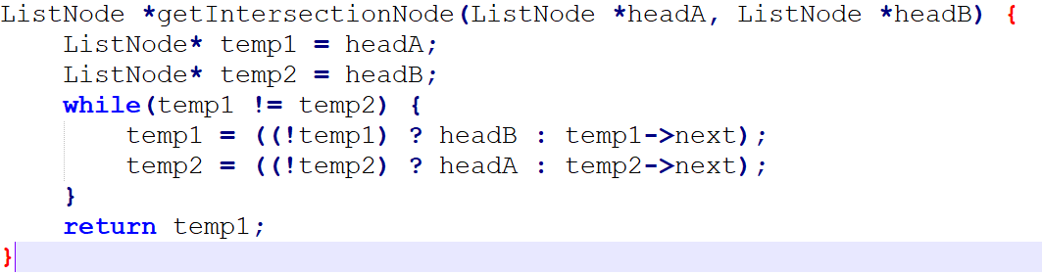
Intersection of 2 lists

Slide 5
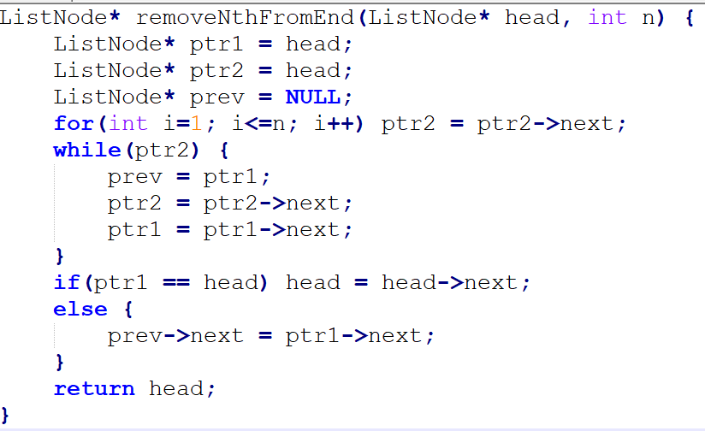
Remove Nth Node From End of List https://leetcode.com/explore/learn/card/linked-list/214/two-pointer-technique/1296/

Slide 6
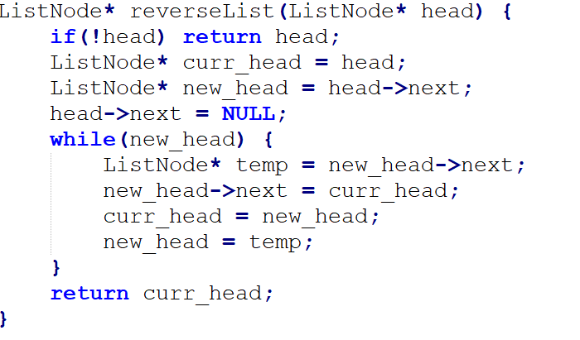
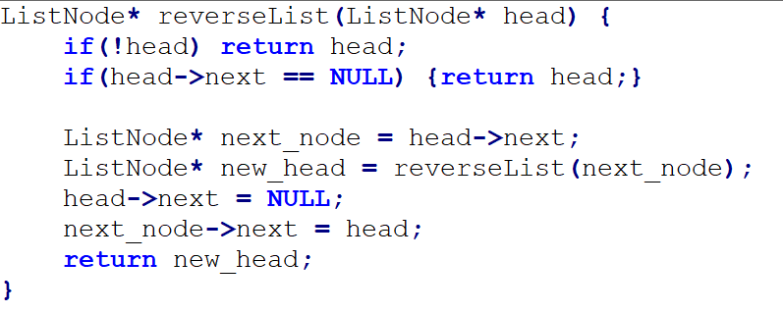
Reverse Linked List
Recursive
Iterative

Slide 7
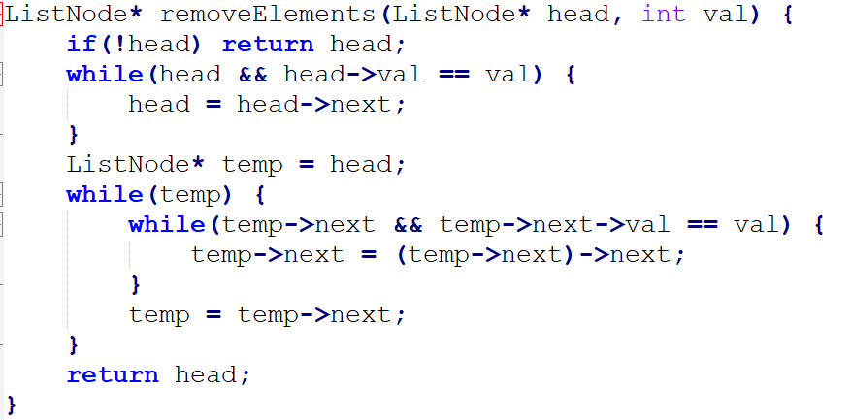
Remove Linked List Elements https://leetcode.com/explore/learn/card/linked-list/219/classic-problems/1207/

Slide 8
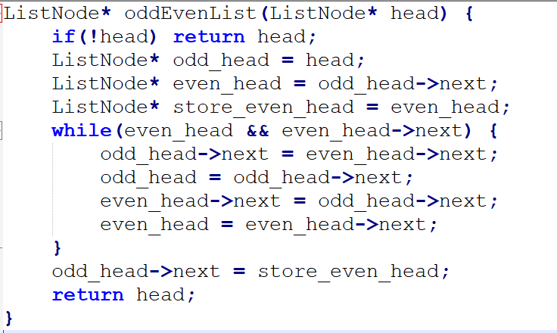
Odd Even Linked List https://leetcode.com/explore/learn/card/linked-list/219/classic-problems/1208/

Slide 9
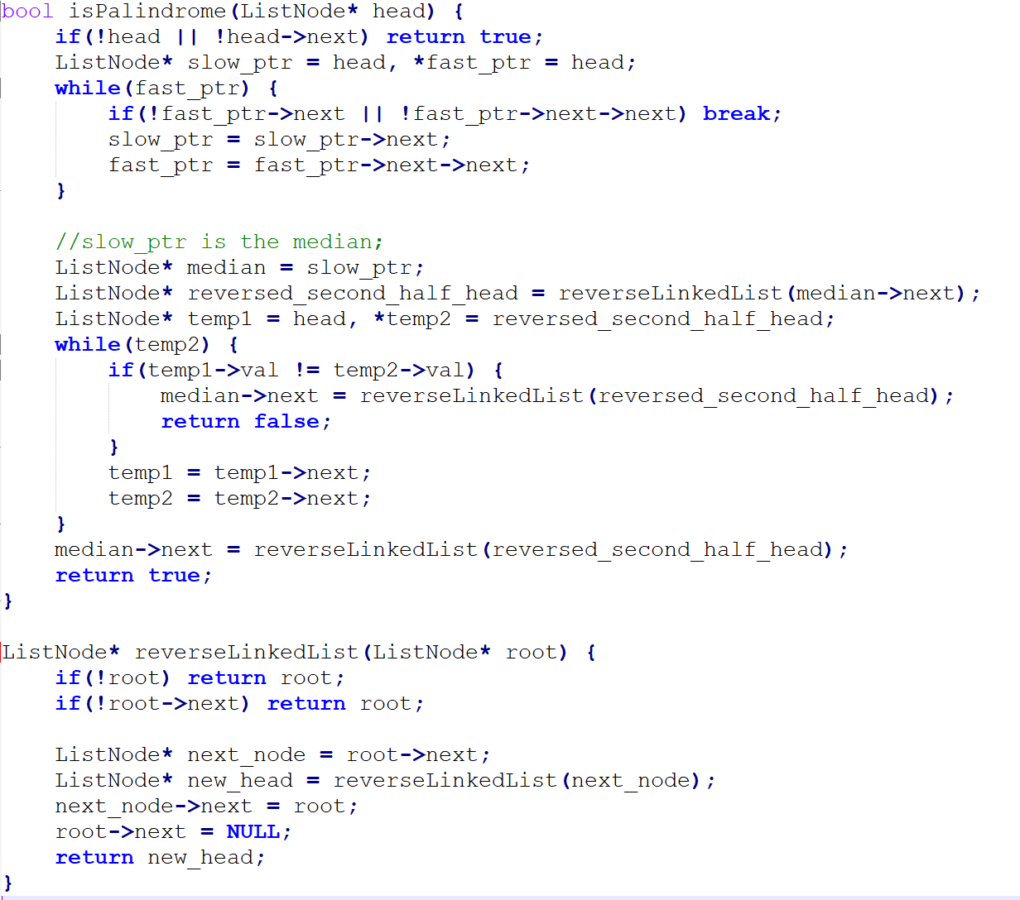
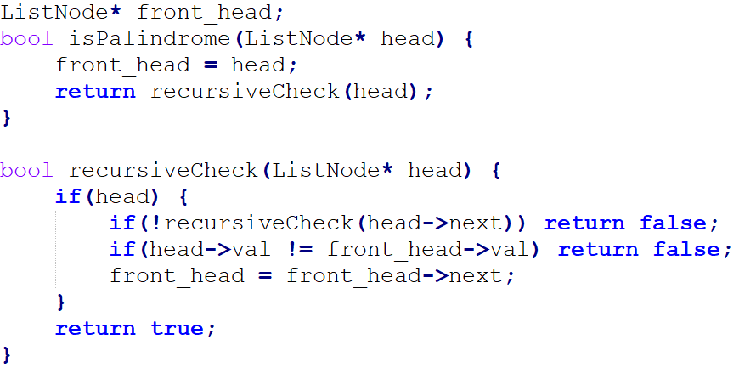
Palindrome Linked List https://leetcode.com/explore/learn/card/linked-list/219/classic-problems/1209/
Recursive Approach

Slide 10
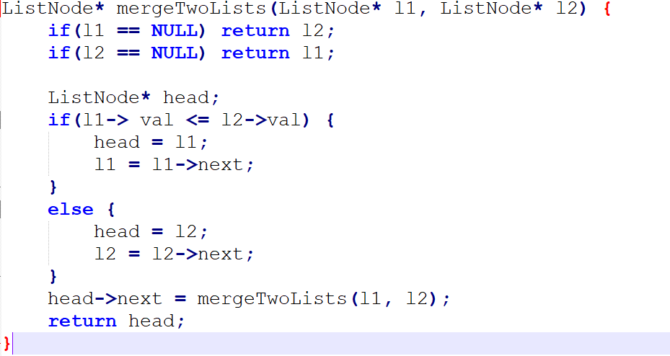
Merge sorted lists https://leetcode.com/explore/learn/card/linked-list/213/conclusion/1227/

Slide 11
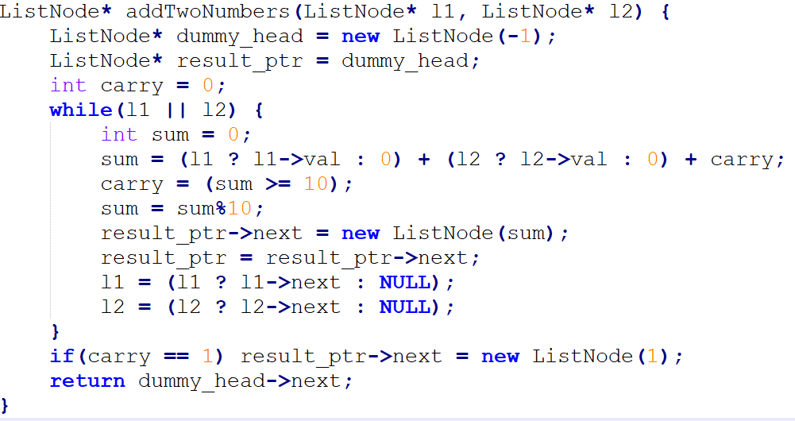
Add Two Numbers https://leetcode.com/explore/learn/card/linked-list/213/conclusion/1228/

Slide 12
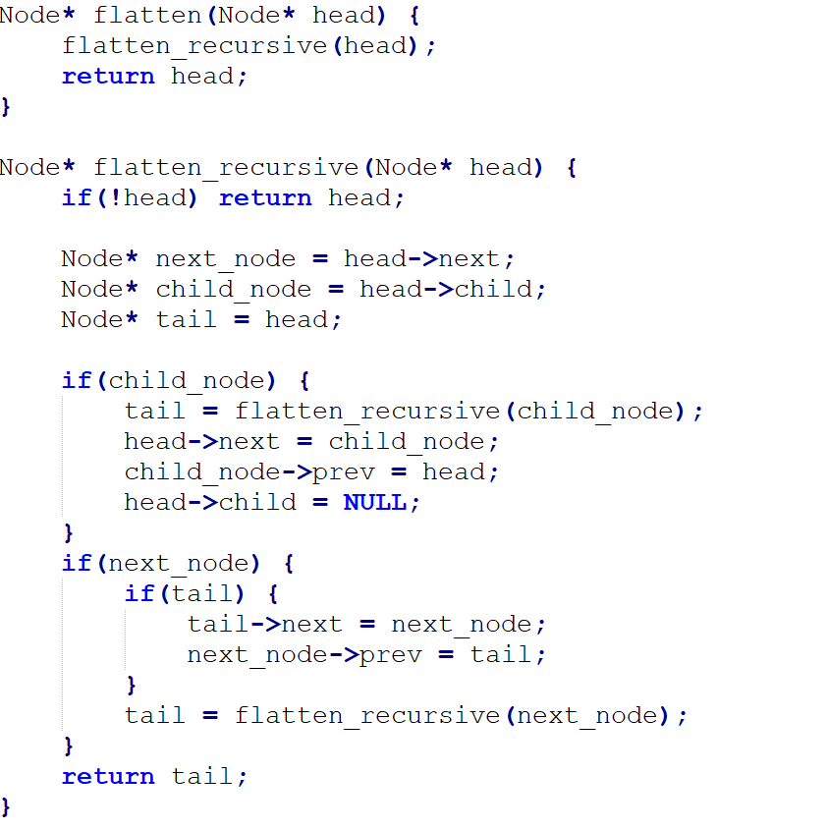
Flatten Multi-Level Linked List https://leetcode.com/explore/learn/card/linked-list/213/conclusion/1225/

Slide 13
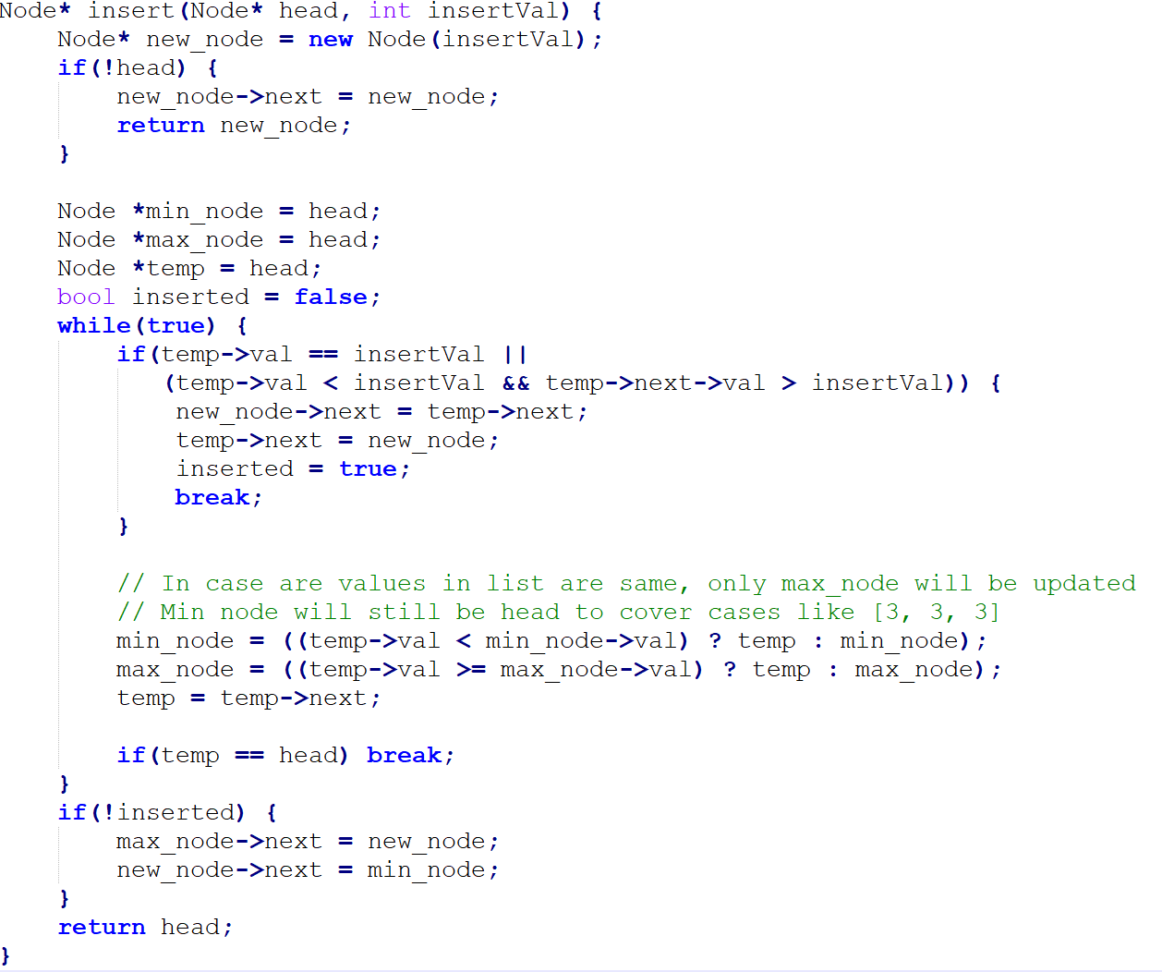
Insert into a Cyclic Sorted List https://leetcode.com/explore/learn/card/linked-list/213/conclusion/1226/

Slide 14
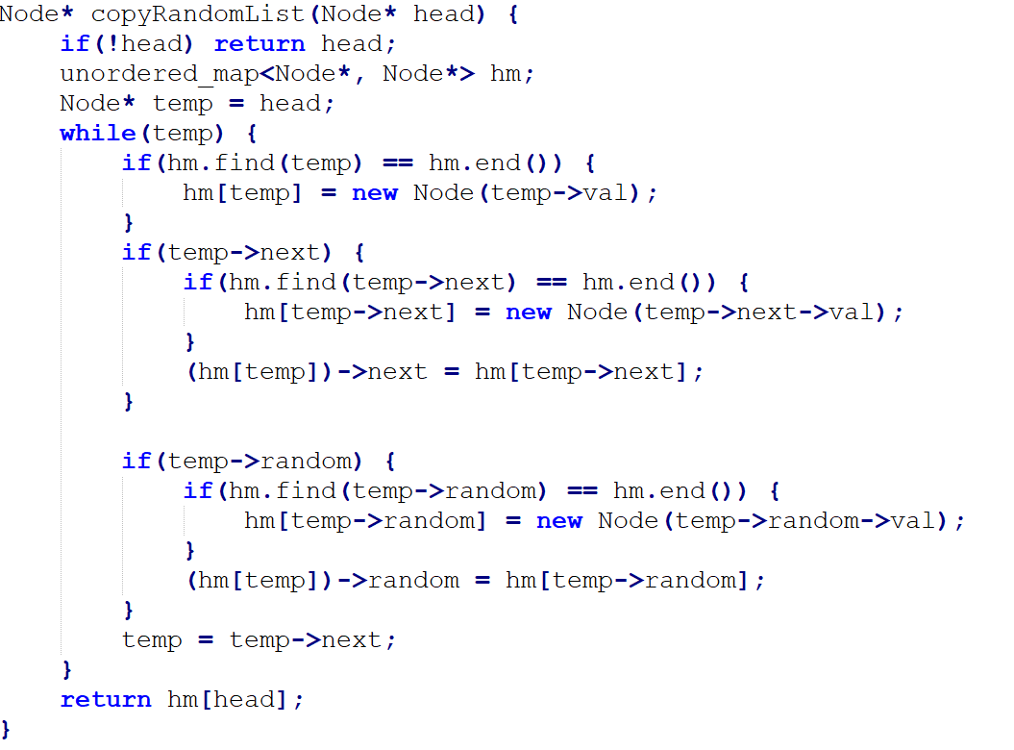
Copy List with Random Pointer https://leetcode.com/explore/learn/card/linked-list/213/conclusion/1229/

Slide 15
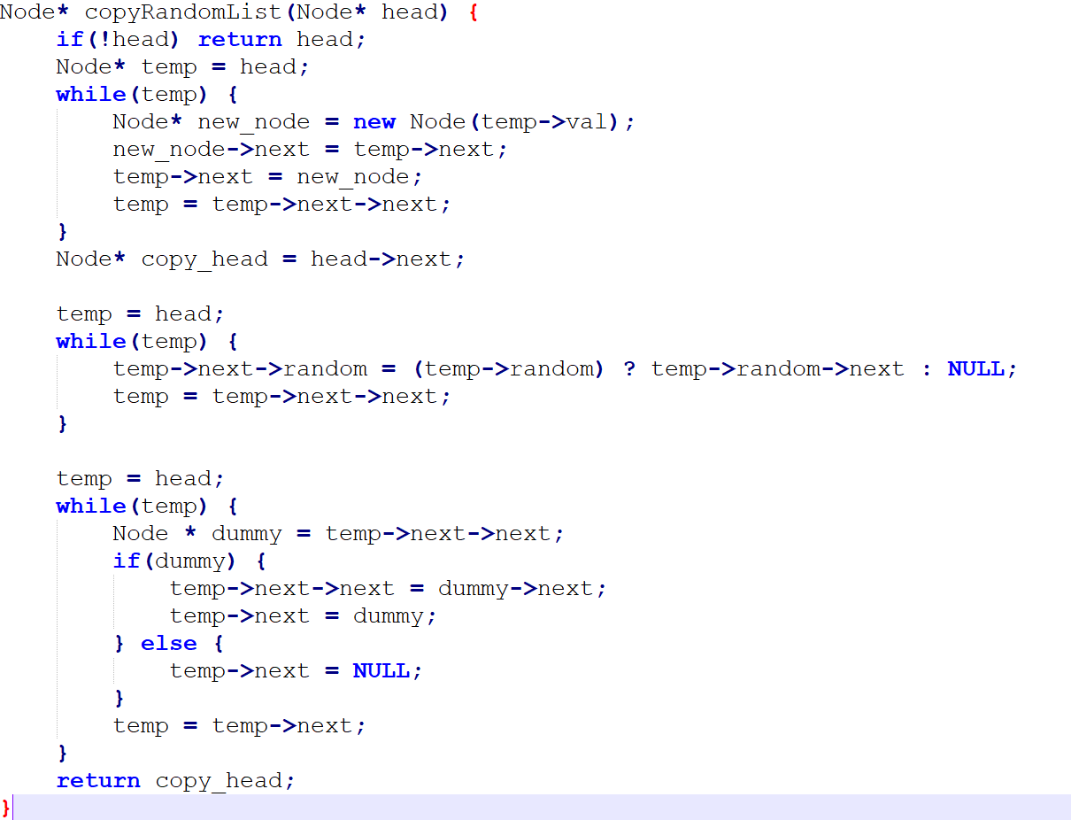
Copy List with Random Pointer https://leetcode.com/explore/learn/card/linked-list/213/conclusion/1229/
Without Extra Space

Slide 16
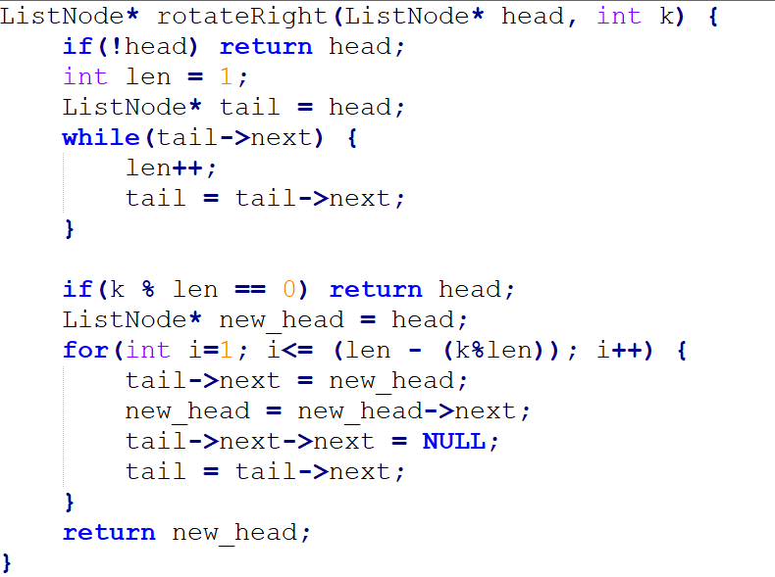
Rotate List https://leetcode.com/explore/learn/card/linked-list/213/conclusion/1295/

