Slide 1
Queue and Stack
Restricted Access Order

Slide 2
Queue -> First In First Out Order
class MyCircularQueue {
private:
vector<int> queue;
int head;
int actual_sz;
public:
MyCircularQueue(int k) {
head = 0;
actual_sz = 0;
queue.resize(k);
}
bool enQueue(int value) {
if(isFull()) return false;
queue[(head + actual_sz)%queue.size()] = value;
actual_sz++;
return true;
}
bool deQueue() {
if(isEmpty()) return false;
head = (head + 1)%queue.size();
actual_sz--;
return true;
}
int Front() {
if(isEmpty()) return -1;
return queue[head];
}
int Rear() {
if(isEmpty()) return -1;
return queue[(head + actual_sz - 1)%queue.size()];
}
bool isEmpty() {
return (actual_sz == 0);
}
bool isFull() {
return (actual_sz == queue.size());
}
};

Slide 3
Queue stl
front()
back()
empty()
push()
pop()
size()

Slide 4
Queue Applications
BFS
Shortest distance b/w 2 nodes

Slide 5
Walls and Gates https://leetcode.com/explore/learn/card/queue-stack/231/practical-application-queue/1373/
void wallsAndGates(vector<vector<int>>& rooms) {
int m = rooms.size(), n = rooms[0].size();
queue<pair<int,int>> q;
for(int i=0; i<m; i++) {
for(int j=0; j<n; j++) {
if(rooms[i][j] == 0)
q.push(make_pair(i,j));
}
}
int step = 1;
vector<vector<int>> dirs = {{-1,0}, {1,0}, {0,-1}, {0, 1}};
while(!q.empty()) {
int sz = q.size();
for(int i=0; i< sz; i++) {
pair<int, int> curr = q.front();
q.pop();
for(auto dir : dirs) {
if((dir[0] + curr.first) >= 0 && (dir[0] + curr.first) < m &&
(dir[1] + curr.second) < n && (dir[1] + curr.second) >= 0 &&
rooms[(dir[0] + curr.first)][(dir[1] + curr.second)] == INT_MAX) {
rooms[(dir[0] + curr.first)][(dir[1] + curr.second)] = step;
q.push(make_pair((dir[0] + curr.first), (dir[1] + curr.second)));
}
}
}
step++;
}
}

Slide 6
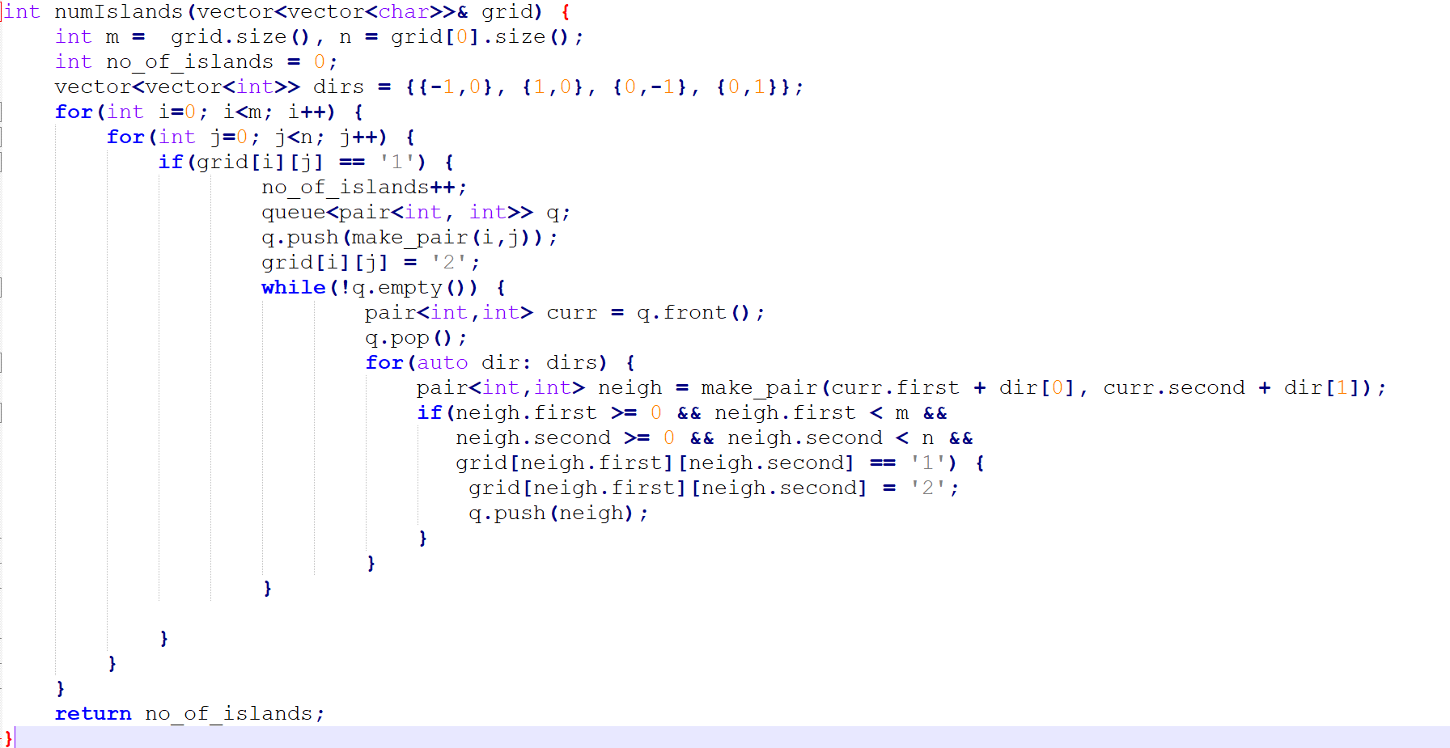
Number of Islands https://leetcode.com/explore/learn/card/queue-stack/231/practical-application-queue/1374/

Slide 7
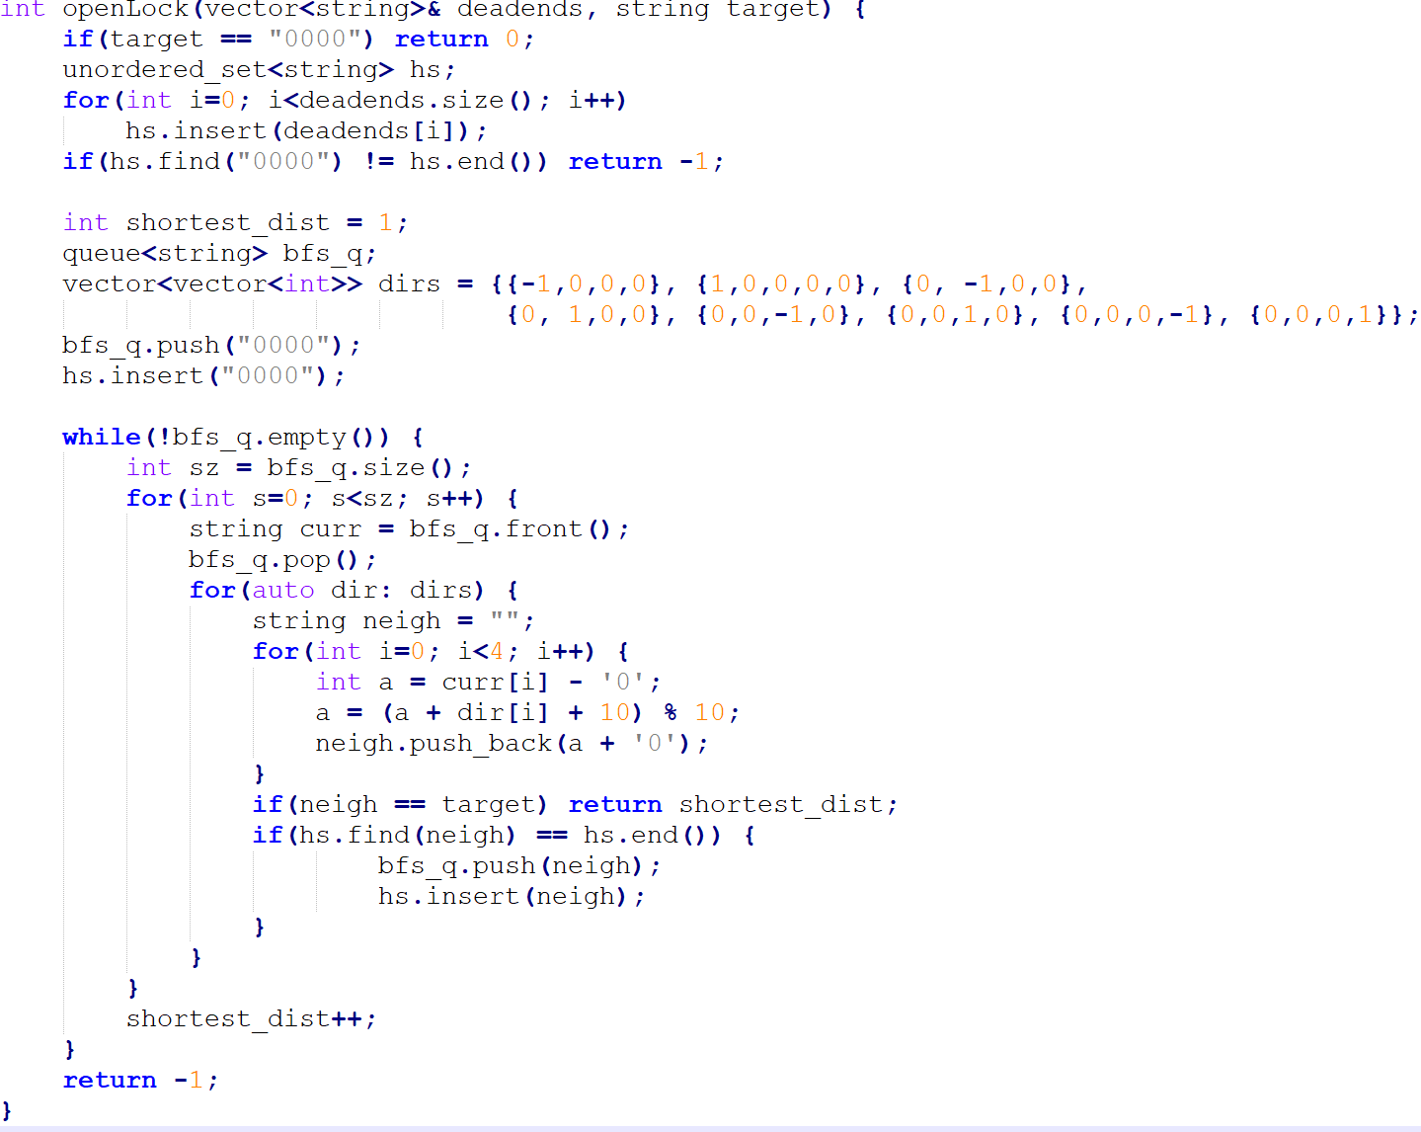
Open the Lock https://leetcode.com/explore/learn/card/queue-stack/231/practical-application-queue/1375/
Suggestion:
Faster implementation would be using a interger array of size 10000 instead of hashset

Slide 8
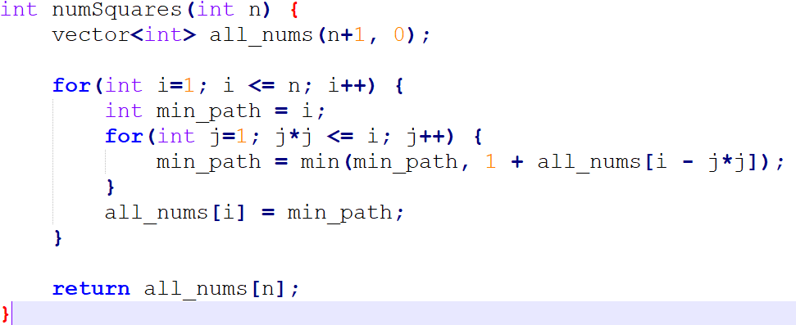
Perfect Squares https://leetcode.com/explore/learn/card/queue-stack/231/practical-application-queue/1371/

Slide 9
Stacks – Last In First Out
class Stack {
vector<int> data;
public:
bool empty() return data.empty();
void push(int x) data.push_back(x);
bool pop() {
if(empty()) return false;
data.pop_back();
return true;
}
int top() return data.back();
};

Slide 10
Stack stl usage
Stack<int> s -> Initialization
s.empty() -> to know if empty
s.size() -> returns the size
s.push()
S.pop()
S.top -> Return the top elt of the queu

Slide 11
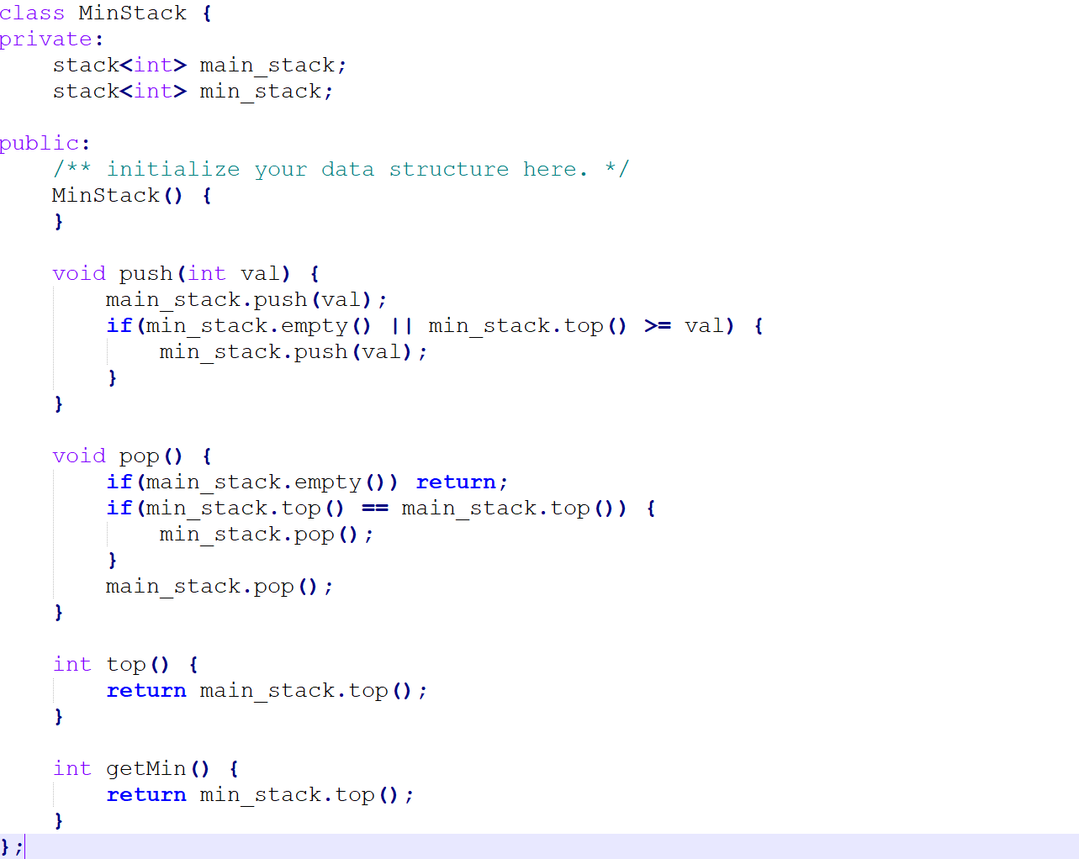
Min Stack https://leetcode.com/explore/learn/card/queue-stack/230/usage-stack/1360/

Slide 12
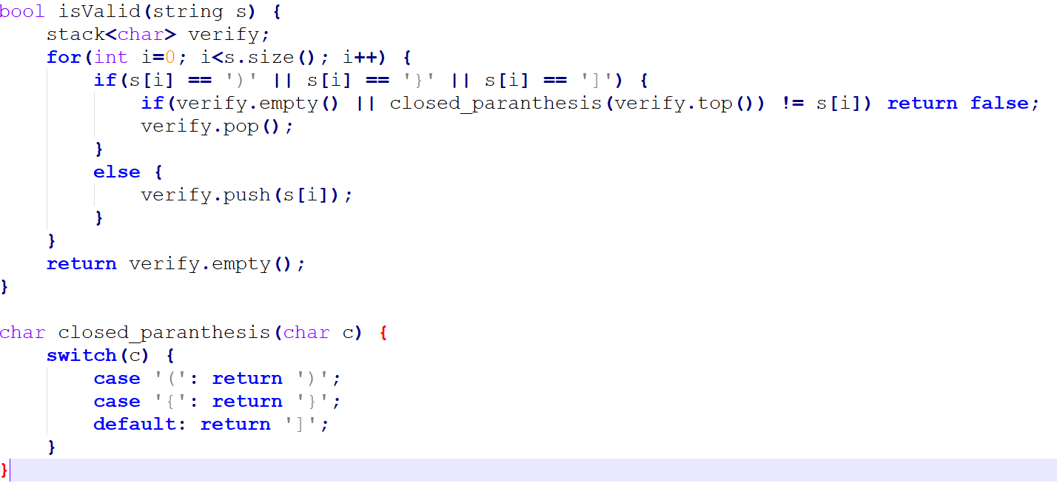
Valid Parentheses https://leetcode.com/explore/learn/card/queue-stack/230/usage-stack/1361/

Slide 13
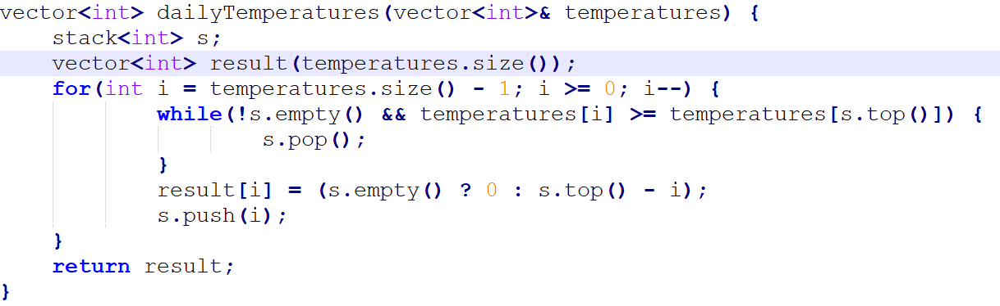
Daily Temperatures https://leetcode.com/explore/learn/card/queue-stack/230/usage-stack/1363/

Slide 14
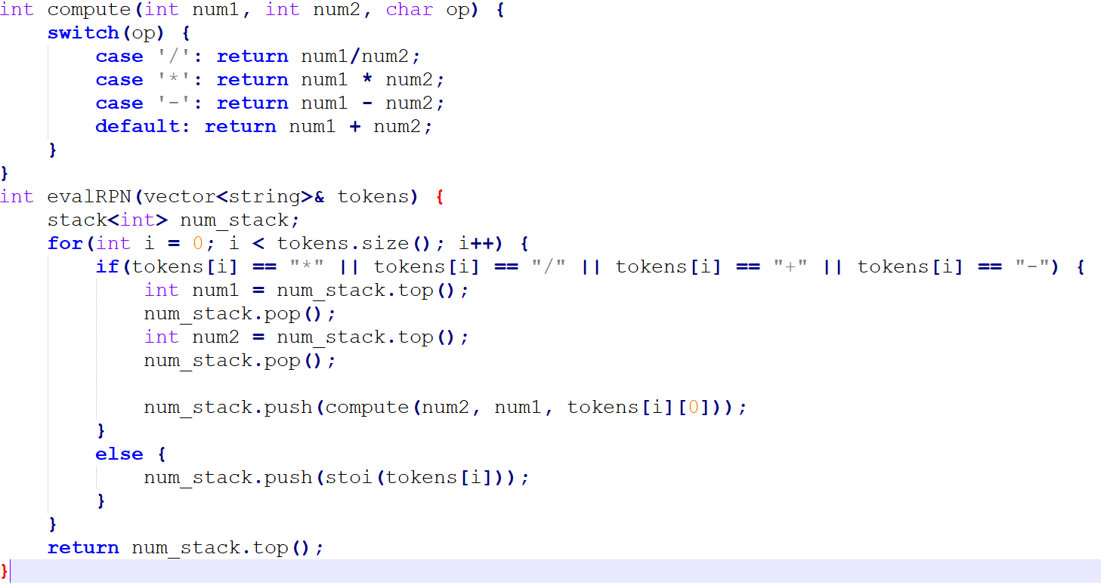
Evaluate Reverse Polish Notation https://leetcode.com/explore/learn/card/queue-stack/230/usage-stack/1394/

Slide 15
DFS – We only trace back, after we reach the deepest node The processing order of nodes, is exactly opposite of how we added them -> Thus usage of Stack

Slide 16
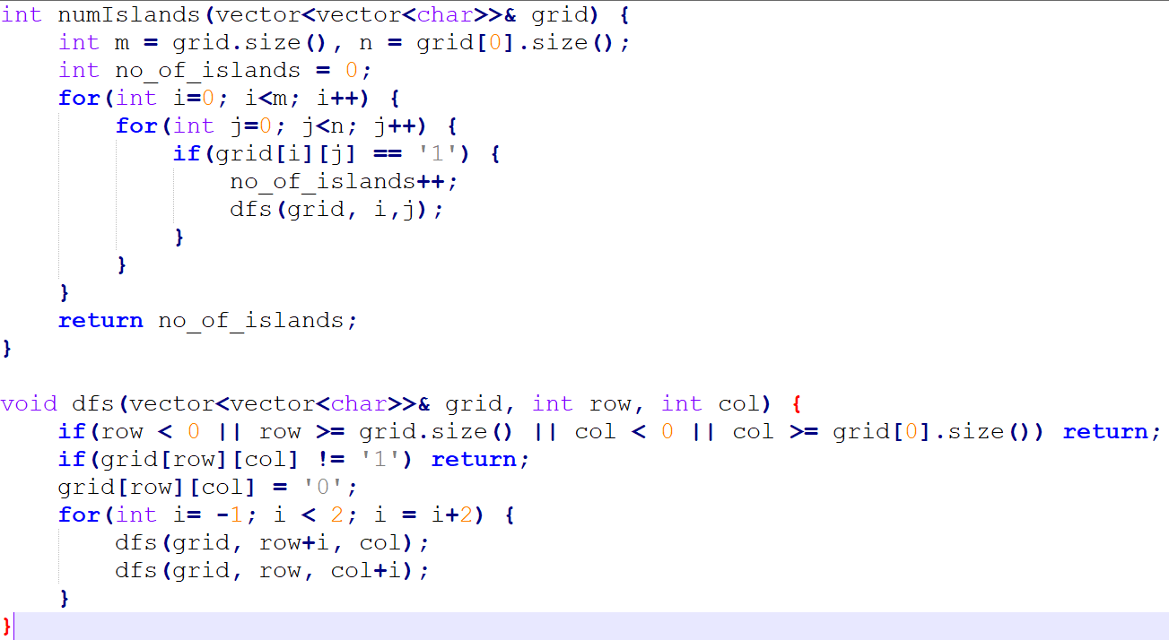
Number of Islands -> using dfs https://leetcode.com/explore/learn/card/queue-stack/232/practical-application-stack/1380/

Slide 17
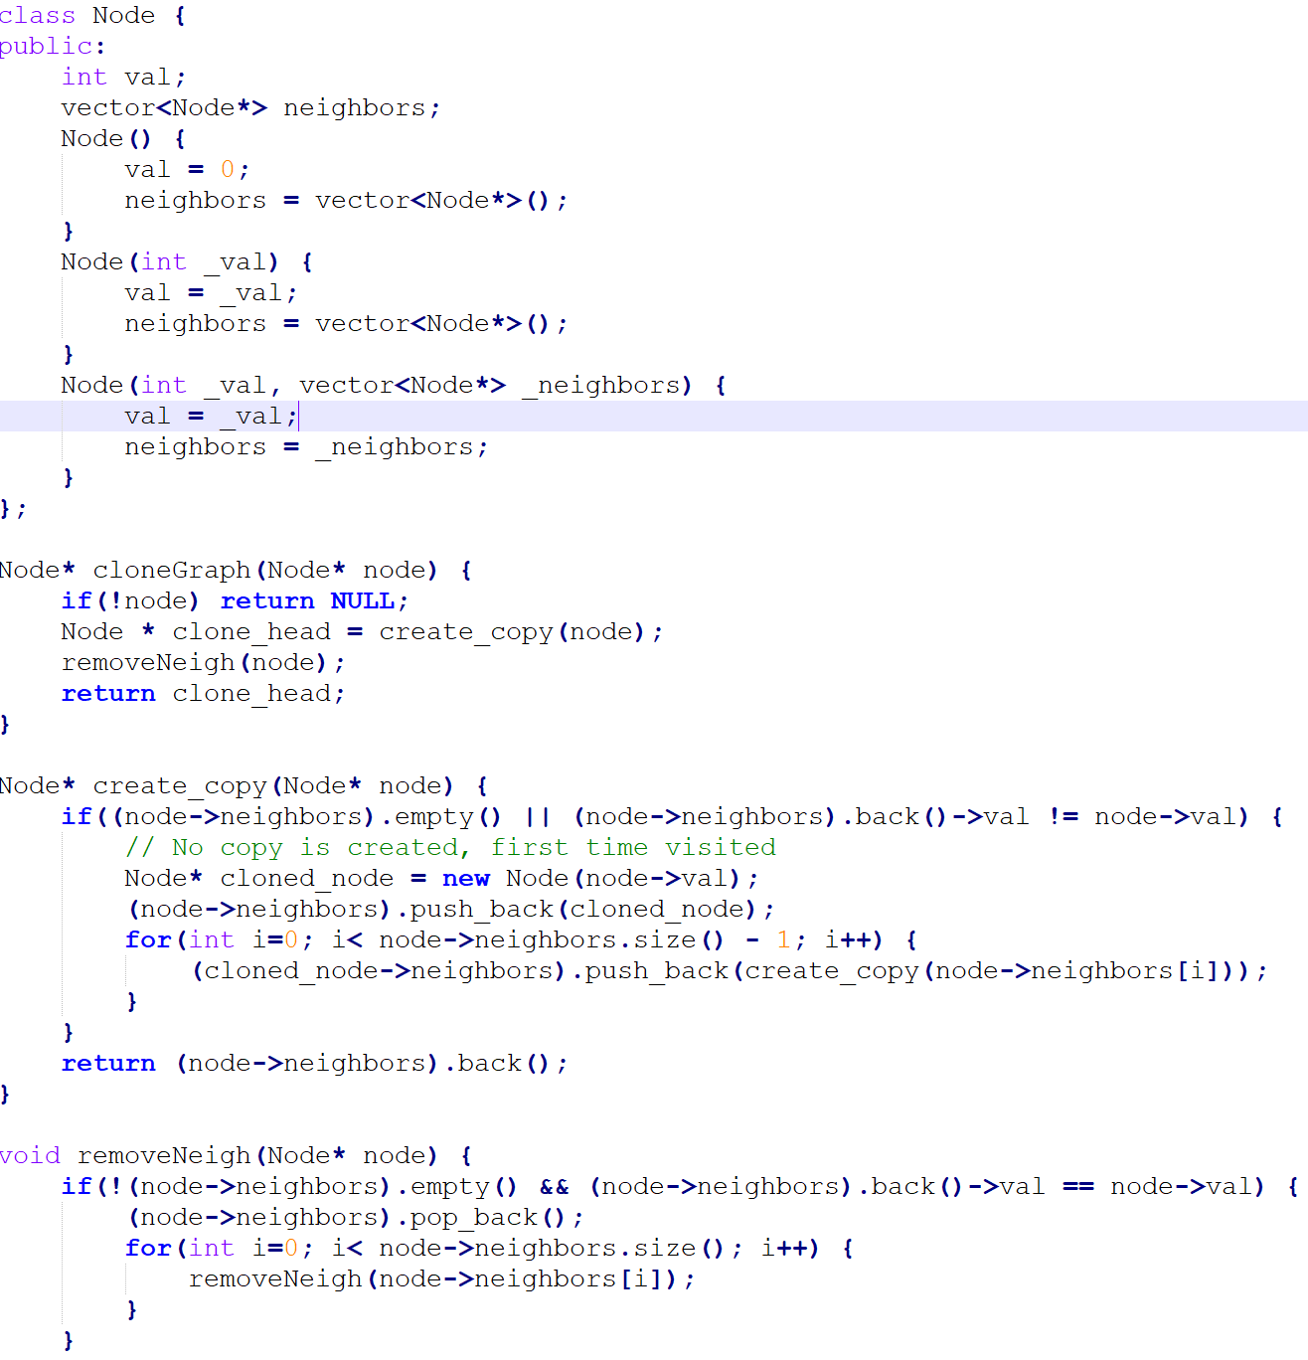
Clone Gragh https://leetcode.com/explore/learn/card/queue-stack/232/practical-application-stack/1392/

Slide 18
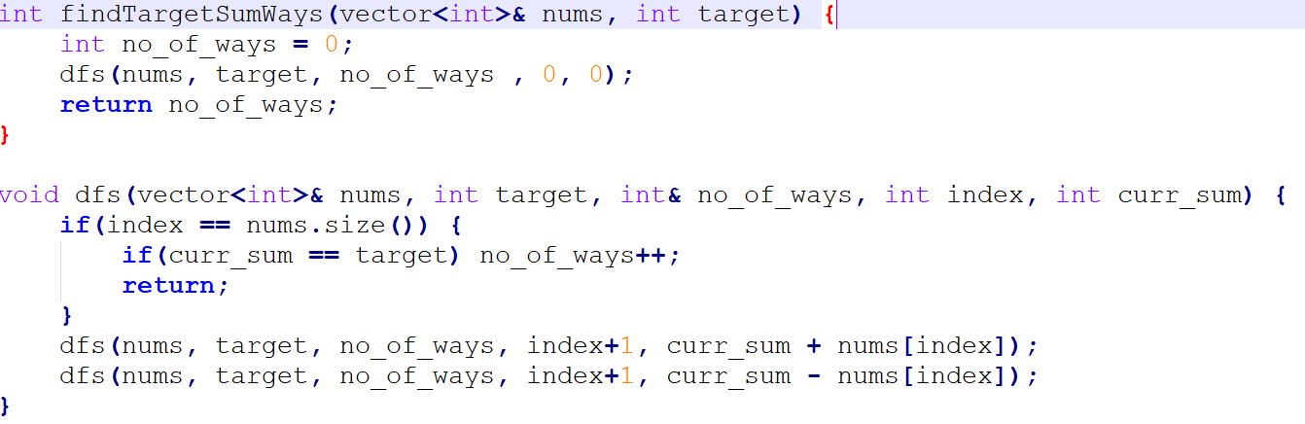
Target Sum https://leetcode.com/explore/learn/card/queue-stack/232/practical-application-stack/1389/

Slide 19
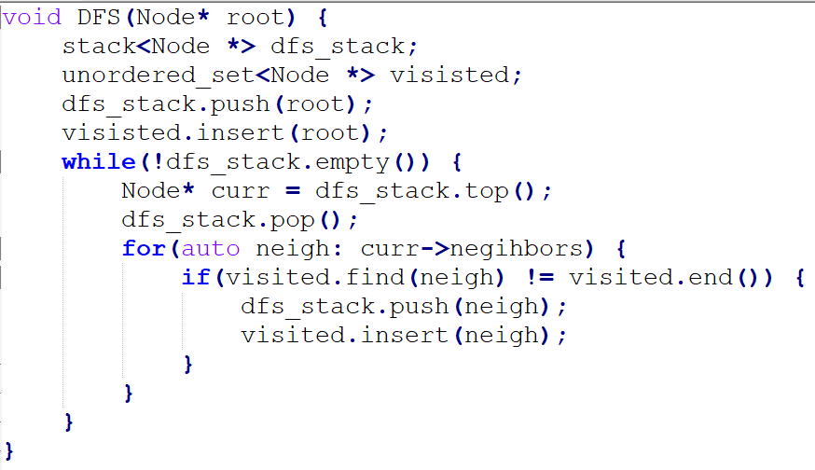
DFS Template – 2 using stack

Slide 20
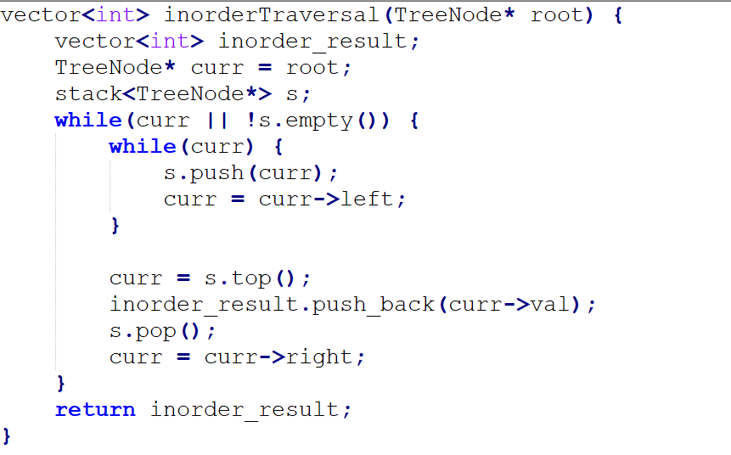
Inorder Traversal of Binary Tree -> Iterative https://leetcode.com/explore/learn/card/queue-stack/232/practical-application-stack/1383/

Slide 21
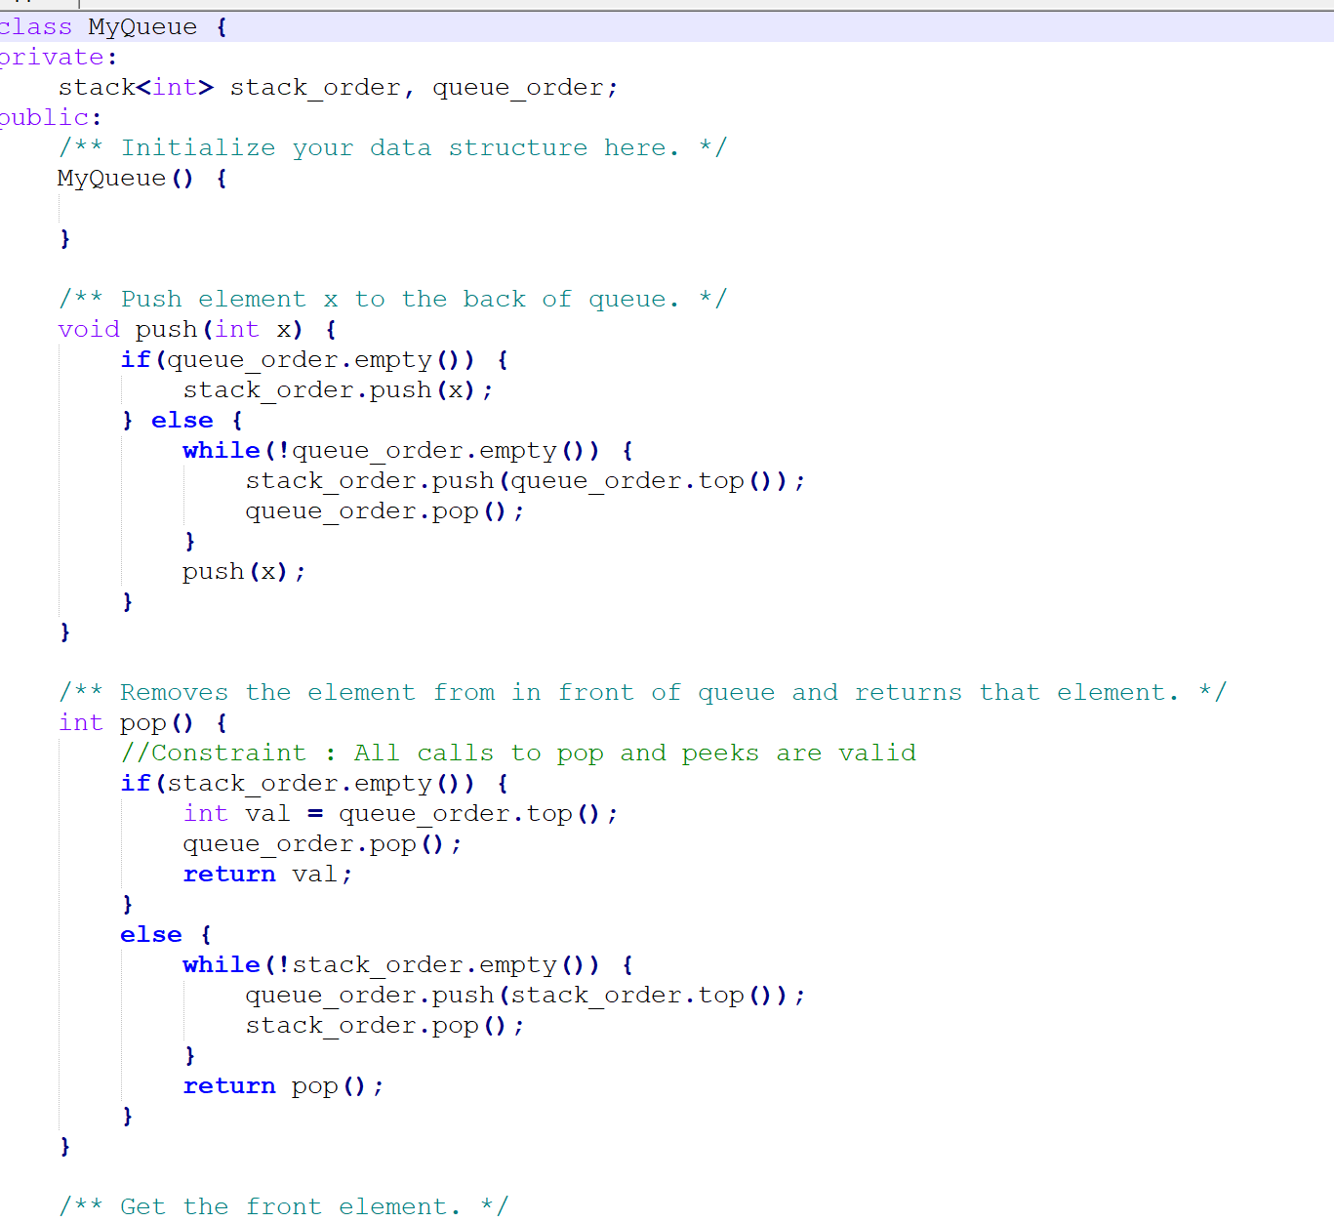
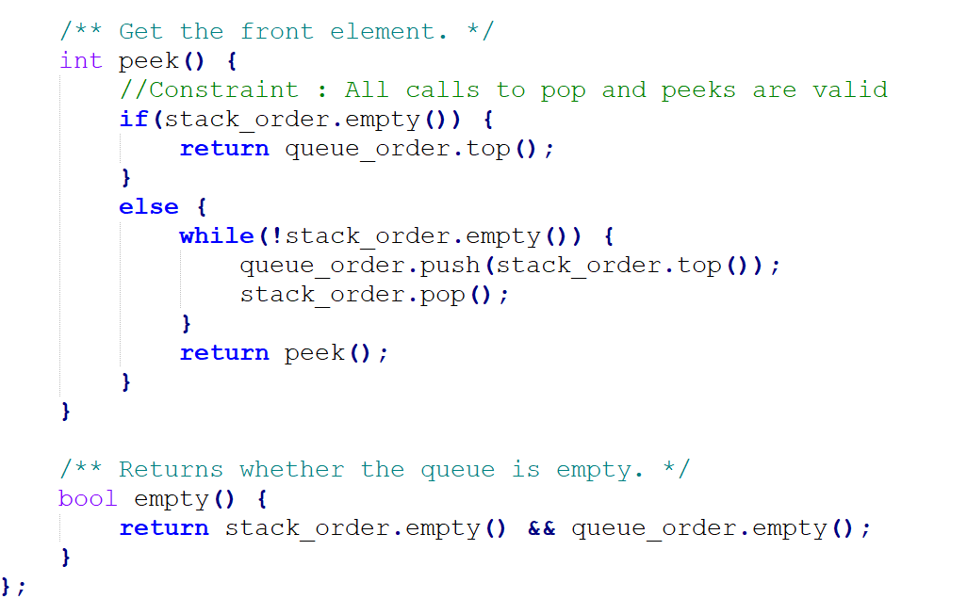
Implement Queue using Stacks https://leetcode.com/explore/learn/card/queue-stack/239/conclusion/1386/

Slide 22
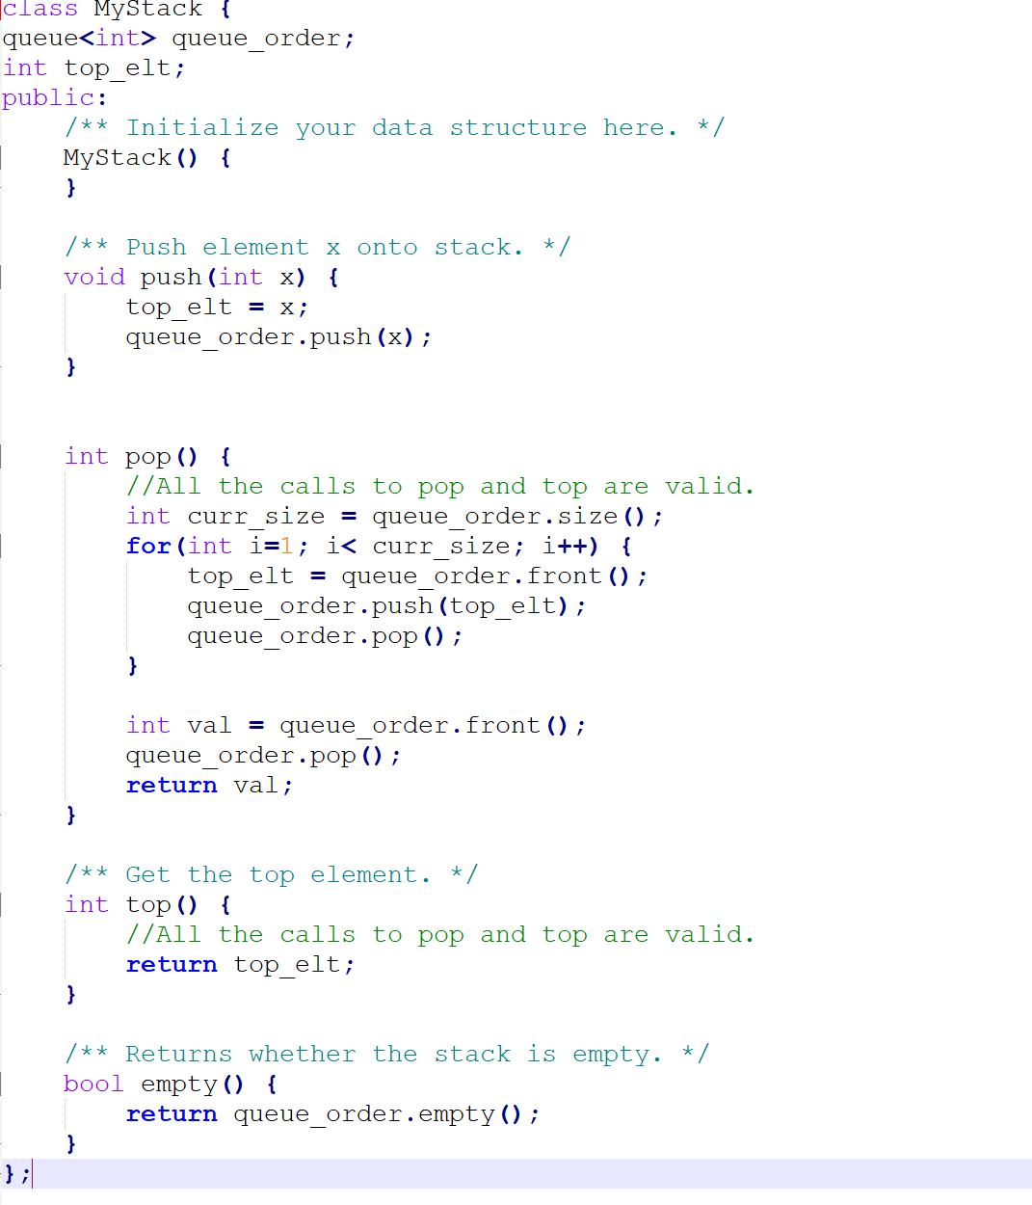
Implement Stack using Queues https://leetcode.com/explore/learn/card/queue-stack/239/conclusion/1387/

Slide 23
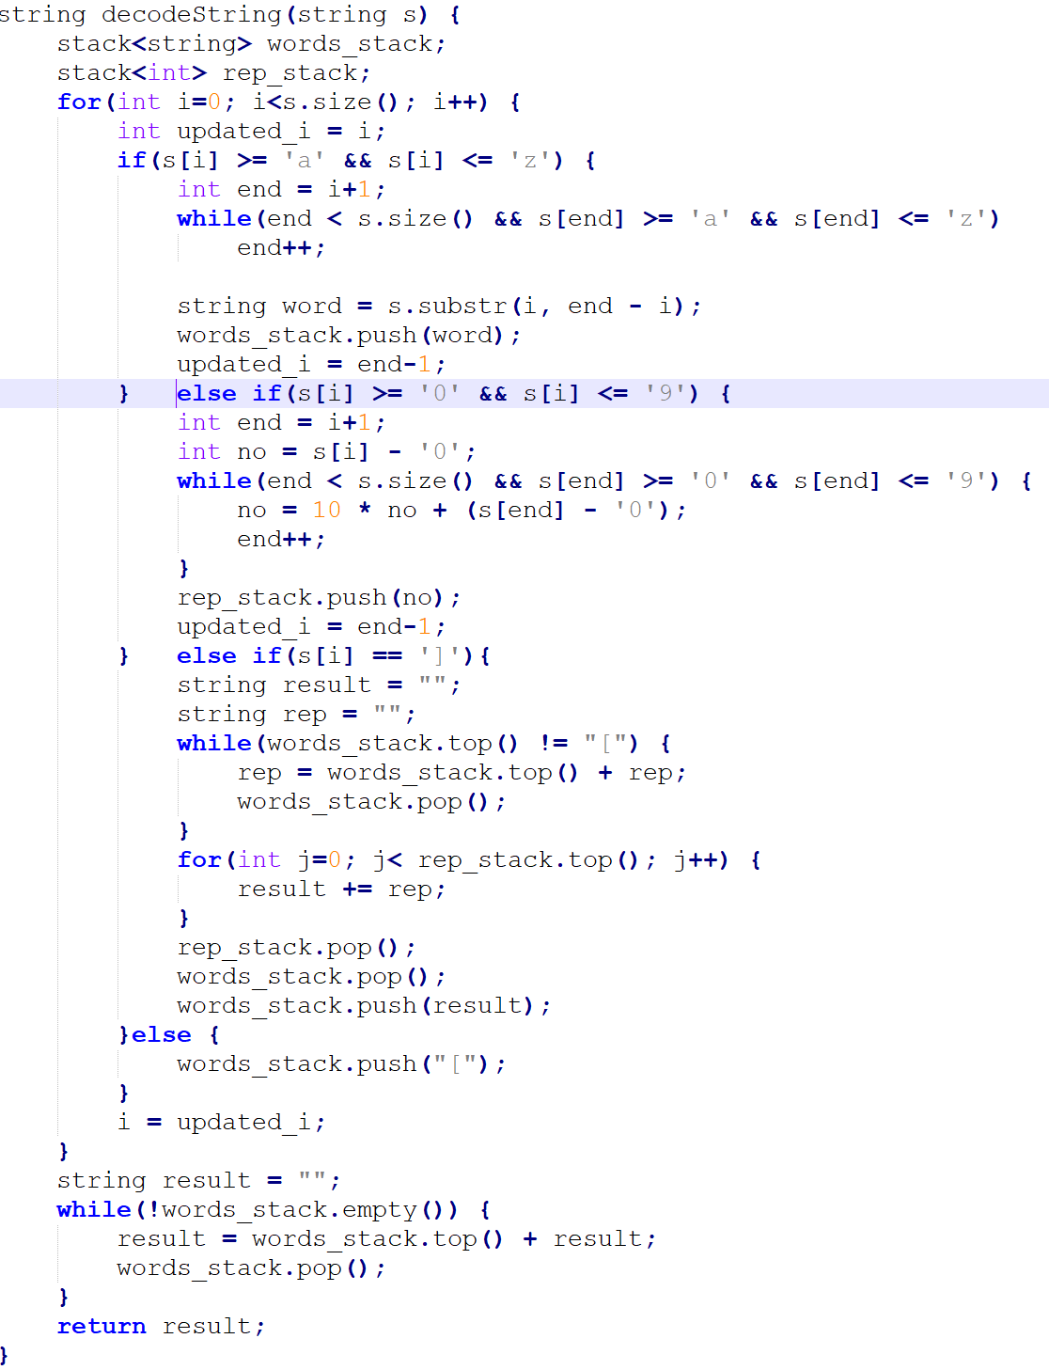
Decode String https://leetcode.com/explore/learn/card/queue-stack/239/conclusion/1379/

Slide 24
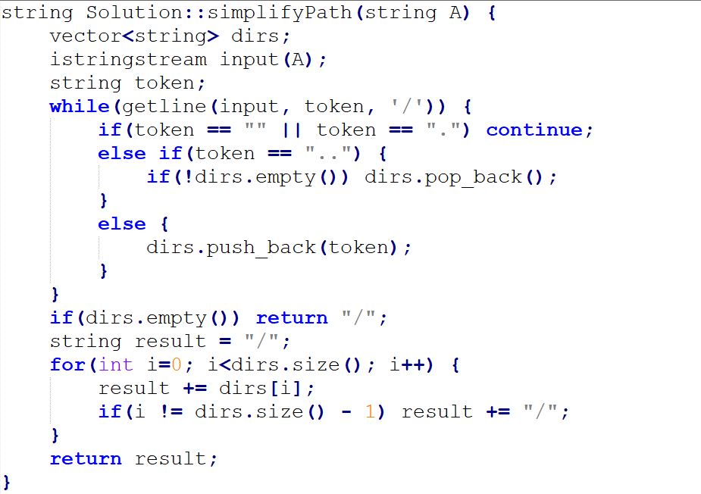
Simplify Directory Path https://www.interviewbit.com/problems/simplify-directory-path/

Slide 25
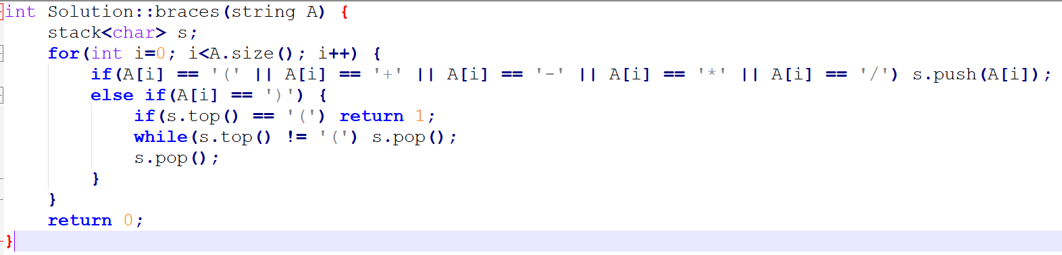
Redundant Braces https://www.interviewbit.com/problems/redundant-braces/

Slide 26
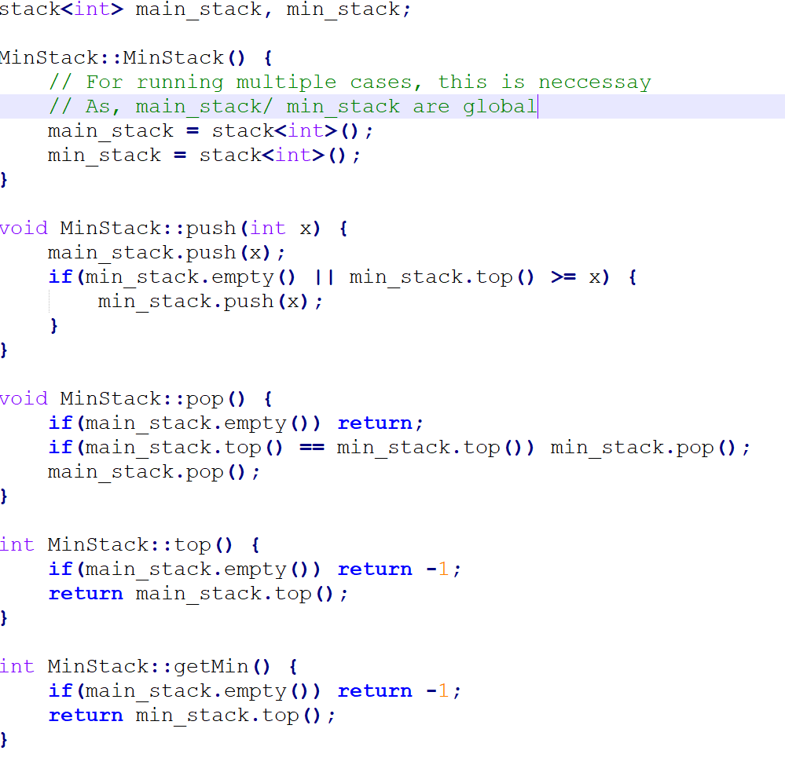
Min Stack https://www.interviewbit.com/problems/min-stack/

Slide 27
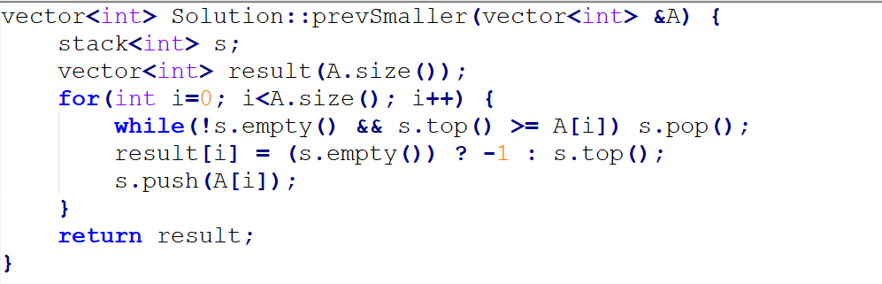
Nearest Smaller Element https://www.interviewbit.com/problems/nearest-smaller-element/

Slide 28
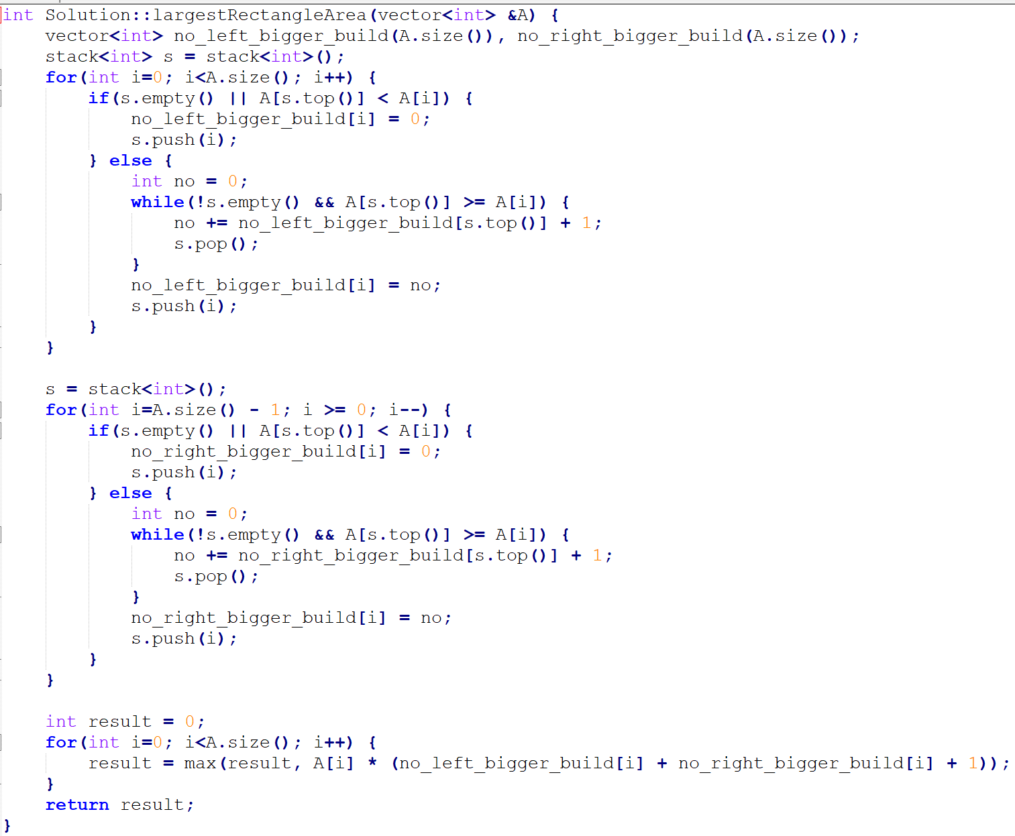
Largest Rectangle in Histogram https://www.interviewbit.com/problems/largest-rectangle-in-histogram/

Slide 29
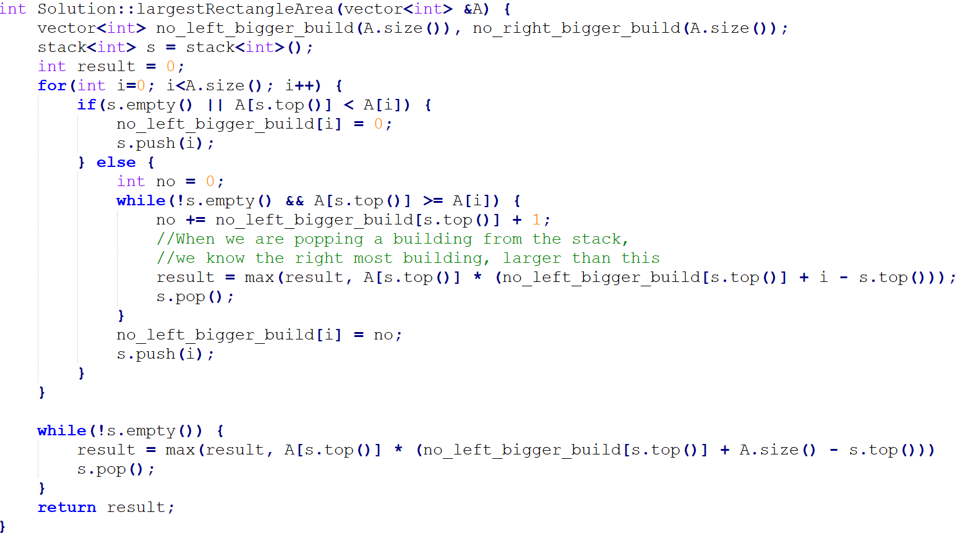
Largest Rectangle in Histogram https://www.interviewbit.com/problems/largest-rectangle-in-histogram/
Optimized

Slide 30
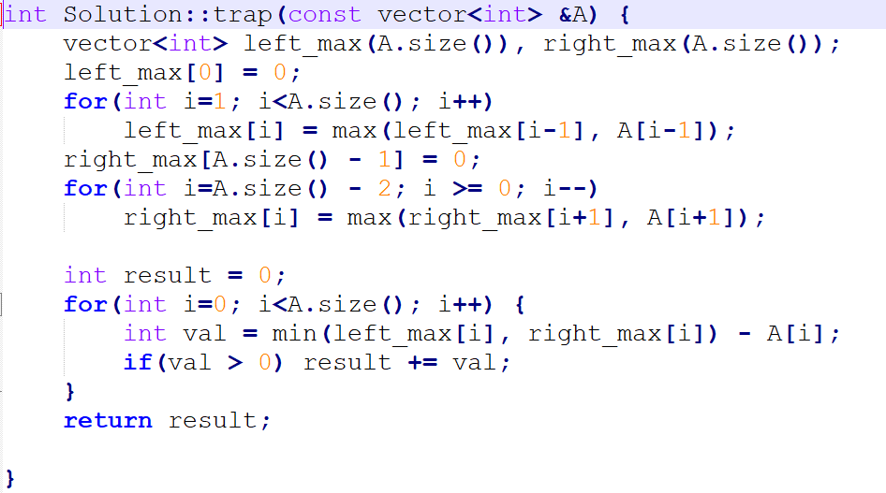
Rain Water Trapped https://www.interviewbit.com/problems/rain-water-trapped/

Slide 31
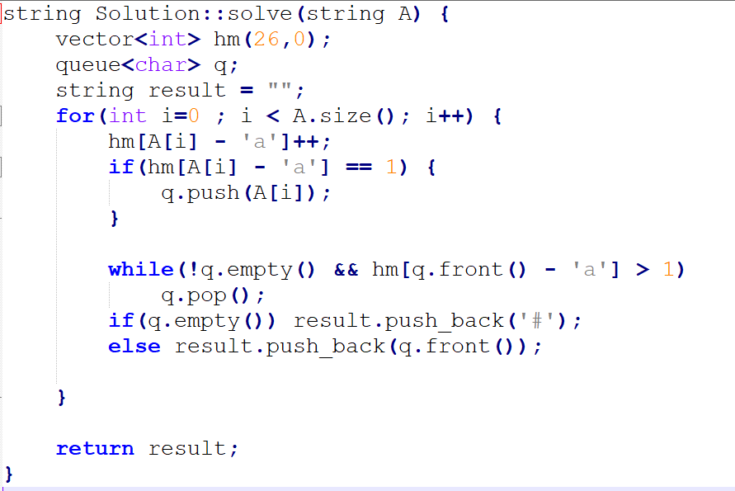
Find non-repeating char in stream https://www.interviewbit.com/problems/first-non-repeating-character-in-a-stream-of-characters/

Slide 32
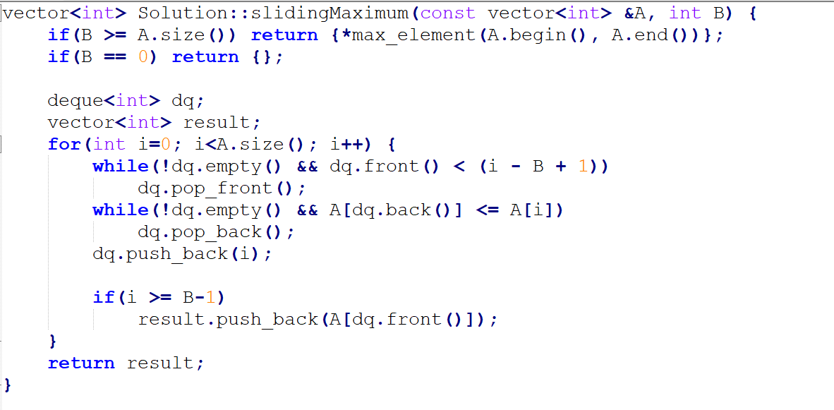
Sliding Window Maximum https://www.interviewbit.com/problems/sliding-window-maximum/

Slide 33
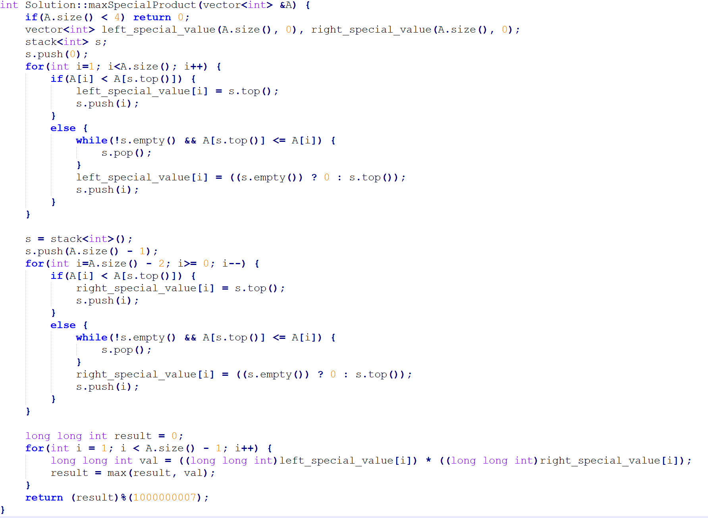
MAXSPPROD https://www.interviewbit.com/problems/maxspprod/

