Slide 1
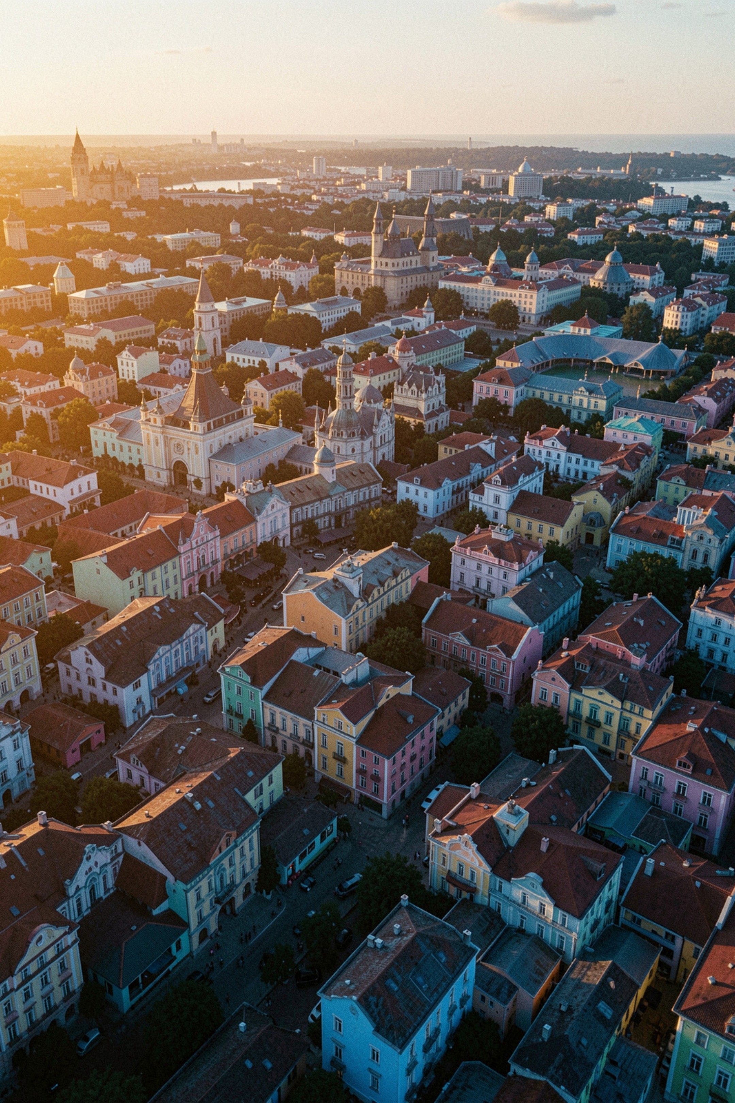
SmartTour: An Intelligent Tourist Places Guide
Review-2 Presentation
Team: J. Kumudavalli | Y. Revanth | A. Nikitha | G. Sai Rithwik · Guide: Swapna Reddy

Slide 2


The Problem We're Solving
Hours of Searching
Travellers spend hours searching across multiple websites just to gather basic destination information.
Scattered & Inconsistent Data
Information is spread across platforms — inconsistent, hard to compare, and unreliable.
No Centralized Platform
There is no single, unified solution for discovering, exploring, and planning tourist destinations efficiently.

Slide 3


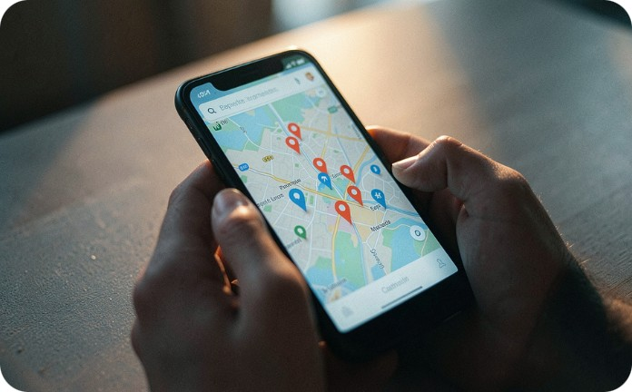
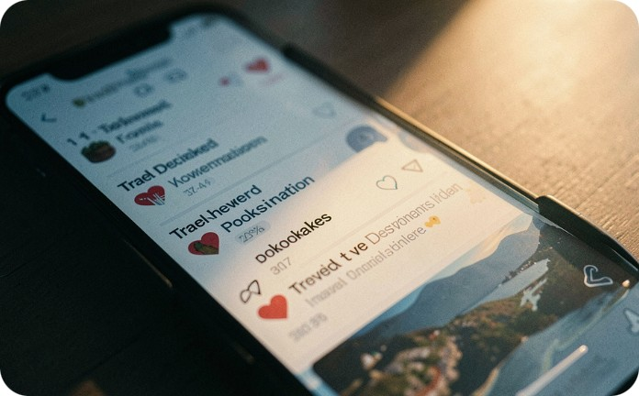
SmartTour Solution
Unified Search & Explore
Rich Destination Info
Map & Navigation
Personal Favourites
History, culture, geography, and imagery — all in one place for every destination.
Integrated maps for navigation and automatic discovery of nearby attractions.
Save favourite destinations to a personal list for quick, convenient future access.
One platform to search, discover, and explore tourist destinations with comprehensive details.

Slide 4





Technology Stack
Frontend
HTML, CSS, JavaScript — fully responsive UI
Backend
Python / Node.js with REST APIs
Database
MySQL / MongoDB for destination data storage
Maps
Google Maps API for location and navigation services

Slide 5

System Architecture & Workflow
Search
Retrieve
Map
Favourites
A clean, end-to-end data flow from user query to personalized destination experience.

Slide 6
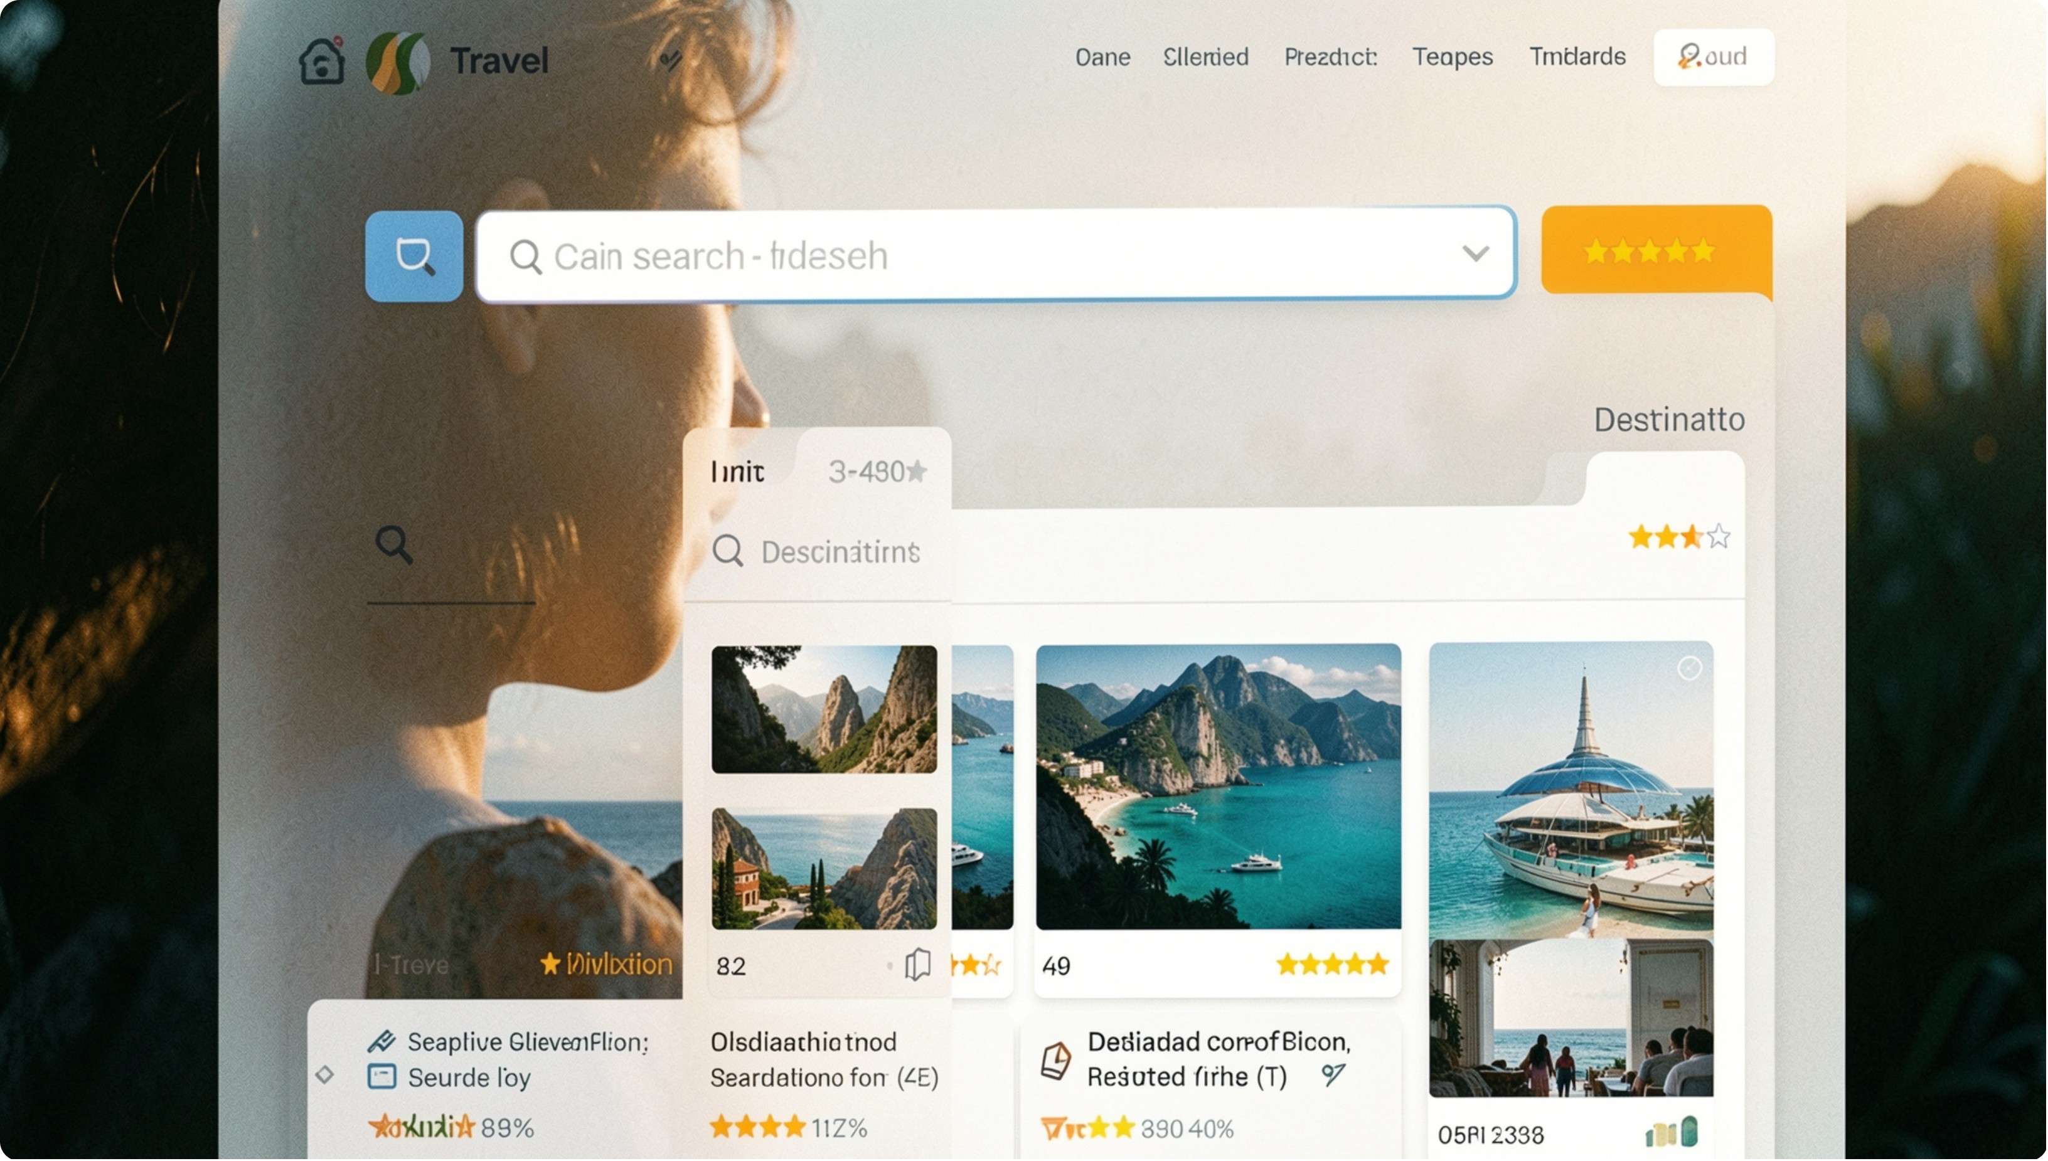

Module 1: Search & Destination Display
FRONTEND UI COMPLETE
What It Does
Search bar with autocomplete functionality
Destination cards showing images, ratings, and key details
Backend APIs currently in progress
Ready to demo: UI mockups and sample data integration

Slide 7
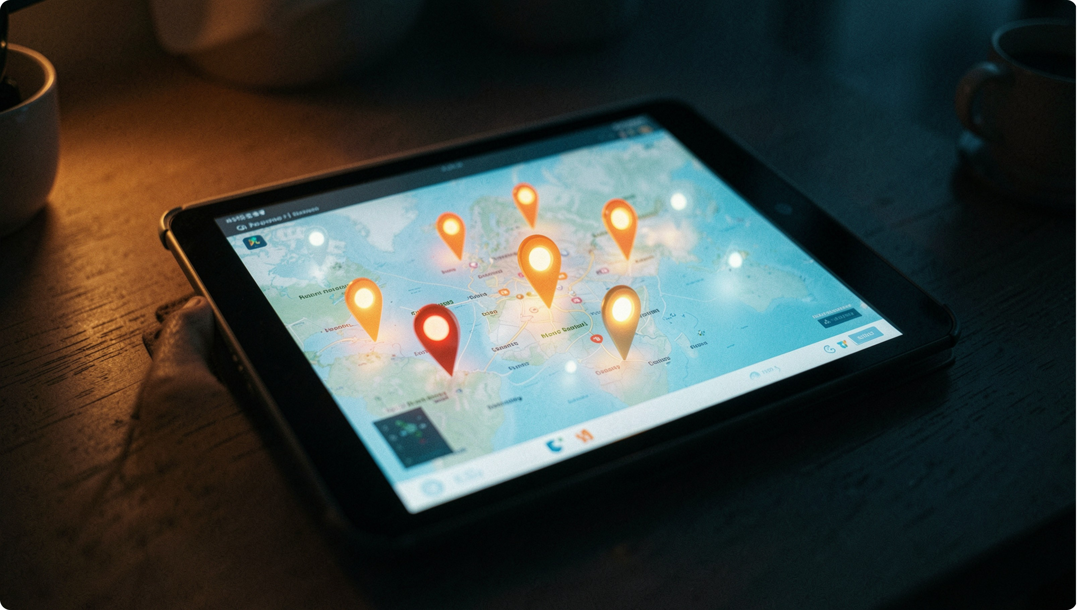
Module 2: Map Integration & Navigation
What's Working
Google Maps API fully integrated
Location markers rendering correctly
Interactive map with destination coordinates
Route planning for efficient travel
Ready to demo: Live map with multiple destination pins

Slide 8
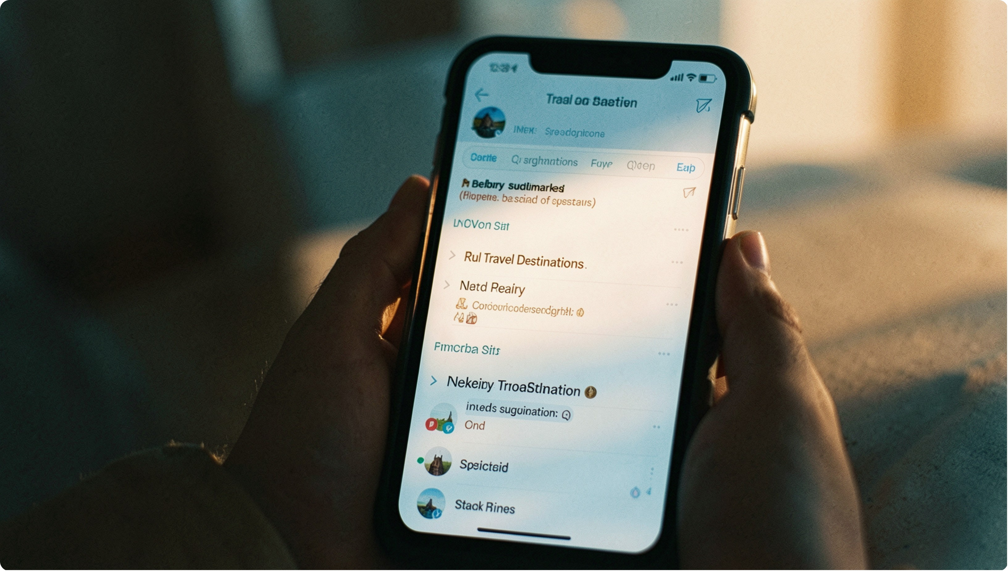
Module 3: Favourites & Recommendations
FRONTEND COMPLETE
Key Capabilities
Save / unsave destinations to a personal Favourites list
Nearby attractions auto-recommended based on current location
Backend database queries currently in progress
Ready to demo: Favourites UI and recommendation algorithm

Slide 9



Implementation Progress
Completed
In Progress
Up Next
Frontend UI, database schema design, and API endpoint architecture
Backend API development, user authentication, and data integration
Testing, performance optimization, and deployment setup

Slide 10

Conclusion & Future Scope
Current Status
Future Roadmap
Core features are functional. Backend completion and final polishing are actively underway — SmartTour is on track.
AI-powered personalized recommendations
Multilingual support
Weather integration
Hotel & transport booking
User reviews & offline mode

