Slide 1
AI-POWERED PRICING STRATEGY ASSISTANT
The Business Problem
A simulated EdTech platform is losing revenue to inconsistent pricing decisions: learners on the wrong plan, discounts handed out without a strategy, and no systematic way to flag who is about to churn versus who is ready to upgrade.
Retention
Renewals
Pricing
No system flags at-risk learners before they churn
Renewal rates vary 4x across segments with no clear reason why
Discounts are reactive, not tied to actual learner behavior
1

Slide 2
OBJECTIVE
Build a transparent, rule-based pricing engine
Every recommendation must be explainable in one sentence to a non-technical stakeholder — no black boxes, no ML predictions no one can audit.
Deliberately NOT used
Machine learning / deep learning
Predictive or classification models
RAG, vector databases, LangChain
Tableau or Power BI
Cloud deployment
1
Identify
2
Recommend
Learners at risk of churn, and learners ready to upgrade
A specific plan, discount, or action per learner — via SQL rules
3
Personalize
4
Measure
Turn each recommendation into a natural message via Gemini
Success with real product metrics — MRR, renewal, conversion
Why: for a new product with no historical A/B data, every SQL rule can be justified individually in a business review — a trained model can't.
2

Slide 3
THE DATA
1,600 simulated learners, 12 months of history
1,600
4
6
19
learner records
subscription plans
learner segments
data columns
Plans (monthly)
Segments (renewal rate)
Built with intent, not randomness
Basic
Rs 299
Power Learner
86.7%
Standard
Rs 599
Cert. Seeker
78.8%
Engagement, completion, and renewal are correlated by segment on purpose — Power Learners complete 88% of courses vs 27% for Casual Learners. This is what lets the SQL analysis surface a coherent story instead of noise.
Pro
Rs 999
Career Switcher
74.5%
Premium
Rs 1,499
Working Prof.
74.4%
College Student
62.7%
Casual Learner
19.6%
3

Slide 4
SQL ANALYSIS
22 queries, every insight verified against real output
Pro beats Standard on revenue
Rs 4.3L vs Rs 3.2L, despite fewer subscribers — price point beats volume
Discount users complete less
54% vs 66% completion for full-price learners — a real pricing trade-off
Support tickets track disengagement
2.8 tickets avg at <40% completion, down to 0.5 at 70%+
4

Slide 5
PRODUCT INSIGHTS
What the data says about each segment
The 3x gap
Power Learners renew at 86.7% vs 19.6% for Casual Learners — a gap that dwarfs the ~17-point spread between Premium and Basic plan renewal rates.
Engagement predicts renewal far better than plan tier does. Pricing alone won't fix a Casual Learner's churn risk — the recommendation engine treats these differently.
5

Slide 6
RECOMMENDATION ENGINE
22 business rules, 14 pricing parameters, zero ML
22
14
0
business rules (target: 20+)
pricing parameters (target: 10+)
machine learning models used
Priority-ordered logic (excerpt)
Why priority order matters
1
Support tickets ≥ 3
→ CS outreach BEFORE any upsell
Satisfaction and churn-risk rules are checked first, so a struggling learner is never pitched an upgrade before their support issue is resolved. This ordering is itself a product decision, not just SQL syntax.
2
Inactive 60+ days & not renewed
→ High churn risk, 20% win-back
3
Power Learner, 80%+ completion
→ Recommend Premium
4
Basic/Standard, high completion & hours
→ Recommend upgrade to Pro
5
College Student, 70%+ completion
→ Student discount (15%)
6

Slide 7
LLM LAYER
Gemini explains the decision. It never makes it.
SQL OUTPUT (the decision)
Design guardrails
Current Plan: Basic
Recommendation: Upgrade to Pro
Reason: "82% completion, 7.4 hrs/week"
SQL decides plan, discount, and action — always
Gemini is instructed NOT to alter the recommendation
Output capped at 60 words, second person, no mention of automation
One failed API call never breaks the batch (per-row error handling)
GEMINI OUTPUT (the phrasing)
“You're putting in real effort — 82% course completion and multiple hours a week. Pro would unlock more advanced content that matches how seriously you're taking this.”
7

Slide 8
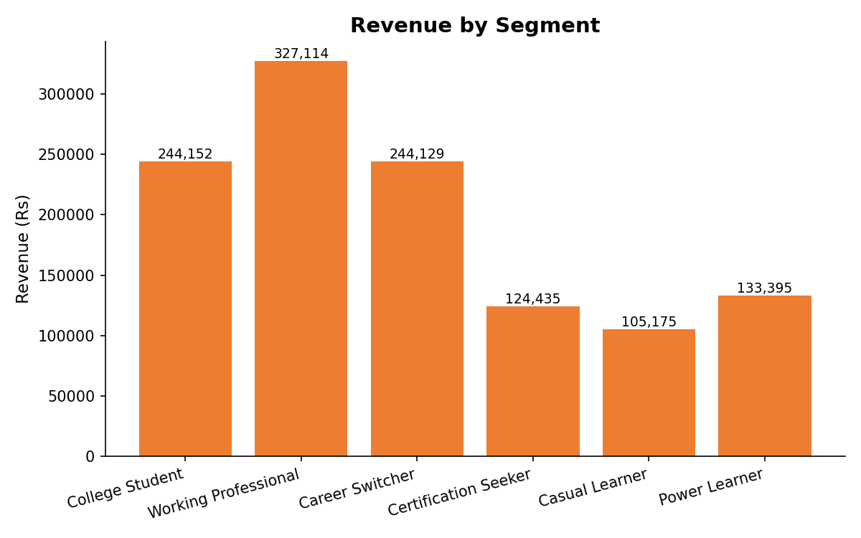
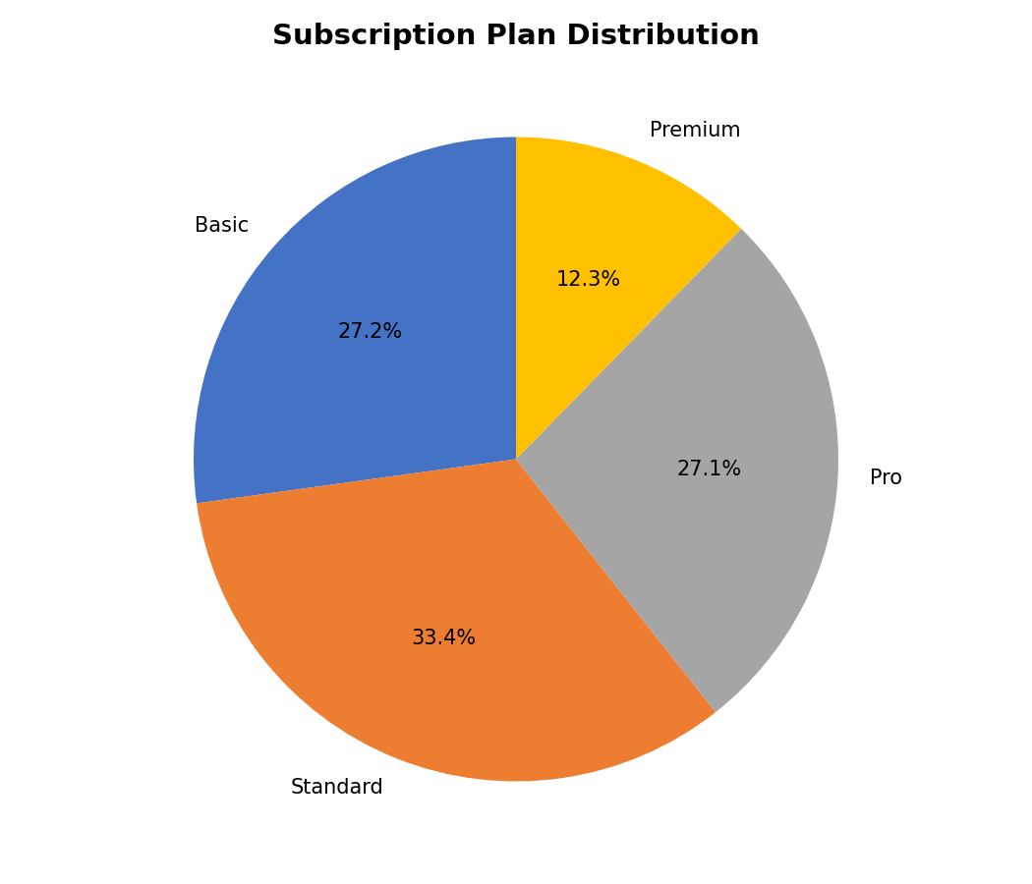
VISUALIZATIONS
Formula-driven Excel, zero recalculation errors
1,630 formulas across the workbook • 0 recalculation errors • All charts sourced from SUMIF / AVERAGEIF / COUNTIFS, not hardcoded values
8

Slide 9
PRODUCT METRICS
The numbers a PM would report to leadership
Rs 11.78L
Rs 736.50
64.7%
Monthly Recurring Revenue
ARPU
Renewal Rate
34.3%
58.8%*
29.9%*
Discount Redemption Rate
Conversion Rate
Upgrade Rate
* Conversion and Upgrade Rate use explicitly-labeled proxy definitions, since this dataset is a snapshot, not a before/after funnel log. Documented in product_metrics.sql.
9

Slide 10
CONCLUSION
A pricing system every stakeholder can audit
Transparent
Grounded
Extensible
Every decision traces to a named SQL rule, not a model weight
Every number in this deck was run against the live dataset, not estimated
New rules or parameters can be added without retraining anything
What I'd build next
Real event-level data to measure true conversion, not a snapshot proxy
A/B test the SQL engine's discount offers against a control group
Feedback loop: do Gemini-personalized messages outperform raw SQL text?
10

