Slide 1
CSS

Slide 2
CSS
What is CSS?
CSS stands for Cascading Style Sheets
CSS describes how HTML elements are to be displayed on screen, paper, or in other media
CSS saves a lot of work. It can control the layout of multiple web pages all at once
External stylesheets are stored in CSS files

Slide 3



Slide 4


Slide 5
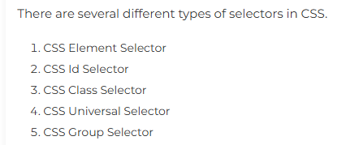
CSS Selector
CSS selectors are used to select the content you want to style. Selectors are the part of CSS rule set. CSS selectors select HTML elements according to its id, class, type, attribute etc.

Slide 6
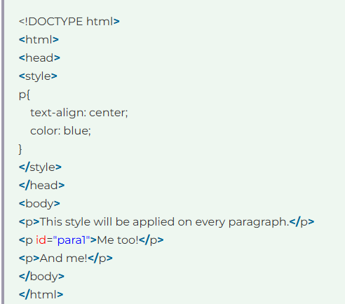
Element Selector
Output
?

Slide 7

Element Selector

Slide 8

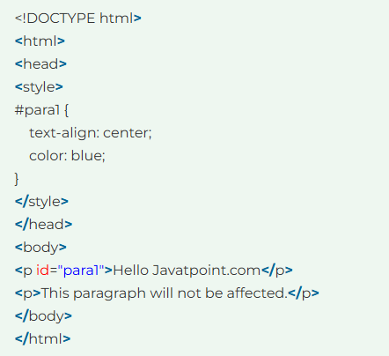


Slide 9

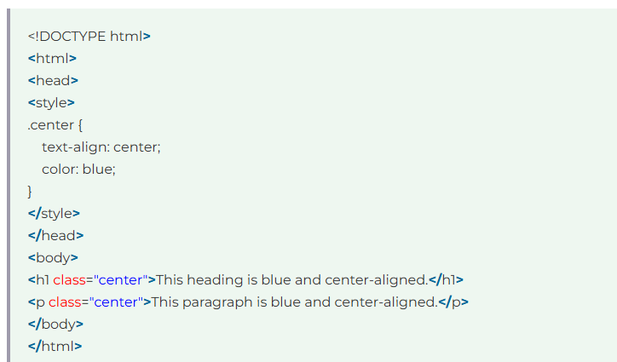

Slide 10

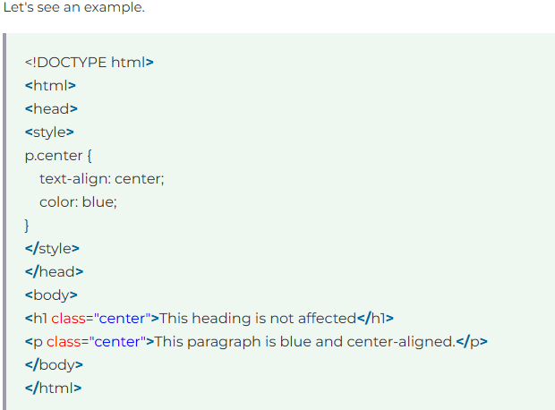

Output

Slide 11

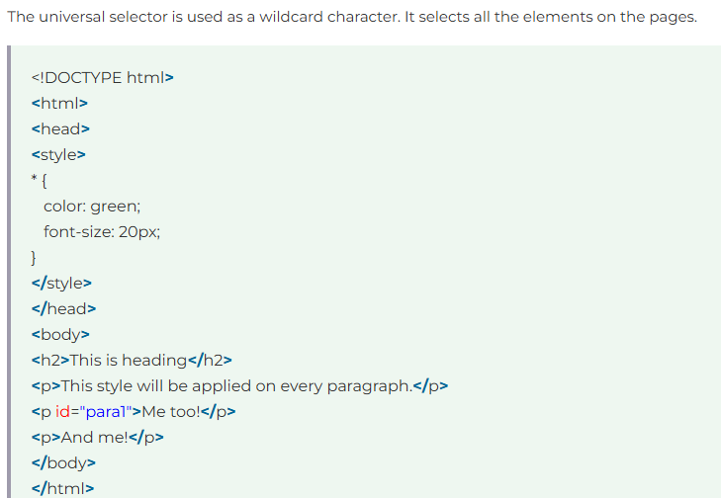
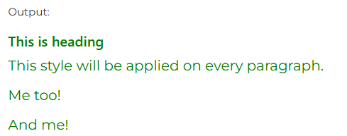

Slide 12

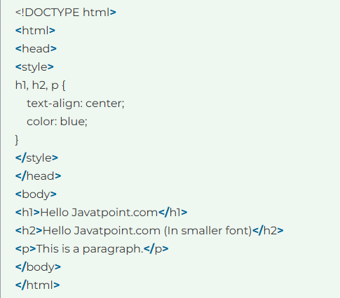


Slide 13


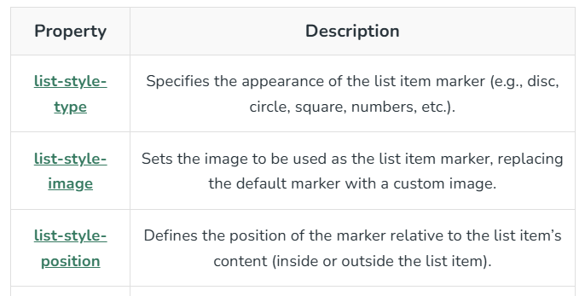

Slide 14

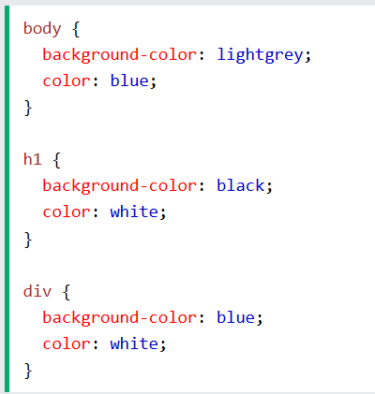

Slide 15

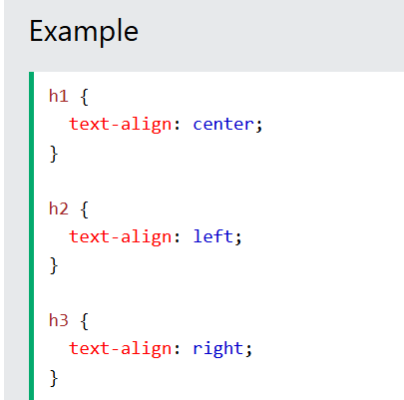

Slide 16

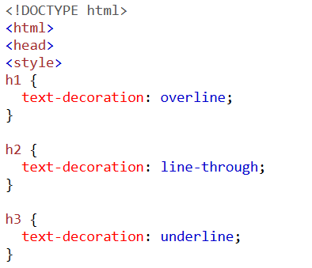
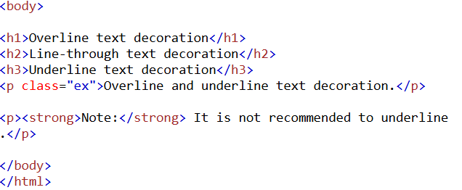
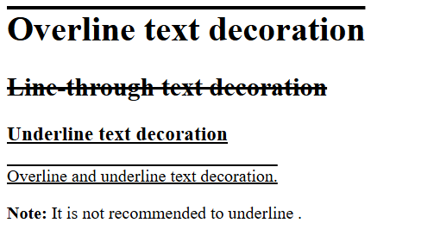


Slide 17

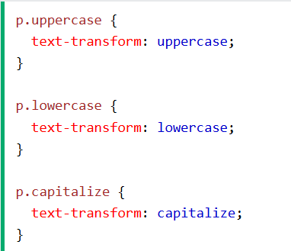

Slide 18
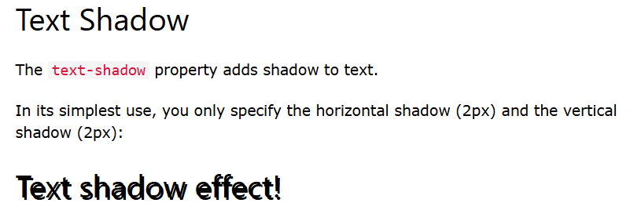


Slide 19



Slide 20




