Slide 1
Unit-6
Node JS:
A Server Side JS

Slide 2
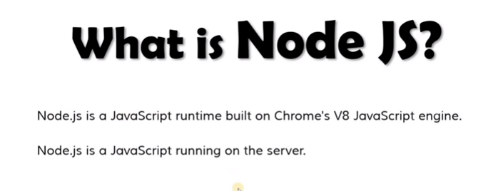

Slide 3
What is Node.js?
Node.js is an open source server environment
Node.js is free
Node.js runs on various platforms (Windows, Linux, Unix, Mac OS X, etc.)
Node.js uses JavaScript on the server

Slide 4
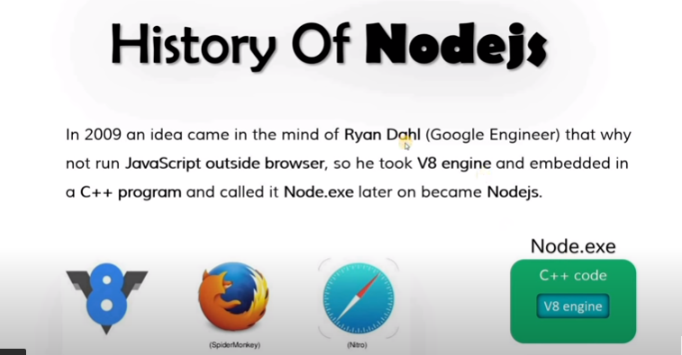

Slide 5
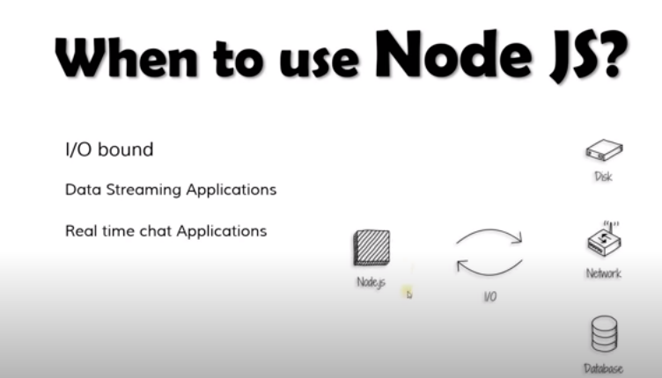

Slide 6
Node JS Architecture
Node.js Server Architecture: To manage several concurrent clients, Node.js employs a “Single Threaded Event Loop” design. The JavaScript event-based model and the JavaScript callback mechanism are employed in the Node.js Processing Model. It employs two fundamental concepts:
Asynchronous model
Non-blocking of I/O operations

Slide 7
Node JS Architecture
These features enhance the scalability, performance, and throughput of Node.js web applications.
Components of the Node.js Architecture:
Requests: Depending on the actions that a user needs to perform, the requests to the server can be either blocking (complex) or non-blocking (simple).
Node.js Server: The Node.js server accepts user requests, processes them, and returns results to the users.
Event Queue: The main use of Event Queue is to store the incoming client requests and pass them sequentially to the Event Loop.
Thread Pool: The Thread pool in a Node.js server contains the threads that are available for performing operations required to process requests.
Event Loop: Event Loop receives requests from the Event Queue and sends out the responses to the clients.
External Resources: In order to handle blocking client requests, external resources are used. They can be of any type ( computation, storage, etc).

Slide 8
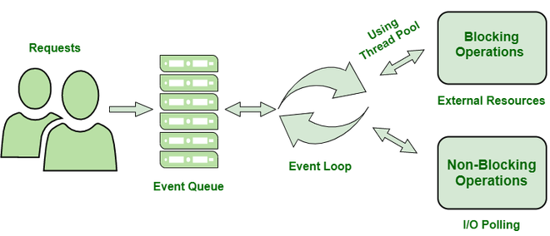
Node JS Architecture

Slide 9
Node JS Architecture
Users send requests (blocking or non-blocking) to the server for performing operations.
The requests enter the Event Queue first at the server-side.
The Event queue passes the requests sequentially to the event loop. The event loop checks the nature of the request (blocking or non-blocking).
Event Loop processes the non-blocking requests which do not require external resources and returns the responses to the corresponding clients
For blocking requests, a single thread is assigned to the process for completing the task by using external resources.
After the completion of the operation, the request is redirected to the Event Loop which delivers the response back to the client.

Slide 10
Advantages:
The Node.js server can efficiently handle a high number of requests by employing the use of Event Queue and Thread Pool.
There is no need to establish multiple threads because Event Loop processes all requests one at a time, therefore a single thread is sufficient.
The entire process of serving requests to a Node.js server consumes less memory and server resources since the requests are handled one at a time

Slide 11
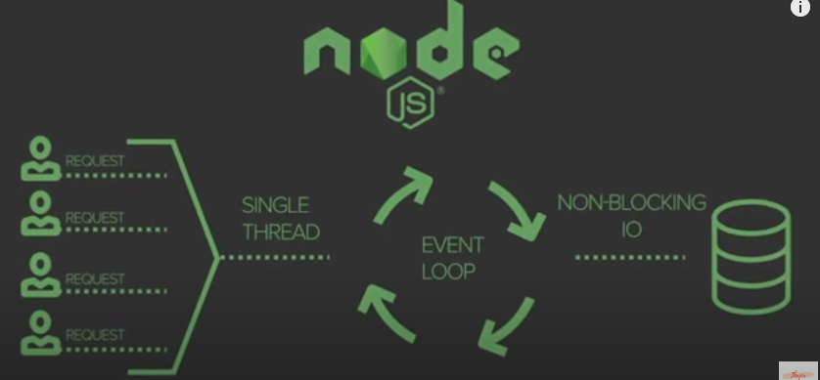

Slide 12
Why Node.js?
Node.js uses asynchronous programming!
A common task for a web server can be to open a file on the server and return the content to the client.
Here is how PHP or ASP handles a file request:
Sends the task to the computer's file system.
Waits while the file system opens and reads the file.
Returns the content to the client.
Ready to handle the next request.
Here is how Node.js handles a file request:
Sends the task to the computer's file system.
Ready to handle the next request.
When the file system has opened and read the file, the server returns the content to the client.
Node.js eliminates the waiting, and simply continues with the next request.
Node.js runs single-threaded, non-blocking, asynchronously programming, which is very memory efficient.

Slide 13
What Can Node.js Do?
Node.js can generate dynamic page content
Node.js can create, open, read, write, delete, and close files on the server
Node.js can collect form data
Node.js can add, delete, modify data in your database

Slide 14
What is a Node.js File?
Node.js files contain tasks that will be executed on certain events
A typical event is someone trying to access a port on the server
Node.js files must be initiated on the server before having any effect
Node.js files have extension ".js"

Slide 15
Download Node.js
The official Node.js website has installation instructions for Node.js: https://nodejs.org
Getting Started
Once you have downloaded and installed Node.js on your computer, let's try to display "Hello World" in a web browser.
Create a Node.js file named "myfirst.js", and add the following code:

Slide 16
myfirst.js
var http = require('http'); http.createServer(function (req, res) { res.writeHead(200, {'Content-Type': 'text/html'}); res.end('Hello World!'); }).listen(8080);

Slide 17
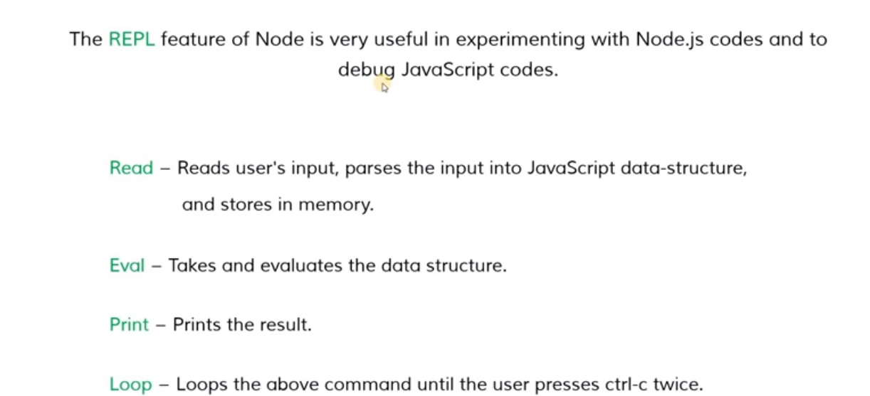
Node JS REPL

Slide 18
Node.js Modules
What is a Module in Node.js?
Consider modules to be the same as JavaScript libraries.
A set of functions you want to include in your application.
Built-in Modules
Node.js has a set of built-in modules which you can use without any further installation.

Slide 19
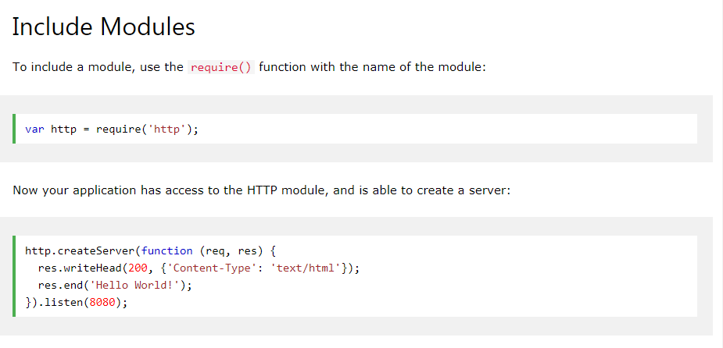

Slide 20
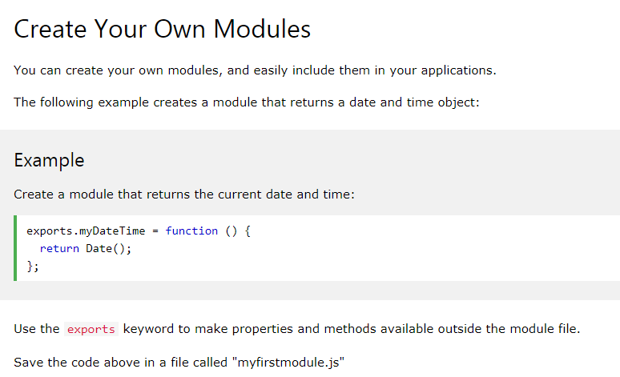

Slide 21
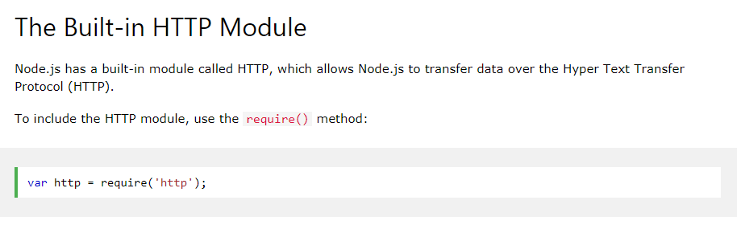
Node.js HTTP Module

Slide 22
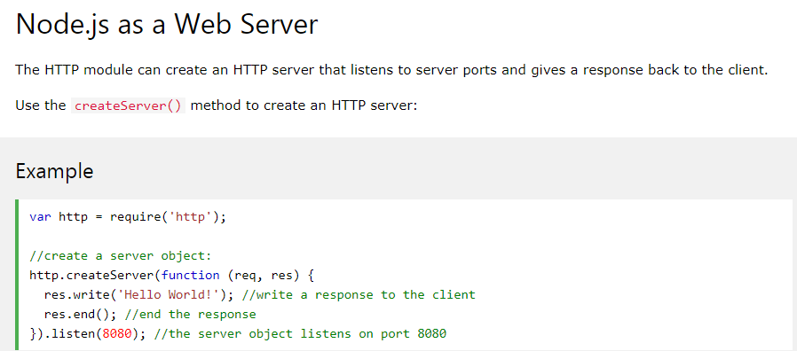
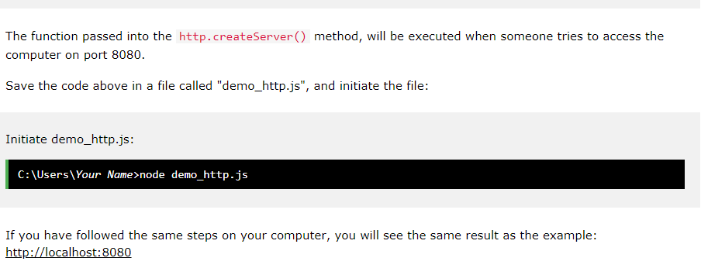

Slide 23
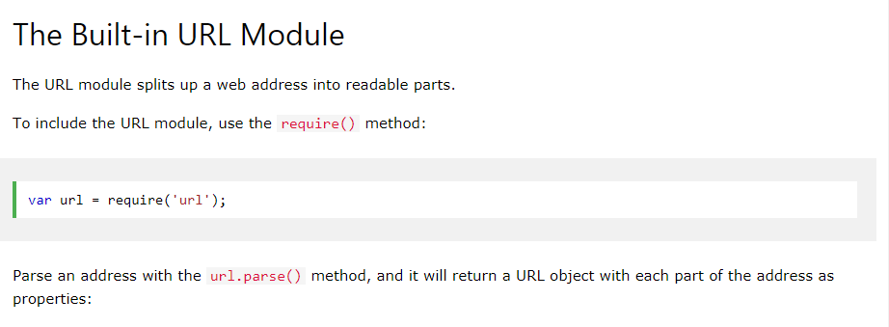
Node.js URL Module

Slide 24
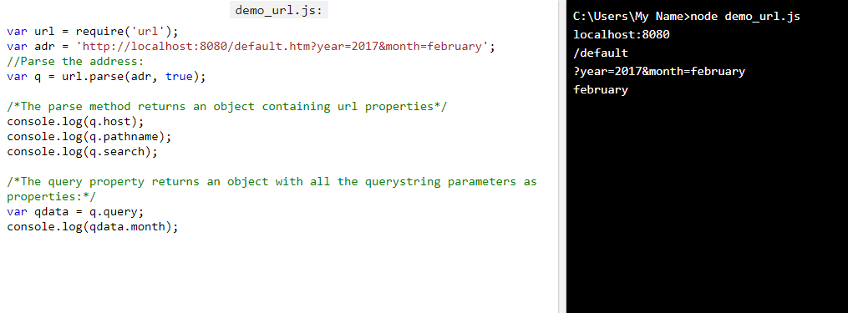

Slide 25
Node.js NPM
What is NPM?
NPM is a package manager for Node.js packages, or modules if you like.
www.npmjs.com hosts thousands of free packages to download and use.
The NPM program is installed on your computer when you install Node.js

Slide 26
What is a Package?
A package in Node.js contains all the files you need for a module.
Modules are JavaScript libraries you can include in your project.

Slide 27
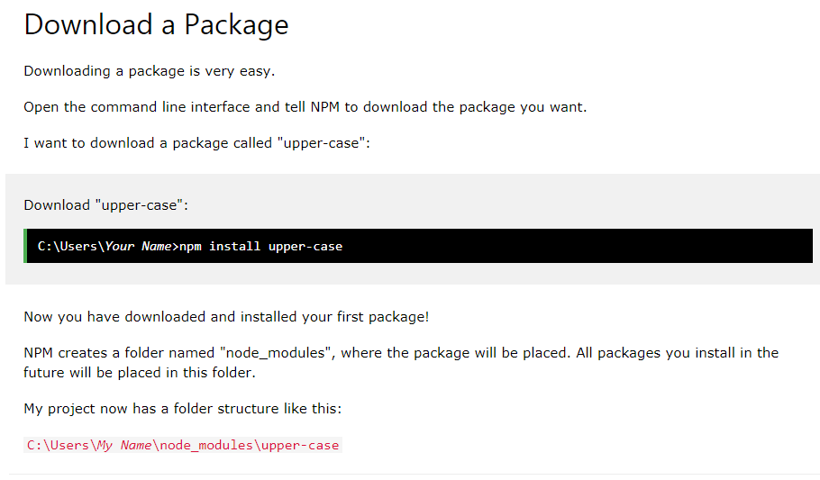

Slide 28
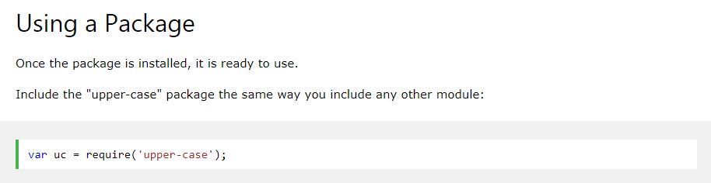

Slide 29
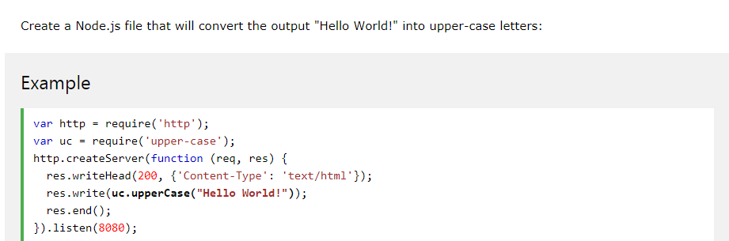

Slide 30
Node.js Events
Node.js is perfect for event-driven applications.
Events in Node.js
Every action on a computer is an event. Like when a connection is made or a file is opened.
Objects in Node.js can fire events, like the readStream object fires events when opening and closing a file:

Slide 31
