Slide 1
MYSQL database with Node.js:
Unit6

Slide 2
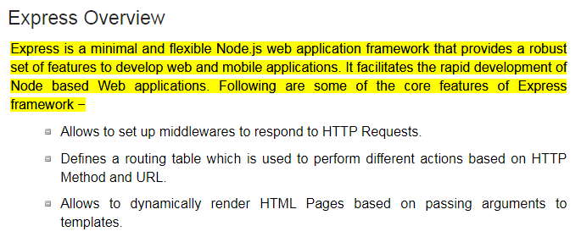
Node JS Express

Slide 3
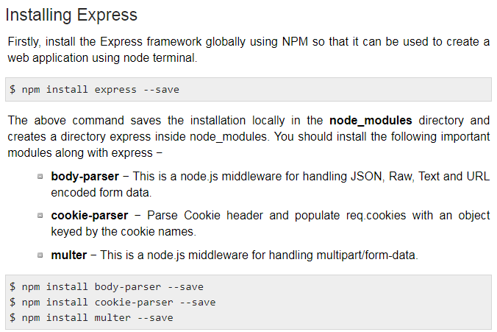

Slide 4
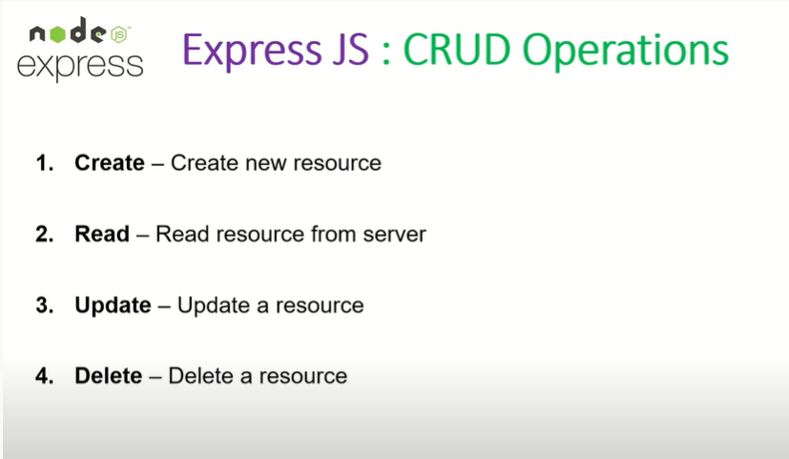

Slide 5
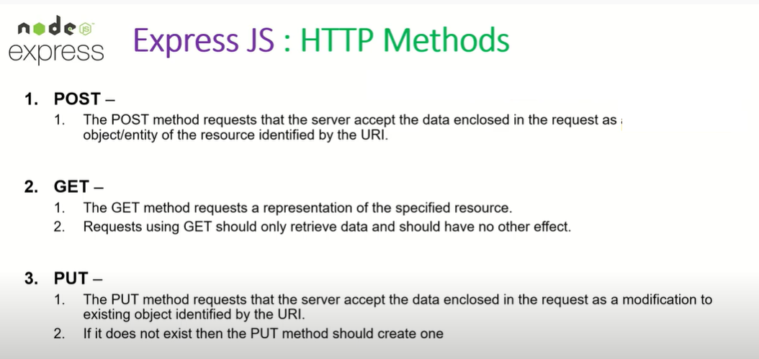

Delete method request that server deletes specified resource.

Slide 6
Node JS Express
In Node JS Express Every route is associated route handler.
A route associates a HTTP verb like GET or POST, a URL path and a function that is called to handle that pattern.
Routes allow you to match particular patterns of characters in a URL, and extract some values from the URL and pass them as parameters to the route handler.
Routes are URL Schemas

Slide 7
Basic Routing
We have seen a basic application which serves HTTP request for the homepage. Routing refers to determining how an application responds to a client request to a particular endpoint, which is a URI (or path) and a specific HTTP request method (GET, POST, and so on).
We will extend our Hello World program to handle more types of HTTP requests.

Slide 8
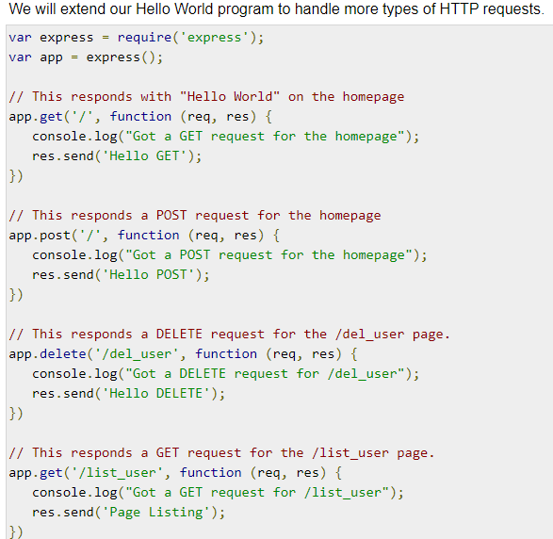

Slide 9
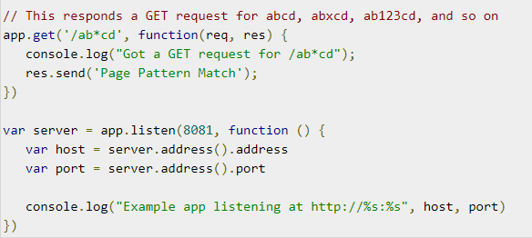
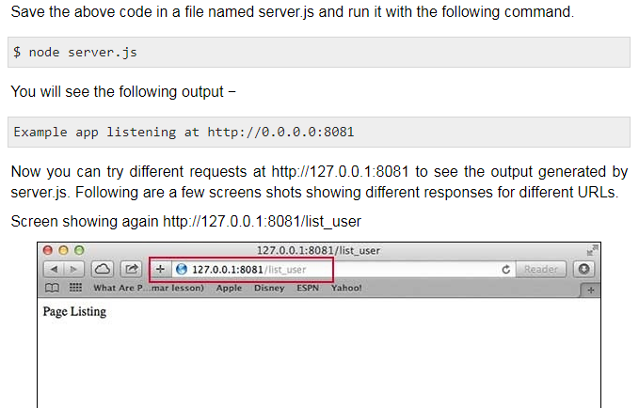

Slide 10
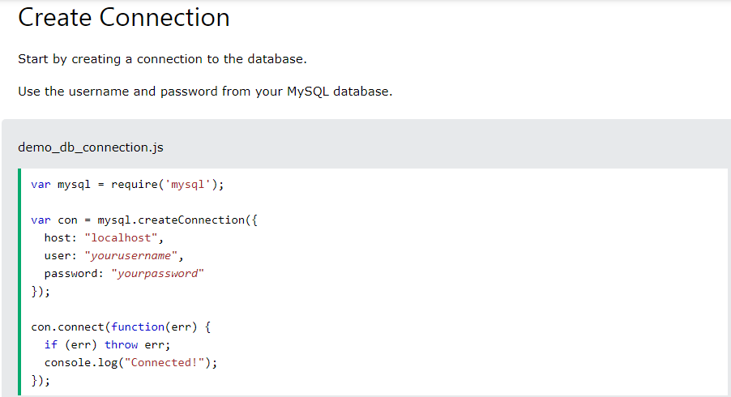
Node JS With MYSQL

Slide 11
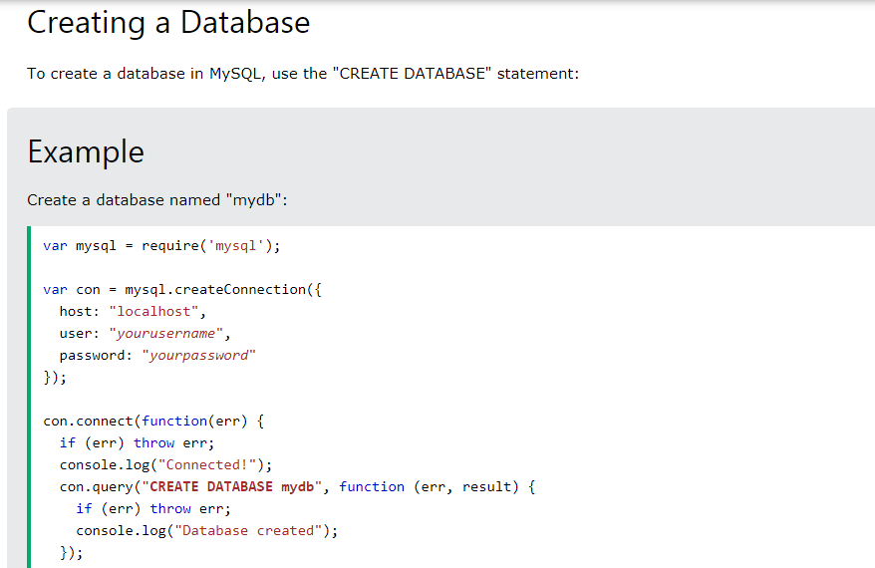

Slide 12

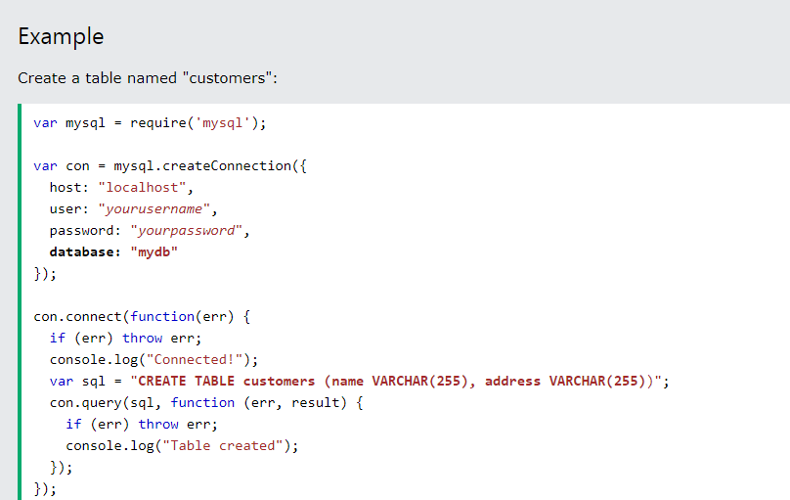
Create Table

Slide 13
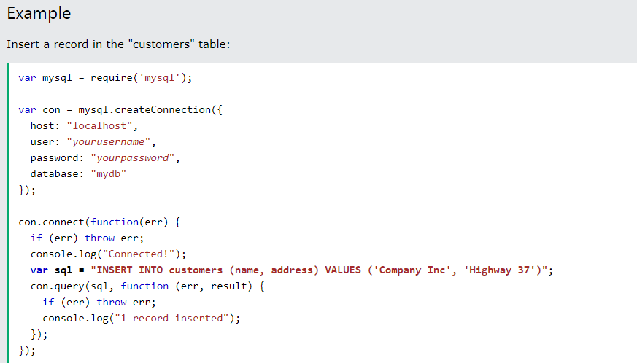
Script to insert Single Record

Slide 14
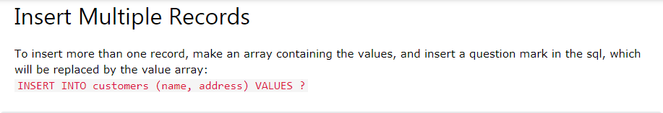
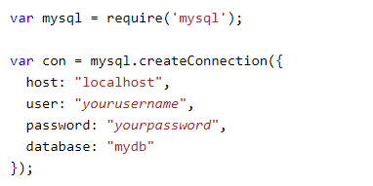
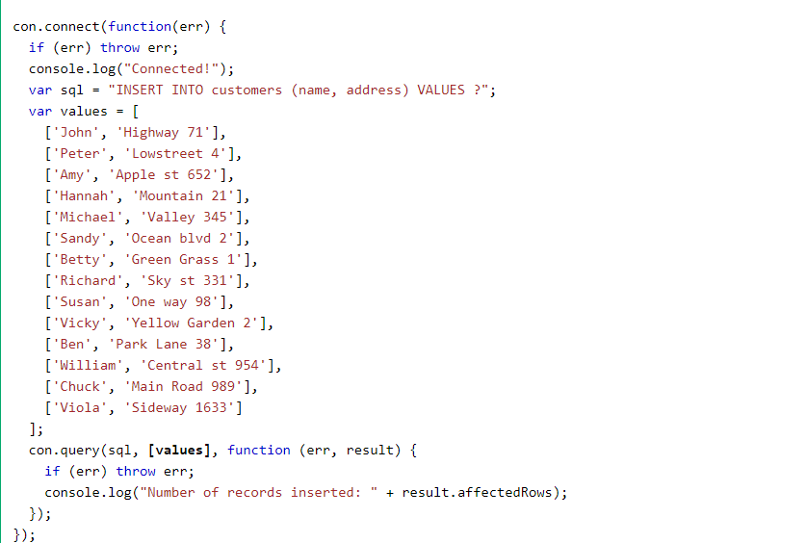
Insert Multiple Records Using array

Slide 15
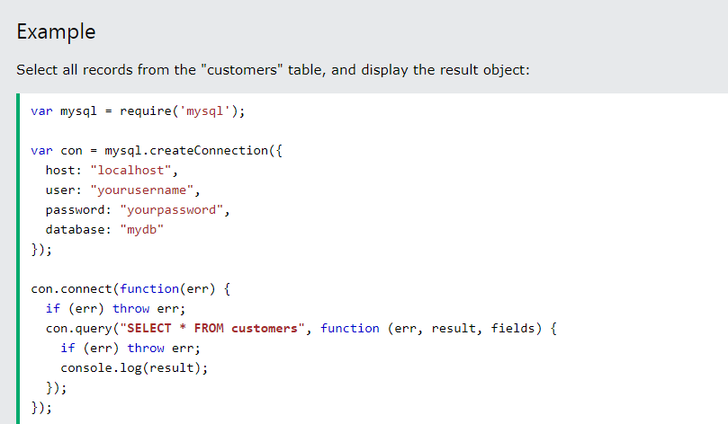

Slide 16
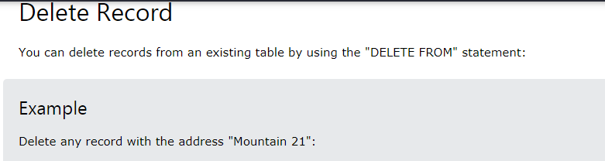
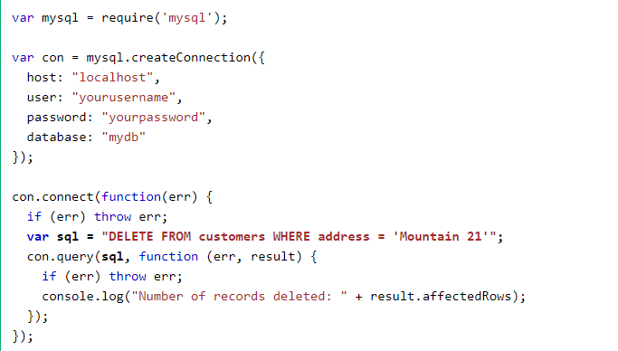

Slide 17
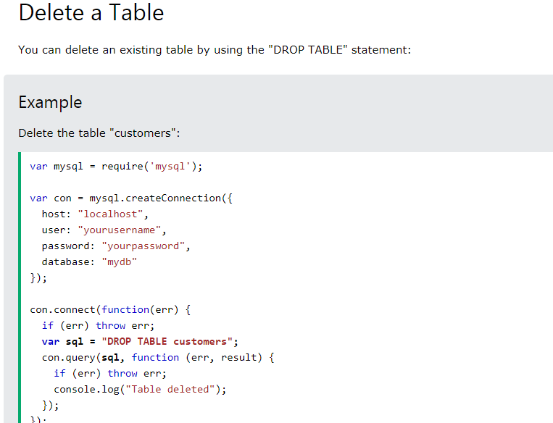

Slide 18
Thank You

