Slide 1

Microprocessor Application
Project
ARM Code Optimization for Image Converting with Keil MDK
Department
Course No.
Group No.
Electronic Engineering
2150321601 (12:00, Tue)
1
박진서 20222971 (Presenter)
이건아 20201599 장민경 20221616 정재훈 20202996

Slide 2
Table
- Outline
- Load Image
- Block diagram of Functions
- Explanation of Three Functions
- Memory Relocation
- Functions with memory relocation
- Performance comparison
- Optimization
- Result : Extracted Image
- Project Daily log
- Troubleshooting

Slide 3
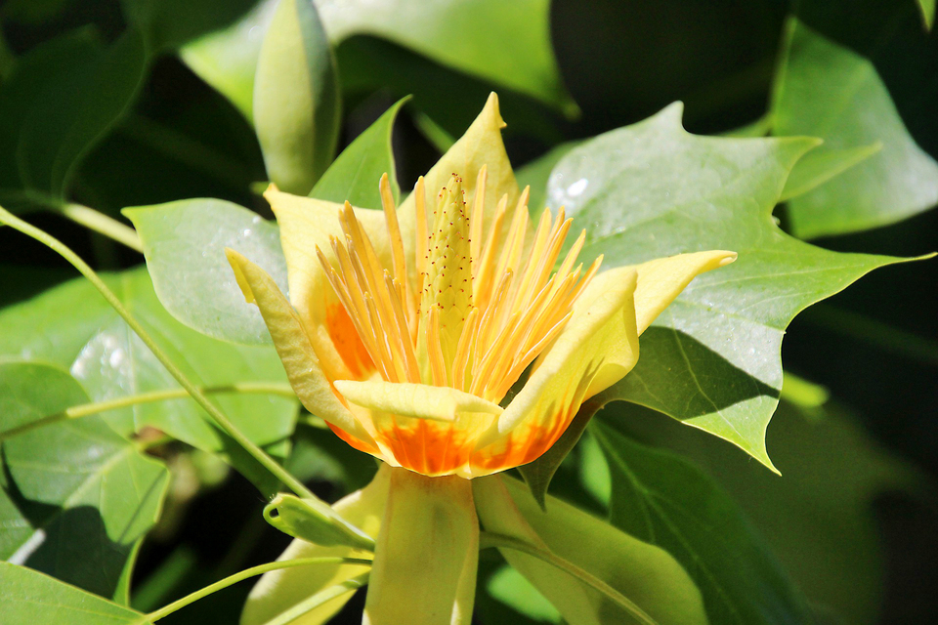
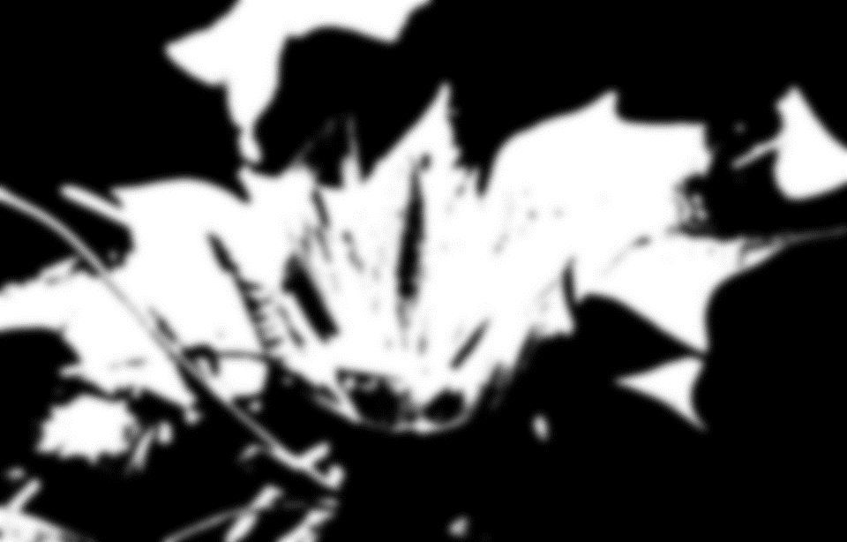


Outline
- Keil MDK를 활용, 이미지 처리 및 변환을 수행하는 ARM 코드 작성
- 작성 코드 최적화, 성능 비교 수행
32-bit RGBA
8-bit RGB
Grayscale
Binary

Slide 4
Load Image
Image
0x20000000 - …
0x30000000 - …
Image
Load
.hex
Load
Memory
0x40000000 - …
Load “C\\ …”

Slide 5
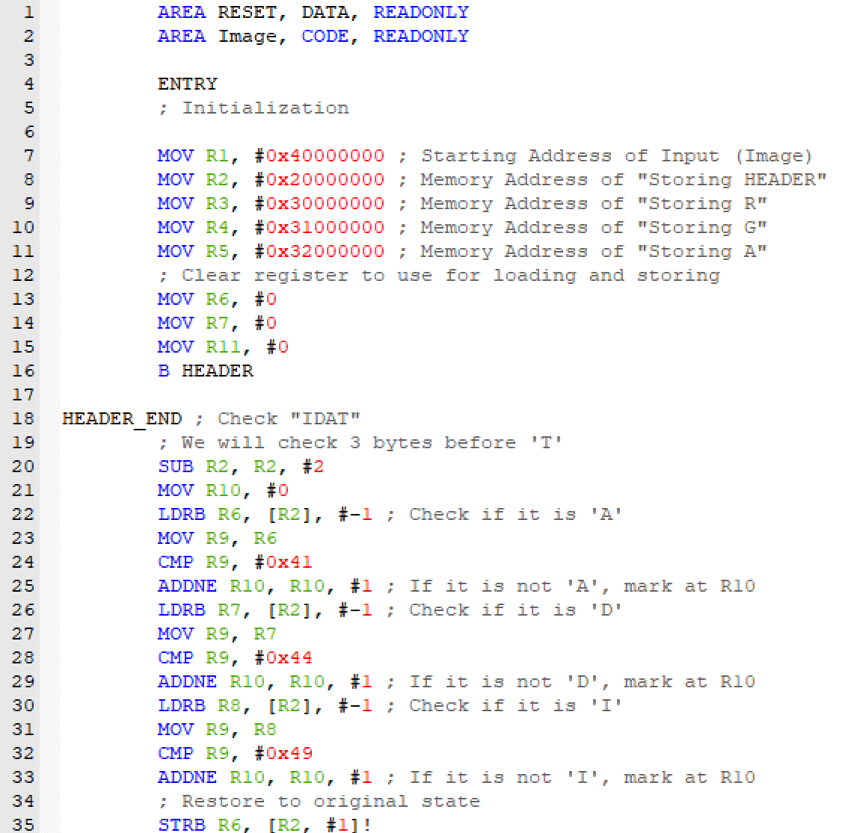
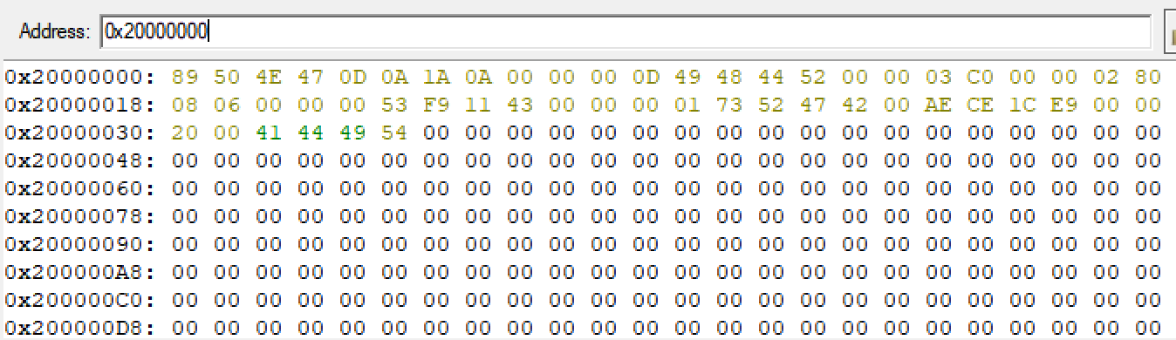
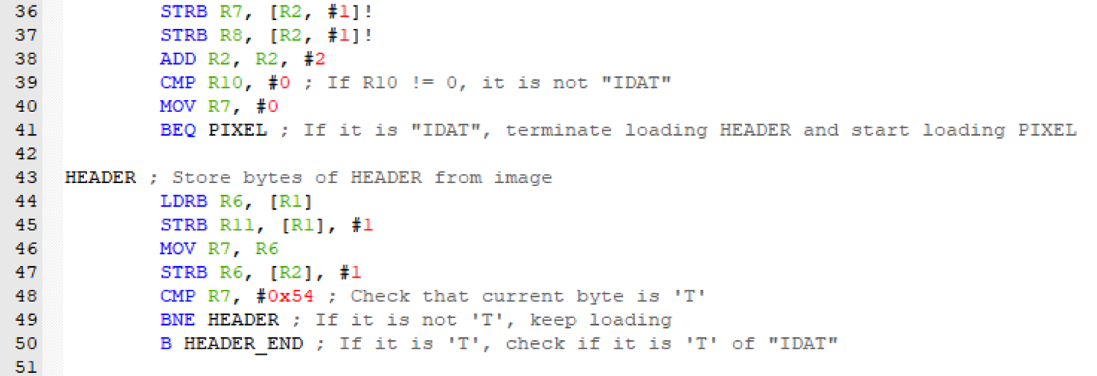
Load Image : Header
^ ^ ^ ^
0x49 = ‘I’ 0x44 = ‘D’ 0x41 = ‘A’ 0x54 = ‘T’

Slide 6
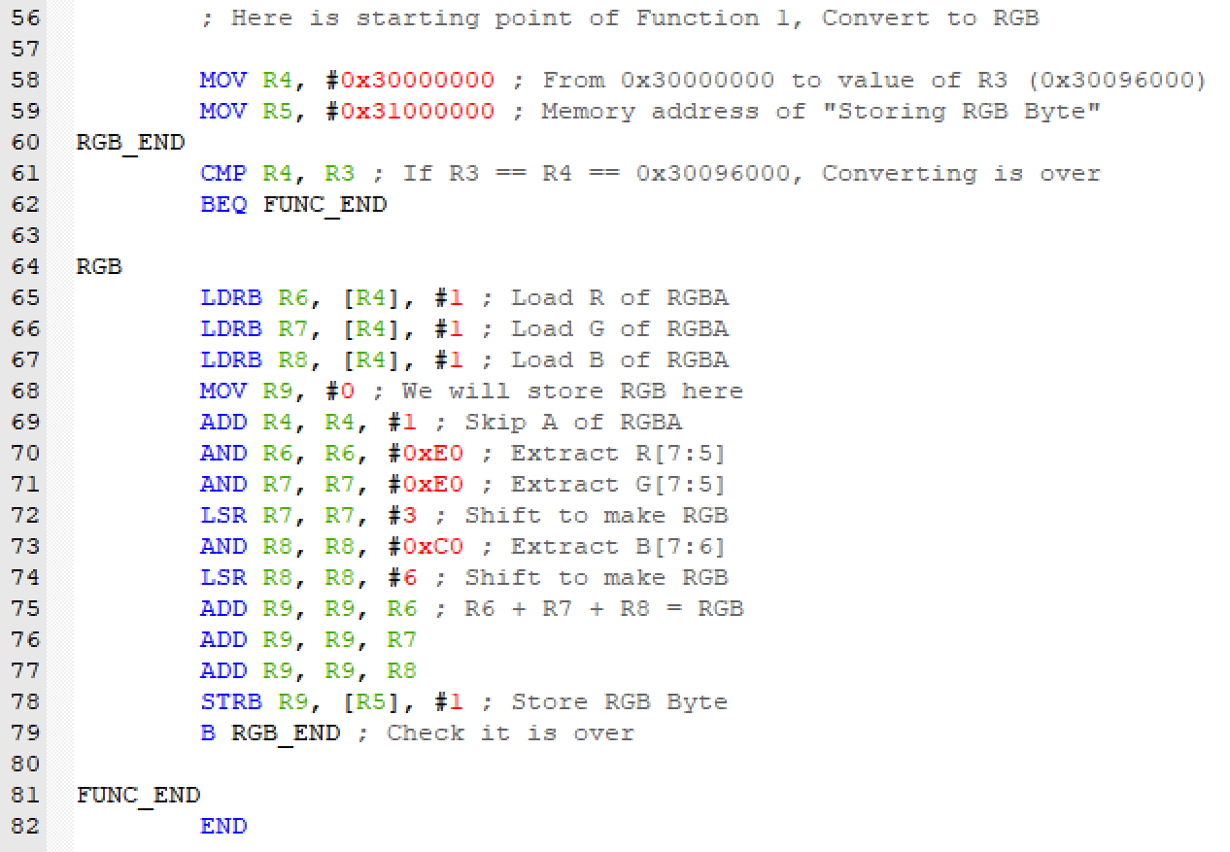
Function 1 : 8-bit RGB

Slide 7
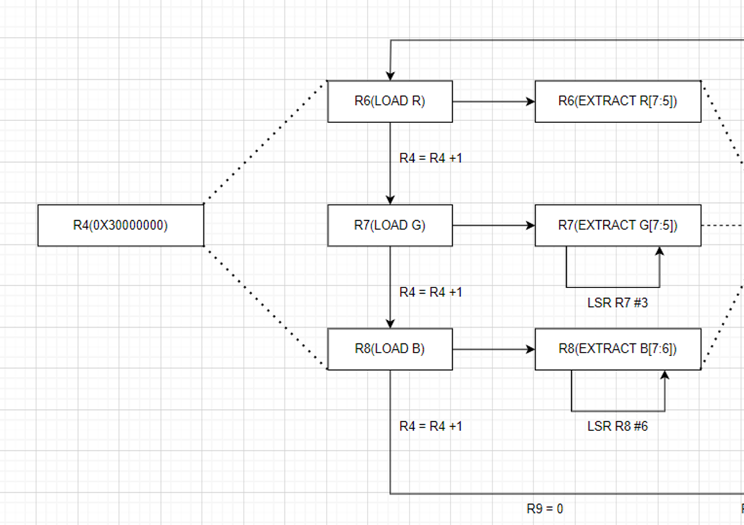
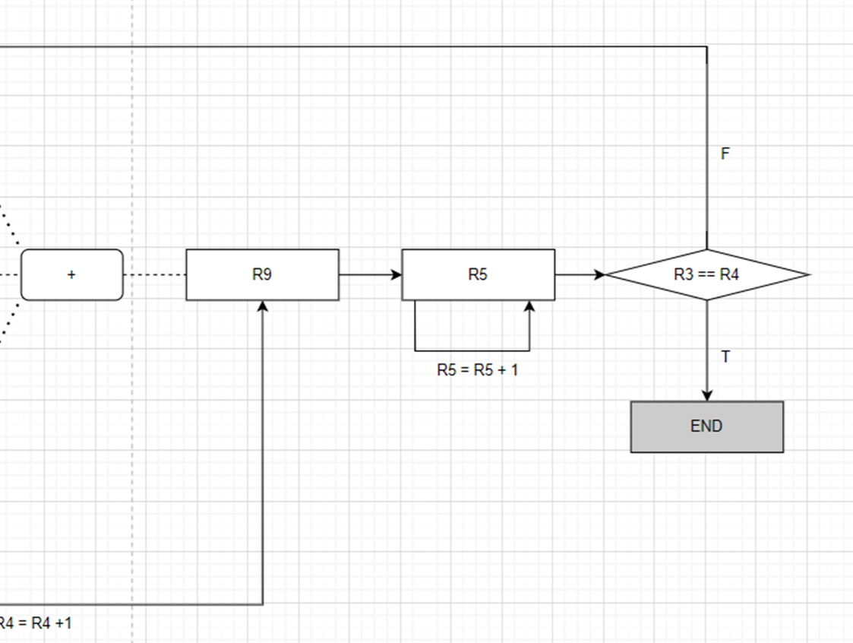
Function 1 : 8-bit RGB

Slide 8
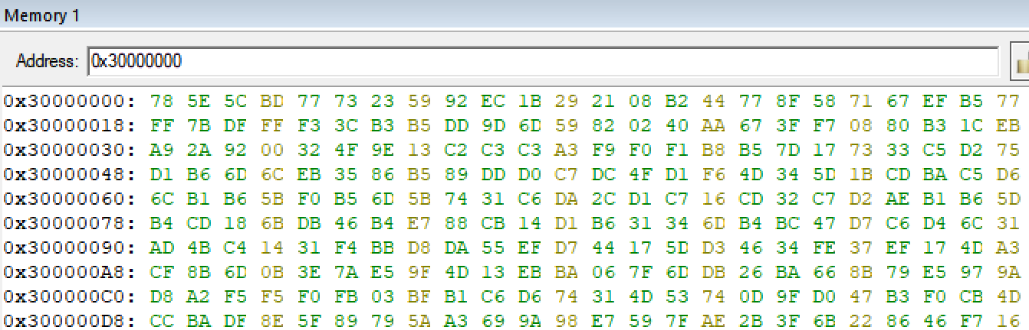
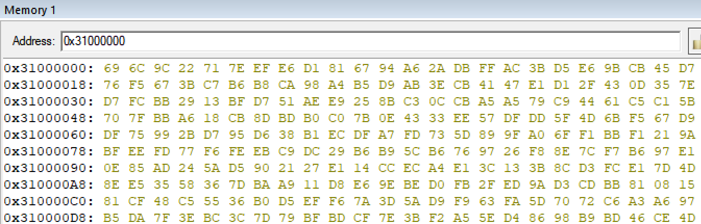
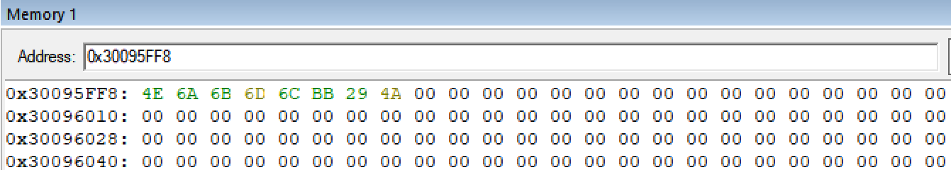
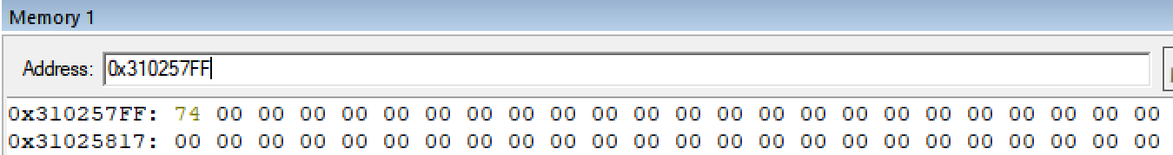
Function 1 : 8-bit RGB
32-bit RGBA
0x30000000 - 0x30095FFF
614,400 Bytes
8-bit RGB
0x31000000 - 0x310257FF
153,600 Bytes
÷ 4

Slide 9
Function 1 : 8-bit RGB
^ ^ ^ ^
0x30000000 - 0x30000003
(R) 0x78 = 01111000
(G) 0x5E = 01011110
(B) 0x5C = 01011100
0xBD = Not used
^
0x31000000
(RGB) 0x69 = 01101001

Slide 10
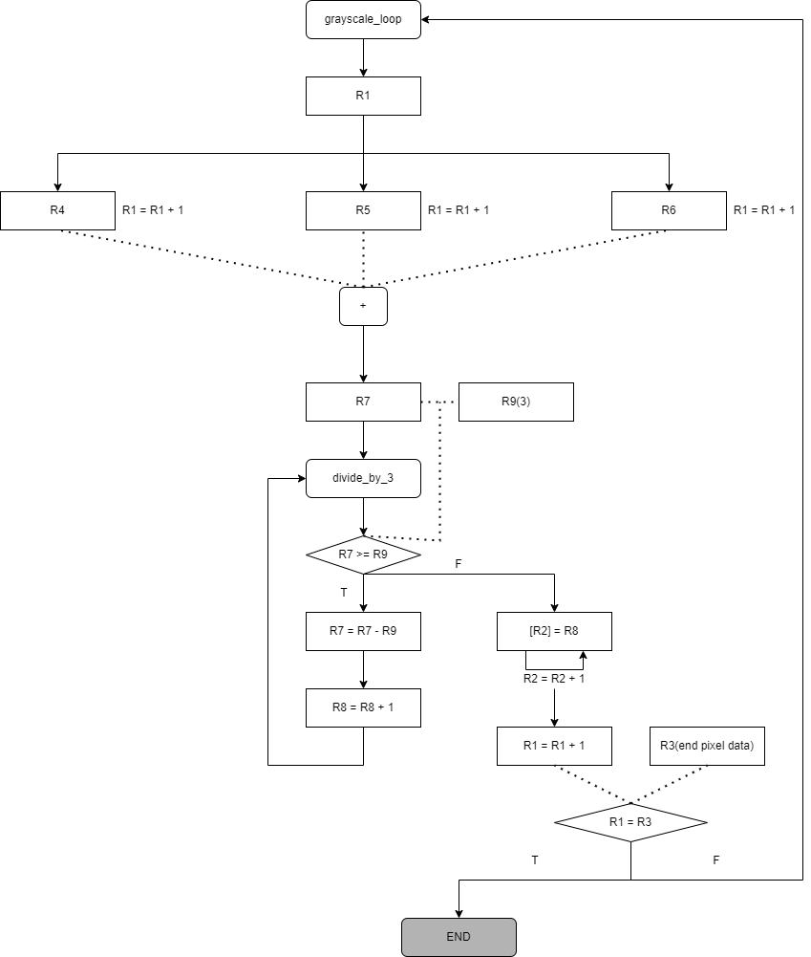
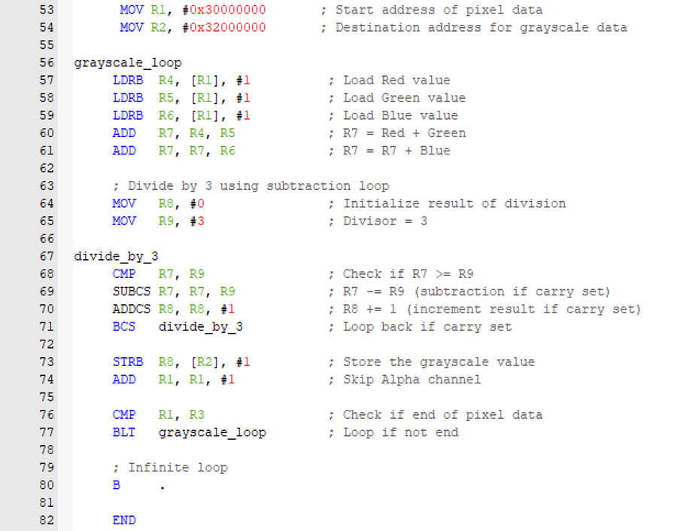
Function 2 : Grayscale

Slide 11
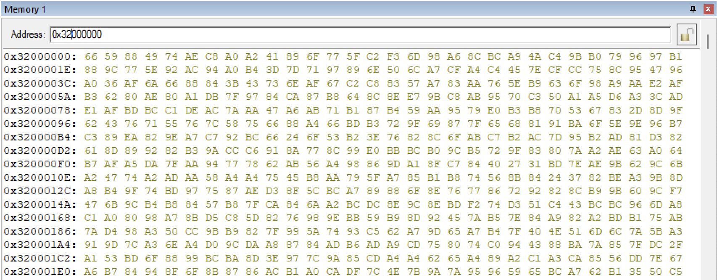
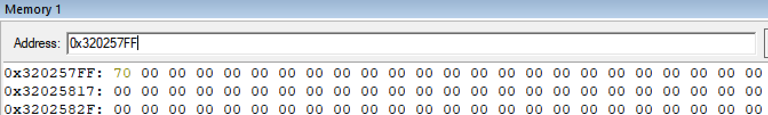
Function 2 : Grayscale
32-bit RGBA
0x30000000 - 0x30095FFF
614,400 Bytes
8-bit Grayscale
0x32000000 - 0x320257FF
153,600 Bytes
÷ 4

Slide 12
Function 2 : Grayscale
^ ^ ^ ^
0x30000000 - 0x30000003
(R) 0x78 = 01111000
(G) 0x5E = 01011110
(B) 0x5C = 01011100
0xBD = Not used
0x78 (120) + 0x5E (94) + 0x5C (92) = 0x132 (306)
306 / 3 = 102
^
0x32000000
(Grayscale) 0x66 (102)

Slide 13
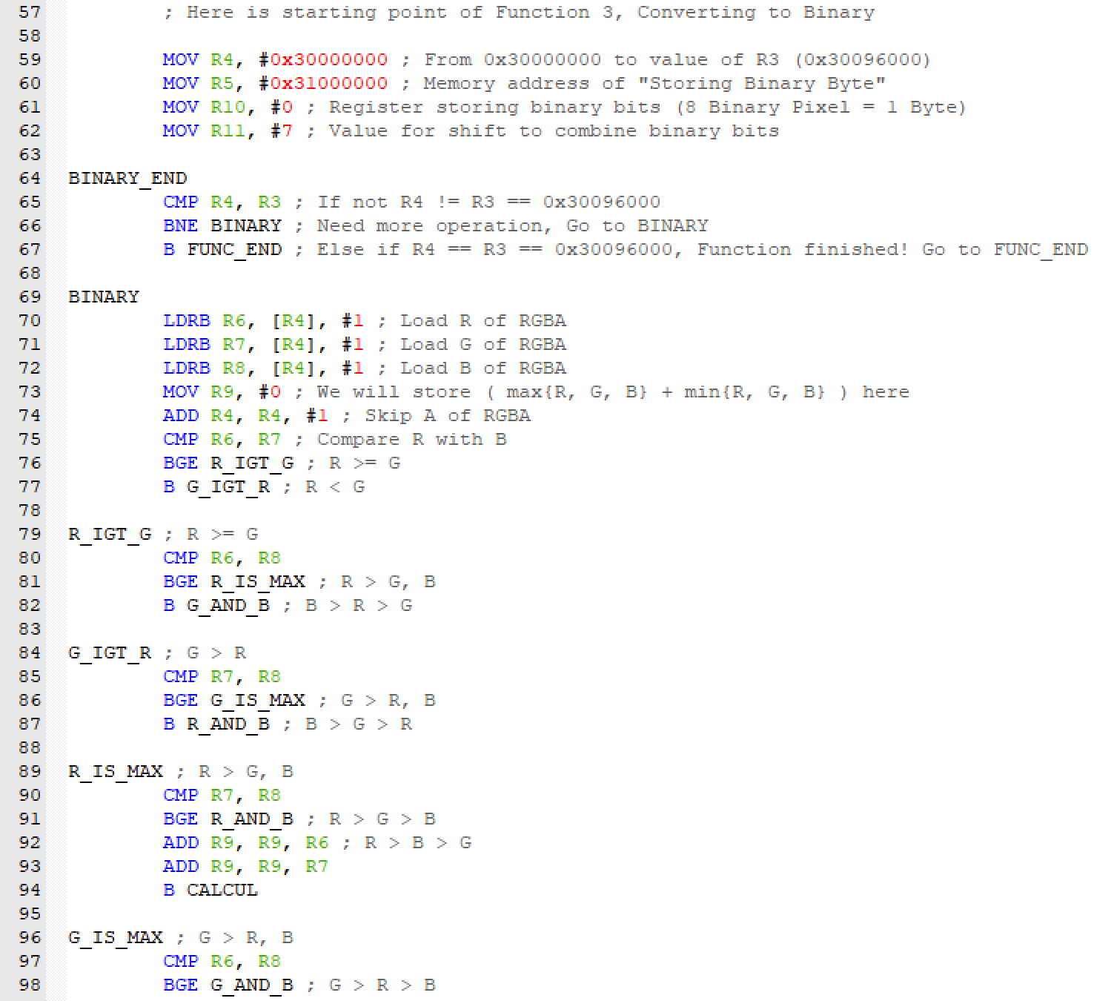
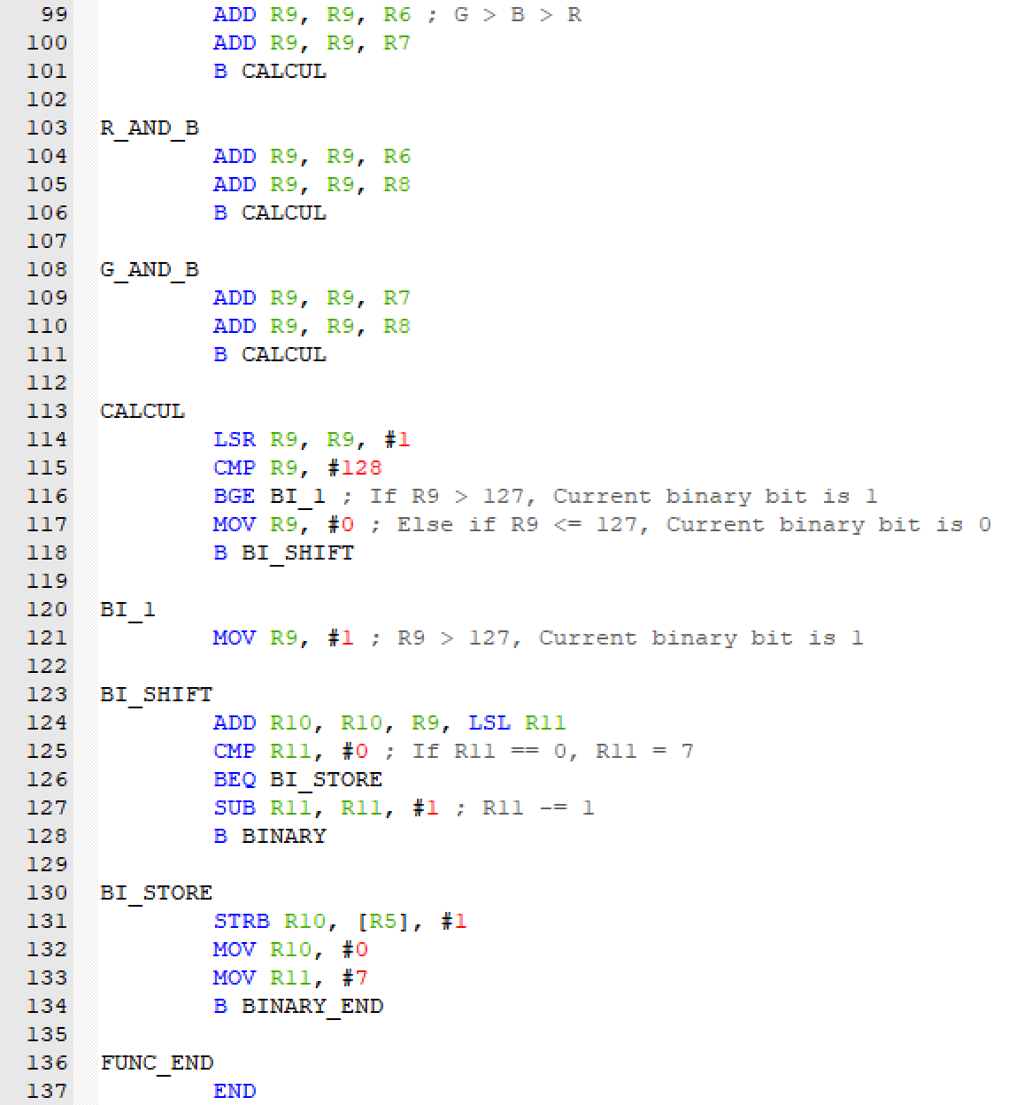
Function 3 : Binary

Slide 14
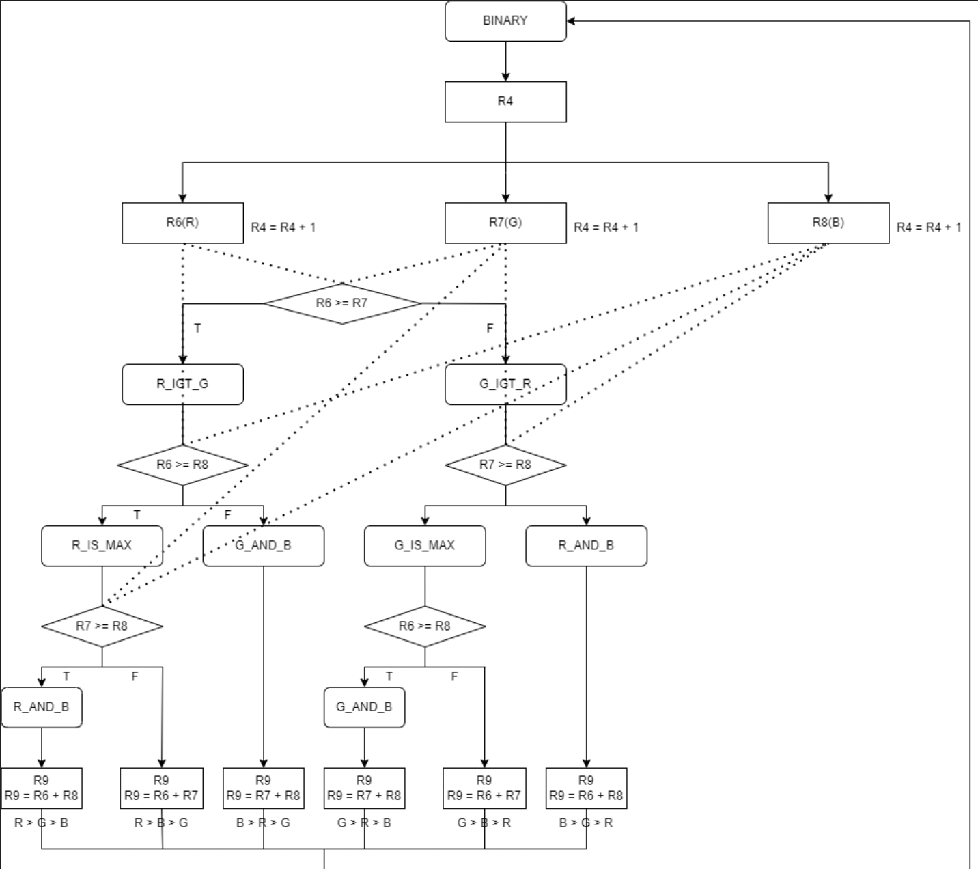
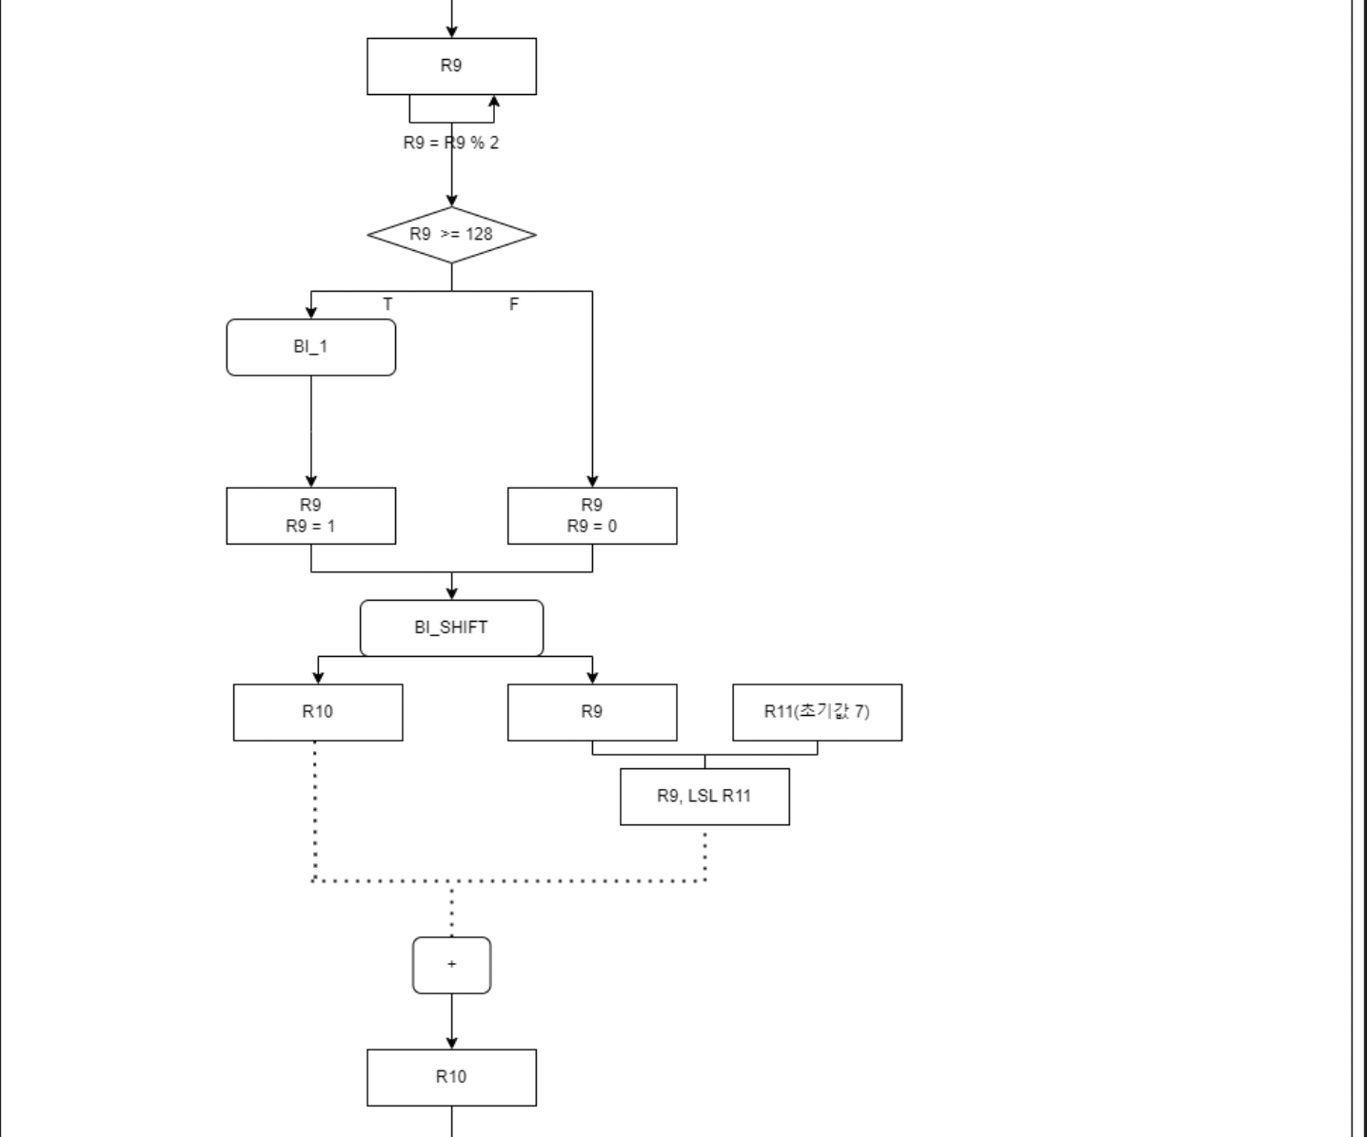
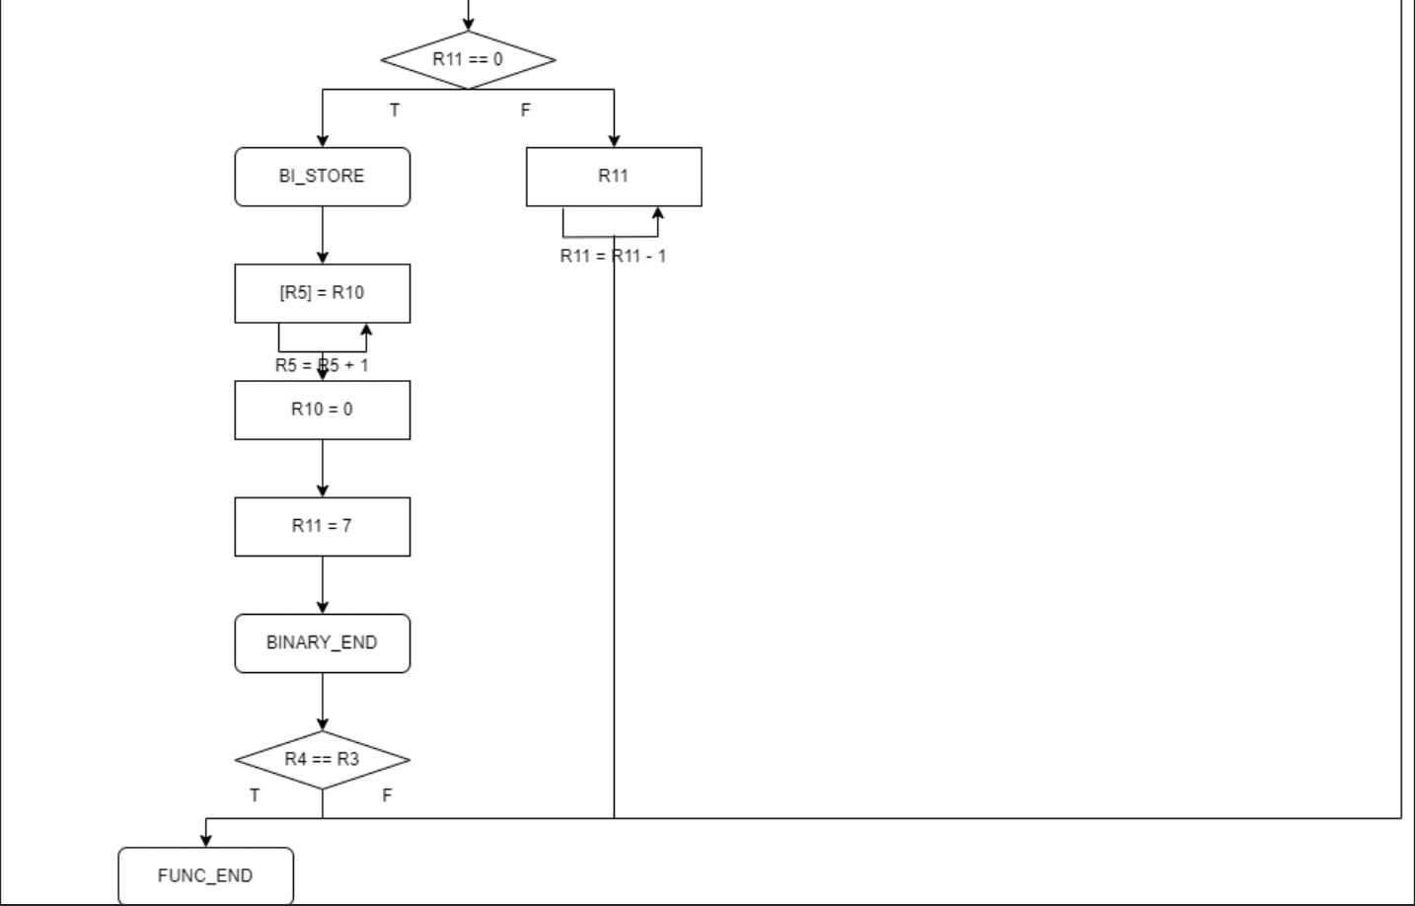
Function 3 : Binary

Slide 15
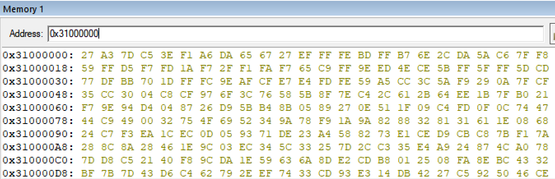
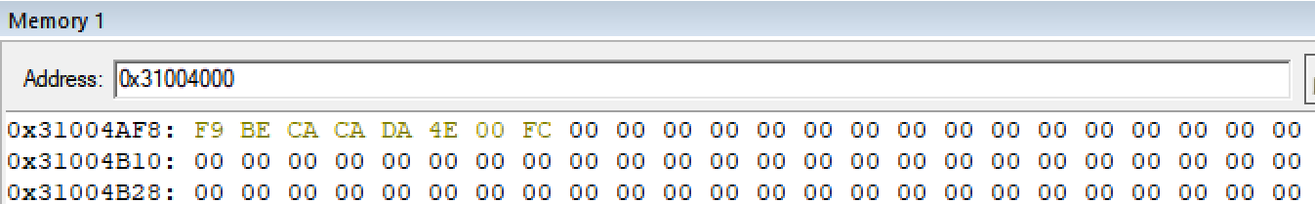
Function 3 : Binary
32-bit RGBA
0x30000000 - 0x30095FFF
614,400 Bytes
1-bit Binary
0x31000000 - 0x31004AFF
19,200 Bytes
÷ 4 ÷ 8

Slide 16
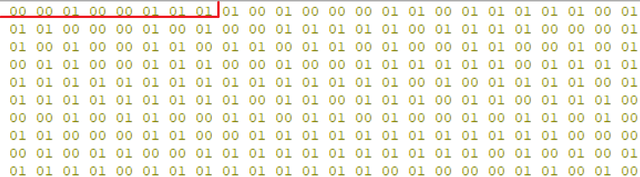
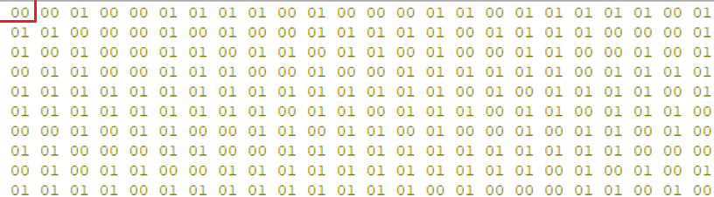
Function 3 : Binary
^ ^ ^ ^
0x30000000 - 0x30000003
(R) 0x78 = 01111000
(G) 0x5E = 01011110
(B) 0x5C = 01011100
0xBD = Not used
Max : 0x78 = 120 / Min : 0x5C = 98
(Max + Min ) / 2 = 101 < 127
[ Result ] 0
^
0x31000000
(RGB) 0x27 = 00100111

Slide 17
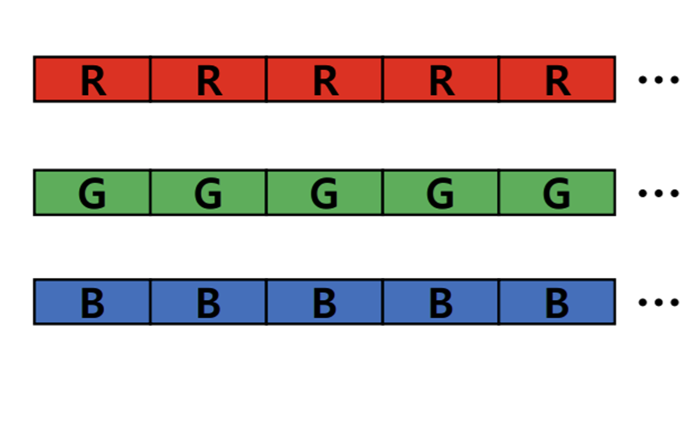
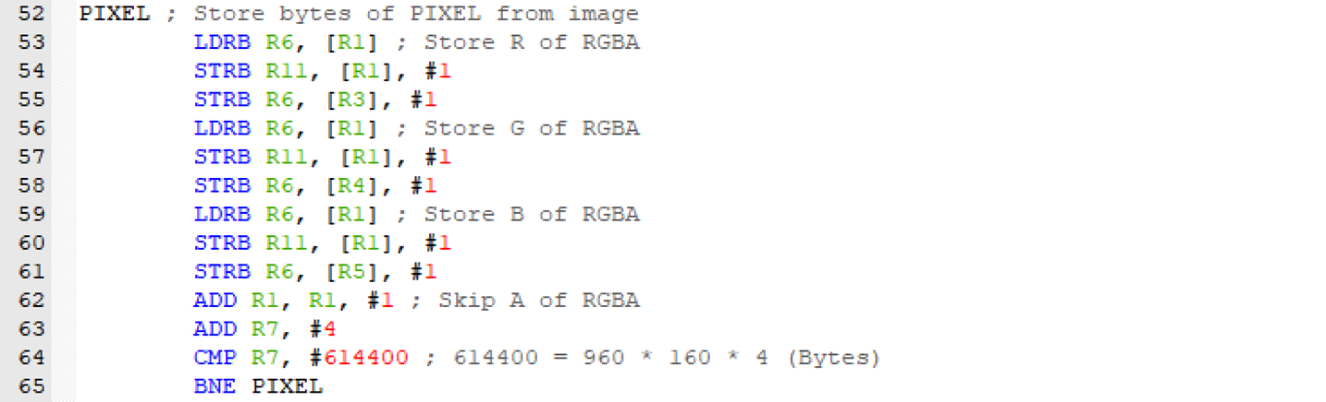
Memory Relocation
R3
←
R4
←
R6
←
Image
←
R5
“Image를 Memory에 탑재하는 과정에서 A를 제외하고 R / G / B를 따로 배치”

Slide 18
Memory Relocation : Effect
투명도 정보 손실 이미지 파일 크기 감소
호환성 증가
색상 왜곡 X 추가 정보 (배경 색상) 필요

Slide 19
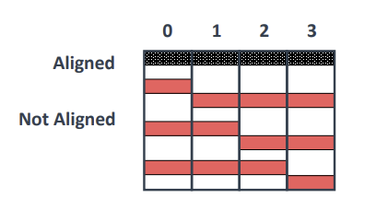
Memory Relocation : Effect
* Image by Prof.
[!] Word-aligned

Slide 20
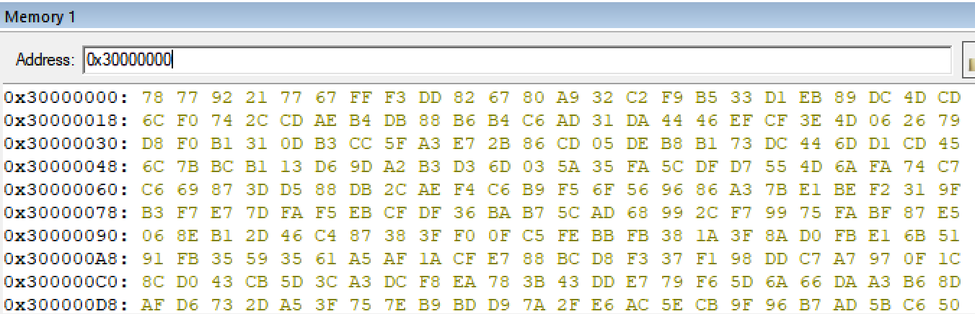
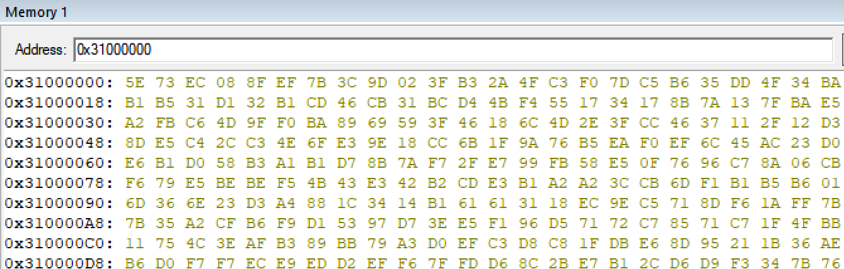
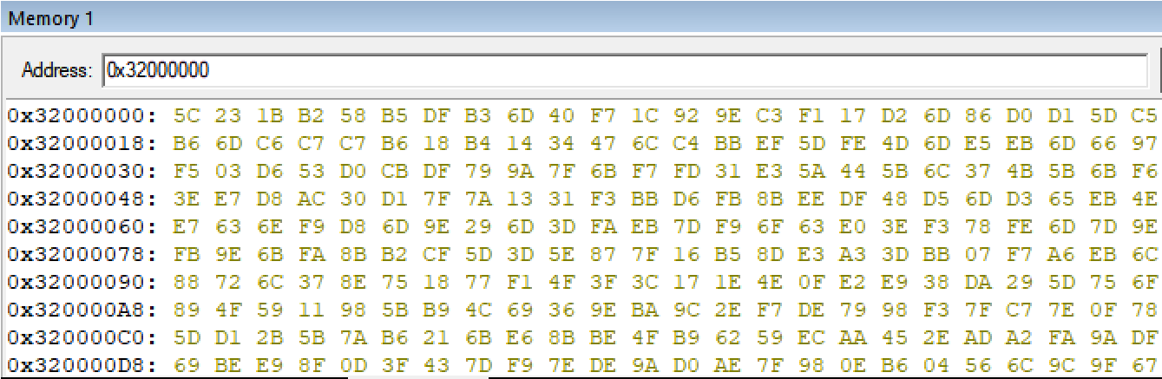
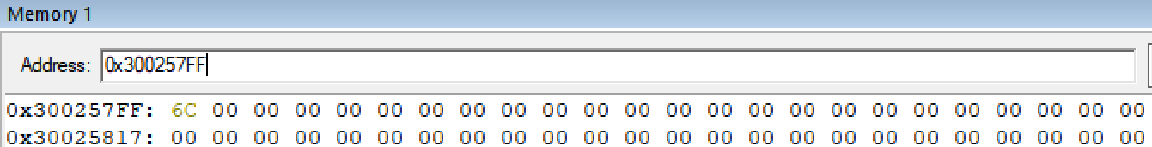
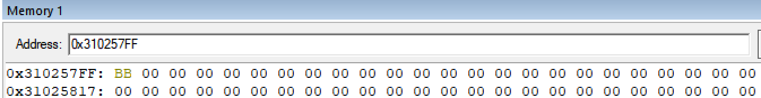
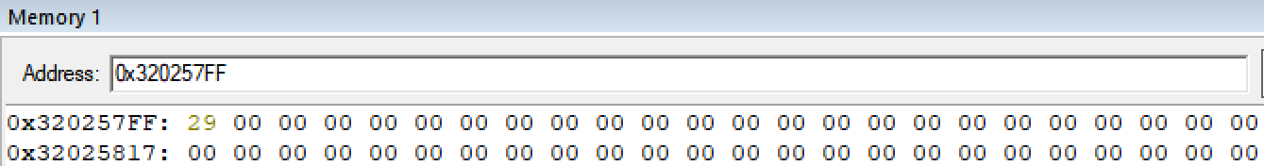
Memory Relocation
R
0x30000000 - 0x300257FF
153,600 Bytes
G
0x31000000 - 0x310257FF
153,600 Bytes
B
0x32000000 - 0x320257FF
153,600 Bytes

Slide 21
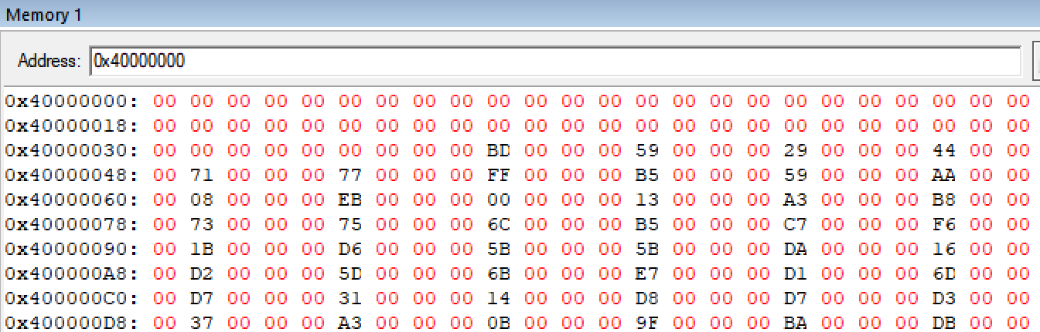
Memory Relocation
A Skip

Slide 22
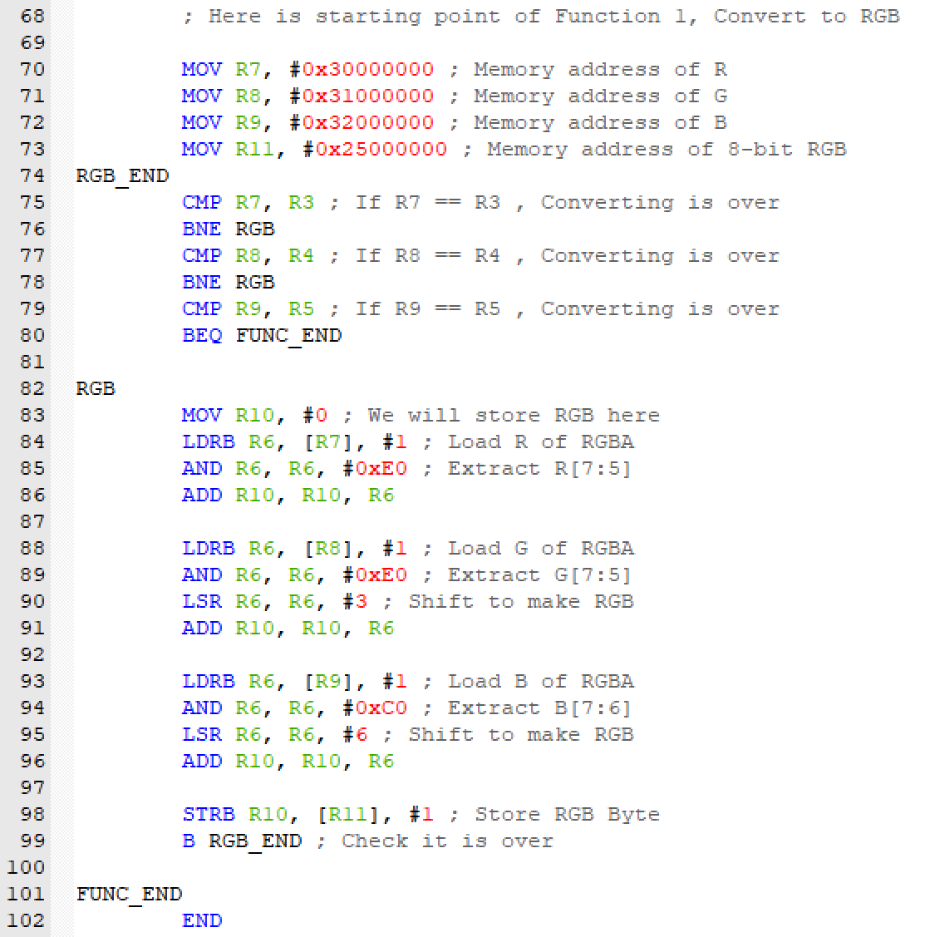
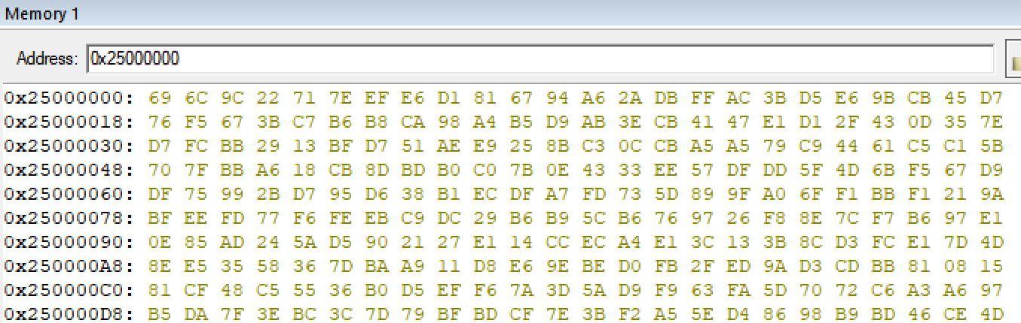
Memory Relocation : 8-bit RGB
Before
Memory Relocation
After
Memory Relocation

Slide 23
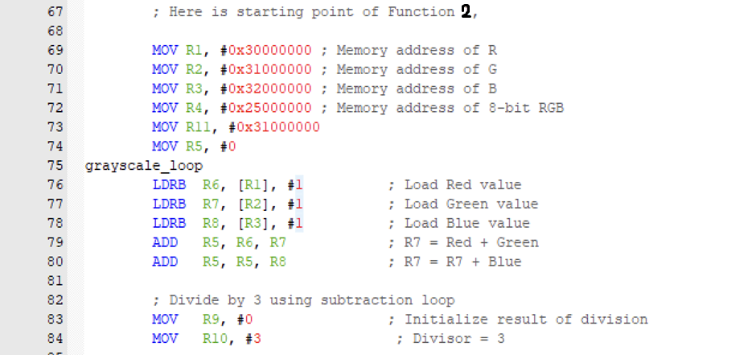
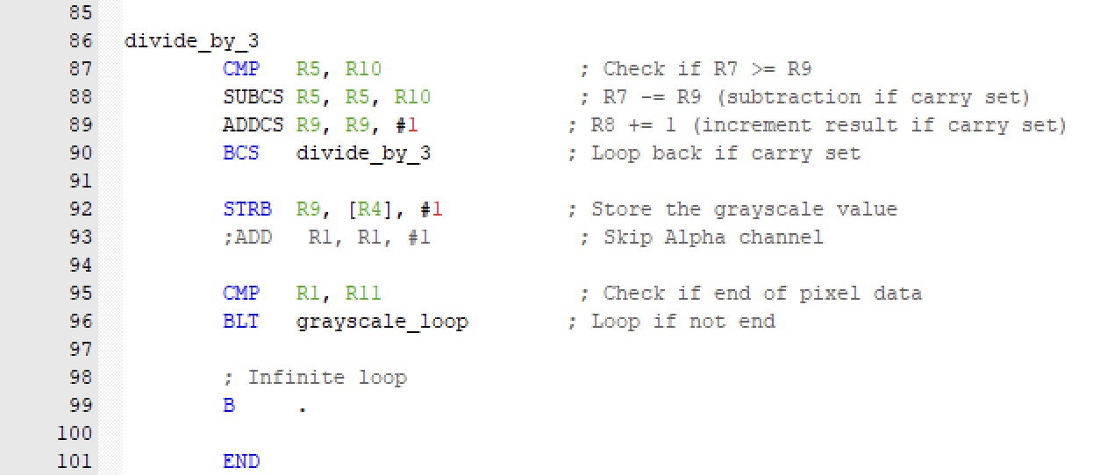
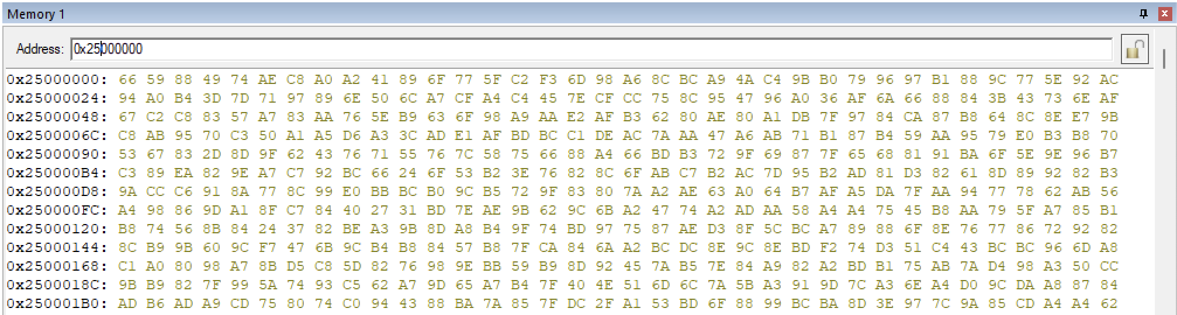
Memory Relocation : Grayscale
Before
Memory Relocation
After
Memory Relocation

Slide 24
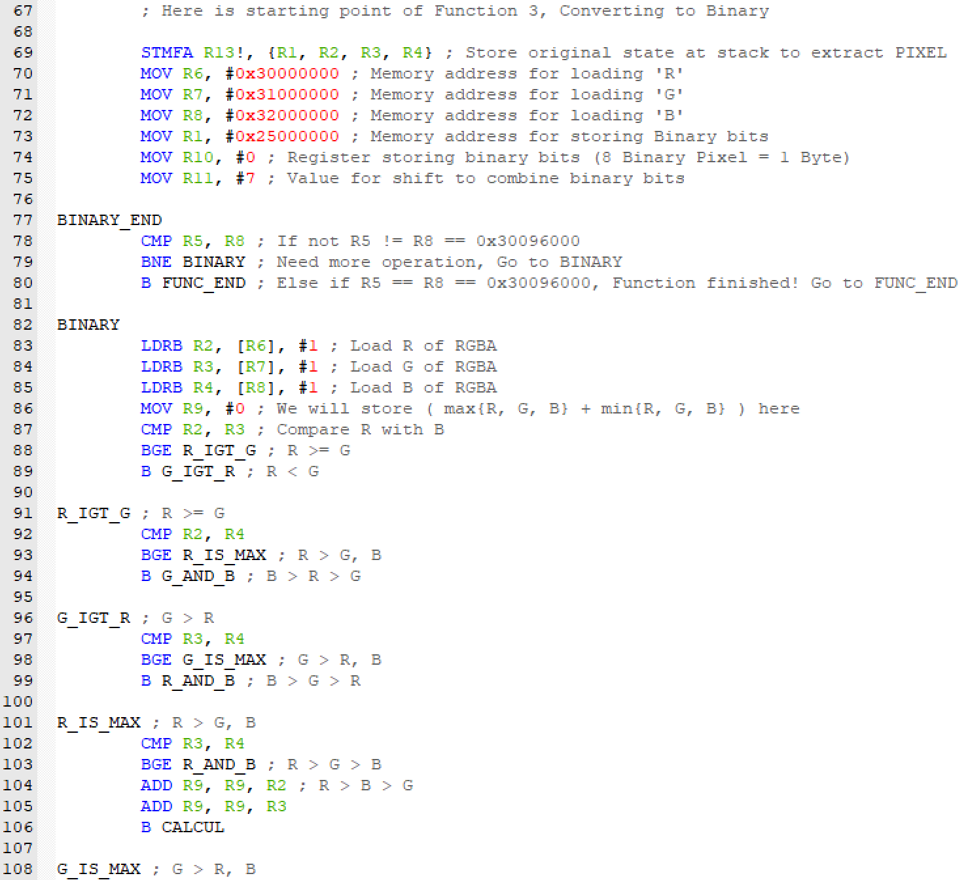
Memory Relocation : Binary

Slide 25
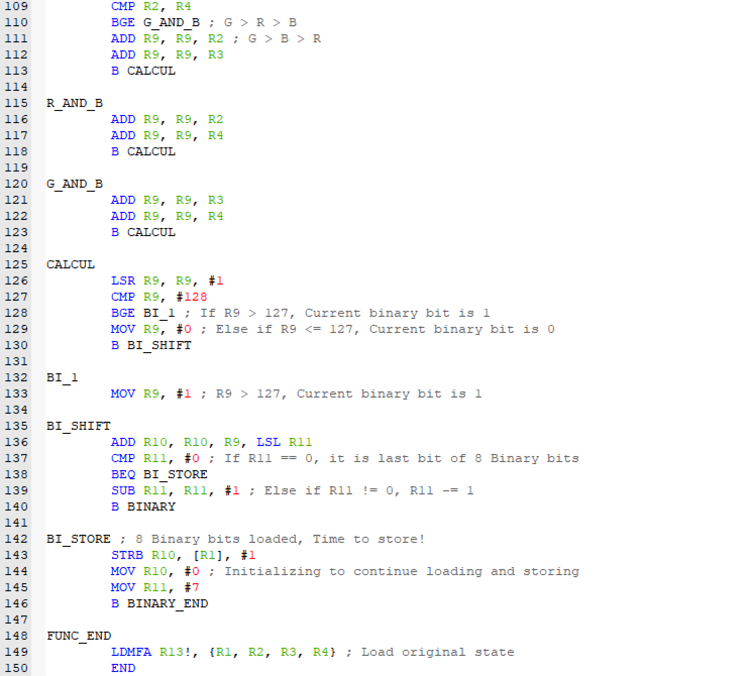

Memory Relocation : Binary
Before
Memory Relocation
After
Memory Relocation

Slide 26
Performance Comparison : # of Instruction

Slide 27
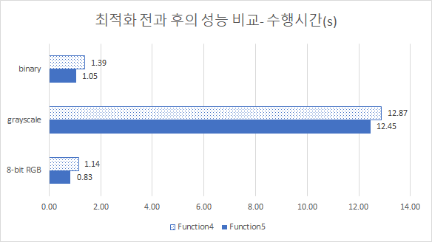
Performance Comparison : Run-Time
- 전체적으로 명령어 개수는 증가
- BUT 수행 시간은 감소
- 8-bit RGB 27% 감소
- Grayscale 3.3% 감소
- Binary 24.5% 감소

Slide 28
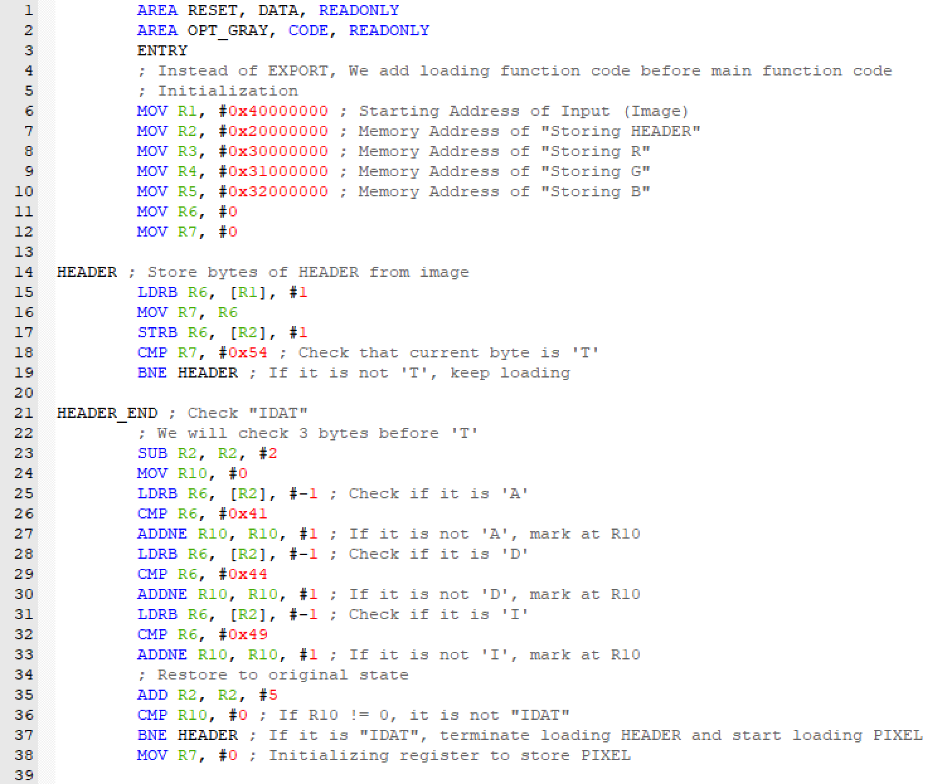
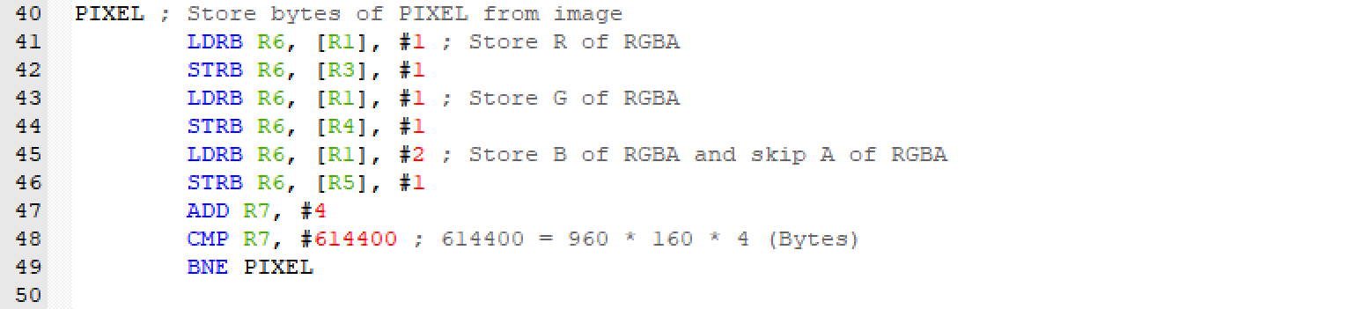
Optimization : Memory Relocation Part
- Load한 Image 데이터를 0으로 대체하는 동작 생략
- 불필요한 복원 명령어 (LDR – MOV – STR) 삭제
IDAT 순서가 바뀌는 문제 해결
- 특정 값 판별 시 사용하는 Register 단일화
- Alpha를 Skip하는 과정을 Blue를 Load하는 명령어에 병합

Slide 29
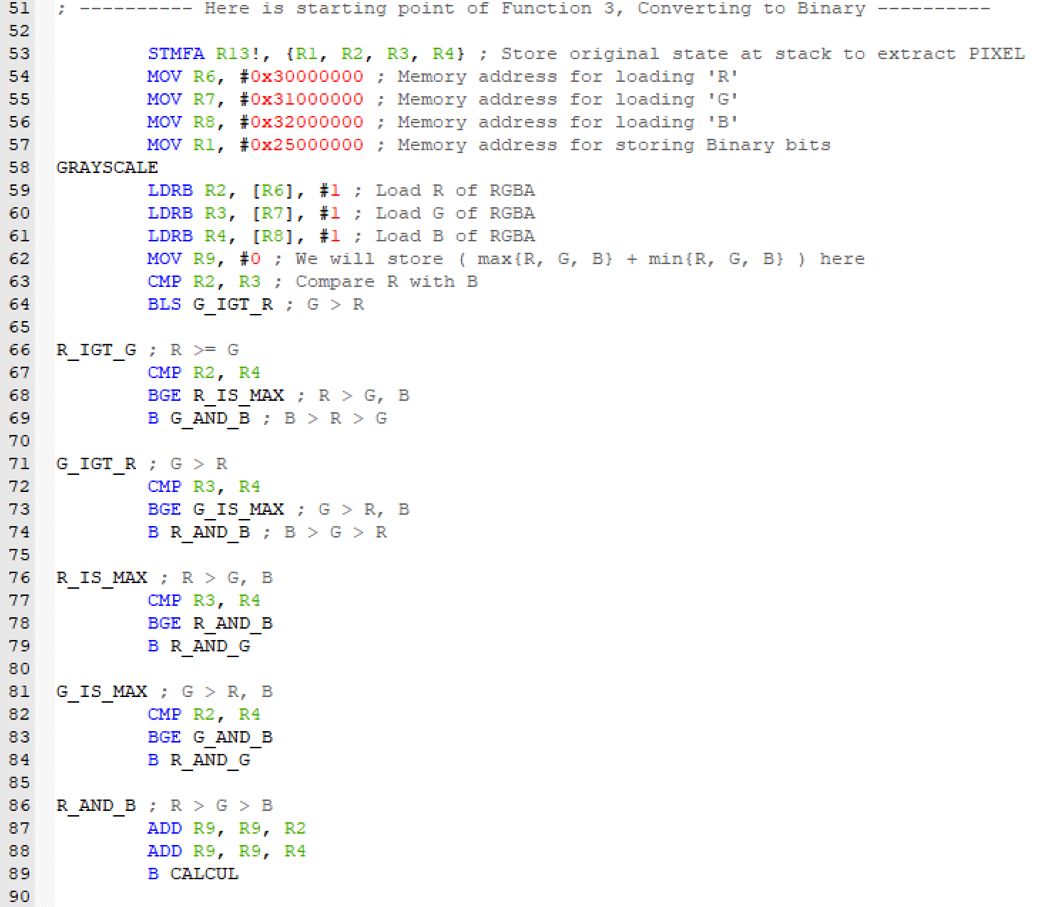
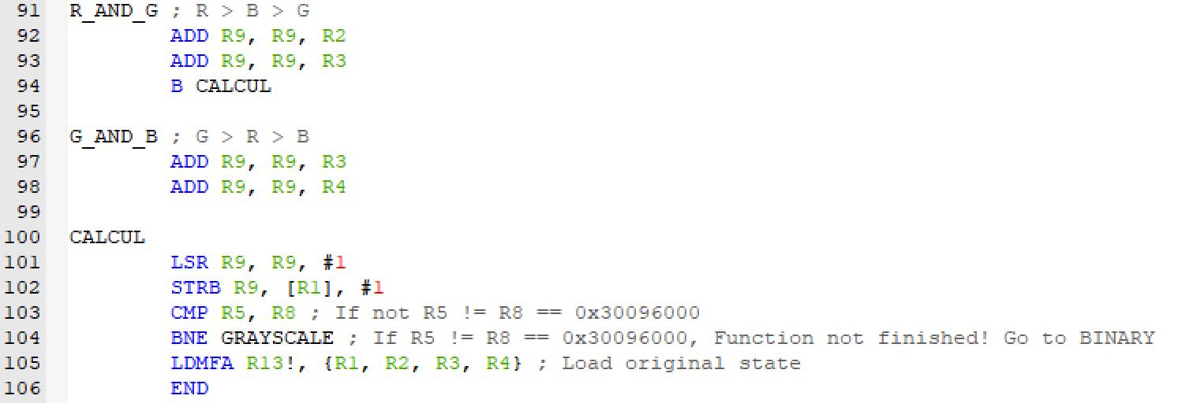
Optimization : Function Part
- (공통) 명령어 실행의 유연성을 위해 Label, 명령어 순서 변경
- (8-bit RGB) 함수 종료를 위한 명령어 축소
- (Grayscale) 값 계산 방법 변경 (왼쪽 Code)
- (Binary) 0 또는 1 저장 과정 단축

Slide 30
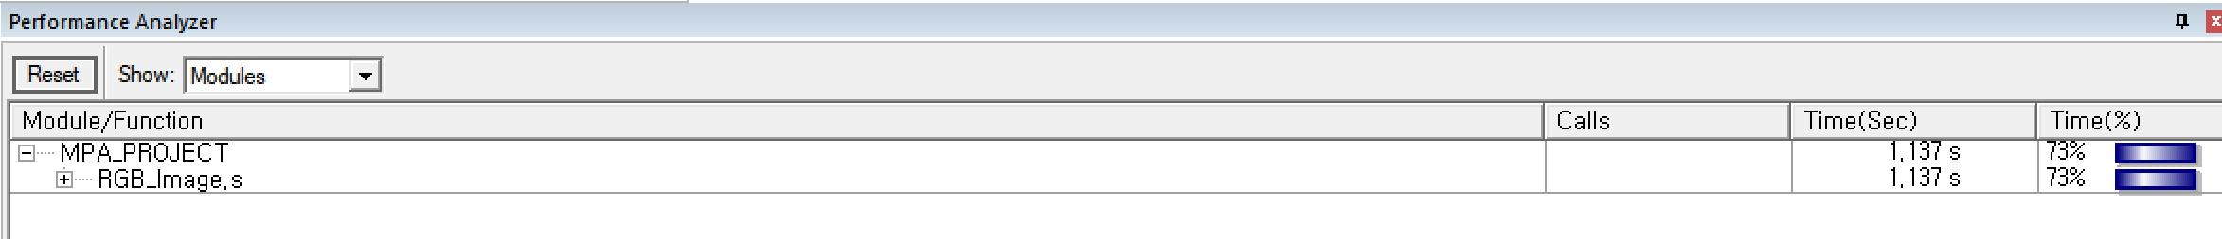
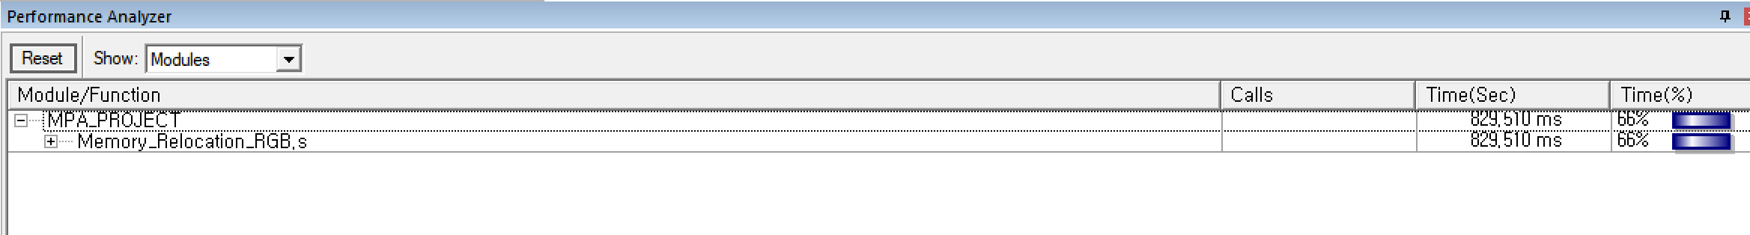
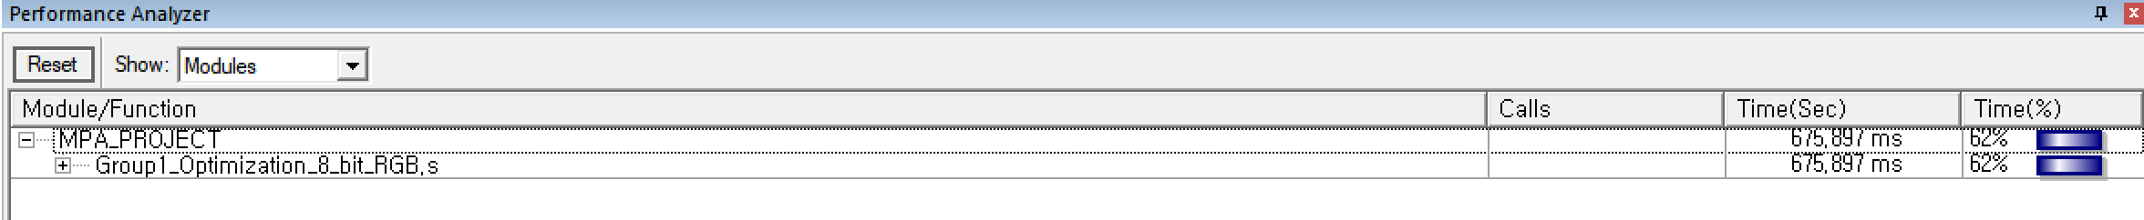
Optimization : 8-bit RGB
Before Memory Relocation
1.137 s
After Memory Relocation
0.830 s
Instruction
Time
- 19 Instructions
- 18.52%
After Optimization
0.676 s

Slide 31


Optimization : Grayscale
Before Memory Relocation
12.866 s
After Memory Relocation
12.455 s
Instruction
Time
- 2 Instructions
- 1578%
After Optimization
0.789 s

Slide 32


Optimization : Binary
Before Memory Relocation
1.390 s
After Memory Relocation
1.052 s
Instruction
Time
- 19 Instructions
- 12.24%
After Optimization
0.923 s

Slide 33


Extracted Image

Slide 34

Extracted Image
Condensed RGBA
New RGBA

Slide 35



Extracted Image
8-bit RGB
Grayscale
Binary

Slide 36



Result : Extracted Image
8-bit RGB
Grayscale
Binary

Slide 37
Troubleshooting
🤔

Slide 38
Thank you :)

