Slide 1

Online Charity Management System Major Project KCS 753/ 7th Sem
STUDENT NAME:
1.Kunal Srivastava(2000320120099)
2.Kapil Panwar(2000320120093)
3.Himanshu Sikarwar(2000320120085)
4.Mradul Pratap(2000320120111)
SUPERVISOR NAME:
Dr. Neha Gupta
CS Department

Slide 2
ABSTRACT
The majority of NGOs have had trouble obtaining cash or other necessary items. Obtaining donors is a highly difficult endeavour, and occasionally dealing with some donors' conditions can be quite difficult for NGOs to complete. This charity management system will make it simple for NGOs to locate contributors.
This system has three modules: Management (Admin), NGO, and Donor.
In this,admin can oversee the request made by the NGO by approving or denying it by logging in with their credentials. After examining the NGO documents that were uploaded by the NGO, approval will be given.
Donors only need to register and login using their credentials. They will be notified of the donation request put forth by NGOs. Upon request approval, they must fill out the donation information. The donor will receive the contribution date. They can also view the history of donations .
A charity management system is a specialized software/website designed for organizations to automate the process of managing their donor relations, fundraising campaigns, and overall financial operations

Slide 3
OBJECTIVE
● The main aims and objectives of this project is to design a website that helps the Donors and The NGO’s Ease their work.
● Develop and integrate an automated system to improve service and reduce time spent on calls and inquiries.
●Create an online payment gateway so people can easily pay via their phones.
● Design and implement users register page, login, and online appointment booking.
●Therefore, we want a charity management system to be create for the distribution of charitable donation,so that people are aware of the surplus and share it with the poor who need help.

Slide 4
Scope the Problem Statement
The ' CineSense - Your Go-To Movie Recommender System ' project involves creating a streaming platform resembling Netflix, enhanced with a personalized recommendation system driven by TMDB data
The project will encompass user profiles, content library, streaming capabilities, responsive UI, and an advanced recommendation algorithm.
The scope also includes backend setup, API integration, and deployment.
By achieving these goals, 'CineSense - Your Go-To Movie Recommender System' aims to showcase expertise in full-stack development, API utilization, and user-oriented design, contributing to an innovative content discovery experience."

Slide 5
LITERATURE REVIEW
S.No : 1
TITLE : Improve quality of servicing of website
AUTHORS : Buuer, H.H.Falk, Hammerschmidt
Year of Publication : 2006
Journal/Conference/Book Chapter Name: Quality and Services
Technology / Algorithm Used : eTransQual, Java Script
Summary : A transaction process-based approach for improving the service quality of online transactions and make the website response faster.
Gap :React only deals with the View from MVC therefore we need other tooling to finish the backend development too .Reacts environment changes so fast that developers often find it difficult to adopt to the new changes, relearn and implement them.

Slide 6
LITERATURE REVIEW
S.No : 2
TITLE : Online wait managed
AUTHORS : Lee, Chen, A.n. Ilie
Year of Publication : 2012
Journal/Conference/Book Chapter Name: Response Time
Technology / Algorithm Used : jquery, Css
Summary :The effect of filter interfaces and presentations modes on perceived waiting time online and enhance the quality of response to the customers query online fastly or in time.
Gap : It does not tell about the use of hooks in React JS and there can be some cons of React too like heavy codes , less documentation available . Don’t tell us how to fetch data as per user choice.

Slide 7
LITERATURE REVIEW
S.No : 3
TITLE : Contribution. Giving lead to happiness
AUTHORS : Liu, Aaker
Year of Publication : 2008
Journal/Conference/Book Chapter Name: J.Consumer Research
Technology / Algorithm Used : Knowledge Contribution
Summary : Two distinct mind-set that influence consumers’ willingness to donate a chantable causes (monetary donation and volunteer time). This effect reaches from different mindsets caused by money versus time.
Gap: Deployment challenges such as cold start, scalability, sparsity, etc. Challenges faced when employing different recommender algorithms for different applications, In collecting implicit user data, and in handling real-time user feedback.

Slide 8
LITERATURE REVIEW
S.No : 4
TITLE: Prosocial attitude, Organizational ownership norm, Information Sharing
AUTHORS : Fisher and Ackerman
Year of Publication : 1998
Journal/Conference/Book Chapter Name: J.Consumer Research,Inform System Research
Technology / Algorithm Used: Knowledge Contribution,Prosocial
Summary: The impact of prosocial attitude and organizational norms in information sharing in organization. Promotional appeals based on group need and promised recognition are effective only when they are used in combination.
Gap: A major concern here is respecting people’s privacy. The second challenge is to create recommendation algorithms that combine multiple types of information, probably acquired from different sources at different times.

Slide 9
LITERATURE REVIEW
S.No : 5
TITLE: Volunteering. Charitable giving(gifts)
AUTHORS: Farrow and Yuan
Year of Publication : 2011
Journal/Conference/Book Chapter Name: J.Computer Medicated Comm. Research
Technology / Algorithm Used: Knowledge Contribution, Attitude towards volunteerism.
Summary: Movie recommendation system proposed whose primary objective is to suggest a recommended list through singular value decomposition, collaborative filtering and cosine similarity. The very common purposes where the recommender system is applied are OTT platforms, search engines, articles, music, videos etc during this work we tend to propose a Collaborative approach-based Movie Recommendation system.
Gap : These techniques discover the rating pattern from historical data and give highly accurate and effective recommendations from some sample data.

Slide 10
LITERATURE REVIEW
S.No : 6
TITLE : High Rating Recent Preferences Based Recommendation System​
AUTHORS : Sanjeev Dhawana , Kulvinder Singhb , Jyoti​
Year of Publication : 2017​
Journal/Conference/Book Chapter Name: Procedia Computer Science​
Technology / Algorithm Used :​ Machine learning
Summary : The main objective of this research is to build a collaborative filtering recommender system that is able to compute the item-to item similarity between any two movies using three different similarity measures: Pearson similarity, Cosine based similarity and Euclidean distance measure. The main goal is to integrate all three measures in a single system. This system generated high rated recommendations only, i.e. the movies which are rated greater than equal to three will be recommended to users to improve the quality of recommendations. ​
Gap : The performance can be enhanced by distributing the recommender algorithm over multi-core, multi-thread online systems. One can directly implement the technique in distributed manner on Apache Spark or Mahout.​

Slide 11
LITERATURE REVIEW
S.No : 7
TITLE :Dropout: A Simple Way to Prevent Neural Networks from Overfitting
AUTHORS : Nitish Srivastava, Geoffrey Hinton, Alex Krizhevsky, et al.
Year of Publication : 2020
Journal/Conference/Book Chapter Name: Neural Network
Technology / Algorithm Used : Content based and collaborative filtering
Summary : Dropout is a widely-used regularization technique to prevent overfitting in neural networks. It has been applied to improve the generalization capabilities of digit recognition models.
Gap : Here more importance is given to rating characteristics than various properties.

Slide 12
LITERATURE REVIEW
S.No : 8
TITLE :SVM and Kernels on the Generalized RBF Networks for DigitRecognition"
AUTHORS : Peng-Yeng Yin and Chia-Hua Ho
Year of Publication :2019
Journal/Conference/Book Chapter Name: Journal of Information Processing
Technology / Algorithm Used : Radial basis function
Summary : This paper explores the use of Support Vector Machines (SVMs) with radial basis function (RBF) kernels for digit recognition, providing an alternative approach to deep learning methods.
Gap : The implementation processed in this paper using R programming took a very long time. Therefore, we propose to reduce the experiment time.

Slide 13
LITERATURE REVIEW
S.No : 9
TITLE : Implementation of online product recommendation system using collaborative filtering
AUTHORS : Shivani Patel and Pooja Songadkar
Year of Publication : 2019
Journal/Conference/Book Chapter Name: International Journal of Advanced Research
Technology / Algorithm Used : Machine Learning
Summary :The proposed system uses a combination of collaborative filtering and content based recommendation system also known as personality based approach. CB uses principal component analysis for dimensionality reduction similar to UV decomposition for UV matrix. The main ideology behind using a hybrid system is to use all the available data optimally.
Gap : In this, web applications are developed and web services in particular suffer from producing recommendations of innumerable items to millions of users. The time and computational power can restrain the performance of even the best hybrid systems available.

Slide 14
LITERATURE REVIEW
S.No : 10
TITLE:Handwritten Digit Recognition with a Committee of Recurrent Neural Nets
AUTHORS : Raia Hadsell, Sumit Chopra, and Yann LeCun
Year of Publication : 2018
Journal/Conference/Book Chapter Name: International Journal for Research Trends and Innovation
Technology / Algorithm Used : demographic filtering, RNNs
Summary :This paper introduced the concept of using a committee of recurrent neural networks (RNNs) for digit recognition, highlighting the benefits of ensemble learning.
Gap :The memory capacity should be increased so that the system loads the data and its rating for a longer period without any data loss and We can increase the precision and make our recommendation more relative and personalized.

Slide 15
LITERATURE REVIEW
S.No : 11
TITLE : Enhancing the Performance of Convolutional Neural Networks on Quality Handwritten Digit Recognition through Data Augmentation
AUTHORS : Jyoti Sinha, A. G. Ramakrishnan, and Surekha Bhanot
Year of Publication :2019
Journal/Conference/Book Chapter Name: IJRIE
Technology / Algorithm Used : genre correlation, content based filtering
Summary :Data augmentation techniques, such as rotation and translation, were discussed in this paper to improve the robustness of CNN-based digit recognition models.
Gap :The user data is always useful in recommender systems. It needs to collect more user data and add a user dislike movie list. Input of dislike movie list into the recommender system as well and generate scores that will be added to previous result. By this way we can improve the result of recommender system

Slide 16
LITERATURE REVIEW
S.No : 12
TITLE: Personalized web based application
AUTHORS : Killian Duay
Year of Publication :2019
Journal/Conference/Book Chapter Name: IJRASET
Technology / Algorithm Used : React JS , TMDB
Summary : The paper focuses how to build the whole architecture that allows users to log in to the application, search for movies, add them to their profile and get recommendations. The whole architecture contains a backend, a frontend, a database and several Application Programming Interfaces (APIs). Each part of this architecture could be implemented in different ways and the selected technologies should be presented to recommend the content of user choice.
Gap : The main challenge is to integrate the recommendation system with the web application and the database used is not updated regularly.

Slide 17
LITERATURE REVIEW
S.No : 13
TITLE: The Recommender System: Operations Research
AUTHORS :SAnoushka Shah , Ansh Rathod , Arnav Jain , Aryan Chopra
Year of Publication :2021
Journal/Conference/Book Chapter Name: International Journal of All Research Education and Scientific Methods
Technology / Algorithm Used : Hungarian Assignment method
Summary :This paper highlights the challenge faced by platforms in recommending diverse and appropriate content to users despite advanced recommender systems. It proposes a unique recommender system based on users' genre preferences and viewing history, using the Hungarian Assignment method from operations research .The paper suggests future enhancements like user surveys and continuous updates to adapt to changing viewer preferences, ultimately aiming to improve the experience.
Gap :The randomly generated numbers to solve assignment problem could be a limitation to the efficiency of the recommender system. The proposed method cannot recommend latest movies. The system does not account for shifts in the user's preferences over time unless there is a collection of new data and a repetition of the process

Slide 18
LITERATURE REVIEW
S.No : 14
TITLE: Content Recommendation System
AUTHORS :Ayush Mishra, Malhaar Waghela, Madhavi Gavade, Asst Prof. Odilia Gonsalves
Year of Publication : 2021
Journal/Conference/Book Chapter Name: International Research Journal of Engineering and Technology
Technology / Algorithm Used : Content and collaborative filtering
Summary : This paper highlights the recommendation of content using content as well as collaborative filtering .The proposed system is effective in providing much more accurate and fast results. The system proves to be time-saving and requires less maintenance. This system is useful and easy to use and has a very attractive user interface so many users will surely give try to this. Many users like to watch regional languages movies, So they can watch that by getting a recommendation system
Gap : Collaborative filtering systems suffer from the 'sparsity' and 'new user' problems also cannot handle new movies while content based filtering The model can only make recommendations based on existing interests of the user. In other words, the model has limited ability to expand on the users' existing interests

Slide 19

LITERATURE REVIEW
S.No : 15
TITLE: A Survey of Recent Advances in Handwritten Chinese Character Recognition.
AUTHORS : Chao Yao, Cheng-Lin Liu, and Yi-Zhang Jiang ​
Year of Publication : 2022​
Journal/Conference/Book Chapter Name: International conference on big data, modeling and machine learning ​
Technology / Algorithm Used : Cosine Similarity​
Summary : While primarily focused on Chinese character recognition, this survey paper provides insights into various techniques that can be adapted for digit recognition, including CNNs and recurrent models.
Gap: However, this approach is a starting point towards a more sophisticated recommendation system that considers other features such as the duration.​

Slide 20
Proposed Methodology :
UI Design with HTML,CSS, React JS:
Conducted user research to understand preferences and expectations for charity-based web-site design. Implement the user interface using HTML, CSS, and React components based on the design. Utilize React for managing the frontend application state and user interactions. Design forms, donation modules, and other interactive elements using React components.
Building the Backend with MongoDB :
Develop RESTful APIs or GraphQL endpoints using Node.js or a framework like Express.js to handle data request between the frontend and MongoDB. Use CRUD (Create, Read, Update, Delete) operations to interact with the MongoDB database. Ensure appropriate verification and validation for data security.
Security Measures and Data Privacy :
Encryption and secure data storage practices to keep the user private. Comply with data protection laws and ethical considerations when processing user data.
Documentation :
Provide comprehensive documentation for users on website features and functionalities.

Slide 21
Integrating Functionality :
Connect the frontend React components with backend APIs to enable functionalities like user registration, donation submission, volunteer management, etc. Implement data validation on both the frontend and backend sides. Integrate MongoDB queries and commands to store and retrieve data as needed..
Hosting and Deployment :
Deploy the frontend React application and backend Node.js server on suitable hosting platforms. Configure domain settings, SSL certificates, and security measures. Set up continuous integration and deployment pipelines if required.
Post-Launch Maintenance :
Regularly update the website's content, security patches, and dependencies. Monitor server performance, database usage, and website analytics for improvements and enhancements. Address user feedback and make necessary enhancements based on user experiences.
Data Management and Backup :
Implement a backup strategy for the MongoDB database to prevent data loss. Consider data security measures to protect sensitive information stored in the database.

Slide 22
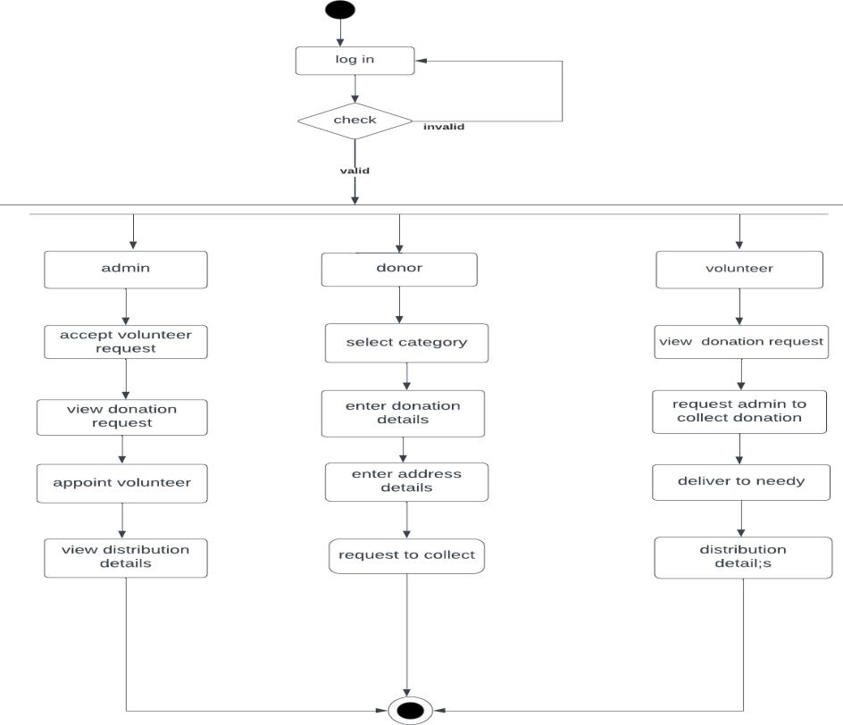
Flow Chart:

Slide 23
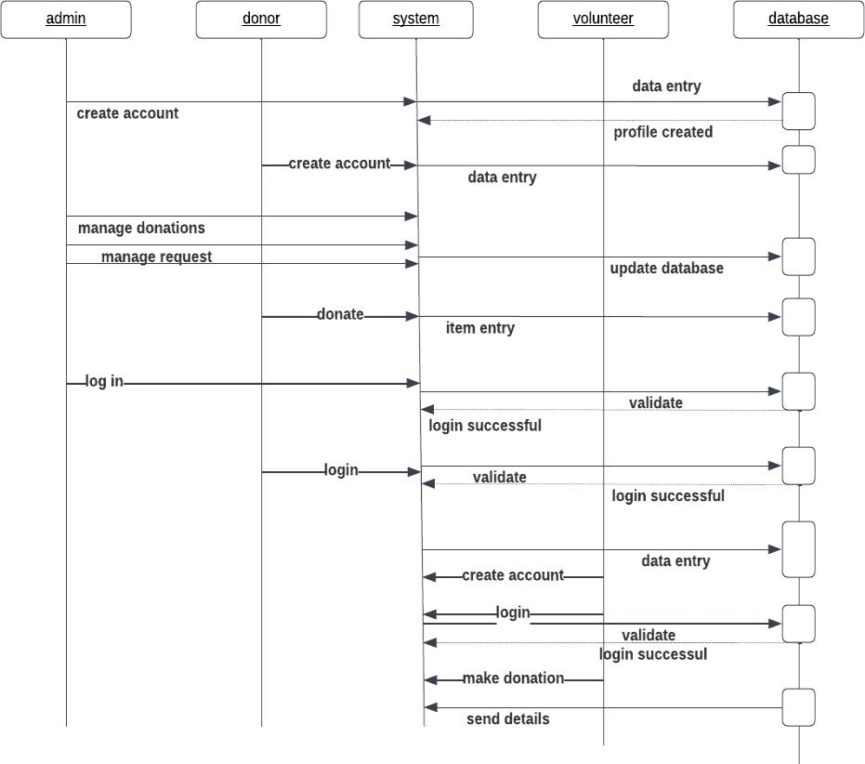

Slide 24

Implementation

Slide 25


Slide 26
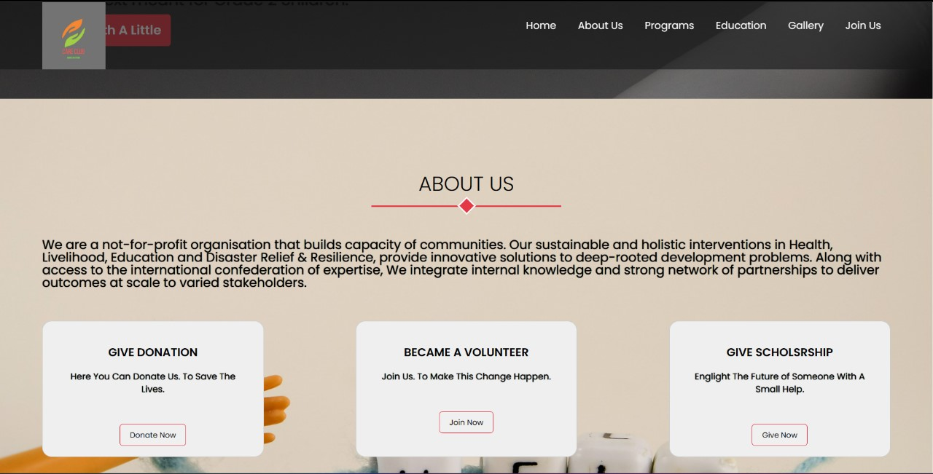

Slide 27
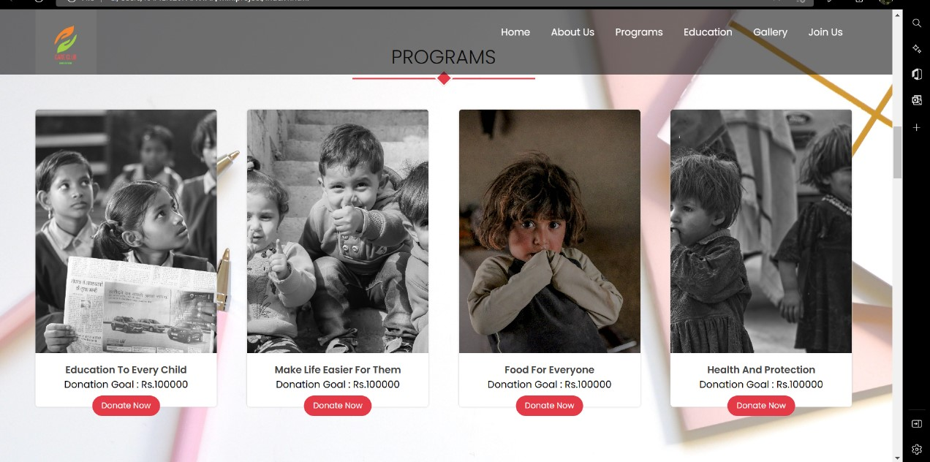

Slide 28
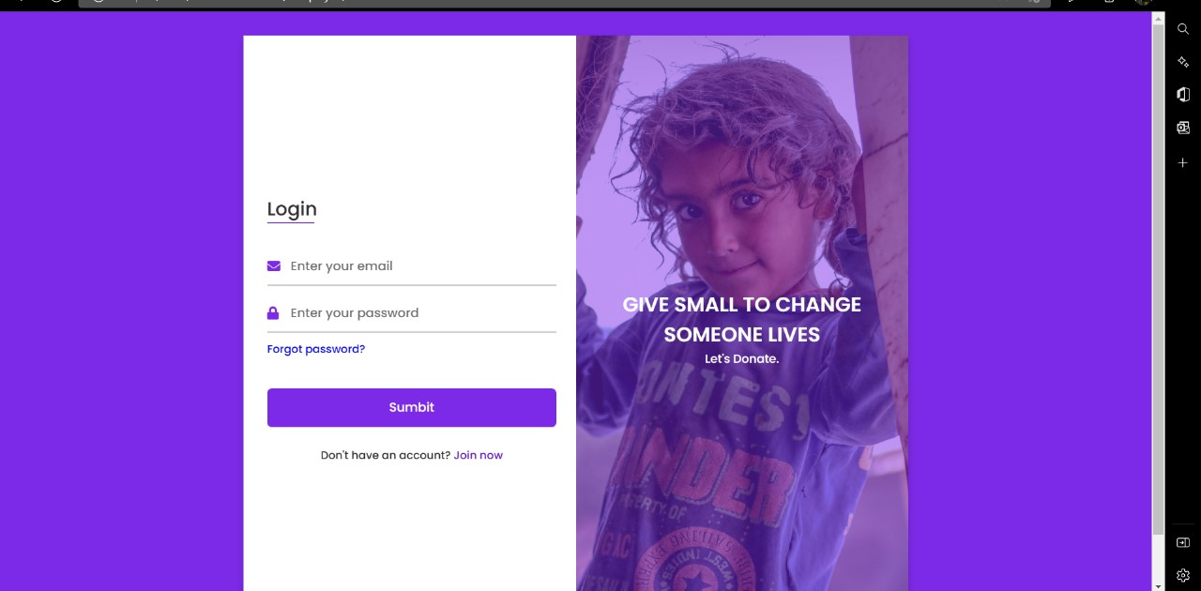

Slide 29
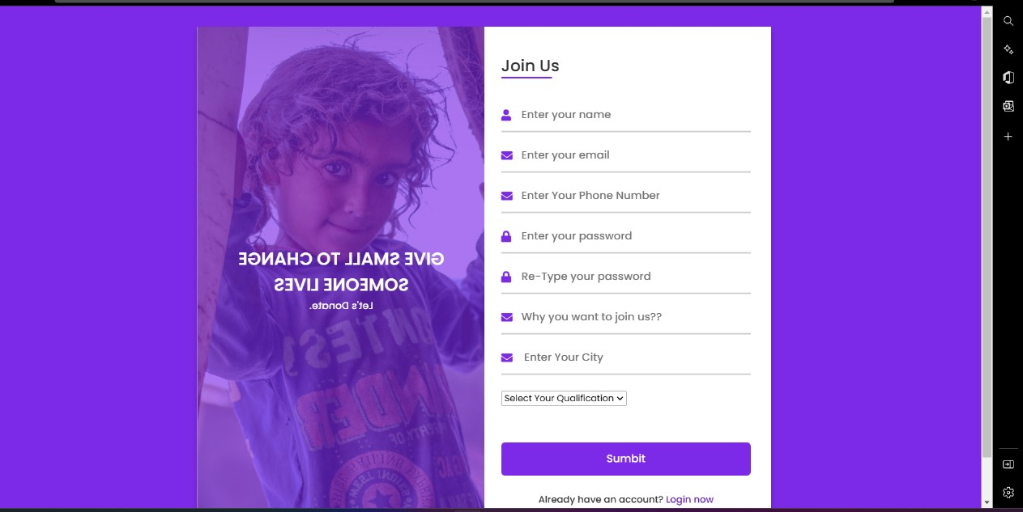

Slide 30
Conclusion and Future Scope
Online Charity Management System are designed to be user-friendly and flexible to serve the needs of various types of non-profits. Some of the most common features included in these systems are donors, volunteers, events, products, contracts, etc. stores information about and fundraising announcements, etc. databases that create it. Customizable reporting tools for personalized reporting, free work online with free money and more. The system is also important in terms of security and privacy.
The proposed methodology for developing the web-based charity management system is well-structured and comprehensive. It covers all the key aspects of the project, including the development of front end of webpage, backend servers, database administration.
Here are some additional benefits of the proposed system:
● The utilization of modern web development technologies has leveraged the power of the digital landscape, contributing to a dynamic and interactive web presence.
● The implementation of responsive design using HTML, CSS, JavaScript ensures that the website functions seamlessly on various devices, enhancing user accessibility and user experience.
● The responsive design and interactive features have resulted in a user-friendly and engaging website that caters to users across a range of devices.
The proposed system has the potential to save lives and improve the quality of care for patients in emergency situations.

Slide 31
Tools and Technologies used
VS Code,
React JS,
Tailwind css,
Firebase,
TMDB,
Machine Learning
Jupyter
Recommendation system

Slide 32
References
[1] Harmon, R. (2003, March 13). System and method of funding a charity. Retrieved from https://patents.google.com/patent/US20040181468A1/en
[2]Barton, N., and West, M. 2011. “Web-Savvy Supporters Help Make Online Giving an Expanding Bright Spot,” The Chronicle of Philanthropy, May 1 (online at http://philanthropy.com/article/Online-Donations-Grew Fast/127306/).
[3]Bennett, R., and Ali-Choudhury, R. 2009. “Second-Gift Behaviour of First-Time Donors to Charity: An Empirical Study,” International Journal of Nonprofit and Voluntary Sector Marketing (14), pp. 161-180.
[4]Clary, E. G., Snyder, M., Ridge, R. D., Copeland, J., Stukas, A. A., Haugen, J., and Miene, P. 1998. “Understanding and Assessing the Motivations of Volunteers: A Functional Approach,” Journal of Personality and Social Psychology (74:6), pp. 1516- 1530.
[5]Lee, Y., and Kozar, K. 2004. “Developing a Theory of Website Usability: An Exploratory Study to Identify Constructs and Nomological Networks,” in Proceedings of the 25th International Conference on Information Systems, Washington, DC, December 9-12, Paper 51.

Slide 33
References
[6]. Johnson, A. (2007, September 1). Fund-Raising effectiveness. Retrieved from journals.sagepub.com: https://journals.sagepub.com/doi/abs/10.1177/0275074006294390.
[7]Horn, J. (2002, February 13). Automated accounting fundraising system. Retrieved from patents.google.com: https://patents.google.com/patent/US20020116214A1/en
[8] F.Saeed and Z.Li, "A Web-based Donor-Charity Relationship Management System," 2016 IEEE 40th Annual Computer Software and Applications Conference (COMPSAC), Atlanta, GA, USA, 2016, pp. 477-482, doi: 10.1109/COMPSAC.2016.102.
[9] B. Shashikala, M. Pushpalatha, and B. Vijaya, "Web Based Blood Donation Management System (BDMS) and Notifications," in International Conference on Cognitive Computing and Information Processing, 2017, pp. 118-129.
[10] E. Prasanthi, K. Divya, and G. Dilip, "ONLINE BLOOD DONATION MANAGEMENT SYSTEM," International Journal of Pure and Applied Mathematics, vol. 119, pp. 3145-3156, 2018.

Slide 34
References
[11] D. Jethwa, A. Agrawal, R. Kulkarni, and L. Raut, "FOOD WASTAGE REDUCTION THROUGH DONATIO," JJRTER, ISSNOnline, pp. 2455-145.
[12 K. Patel, M. Patel, and S. Dudhaiya, "ESharing: Web Based Online Donation System," Journal of Web Engineering & Technology, vol. 6, pp. 25-36, 2019
[13] M. O. Alshammari, A. A. Almulhem, and N. Zaman, "Internet of Things (IoT): Charity Automation," International Journal of Advanced Computer Science and Applications (IJACSA), vol. 8, 2017
[14] Venkatesh, V., Thong, J. Y. L., and Xu, X. 2012. “Consumer Acceptance and Use of Information Technology: Extending the Unified Theory of Acceptance and Use of Technology,” MIS Quarterly (36:1), pp. 157-178
[15] 8 L. Liu and H. Miao, "A specification-based approach to testing polymorphic attributes," in Formal Methods and Software Engineering: Proceedings of the 6th International Conference on Formal Engineering Methods, ICFEM 2004, Seattle, WA, USA, November 8-12, 2004, J. Davies, W. Schulte, M. Barnett, Eds. Berlin: Springer, 2004. pp. 306-19..

