Slide 1
Capstone project on football data analysis
By: KUNAAL bhandari
Enrolment Number- EN12024081610
Batch - DA326S32
Mentor – mrs. komilla bhatia

Slide 2
Areas of Interests
Performance Analysis
Business Objective: Analyze the team performance metrics to identify key performance indicators (KPIs) and trends.
Player Profile and Market Value Analysis
Business Objective: Visualize the relationship between player profiles and their market values to identify trends and anomalies.
Team Comparison Analysis
Business Objective: Compare team performance across various metrics to identify strengths, weaknesses, and areas for improvement.
Attendance and Stadium Analysis
Business Objective: Visualize attendance trends and stadium utilization to optimize fan engagement and stadium operations.
Referee Analysis
Business Objective: Analyze referee decisions and their impact on match outcomes to ensure fairness and consistency.
Substitution Patterns Analysis
Business Objective: Visualize substitution patterns and their impact on match outcomes to optimize in-game strategies.
Event Analysis
Business Objective: Analyze and visualize key match events (e.g., goals, fouls, corners) to identify patterns and strategic insights
Competition Analysis
Business Objective: Visualize competition-level metrics to assess team and player performance in different competitions.
Player Attributes and Demographics Analysis
Business Objective: Visualize player attributes and demographics to identify trends and insights for talent management.
Contract Management Analysis
Business Objective: Analyze and visualize player contracts to optimize contract negotiations and financial planning.

Slide 3
PROBLEM STATEMENT
This PowerPoint presentation is outlining potential research areas for a capstone project on football data analysis. The goal of the project is to analyze various aspects of football performance, player profiles, team comparisons, and other related areas to gain valuable insights and support decision-making in the football industry.

Slide 4
Tools used for the project
Jupyter notebook – I have used python for merging the tables, cleaning and treating missing value treatment. All the ML models have been made here.
Tableau – I have used Tableau for creating various charts for data visualization and interpreting the data.
Excel – I have used this software to check if there is a significant difference in the goals scored by teams at home vs. away games.

Slide 5
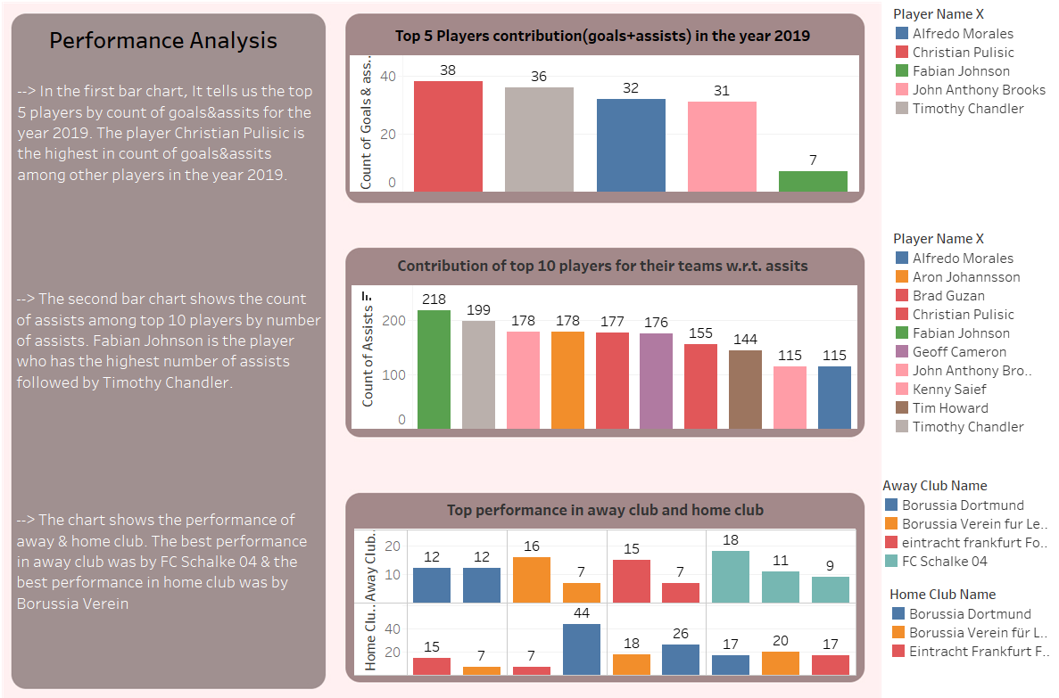

Slide 6
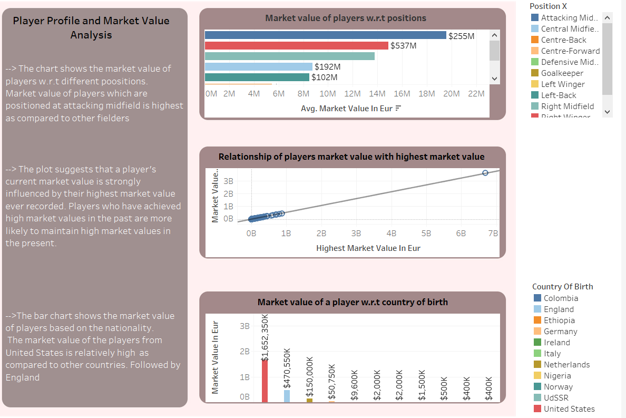

Slide 7
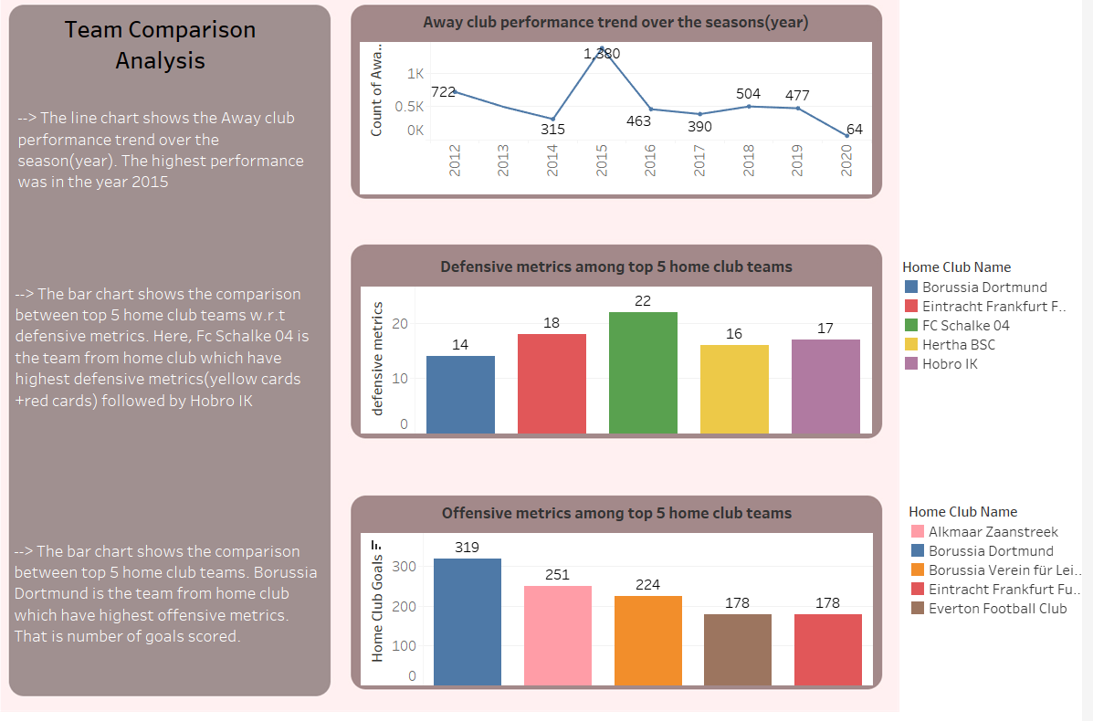

Slide 8
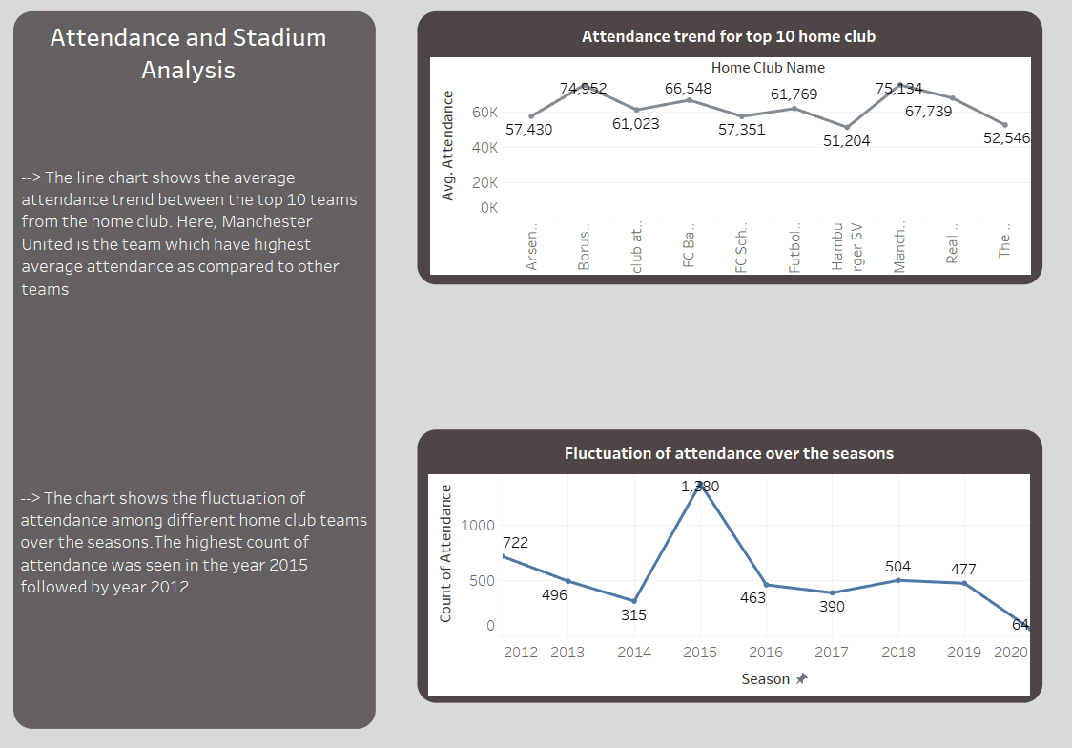

Slide 9
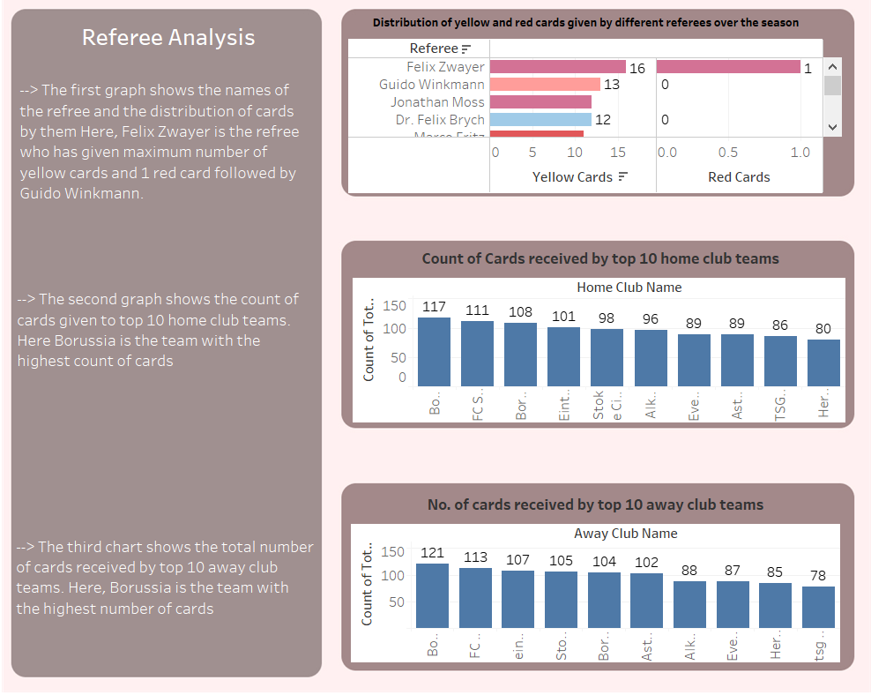

Slide 10
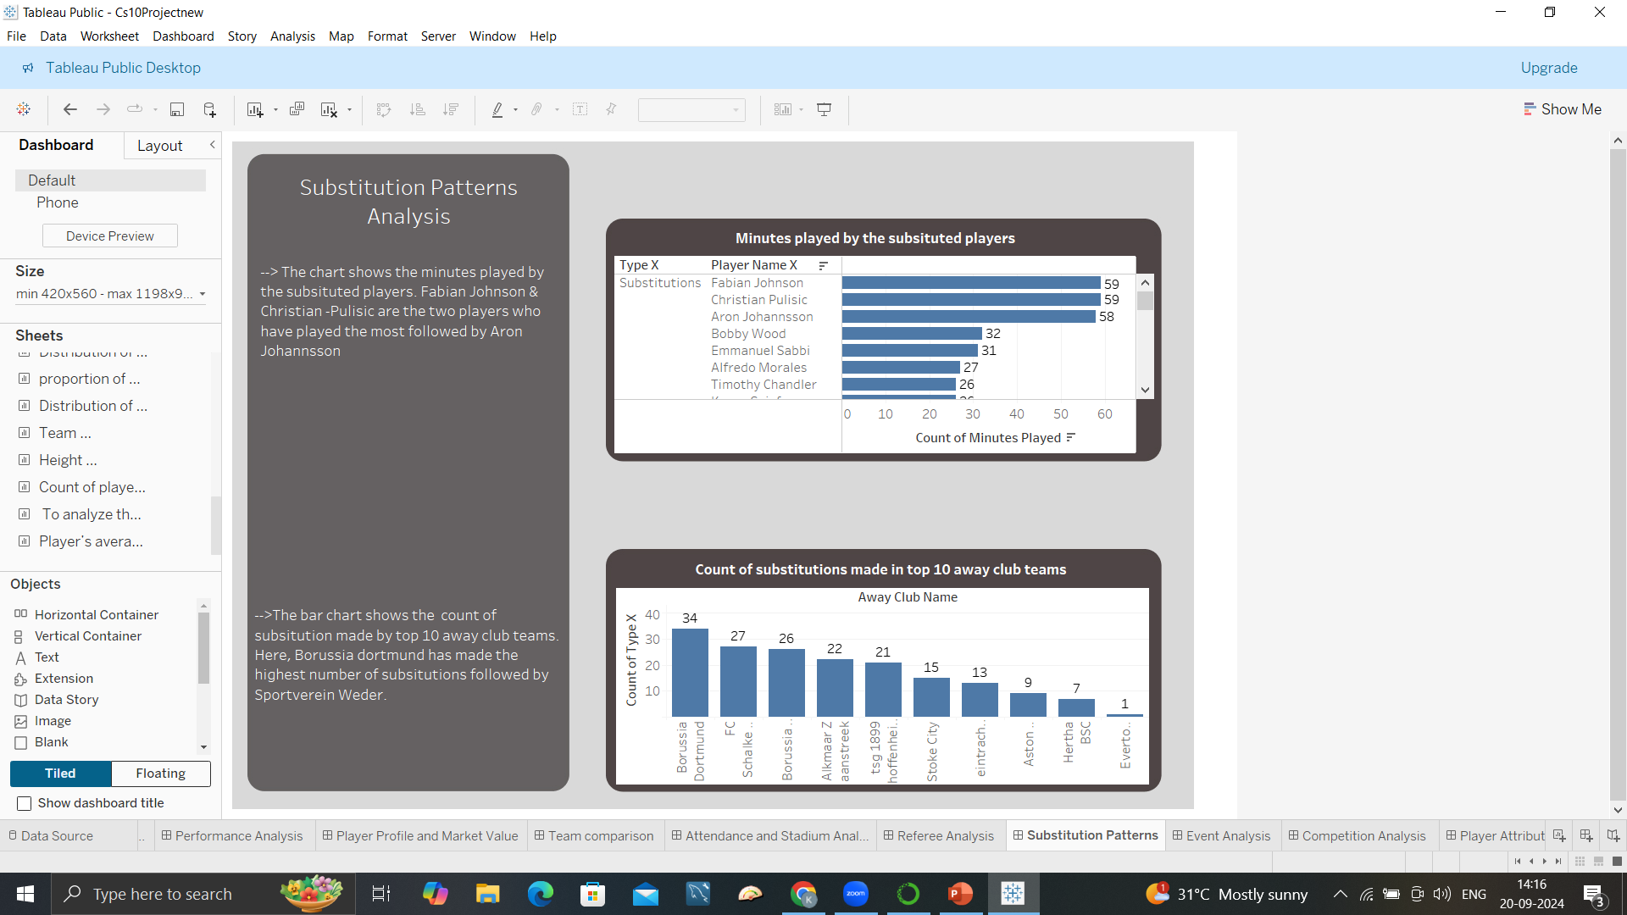

Slide 11
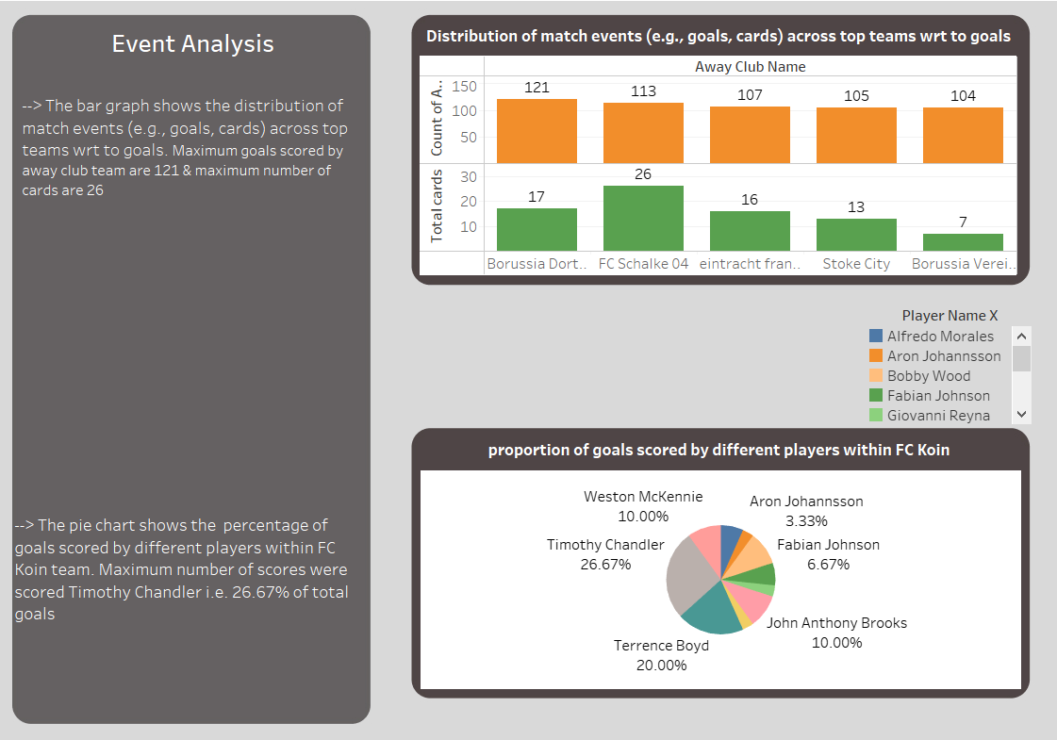

Slide 12
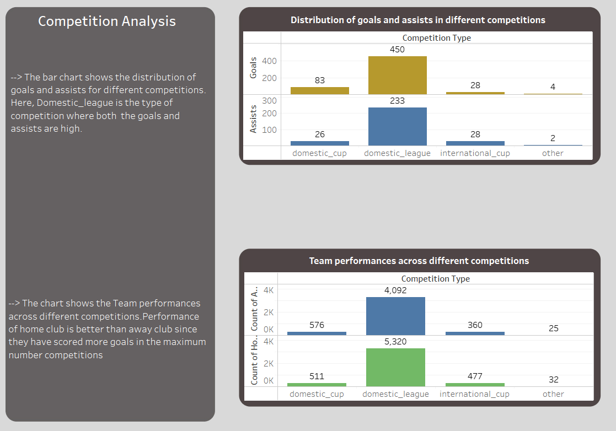

Slide 13
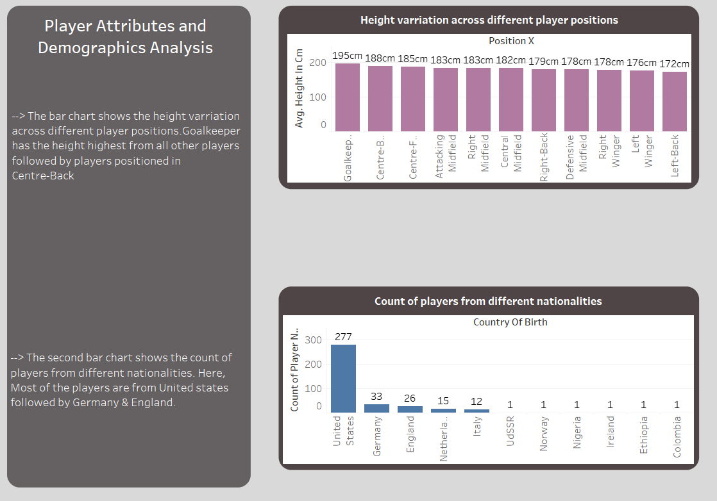

Slide 14
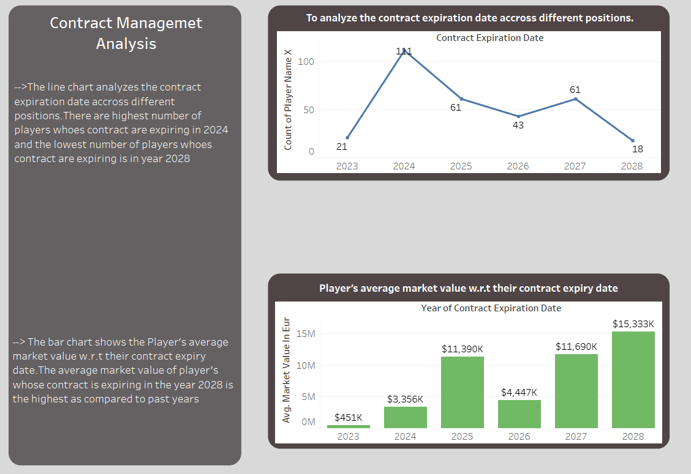

Slide 15
Can we predict if a player is a captain based on their performance?
I have used logistic regression model for predicting if the player is captain based on their performance. Here the target column was ‘Team Captain’ and Independent variables were ‘Goals’,’Assists’,’Minutes played’ .
The training score came out to be 95.40% which says the model is performing very well.
This model will help to predict if the performance of the player is extremely good then that player can be a team captain.
It will make the decisions easy for the future team captains as the player with the best performance has the highest chances to become a team captain.

Slide 16
Can we predict the player's position in a match based on their performance and match statistics?
KNN Classifier has been used here to predict the player’s position based on the player’s performance and match statistics. Here, the target column is ‘Position Y’ and independent variables are 'minutes played', 'goals', 'assists', 'home club goals', 'away club goals’.
The model achieved an accuracy of 90.75%, indicating that it correctly classified 90.75% of the test samples is a relatively high accuracy score, suggesting that the model is performing well.
This model will help in predicting the position of players according to their performance so that the players can be positioned accordingly in the future matches and can lead to more successful matches.

Slide 17
Can we predict a player's market value based on their performance metrics and market history?
Multicollinearity has been used to predict the players market value based on their performance and market history. The dependent variable is ‘'market value in eur’ and independent variables are 'goals','minutes played','assists','highest market value in eur','home club goals','yellow cards’ & ‘red cards’
The training performance of this model comes out to be 85.29% which is a very well performance.
This model can help in predicting the future value of a player based on the in field performance of that player.

Slide 18
Segmenting Players Based on Market Value and Height
K means has been used to segment the players based on market value and height. Here two columns was taken i.e. Market value in eur & height in cm.
The highest performance of this model comes out to be 97.63% which is considered to be excellent performance.
This model can help in segmenting the players based on height and market value of that player.
- For future use, it will be easy for segmenting the players.

Slide 19
Summary
This project was focusing on several key areas of football performance:
Performance Analysis: Analyzing team metrics to identify key performance indicators (KPIs) and trends.
Player Profile and Market Value: Exploring the relationship between player profiles and market values.
Team Comparison: Comparing team performance across different metrics.
Attendance and Stadium Utilization: Examining trends to optimize fan engagement and operations.
Referee, Substitution Patterns, and Event Analysis: Studying the impact of referees, substitutions, and key match events.
Player Attributes and Contract Management: Visualizing player attributes and contracts for strategic decisions.
The project uses various machine learning models, including logistic regression, KNN, and K-means, to predict outcomes such as team captains, player positions, market values, and player segmentation based on performance.

Slide 20
Conclusion
The capstone project provides a comprehensive analysis of football performance, player profiles, and team dynamics using advanced data analysis techniques. By employing various machine learning models, the project successfully predicts key aspects like team captains, player positions, and market values based on performance metrics. The high accuracy rates of the models, such as the logistic regression model predicting team captains with 95.4% accuracy, demonstrate the potential of data-driven insights in football.
Through segmentation, performance analysis, and comparisons, the project enables a deeper understanding of how players' attributes, market values, and team metrics influence match outcomes and decision-making in the football industry. Additionally, the use of tools like Jupyter Notebook, Tableau, and Excel enhances the visual representation and understanding of the findings. The project lays a solid foundation for future applications in player scouting, team strategy optimization, and financial management within the sport.
In conclusion, this project exemplifies how football clubs and analysts can leverage data analysis and machine learning to make informed decisions, enhance player development, and improve team performance in a competitive environment.

Slide 21
THANK YOU

