Slide 1
U.S. Financial Market Analysis
Power BI Project
End-to-end financial analytics workflow combining automation, Python, Google Drive API, Power Query, DAX and Power BI.
Power BI • Power Query • DAX • Python • Google Drive API • Power Automate • Outlook

Slide 2
Project Workflow
Automation → Data → BI
1
Outlook Rules
Automatically organize incoming files received through email.
2
Power Automate
Move files automatically to Google Drive.
3
Google Cloud
Create a project and enable the Google Drive API.
4
Python
Programmatically access and prepare data from Google Drive.
5
Power BI
Load data, clean and transform it, calculate metrics and build the dashboard.
2

Slide 3
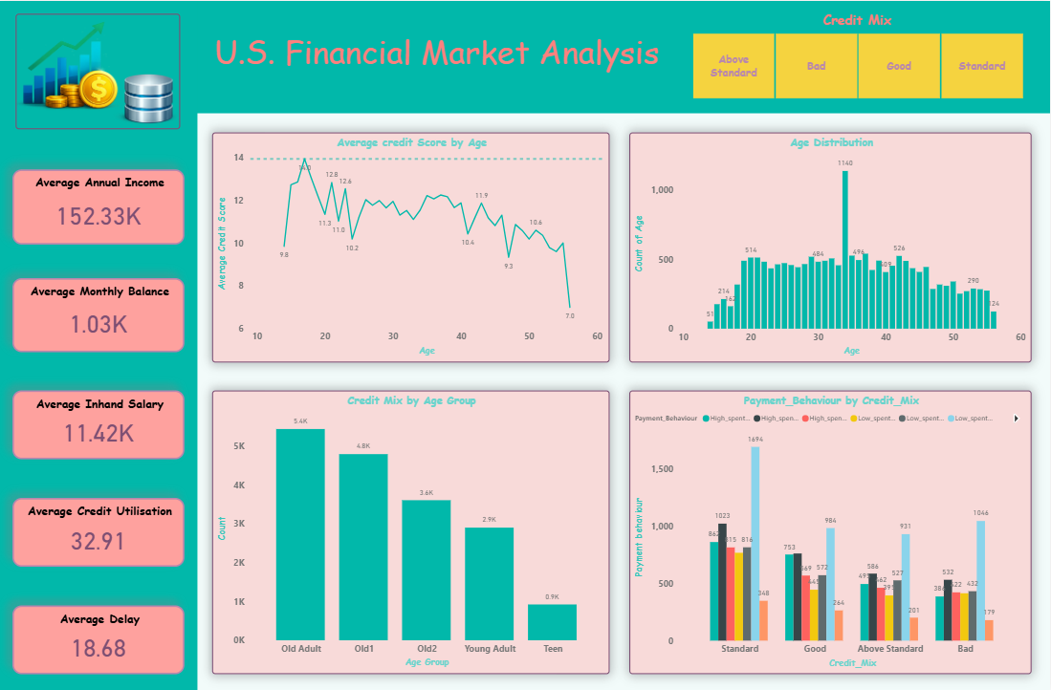
Dashboard — Financial Analysis | Page 1
Original dashboard visual
3

Slide 4
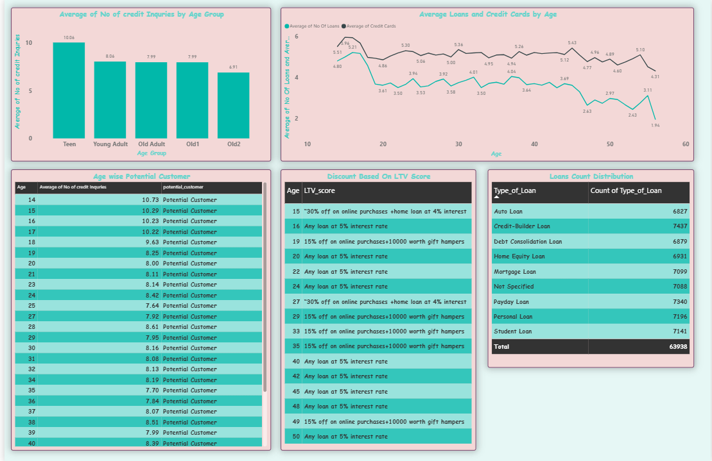
Dashboard — Financial Analysis | Page 2
Original dashboard visual
4

Slide 5
Key Insights — Customer & Credit Profile
Page 1
Credit score & age distribution
Age 17 has the highest average credit score at 13.95, followed by Age 18 at approximately 13.04.
Age 34 has the highest customer count at 1,140, while Age 14 has the lowest at 51.
The Old Adult age group has the highest customer count, with approximately 5.4K customers.
Payment behaviour & inquiries
Low-spent, small-value payments have the highest transaction count across all credit-mix categories, peaking at 1,694 within the Standard credit-mix category.
The Teen age group has the highest average number of credit inquiries at 10.06, followed by Young Adults at 8.06.
Loans, cards & potential customers
At age 16, customers have approximately 5.94 credit cards on average and around 5.21 loans on average.
Age 14 has the highest average number of credit inquiries at 10.73 and is classified as a potential customer in the dataset.
6

Slide 6
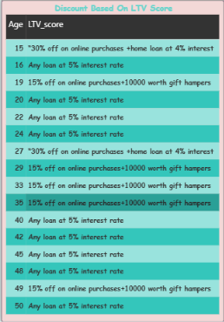
LTV-Based Offer Analysis
Original visual
Key observations
The 5% interest-rate loan offer is the most frequently assigned offer across the displayed age groups.
A 30% online-purchase discount combined with a 4% home-loan interest rate is assigned to customers aged 15 and 27.
A 15% online-purchase discount with a ₹10,000-worth gift hamper is assigned to several age groups, including 19, 29, 33, 35 and 49.
5

Slide 7
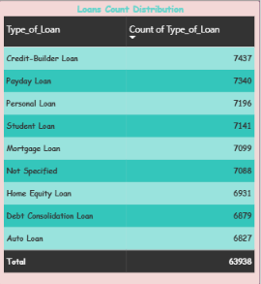
Key Insights — Loan Distribution
Page 2
Loan distribution
Credit-Builder Loans have the highest loan count at 7,437, followed by Payday Loans at 7,340.
7

Slide 8
Project Outcome
Project Outcome
End-to-end analytics workflow
What this project demonstrates
Automated file organization and movement from email to cloud storage.
Connected Google Drive data access with Python and Power BI.
Applied Power Query for data cleaning and transformation.
Used DAX to create analytical measures and business metrics.
Built interactive views covering credit score, customer age, credit mix, payment behaviour, LTV, potential customers, loans and credit cards.
Converted dashboard observations into quantified business insights.
Power BI | Power Query | DAX | Python | Google Drive API | Power Automate | Outlook

