Slide 1
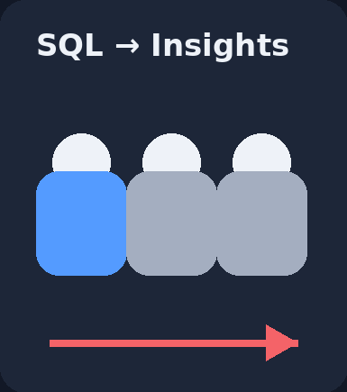
WORLD LAYOFFS
ANALYSIS USING SQL
End-to-End Data Cleaning & Exploratory Data Analysis
Turning raw workforce data into business insights
Prepared by Kunal Kashyap
World Layoffs Analysis • SQL Case Study
01

Slide 2
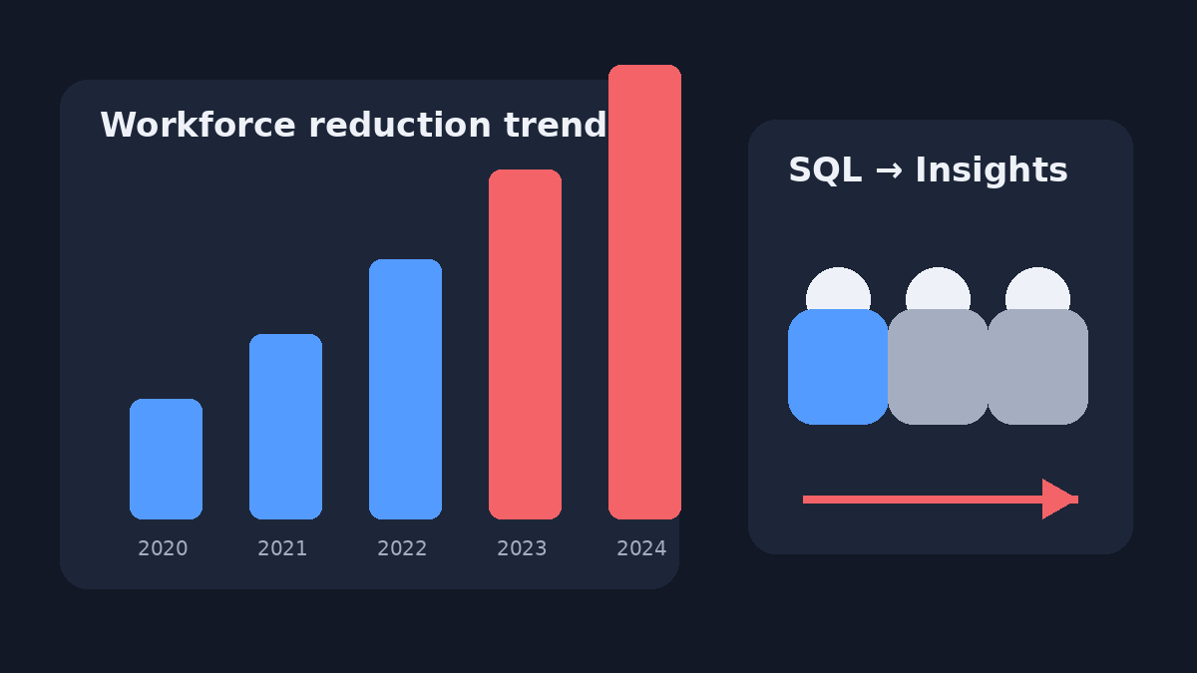
Why Analyze Layoffs?
A business-focused view of workforce reductions
What this project explores
• Which companies recorded the largest layoffs?
• Which countries and industries were most affected?
• How did company stage and funding relate to layoffs?
• How can SQL window functions reveal deeper patterns?
The goal is not only to query the data — it is to turn query results into clear business conclusions.
World Layoffs Analysis • SQL Case Study
02

Slide 3
Project Overview
OBJECTIVE
Clean raw layoff data and generate business insights.
TOOLS & SKILLS
SOURCE WORKFLOW
• MySQL Workbench
• Data Cleaning
• Exploratory Data Analysis
• Window Functions
• Ranking
Raw Dataset → Working Copy → Remove Duplicates → Standardize Data → Handle NULLs → EDA → Business Insights
World Layoffs Analysis • SQL Case Study
03

Slide 4
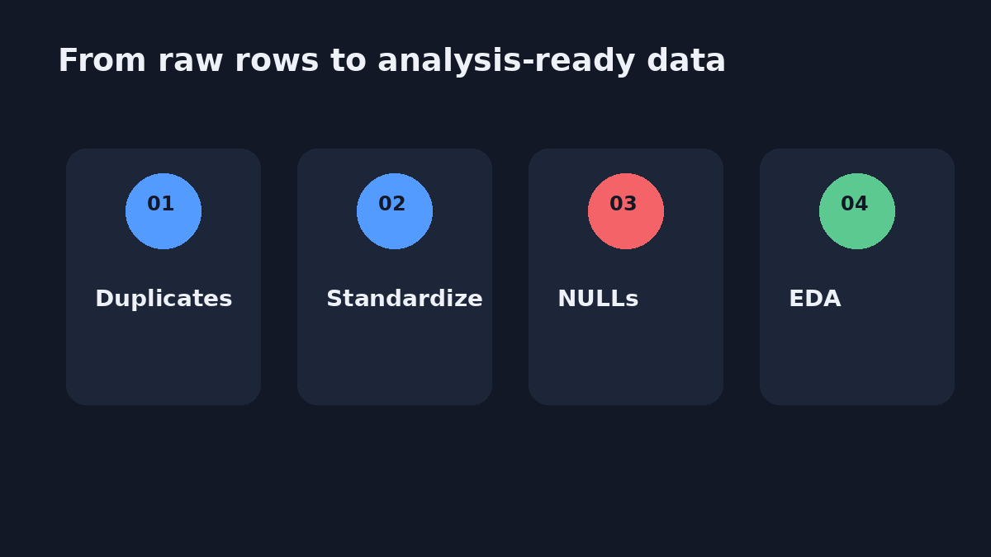
Data Cleaning
Prepare the dataset before asking business questions
Cleaning steps used in the SQL project
• Remove duplicate records using ROW_NUMBER()
• Standardize company, industry, date and country values
• Check and handle NULL / blank values
• Remove unnecessary rows and columns
The SQL file explicitly defines these four cleaning tasks before EDA.
World Layoffs Analysis • SQL Case Study
04

Slide 5
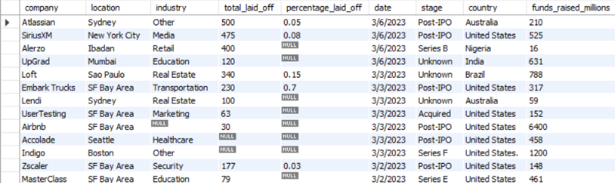
Dataset Overview
Start with the raw records and understand the available fields
BUSINESS QUESTION
What does the layoff dataset contain before deeper analysis?
SQL QUERY
SELECT *
FROM layoffs;
OUTCOME
The dataset includes company, industry, country, stage, funding and layoff details.
World Layoffs Analysis • SQL Case Study
05

Slide 6
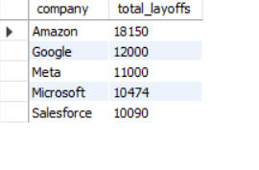
Company-wise Layoffs
BUSINESS QUESTION
Which companies recorded the highest total layoffs?
SQL QUERY
SELECT company,
SUM(total_laid_off) AS total_layoffs
FROM layoffs2
GROUP BY company
ORDER BY SUM(total_laid_off) DESC
LIMIT 5;
OUTCOME
Amazon ranked #1 with 18,150 layoffs, followed by Google, Meta, Microsoft and Salesforce.
World Layoffs Analysis • SQL Case Study
06

Slide 7
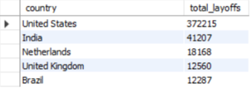
Country-wise Layoffs
BUSINESS QUESTION
Which country recorded the highest total layoffs?
select
country,
sum(total_laid_off) as total_layoffsfrom layoffs2
group by country
order by sum(total_laid_off) desc
limit 5;
SQL QUERY
OUTCOME
United States ranked #1 with 372215 layoffs, followed by India, Netherlands, United Kingdom and Brazil.
World Layoffs Analysis • SQL Case Study
06

Slide 8
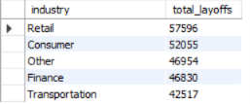
Industry-wise Layoffs
BUSINESS QUESTION
Which industries were most affected by layoffs?
SQL QUERY
SELECT industry,
SUM(total_laid_off) AS total_layoffs
FROM layoffs2
GROUP BY industry
ORDER BY SUM(total_laid_off) DESC
LIMIT 5;
OUTCOME
Retail was the most affected industry with 57,596 layoffs, followed by Consumer with 52,055.
World Layoffs Analysis • SQL Case Study
08

Slide 9
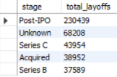
Stage-wise Layoffs
BUSINESS QUESTION
At which company stage were the most layoffs recorded?
SQL QUERY
SELECT stage,
SUM(total_laid_off) AS total_layoffs
FROM layoffs2
GROUP BY stage
ORDER BY SUM(total_laid_off) DESC
LIMIT 5;
OUTCOME
Post-IPO companies recorded the highest layoffs in the dataset (230,439).
World Layoffs Analysis • SQL Case Study
09

Slide 10
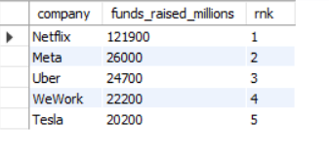
Funding Analysis
BUSINESS QUESTION
Which companies had the highest funding raised?
SQL QUERY
SELECT DISTINCT company,
funds_raised_millions,
DENSE_RANK() OVER (
ORDER BY funds_raised_millions DESC
) AS rnk
FROM layoffs2;
OUTCOME
High funding did not guarantee workforce stability; heavily funded companies still experienced major layoffs.
World Layoffs Analysis • SQL Case Study
10

Slide 11
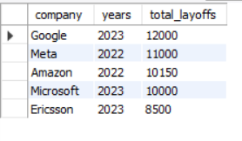
Top Companies by Year
BUSINESS QUESTION
Who were the top 5 companies by layoffs in each year?
SQL QUERY
WITH com_layoff AS (
SELECT company,
EXTRACT(YEAR FROM date) AS years,
SUM(total_laid_off) AS total
FROM layoffs2
GROUP BY company, EXTRACT(YEAR FROM date)
)
SELECT company, total, years,
DENSE_RANK() OVER (
PARTITION BY years ORDER BY total DESC
) AS rnk
FROM com_layoff;
OUTCOME
Google led layoffs in 2023; the leading companies changed across years.
World Layoffs Analysis • SQL Case Study
11

Slide 12
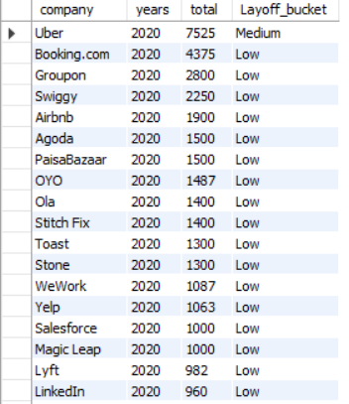
Layoff Bucket
BUSINESS QUESTION
How can companies be classified into Low, Medium and High layoff groups?
SQL QUERY
SELECT company,
EXTRACT(YEAR FROM date) AS years,
SUM(total_laid_off) AS total,
CASE
WHEN SUM(total_laid_off) >= 10000 THEN 'High'
WHEN SUM(total_laid_off) >= 5000 THEN 'Medium'
ELSE 'Low'
END AS Layoff_bucket
FROM layoffs2
GROUP BY company, EXTRACT(YEAR FROM date);
OUTCOME
CASE WHEN converts raw totals into three easy-to-interpret business buckets.
World Layoffs Analysis • SQL Case Study
12

Slide 13
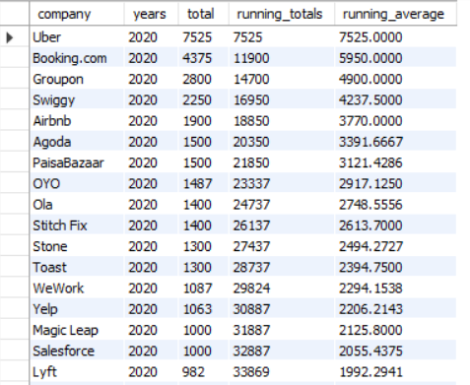
Running Total & Average
BUSINESS QUESTION
How do cumulative layoffs and average layoffs evolve within each year?
SQL QUERY
WITH running_total_avg AS (
SELECT company,
EXTRACT(YEAR FROM date) AS years,
SUM(total_laid_off) AS total
FROM layoffs2
GROUP BY company, EXTRACT(YEAR FROM date)
)
SELECT company, years, total,
SUM(total) OVER (
PARTITION BY years
ROWS BETWEEN UNBOUNDED PRECEDING AND CURRENT ROW
) AS running_totals,
AVG(total) OVER (
PARTITION BY years
ROWS BETWEEN UNBOUNDED PRECEDING AND CURRENT ROW
) AS running_average
FROM running_total_avg;
OUTCOME
Window functions provide cumulative totals and running averages without collapsing the underlying rows.
World Layoffs Analysis • SQL Case Study
13

Slide 14
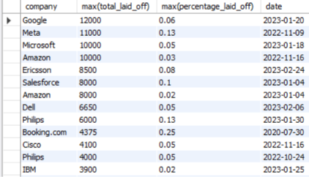
Maximum Layoffs
BUSINESS QUESTION
What are the largest single layoff events by company and date?
SQL QUERY
SELECT company,
MAX(total_laid_off),
MAX(percentage_laid_off),
date
FROM layoffs2
GROUP BY company, date
ORDER BY MAX(total_laid_off) DESC,
MAX(percentage_laid_off) DESC;
OUTCOME
The analysis highlights the largest individual layoff events, including Google's 12,000 layoffs in 2023 with a percentage of 0.06.
World Layoffs Analysis • SQL Case Study
14

Slide 15
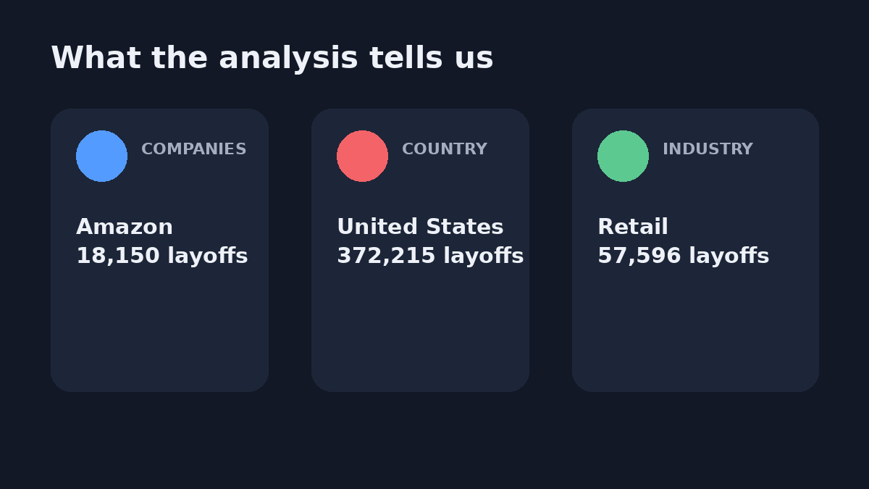
Key Business Insights
The strongest findings from the SQL analysis
1
Amazon led total layoffs • US had the largest country-level impact • Retail was the most affected industry
World Layoffs Analysis • SQL Case Study
16

Slide 16
Future Scope
Turn the SQL analysis into a broader analytics portfolio project
01
02
03
Power BI
Python EDA
Visualization
Build an interactive dashboard
Add deeper statistical exploration
Create interactive charts and trends
World Layoffs Analysis • SQL Case Study
17

Slide 17
THANK YOU
Portfolio links
World Layoffs Analysis using SQL
GitHub: Add repository link
LinkedIn: Add profile link
Questions & Discussion
Prepared by Kunal Kashyap
World Layoffs Analysis • SQL Case Study
18

