Slide 1
DIWALI SALES DATASET
Exploratory Data Analysis
Graph-by-graph insights & business observations
Python • Pandas • NumPy • Matplotlib • Seaborn
End-to-end EDA project
Diwali Sales EDA • 1

Slide 2
02
EDA Approach
Understand the data → clean it → explore patterns → visualize → interpret
01
02
03
04
05
Understand
Clean
Explore
Visualize
Interpret
11,251 rows × 15 columns initially
Removed 2 unnecessary columns and 12 null Amount rows
Demographics, geography, occupation & products
Count plots and sales/value comparisons
Identify customer segments and sales opportunities
Final analytical dataset: 11,239 rows
Diwali Sales EDA • 2

Slide 3
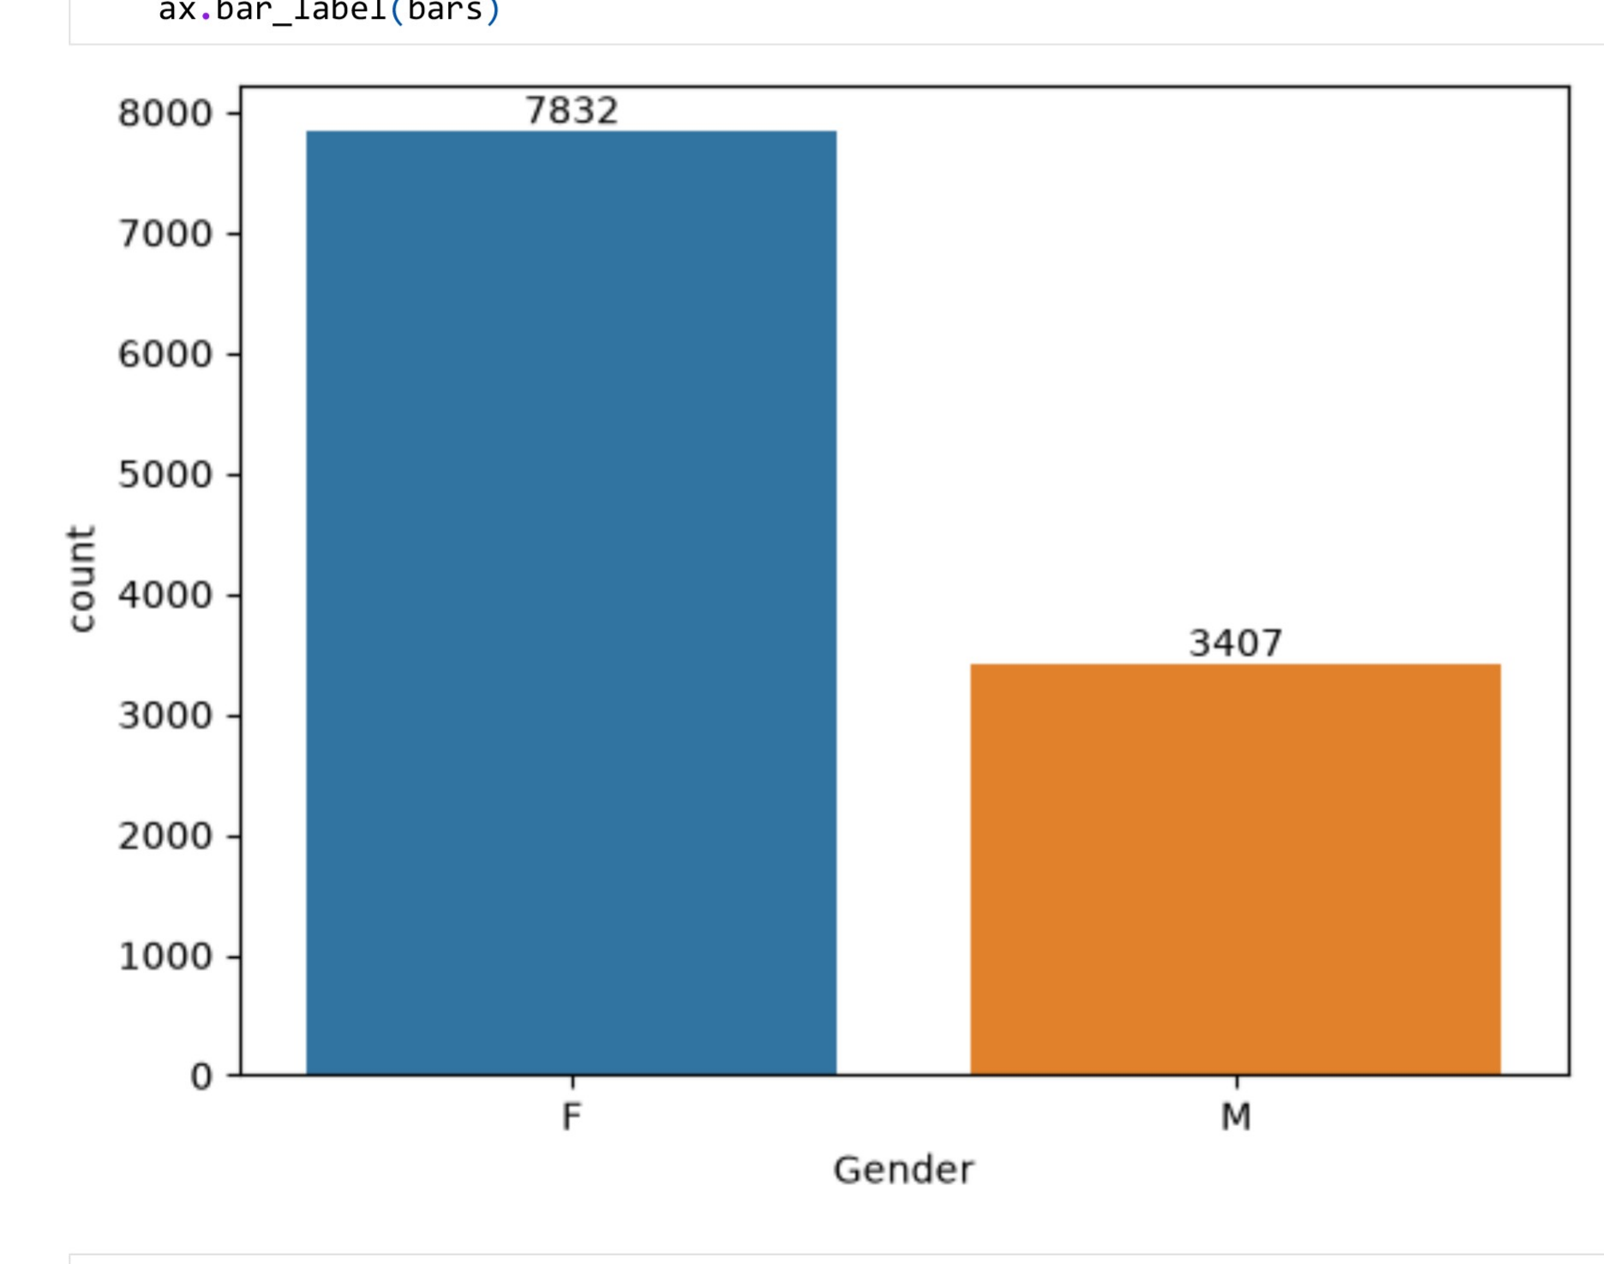
03
Gender-wise Buyer Distribution
Number of buyers by gender
BUSINESS PROBLEM Which gender should marketing campaigns prioritize to maximize buyer reach?
Key Insight
Female buyers are substantially higher in number: 7,832 females versus 3,407 males.
ax = sns.countplot(data=df, x='Gender', hue='Gender')
for bars in ax.containers:
ax.bar_label(bars)
BUSINESS TAKEAWAY
Female customers are the dominant buyer segment.
Diwali Sales EDA • 3

Slide 4
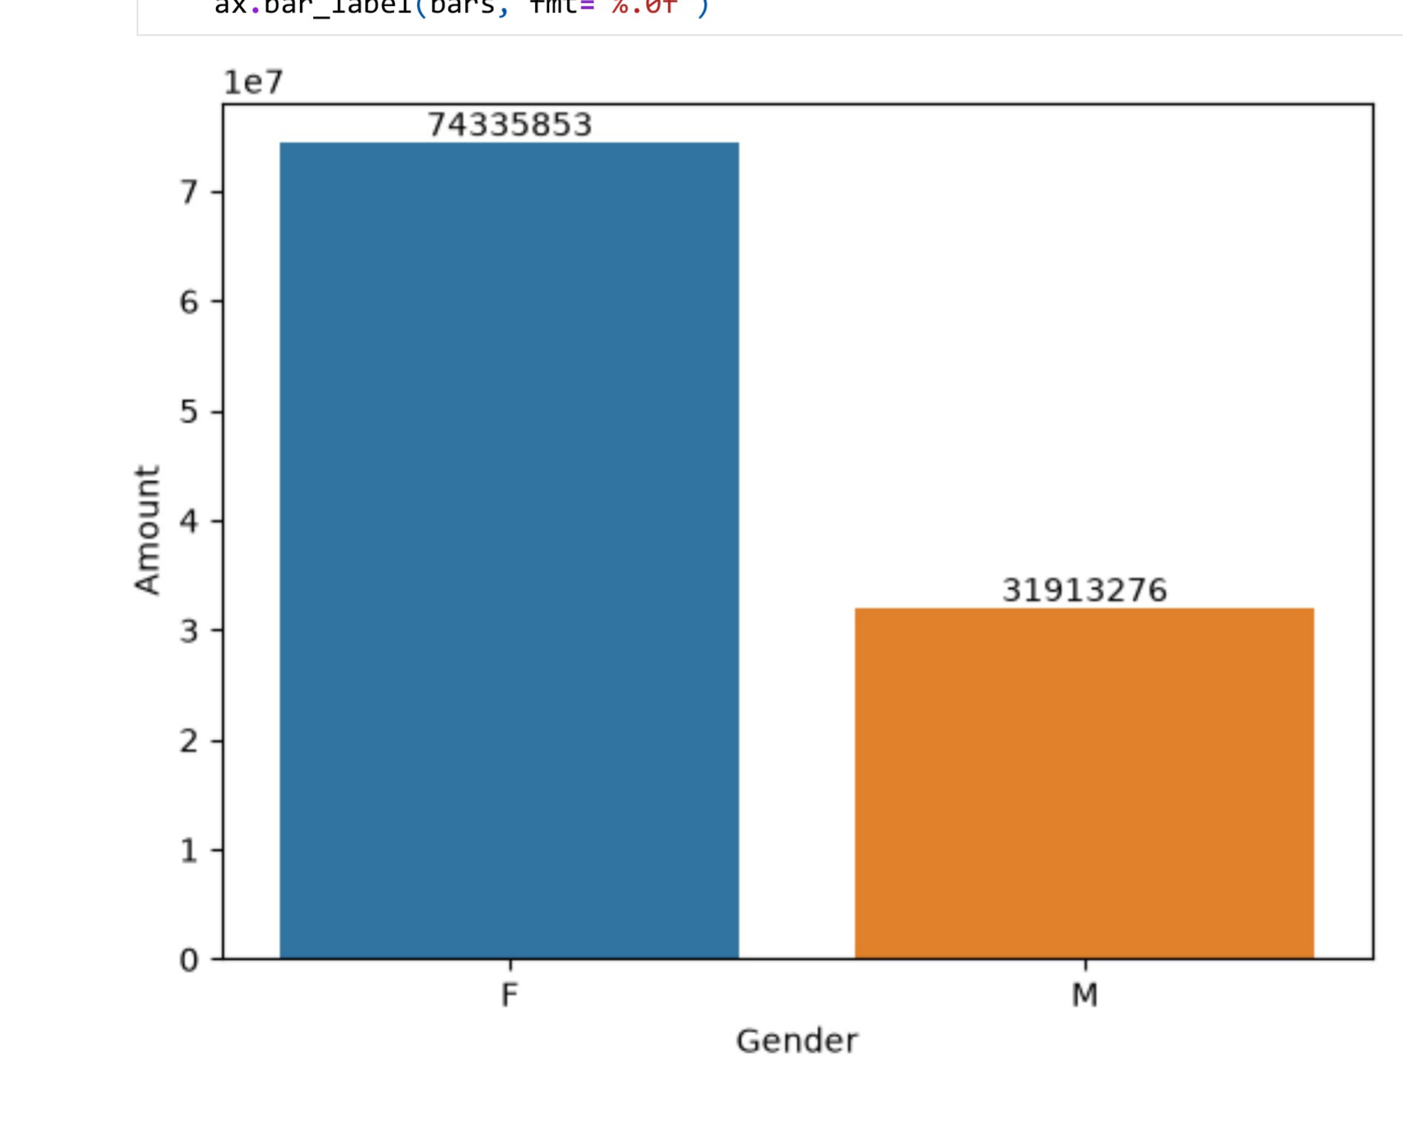
04
Sales by Gender
Total Amount generated by gender
BUSINESS PROBLEM Which gender generates more revenue and deserves greater marketing investment?
Key Insight
Female customers contribute ₹74,335,853 in total Amount, compared with ₹31,913,276 from male customers.
sales_per_gender = df.groupby('Gender', as_index=False)['Amount']
.sum().sort_values(by='Amount', ascending=False)
ax = sns.barplot(data=sales_per_gender, x='Gender', y='Amount', hue='Gender')
for bars in ax.containers:
ax.bar_label(bars, fmt='%.0f')
BUSINESS TAKEAWAY
Female purchasing power is considerably higher.
Diwali Sales EDA • 4

Slide 5
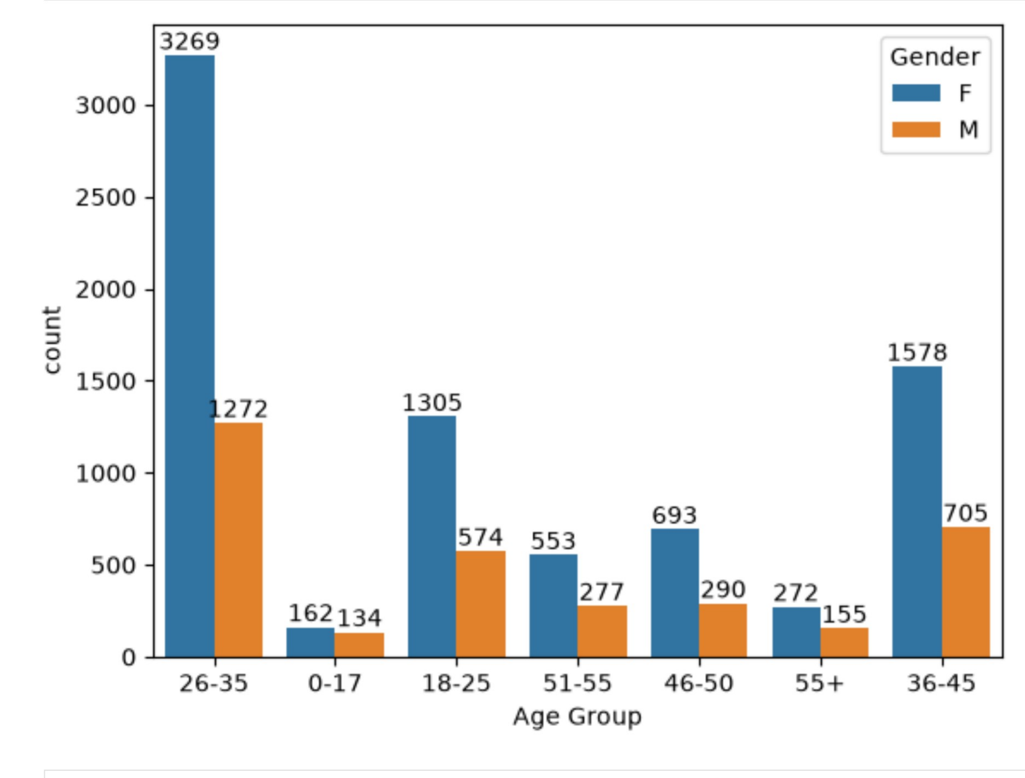
05
Age Group Distribution
Buyer count split by age group and gender
BUSINESS PROBLEM Which age group forms the core customer base for targeted campaigns?
Key Insight
The 26–35 age group is the largest segment, with 3,269 female buyers and 1,272 male buyers.
ax = sns.countplot(data=df, x='Age Group', hue='Gender')
for bars in ax.containers:
ax.bar_label(bars)
BUSINESS TAKEAWAY
26–35 is the core customer segment.
Diwali Sales EDA • 5

Slide 6
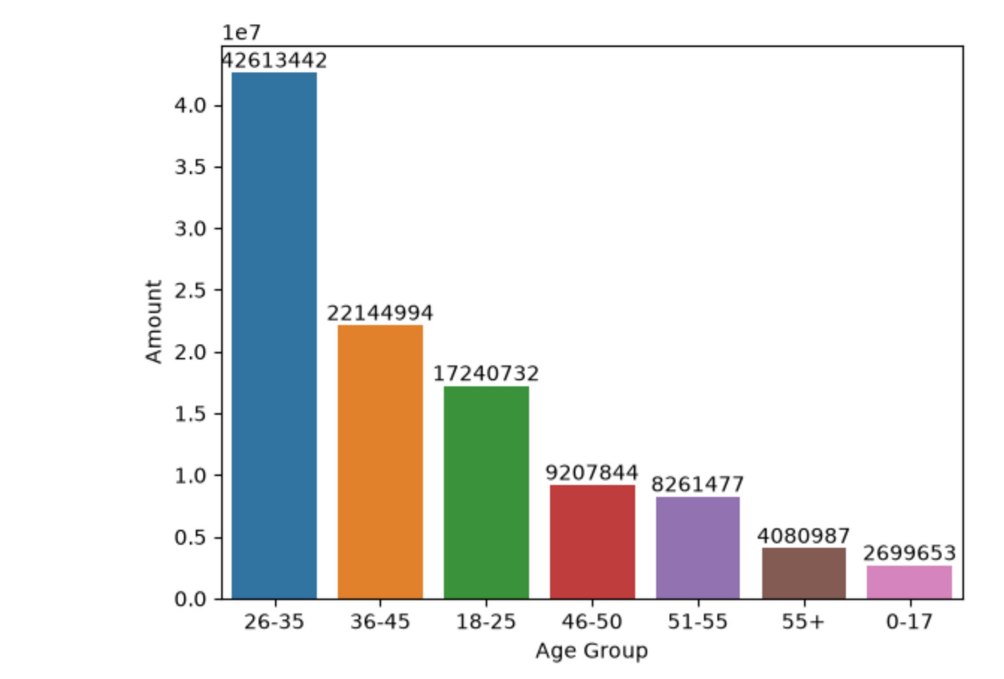
06
Sales by Age Group
Total Amount across customer age groups
BUSINESS PROBLEM Which age segment contributes the most revenue and should be prioritized for retention?
Key Insight
The 26–35 segment has the highest total Amount, followed by 36–45 and 18–25.
sales_per_age = df.groupby('Age Group', as_index=False)['Amount']
.sum().sort_values(by='Amount', ascending=False)
ax = sns.barplot(data=sales_per_age, x='Age Group', y='Amount', hue='Age Group')
for bars in ax.containers:
ax.bar_label(bars, fmt='%.0f')
BUSINESS TAKEAWAY
Prioritize the 26–35 segment in customer-focused campaigns.
Diwali Sales EDA • 6

Slide 7
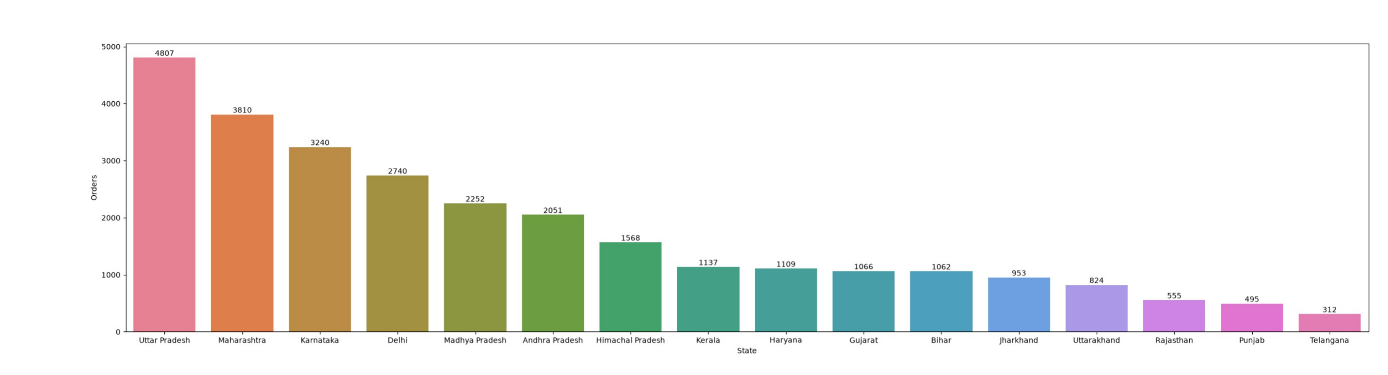
07
State-wise Total Orders
Order activity across Indian states
BUSINESS PROBLEM Which states generate the highest order volume and need strong regional logistics support?
Key Insight
The project identifies Uttar Pradesh, Maharashtra and Karnataka as the leading states by total orders.
state_wise_order = df.groupby('State', as_index=False)['Orders']
.sum().sort_values(by='Orders', ascending=False)
plt.figure(figsize=(30,7))
ax = sns.barplot(data=state_wise_order, x='State', y='Orders', hue='State')
BUSINESS TAKEAWAY
These states are key regional demand markets.
Diwali Sales EDA • 7

Slide 8
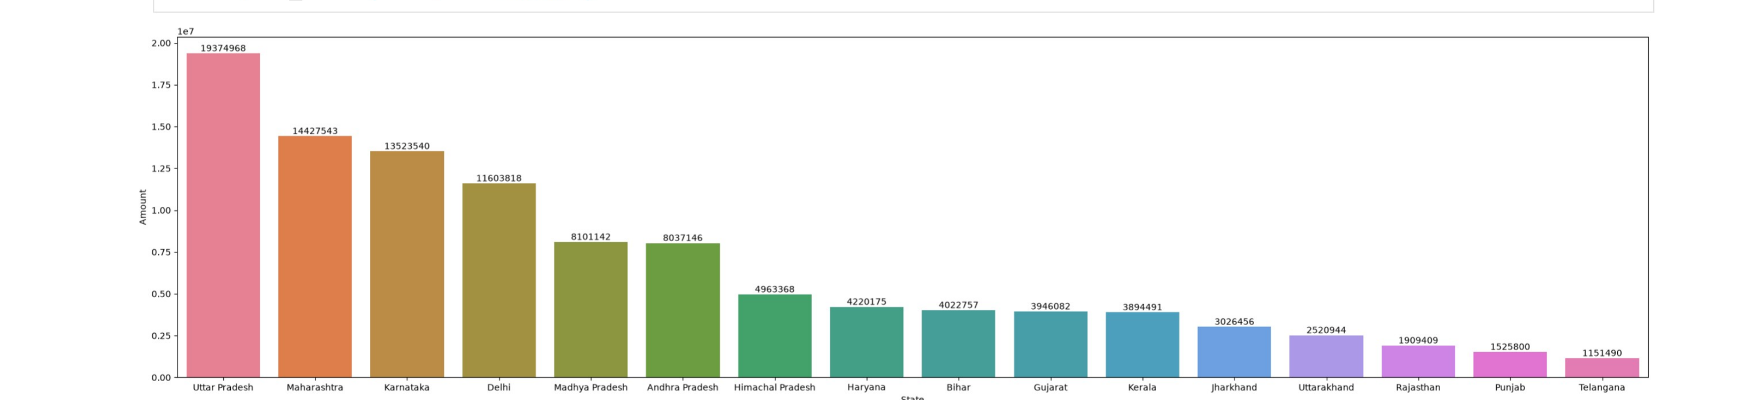
08
State-wise Sales
Total Amount generated by state
BUSINESS PROBLEM Which states contribute the most revenue and deserve focused regional sales strategy?
Key Insight
Sales value is concentrated among the leading states, followed by a long tail of lower-contributing states.
state_wise_amount = df.groupby('State', as_index=False)['Amount']
.sum().sort_values(by='Amount', ascending=False)
plt.figure(figsize=(30,7))
ax = sns.barplot(data=state_wise_amount, x='State', y='Amount', hue='State')
BUSINESS TAKEAWAY
Regional sales strategies can focus on the strongest markets.
Diwali Sales EDA • 8

Slide 9
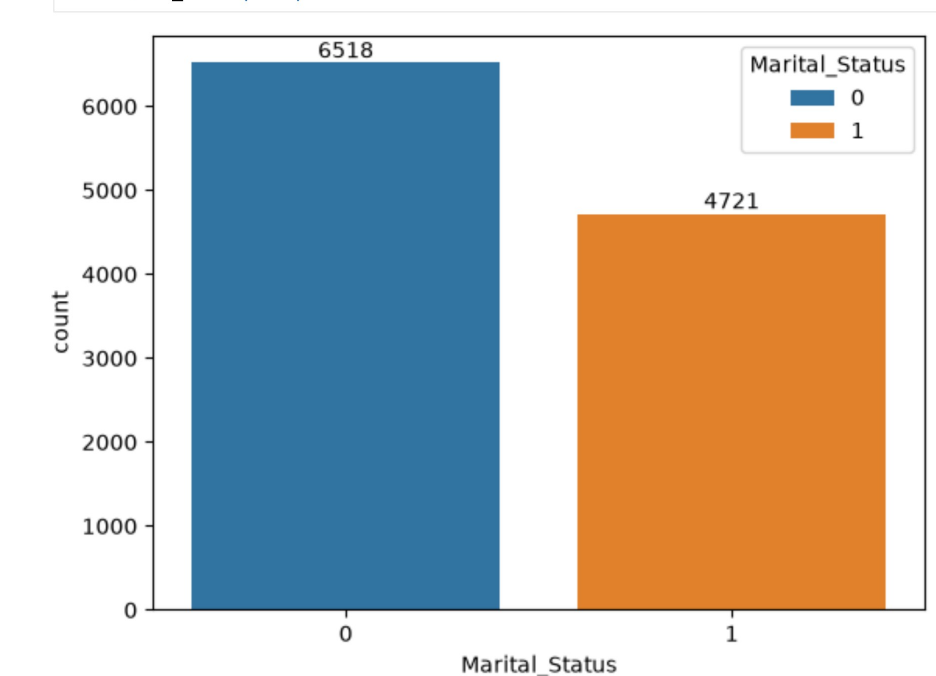
09
Marital Status Distribution
Buyer count by marital status
BUSINESS PROBLEM Does marital status affect buyer volume, and should campaigns be tailored accordingly?
Key Insight
The dataset has 6,518 unmarried buyers (0) and 4,721 married buyers (1).
ax = sns.countplot(data=df, x='Marital_Status', hue='Marital_Status')
for bars in ax.containers:
ax.bar_label(bars)
BUSINESS TAKEAWAY
Marital status is a useful customer-segmentation variable.
Diwali Sales EDA • 9

Slide 10
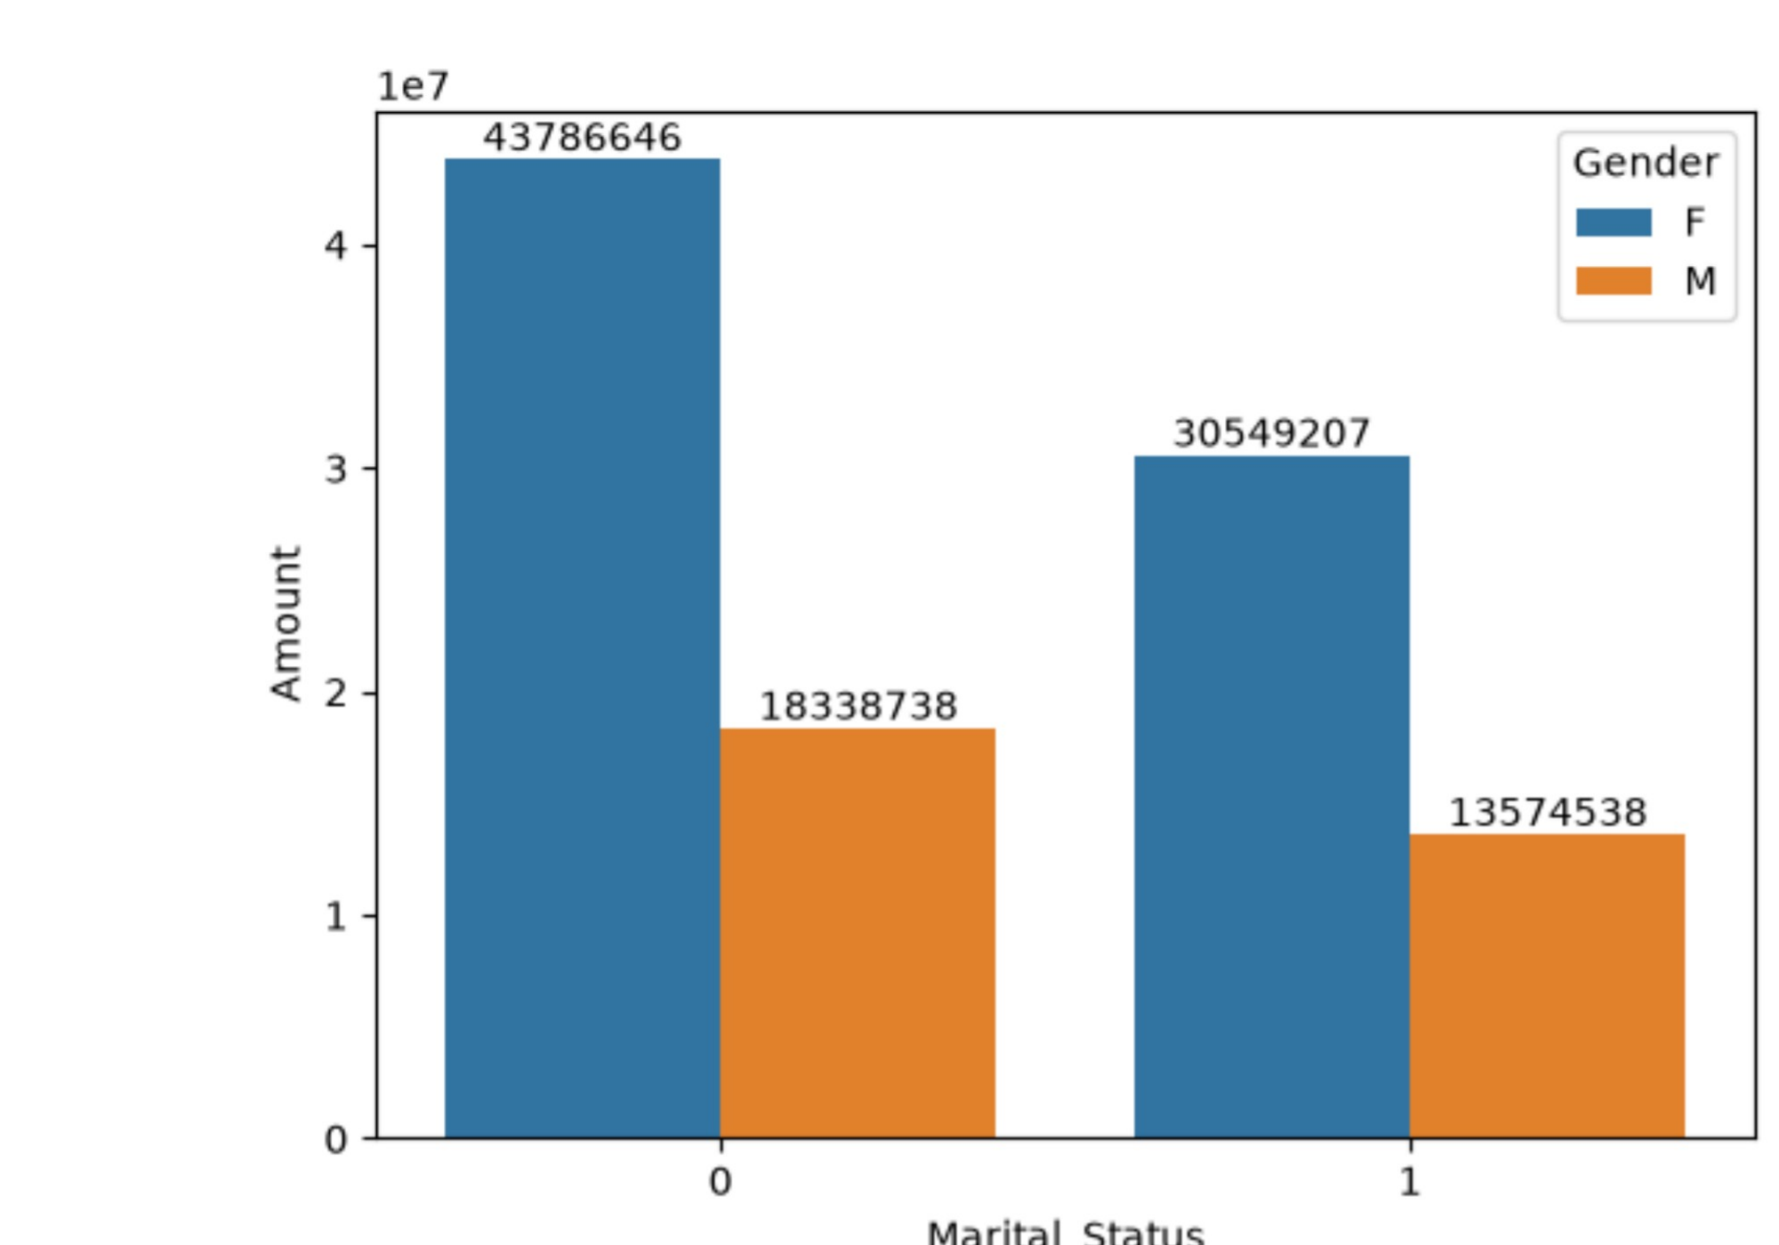
10
Sales by Marital Status & Gender
Total Amount split by marital status and gender
BUSINESS PROBLEM Within marital-status segments, which gender drives more purchasing value?
Key Insight
Women contribute the larger Amount within both groups; unmarried (0) female Amount is ₹43,786,646.
marital_status_amount = df.groupby(['Marital_Status','Gender'],
as_index=False)['Amount'].sum().sort_values(by='Amount', ascending=False)
ax = sns.barplot(data=marital_status_amount, x='Marital_Status',
y='Amount', hue='Gender')
BUSINESS TAKEAWAY
Female customers drive a large share of purchasing value across segments.
Diwali Sales EDA • 10

Slide 11
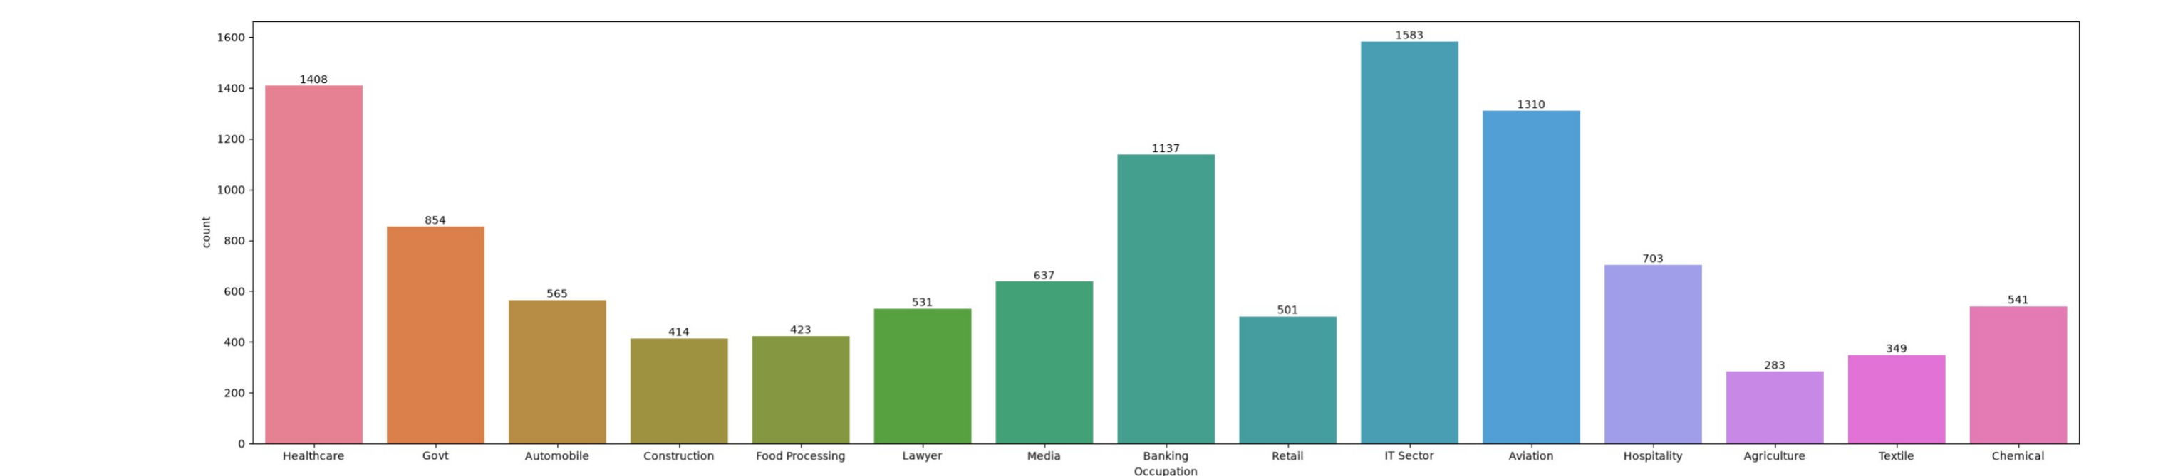
11
Occupation-wise Buyer Distribution
Number of buyers across occupations
BUSINESS PROBLEM Which occupation groups should be targeted for customer acquisition?
Key Insight
The project identifies IT Sector, Aviation and Healthcare among the prominent buyer occupations.
plt.figure(figsize=(30,7))
ax = sns.countplot(data=df, x='Occupation', hue='Occupation')
for bars in ax.containers:
ax.bar_label(bars)
BUSINESS TAKEAWAY
Occupation can support targeted customer segmentation.
Diwali Sales EDA • 11

Slide 12
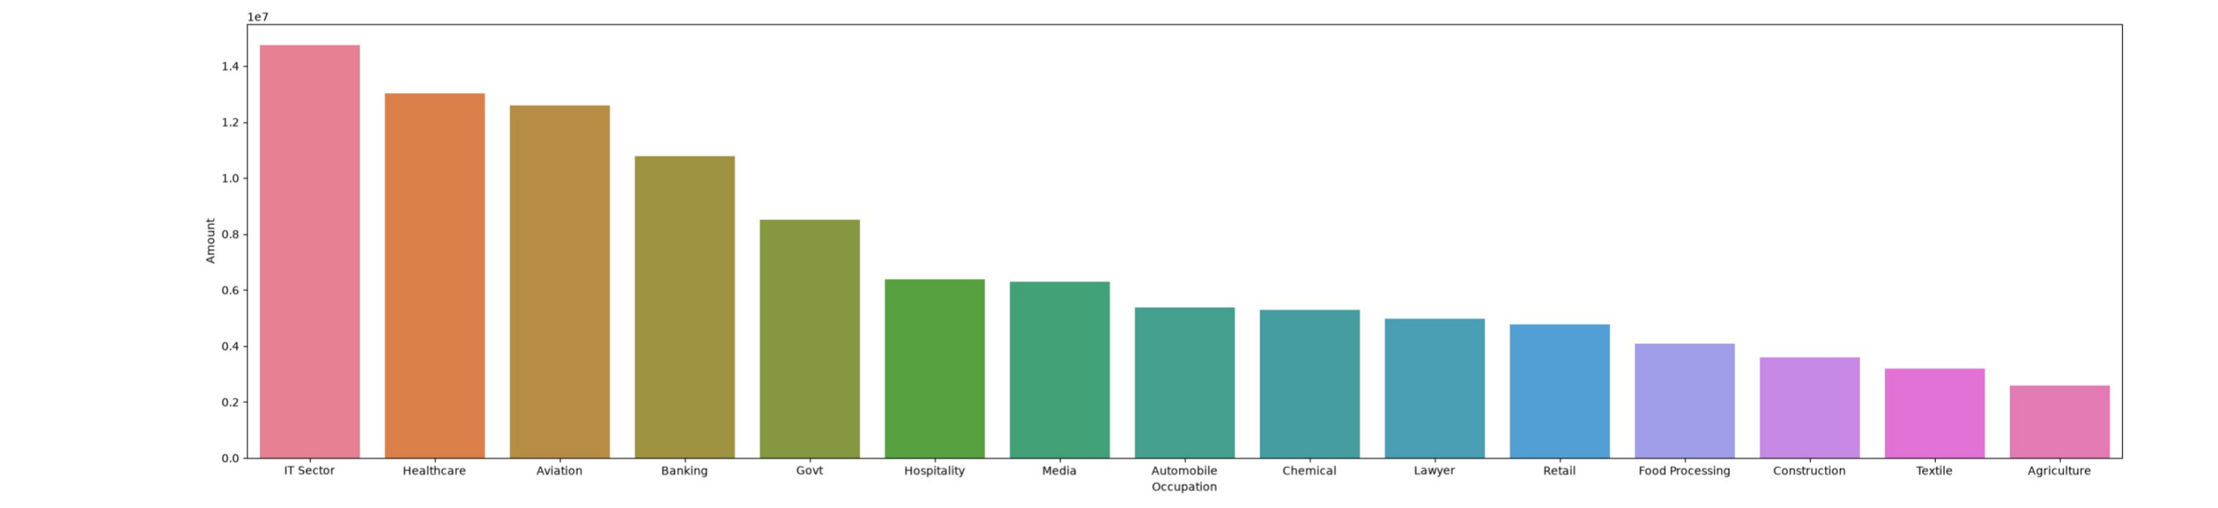
12
Occupation-wise Sales
Total Amount by occupation
BUSINESS PROBLEM Which occupations generate the highest revenue and warrant premium targeting?
Key Insight
Sales contribution varies across occupations, with IT Sector, Healthcare and Aviation leading the ranking.
occupation_amount = df.groupby(['Occupation'], as_index=False)['Amount']
.sum().sort_values(by='Amount', ascending=False)
plt.figure(figsize=(30,7))
sns.barplot(data=occupation_amount, x='Occupation', y='Amount', hue='Occupation')
BUSINESS TAKEAWAY
Occupation-level targeting can prioritize high-value audiences.
Diwali Sales EDA • 12

Slide 13
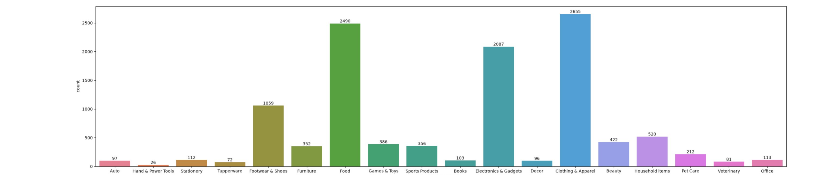
13
Product Category Distribution
Buyer/order volume across product categories
BUSINESS PROBLEM Which product categories see the highest demand and need inventory focus?
Key Insight
The project highlights Food, Clothing & Apparel and Electronics & Gadgets as important categories.
plt.figure(figsize=(30,7))
ax = sns.countplot(data=df, x='Product_Category', hue='Product_Category')
for bars in ax.containers:
ax.bar_label(bars)
BUSINESS TAKEAWAY
These categories deserve strong merchandising and campaign attention.
Diwali Sales EDA • 13

Slide 14
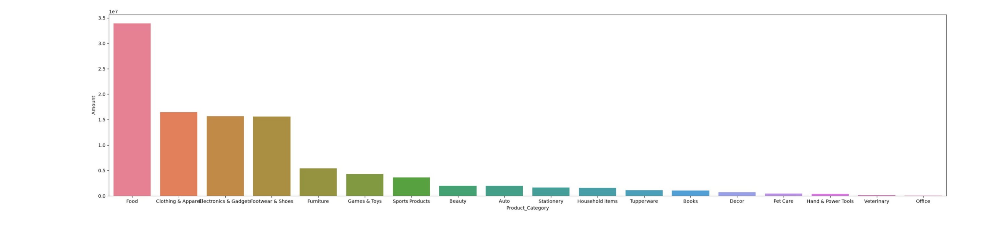
14
Sales by Product Category
Total Amount generated by category
BUSINESS PROBLEM Which categories generate the most revenue and deserve marketing and promotional focus?
Key Insight
Food is the clear revenue leader, followed by Clothing & Apparel, Electronics & Gadgets and Footwear & Shoes.
prd_cat_amount = df.groupby(['Product_Category'], as_index=False)['Amount']
.sum().sort_values(by='Amount', ascending=False)
plt.figure(figsize=(32,7))
sns.barplot(data=prd_cat_amount, x='Product_Category', y='Amount',
hue='Product_Category')
BUSINESS TAKEAWAY
Use category sales contribution to prioritize products and promotions.
Diwali Sales EDA • 14

Slide 15
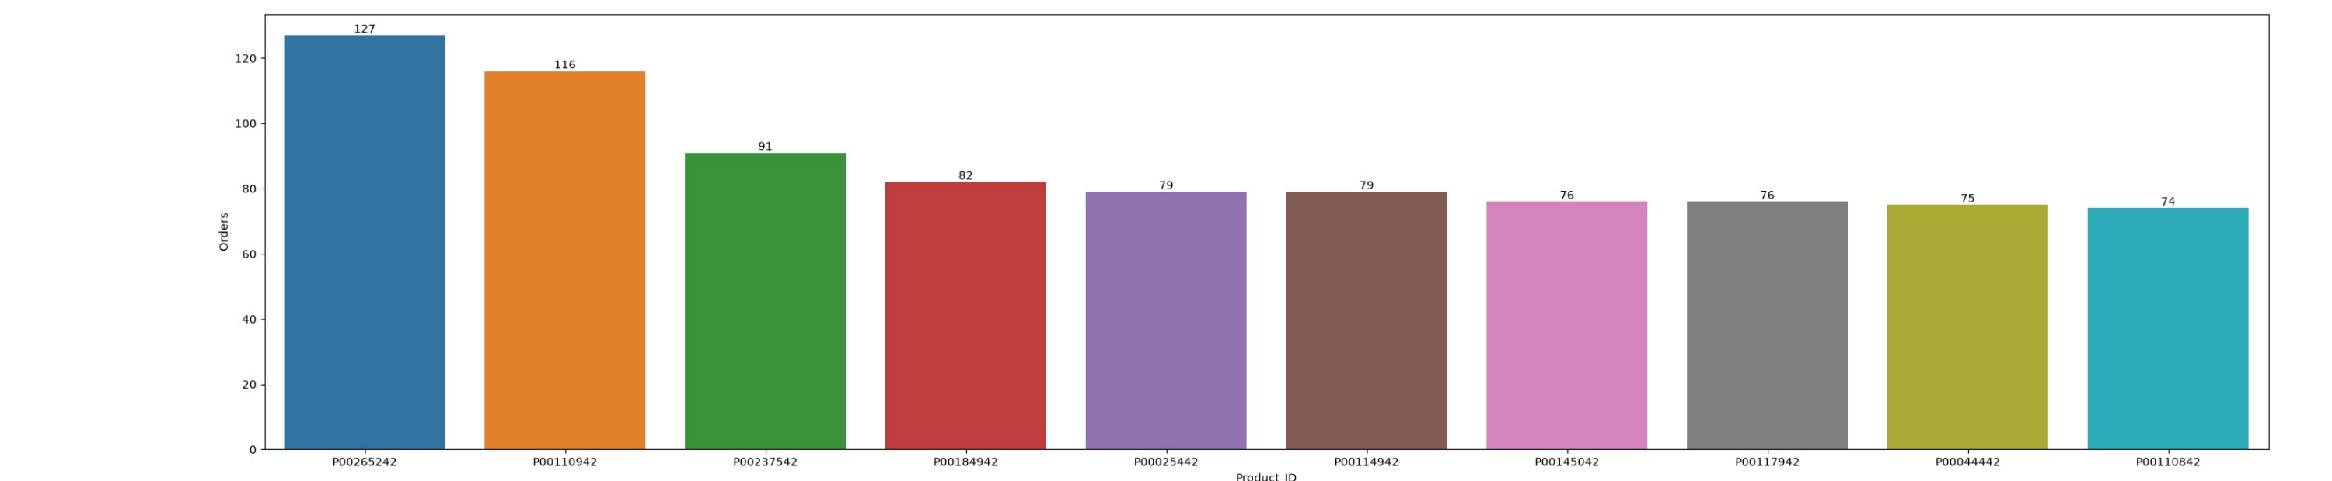
15
Top 10 Products by Orders
Product IDs with the highest total orders
BUSINESS PROBLEM Which specific products are bestsellers and should be prioritized for stock availability?
Key Insight
Product P00265242 leads with 127 orders, followed by P00110942 (116) and P00237542 (91).
prd_ord = df.groupby(['Product_ID'], as_index=False)['Orders'].sum()
.sort_values(by='Orders', ascending=False).head(10)
plt.figure(figsize=(32,7))
ax = sns.barplot(data=prd_ord, x='Product_ID', y='Orders', hue='Product_ID')
BUSINESS TAKEAWAY
Top products can be prioritized for inventory and promotion decisions.
Diwali Sales EDA • 15

Slide 16
16
Final Business Insights
What the complete EDA tells us
1
Female customers are the dominant buyer group and contribute higher total purchasing value.
2
The 26–35 age group is the strongest customer segment and is predominantly female.
3
Uttar Pradesh, Maharashtra and Karnataka are highlighted as leading states for order activity.
4
Occupation, marital status and product category provide useful dimensions for customer segmentation.
5
Food, Clothing and Electronics are highlighted as important product categories.
EDA outcome: customer understanding → segmentation → actionable sales strategy
Diwali Sales EDA • 16

