Slide 1
DATA STRUCTURES
Linear
Array
Linked List
Stack
Non-Linear
Tree
Graph
Heap

Slide 2
ALGORITHM
Time
Ω (Best)
Θ (Average)
O (Worst)
Space
Ω (Best)
Θ (Average)
O (Worst)

Slide 3
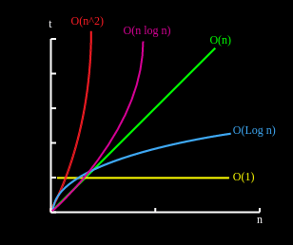
Big - O
O : n is the no of instruction run
(n)
1) Void Print(int n){
for(int x=0;x<n;x++){
system.out.println(x);
}
}
2) Void Print(int n){
for(int x=0;x<n;x++){
system.out.println(x);
}
for(int y=0;x<n;y++){
system.out.println(y);
}
}

