Slide 1
RADIUS SIMULATOR
Remote Authentication Dial In User Service
Submitted By :
Group 6
Haritima Manchanda (UE143038)
Kunal Taneja (UE143053)
Siddharth Kumar (UE143093)

Slide 2
Introduction of the Project:
The project is based on developing a tool that facilitates the radius client functionality. The aim is to identify the shortcomings in the existing tool and develop an improved version of the radius protocol tool.
In this project we developed a RADIUS client tool which will be able to authenticate multiple dial-in users (user equipments) with centralized RADIUS server and authorize them to use network services and along with that it will account all the users for the services provided to them.
The project is an industry based project that tends to cater the needs of the organisations that require centralised Authentication, Authorisation and Accounting (AAA) management for users that connect and use a network service. It is often used by Internet service providers(ISPs) and enterprises to manage access to the Internet or internal networks, wireless networks, and integrated e-mail services.

Slide 3
What is RADIUS?
Remote Authentication Dial-In User Service (RADIUS) is a protocol for remote user authentication and accounting.
It’s primary use is for Internet Service Providers to authenticate username and passwords, though it may as well be used on any network that needs a centralized authentication and/or accounting service for its workstations.

Slide 4
What is RADIUS?
RADIUS Protocol is based on three major components:
Authentication
“Who are you?”
Authorization
“What services am I allowed to give you?”
Accounting
“What did you do with my services while you were using them?,,Accounting information may be used to track the user's usage for charging purposes

Slide 5
Why use Radius?
The embedded systems generally cannot deal with a large number of users with distinct authentication information. This requires more storage than many embedded systems possess.
RADIUS facilitates centralized user administration, which is important for several of these applications. Many ISPs have tens of thousands, hundreds of thousands, or even millions of users. Users are added and deleted continuously throughout the day, and user authentication information changes constantly.
RADIUS consistently provides some level of protection against a sniffing, active attacker. Other remote authentication protocols provide either intermittent protection, inadequate protection or non-existent protection.

Slide 6
Why use Radius?
RADIUS support is nearly omni-present. Other remote authentication protocols do not have consistent support from hardware vendors, whereas RADIUS is uniformly supported. RADIUS is exclusive to its own protocol.
Advantages of RADIUS:
Lightweight and efficient
Supported by many clients, e.g. 802.1x, switches and routers
Disadvantages of RADIUS:
Limited attribute set, limited use for desktop authentication

Slide 7
How does RADIUS work?
Authentication
Password authentication, plain text and hashed
Lookup in various user databases: passwd, SQL, text
Authorization
Using a set of rules or other templates
Accounting
Measuring, communicating and recording resources accessed by user

Slide 8
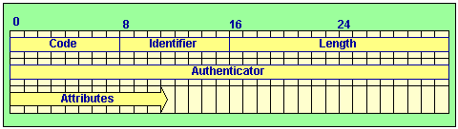
Protocol Format
Code - An octet containing the RADIUS command/response.
Code - An octet containing the RADIUS command/response.
Identifier - An octet used to match the command and response.
Length - The length of the packet (2 octets).
Authenticator - Value used to authenticate the reply from the RADIUS server, and is used in the password hiding algorithm..
Attributes - The data belonging to the command or response.

Slide 9
Protocol Format
The identifier is a one octet value that allows the RADIUS client to match a RADIUS response with the correct outstanding request.
The attributes section is where an arbitrary number of attribute fields are stored. The only pertinent attributes for this discussion are the User-Name and User-Password attributes.
This description will concentrate on the most common type of RADIUS exchange: An Access-Request involving a username and user password, followed by either an Access-Accept, Access-Reject or a failure. The client is the entity that has authentication information that it wishes to validate. The server is the entity that has access to a database of authentication information that it can use to validate the client's authentication request.

Slide 10




RADIUS Architecture
In this, a front-end NAS (network access server) or RAS (remote access server) performs authentication of a user with a backend RADIUS server. The NAS/RAS sends user information (credentials) to the RADIUS server carried in RADIUS packets. The RADIUS server implements the access policy (who is granted access with what authorizations) or may retrieve policies from a database through LDAP (Lightweight Directory Access Protocol).
RADIUS server may optionally contain policy DB
LDAP
SQL
RADIUS Server
LDAP/SQL
RADIUS
Access Line
(e.g. PPP)
Towards the Internet
User
NAS / RAS

Slide 11













RADIUS Authentication
A RADIUS transaction typically starts with an Access-Request carrying user credentials followed by a RADIUS server response with a grant or denial of access.
User
NAS
RADIUS
DB
ser
ver
DB
User data packet
Reject access
Access-Request
hashed password (RSA MD5)
Access-Reject
Lookup credentials for authorization
'Wrong credentials'
with username and
Auth. failure
User data packet
Grant access
Access-Request with username and
hashed password (RSA MD5)
Access-Accept
Lookup credentials for authorization. Create session record.
'Correct credentials'
Auth. success

Slide 12
RADIUS Accounting
Once a network session is up and running (successful authentication), the NAS may request to start counting network usage of the user.
User
NAS
RADIUS
DB
Ser
ver
ce
User data packet
Accounting-Request
(Start)
Start counting resour
usage (e.g. online time)
Accounting-Response
End of network session
Accounting-Request
(Stop)
Stop counting resource
usage
Accounting-Response

Slide 13
Detailed Procedure
Network Access Server get username/password pair from remote user, crypts this information with a shared secret key and sends this with an 'Access-request' to the RADIUS Server (Authentication phase).
When the user and password combination is valid then the RADIUS Server sends an 'Accept-accept' with extra information (For example: IP-address, network mask, allowed session time, etc.) to the Network Access Server (Authorization phase).
The network Access Server sends an 'Accounting-request (start)' to indicate that the user is logged onto the network (Accounting phase).
The RADIUS Server responds with an 'Accounting-response' when the accounting information is stored.
When a user logs out then the Network Access Server will send an 'Accounting-request (Stop)'
The RADIUS Server responds with an 'Accounting-response' when the accounting information is stored.

Slide 14
RADIUS message types and attributes
Message types:
Access-Request
Access-Challenge
Access-Accept
Access-Reject
Accounting-Request
Accounting-Response
Status-Server (experimental)
Status-Client (experimental)
Attributes:
User-Name
User-Password
NAS-IP-Address
NAS-Port
Service-Type
NAS-Identifier
Framed-Protocol
Vendor-Specific
Calling-Station-ID
Called-Station-Id

Slide 15
Objectives of the Project
To implement the Radius protocol FreeRADIUS is campaigned as the most used Radius tool in the world. The popularity is explained, with an easy-to-use approach, no cost required to use (downloadable from an official website), user-friendliness, quick and easy installation and comparable security to the payable servers. However FreeRADIUS comes with its own set of limitations. Our objective was to study those limitations and develop a tool that incorporates all the desirable properties of the FreeRADIUS while overcoming the limitations of the FreeRADIUS tool.

Slide 16
What is FreeRADIUS?
FreeRADIUS is a modular, high performance free RADIUS suite developed and distributed under the GNU General Public License, version 2, and is free for download and use.
FreeRADIUS is the most popular open source RADIUS server and the most widely deployed RADIUS server in the world. It supports all common authentication protocols.It is the basis for many commercial RADIUS products and services, such as embedded systems, RADIUS appliances that support Network Access Control

Slide 17
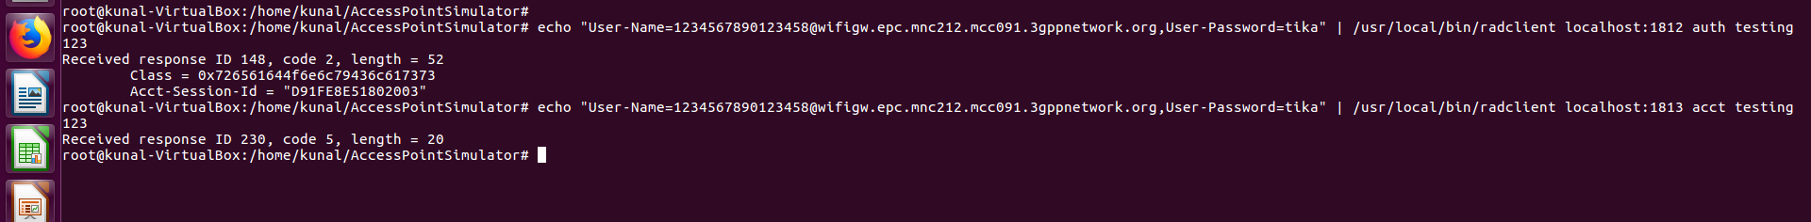
Implementation of FreeRADIUS To access the server the client send an access-request and enters the user credentials such as User-Name and User-Password. The server responds by specifying the class id and the session id. In FreeRADIUS we process authentication requests at port 1812 while the accounting requests are addressed at port 1813.

Slide 18
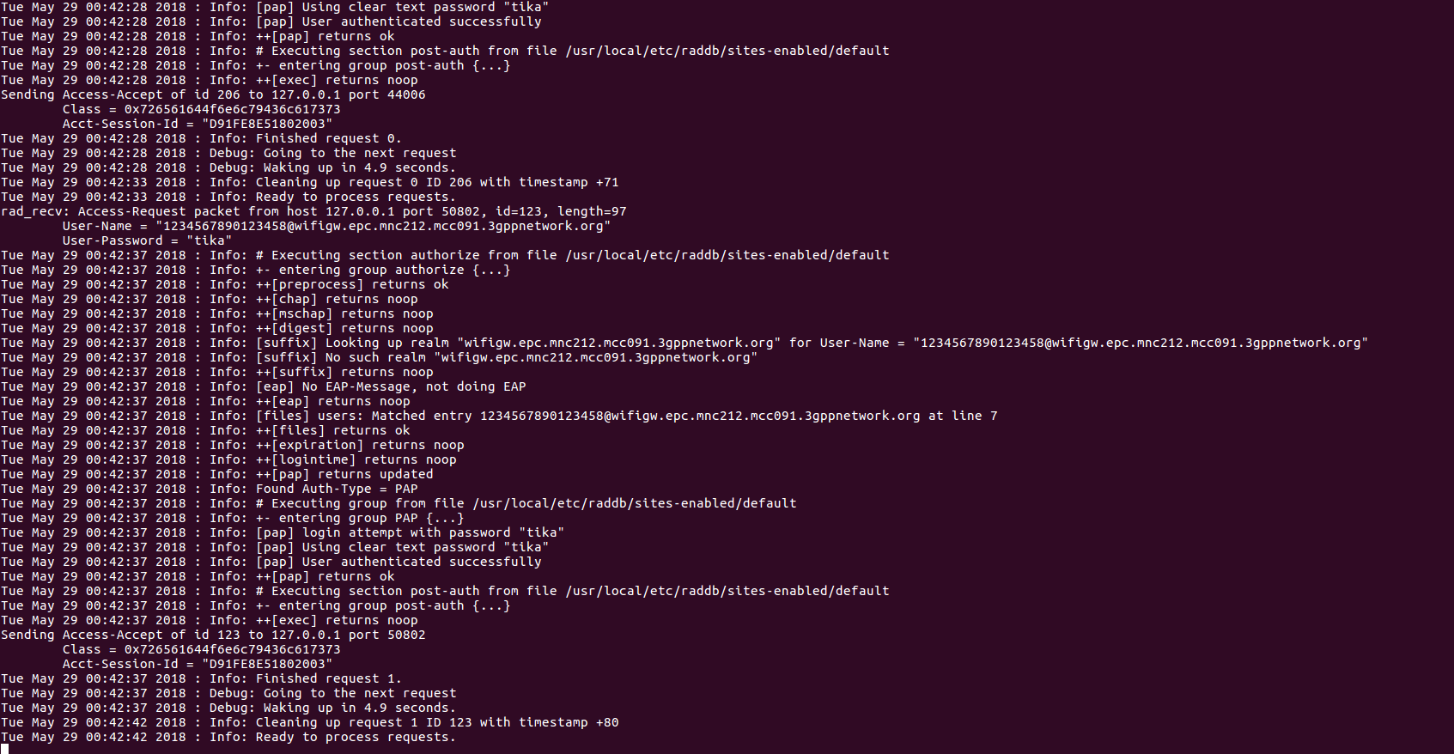
This is a snapshot of the server log which mentions that the user has been authenticated successfully.

Slide 19
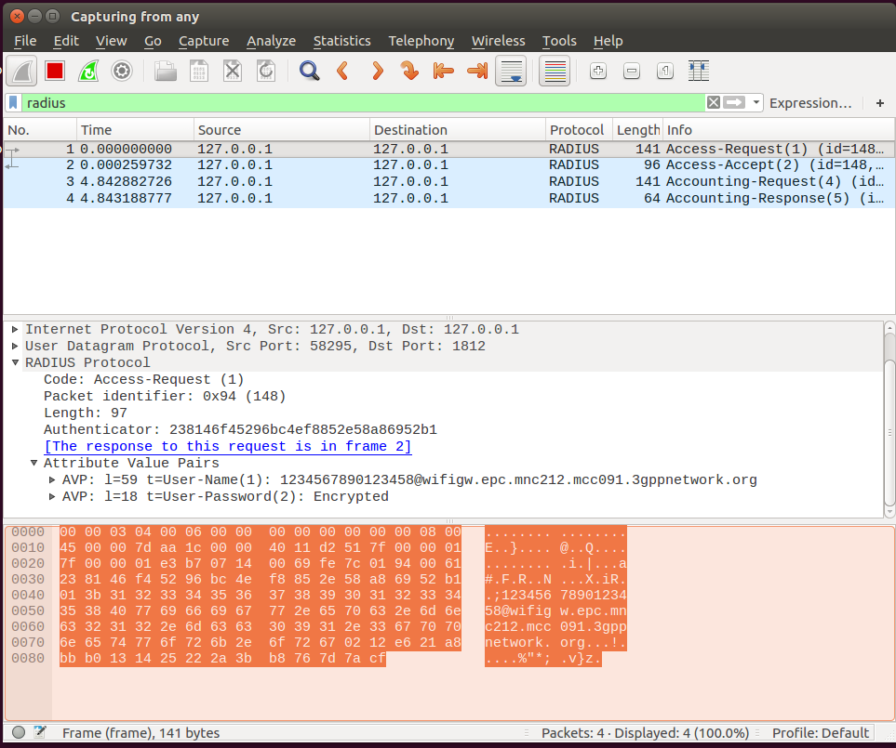
The following is the screenshot of Wireshark which is a network analyser tool. It lets us see what’s happening in the network at the microscopic level and helps us to maintain a log of the requests sent and processed in a concise manner.

Slide 20
Shortcomings of FreeRADIUS
FreeRADIUS allows accounting to start before the access request has been processed. So before the user has been authenticated accounting.
FreeRADIUS can process one request at a time.
In FreeRADIUS a user has to type long statements to request access to a server and start accounting request.

Slide 21
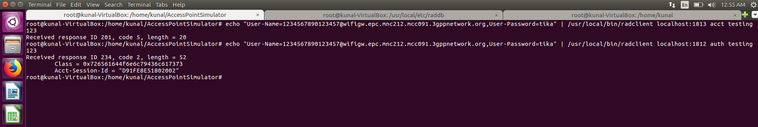
The following snapshot indicates one of the shortcomings of FreeRADIUS that even when the user has not been authenticated, accounting request can be generated by the client. As we can see the accounting request with port number 1813 sent before the authentication request is treated as an ideal case and no error message is generated.

Slide 22
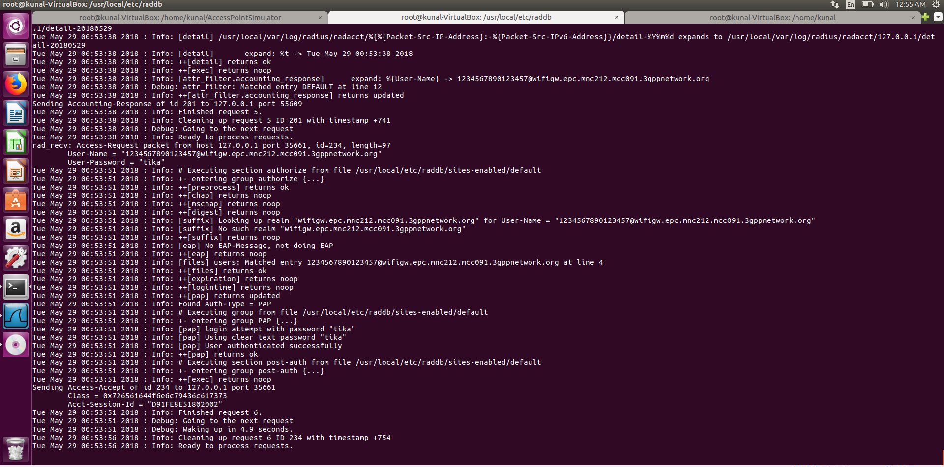
The processes the accounting request first and then the authentication request.

Slide 23
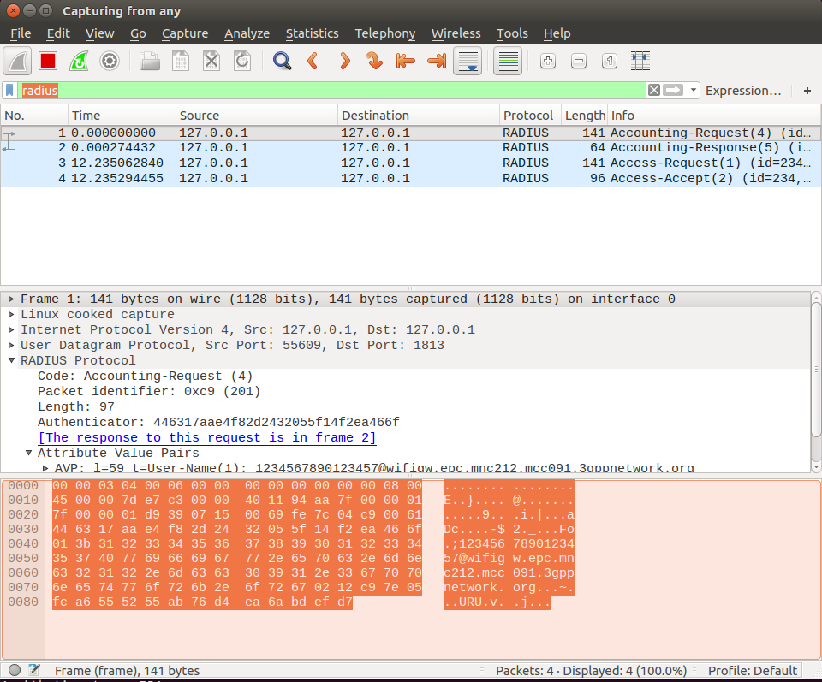
A Wireshark representation of the same:

Slide 24
Proposed System
The proposed system targets an increase in scalability and congestion control by allowing multiple user requests to be handled at a time. It also allows accounting to take place only after the user has been authenticated or the request for access has been processed. The system uses CHAP protocol for authenticating the users.

Slide 25
Design Strategy
In this project, keeping in mind the AAA services of RADIUS protocol we designed a multi-threaded system in which to each service, single thread was devoted. Moreover, concurrency control such as mutual exclusion and serializability were enforced.
1st thread (Authentication) - Responsible for fetching first request of each user of respective client and authenticating it against the entries present in server.
2nd thread (Authorization) - After successful authentication, this thread manages the communication between the server and user. For example, user might request accounting services from the server, and the latter after validating the state of the user authorises the user for respective services.
3rd thread (Accounting) - This thread monitors the resources used by clients and for what duration these resources are used.

Slide 26
Implementing proposed system:
Brief Description of Various Modules of the system :
FreeRADIUS Server: FreeRADIUS is the most popular open source RADIUS server and the most widely deployed RADIUS server in the world.The FreeRADIUS Suite includes a RADIUS server, a BSD-licensed RADIUS client library, a PAM library, an Apache module, and numerous additional RADIUS related utilities and development libraries.
RADIUS Client-Side program written in C: The heart of our project lies in this module, as in this we design and formulate the client-side architecture of the RADIUS. It is here we develop the AAA structure and scale our program such that the whole RADIUS environment can support multiple client requests simultaneously. Various concepts of C such as Multithreading, Socket Programming (UDP), Message IPC, Message Synchronisation are used to develop the complete architecture.

Slide 27
Implementing proposed system:
Brief Description of Various Modules of the system :
Graphical User Interface: In order to provide flexibility and ease of access to the services provided by the simulator our project supports a GUI which is a simple menu driven interface through which the user can provide the credentials and create the input file, the server after accessing the input file runs the C program at the back end which takes care of the AAA services.
Wireshark: Wireshark is the world’s foremost and widely-used network protocol analyzer. It lets you see what’s happening on your network at a microscopic level and is the de facto (and often de jure) standard across many commercial and non-profit enterprises, government agencies, and educational institutions. Wireshark lets the user put network interface controllers into promiscuous mode (if supported by the network interface controller), so they can see all the traffic visible on that interface including unicast traffic not sent to that network interface controller's MAC address.

Slide 28
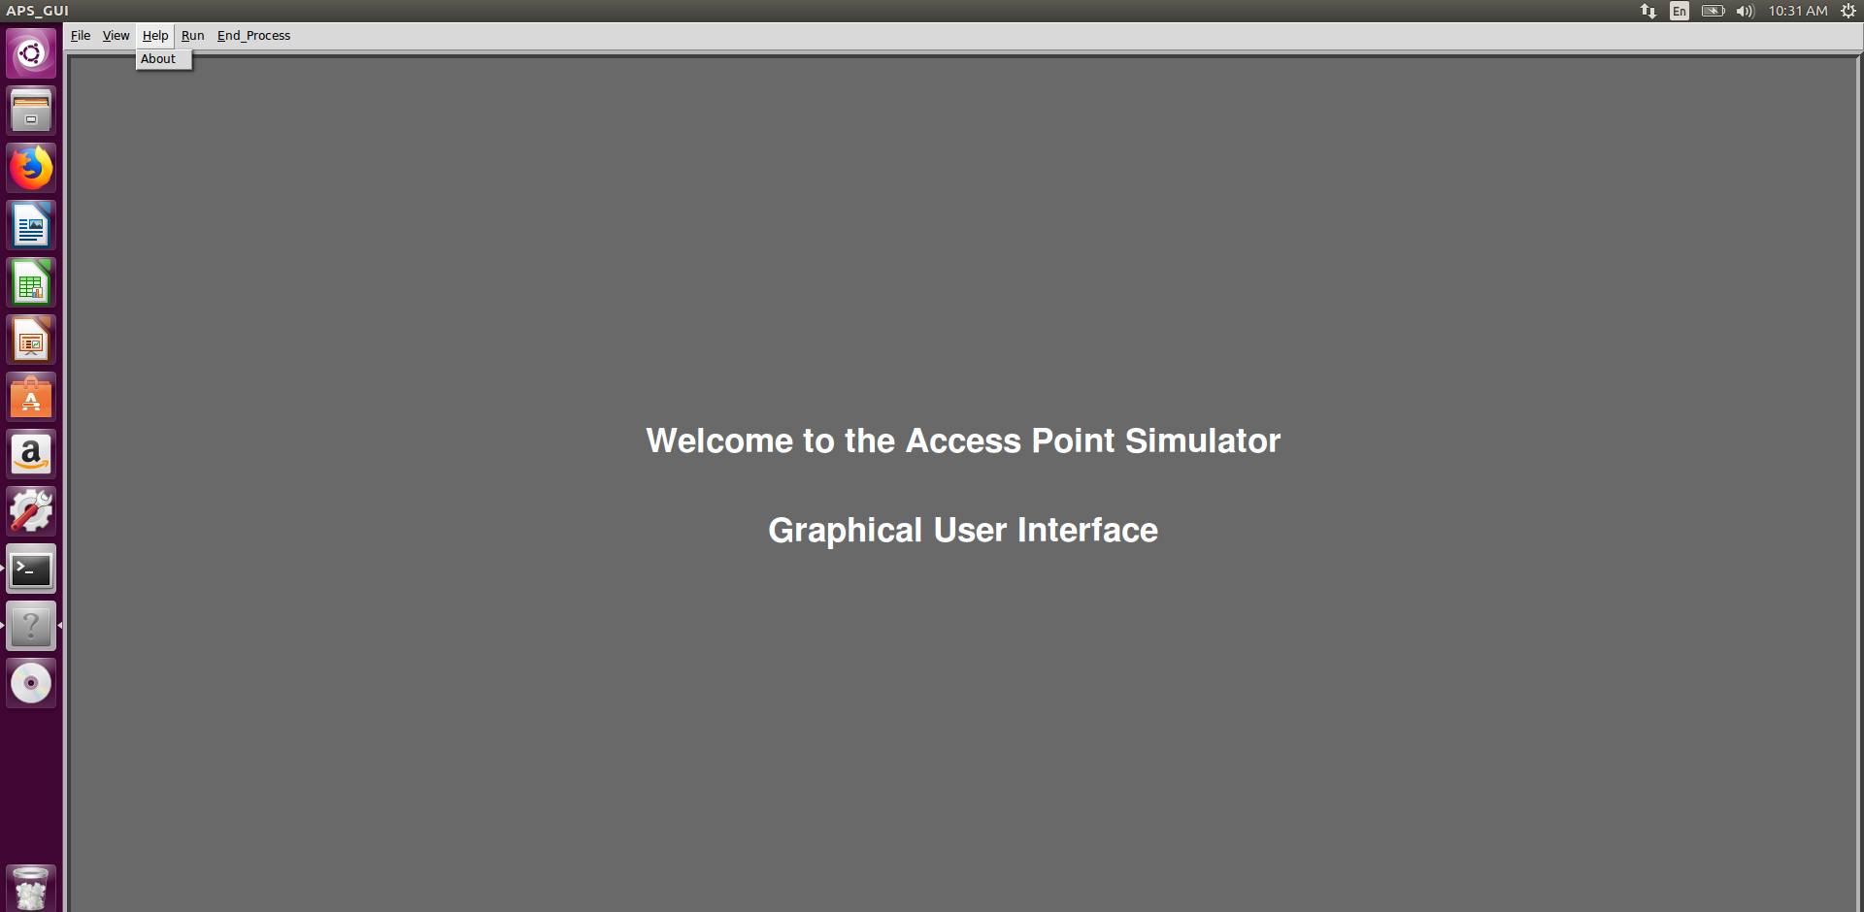
GUI Representation:
The GUI is a simple menu based structure which performs specific back end operations corresponding to each and every option of the menu.

Slide 29
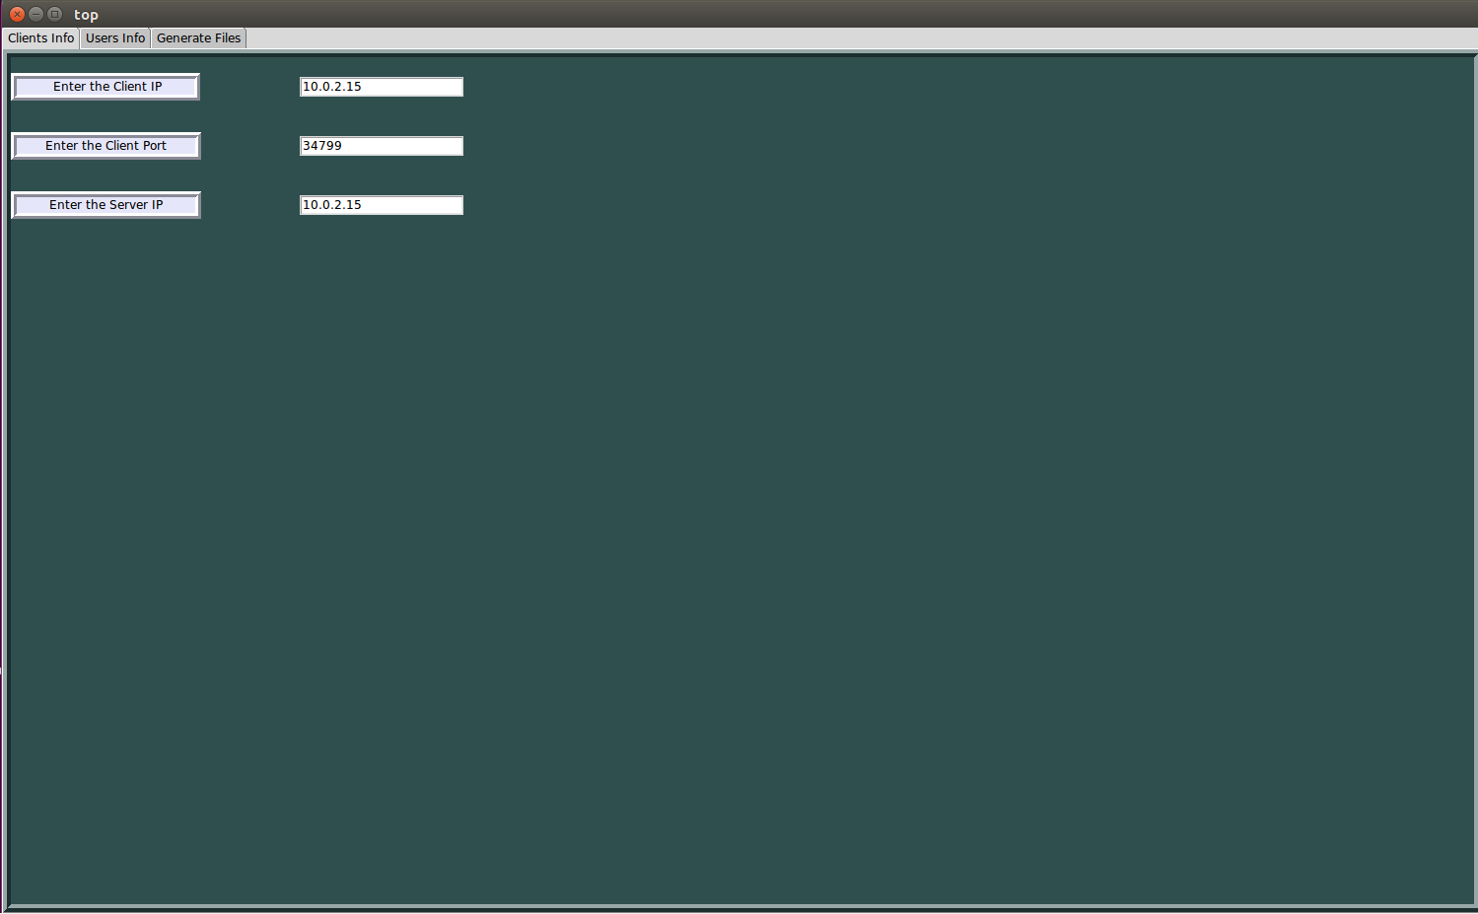
GUI Representation:
File tab: Under this tab we find option ‘New’ and after clicking on this we’re presented with a new window which asks for the client information.

Slide 30
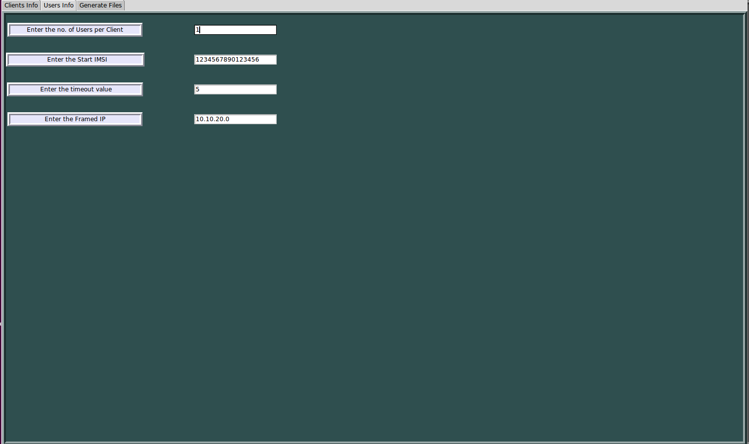
GUI Representation:
After entering the client information, next we’re asked for the user specific credentials.

Slide 31
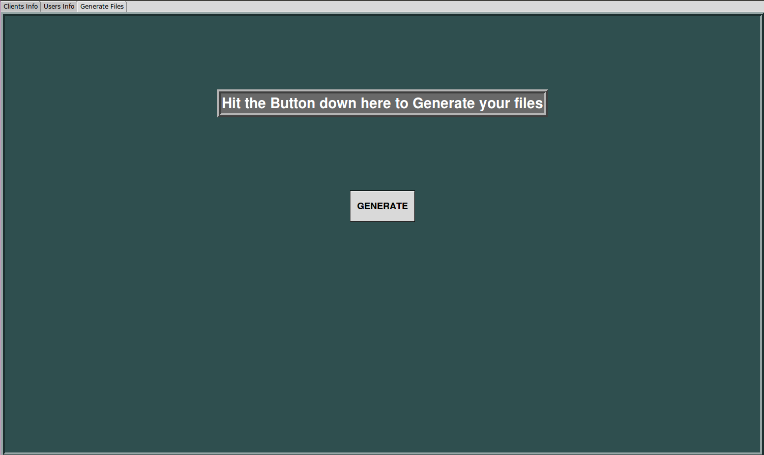
GUI Representation:
Finally after entering all the credentials we go and click on the generate files button to populate our database of users and clients which can be later on cross verified in the file ‘inputFile’.

Slide 32
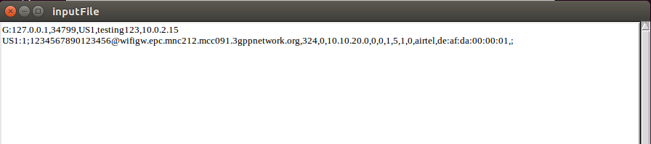
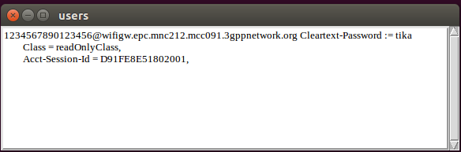
GUI Representation:
InputFile: All the information that GUI accepts from the user is stored under this file which is further used by the server for authentication mechanisms.
users: This file contains the user specific information that is information like User-name, User-Password, Class, Session-ID which is provided by the RADIUS server automatically when it successfully authenticates the client.

Slide 33
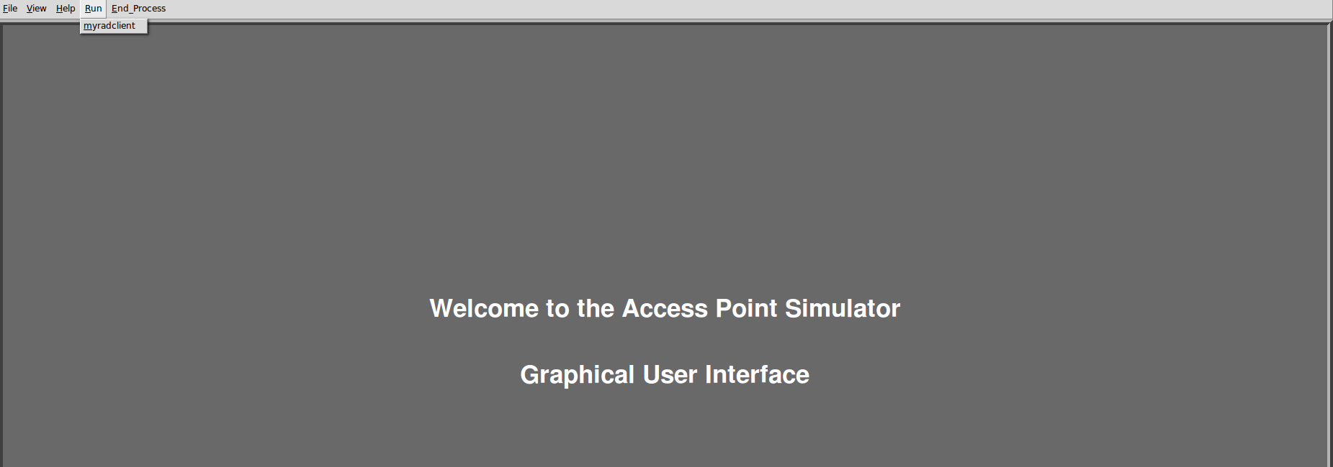
GUI Representation:
Finally after entering all the credentials we go and click on the generate files button to populate our database of users and clients which can be later on cross verified in the file ‘inputFile’.

Slide 34
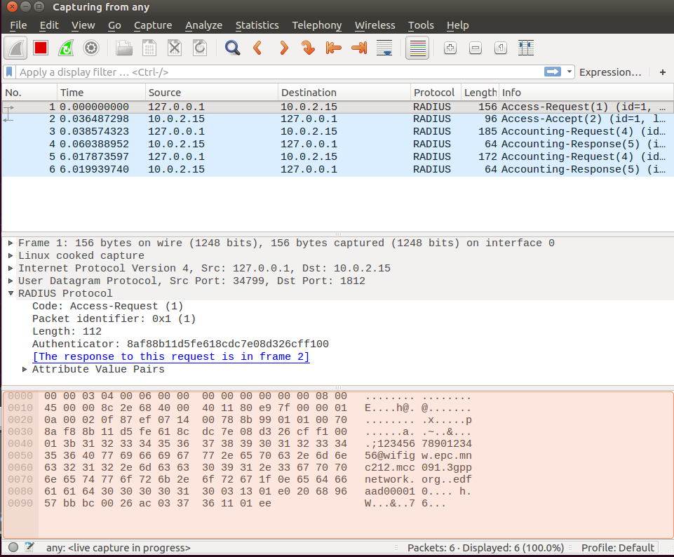
Capturing RADIUS Packets in Wireshark:

Slide 35
THANK YOU !!

