Slide 1

Vallabh Vidyanagar-388120
Birla Vishvakarma Mahavidyalaya Engineering College An Autonomous Institute
Subject : Machine Learning(4IT47)
Project: Student Grade Analysis System
Presented By :
Project coordinator :
Jainam Patel (20IT407)
Manav Shah (20IT422)
Kunal Panchal(20IT448)
Arya Shah (20IT481)
Dr. Zankhana Shah

Slide 2

OUTLINE
Introduction
Key Features
Project Details
Implementation

Slide 3
INTRODUCTION
Student Grade Analysis System using machine learning is an advanced educational tool.
It employs algorithms to analyze historical data and various factors for student performance.
Factors considered include subject marks, SPI & CPI.
It provides insights for personalized interventions by educators.
Data-driven predictions and recommendations enhance the educational experience.
Overall, it ensures student success by improving academic support and guidance.

Slide 4
TECHNOLOGIES USED:
ML
PYTHON
STREAMLIT (UI)

Slide 5
KEY FEATURES
1. Data Integration: Collects and integrates data from various sources, including mid-semester exam results, end-semester exam results, and internal assessment scores.
2. Data Preprocessing: Cleans and prepares the data for analysis, handling missing values and outliers.
3. Grade Prediction: Predicts final course grades by considering the weightage of mid-semester marks, end-semester marks, and internal assessment scores.
4. Machine learning Algorithms: Uses regression machine learning algorithms like Linear regression, gaussian regression, Support vector regression, ridge regression and lasso regression, it also uses LSTM (Long-short term memory) algorithm to predict future data.
5. Subject wise representation: Utilizes matplotlib library to represent data into graphical format.
6. Individual Student Data: Creates individual profiles for each student, highlighting their strengths and areas that need improvement.

Slide 6
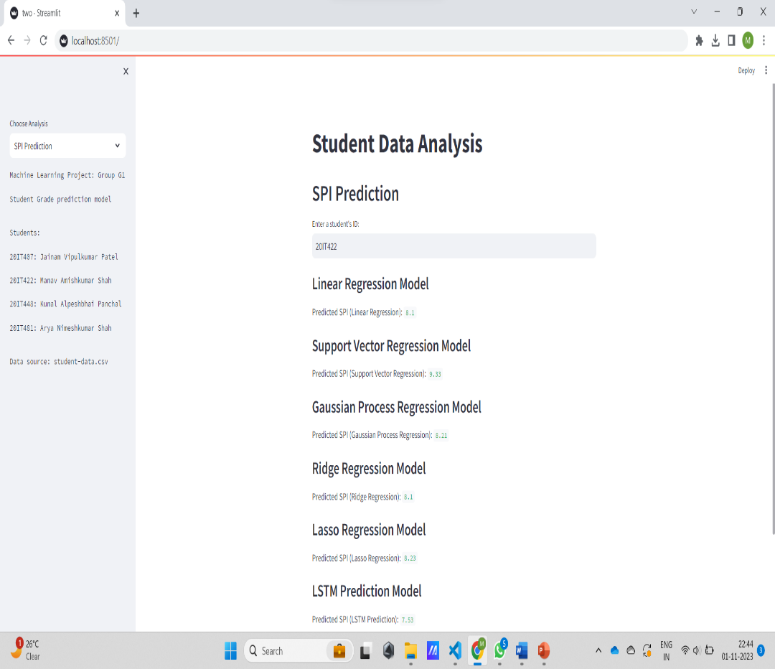
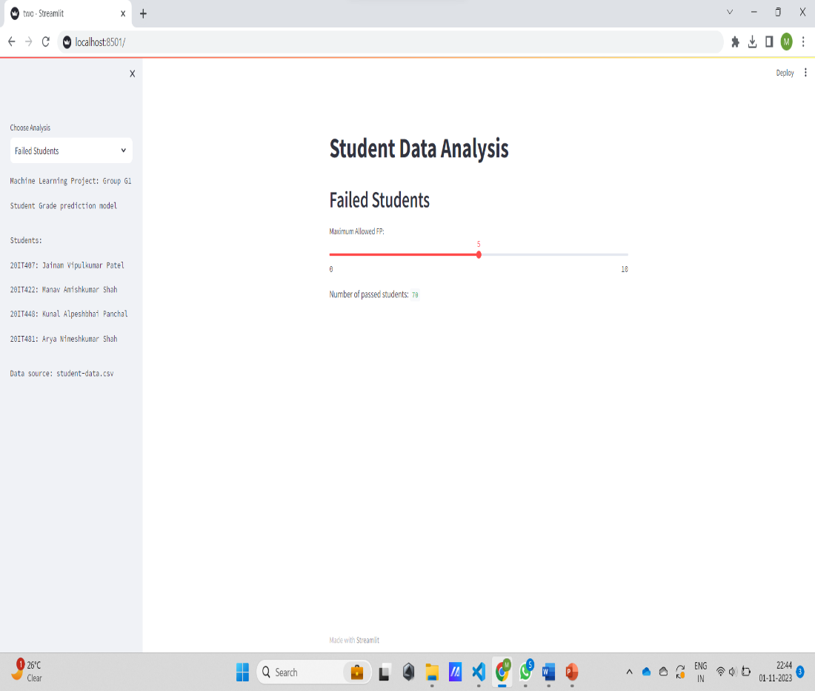
IMPLEMENTATION

Slide 7
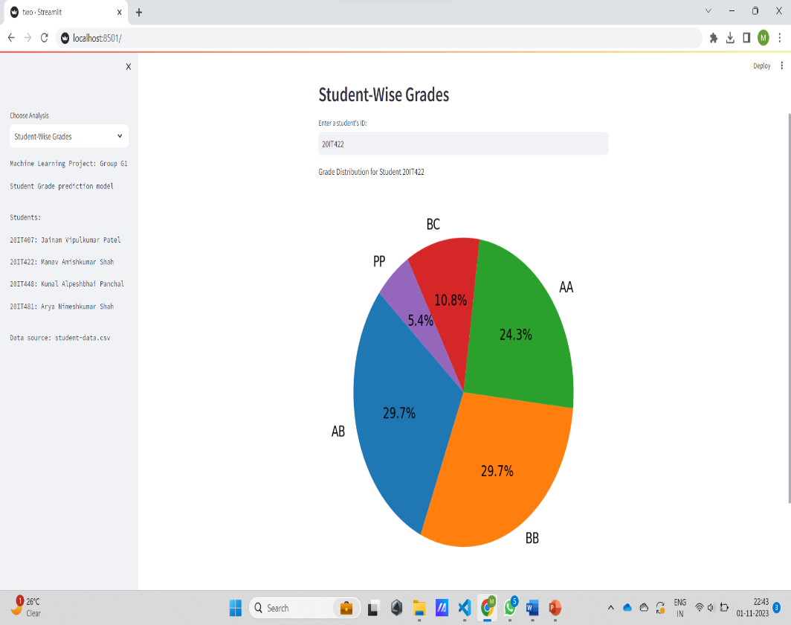
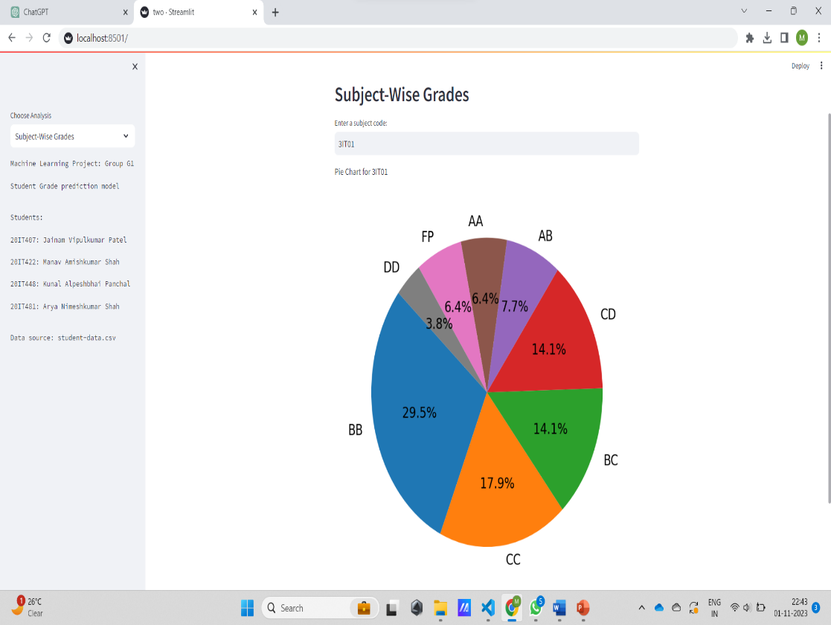
IMPLEMENTATION

Slide 8
CONCLUSION
In conclusion, the Student Grade Analysis System, which leverages end-semester marks, semester performance index & cumulative performance index is a transformative tool for educational institutions. It empowers colleges and universities to harness the power of data to gain insights into student performance, identify areas of improvement, and provide timely interventions. By predicting grades, offering personalized recommendations, and enabling continuous improvement in teaching methods, this system enhances the overall educational experience. It not only benefits students by helping them succeed but also aids faculty and institutions in optimizing resources and improving the quality of education. In an era of data-driven decision-making, this system plays a pivotal role in shaping the future of higher education.

Slide 9

THANK YOU

