Slide 1

Development of ML models to predict client emotions based on facial expressions in various online meeting platforms.
Group Members
Harsh Trivedi - 0788765
Kunal Ghaware - 0769182
Panav Jadhav - 0774109
Kavita Virk - 0787818

Slide 2
Table of Contents
Problem Identification
Dataset
Data Assessment
Pre-processing
EDA
Results
Next Steps
References

Slide 3
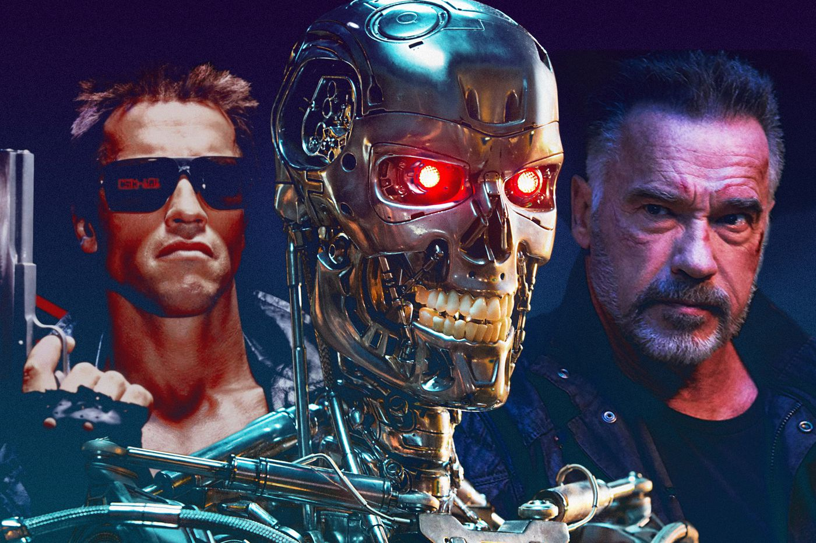

Slide 4
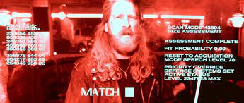

Slide 5
Problem Identification
Predicting emotions of the client from facial expressions and speech input.
Deploy the model on the Web Page of an existing website using API to support end to end analysis.

Slide 6
DATASET
FER – 2013 (Kaggle)
48 x 48 pixel images
Grayscale images
Dataset is already divided into 7 categories.
Angry
Disgust
Fear
Happy
Sad
Surprise
Neutral
TESS (Kaggle)
WAV Format
Dataset is already divided into 7 categories.
Angry
Disgust
Fear
Happy
Sad
Pleasant Surprise
Neutral

Slide 7
Data Assessment
Image dataset is Imbalanced
Images are consistent
Audio data is evenly distributed and well balance
Audio data is inconsistent
FER Dataset
TESS Dataset
Train
Test
Train
Test
28,709
7,178
2240
560

Slide 8
Pre-processing
Resize
Rescale
Normalization

Slide 9
Pre-processing
Feature Extraction
Extracted Features to array
Categorized labels

Slide 10
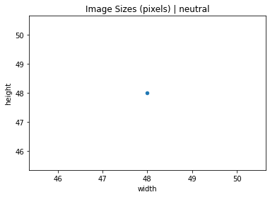
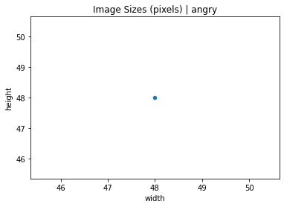
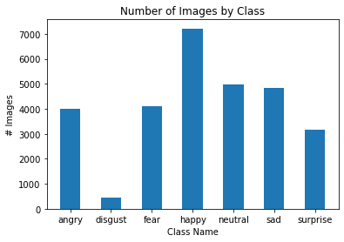

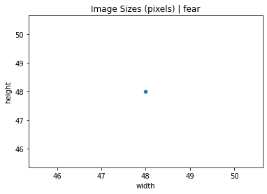

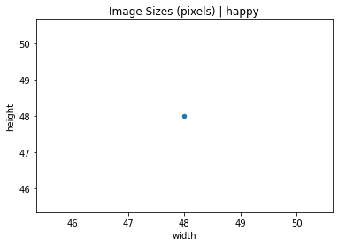
EDA

Slide 11
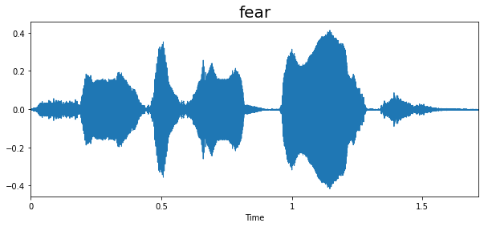
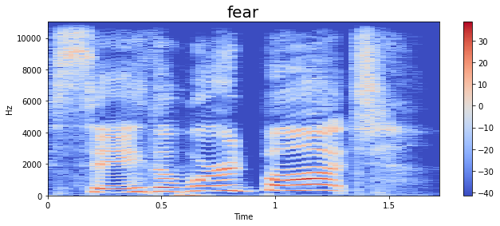
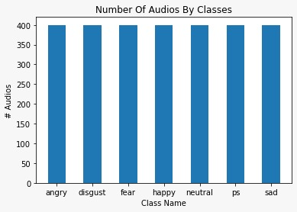
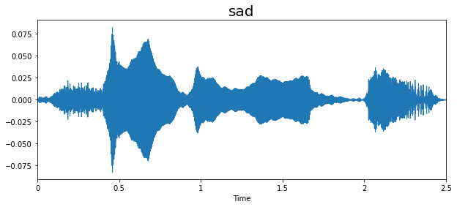
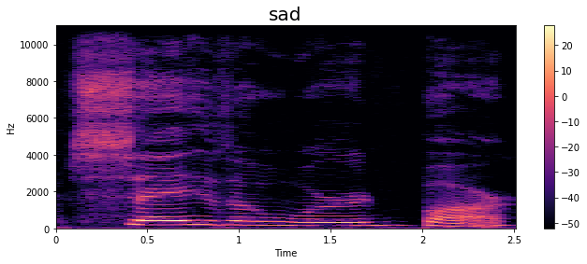
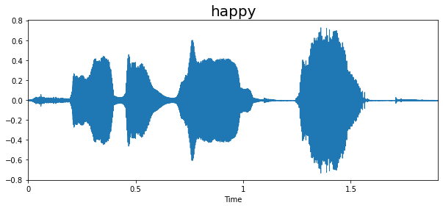
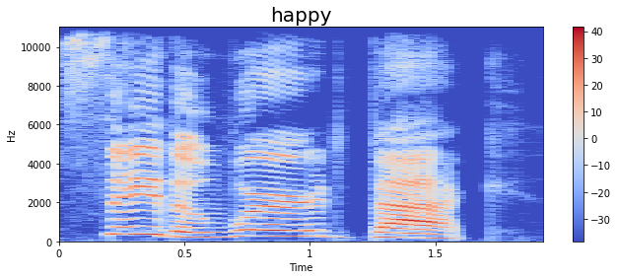
EDA

Slide 12
Results
Models tested for Video – MobileNet, VGG16, AlexNet, CNN
Model tested for Audio – LSTM and CNN
Models tested | Accuracy
MobileNet | 96.16
AlexNet | 82.12
VGG16 | 92.67
CNN | 48.54
VGG16 using ImageNet | 82.34
Models tested | Accuracy
LSTM | 97.96
CNN | 84.43

Slide 13
Deployment of the trained models
What is an API?
Why API?
How API is used in our project: -
Created a static webpage
Created a Restful API using Flask Creating a bar plot from
the returned dictionary
Calling and saving the model
Returning the output
Converting the video input into frames Dictionary to the webpage
Applying prediction model Saving all the predicted results
on each frame in a Dictionary

Slide 14
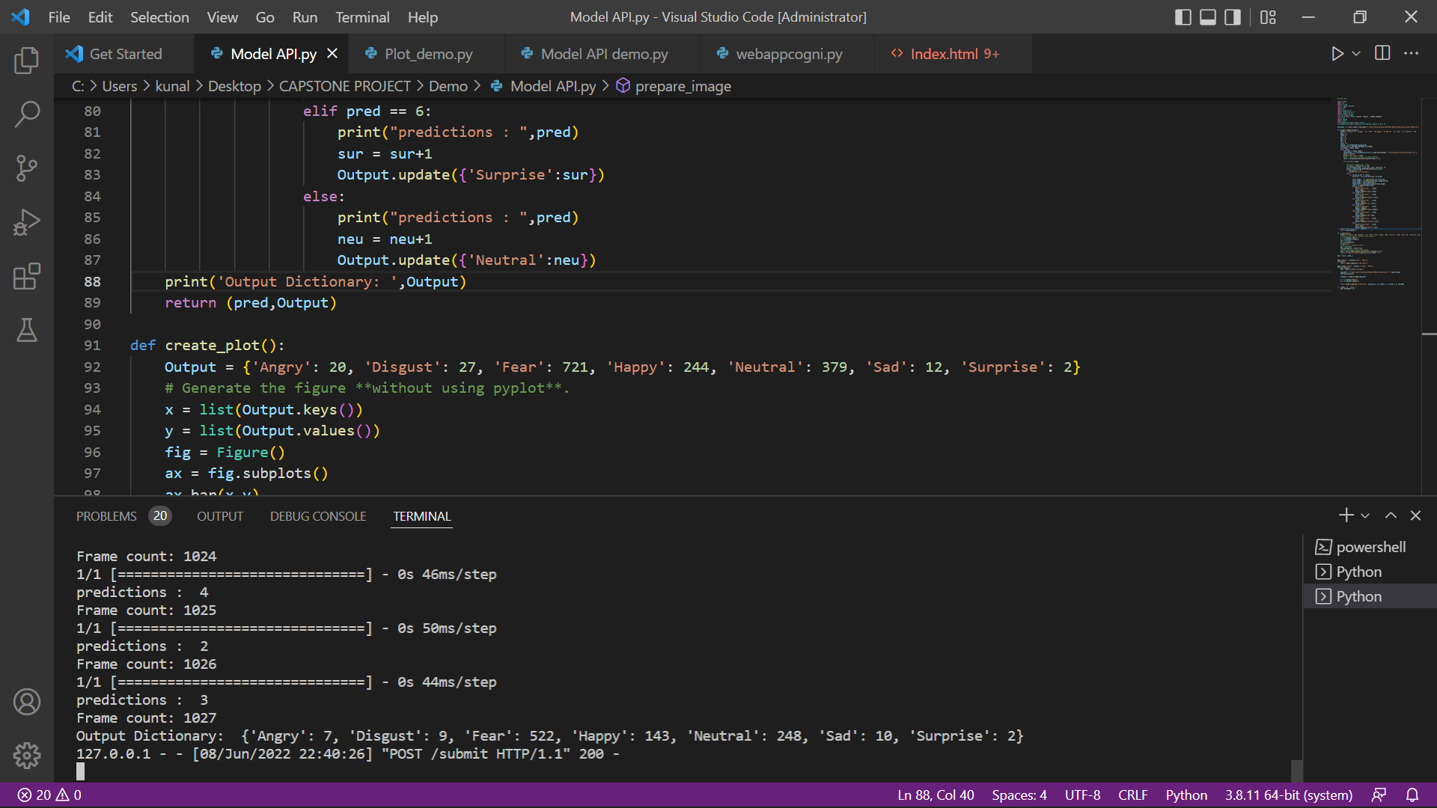
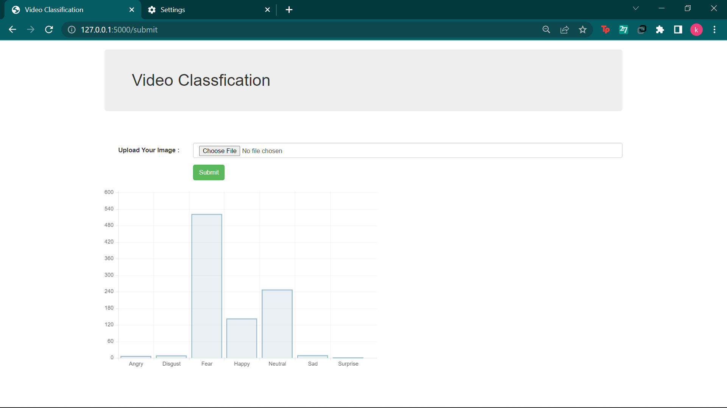
OUTPUT DICTIONARY
Webpage

Slide 15
Next Steps
Performing Data Augmentation and Fine Tuning the model
Improving the Accuracy
Calculating the F1 score, Precision and Confusion Matrix
Deploying Audio Model in API
Improving the GUI of the webpage
Testing the API on the business server

Slide 16
References
Jojo George, Kavita Koradiya, Kinjal Bhatt, Krishna Dilip, Tarunkumar Reddy. (2022). Emotion Classification Using Video and Audio Data: CNNs Provides Detailed Analysis with Combination of Data.
Al-Darraji, Salah & Berns, Karsten & Rodić, Aleksandar. (2017). Action Unit Based Facial Expression Recognition Using Deep Learning. 540. 413-420. 10.1007/978-3-319-49058-8_45.
Bagus Tris Atmaja, Kiyoaki Shirai and Masato Akagi. (2020). Speech Emotion Recognition Using Speech Feature and Word Embedding.
Github Link
https://github.com/kunal1049/CAPSTONE
https://github.com/harshtrivedi07/CAPSTONE
https://github.com/PranavJadhav611/CAPSTONE
https://github.com/Kavita-Virk/CAPSTONE

