Slide 1
San Francisco Crime Detection
- Kaggle Data Challenge

Slide 2
Objective
Classification is a common and a useful analysis to perform on real-world data
With the ever increasing capability to harness large volumes of data it is only logical to tackle classification as a big data problem
Crime classification is a really important task when it comes to handling criminal cases
The type of a crime sets its appropriate judicial course of action. This work is usually done manually.
Developing a machine learning classifier is the obvious next step to automate this process.
With the accurate prediction of crime rates, we can analyze the types of crimes across various neighborhood and help layman to have a notion of safe and unsafe areas.

Slide 3
Dataset
In this project, we have used the San Francisco Crime Data (available on Kaggle) to perform classification.
The classification that we have done is on the category of crime ranging from larceny to burglary in the San Francisco area for past 12 years.
The data contains atleast 300,000 records

Slide 4
Dataset
The SFO crime dataset(train data) contains attributes such as :
The date and time of occurrence of the crime incident
The district of the police department which handles the incident
Day (day of week) of the incident
The street address and the type of crime
The test data set for predicting the class of crime does not include the attributes such as the day of week.

Slide 5
Approach
Developed a machine learning classifier to automate the process of crime detection
Given various features of a new incident, one should with reasonable accuracy be able to predict the kind of crime attached to the incident
Once we have a prediction of crimes, we can analyze the crime rate and the type of crimes across various neighborhoods
The approach for solving this problem is as below :
Leveraged attribute information to extract additional features
Used feature engineering to build machine learning classifier pipelines
Analyzed various metrics and comparison of various classifiers implemented

Slide 6
Feature Engineering
Weekend feature,
Time-related features
Neighborhood feature –
1) Zillow API : neighborhoods for California as a shapefile
2) ESRI geometry API : spatial data processing and check if a point is inside a polygon (corresponding to a neighborhood)
Address features –
1) street 1 / street 2 to denote an intersection
2) number Block of street
Day or night feature – used the sunrise-sunset.org API
Weather features

Slide 7
Machine Learning Pipeline
Dataset divided into 70% for training and 30% for testing
Implemented the feature engineering and pipelines in Apache Spark using Scala.
The classifiers used: (multi class classification)
Random Forest - It is unexcelled in accuracy among current algorithms, it runs efficiently on large data sets, It can handle thousands of input variables without variable deletion
Decision Tree - Information Gain, that measures how well a given attribute separates (Used depth 10)
Naive Bayes - feature are conditionally independent, which may be false with our feature vector as the filed PdDistrict is related to coordinate (X,Y) to some extent

Slide 8
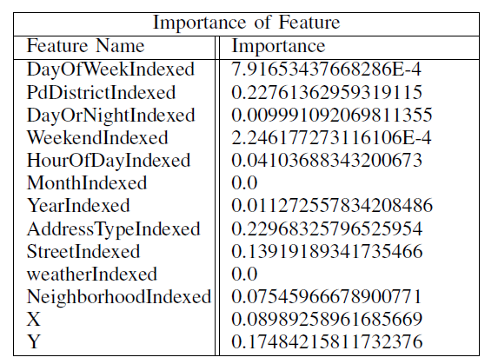
Analysis : Feature Importance

Slide 9
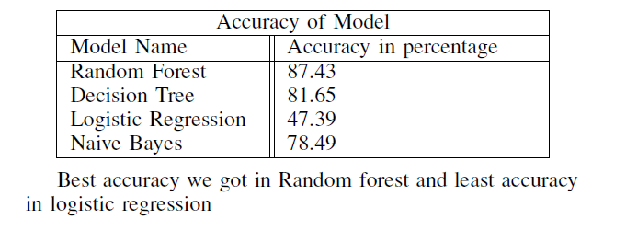
Analysis : Accuracy of Models

Slide 10
Visualization Dashboards
Visualization charts created in Tableau for the following:
Crime distribution by location
Crime distribution by day/night and day of week
Crime distribution by day of week and district
Crime distribution by day/night and district
Crime distribution by weekend and district
Crime distribution by weather and weekend

Slide 11
Challenges and Future Work
Random forest turned out to be the best model in our experiment, but it is relatively time consuming
The resources were not sufficient to run the classifier on huge data files
Weather feature extracted from the API was not accurate, it gave the most occurring weather condition and average temperature for that day.
Neighborhood data was not accurate, as for 2/3rd part of the dataset, the neighborhood details were not found

Slide 12
References
[1] H. Kopka and P. W. Daly, A Guide to LATEX, 3rd ed. Harlow, England:
Addison-Wesley, 1999.
[2] San Francisco Crime Dataset(2015). Available from: https://www.kaggle.com/c/sf-crime/data
[3] San Francisco Crime Classification Evaluation(2015). Available from: https://www.kaggle.com/c/sfcrime/details/evaluation
[4] Data Transformation / Learning with Counts(2015). Available from: [5] UCI Machine Learning Repository (2012). Available from: http://archive.ics.uci.edu/ml/datasets.html https://msdn.microsoft.com/enus/library/azure/dn913056.aspx
[6] Breiman, Leo, et al. Classification and regression trees. CRC press, 1984.

Slide 13
Thank You..!

