Slide 1
MagicBricks Real Estate Market Analysis
End-to-End EDA & Visualization of Indian Metro Rentals
Presented by Kunal

Slide 2
Project Overview & Objective
Analyze rental market trends in 5 major Indian metros: Bangalore, Chennai, Hyderabad, Mumbai, and Pune.
Comprehensive study from automated data collection to visual storytelling.
Identify key drivers of rental pricing and available property configurations.
Uncover regional differences in housing supply and demand.

Slide 3
Data Acquisition (Web Scraping)
Source: MagicBricks Property for Rent section.
Tool: Python with BeautifulSoup and Requests libraries.
Strategy: Iterative page-wise extraction to ensure broad city coverage.
Extracted Features: BHK, Price, Area, Furnishing, Facing, Tenant Type, and more.

Slide 4
Data Cleaning & Processing
Standardized text values: Converted price strings like '2.3 Lac' into numeric 230,000.
Regex extraction: Isolated square footage from complex text formats.
Standardization: Cleaned neighborhood names and aligned categorical values.
Imputation: Filled missing values in 'Facing' and 'Locality' using city-specific mode frequencies.

Slide 5
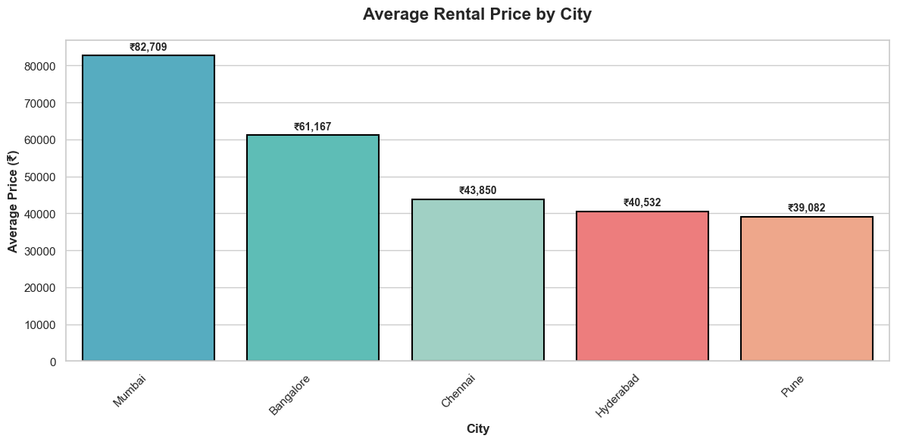
Rental Price Distribution by City
Bangalore and Mumbai show the highest variability and median rents compared to other metros.

Slide 6
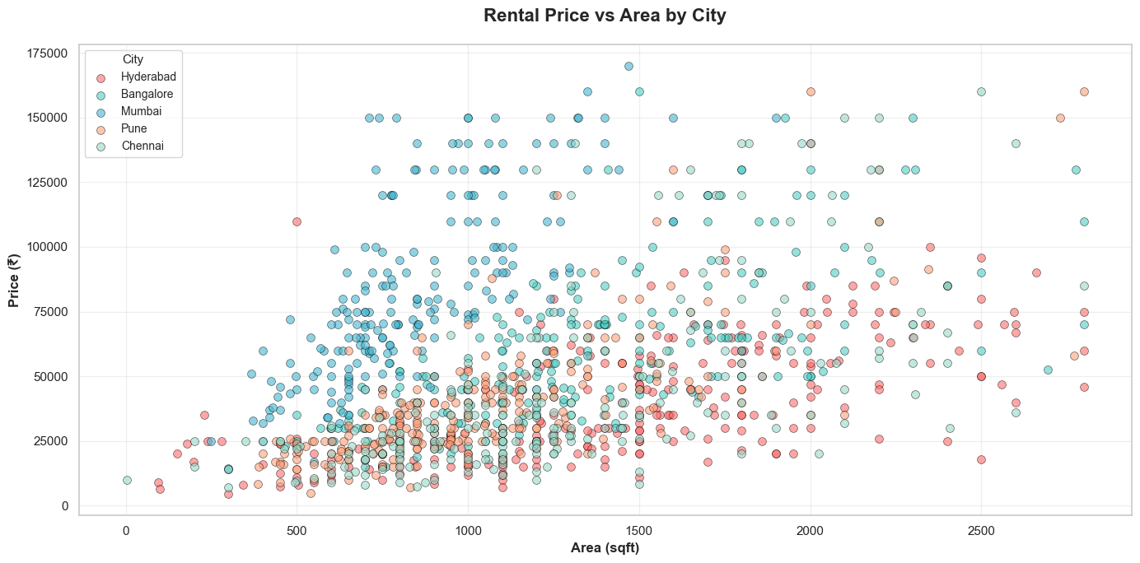
Price vs Area Correlation
Clear positive correlation across all cities; however, Mumbai properties command higher prices for smaller footprints.

Slide 7
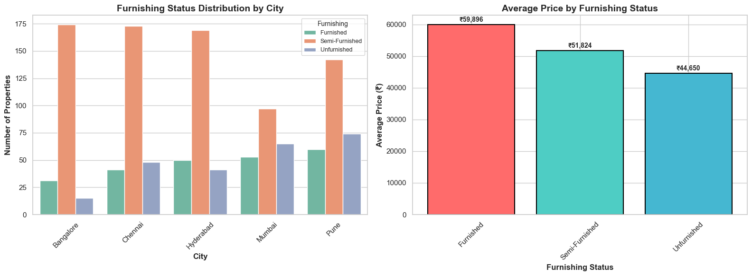
Furnishing Status & Pricing
Semi-furnished properties dominate the market, while fully furnished units often represent a premium or niche segment.

Slide 8
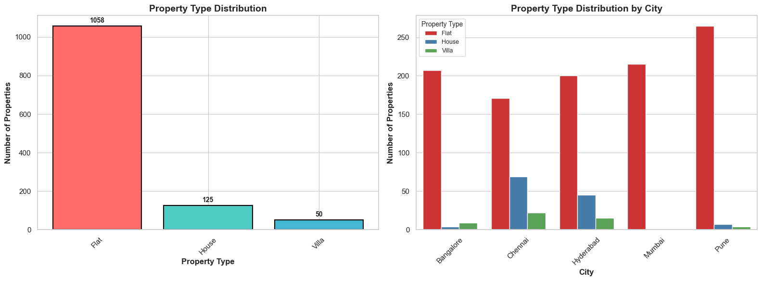
Market Supply by Property Type
Urban apartments (Flats) represent over 85% of listings, followed by independent houses and luxury villas.

Slide 9
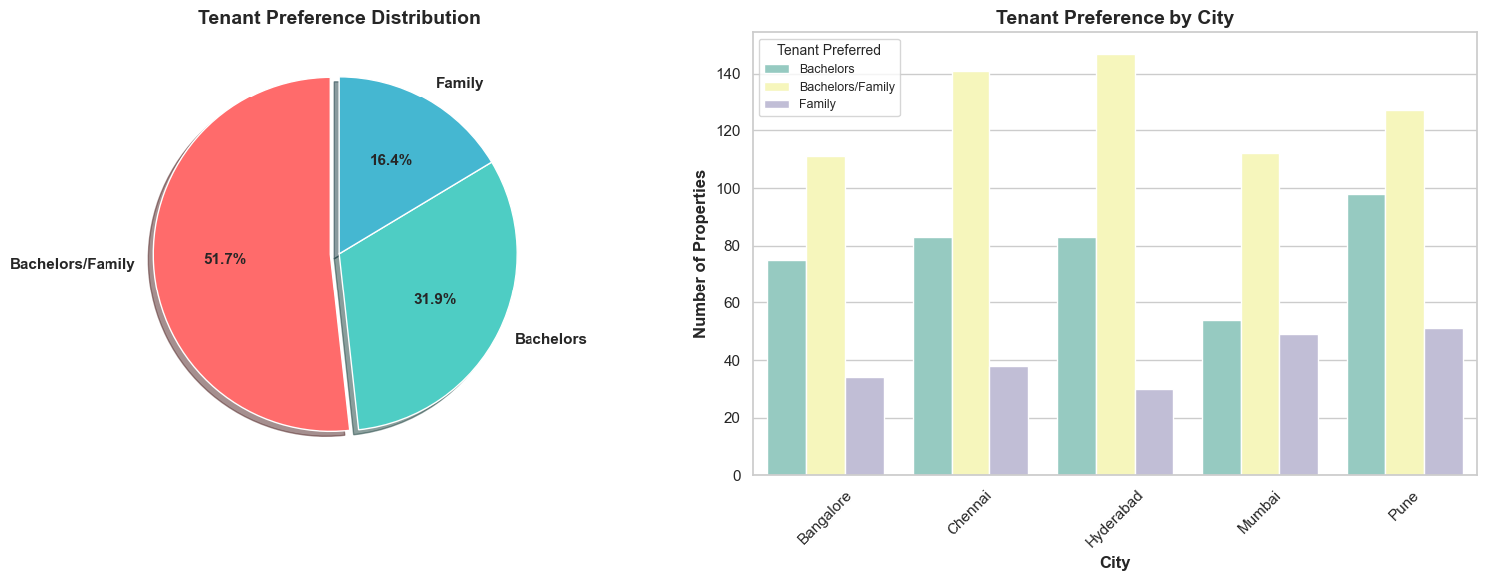
Tenant Preference Distribution
High market inclusivity: Over 50% of listings are open to both Bachelors and Families.

Slide 10
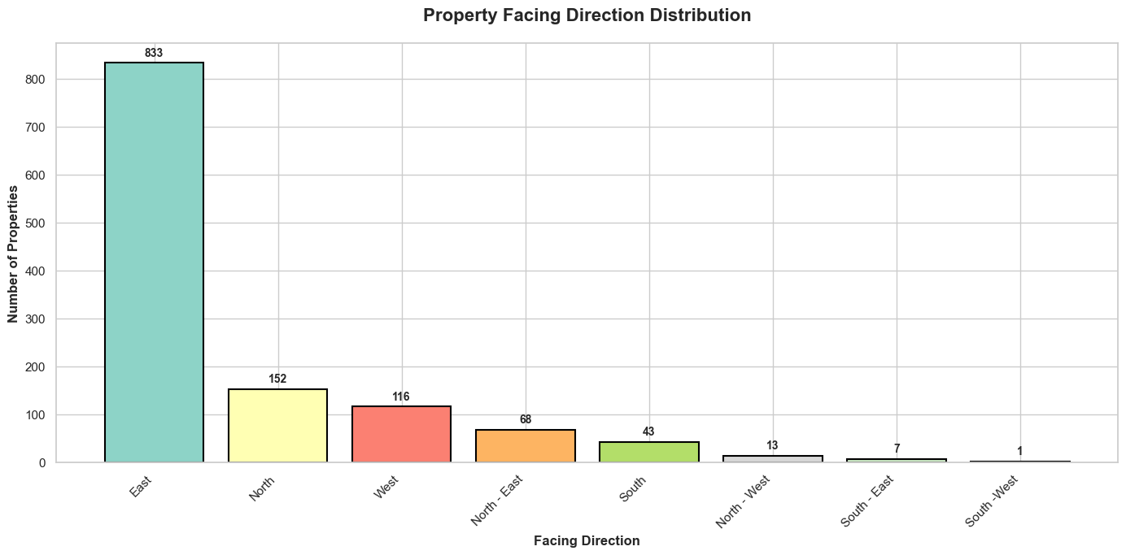
Vastu Influence: Facing Direction
Significant skew toward East-facing properties, reflecting deep cultural demand for Vastu-compliant homes.

Slide 11
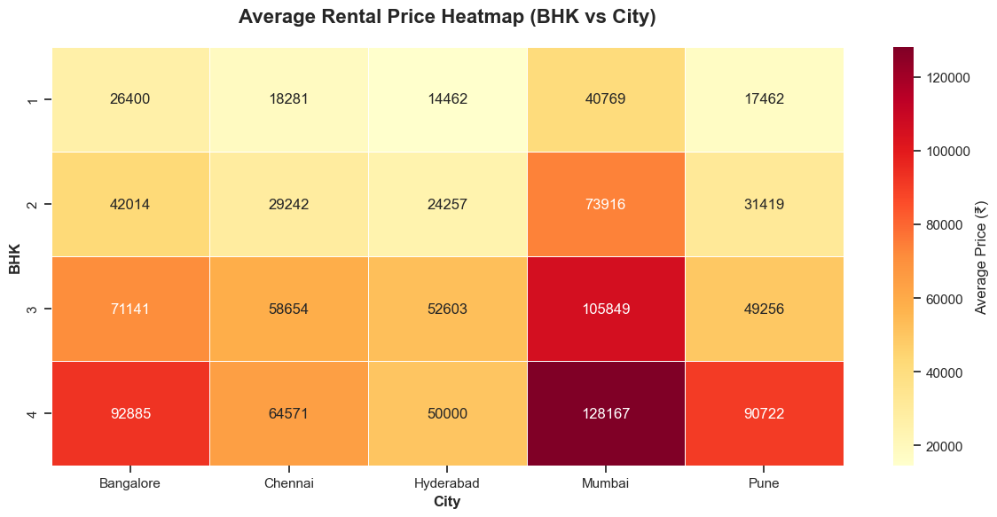
Average Rent: BHK vs City Heatmap
Mumbai's 4 BHK segment reaches highest average rents, while Hyderabad remains the most affordable.

Slide 12
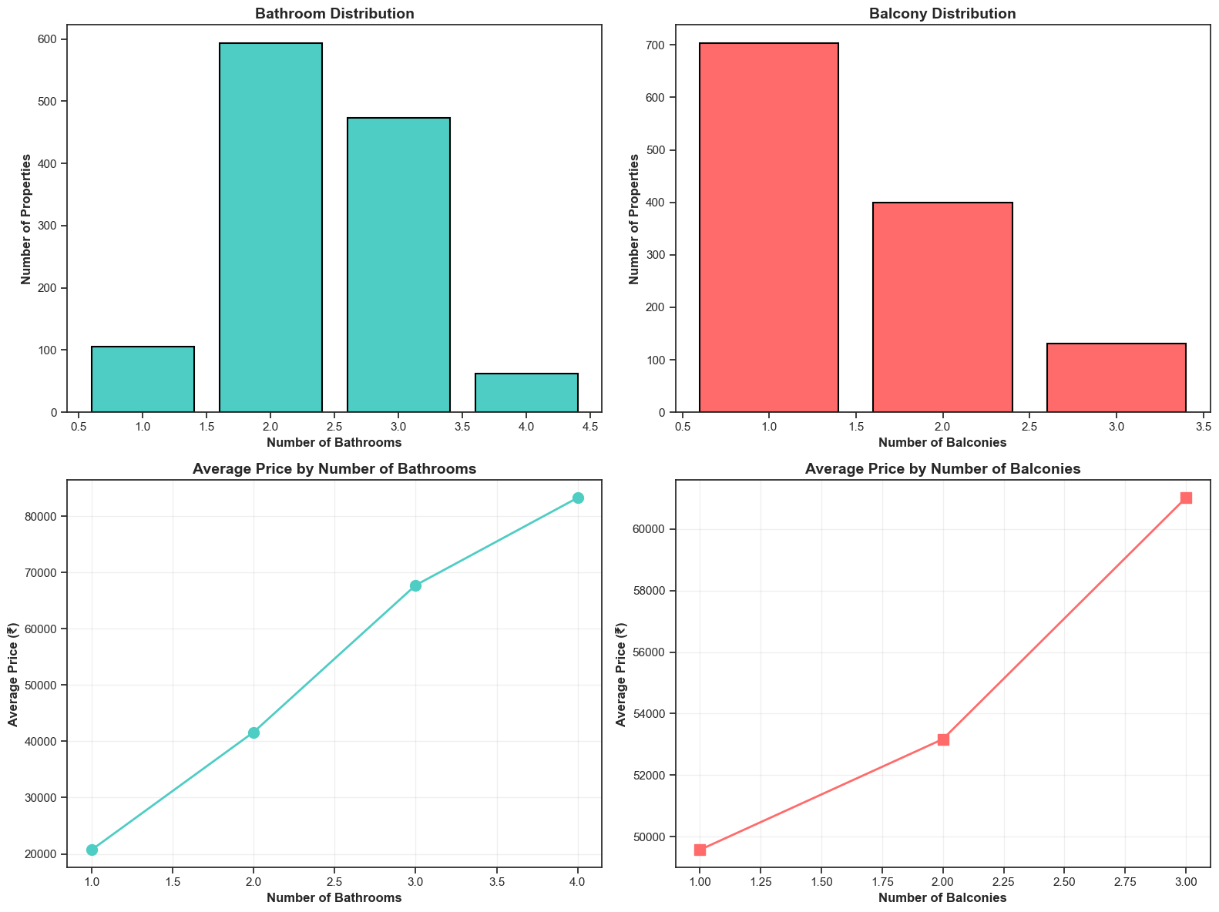
Impact of Bathrooms & Balconies
Bathroom count is a stronger driver of price than balcony count, scaling directly with BHK configuration.

Slide 13
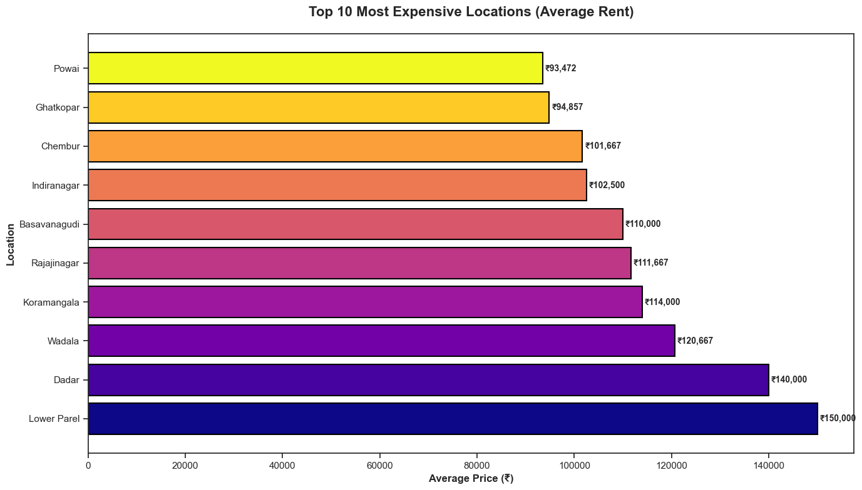
Most Expensive Neighborhoods
Lower Parel and Dadar (Mumbai) lead as the most expensive rental pockets.

Slide 14
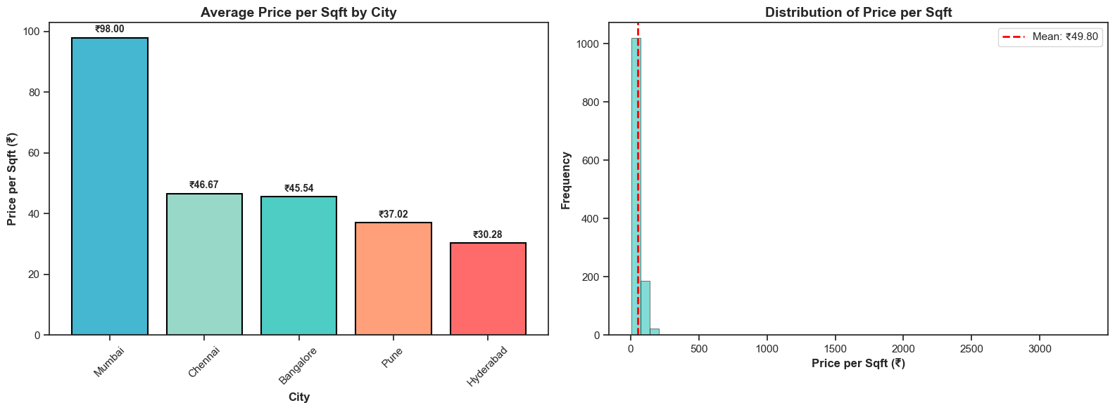
The Mumbai Premium: Price per Sqft
Mumbai's rate per sqft (₹98) is roughly triple that of Hyderabad (₹30), indicating extreme density demand.

Slide 15
Conclusion & Market Insights
Mumbai and Bangalore emerge as the premium markets with highest rent per square foot.
Urban living is highly standardized with 2-3 BHK configurations dominating supply.
Cultural preferences (Vastu-facing) significantly shape the available housing inventory.
Market liquidity is high, with the vast majority of units ready for immediate possession.

