Slide 1
LASSO Regression for Variable Selection
Notes:
In this presentation we want to discuss how we can use Lasso regression for variable selection.

Slide 2
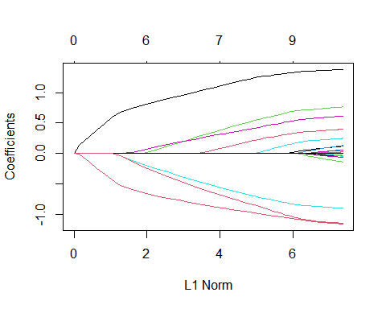
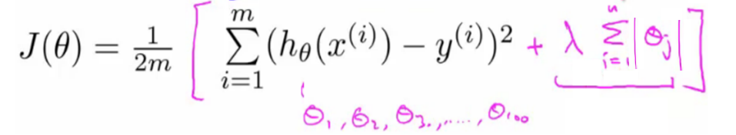
LASSO Recap
library(glmnet)
## Warning: package 'glmnet' was built under R version 4.0.2
## Loading required package: Matrix
## Loaded glmnet 4.0-2
# Dowload QuickStartExample.RData from the follwowing Github site. # https://github.com/cran/glmnet/blob/master/data/QuickStartExample.RData load("C:/Users/R/Downloads/QuickStartExample.RData") fit = glmnet(x, y) plot(fit)
Notes:
Let’s re-visit our Lasso example. In this example, we had 20 predictor variables. The plot shows how changing the L1 norm of the coefficients will change the model’s coefficient values. As we can see by reducing the total sum absolute value of the coefficient or the L1 norm, more and more coefficients are forced to zero. Recall that the model is trying to do so while still seeking to minimize the training error that is the first part of our cost function. So what does this imply? Well, this implies that the coefficient that were set to zero earlier are probably contributing less in minimizing the error and therefore now that the model is pressurized to reduce the total sum absolute value of the coefficients, it set the coefficients for those less contributing variables to zero or in other words the model dismissed those variables. A relevant analogy is to consider a company that is experiencing financial distress. The company has a limited budget and a large number of employees. If the budget start to shrink, employees get pay cuts but also the company may start the layoff process. Now, who is likely to be dismissed first? Well in the perfect world where you do don’t have politics involved, the employer with the least contribution to the organization’s goal will be dismissed first. If the budget continue to shrink then you can expect additional pay cuts as well as more employees to be dismissed. Same way, in the Lasso, when we start to decrease the L1 norm, that is the total sum absolute value of the coefficients that we can allocate and is like our total budget, we start loosing variables one after each other while the coefficients of the remaining variables also decreases. We can argue that by doing this process, we can rank-order the importance of the variables assuming that the least contributing variable leaves the model first and the most contributing variable will remain until the end. Such rank ordering is very useful as we can use it for variable selection. If you recall, in some tasks we will have a very large number of variables where not all of them may be relevant to the modelling task. Reducing the number of variables by eliminating irrelevant variables enhances the model and its interpretation and reduces the chance of overfitting.

Slide 3
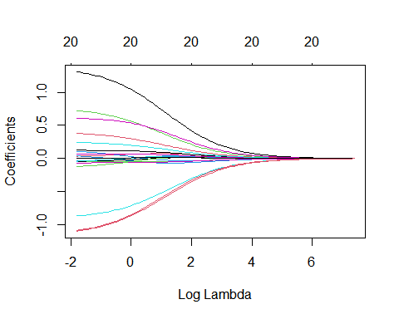
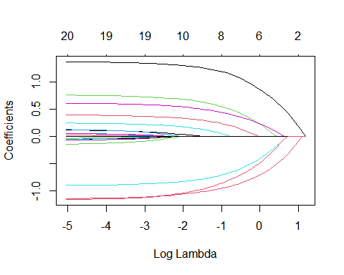
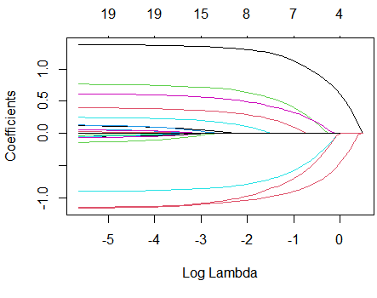
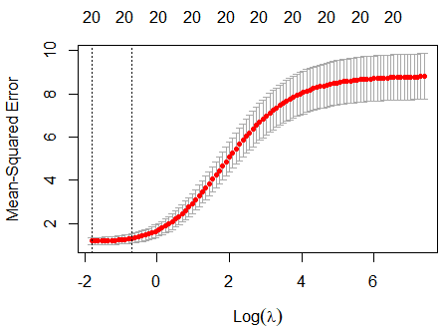
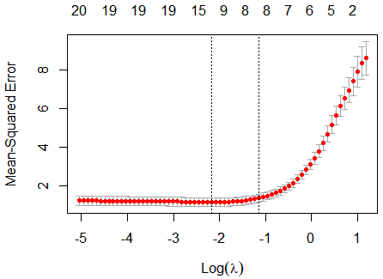
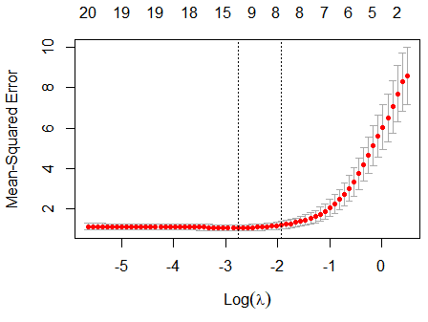
Ridge, Lasso and Elastic Net Comparison
Ridge
Elastic Net
Lasso (Default)
fit.ridge <- glmnet(x, y, alpha=0) plot(fit.ridge, xvar="lambda") plot(cv.glmnet(x, y, alpha=0))
fit.elnet <- glmnet(x, y, alpha=0.5) plot(fit.elnet, xvar="lambda") plot(cv.glmnet(x, y,alpha=0.5))
fit.lasso <- glmnet(x, y, alpha=1) plot(fit.lasso, xvar="lambda") plot(cv.glmnet(x, y,alpha=1))
Notes:
Now, lets go back and revisit our other example when we compared Ridge and Lasso models. As you can see increasing the lambda, expectedly, shrinks the coefficient values for both Ridge and Lasso model. But looking closely at the Ridge model, we can see that the model does not fully eliminate any variable. On the top horizontal axis, you can see the n umber of variables with non-zero coefficient. For the lasso model, that number has remained as 20. In other words, with lasso all variables are shrunken but still stay in the model. Considering our erlier analogy, here Ridge acts like a compony that doesen’t dismiss any employee, instead everyone gets more pay cut! Just an as an example, consider the black curve which seems to be associated to a predictive variable. In the Lasso model the coefficient for that variable has remained almost unchanged or has been just slightly reduced whem the log of lambda varied from -5 say to about -2. During this window, the model has lost many variables already. More specifically, when the log of Lambda is -5, there are 19 variables in the mode, while when the log of lambda is -2, there are only 8 variables left in the model. Looking at the Ridge model, we can see a completely different behavior. The coiefficients for the variable shown in Black start to derease almost immediately as we increased lambda and such reductions are very steep although it flatten when it reaches close to zero and stays small but non-zero.

Slide 4



Effect of Lambda for Lasso
OLS $(λ=0)$
$$λ=0.1$$
$$λ=1$$
lm_fit=lm(y~x) as.data.frame(lm_fit$coefficients)
## lm_fit$coefficients ## (Intercept) 0.109067988 ## x1 1.381071949 ## x2 0.025015709 ## x3 0.767490421 ## x4 0.066767260 ## x5 -0.905977866 ## x6 0.618387562 ## x7 0.124492042 ## x8 0.401052248 ## x9 -0.036556115 ## x10 0.136529912 ## x11 0.251596919 ## x12 -0.069913386 ## x13 -0.049395801 ## x14 -1.164018235 ## x15 -0.147334273 ## x16 -0.051571742 ## x17 -0.055904041 ## x18 0.057080776 ## x19 -0.006423312 ## x20 -1.148533580
coef(fit,s=0.1)
## 21 x 1 sparse Matrix of class "dgCMatrix" ## 1 ## (Intercept) 0.150928072 ## V1 1.320597195 ## V2 . ## V3 0.675110234 ## V4 . ## V5 -0.817411518 ## V6 0.521436671 ## V7 0.004829335 ## V8 0.319415917 ## V9 . ## V10 . ## V11 0.142498519 ## V12 . ## V13 . ## V14 -1.059978702 ## V15 . ## V16 . ## V17 . ## V18 . ## V19 . ## V20 -1.021873704
coef(fit,s=1)
## 21 x 1 sparse Matrix of class "dgCMatrix" ## 1 ## (Intercept) 0.46953687 ## V1 0.61817569 ## V2 . ## V3 . ## V4 . ## V5 -0.00867040 ## V6 . ## V7 . ## V8 . ## V9 . ## V10 . ## V11 . ## V12 . ## V13 . ## V14 -0.46135970 ## V15 . ## V16 . ## V17 . ## V18 . ## V19 . ## V20 -0.01019119
Notes:
Again, here you can see how increasing lambda will result in shrinking the coefficients as well as removing variables from the Lasso model. For example, the coefficient for the first variable in the un-regularized model is 1.38 that is reduced to 1.32 and 0.61 when lambda is increased from zero to 0.1 and 1 respectively.

Slide 5
LASSO Versus OLS ANOVA
LASSO
OLS
DF=cbind(data.frame(x),y) anova(lm(y~., data=DF))
## Analysis of Variance Table ## Response: y ## Df Sum Sq Mean Sq F value Pr(>F) ## X1 1 265.938 265.938 283.9731 < 2.2e-16 *** ## X2 1 19.590 19.590 20.9180 1.751e-05 *** ## X3 1 64.878 64.878 69.2777 2.041e-12 *** ## X4 1 0.010 0.010 0.0109 0.9171456 ## X5 1 115.717 115.717 123.5640 < 2.2e-16 *** ## X6 1 53.128 53.128 56.7311 7.070e-11 *** ## X7 1 1.754 1.754 1.8728 0.1750285 ## X8 1 35.539 35.539 37.9486 2.858e-08 *** ## X9 1 12.501 12.501 13.3486 0.0004635 *** ## X10 1 0.208 0.208 0.2219 0.6389045 ## X11 1 0.104 0.104 0.1110 0.7399257 ## X12 1 11.992 11.992 12.8051 0.0005944 *** ## X13 1 0.224 0.224 0.2391 0.6262057 ## X14 1 113.190 113.190 120.8657 < 2.2e-16 *** ## X15 1 0.137 0.137 0.1460 0.7033788 ## X16 1 0.480 0.480 0.5128 0.4760267 ## X17 1 0.836 0.836 0.8923 0.3477394 ## X18 1 0.001 0.001 0.0014 0.9702669 ## X19 1 0.522 0.522 0.5574 0.4575118 ## X20 1 81.749 81.749 87.2925 2.083e-14 *** ## Residuals 79 73.983 0.936 ## Signif. codes: 0 '***' 0.001 '**' 0.01 '*' 0.05 '.' 0.1 ' ' 1
coef(cvfit, s = "lambda.min")
## 21 x 1 sparse Matrix of class "dgCMatrix" ## (Intercept) 0.14936467 ## V1 1.32975267 ## V2 . ## V3 0.69096092 ## V4 . ## V5 -0.83122558 ## V6 0.53669611 ## V7 0.02005438 ## V8 0.33193760 ## V9 . ## V10 . ## V11 0.16239419 ## V12 . ## V13 . ## V14 -1.07081121 ## V15 . ## V16 . ## V17 . ## V18 . ## V19 . ## V20 -1.04340741
Notes:
It may be also interesting to examine the statistical significance of the coefficients that are left in the optimal model and compare that with the ANOVA analysis of the ordinary least square model where the model was not regularized. Looking at the ANOVA analysis of the OLS model, we can see that the variables that are left in the LASSO model are mostly identified as being statistically significant with low p-values. However, we can still see some small disagreements between the two models. For example, Lasso has kept V11 in the model but was not shown to be statistically significant in the OLS model. Moreover, V2, V9 and V12 were shown to be statistically significant in the OLS model but were not kept in the LASSO model. A closer examination of the p-values, however, reveal the p-value of these three variables were not as small as the others since the p-value of most other variables were smaller than 1e-7.

Slide 6
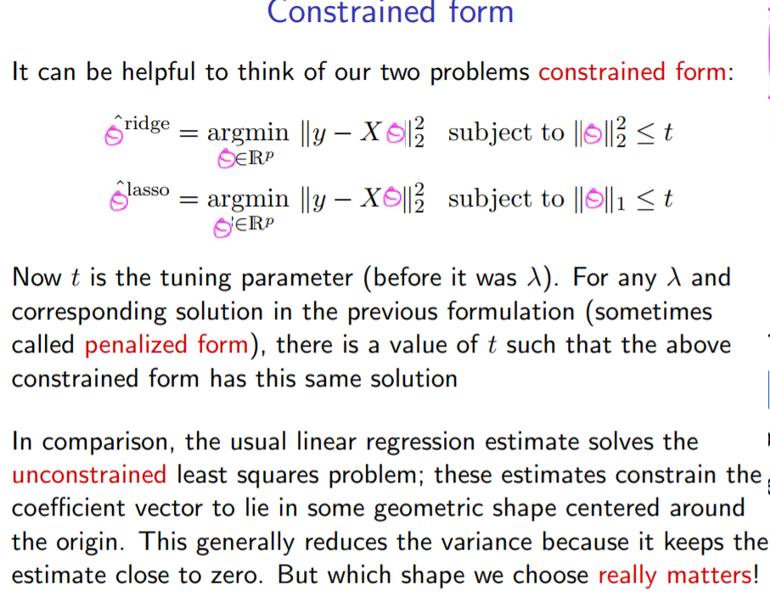
Constrained Forms
Notes:
As we discussed in our analogy, you can change the form of our optimization problem into a constrained form. In the constrained form, our goal is to minimize the sum square of the errors in our training data subject to the sum square or sum absolute value of the coefficients being smaller than a given constant, t. Now t is our running parameter where smaller t means heavier regularization. Compared to the original poetization form decreasing t is the same as increasing lambda. Both results in heavier regularization. For an regularized model such as the ordinary least squarer regression there will be no constraint. In other words t will be infinity.

Slide 7
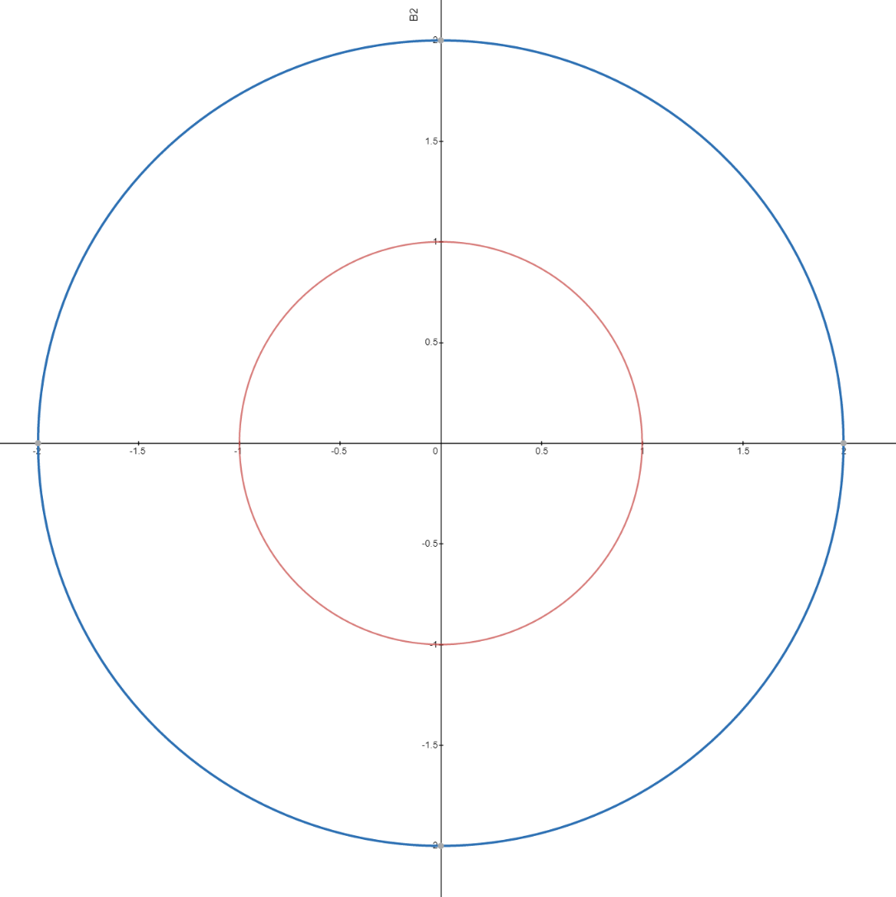
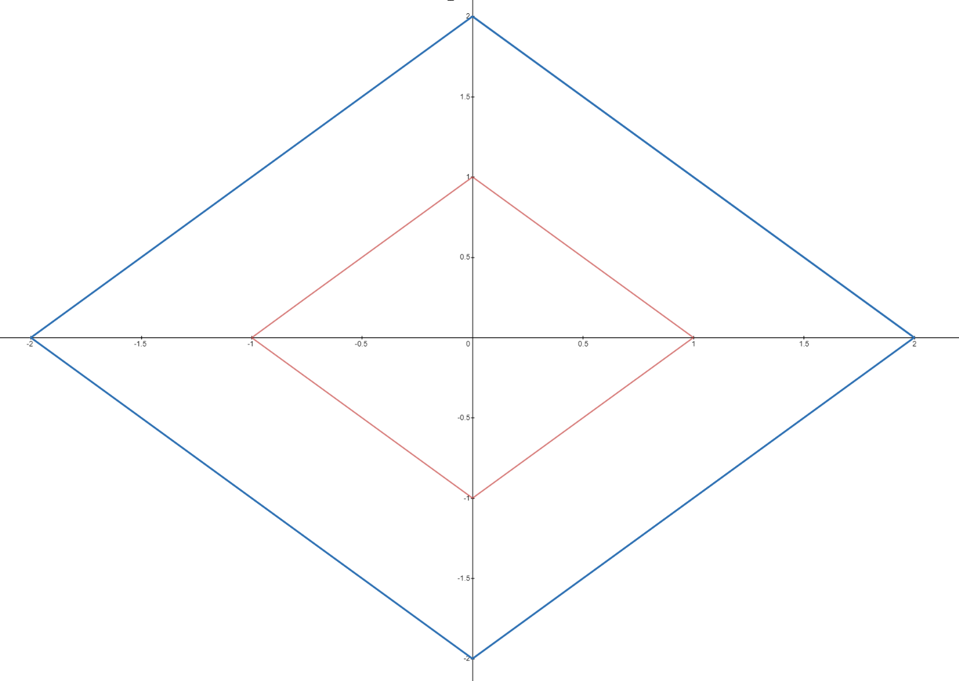








Constrained Forms
Ridge
Lasso
$$β_{2}$$
$$β_{2}$$
$β_{1}^{2}$+ $β_{2}^{2}=$4
${\text{|}β}_{1}$| + | $β_{2}\text{|}=$2
$β_{1}^{2}$+ $β_{2}^{2}=1$
${\text{|}β}_{1}$| + | $β_{2}\text{|}=1$
$$β_{1}$$
$$β_{1}$$
Notes:
Lets consider a simple example of Ridge and Lasso regularization. In this example, we assume we have only two predictor variables and two coefficients namely Beta1 and Beta2. In the constrained form, for the Ridge regression, we know that the sum square of the coefficients should be smaller than a constant t. The Figure on the left shows the circle where the sum square of Beta1 and Beta2 is less than 4. The acceptable solution should be inside this circle since for any point outside this circle the sum of the Beta1 squared plus Beta2 squared will more than 4. If t is reduced to 1, then we will have the red circle as the solution boundary.
Now consider the Lasso solution. Here, we want the sum of the absolute values of Beta1 and Beta2 to be smaller than t, say 2 in this example. The result is a diamond shape as shown. The acceptable solutions will be inside this diamond. As you can see, in both cases the solution boundaries are symmetrical across both axis. This is because as we discussed the signs of the coefficients does not matter. All what we care for is the actual amplitude of the coefficients.

Slide 8
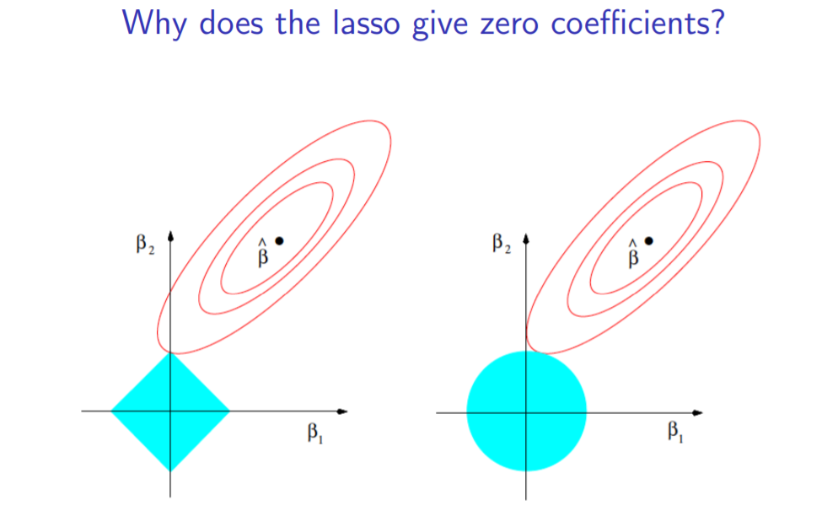
Constrained Forms
Lasso
Ridge
Notes:
Now, let’s assume that Beta hat shows the un-regularized solution that is the optimal Beta1 and Beta2 values to minimize the training error. Now, lets consider lasso regression. With the Lasso, the sum of the absolute value of Beta1 and the absolute value of Beta2 is constrained as shown in the previous slide. Lets say the blue diamond area shows the acceptable solution region. The redlines show the optimization search path. The optimization ends as soon as the red search path touches the acceptable region. Similarly , for Ridge regression the acceptable solution area is shown as a blue circle. We can see the optimization path touches the lasso acceptable solution area at a point where Beta1 is 0. This implies removing Beta1 from the model entirely. In contrast, the search path touches the Ridge acceptable solution circle area at a point where Beta1 is small but not zero. That is why Ridge does not fully dismiss a variable as appose to Lasso. Of course this is a simplified visual explanation of the Lasso and Ridge regression models’ behavior and the math behind is much more involved.

Slide 9
Thank You.

