Slide 1

Unified Patient Treatment Platform (UPTP) Development - "Aarogya"
IC HACK 2.0 | IEEE India Council
Winning_Hawks :
ADITI BHARGAV
MOHIT KUMAR
KUNAL MUKHERJEE
SOUNAK SHOME

Slide 2

Developing an innovative Unified Patient Treatment Platform (UPTP) to address critical healthcare industry needs is a complex task. The primary goals of this platform are to boost patient engagement, ensure quick access to medical records, and empower healthcare providers to offer more accurate and efficient care.
Key Objectives and Goals:
Seamless Data Exchange: Fosters secure, seamless patient data sharing, ensuring a unified medical history accessible to all care providers.
Enhanced Patient Engagement: The platform empowers patients with user-friendly tools for medical record access, appointment scheduling, and provider communication.
Timely Access to Medical Records: UPTP ensures timely access to up-to-date medical records for informed decision-making and coordinated care, anytime, anywhere.
Efficient and Expedited Care: UPTP streamlines data for faster, precise diagnoses, enhancing patient outcomes through improved access to medical histories.
Data Security and Compliance: UPTP prioritizes healthcare security, implementing strong measures and complying with regulations like HIPAA to safeguard patient data.

Slide 3
TECHNOLOGY STACK :
Component | Technology used
Back-End Development | Develop a robust back-end using Express JS. Implement REST APIs for communication between front-end and back-end.
Data Storage and Management | Utilize a database for data storage and retrieval using MongoDB
Security and Compliance | Implement robust security measures, Encryption, firewalls, intrusion detection systems , Hashing. Set up a secure and scalable data storage solution considering HIPAA compliance.
Analytics and Reporting | Enable customizable dashboards using JavaScript.

Slide 4

MARKET PROSPECT
The market prospects for a Unified Patient Treatment Platform (UPTP) are promising due to several key factors that are shaping the healthcare industry. Here are some of the market prospects and trends that suggest a strong demand for UPTPs:
Interoperability : Support seamless patient data exchange among healthcare providers.
Efficiency and Cost Reduction : Streamline healthcare processes, reducing administrative costs.
Telehealth Integration : UPTPs facilitate remote care and telehealth platform integration.
Data Security and Compliance: UPTPs prioritize data security and regulatory compliance like HIPAA.
Customization : UPTPs offer adaptability for diverse healthcare settings.
Government Support : Initiatives and funding boost UPTP adoption.
Global Expansion : UPTPs can expand internationally for cross-border data sharing.
Data-Driven Tools : UPTPs offer data analytics for informed healthcare decisions.

Slide 5
FUTURE SCOPE:
Testing and Quality Assurance​ | Conduct rigorous testing, including unit testing, integration testing, and security testing.​
Maintenance and Updates​ | Plan for ongoing maintenance, updates, and bug fixes.​
User Training and Support​ | Provide training resources and support for healthcare providers and patients.​
Monitoring and Performance Optimization​ | Implement monitoring tools to track system performance.​
Feedback Loop​ | Establish a feedback mechanism for continuous improvement based on user feedback and evolving healthcare needs.​

Slide 6

Execution:
Front-End Development:
Utilizes HTML5, CSS3, and JavaScript for a responsive user interface.
Potential use of React or Angular for enhanced user experience.
Implements secure user authentication and authorization.
Back-End Development:
Express JS, a Node.js framework, for robust server-side logic.
Strict adherence to healthcare privacy regulations with data encryption, access controls, and efficient indexing.
Interoperability:
Integrates seamlessly with Electronic Health Records (EHR) systems and healthcare databases.
Machine Learning and AI:
Incorporates machine learning for predictive analytics.
Scalability and Security:
Leverages cloud deployment, potentially via AWS, Azure, or Google Cloud, for scalability and security.
Testing and Maintenance:
Ongoing testing, including security testing, to ensure platform reliability.
Continuous maintenance and updates for platform quality and security.
User Support and Feedback:
Provides user support resources for healthcare providers and patients.
Establishes feedback mechanisms for continuous improvement.

Slide 7

The Unified Patient Treatment Platform (UPTP) holds promise for substantial positive societal impact:
Enhanced Patient Care: UPTP empowers patients with easy access to medical records.
Cost Savings.
Continuous Improvement: Feedback mechanisms drive UPTP's evolution.
Efficient Healthcare Delivery: Healthcare providers gain swift.
Reduced Medical Errors: Accurate and up-to-date patient information minimizes medical errors.
Healthcare Research: UPTP's data analytics.
IMPACT ON SOCIETY:

Slide 8
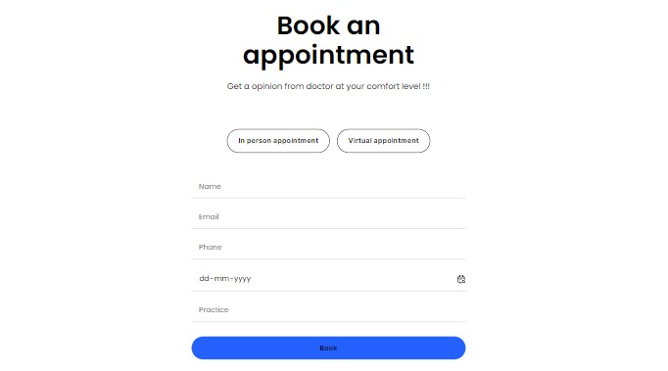
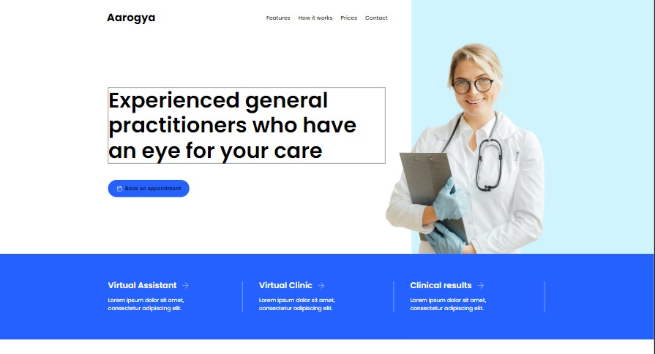
User interface: Home page

Slide 9
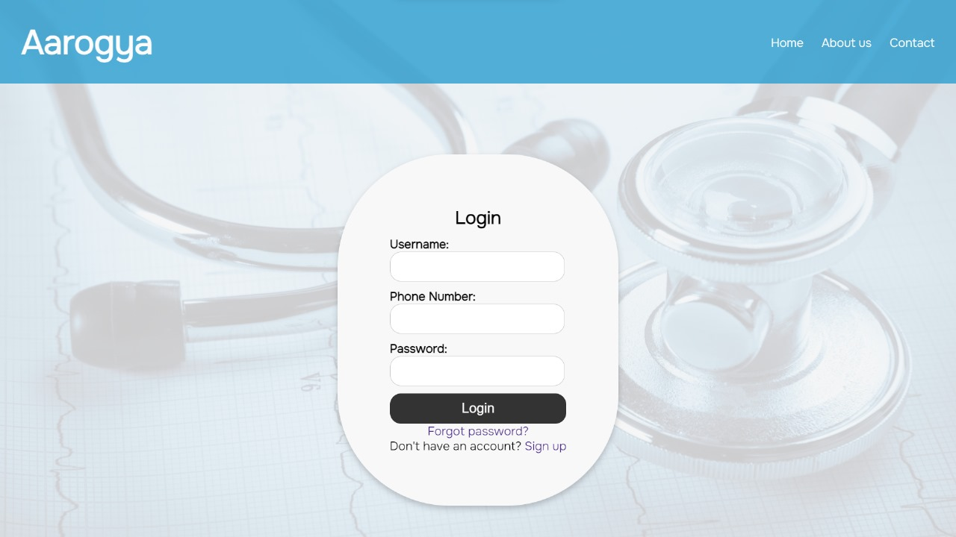
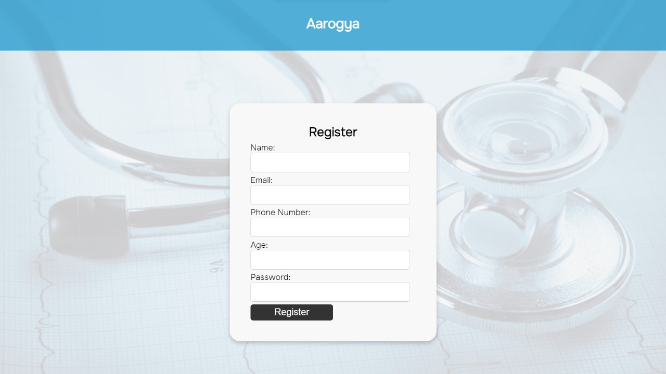
Login page and Registration Page:

Slide 10
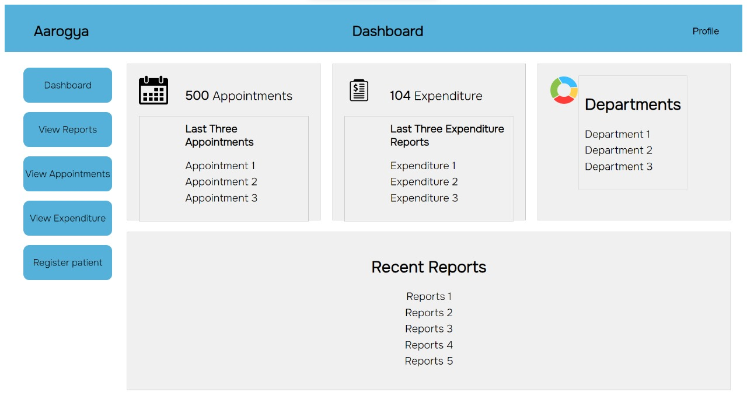
Dashboard:

Slide 11
Overview:
The Unified Patient Treatment Platform (UPTP) leverages modern web technologies for its user interface, employing HTML5, CSS3, and JavaScript (e.g., React or Angular). On the backend, a robust server-side logic is developed using Express JS, supported by a database like MongoDB. Secure data storage and management adhere to healthcare data privacy regulations, with encryption, access controls, and efficient indexing. Integration with EHR systems and healthcare databases follows HL7 or FHIR standards, ensuring interoperability. Machine learning and AI enhance the platform for predictive analytics and NLP-based clinical data processing. Cloud deployment, mobile accessibility, and rigorous testing ensure scalability, reliability, and security. Ongoing maintenance, user support, and feedback mechanisms sustain platform excellence.

Slide 12
Thank you !!!

