Slide 1
EASYNOTES
NAME – KUNAL JAIN
ENROLLMENT NO. – 0103CS181076

Slide 2
ABOUT THE PROJECT
It’s a web application in which one can create and manage his/her notes, unlike other notes application here one can create his/her notes instantly just by speaking it’s content or type as he/she want, Nowadays many have not enough time especially students (while studying about some topics) to do both work of concentrating on topics they are studying and making notes of it simultaneously with full efficiency, they either understand that topic properly or end up to make perfect notes of it. So, here is the solution, now they just have to concentrate properly on topics they want to learn and work of making notes just leave to that application.

Slide 3
FEATURES PROVIDED
ADD NOTE – Here one can add note, either by typing or dictating it’s content, not necessary to dictate by himself/herself, it can detect foreign voices (sound from speakers), also can choose the colour of note.
EDIT NOTE – Here one can edit his/her created notes, same as he/she do to create a note.
DELETE NOTE – By this one can delete his/her created notes.
PIN NOTE – By this one can pin a note to top in Pinned Notes section.
SORTED NOTES – Notes are arranged in sorted order of date.
VOICE TYPING – One of the features that make that application different from other available applications.

Slide 4
TECHNOLOGY USED
Angular 11 – as front-end framework.
Sass – for styling.
TypeScript – for scripting.
REST API – as connector of front-end and back-end.
Django – as backend framework.
Speech Recognition API – for voice typing.

Slide 5
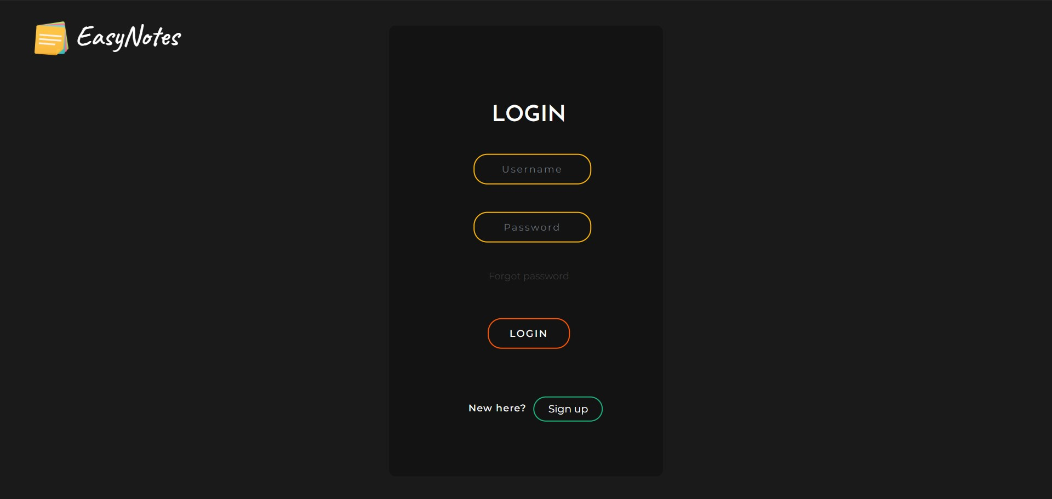
SCREENSHOTS
Login page

Slide 6
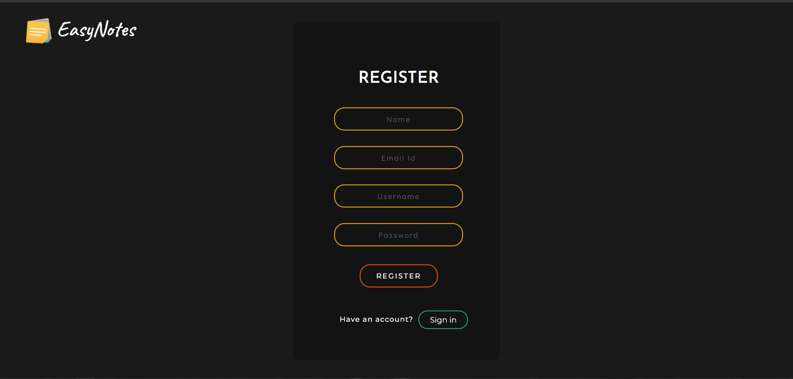
Register page

Slide 7
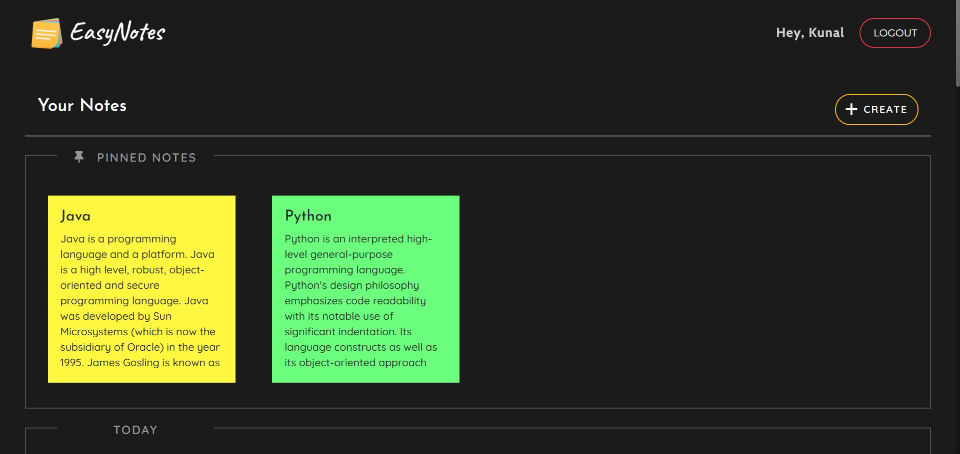
Dashboard page

Slide 8
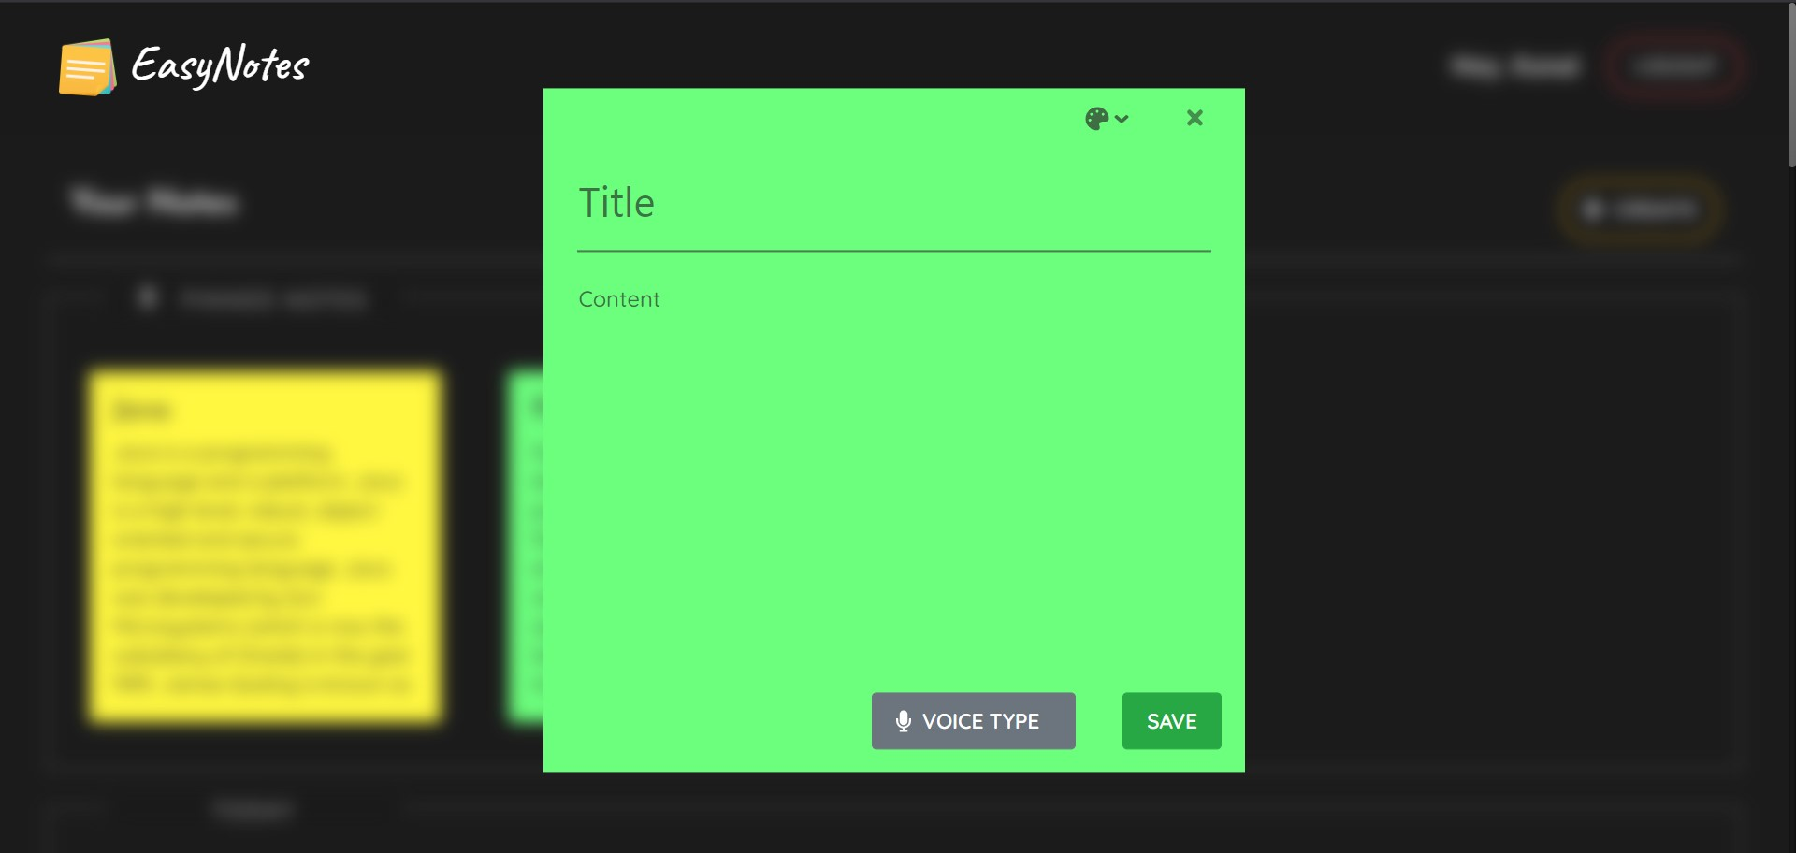
Create note box

Slide 9
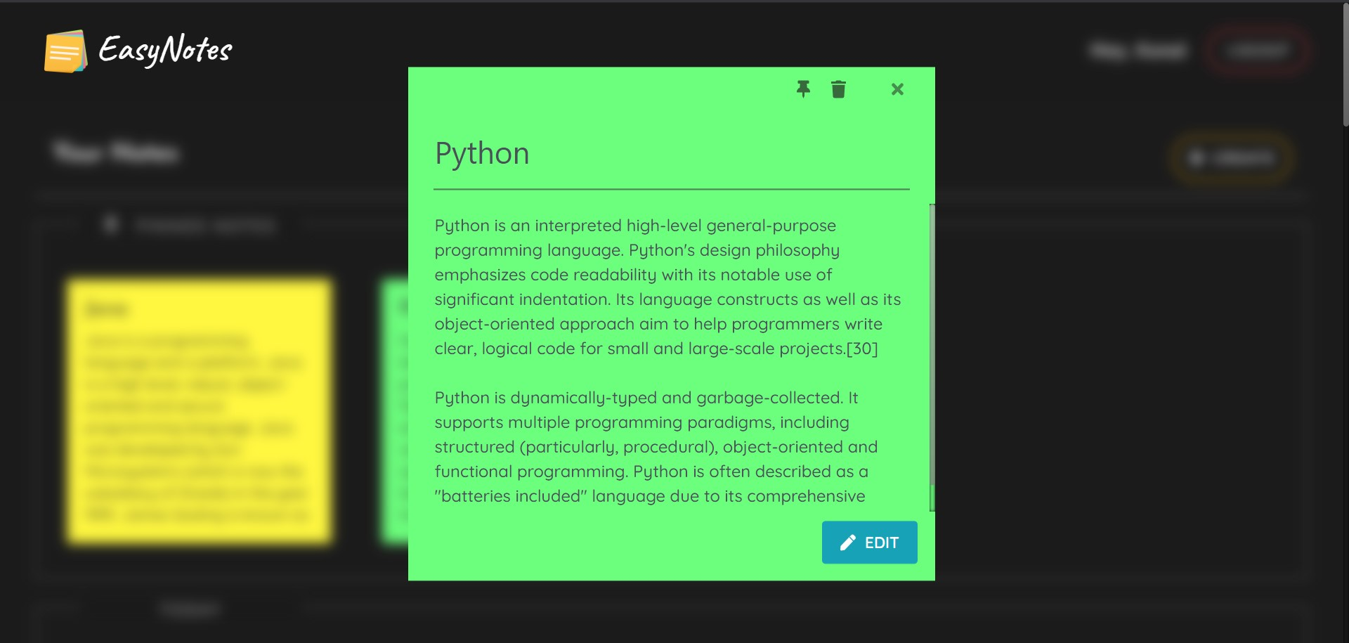
Edit note box

Slide 10
ADVANTAGES
Can make notes just by dictating the content, so typing work will be reduced.
Here one can create and manage his/her unlimited notes digitally, so paper work will be reduced.
Data can be accessed anytime anywhere.
Data is totally safe with strong authentication channel, only accessed with valid credentials.

Slide 11
DISADVANTAGES
It needs working internet connection to access and manage your data, so in case of poor or no internet connection you can’t use it.
Not yet found another.

