Slide 1
Console Based Bank Banking Operations System
By – Kunal Uttekar

Slide 2
Contents-:
1. Introduction
2. Python and its implementation
3. Scope of Project
4. Class Design
5. Class Design – Single Canvas
6. Functional Requirements of App
7. Operating Environment
8. Summary

Slide 3
Purpose of the Document- The purpose of this document is to provide an overview of the Bank Operation Project developed using Python. It outlines the system's requirements, architecture, features, testing procedures.
Project Overview - The Banking Operation System is a Console-Based Application that allows users to perform various banking activities such as account management operations like Deposit, Withdrawal, Fund Transfers, Balance Enquiry

Slide 4
Python and its implementation-:
Python is a computer programming language often used to build websites and software, automate tasks, and conduct data analysis. Python is a general-purpose language, meaning it can be used to create a variety of different programs and isn't specialized for any specific problems.
An “implementation” of Python should be taken to mean a program or environment which provides support for the execution of programs written in the Python language.
Compiler is a function that converts one programming language to another, typically from a high-level language(C, C++) to a low-level language(Machine code, Assembly language) to create an executable file.
Interpreter is a function that directly executes a programming language without it being compiled and converted to machine code.

Slide 5
Scope of the project
1)Account Management :
A) Creation of an Account with predefined account number and Initial/starting balance.
B) Deposit / Withdrawal of funds between accounts.
2)Transfer of funds – This includes the transfer of funds from one account to another.
3)This also includes the interest rate applied while depositing the money into a particular account.
4)Balance Inquiries- To check the current and updated balance after each transaction into a particular bank account.

Slide 6
Class Design- Individual Class
Bank Account
#Balance
#Accounts
+__init__()
+ deposit()
+ Check Balance()
+ account Number()
+ withdraw()
+ transfer()
Savings Account
+__init__()
+ deposit()
Current Account
+__init__()
+ withdraw()

Slide 7
Class Design on Single Canvas
Bank Account
#.AccNumber
#.CurrentBalance
.deposit()
.withdraw()
.checkbalance()
.Transfer()
Current Account
.ChargeWithdraw()
SAVINGS ACCOUNT
.interest()

Slide 8
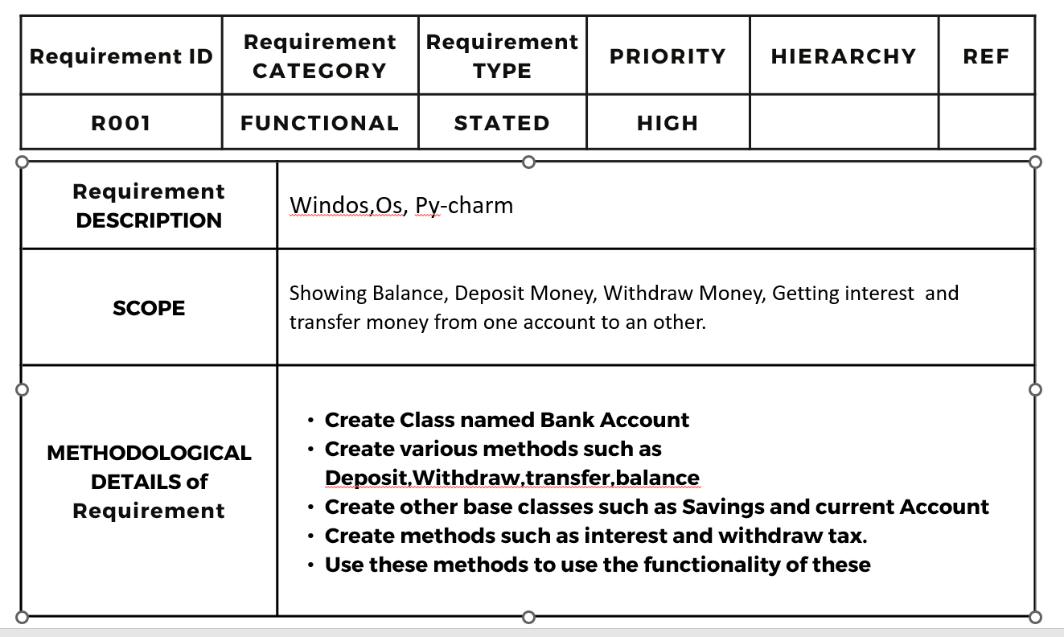

Slide 9

Operating Environment
Windows
Python
PyCharm
1
2
3

Slide 10
Functional Requirements of App
The Functional Requirements for this Python Project for Banking Operations is to create a class hierarchy of bank accounts where we can deposit cash into a certain account specified by us then obtain the balance of the accounts and make a withdrawal from an account where specific charge fees will be applicable and transfer amount.
Some of the accounts provide interest and others charge fees for withdrawals.

Slide 11
Summary of Application
The Python Project involving the application of Banking System Operations has showed us how a basic functionalities of bank work.
The Banking System consist of various functionalities such as Check balance, Deposit money , withdraw money etc.
This shows us how interest is added while depositing money in the account and how charges are levy on us while withdrawing money.
This application shows us the working of a bank application.

Slide 12
Thank you By: Kunal Uttekar

