Slide 1
Anti-phishing classifier
Kumar Kunal Harshit Agrawal Noopur R. Kalawatia Richa Singh

Slide 2

Datasets
https://research.aalto.fi/en/datasets/phishstorm--phishing--legitimate-url-dataset(f49465b2-c68a-4182-9171-075f0ed797d5).html
Phishtank - http://data.phishtank.com/data/online-valid.csv (Only fishing links, No Features)

Slide 3
Challenges with combining datasets
Data URL not consistent. Largest dataset doesn’t contain https:// => Loss of feature.
Different datasets have different features(# of days the link has been registered for, Page ranking).
Taking union of all the features with 0/mean/mode at missing data-points doesn’t necessarily increase the accuracy. Sometimes the accuracy drops.
Need universal way to generate missing features for all the different data-points. WhoIs API
WhoIs => ICANN Lookup
Need visualization to generate relevant features.

Slide 4
Feature | Explanation
Length of the URL | Phishers can use long URL to hide the doubtful part in the address bar
Presence of IP address in the URL | If an IP address is used as an alternative of the domain name in the URL, such as “http://125.98.3.123/fake.html”, users can be sure that someone is trying to steal their personal information
Presence of dash in the URL | The dash symbol is rarely used in legitimate URLs. Phishers tend to add prefixes or suffixes separated by (-) to the domain name so that users feel that they are dealing with a legitimate webpage.
Number of Domain Name | Varying number of domains also is a sign of phishing website
Number of subdomains | If the dots are greater than two, it is classified as “Phishing” since it will have multiple sub domains.
Presence of @ | Using “@” symbol in the URL leads the browser to ignore everything preceding the “@” symbol and the real address often follows the “@” symbol.

Slide 5
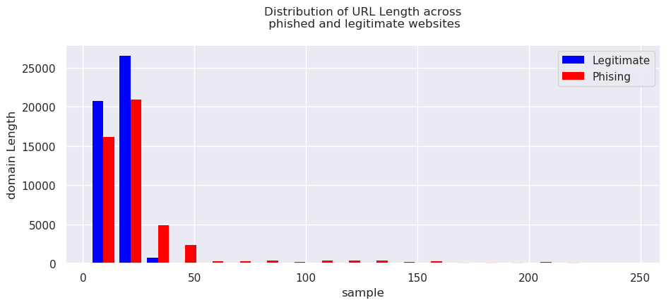
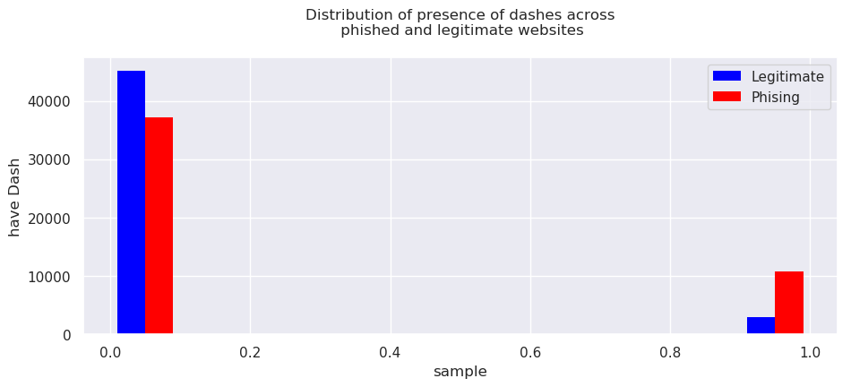
Features Visualization

Slide 6
Experiments
Cross Validation with a 80-20 split for training and testing data for a data of ~10000 datapoints.
Cross Validations using GridSearchCV for 5-10-20 fold validations.
Experiments with different Parameter settings for different classifiers.
Hyperparameters tuning:
Logistic Regression: penalty=‘L1’ => Score: 0.85125
KNeighborsClassifier: metric= 'minkowski’, n_neighbors=96, weights='distance’ => Score: 0.89175
DecisionTreeClassifier: criterion='gini’ , min_samples_split=14 => Score: 0.88775
RandomForestClassifier: bootstrap=True, criterion='gini', max_depth=13, n_estimators=70
Score=> 0.91225

Slide 7
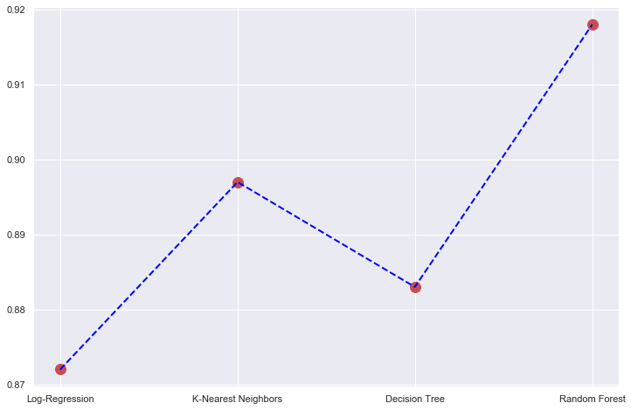
Models used for Classification
LogisticRegression
Accuracy = 87 %
KNeighborsClassifier
Accuracy = 89 %
DecisionTreeClassifier
Accuracy = 88 %
RandomForestClassifier
Accuracy = 92 %

