Slide 1

Obstacle Avoiding Arduino Car
A
Project Presentation
Submitted In Partial Fulfillment Of The Requirements
For The Award Of The
Major Project
Under The Guidance Of
Prof. Pratap Sharma

Slide 2




Submitted By
Kunal Gautam Sweta Singh Sayan Golder Ashmita Chakraborty
32301222091 32301222033 32301222031 32301222029

Slide 3
CONTENT
INTRODUCTION
OBJECTIVE
METHODOLOGY
TECHNICAL OVERVIEW
TESTING
CONCLUSION

Slide 4
INTRODUCTION

Slide 5
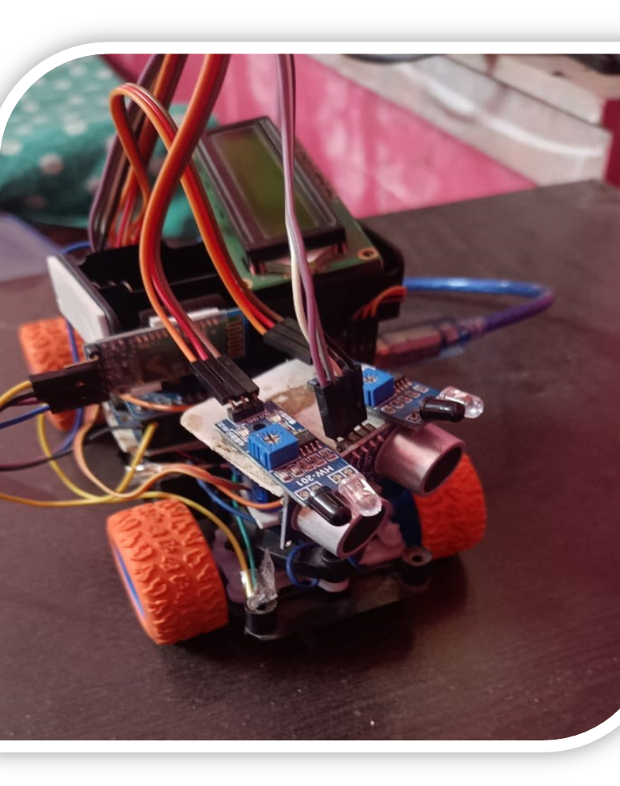

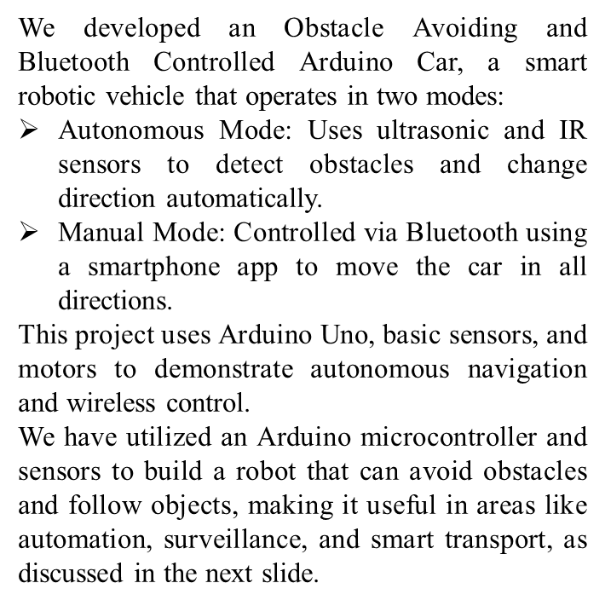

Slide 6
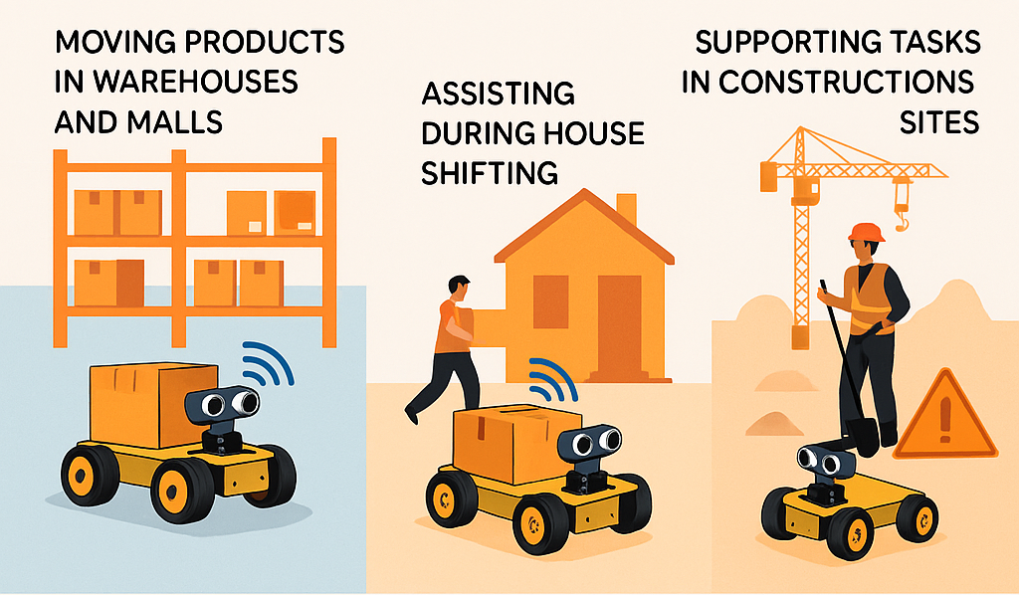
Why...??
This project aims to explore how low-cost robotics can help address real-world problems. While it doesn't solve them entirely, it serves as a prototype to understand and demonstrate how automation can be applied in everyday scenarios.
It shows the potential for:
Moving products easily in warehouses and malls
Assisting during house shifting
Supporting tasks in construction sites where mobility and obstacle avoidance are important
By combining obstacle detection and Bluetooth control, this project gives a practical insight into how robotics could be used in automation, logistics, and smart systems.

Slide 7
How...??
Ultrasonic sensor continuously scans the environment, sending sound waves and measuring echo return time
Arduino processes sensor data to calculate distance to objects in real-time
Smart algorithm determines whether to avoid obstacles or follow objects based on distance thresholds
Motor driver controls wheel movement for precise navigation and directional changes
Continuous feedback loop ensures smooth operation and collision prevention

Slide 8
OBJECTIVE
The main objectives of the Obstacle Avoiding and Bluetooth Controlled Arduino Car are:
1. To build a robotic car that can automatically detect and avoid obstacles using ultrasonic and IR sensors for safe navigation.
2. To enable manual control of the car using Bluetooth and a smartphone, allowing the user to move it forward, backward, left, or right.
3. To gain hands-on experience with embedded systems, Arduino programming, and real-time robotics applications through a practical and interactive project.

Slide 9
MOTIVATION
The motivation behind choosing this project includes:
To understand real-time automation using sensors and microcontrollers in a practical way.
To explore how robots can make decisions on their own, like avoiding obstacles automatically.
To learn Bluetooth-based wireless communication, which is useful in many modern applications.
To develop a low-cost and beginner-friendly robotic system using easily available components.
To start our journey in robotics with a simple and interesting project that’s easy to build and fun to test.

Slide 10
What is Obstacle Avoiding Arduino Car?
It is a smart robotic car built using Arduino Uno, controlled by a Bluetooth-based controller, and capable of automatically changing its direction when it encounters an obstacle.
It uses an ultrasonic sensor to detect obstacles in front, and if anything comes close, the car stops and changes direction automatically.
It also includes Bluetooth control, so the car can be moved manually using a smartphone app to go forward, backward, left, or right.
Other components like IR sensors, servo motor, and L293D motor driver help in making movement smooth and responsive.
This project is easy to build and perfect for beginners who want to learn basic robotics, embedded systems, and wireless control.

Slide 11
METHODOLOGY
What we did ...

Slide 12
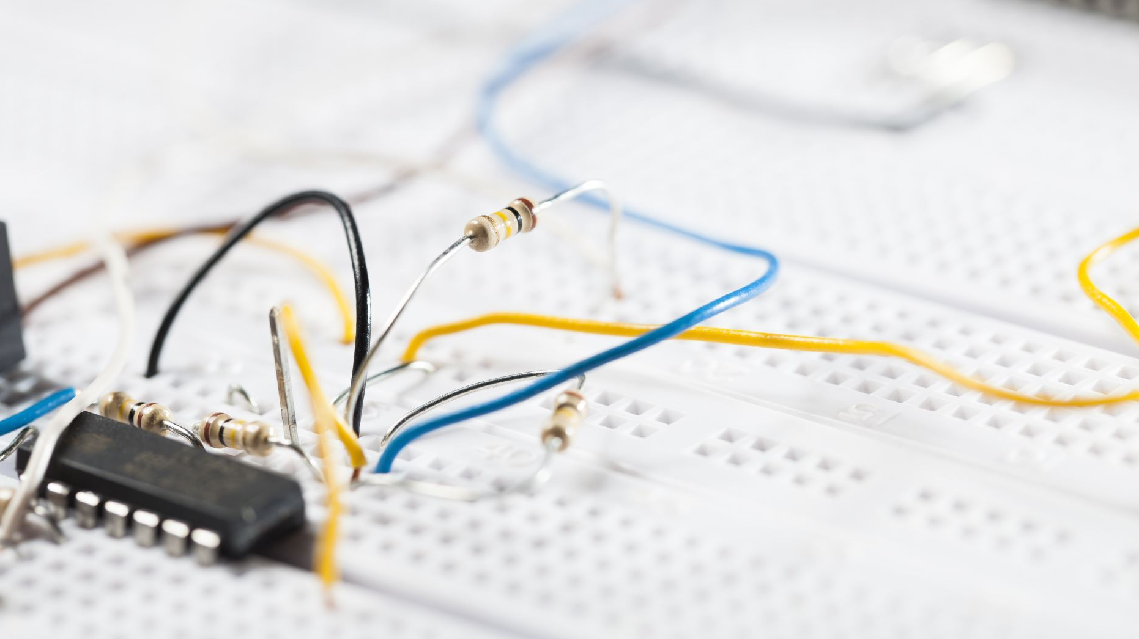
We followed these simple steps to build and test our robotic car:
Selecting Components :-We used basic components like Arduino Uno, ultrasonic and IR sensors, servo motor, motor driver (L293D), DC motors, and a Bluetooth module (HC-05).
Wiring and Assembly :- All the components were connected on a breadboard for initial testing, and then mounted on a car chassis for the final build.
Programming the Arduino :- The Arduino IDE was used to write code for both obstacle detection and Bluetooth control. The program was uploaded to the Arduino Uno.
Testing Autonomous Mode :- We tested how the car detects obstacles using the ultrasonic sensor and changes its direction automatically using motor control.
Testing Manual Mode :- We connected the Bluetooth module to a mobile app and successfully controlled the car using commands like forward, backward, left, right, and stop.

Slide 13
Why Arduino-Based System..??
We chose Arduino for this project because it is:
Beginner-Friendly and Easy to Use :- Arduino has a simple programming environment and lots of online support, which makes it perfect for students and hobbyists.
Affordable and Easily Available :- All the components like Arduino Uno, sensors, and motors are low-cost and available both online and in electronics stores.
Great for Real-Time Control :- Arduino can read sensor data and control motors instantly, which is important for a robot that avoids obstacles and responds to Bluetooth commands.
Open Source with Huge Community Support :- There are many ready-made libraries and example codes available that help in faster development and troubleshooting.
Expandable for Future Projects :- The system can be easily upgraded with new modules like GPS, camera, or Wi-Fi for more advanced versions in the future.

Slide 14
FLOW OF LOGIC/WORKING PRINCIPLE
The car works in two modes — Autonomous Mode and Manual Mode. Here’s how each mode works:
1. Autonomous Obstacle Avoidance Mode
The ultrasonic sensor continuously checks for obstacles ahead.
If an object is too close, the Arduino stops the car.
The servo motor rotates the ultrasonic sensor to scan left and right.
Based on the direction with more space, the car turns and continues moving.
IR sensors help in detecting close objects or edges.
2. Manual Bluetooth Control Mode
The Bluetooth module (HC-05) connects to a mobile app.
The user sends commands like:
F
→ Forward
L
→ Left
S
→ Stop
B
→ Backward
R
→ Right
The Arduino reads these commands and moves the car accordingly using the motor driver.

Slide 15
IMPLEMENTATION & TESTING
Implementation Steps :
Breadboard Testing: We first connected all components on a breadboard to check if the sensors and motors worked properly.
Code Upload & Debugging: We wrote and uploaded the Arduino code using the Arduino IDE. We tested both obstacle detection logic and Bluetooth command response.
Final Assembly: After successful testing, we mounted the components on a robot chassis and used jumper wires and a 7V battery to power the system.
Servo Motor Setup: The servo was programmed to rotate the ultrasonic sensor to scan for obstacles on the left and right side before turning.

Slide 16
TESTING :
Obstacle Avoidance Mode Test: We placed boxes and objects in front of the car. It successfully stopped, scanned for space, and changed direction to avoid collision.
Bluetooth Mode Test: Using a mobile Bluetooth app, we sent control commands. The car responded immediately and moved in the correct direction.
Performance Observed:
Smooth turns and accurate distance detection
Stable Bluetooth connection
Good battery backup for short operation times

Slide 17
How we did ...
TECHNICAL
OVERVIEW

Slide 18
HARDWARE COMPONENTS
Arduino Uno (Microcontroller):
Controls all operations by reading sensor input and sending output to motors.
Executes the logic for obstacle avoidance and Bluetooth control.
Ultrasonic Sensor (HC-SR04):
Measures the distance between the car and obstacles.
Helps the car decide when to stop or change direction.
IR Proximity Sensors:
Detects nearby objects or edges (e.g., walls or table corners).
Provides additional safety and precision.

Slide 19
HARDWARE COMPONENTS
Servo Motor:
Rotates the ultrasonic sensor left and right (0°–180°).
Increases the detection range and field of view.
DC Gear Motors:
Control the car’s movement (forward, backward, left, right).
Powered through the motor driver.
L293D Motor Driver Module:
Acts as a bridge between the Arduino and the motors.
Allows bidirectional motor control and speed adjustment.
HC-05 Bluetooth Module:
Enables wireless communication between smartphone and Arduino.
Accepts directional commands like ‘F’, ‘B’, ‘L’, ‘R’, ‘S’.
7V Battery & Robot Chassis:
Powers the entire system and provides physical structure for mounting components.

Slide 20
SOFTWARE COMPONENTS
Arduino IDE:
Used to write, compile, and upload the C/C++ program to the Arduino Uno.
Allows real-time testing and debugging via the Serial Monitor.
Circuito.io:
Useful for circuit simulation and testing virtually before real hardware assembly.
Helps in visualizing connections and understanding circuit flow.
Bluetooth Controller App (Mobile):
Simple app to send commands to the Bluetooth module.
Helps manually control the car wirelessly.
Embedded C++ Language:
The main programming language for Arduino.
Used to control sensor readings, motor output, and Bluetooth input.

Slide 21
HARDWARE TOOLS
Tool/Component | Purpose
Arduino Uno | Main controller for processing sensor inputs and motor outputs.
Ultrasonic Sensor | Measures distance to detect obstacles in front.
IR Sensors | Detects nearby objects or surface edges.
Servo Motor | Rotates ultrasonic sensor for wider area scanning.
DC Gear Motors | Drives the wheels to move the car.
L293D Motor Driver | Controls motor direction and speed based on Arduino signals.
HC-05 Bluetooth | Connects to mobile for manual control via Bluetooth.
7V Battery | Powers the whole system.
Robot Chassis | Frame to mount and support all components.

Slide 22
SOFTWARE TOOLS
Software/Platform | Purpose
Arduino IDE | Writing, compiling, and uploading code to Arduino Uno.
Circuito.io | Simulating the Arduino circuit before physical assembly (optional).
Bluetooth App (Mobile) | Sending manual control commands like F, B, L, R, S to the car via Bluetooth.
Embedded C / C++ | Core programming language used to write the robot’s logic.

Slide 23
FINDINGS...

Slide 24
Project Output / Result Summary:
Autonomous Mode Output
The ultrasonic sensor detects obstacles ahead.
When an object is detected, the car automatically stops.
The servo motor rotates the sensor to scan both left and right sides.
The car chooses the clearer path and moves in that direction.
IR sensors help improve accuracy for short-range detection.
Result: The car successfully avoided all obstacles placed in front of it during testing.

Slide 25





Manual (Bluetooth) Mode Output :
The car was paired with a smartphone via the HC-05 Bluetooth module.
Commands like (( (Forward), (Ba (Backward), (RiR (Right), (Lef (Left), and
(Stop) were sent.
The car responded instantly and performed each action smoothly.
Result: Real-time control worked effectively with no noticeable lag.
Battery & System Performance :
The system ran continuously for about 30–40 minutes on a full 7V battery.
All sensors and motors worked reliably throughout the tests.
No overheating or performance drops were observed.

Slide 26
Test Case Results:
Test Case | Input / Scenario | Expected Output | Observed Result
Obstacle Detection | Object placed in front (15 cm range) | Car stops and changes direction | Worked as expected
Servo Scanning | Obstacle detected in front | Sensor rotates, scans left & right | Smooth scanning and decision-making
Bluetooth Forward Command (F) | Command sent from mobile app | Car moves forward | Immediate response
Bluetooth Left Command (L) | Command sent from mobile app | Car turns left | Performed accurately
No Obstacle | Clear path ahead | Car moves forward continuously | Maintained straight motion
Battery Performance | 7V fully charged battery used | Minimum 30 min of operation | 35+ minutes observed
Close Range Detection (IR Sensor) | Object <5 cm from IR sensor | IR sensor triggers and stops the car | Worked well in short-range tests

Slide 27
Scope for Improvement:
While the project works well in its current form, there are a few areas where we can improve or upgrade it in the future:
Add a Camera Module
Use a small camera to help the robot "see" its surroundings for better decision-making.
Use a Rechargeable Battery Pack
Replace the basic battery with a rechargeable one to save cost and improve portability.
Integrate Line-Following Capability
Add sensors so the car can follow a white or black path on the ground for more control.
Switch to Wi-Fi or IoT-Based Control
Use a NodeMCU or ESP32 to control the car over the internet or through a web page.
Improve Body Design
Use a stronger or 3D-printed chassis for better durability and outdoor use.
These improvements can make the car smarter, more efficient, and suitable for more advanced real-world applications.

Slide 28
Conclusion
What We Achieved :
Successfully built a smart car that can detect and avoid obstacles on its own.
Implemented Bluetooth-based manual control using a smartphone.
Gained practical experience with Arduino programming, sensor integration, and motor control.
Completed real-time testing and confirmed the system’s accuracy and responsiveness.
Developed a dual-mode system that works in both autonomous and manual operation.
Developed a dual-mode system that works in both autonomous and manual operation.

Slide 29
Conclusion
What We Learned :
How to connect and program sensors and actuators.
How to write logic for autonomous movement using real-time data.
How to control hardware wirelessly through Bluetooth communication.
How to test, debug, and improve a hardware-software integrated project.
Improved our understanding of component compatibility, voltage management, and circuit design.
Learned to present and explain technical work through documentation and presentations.

Slide 30
THANK YOU

