Slide 1
House Price Predication
Presented By:
Hasanji Mariyam Z. (210303128701)
Kunal Kumar (200303125079)
Shaikh Shifa I. (210303105807)
Patel Sagar R. (210303128702)
Guided By:
Yassir Farooqui
Assistant Professor
CSE Department
PIET, Parul University
Internal Project Presentation 1st July, 2023

Slide 2
Content
Introduction
Problem Statement
Research Paper Summary in Table form
Methodology
implemented work
Conclusion
Future Work
References
Project Presentation 2023

Slide 3
Introduction
Machine Learning (ML) is a vital aspect of present-day business and research. It progressively improves the performance of computer systems by using algorithms and neural network models. Machine Learning algorithms automatically build a mathematical model using sample data also referred to as training data which form decisions without being specifically programmed to make those decisions.
People and real estate agencies buy or sell houses, people buy to live in or as an investment and the agencies buy to run a business. Either way, we believe everyone should get exactly what they pay for. over-valuation/under-valuation in housing markets has always been an issue and there is a lack of proper detection measures. Broad measures, like house/Real-estate price-to-rent ratios, give a primary pass. However, to decide about this issue an in-depth analysis and judgment are necessary. Heres where machine learning comes in, by training an ML model with hundreds and thousands of data a solution can be developed which will be powerful enough to predict prices accurately and can cater to everyones needs.
Project Presentation 2023

Slide 4
Introduction
The primary aim of this paper is to use these Machine Learning Techniques and curate them into ML models which can then serve the users. The main objective of a Buyer is to search for their dream house which has all the amenities they need. Furthermore, they look for these houses/Real estates with a price in mind and there is no guarantee that they will get the product for a deserving price and not overpriced. Similarly, A seller looks for a certain number that they can put on the estate as a price tag and this cannot be just a wild guess, lots of research needs to be put to conclude a valuation of a house.
The worth of a house is notable as a blend of a huge assortment of choices. Subsequently, the expectation of home cost presents an original arrangement of difficulties. However a curiously large assortment of room units are committed to the current errand, their presentation and applications are confined by a truly lengthy defer inside the treatment of information, the shortage of genuine settings thus the deficiency of decisions for lodging. Our point is to anticipate the worth of the house advertising abuse characterization strategies during this paper. The vast majority of the current examinations have focused on breakdown the interruption of the expectation of house costs. A few speculations are brought into the world as a result of the investigation work committed by totally various specialists all over the planet. This paper gets the latest expectation investigation to help financial indicators to utilize it. It gives a synopsis of the forecast markets and, together, the current business sectors that form it more straightforward to foresee the market.
Project Presentation 2023

Slide 5
Problem Statement
The aim of this project is to predict the accurate values for the land and property prices since it is a dense city with a lot of population the demand for land and property is gone sky rocketing in recent years this proposed model serves the purpose of finding the essential values and prices of the properties.
Project Presentation 2023

Slide 6
Summary
Sr. number | Paper Title | Publisher | Year | Take-away points
01 | Prediction and Analysis of Housing Price Based on the Generalized Linear Regression Mode | Hindawi | Xinshu Li | This uses generalized linear regression model which provide high accuracy for prediction.
02 | House Price Prediction Using Machine Learning | IJITEE | G. Naga Satish, Ch. V. Raghavendran, M.D.Sugnana Rao, Ch.Srinivasulu | It uses lasso regression as project model because of its adaptable and probabilistic methodology on model selection.
03 | House Price Prediction using a Machine Learning Model | MECS | Nor Hamizah Zulkifley , Shuzlina Abdul Rahman, Nor Hasbiah Ubaidullah, Ismail Ibrahim | The findings of this analysis verified the use of the Artificial Neural Network, Support Vector Regression and XGBoost as the most efficient models compared to others.
04 | A Comparative Study on House Price Prediction using Machine Learning | IRJET | Hardi Joshi, Saket Swarndeep | . In this article discussed about machine learning techniques like Random Forest, Extreme Gradient Boosting (XGBoost), Light Gradient Boosting Machine (LightGBM), Hybrid Regression and Stacked Generalization.
05 | House Price Prediction Using Machine Learning | IJRPR | Robbi Jyothsna | There are various factors that influence the prediction price of a house which include physical conditions, transportation, concept, and location, etc. House rent also defines based on 3 factors like: 1)self occupation[self living] (2) Invenstment[rent] 3) Speculative [sells when price increases]
Project Presentation 2023

Slide 7
Methodology
Data Collection :- we are collect the data from Kaggle.
Data Preprocessing :- we are handle missing value and outlier and using Feature Engineer create new columns.
Data Visualization:- We are using Scatter plot and bar chat for visualization based on independent and dependent variable.
Apply Model Through Pipeline :- We are apply Different model through pipeline like Linear Regression , Lasso Regression , Ridge Regression and Elastic net Regression and get the accuracy.
Apply Model without Pipeline:- first we are convert all the string data to numeric from using one hot encoding then apply different model of our data , like Decision Tree , Random-forest ,Linear Regression , Ridge Regression , Elastic net Regression and Lasso Regression and get the Accuracy of our model.
Project Presentation 2023

Slide 8
Implementation Details
Data Collection:
The first step in building a house price prediction model is to collect relevant data. Some of the commonly used sources of data for house price prediction include real estate websites, government data sources, and real estate agents. The collected data should include features such as the location, number of bedrooms and bathrooms, square footage, year built, and other amenities or features that affect the price of the house.
Project Presentation 2023

Slide 9
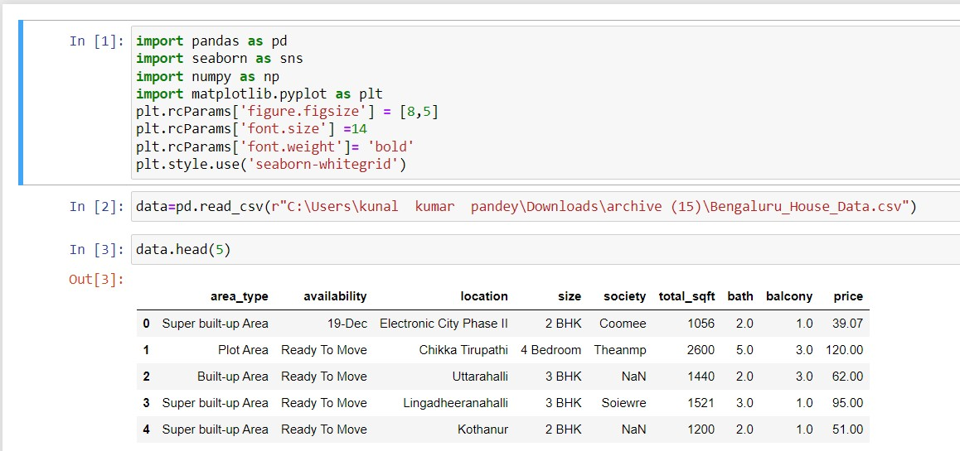
Screen shots of implemented work
Import DataSe
Project Presentation 2023

Slide 10
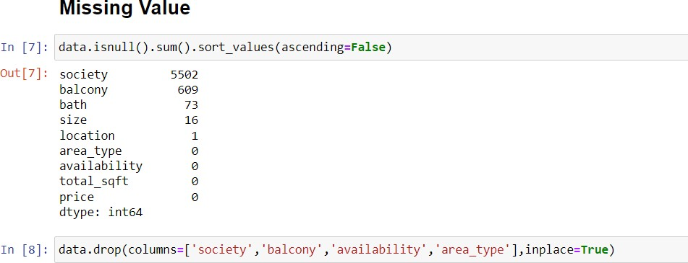
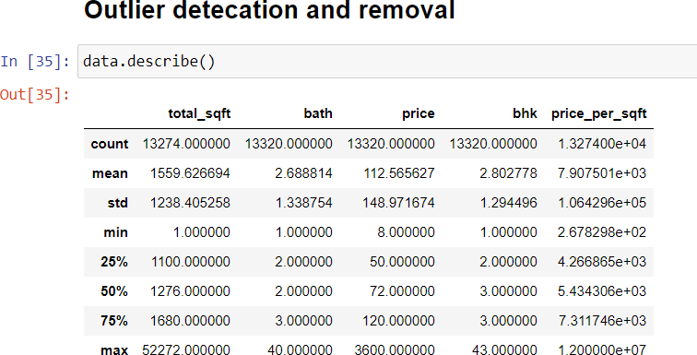
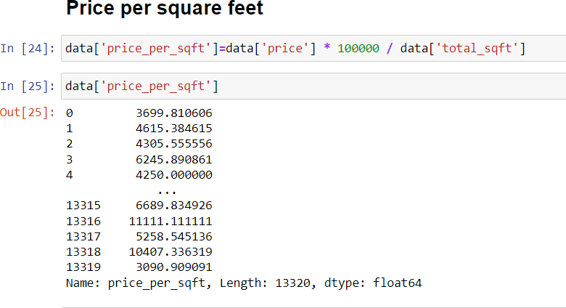
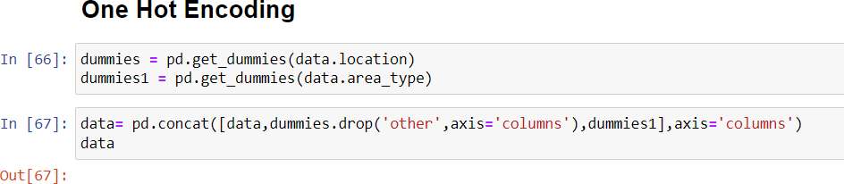
Screen shots of implemented work
Project Presentation 2023

Slide 11
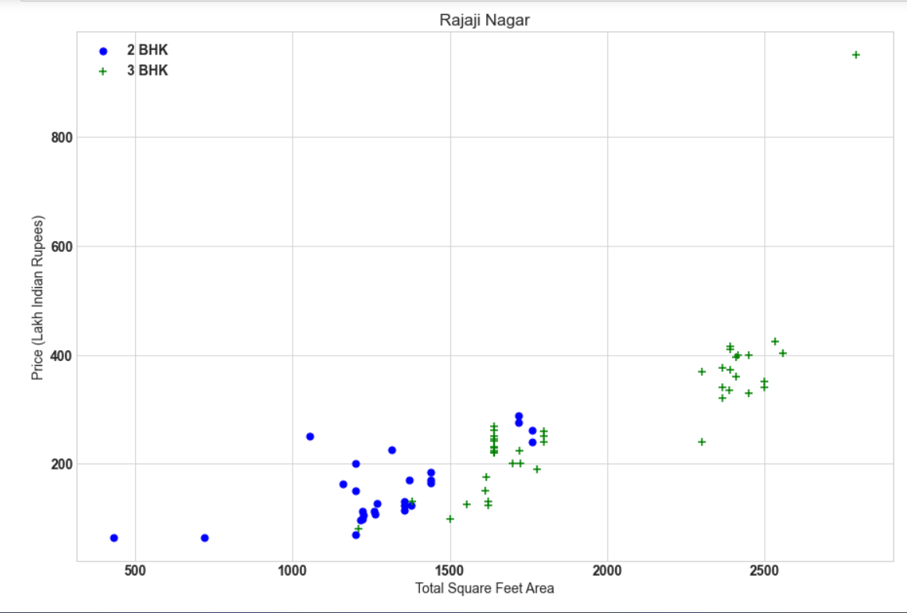
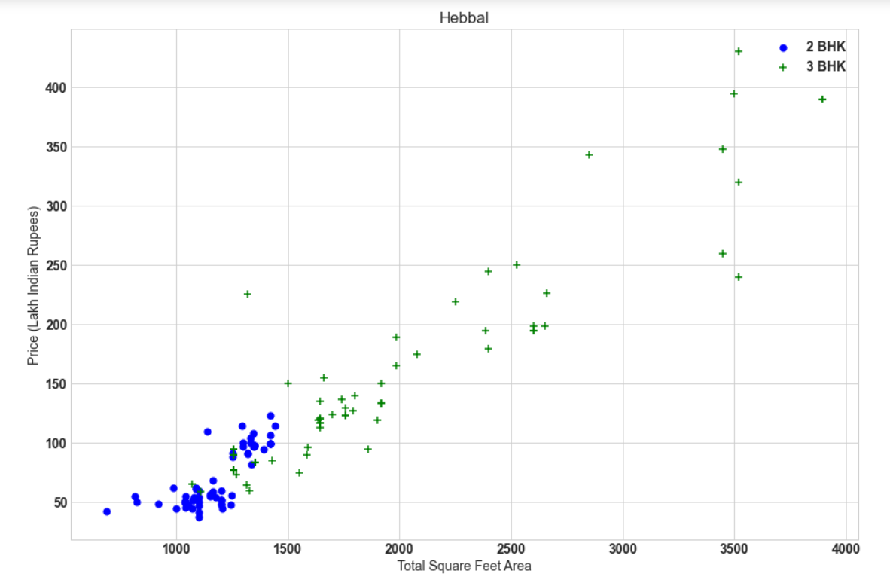
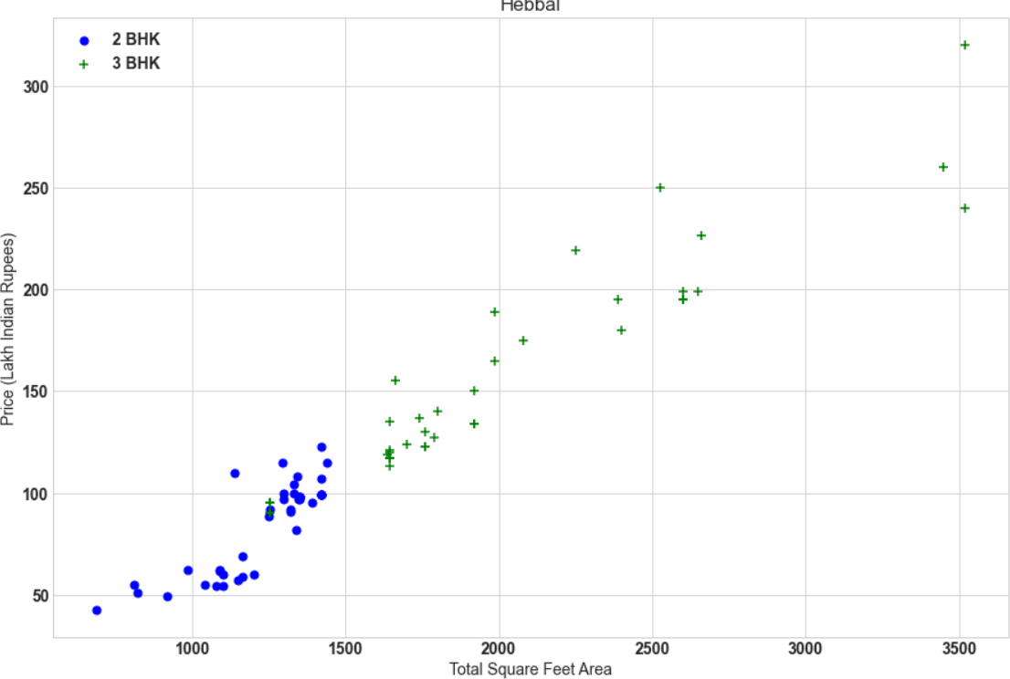
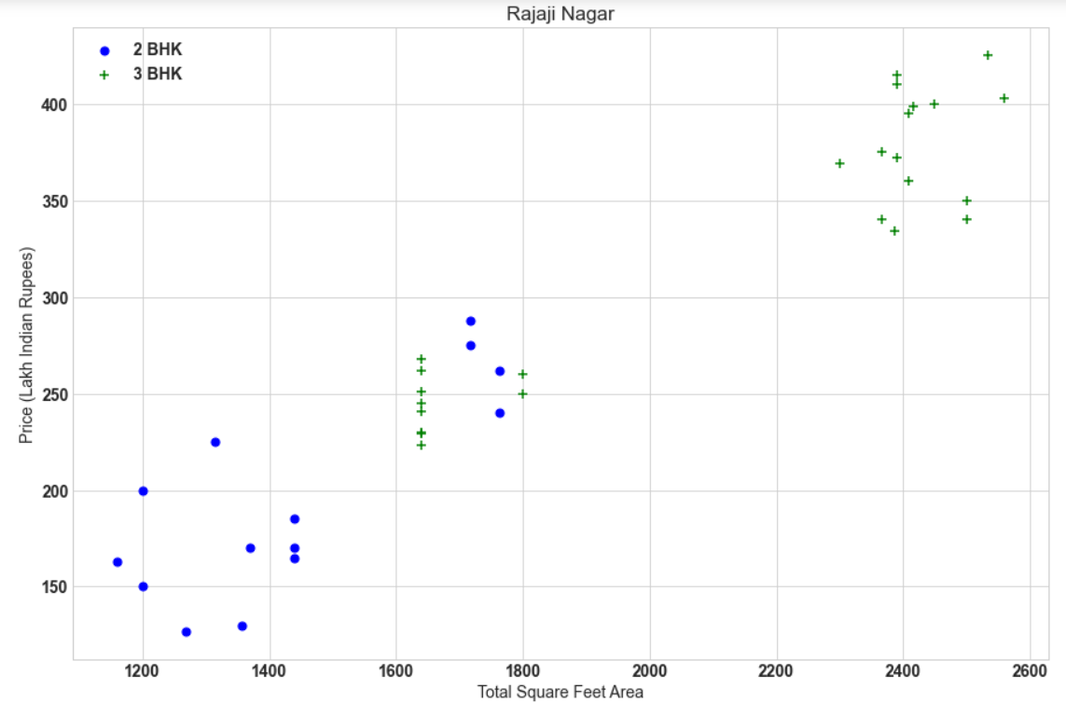
Screen shots of implemented work
Total Square Feet area base on price
Total Square Feet area base on price
Total Square Feet area base on price
Total Square Feet area base on price
Project Presentation 2023

Slide 12
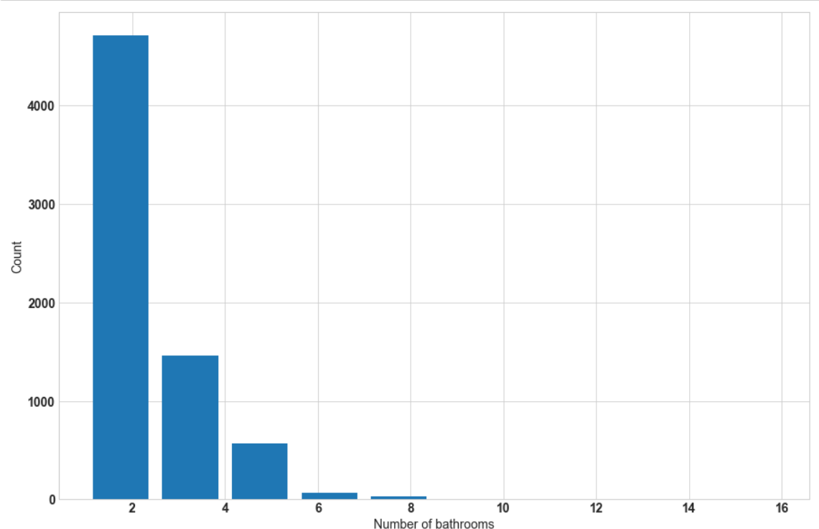
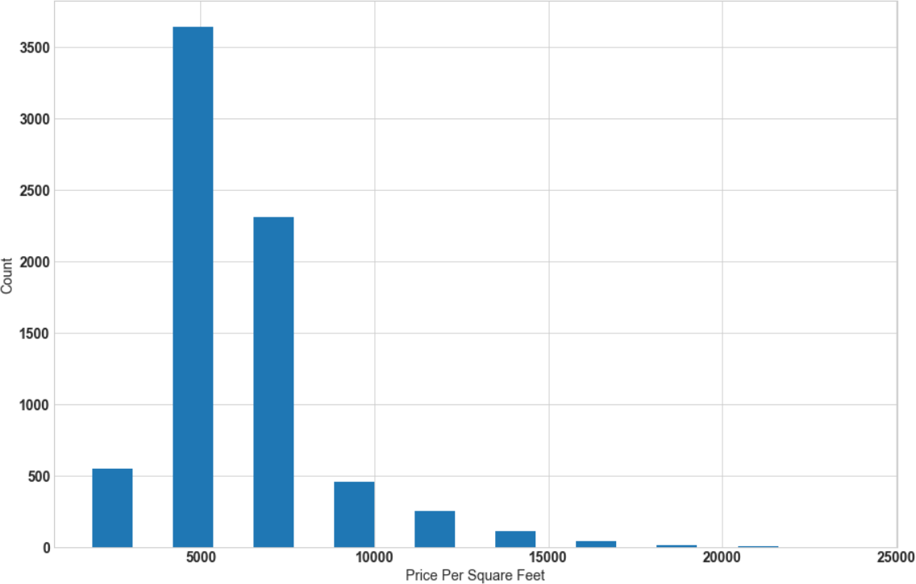
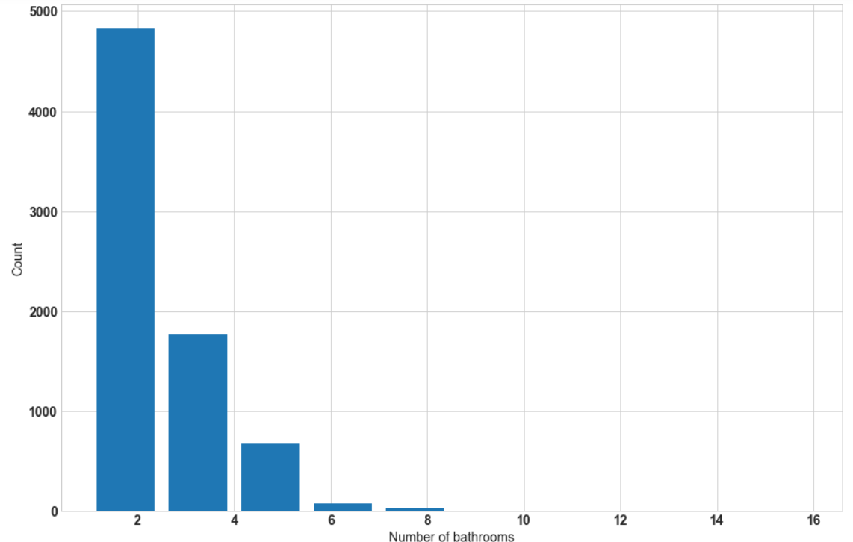
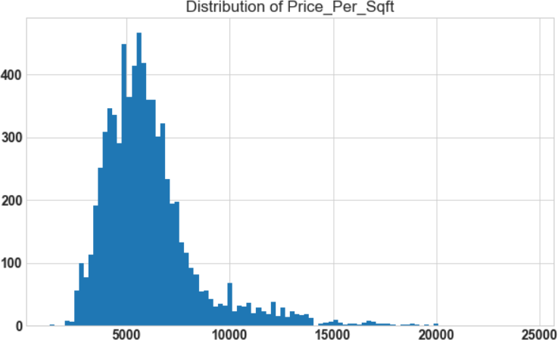
Screen shots of implemented work
No. of bathroom count
Price per Square Fit based on total count
Price per square feet based on count
Distribution of price squre feet
Project Presentation 2023

Slide 13
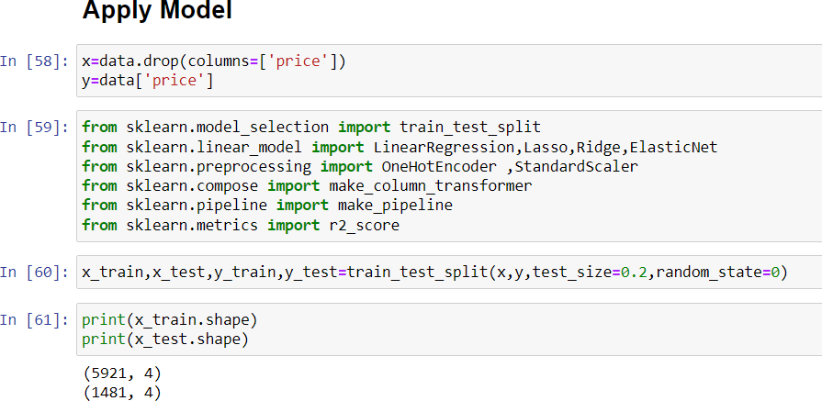
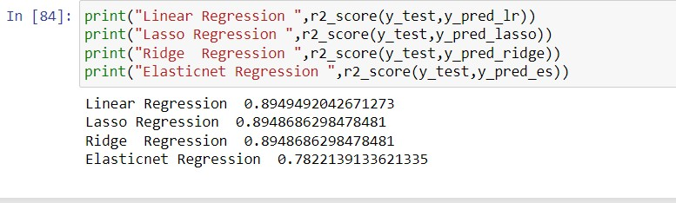
Screen shots of implemented work
Project Presentation 2023

Slide 14
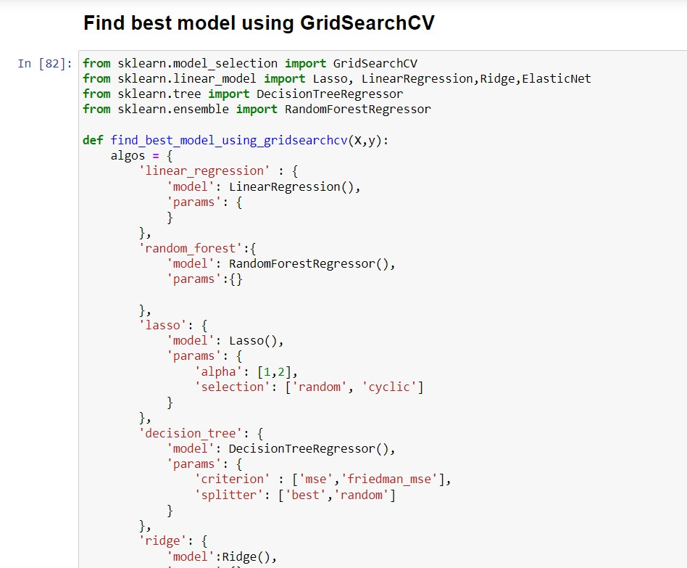
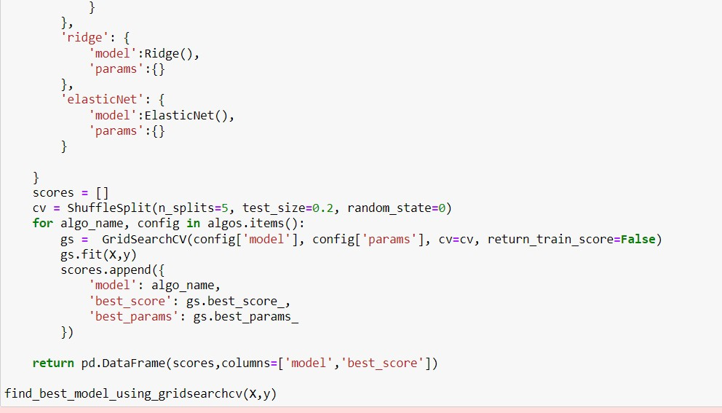
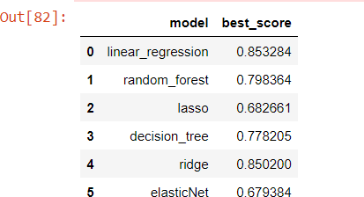
Screen shots of implemented work
Project Presentation 2023

Slide 15
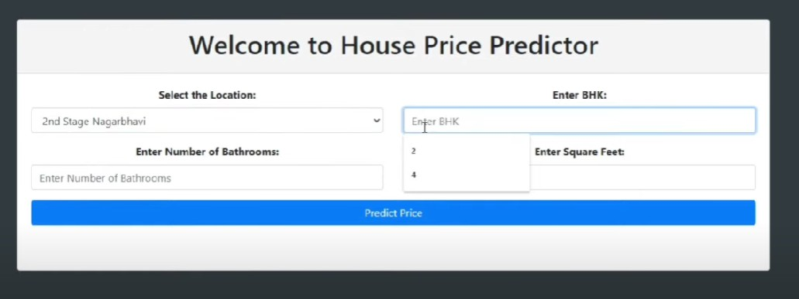
Screen shots of implemented work
Project Presentation 2023

Slide 16
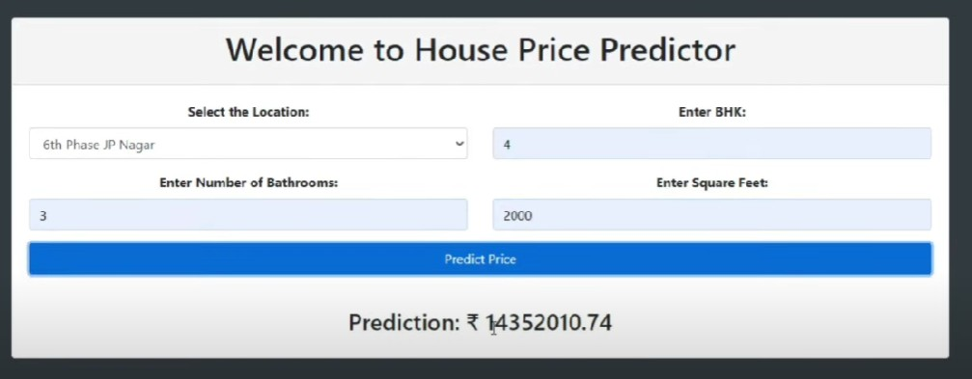
Screen shots of implemented work
Project Presentation 2023

Slide 17
Conclusion
predicting house prices is a complex process that requires consideration of numerous factors. The state of the overall economy, the condition and location of the property, and the availability of financing options are just a few of the factors that can influence housing prices. There are a variety of methods and approaches that can be used to make predictions, including statistical modeling, machine learning algorithms, and expert opinions. However, it's important to keep in mind that any prediction is only an estimate and not a guarantee of future value. Conducting thorough research and consulting with real estate professionals can help to make informed decisions related to buying or selling a property.
Project Presentation 2023

Slide 18
Future Work
House price prediction can help the developer determine the selling price of a house and can help the customer to arrange the right time to purchase a house. The values of X and Y variables are training datasets for the model representation of linear regression.
So we are creating user Friendly website , where user can file all the details , based on requirements website is generate Accurate Price.
Project Presentation 2023

Slide 19
References
[1]. Aminah Md Yusof and Syuhaida Ismail ,Multiple Regressions in Analysing House Price Variations. IBIMA Publishing Communications of the IBIMA Vol. 2012 (2012), Article ID 383101, 9 pages DOI: 10.5171/2012.383101.
[2]. Babyak, M. A. What you see may not be what you get: A brief, nontechnical introduction to over fitting regression-type models. Psychosomatic Medicine, 66(3), 411-421.
[3]. Atharva chogle, priyanka khaire,Akshata gaud, Jinal Jain .House Price Forecasting using Data Mining Techniques International Journal of Advanced Research in Computer and Communication Engine g ISO 3297:2007 Certified Vol. 6, Issue 12, December 2017
[4]. Darshan Sangani,Kelby Erickson, and Mohammad Al Hasan, Predicting Zillow Estimation Error Using Linear Regression and Gradient Boosting, IEEE 14th International Conference on Mobile Ad Hoc and Sensor Systems (MASS), Page(s):530 - 534
Project Presentation 2023

Slide 20
[5]. Model,Azme Bin Khamis, Nur Khalidah Khalilah Binti Kamarudin ,Comparative Study On Estimate House Price Using Statistical And Neural Network, International journal of scientific and technology,research volume 3, ISSUE 12, December 2014,Page(s):126-131.
[6]. Adyan Nur Alfiyatin, Hilman Taufiq, Ruth Ema Febrita, Wayan Firdaus Mahmudy,Modeling House Price Prediction using Regression Analysis and Particle Swarm Optimization Case Study: Malang, East Java, Indonesia. (IJACSA) International Journal of Advanced Computer Science and Applications, Vol. 8, No. 10, 2017, Page(s):323-326
[7]. Nageswara Rao Moparthi,Dr. N. Geenthanjali “ Design and implementation of hybrid phase based ensemble technique for defect discovery using SDLC software metrics”, An International Conference by IEEE, PP. 268 – 274 ,2016
[8]. Nihar Bhagat, Ankit Mohokar, Shreyash House Price Forecasting using Data Mining.International Journal of Computer Applications 152(2):23-26, October 2016.
[9]. Valeria Fonti ,Feature Selection using LASSO Research Paper in Business Analytics, VU Amsterdam, March 30, 2017.
.
Project Presentation 2023

Slide 21
[10]. Peter B. Luh,Neural Network-Based Market Clearing Price Prediction and Confidence Interval Estimation With an Improved Extended Kalman Filter Method, IEEE Transactions on Power Systems 20(1):59 - 66 , March 2005.
[11]. Visit Limsombunchai, Christopher Gan and Minsoo Lee, House Price Prediction: Hedonic Price Model vs. Artificial Neural Network, Lincoln University, Canterbury 8150, New Zealand, American Journal of Applied Sciences 1 (3): 193-201, 2004.
[12]. Dr. Nageswara Rao Moparthi,,Ch Mukesh, Dr. P. Viday Saga,“ Water Quality Monitoring System Using IoT”, An International Conference by IEEE, PP. 109 – 113 ,2018
[13]. Ahmed Khalafallah ,Neural Network Based Model for Predicting Housing Market Performance, Tsinghua Science & Technology 13(S1):325-328 ,October 2008.
[14]. Steven C. Bourassa, Eva Cantoni, Martin Edward Ralph Hoesli,Spatial Dependence, Housing Submarkets and House Price Prediction The Journal of Real Estate Finance and Economics, 143-160, 2007
[15]. Chris Brunsdon, A.Stewart Fotheringham and Martin E. Charlton, Geographically Weighted Regression: A Method for Exploring Spatial Nonstationarity,Geographical analysis, Volume 28, Issue 4,Pages: 281-375,1996.
Project Presentation 2023

Slide 22
Thank you
Project Presentation 2023

