Slide 1
UCI Machine Learning Repository Restaurant & consumer data Data Set Analysis

Slide 2
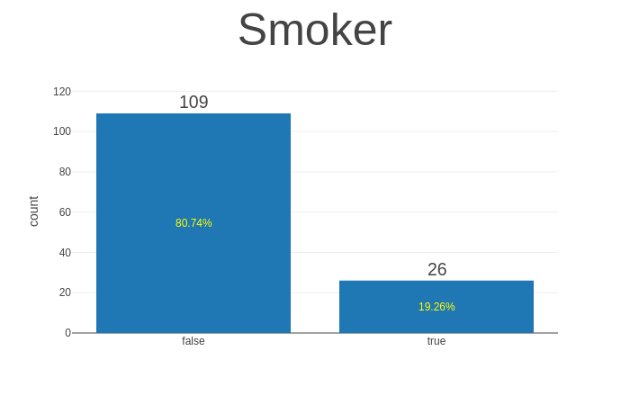
User profile Column
We see that 80.74% of user are not smoker, but 19.26% of user are smoker.

Slide 3
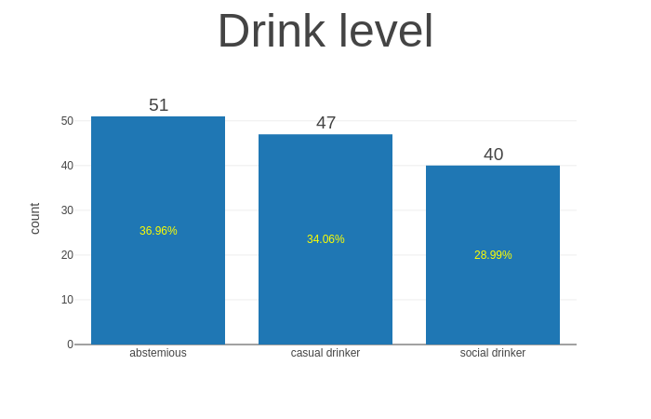
User Profile Column
We see that Drink level are of three type abstemious (36.96%), casual drinker(34.06%) ,social drinker (28.99%)

Slide 4
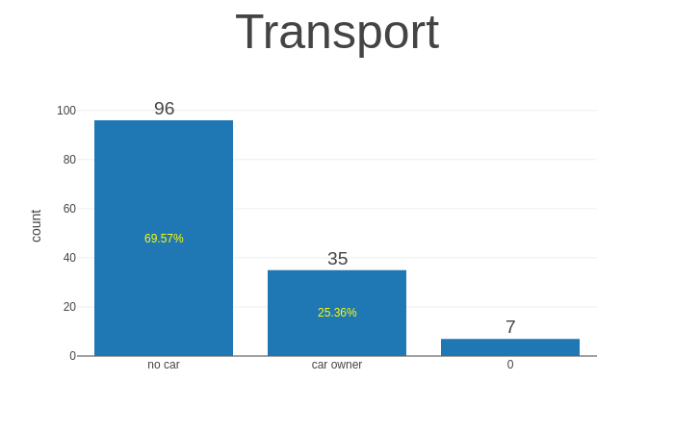
User Profile Column
Here we see that 69.57% user having no car, 25.36% user are car owner and rest is unknown.

Slide 5
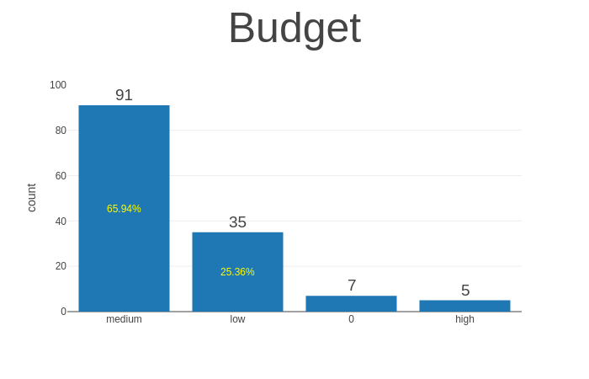
User Profile Column
Basically budget are of three category, medium (65.94%), low (25.36%) and high

Slide 6
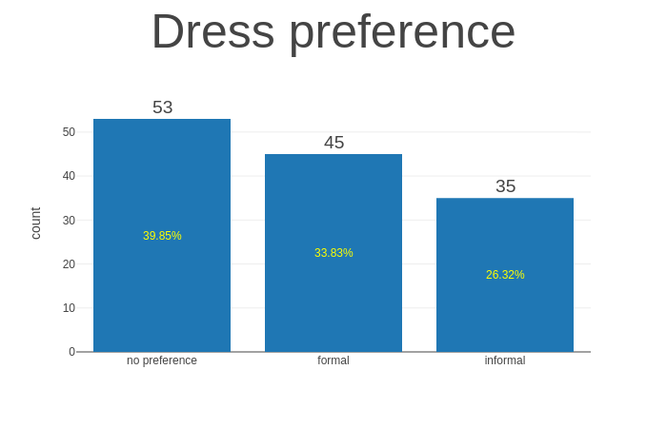
User Profile Column
The Dress preferences have three column no preferences, formal, informal which is 39.85%, 33.83%, 26.32% respectively.

Slide 7
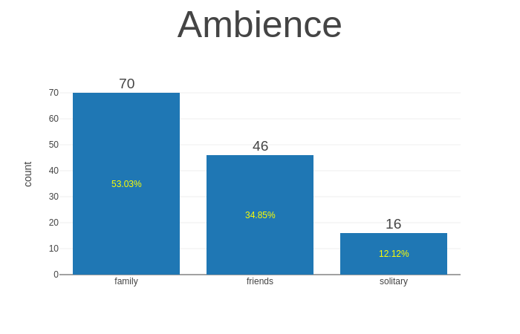
User Profile Column
Here Ambience column is three types as family, friend and solitary which is of 53.03%, 34.85% and 12.12%.

Slide 8
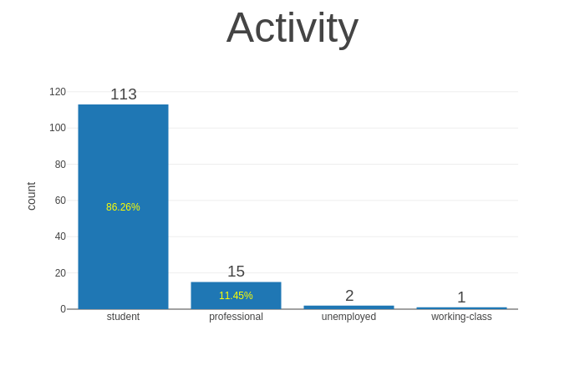
User Profile Column
Here activity column is of four types as student, professional, unemployed, working class which is of 86.26%, 11.45%, 1.54%,0.8% i.e working class is comparatively very low.

Slide 9
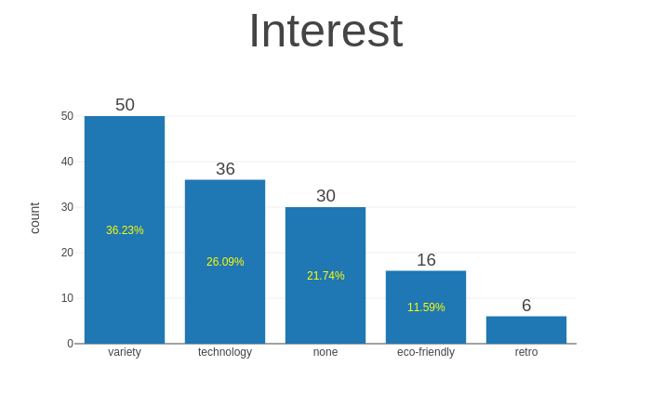
User Profile Column
Here interest are of five category as variety, technology, none, ecofriendly, retro which is of 36.23%, 26.09%, 21.74%, 11.59% respectively. Here we see that retro having very less percentage.

Slide 10
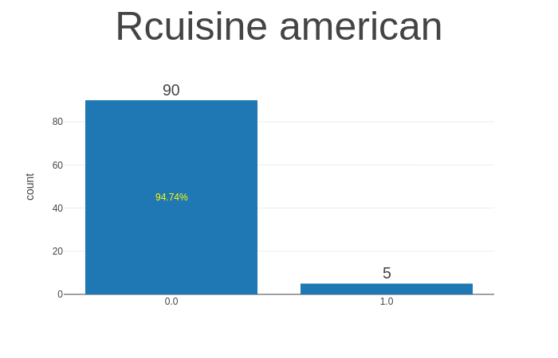
Combined Features of all restaurant having rating
Here 94.74% have zero rating and rest is one rating. Here we can say that Rcuisine american is not much popular.

Slide 11
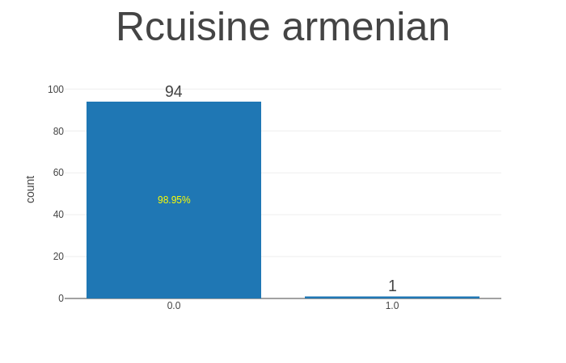
Combined Features of all Restaurant having rating
Here we see that Rcuisin armenian have 98.95% have zero rating and rest have 1.0 rating.

Slide 12
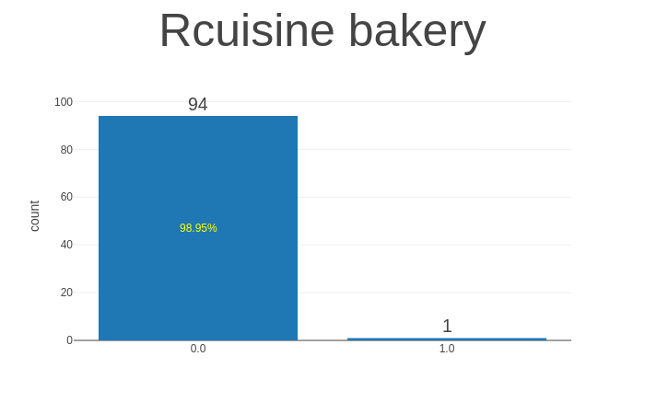
Combined Features of all Restaurant having rating
Here we see that Rcuisin bakery have 98.95% have zero rating and rest have 1.0 rating

Slide 13
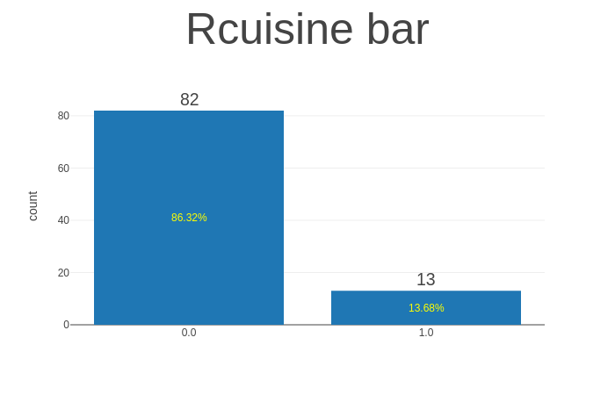
Combined Features of all Restaurant having rating
Here we see that Rcuisin bar have 83.32% have zero rating and 13.68% have 1.0 rating

Slide 14
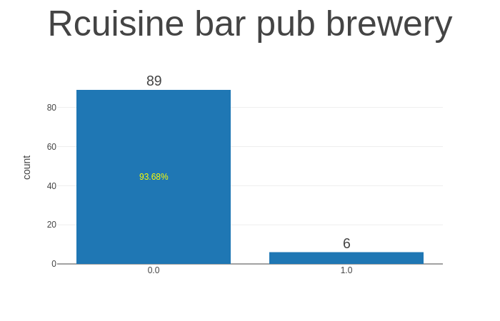
Combined Features of all Restaurant having rating
Here we see that Rcuisin bar pub brewery have 93.68% have zero rating and rest have 1.0 rating

Slide 15
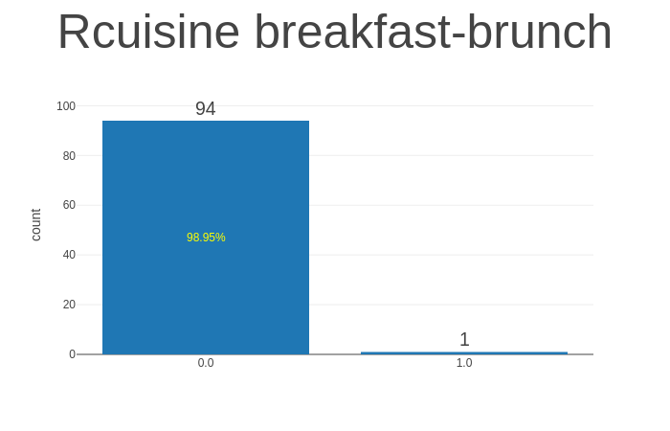
Combined Features of all Restaurant having rating
Here we see that Rcuisin breakfast brunch have 98.95% have zero rating and rest have 1.0 rating

Slide 16
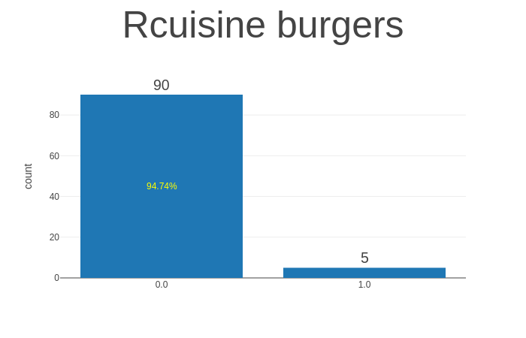
Combined Features of all Restaurant having rating
Here we see that Rcuisin burgers have 94.74% have zero rating and rest have 1.0 rating

Slide 17

Combined Features of all Restaurant having rating
Here we see that Rcuisin cafe-coffee shop have 98.95% have zero rating and rest have 1.0 rating

Slide 18
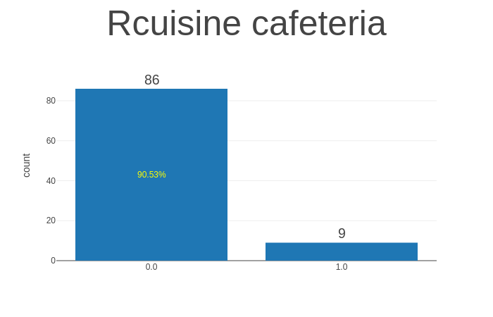
Combined Features of all Restaurant having rating
Here we see that Rcuisin cafeteria have 90.53% have zero rating and rest have 1.0 rating

Slide 19

Combined Features of all Restaurant having rating
Here we see that Rcuisin chinese have 96.84% have zero rating and rest have 1.0 rating

Slide 20
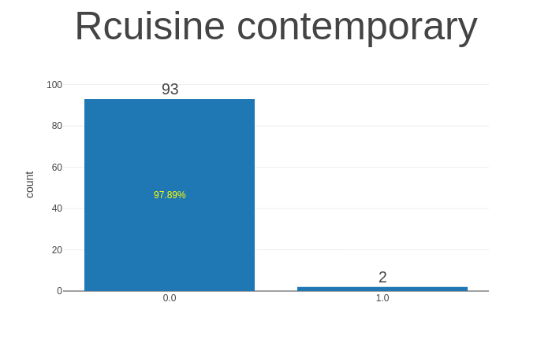
Combined Features of all Restaurant having rating
Here we see that Rcuisin contemporary have 97.89% have zero rating and rest have 1.0 rating

Slide 21
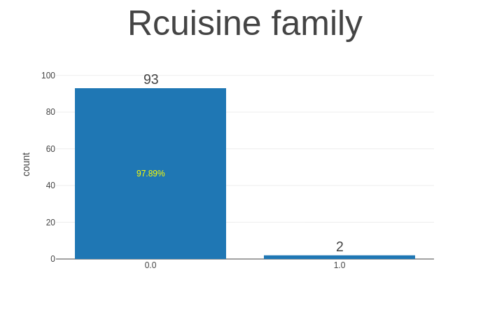
Combined Features of all Restaurant having rating
Here we see that Rcuisin family have 97.89% have zero rating and rest have 1.0 rating

Slide 22

Combined Features of all Restaurant having rating
Here we see that Rcuisin fast food have 91.58% have zero rating and rest have 1.0 rating

Slide 23

Combined Features of all Restaurant having rating
Here we see that Rcuisin game have 98.95% have zero rating and rest have 1.0 rating

Slide 24
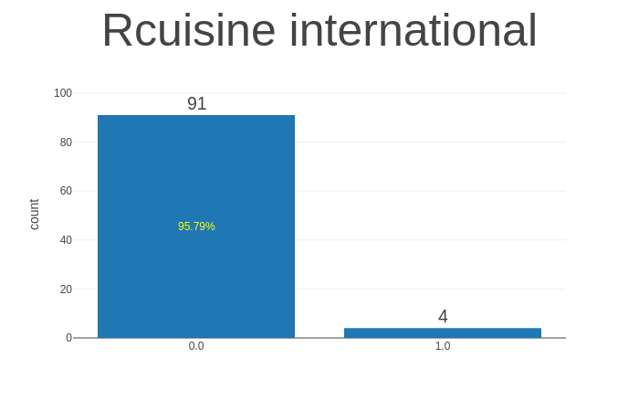
Combined Features of all Restaurant having rating
Here we see that Rcuisin international have 95.79% have zero rating and rest have 1.0 rating

Slide 25
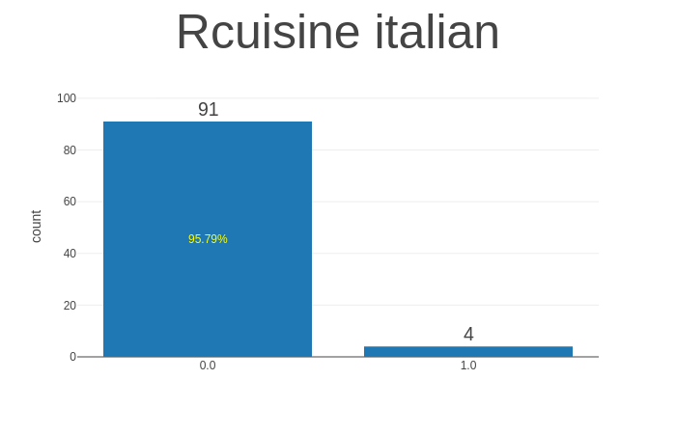
Combined Features of all Restaurant having rating
Here we see that Rcuisin italian have 95.79% have zero rating and rest have 1.0 rating

Slide 26

Combined Features of all Restaurant having rating
Here we see that Rcuisin japanese have 94.74% have zero rating and rest have 1.0 rating

Slide 27

Combined Features of all Restaurant having rating
Here we see that Rcuisin mediterranean have 98.95% have zero rating and rest have 1.0 rating

Slide 28
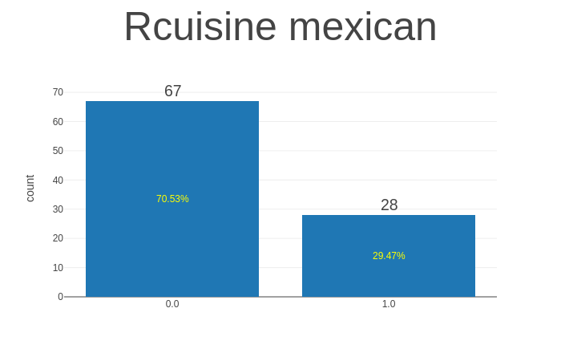
Combined Features of all Restaurant having rating
Here we see that Rcuisin mexican have 70.53% have zero rating and 29.47% have 1.0 rating

Slide 29
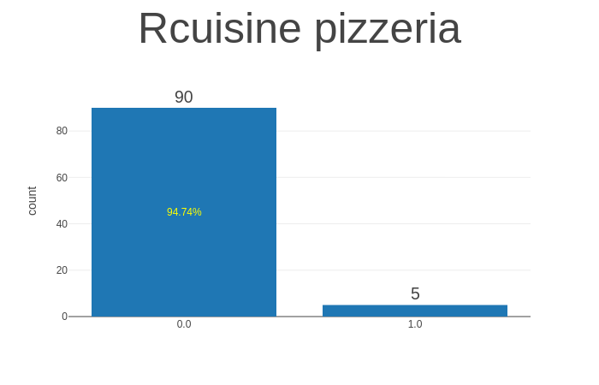
Combined Features of all Restaurant having rating
Here we see that Rcuisin pizzeria have 94.74% have zero rating and rest have 1.0 rating

Slide 30

Combined Features of all Restaurant having rating
Here we see that Rcuisin regional have 98.95% have zero rating and rest have 1.0 rating

Slide 31

Combined Features of all Restaurant having rating
Here we see that Rcuisine seafood have 94.74% have zero rating and rest have 1.0 rating

Slide 32
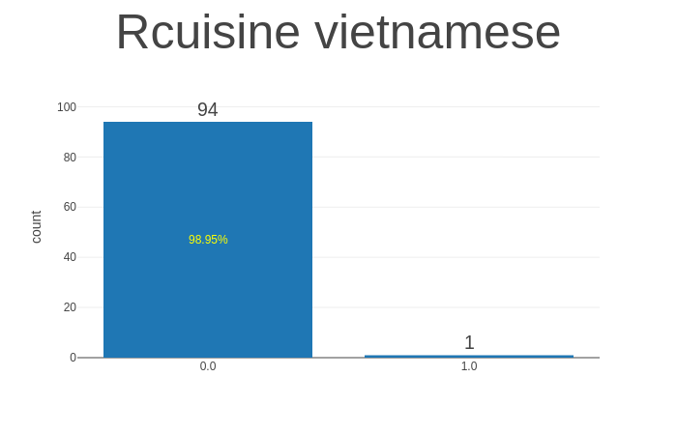
Combined Features of all Restaurant having rating
Here we see that Rcuisine vietnamese have 98.95% have zero rating and rest have 1.0 rating

Slide 33
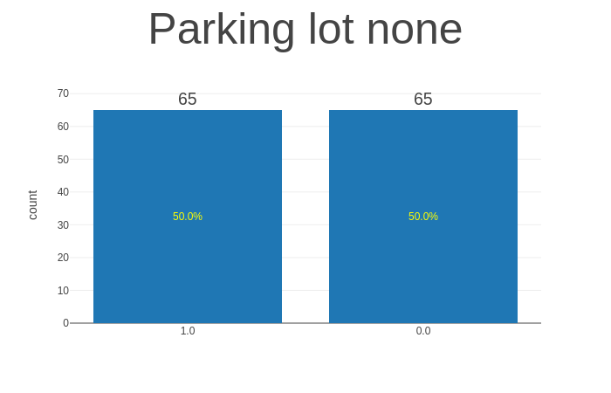
Combined Features of all Restaurant having rating
Here we see that Parking lot none have 50.0% have zero rating and 50.0% have 1.0 rating

Slide 34
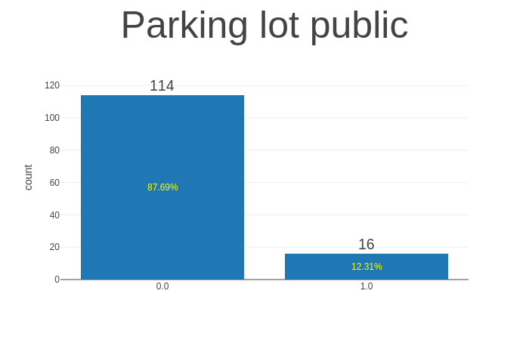
Combined Features of all Restaurant having rating
Here we see that Parking lot public have 87.69% have zero rating and 12.31% have 1.0 rating

Slide 35
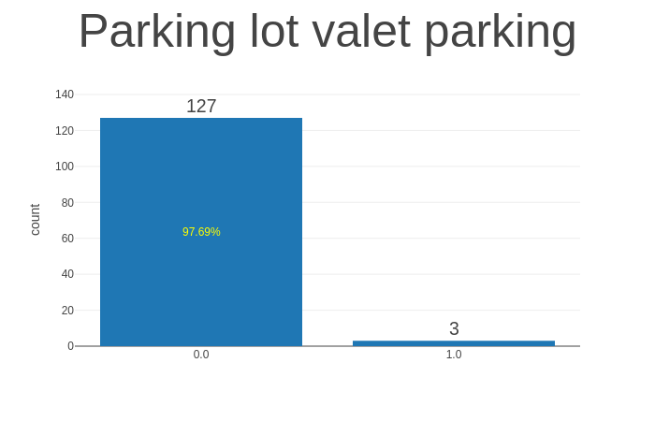
Combined Features of all Restaurant having rating
Here we see that Parking lot valet parking have 97.69% have zero rating and rest have 1.0 rating

Slide 36
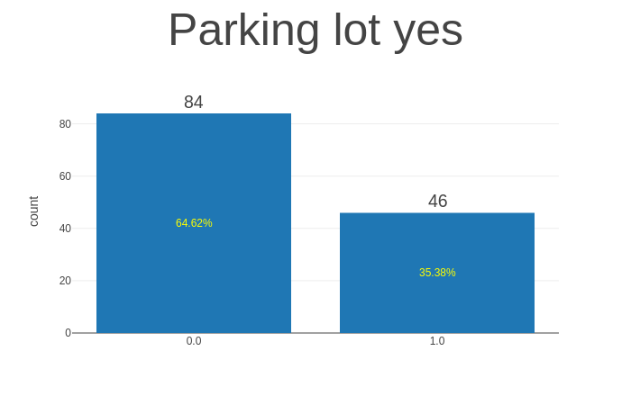
Combined Features of all Restaurant having rating
Here we see that Parking lot yes parking have 64.62% have zero rating and 35.38% have 1.0 rating

Slide 37

Combined Features of all Restaurant having rating
Here we see that Alcohol have three category as No alcohol served, wine beer, full bar which having 66.92%,26.15% and 6.93% respectively. So, we can say that no alcohol served has more percentage.

Slide 38
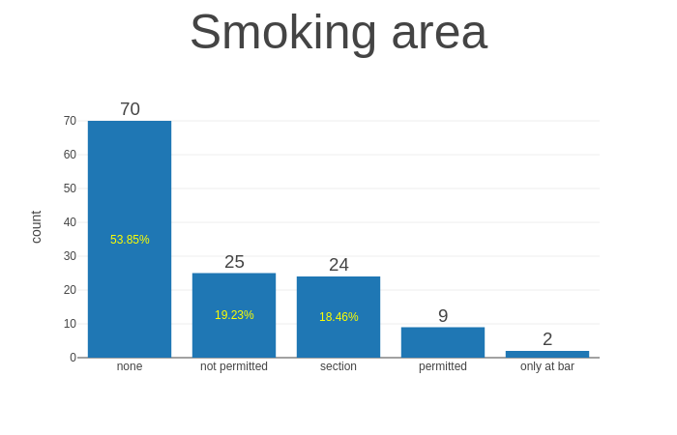
Combined Features of all Restaurant having rating
In Smoking area there is four category as none, not permitted, section, permitted, only at bar which have 53.85%,29.23%,19.48% and rest is from other section respectively.

Slide 39
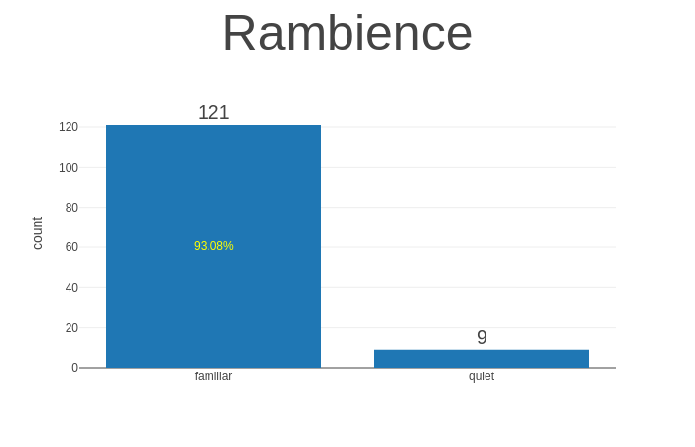
Combined Features of all Restaurant having rating
In Rambience there are basically two category first is familiar which is 93.08% and second one is quiet which is rest percentage. So, we can say that familiar has more rating.

Slide 40
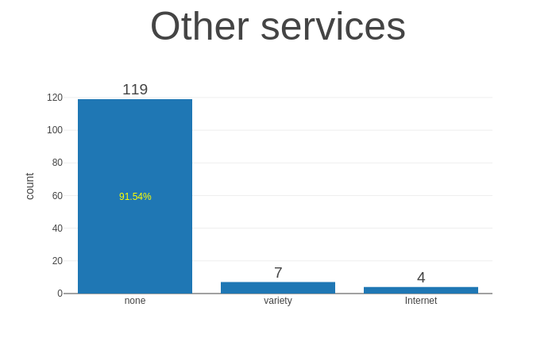
Combined Features of all Restaurant having rating
In Other services type facility, there are basically three kind of service is present none which is 91.54% and rest are variety and Internet facility which is negligible.

Slide 41
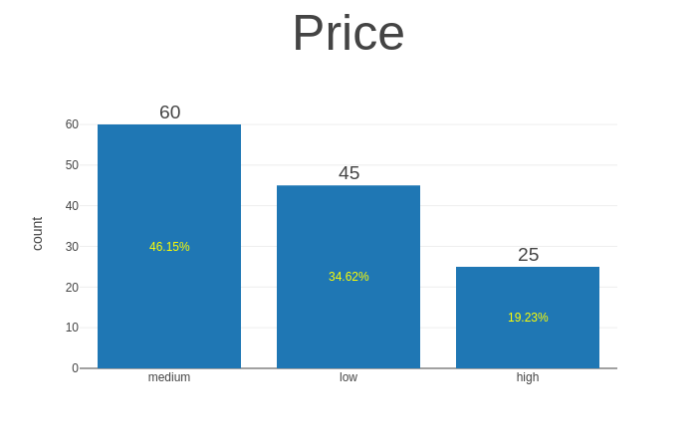
Combined Features of all Restaurant having rating
There are basically three kind of price medium (46.15%), low (34.62%) and High (19.23%).

Slide 42
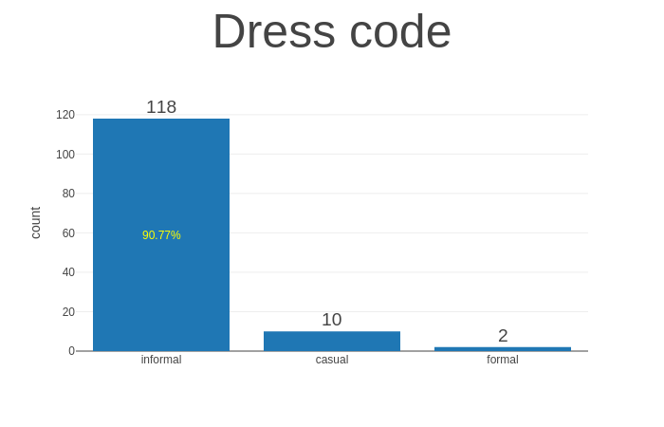
Combined Features of all Restaurant having rating
The Dress code have three category as informal (90.77%) and rest is casual and formal.

Slide 43
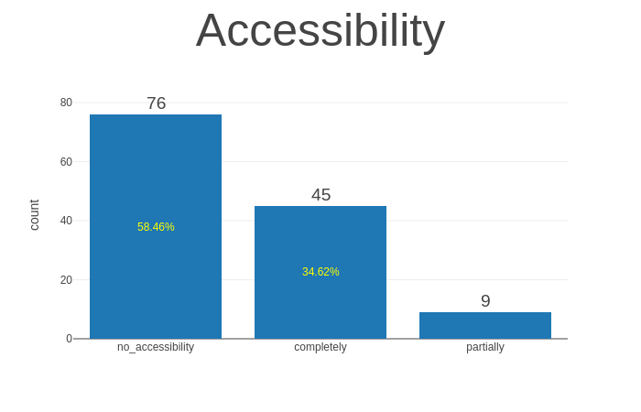
Combined Features of all Restaurant having rating
The Accessibility have three type no_accessibility which have 58.46%, completely which have 34.62% and rest have partially type.

Slide 44
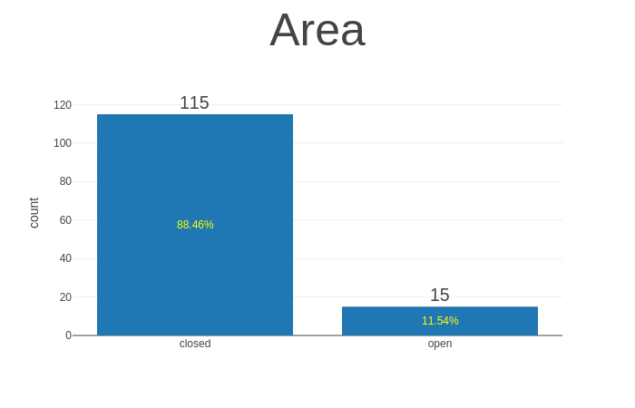
Combined Features of all Restaurant having rating
The Area have basically two type closed which is 88.46% and open 11.54% type. Hence we can say that closed area have high priority.

Slide 45
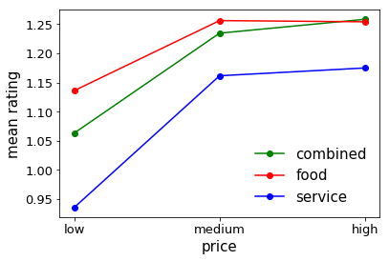
Mean Rating value of all kind of analysis like combined, food and service
Here we see that mean rating for the high price of combined analysis is more as compare to food and at low level price the mean rating of food is more.

Slide 46
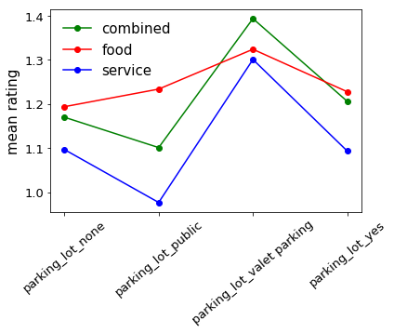
Mean Rating value of all kind of analysis like combined, food and service
Here we see that mean rating of combined analysis of parking lot valet parking is more but food rating is high for parking lot public and parking lot yes also.

Slide 47
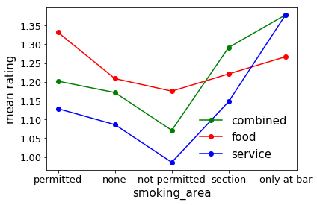
Mean Rating value of all kind of analysis like combined, food and service
Here by analysing these graph we can say that mean rating of smoking area only at bar is same for combined and service analysis both. In not permitted category the food rating is good.

Slide 48
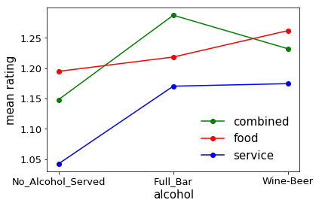
Mean Rating value of all kind of analysis like combined, food and service
Here we see that mean rating of full_Bar alcohol of combined analysis is more while the food rating of no alcohol served and wine beer is more.

Slide 49
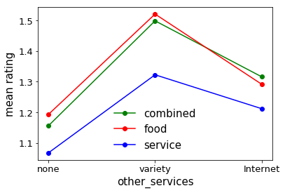
Mean Rating value of all kind of analysis like combined, food and service
Here we see that food rating of variety type other services is high as compare to service and combined rating both.

Slide 50
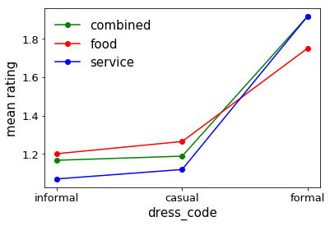
Mean Rating value of all kind of analysis like combined, food and service
Here we see that the combined and service rating for formal dress code is high as compare to food rating and at informal stage service rating is low but in casula the food rating is high.

Slide 51
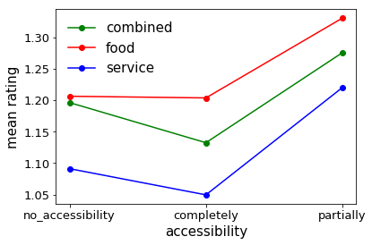
Mean Rating value of all kind of analysis like combined, food and service
Here we see that food rating for partially accessibility is very high as compare to combined and service rating.The completely accessibility is also high for combined rating.

Slide 52
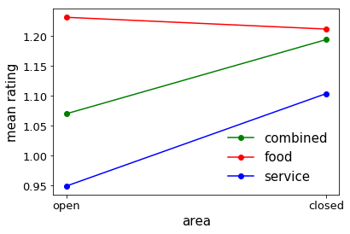
Mean Rating value of all kind of analysis like combined, food and service
After analysing this graph we can say that food rating doesn’t affect the open or closed area but the service and combined rating will increase in closed area.

Slide 53
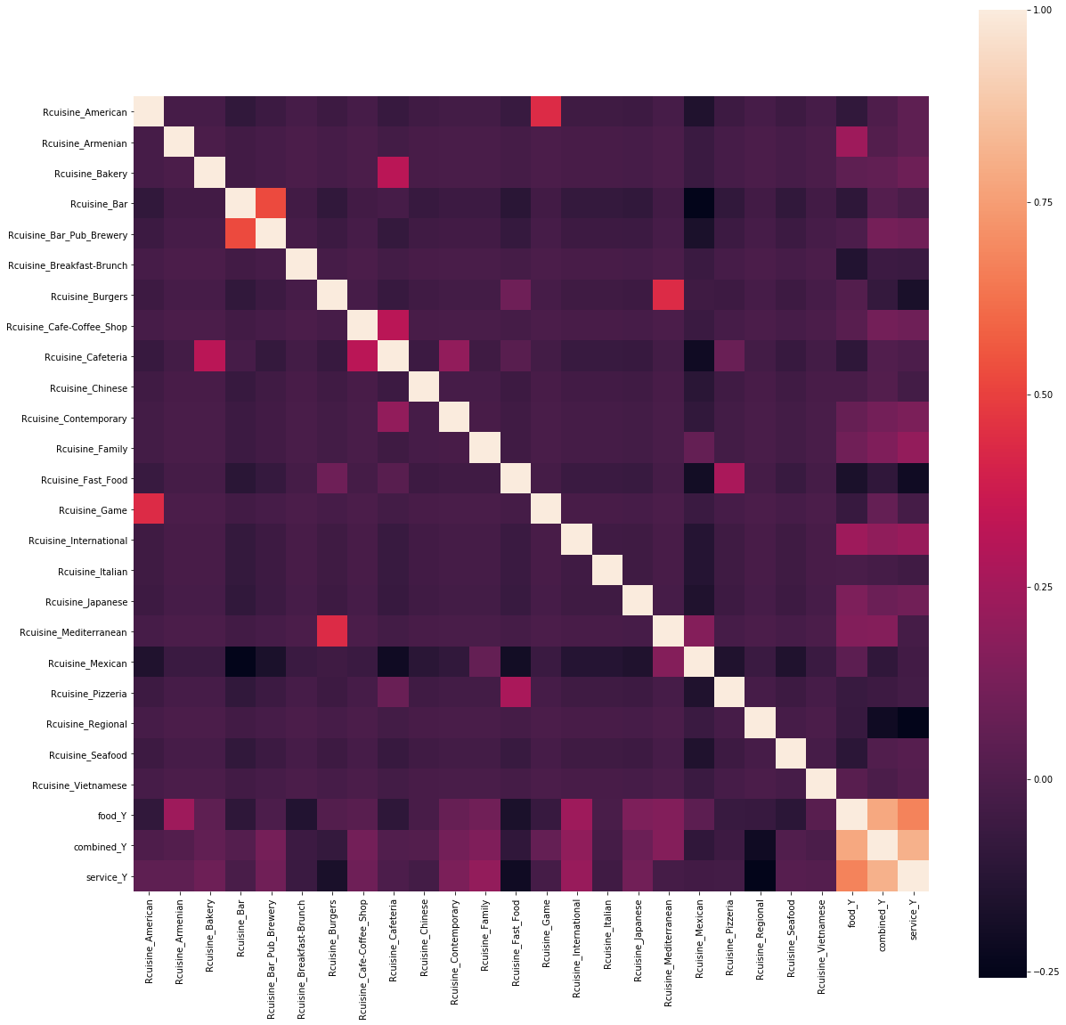
Correlation Matrix plot
Here we can see that the matrix is symmetrical, i.e. the bottom left of the matrix is the same as the top right. This is useful as we can see two different views on the same data in one plot. We can also see that each variable is perfectly positively correlated with each other in the diagonal line from top left to bottom right.

